Slide 1
The convolution theorem
D.A. Forsyth,
University of Illinois at Urbana Champaign

Slide 2
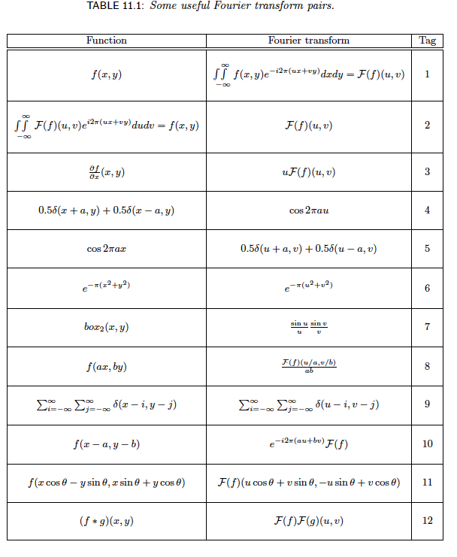
Reference table in notes

Slide 3
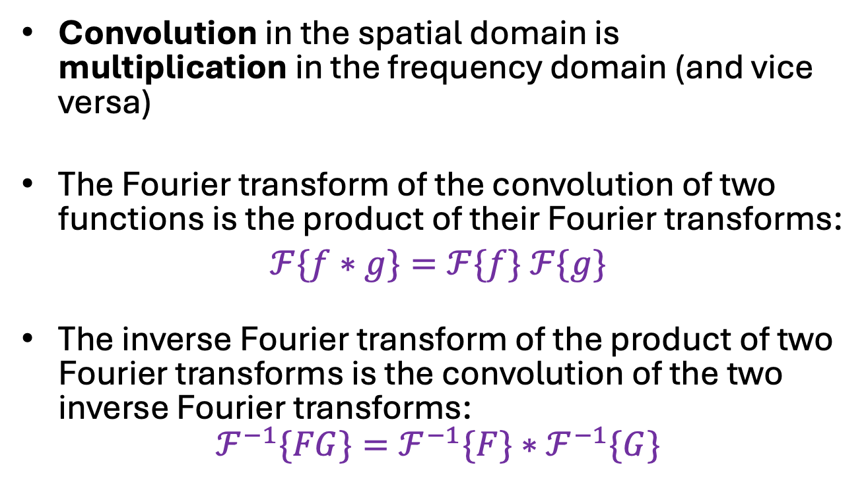
The convolution theorem
Convolution in the spatial domain is multiplication in the frequency domain (and vice versa)
The Fourier transform of the convolution of two functions is the product of their Fourier transforms:
$$ℱ\{f∗g\}=ℱ\{f\} ℱ\{g\}$$
The inverse Fourier transform of the product of two Fourier transforms is the convolution of the two inverse Fourier transforms:
$$ℱ^{−1}\{FG\}=ℱ^{−1}\{F\}∗ℱ^{−1}\{G\}$$

Slide 4
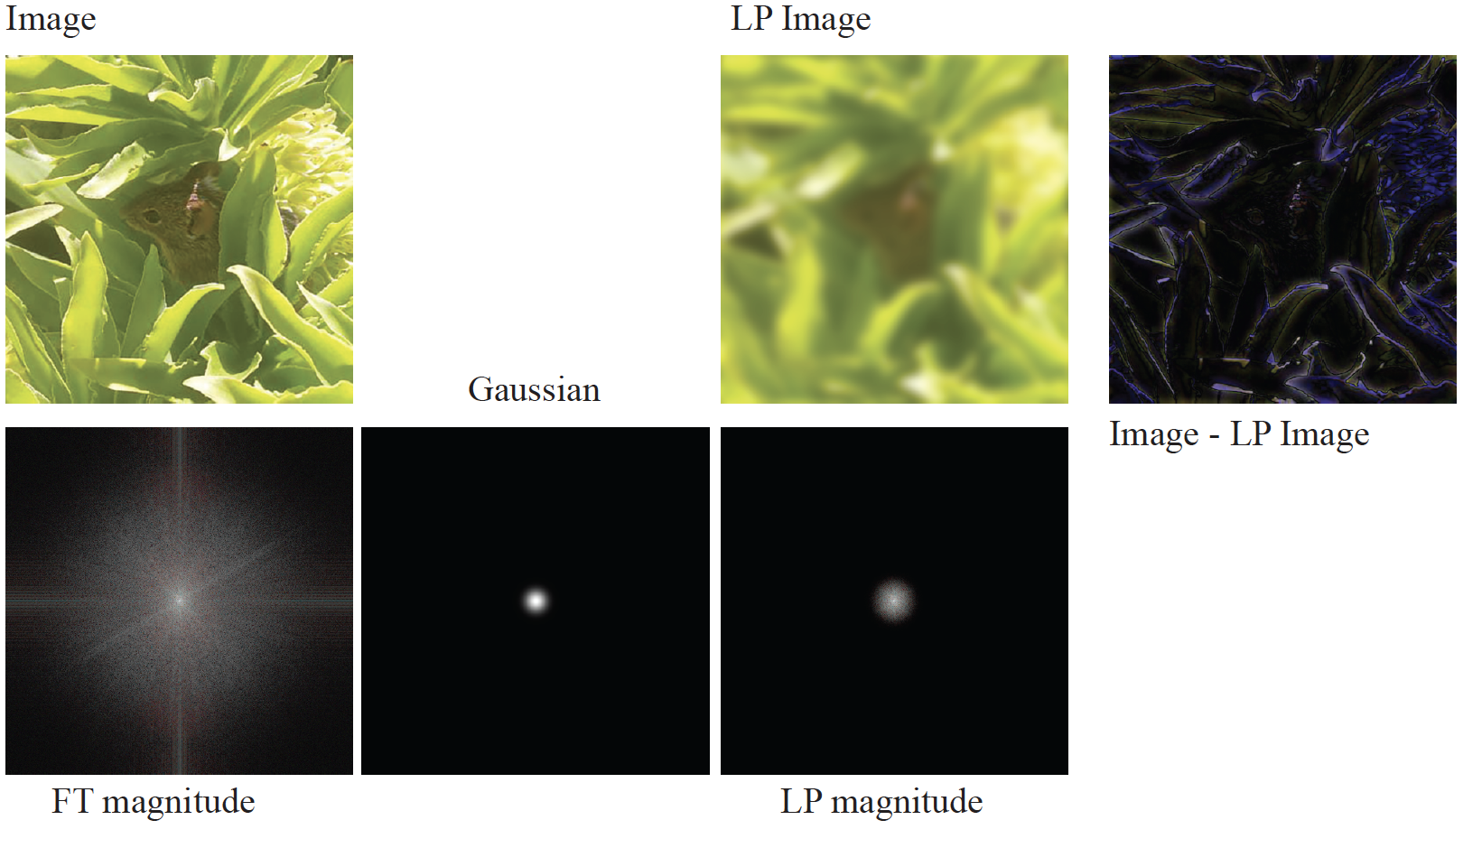
Smoothing by FT

Slide 5
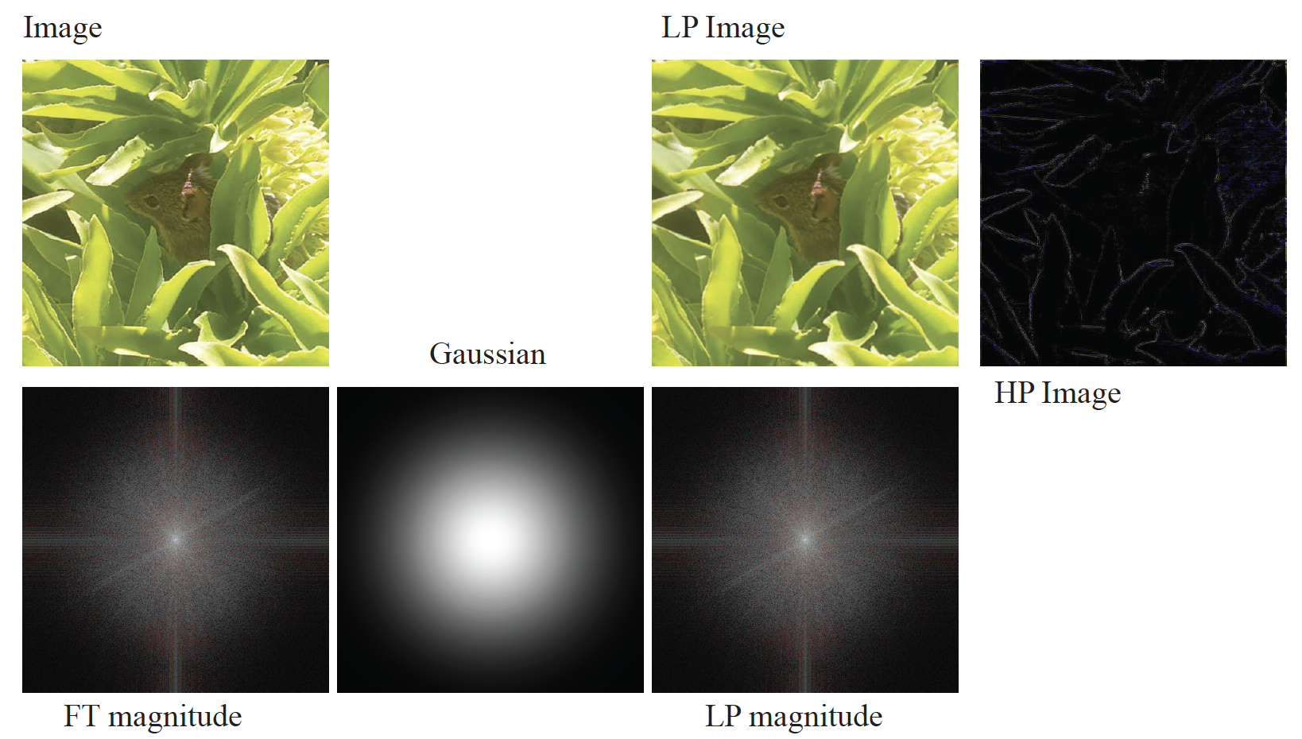
Smoothing with FT

Slide 6
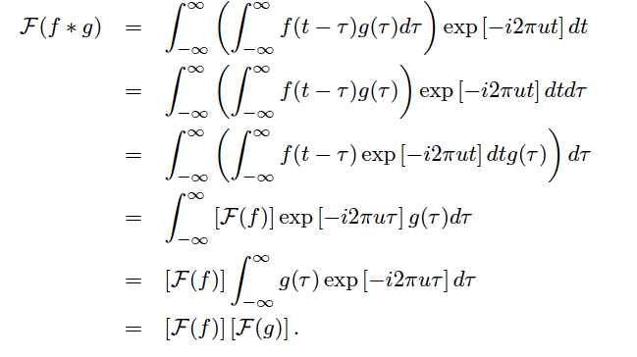
Easy to prove
Swap integration bounds
Move g out of integral
Shift result from before

Slide 7
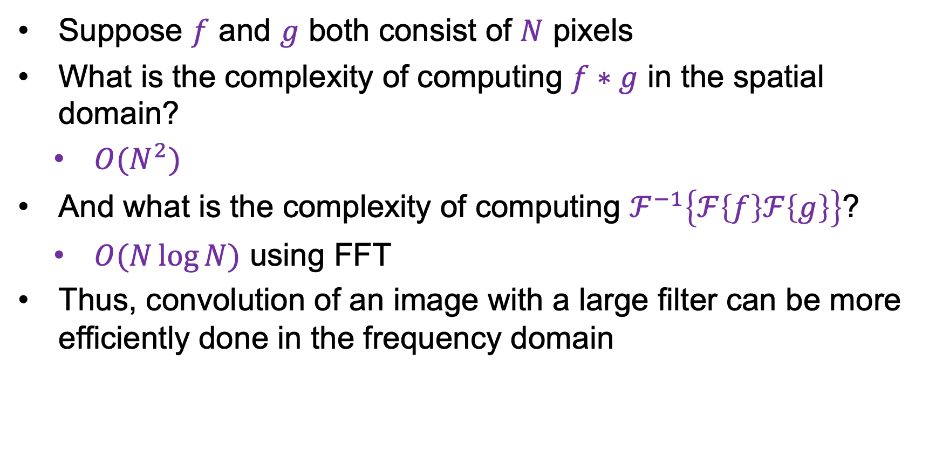
Convolution theorem
Suppose $f$ and $g$ both consist of $N$ pixels
What is the complexity of computing $f∗g$ in the spatial domain?
$O(N^{2})$
And what is the complexity of computing $ℱ^{−1}\left\{ℱ\left\{f\right\}ℱ\left\{g\right\}\right\}$?
$O(N\log{N})$ using FFT
Thus, convolution of an image with a large filter can be more efficiently done in the frequency domain

Slide 8
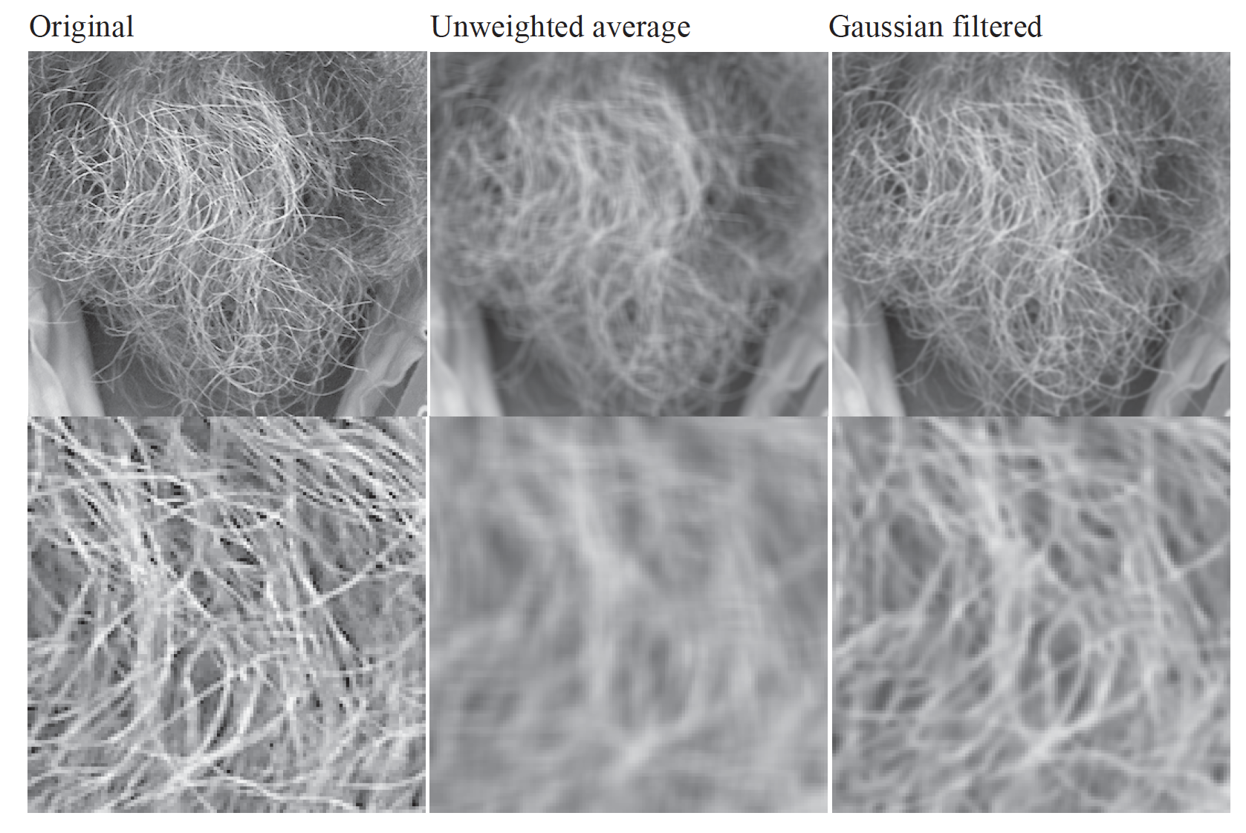
Mystery 1
Why does filtering with a Gaussian give a nice smooth image,
but filtering with a box filter gives artifacts?
Notes:
Things we can’t understand without thinking in frequency
8

Slide 9
Gaussian case
Convolution theorem:
FT (filtered) = FT(gaussian)FT(image)
FT(gaussian)=another gaussian
Weight falls off smoothly at higher frequencies

Slide 10
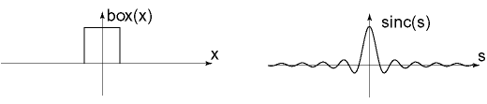




Box filter
Convolution theorem:
FT (filtered)= FT(box)*FT(image)
FT(box)=Sinc
$$sinc\left(u\right)=\frac{\sin\left(πu\right)}{πu}$$
$$box(t)$$
$$−0.5$$
$$0.5$$

Slide 11
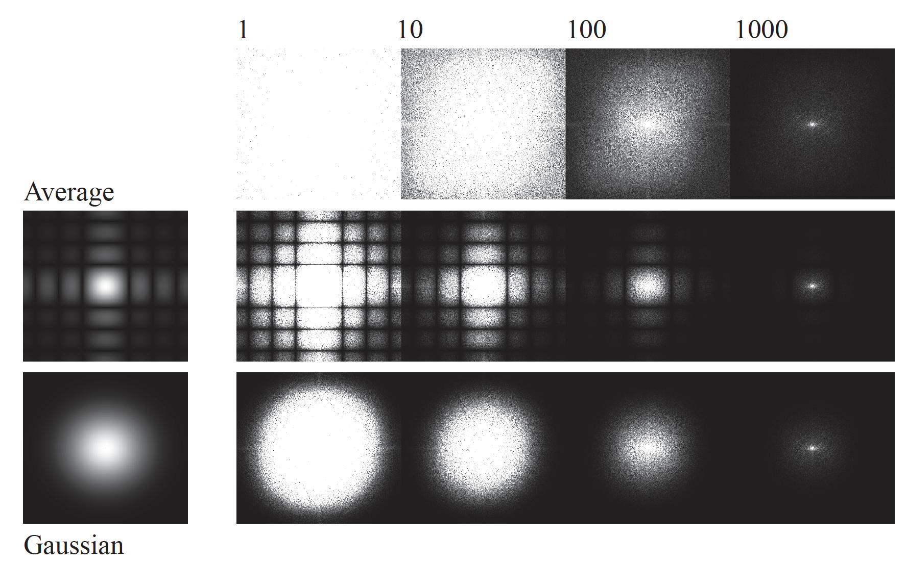
Magnitudes
Image
box filtered
gaussian
filtered

Slide 12
Mystery 1, Solved
Why does filtering with a Gaussian give a nice smooth image,
but filtering with a box filter gives artifacts?
Notes:
Things we can’t understand without thinking in frequency
12

Slide 13
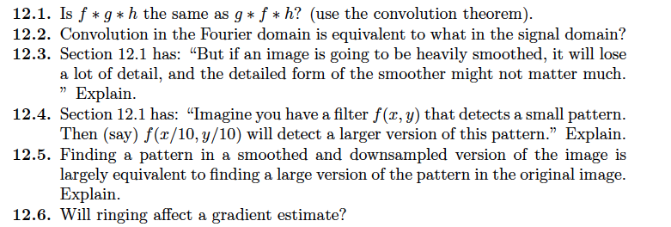
Things to think about...

