Slide 1
Denoising with filters
D.A. Forsyth,
University of Illinois at Urbana Champaign
Some slides adapted from
Svetlana Lazebnik, who adapted from Alyosha Efros, Derek Hoiem

Slide 2
A crucial property of images
Pixels are like their neighbors
  (mostly, for most pixels)
Imagine you wish to denoise an image. You could do so by averaging neighbors (a filter!).

Slide 3
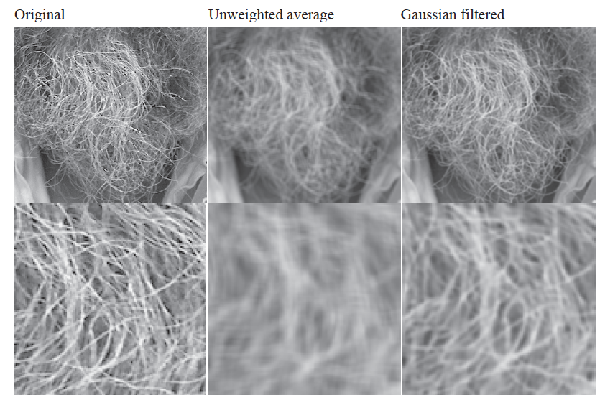
Smoothing with box filter revisited
What’s wrong with this picture?
What’s the solution?

Slide 4
A crucial property of images
Pixels are like their neighbors
  (mostly, for most pixels)
Imagine you wish to denoise an image. You could do so by averaging neighbors (a filter!). Weighting the neighbors so nearby neighbors get heavier weights is a good move.

Slide 5
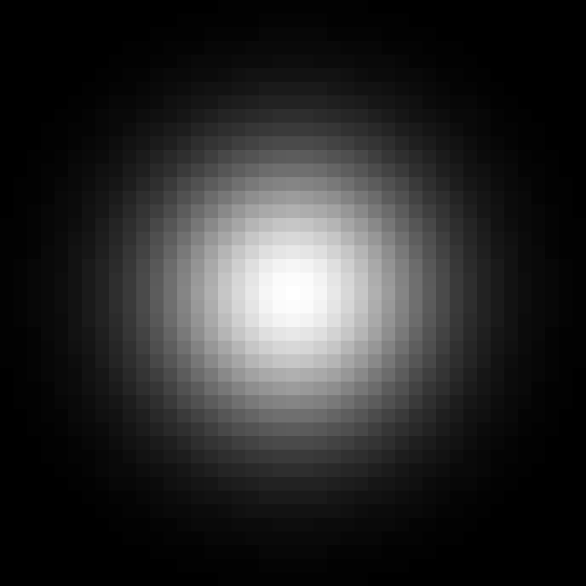
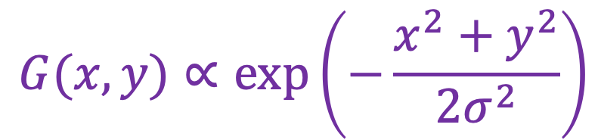
Smoothing
To eliminate edge effects, weight contribution of neighborhood pixels according to their closeness to the center
“proportional to”
(renormalize values to sum to 1)
Gaussian filter
$$G(x,y)∝exp⁡\left(−\frac{x^{2}+y^{2}}{{2σ}^{2}}\right)$$
standard deviation
(determines size of “blob”)
Adapted from D. Fouhey and J. Johnson

Slide 6







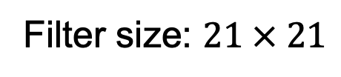

Gaussian filters
$$σ = 1$$
$$σ = 2$$
$$σ = 4$$
$$σ = 8$$
Filter size: $21 × 21$
Adapted from D. Fouhey and J. Johnson

Slide 7
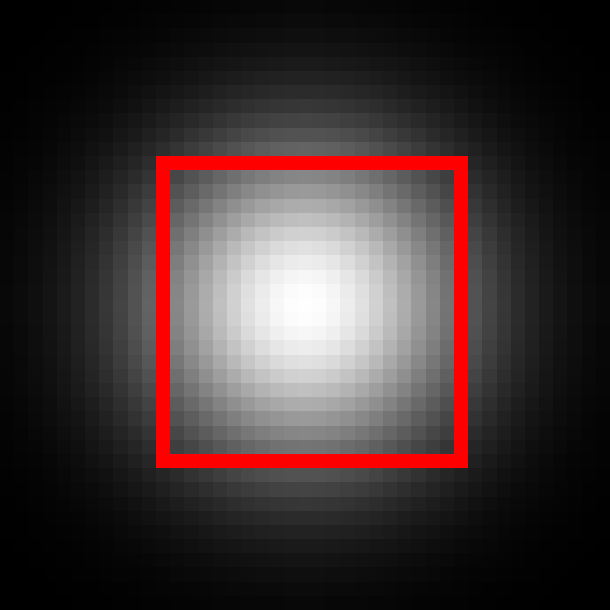
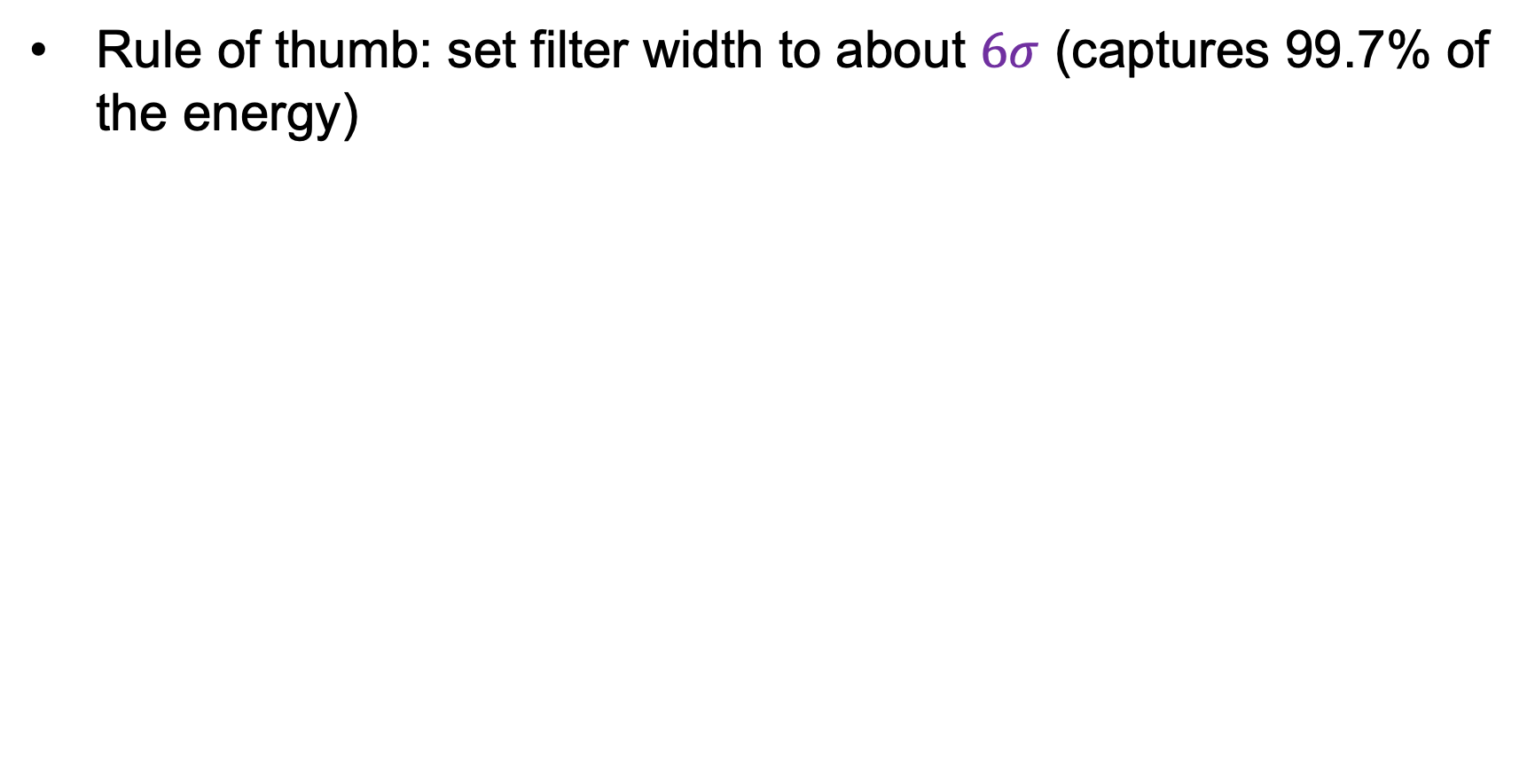


Choosing filter size
Rule of thumb: set filter width to about $6σ$ (captures 99.7% of the energy)
$$σ = 8$$
$$Width=21$$
$$σ = 8$$
$$Width=43$$
Too small!
A bit small (might be OK)
Adapted from D. Fouhey and J. Johnson

Slide 8
Gaussian vs. box filtering

Slide 9
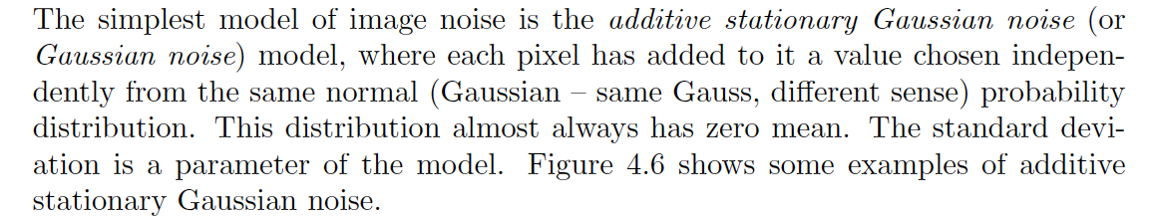
Gaussian noise

Slide 10
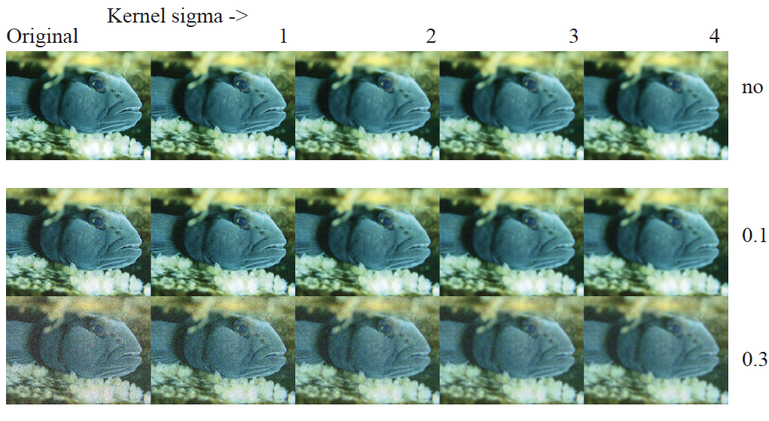
Gaussian smoothing of Gaussian noise

Slide 11
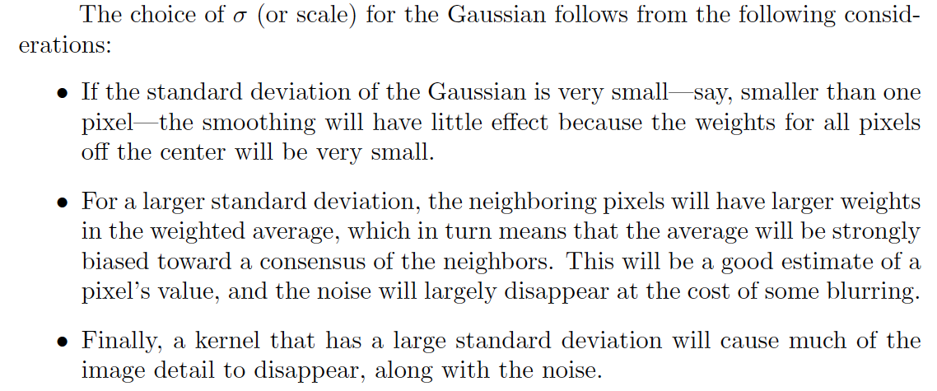
Smoothing by how much?

Slide 12
Poisson noise
For each pixel location, flip a biased coin
  if it comes up heads, move on
  if it comes up tails, flip a fair coin
    if that is heads, pixel -> full bright
    tails, pixel -> full dark
Variants are possible
Models device damage, manufacturing failures, some kinds of transmission error, etc.

Slide 13
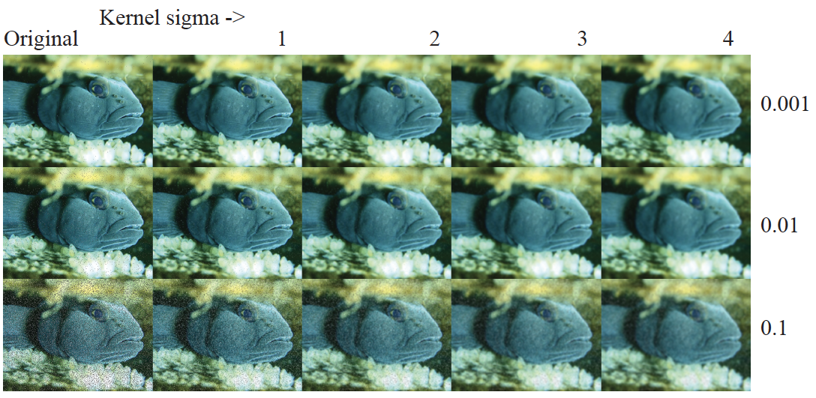
Smoothing Poisson noise with a gaussian filter

Slide 14
The median filter
N_{ij} = median(Neighborhood(O_{ij}))
THIS ISN’T LINEAR!
  (check you’re sure of this)

Slide 15
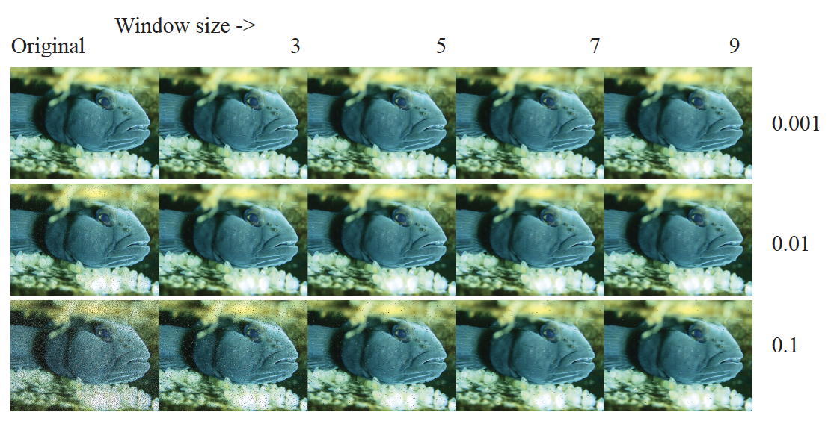
Smoothing Poisson noise with a median filter

Slide 16
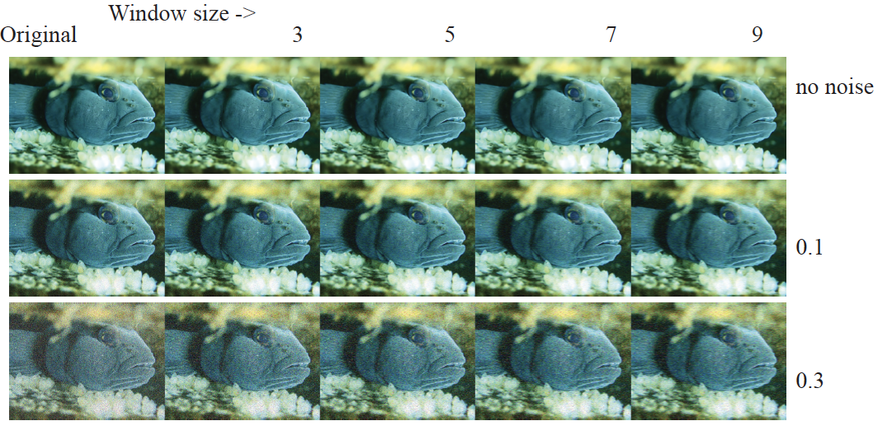
Median filters vs Gaussian noise

Slide 17
Gaussian smoothing of Gaussian noise

Slide 18
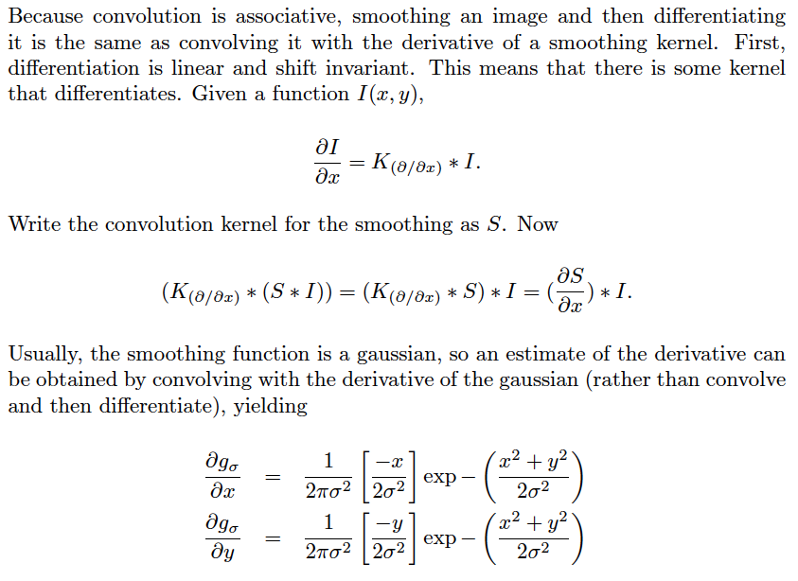
Application: derivative of Gaussian filters

Slide 19
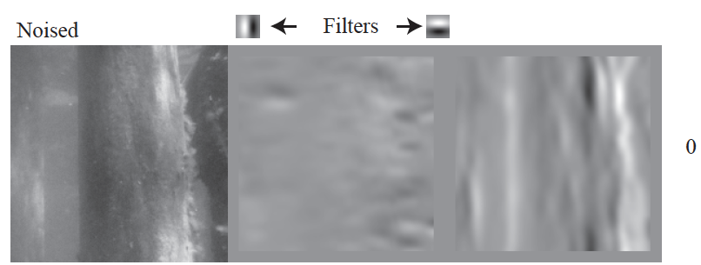
SPOT THE TYPO!

Slide 20
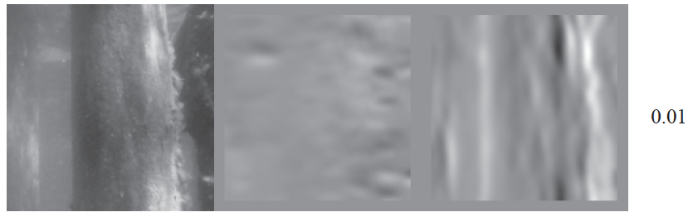

Slide 21
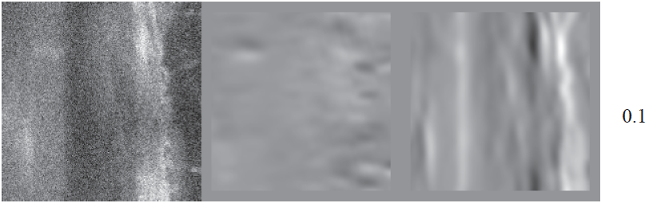

Slide 22
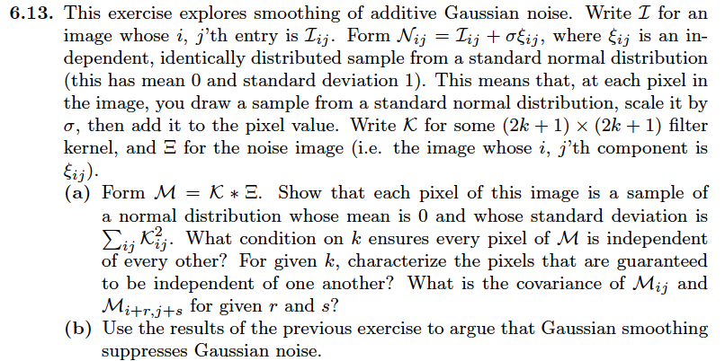
Think about this...

