Slide 1
Edges and orientations
D.A. Forsyth
University of Illinois

Slide 2
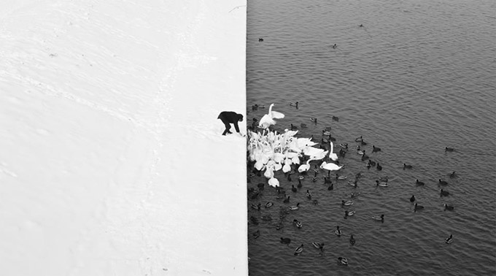
Edge detection
Winter in Kraków photographed by Marcin Ryczek

Slide 3
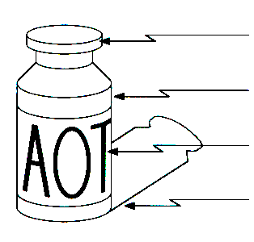
Edge detection
Goal: Identify sudden changes (discontinuities) in an image
Intuitively, edges carry most of the semantic and shape information from the image
surface normal discontinuity
depth discontinuity
surface color discontinuity
illumination discontinuity
Sources: D. Lowe and S. Seitz

Slide 4
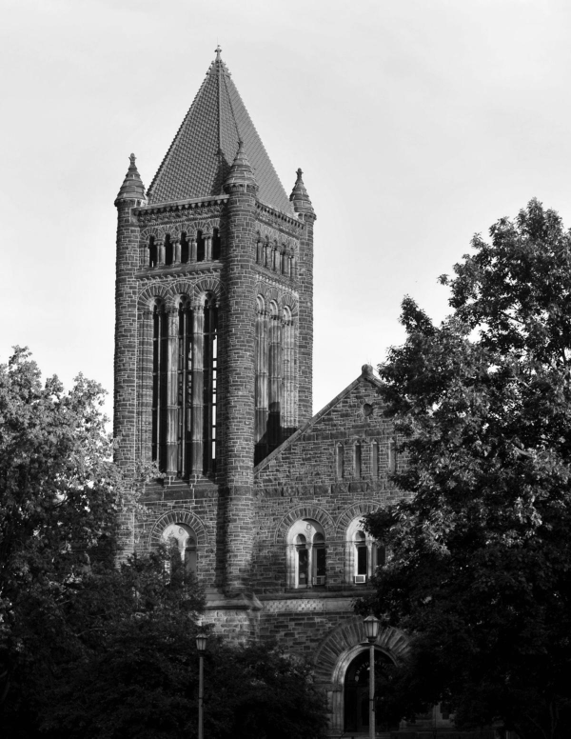

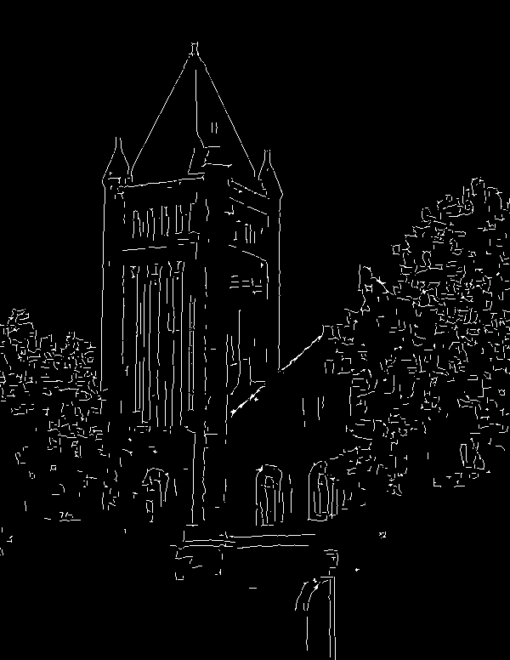
Edge detection
Input photo
Ideal: artist’s line drawing
Reality
Image source
Source: S. Gupta

Slide 5
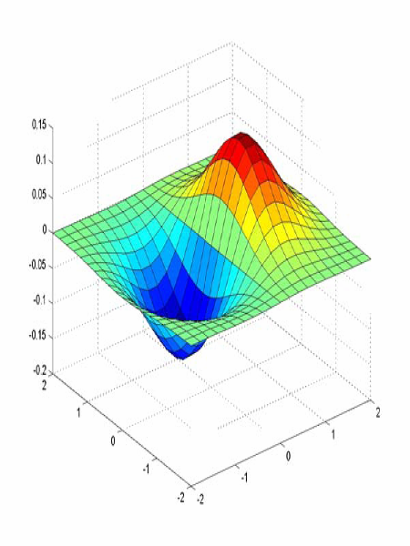
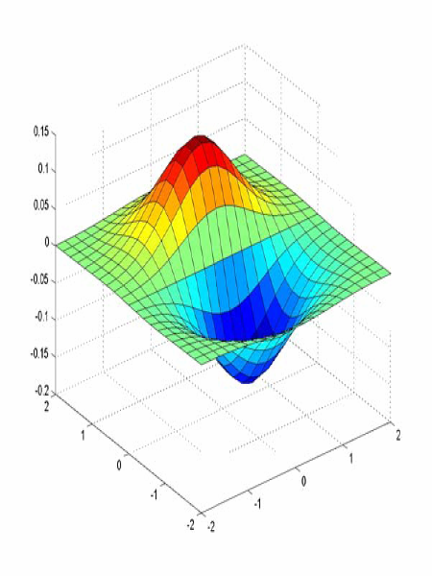


2D Derivative of Gaussian (d.o.g. or dog) filters
$x$-direction
$y$-direction

Slide 6
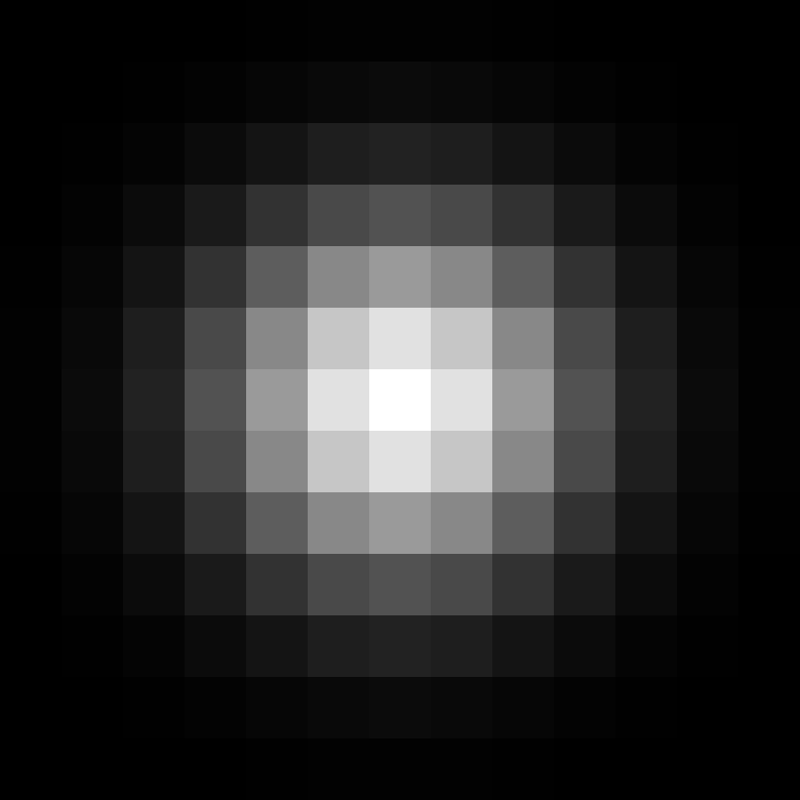
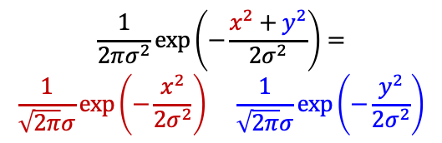
Separability of the Gaussian filter
$$\frac{1}{2πσ^{2}}\exp\left(−\frac{x^{2}+y^{2}}{{2σ}^{2}}\right)=$$
$$\frac{1}{\sqrt{2π}σ}\exp\left(−\frac{x^{2}}{{2σ}^{2}}\right) \frac{1}{\sqrt{2π}σ}exp⁡\left(−\frac{y^{2}}{2σ^{2}}\right)$$
=
⁎
Note: matrix multiplication (outer product) and full convolution are the same in this special case
Adapted from D. Fouhey and J. Johnson

Slide 7
2D Derivative of Gaussian filters
(Unnormalized) Gaussian derivatives:
$$\frac{∂g}{∂x}∝−x exp\left(−\frac{x^{2}}{{2σ}^{2}}\right)exp⁡\left(−\frac{y^{2}}{2σ^{2}}\right)$$
$$\frac{∂g}{∂y}∝−y exp\left(−\frac{y^{2}}{{2σ}^{2}}\right)exp⁡\left(−\frac{x^{2}}{2σ^{2}}\right)$$
These are products of a 1D Gaussian in one direction and 1D derivative of Gaussian in the other direction!

Slide 8
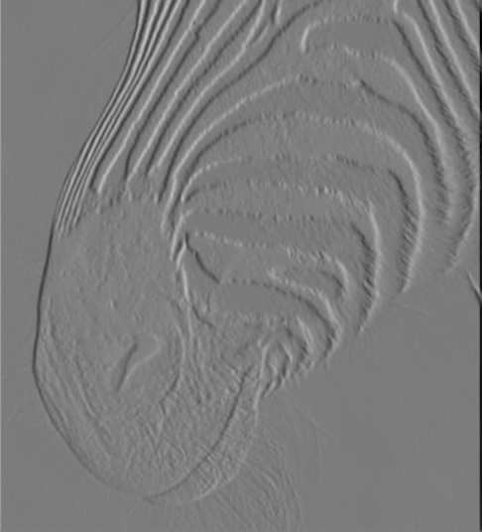
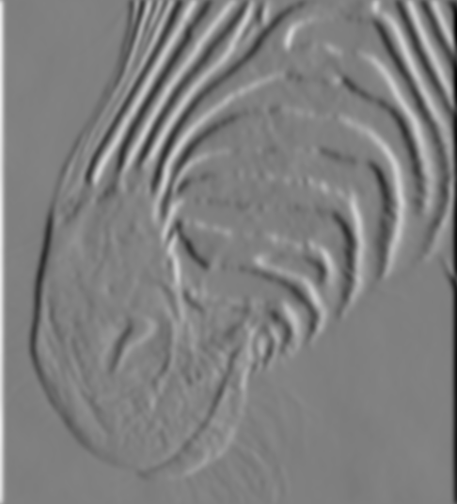
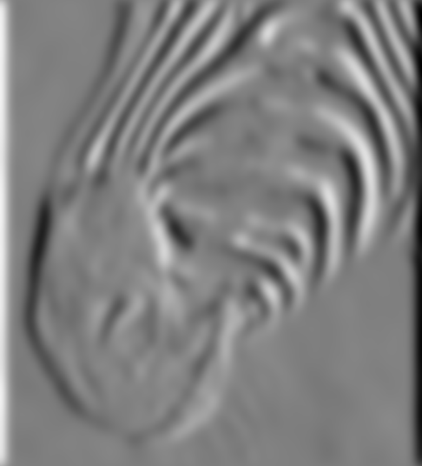

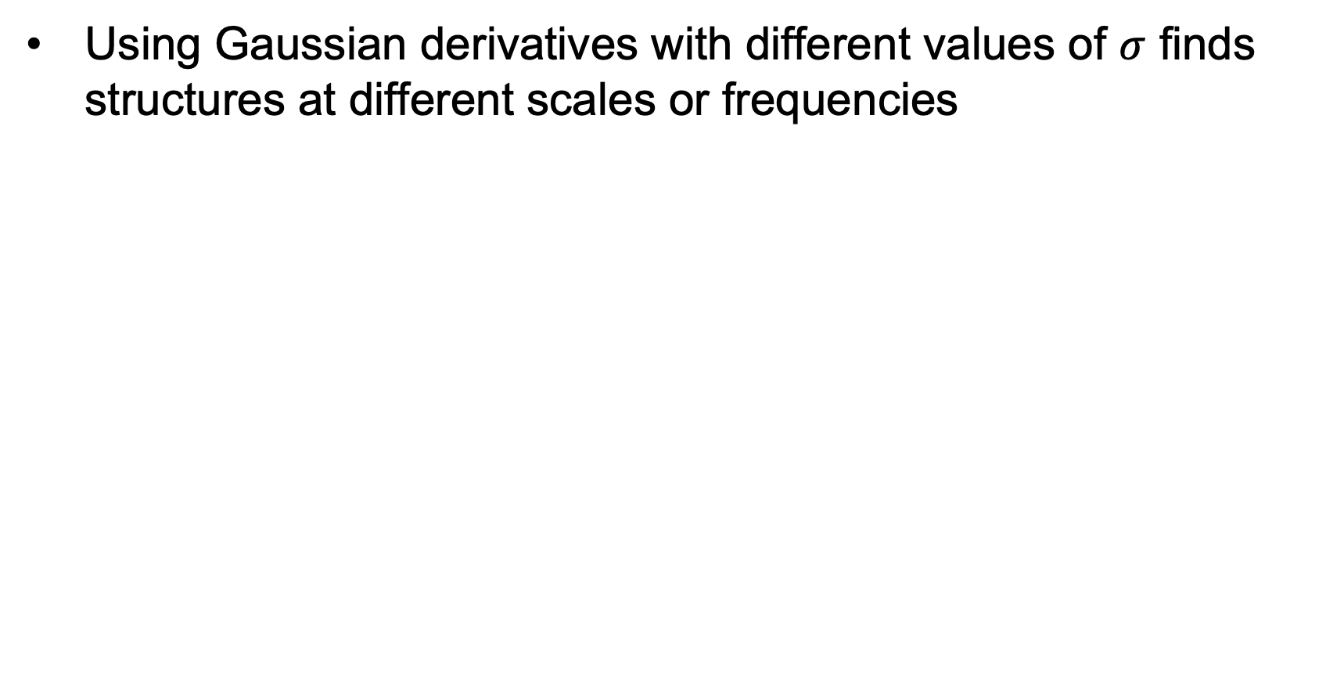


Derivative of Gaussian: Scale
Using Gaussian derivatives with different values of $σ$ finds structures at different scales or frequencies
$σ=1$
$σ=3$
$σ=7$
Source: D. Forsyth

Slide 9
Building an edge detector
original image
final output
J. Canny, A Computational Approach To Edge Detection, IEEE Trans. PAMI, 8:679-714, 1986

Slide 10

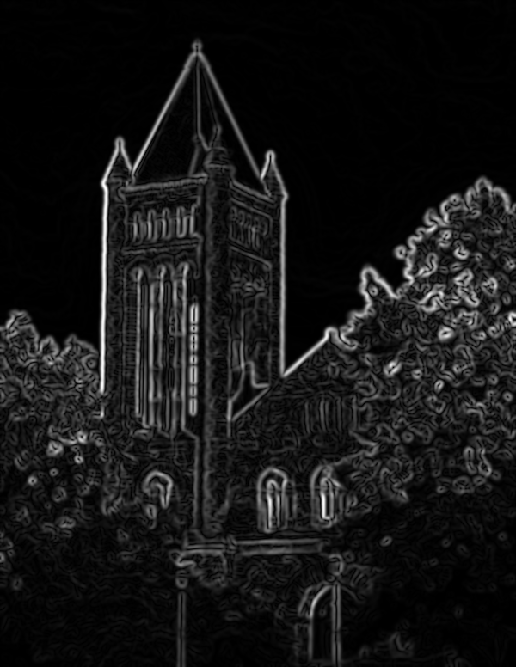
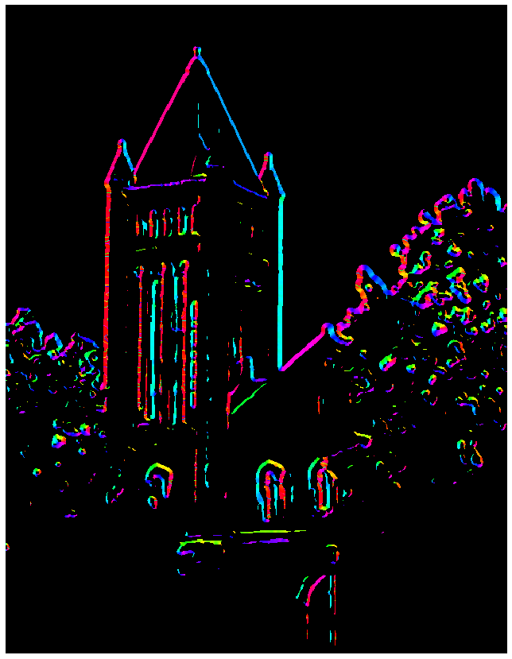

Building an edge detector
Compute$x$and $y$ derivative images
Find magnitude and orientation of the gradient
Source: S. Gupta

Slide 11
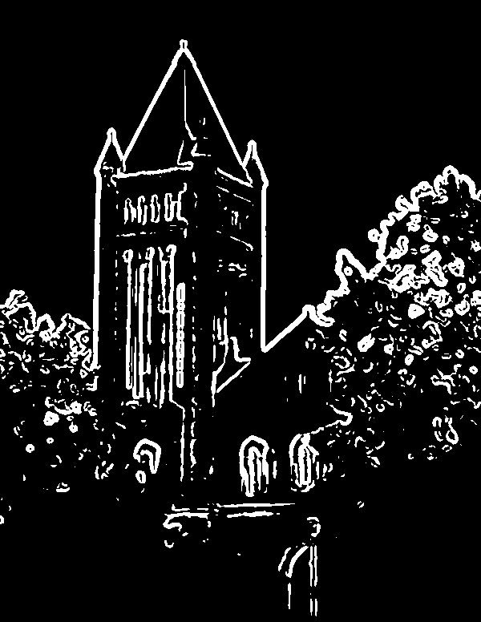
Building an edge detector
We get thick trails, not neat edge curves
Thresholding the gradient magnitude
Source: S. Gupta

Slide 12


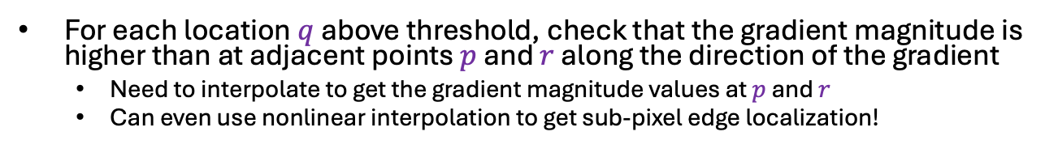






Non-maximum suppression
$$q$$
$$r$$
$$q$$
$$p$$
$$p$$
$$q$$
$$r$$
1D image “slice” normal to the edge
For each location $q$ above threshold, check that the gradient magnitude is higher than at adjacent points $p$ and $r$ along the direction of the gradient
Need to interpolate to get the gradient magnitude values at $p$ and $r$
Can even use nonlinear interpolation to get sub-pixel edge localization!

Slide 13
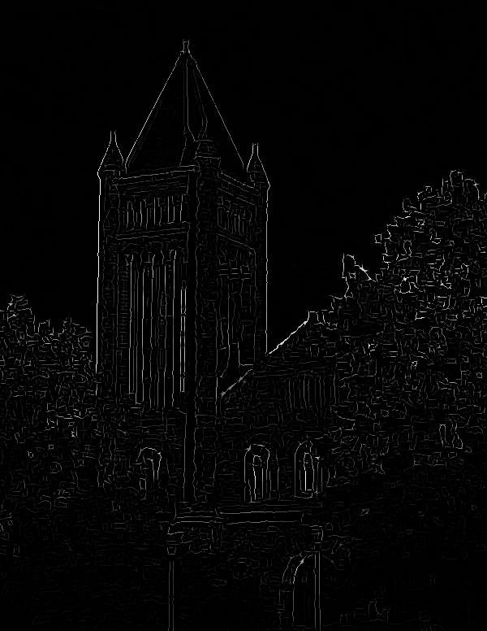
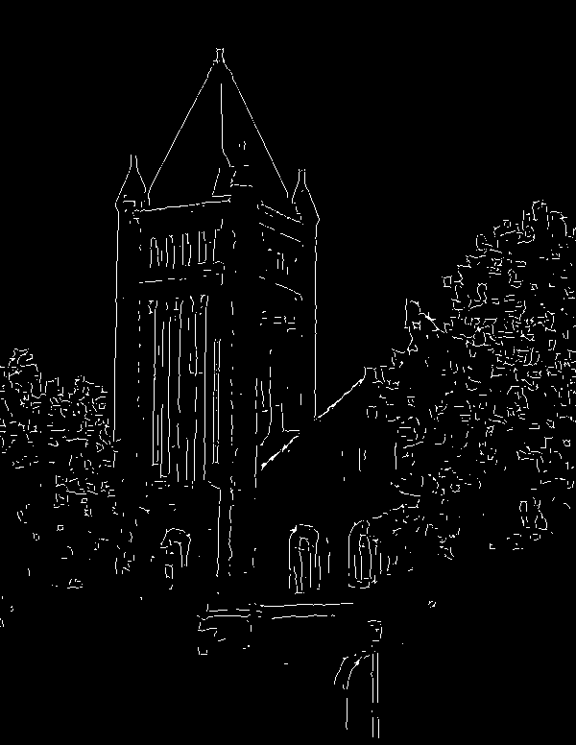
Non-maximum suppression
NMS
NMS > threshold
Another problem: pixels along this edge didn’t survive the thresholding
Source: S. Gupta

Slide 14
Hysteresis thresholding
Use a high threshold to start edge curves, and a low threshold to continue them
Source: Steve Seitz

Slide 15
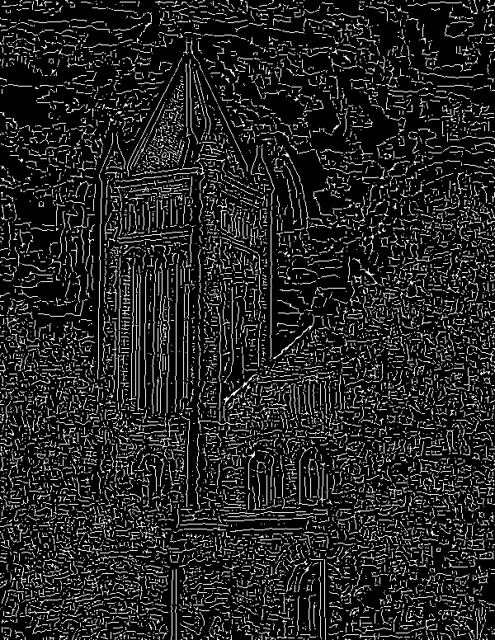
Hysteresis thresholding
high threshold
(strong edges)
low threshold
(weak edges)
hysteresis threshold
Source: S. Gupta

Slide 16
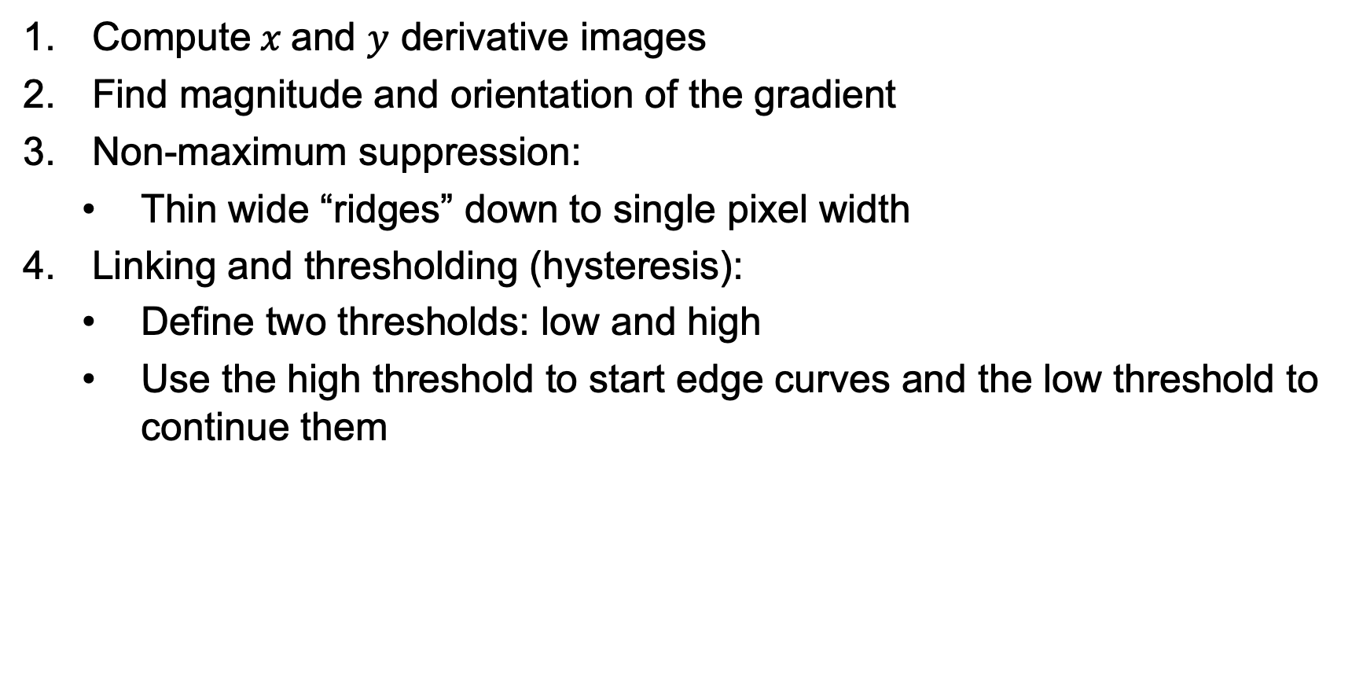
Recap: Canny edge detector
Compute$x$and $y$ derivative images
Find magnitude and orientation of the gradient
Non-maximum suppression:
Thin wide “ridges” down to single pixel width
Linking and thresholding (hysteresis):
Define two thresholds: low and high
Use the high threshold to start edge curves and the low threshold to continue them
J. Canny, A Computational Approach To Edge Detection, IEEE Trans. PAMI, 8:679-714, 1986.

Slide 17
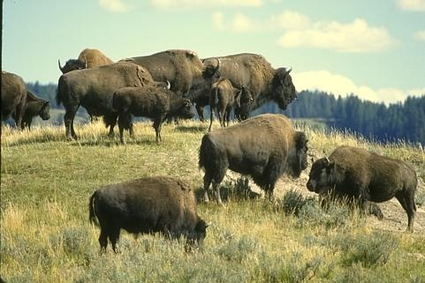
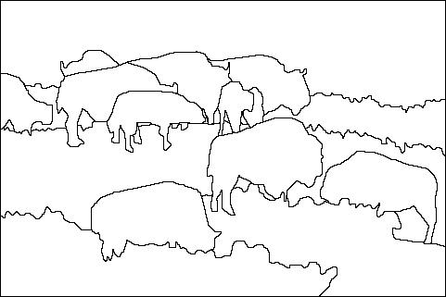
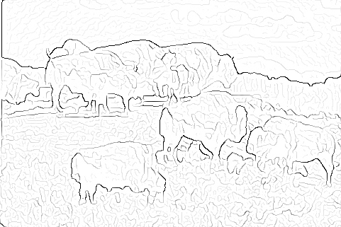

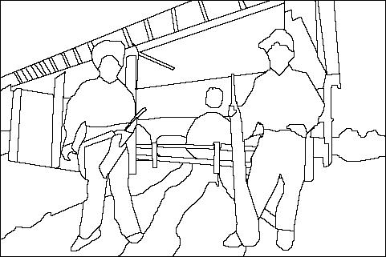
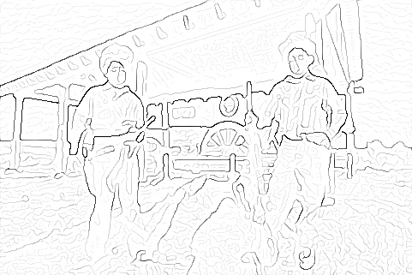
Image gradients vs. meaningful contours
Human segmentation
Gradient magnitude
Image
D. Martin, C. Fowlkes, D. Tal, and J. Malik. A Database of Human Segmented Natural Images and its Application to Evaluating Segmentation Algorithms and Measuring Ecological Statistics. ICCV 2001

Slide 18
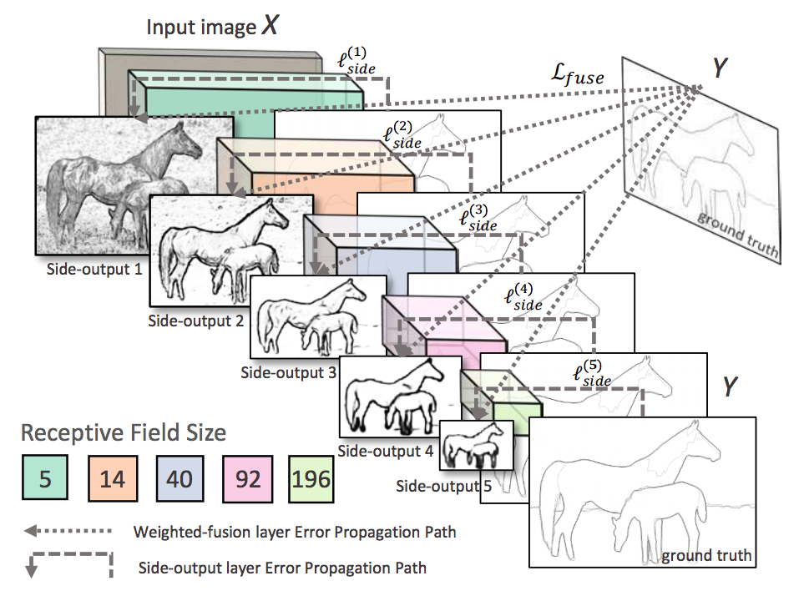
Data-driven edge detection
S. Xie and Z. Tu, Holistically-nested edge detection, ICCV 2015

Slide 19
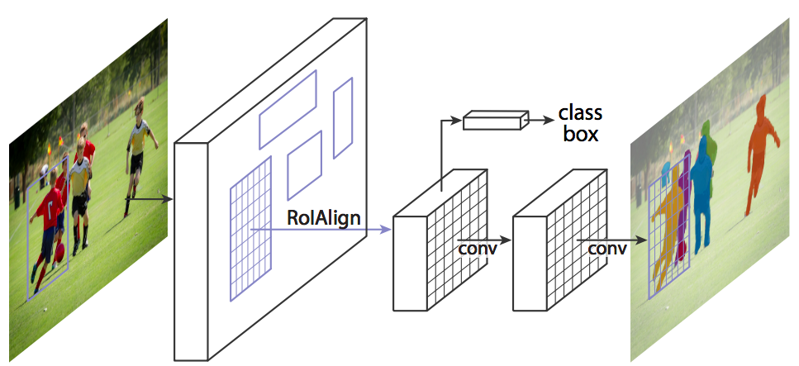
Most successful approach in practice: Top-down segmentation
Classification+regression branch
Mask branch: output binary segmentation for each instance
K. He, G. Gkioxari, P. Dollar, and R. Girshick, Mask R-CNN, ICCV 2017 (Best Paper Award)

Slide 20
Problem:
Scaling the image scales gradient magnitude
Which causes problems with thresholds, etc
- image gets darker, some edges disappear
- image gets lighter, some edges appear
Hysteresis helps, but doesn’t cure

Slide 21
Orientations don’t change with illumination
Q: build a representation out of orientations?

Slide 22
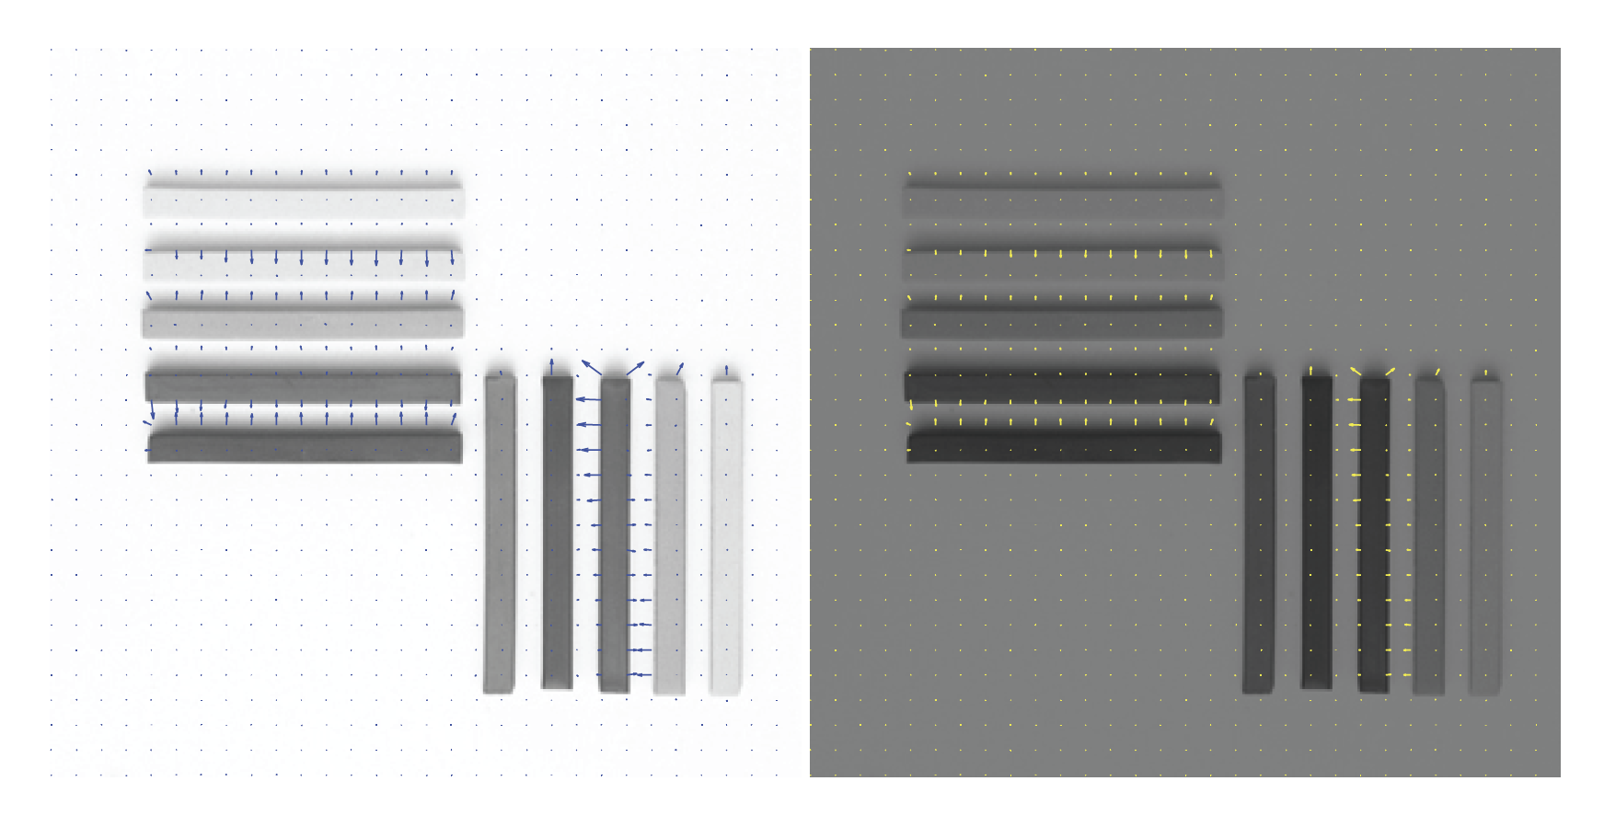

Slide 23
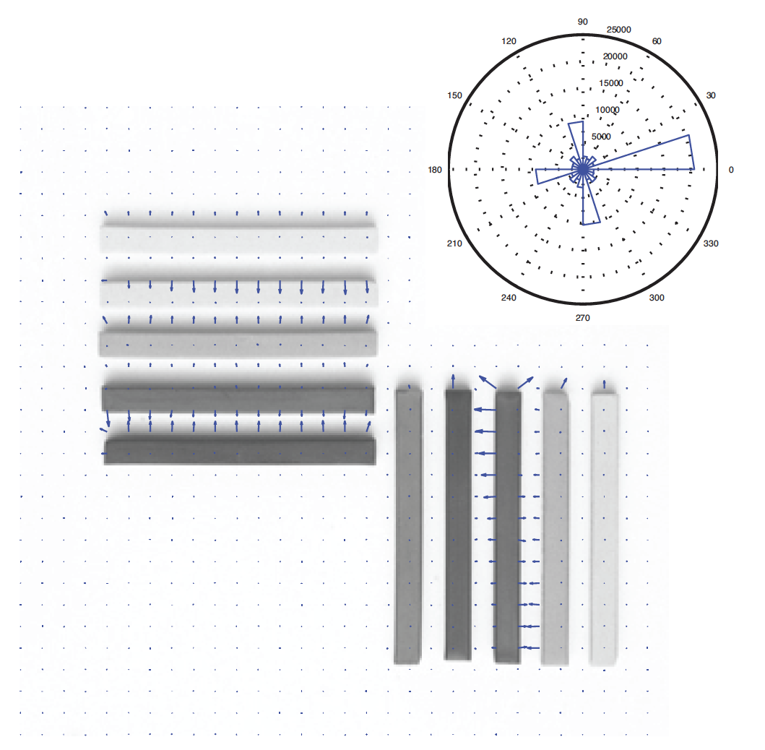
Orientation histograms
Rose plot, which shows
number of vectors at each range of angles

Slide 24
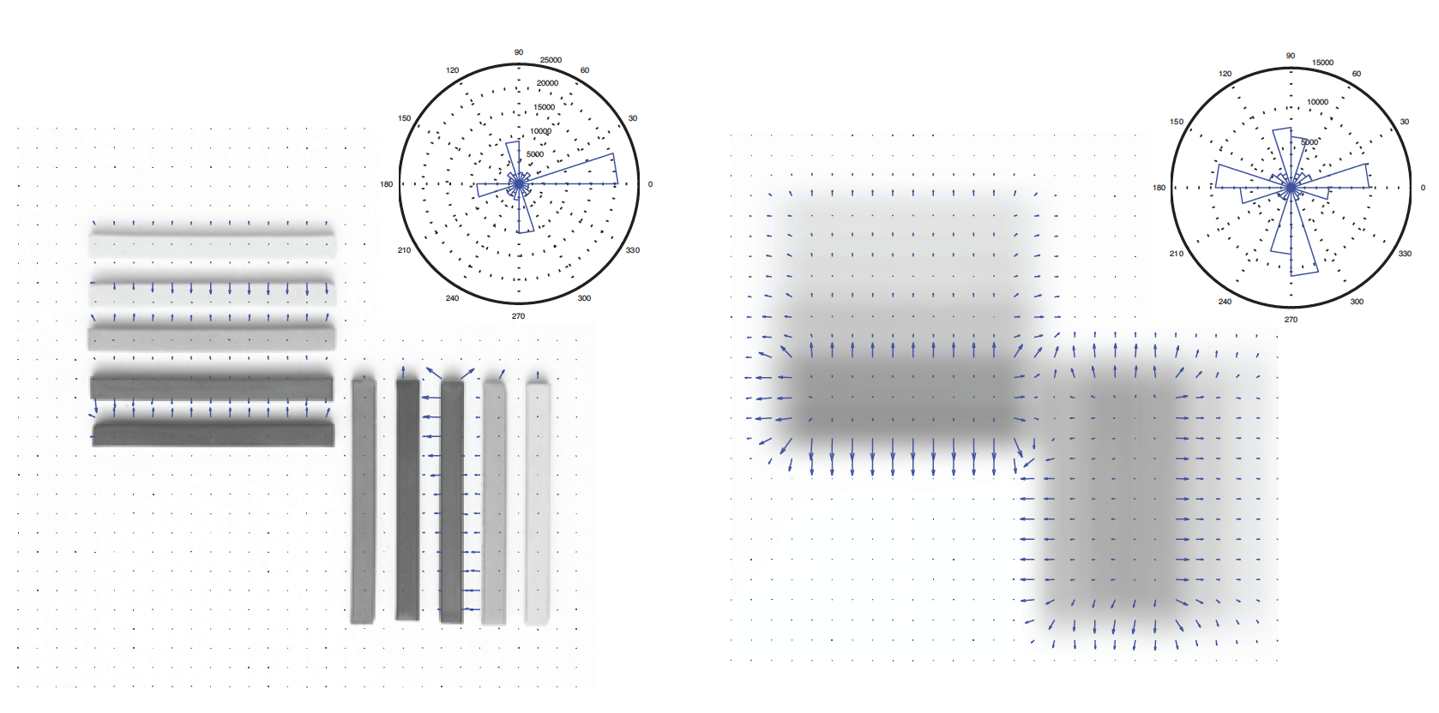
Orientation histogram depends on scale

Slide 25
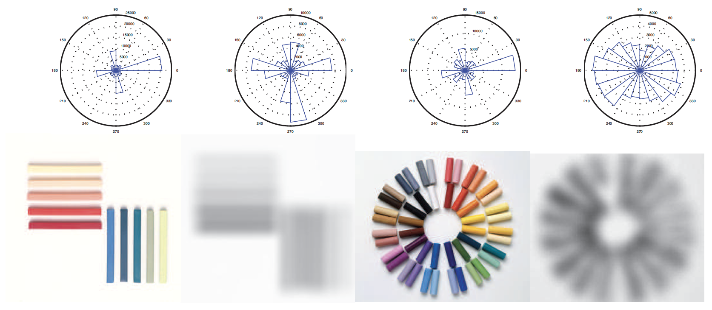
Different patterns have different orientation histograms

Slide 26
Notice something important…

Slide 27
Think about this...

