Slide 1
Encoding and Decoding
D.A. Forsyth
University of Illinois at Urbana Champaign

Slide 2
Image representations - Encoding
Idea:
  Filter banks + ReLU yield scores for many different patterns
Idea:
  You can compose this, so patterns of patterns of …
  Result: a code that describes the image
Idea:
  if filters are well chosen, you could use the representation to:
    denoise images
    find edges
    find interest points
    classify images…
BUT what filters/patterns should we use?

Slide 3
Many different pattern detectors
Yield an overcomplete representation
  redundant information
  one local image patch is scored against many different patterns
downside:
  representation is larger
upside:
  you can recover image despite some errors in representation

Slide 4
Reconstruction
Find the image that produces the representation closest to the one observed
Now imagine input image is noisy:
  The reconstruction might not be
    (with some care and some luck)
Idea:
  Build device that can accept noisy image, produce clean
  Denoising autoencoder
Helps choose filters/patterns – the ones that denoise

Slide 5
Images from codes - Decoding
Idea:
  Code likely (roughly) invertible
    Reconstruct filter responses from ReLU outputs
    Reconstruct image from responses (conv. Theorem)
Decode by:
  Place down instances of detected patterns
  This is filtering
  Use a ReLU to prevent negative values accumulating

Slide 6
Learned Image Representations
Idea:
  It might be possible to produce an image representation from a lot of filters
  AND reconstruct the image from the representation using a lot more filters

Slide 7
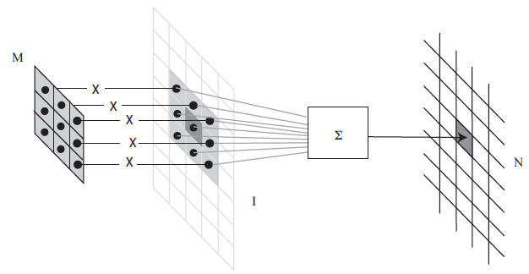
Recall convolution

Slide 8
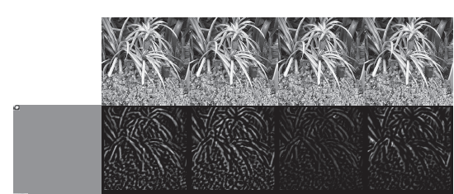
Recall Convolution + ReLU = pattern detector

Slide 9
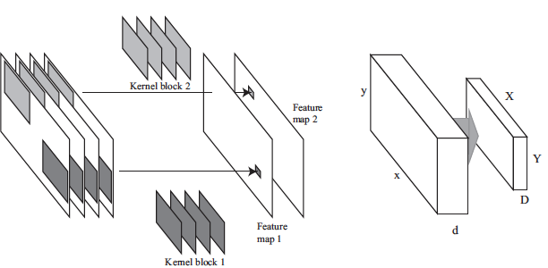
Recall Multi-channel Convolution

Slide 10
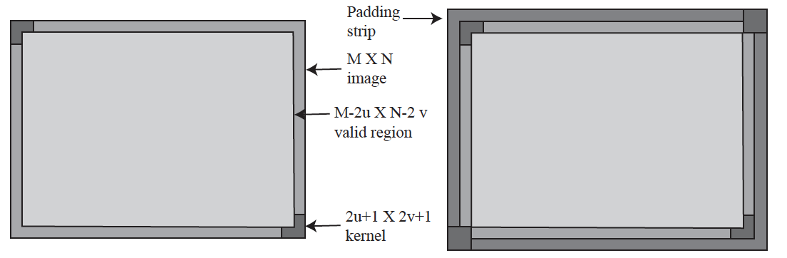
Recall padding

Slide 11
Stride
How far across/down to go to the next pixel?
Stride 1: what we’re used to
Stride 2: place the kernel on every second pixel

Slide 12
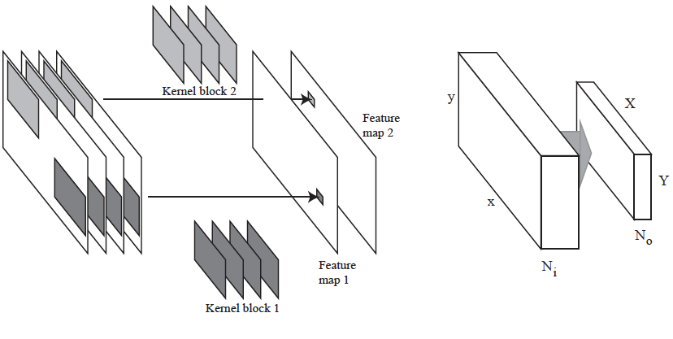
Convolutional Layers

Slide 13
Convolutional Layers
Output number
of features
Input number
of features

Slide 14
Convolutional Layers
Output size will be determined by:
input size,
kernel size,
padding,
stride,

Slide 15
ReLU operates on data block
Trivially – just ReLU at each location

Slide 16
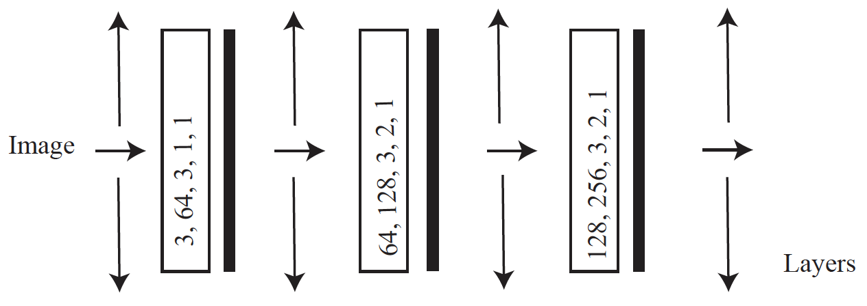
A very simple encoder
ReLU
Patterns of patterns of
patterns
Input number of features, output number of features, kernel size, padding, stride

Slide 17
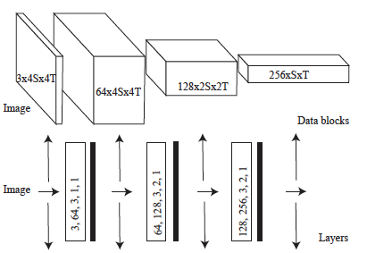
As data blocks
Number of features x Xdim x Ydim

Slide 18
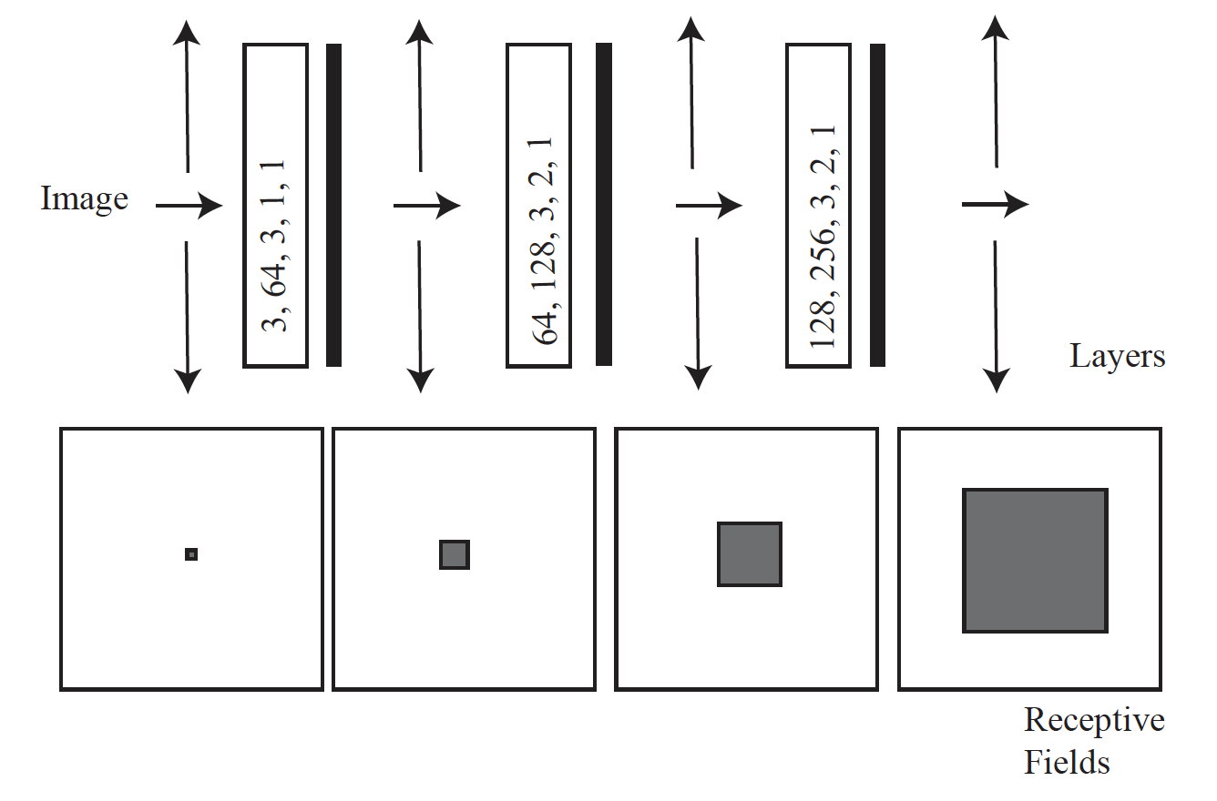
Receptive fields
Support for a value in the feature map

Slide 19
Decoding
Want:
  map rep’n (patterns of patterns of patterns…) to image
Have:
  If rep’n is filter outputs, convolution is enough
  Rep’n is spatially smaller than image
Idea:
  Filter+ReLU+upsample on occasion might do it

Slide 20
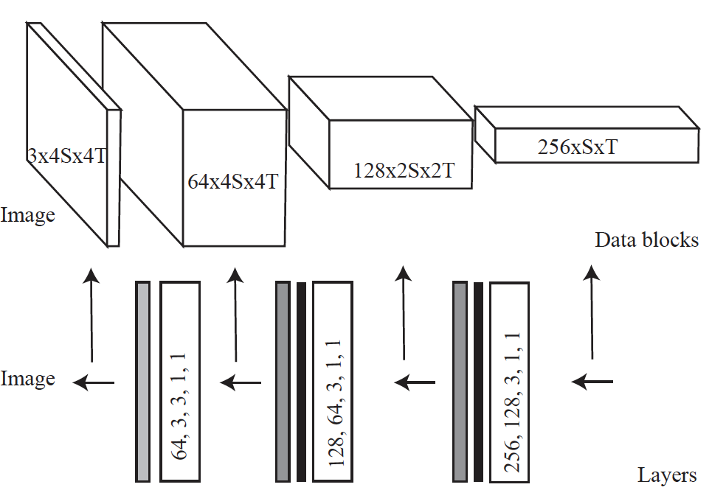
A decoder
Patterns of patterns of
patterns
ReLU
Upsample by 2
Input number of features, output number of features, kernel size, padding, stride

Slide 21
Big idea
With the right choice of filters
  a decoder could reconstruct an image from an encoders rep’n
The rep’n is overcomplete
  “sees” the image at many scales
  so the pair should be able to denoise
But what is the right choice of filters?
Choose filters/patterns that denoise

Slide 22
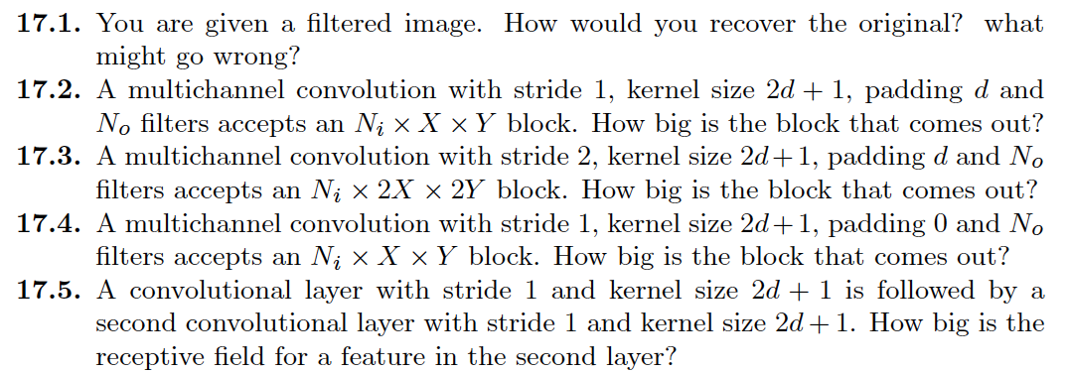
Things to think about...

