Slide 1
Filtering
D.A. Forsyth,
University of Illinois at Urbana Champaign
Some slides adapted from
Svetlana Lazebnik, who adapted from Alyosha Efros, Derek Hoiem

Slide 2
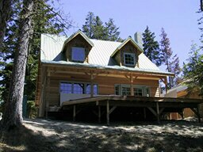
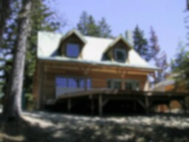
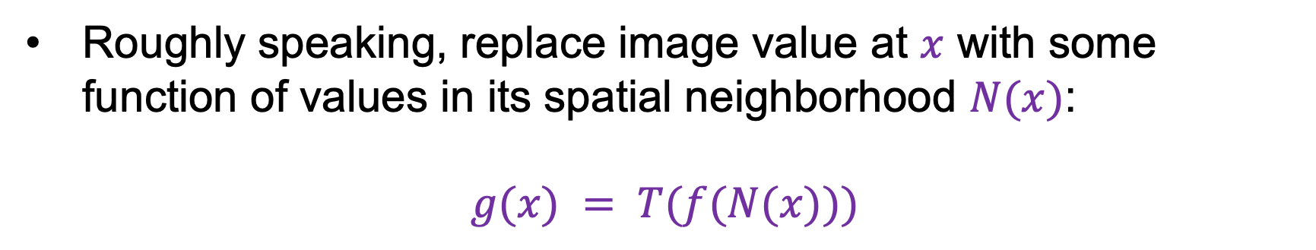
Image filtering
Roughly speaking, replace image value at $x$ with some function of values in its spatial neighborhood $N(x)$:
$$g(x) = T(f(N(x)))$$
f
g
T
Examples: smoothing, sharpening, edge detection, etc.

Slide 3
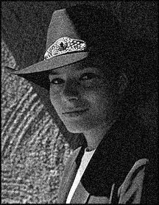
Sliding window operations
Slide a fixed-size window over the image and perform the same simple computation at each window location
Example: reduce image noise
Take the average of pixel values in each window
More generally, we can take a weighted sum where the weights are given by a filter kernel

Slide 4
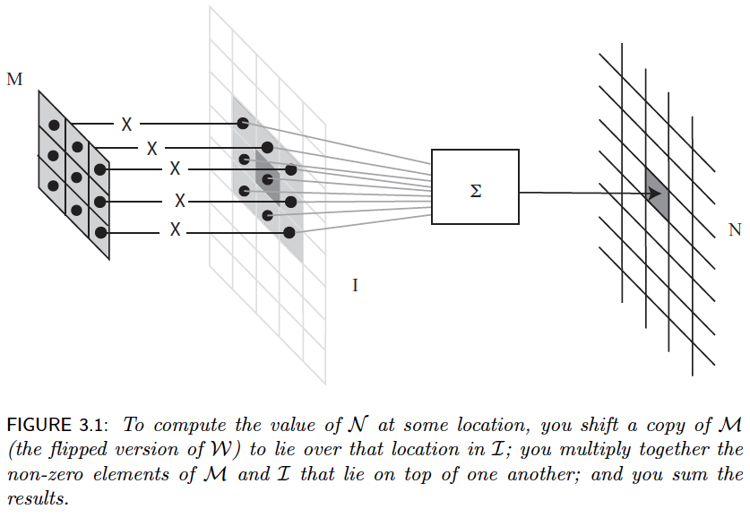

Slide 5
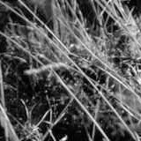
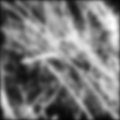
Image filtering example

Slide 6
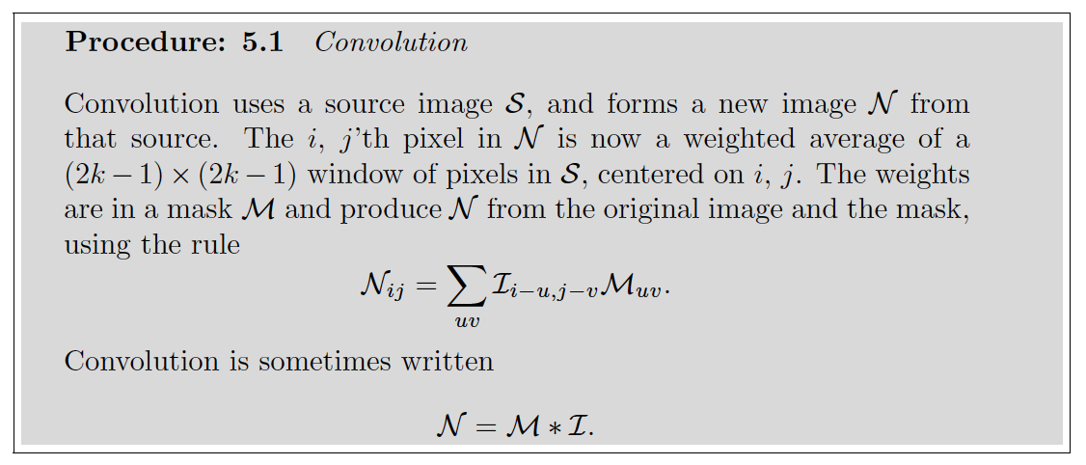
Convolution

Slide 7
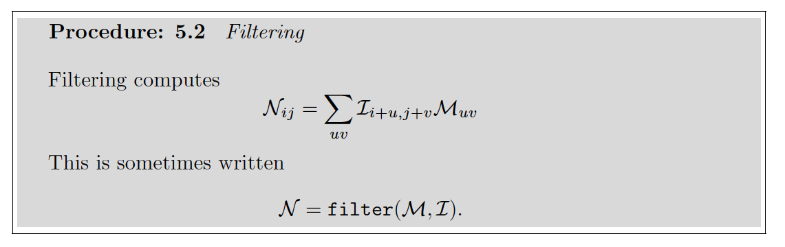
Filtering
Convolution and filtering differ only by how the mask is indexed. The difference matters in
some contexts, but not (much) to us (and is widely ignored).

Slide 8
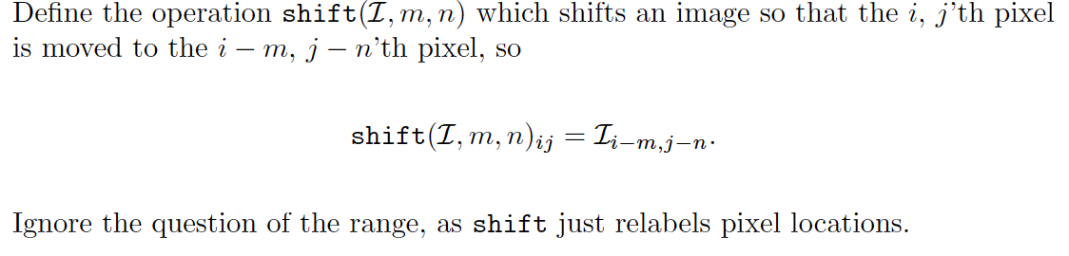
Shifting

Slide 9
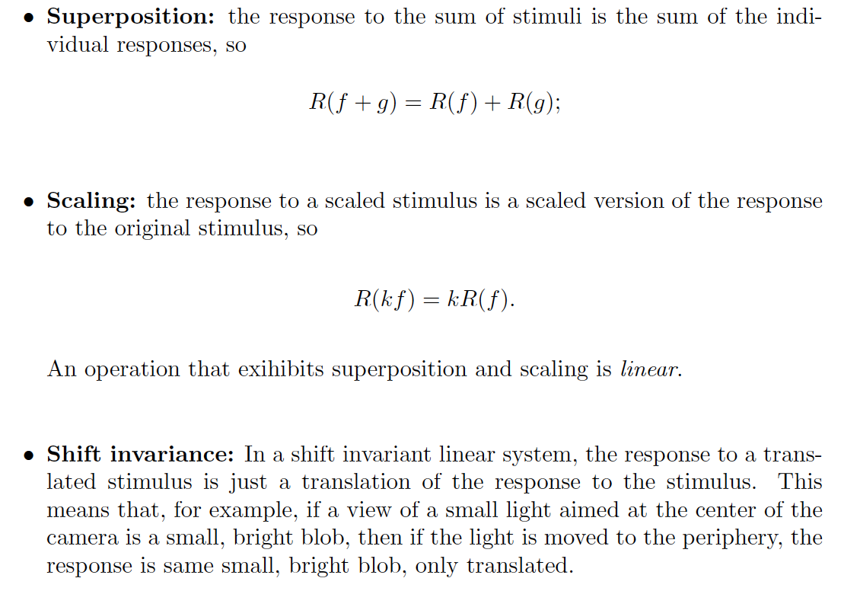
Shift invariant linear systems

Slide 10
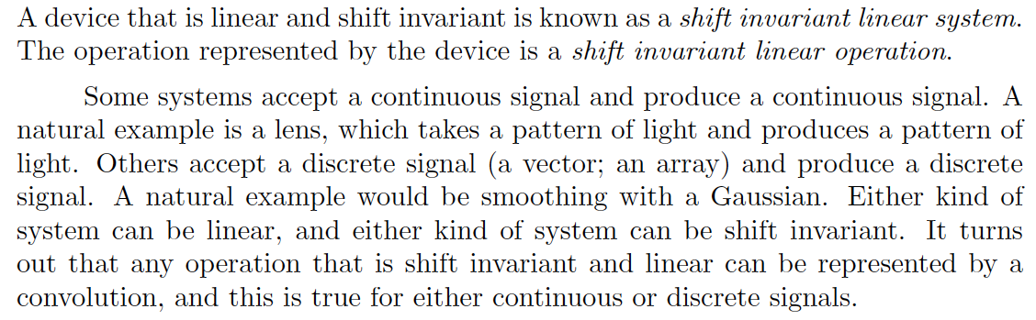
Shift invariant linear systems

Slide 11
Properties of convolution
Linear in
image
mask (or kernel)
Shift invariant
assuming image is infinite or infinitely padded w/ zeros
Associative
(f*g)*h=f*(g*h)

Slide 12
Properties of convolution

Slide 13
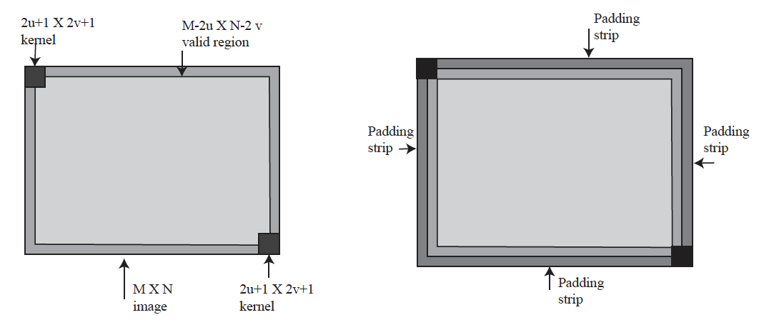
Padding and edges

Slide 14
Padding options
Pad with:
Zeros
Wrap around
Copy edge
Reflect across edge

Slide 15

Note: Filtering vs. “convolution”
In classical signal processing terminology, convolution is filtering with a flipped kernel, and filtering with an upright kernel is known as cross-correlation
Check convention of filtering function you plan to use!
Filtering or “cross-correlation”
(Kernel in original orientation)
“Convolution”
(Kernel flipped in x and y)
Adapted from D. Fouhey and J. Johnson

Slide 16
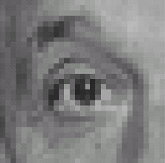
Practice with linear filters
0
0
0
?
0
1
0
0
0
0
Original
Source: D. Lowe

Slide 17
Practice with linear filters
0
0
0
0
1
0
0
0
0
Original
One surrounded by zeros is the identity filter
Filtered
(no change)
Source: D. Lowe

Slide 18
Practice with linear filters
0
0
0
?
0
0
1
0
0
0
Original
Source: D. Lowe

Slide 19
Practice with linear filters
0
0
0
0
0
1
0
0
0
Original
Shifted left
By one pixel
Source: D. Lowe

Slide 20

Practice with linear filters
1
1
1
?
1
1
1
1
1
1
Original
Source: D. Lowe

Slide 21
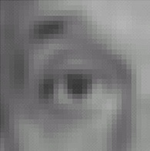
Practice with linear filters
1
1
1
1
1
1
1
1
1
Original
Blur (with a
box filter)
Source: D. Lowe

Slide 22
Practice with linear filters
0
0
0
-
1
1
1
?
0
2
0
1
1
1
0
0
0
1
1
1
Original
Source: D. Lowe

Slide 23
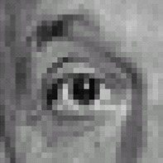
Practice with linear filters
0
0
0
-
1
1
1
0
2
0
1
1
1
0
0
0
1
1
1
Sharpening filter: Accentuates differences with local average
Original
Sharpened
(Note that filter sums to 1)
Source: D. Lowe

Slide 24
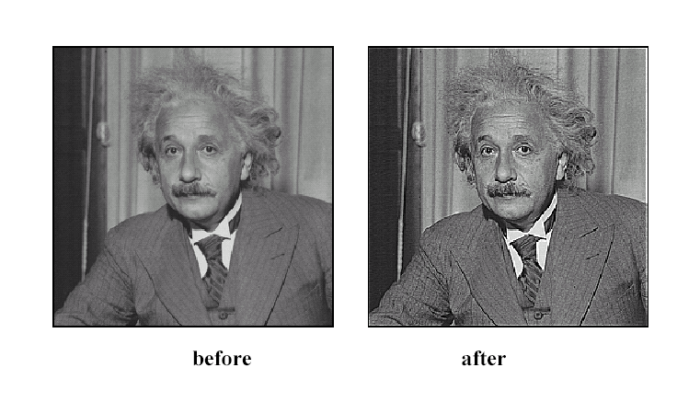
Sharpening
Source: D. Lowe

Slide 25
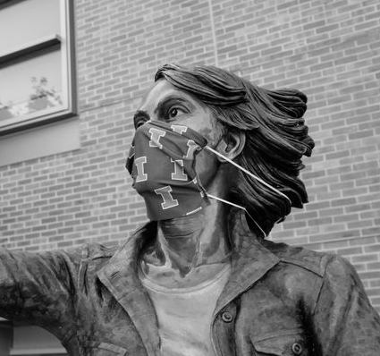

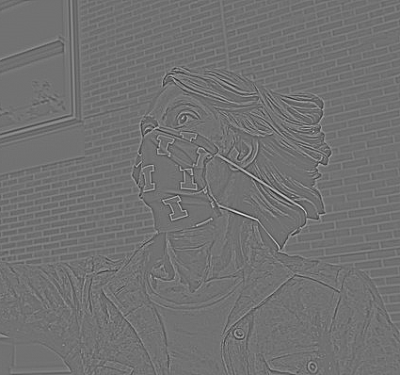
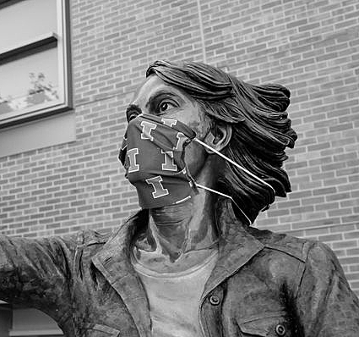



Sharpening
Original
Smoothed
Detail
–
$$=$$
Original
Detail
Sharpened
$$+$$
$$=$$
Source: S. Gupta

Slide 26
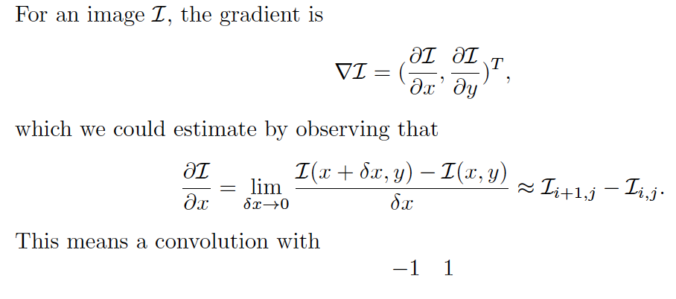
Gradients with finite differences

Slide 27
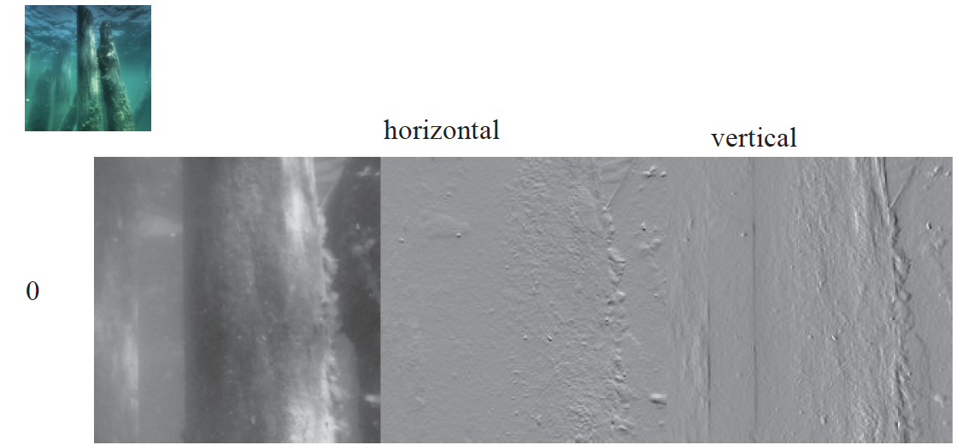

Slide 28
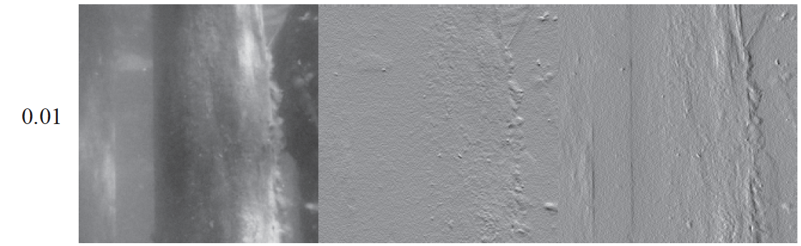

Slide 29
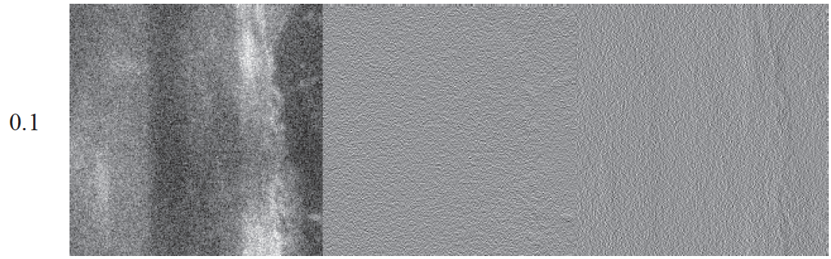

Slide 30
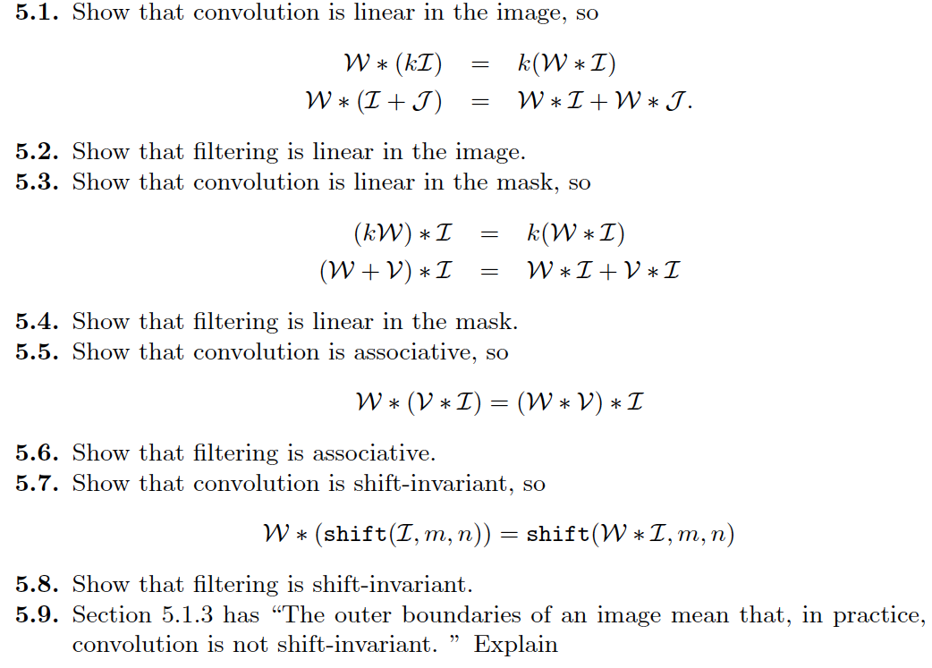
Think about this...

