Slide 1
Quick and dirty Fourier theory - I
D.A. Forsyth
University of Illinois at Urbana-Champaign

Slide 2
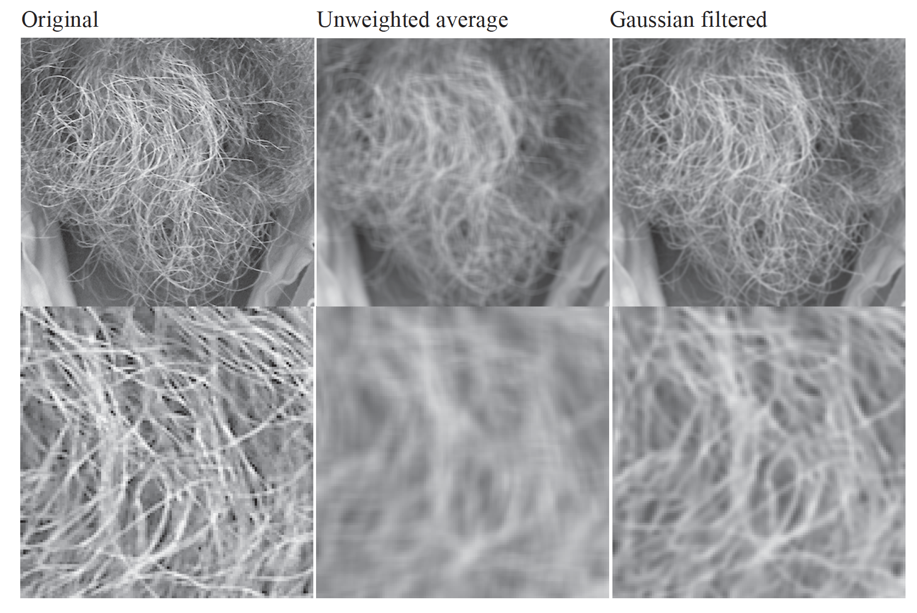
Mystery 1
Why does filtering with a Gaussian give a nice smooth image,
but filtering with a box filter gives artifacts?
Notes:
Things we can’t understand without thinking in frequency
2

Slide 3
Mystery 2
Why can downsampling sometimes lead to aliasing?

Slide 4
Fourier analysis
To understand these, we need a representation of images that allows us to tease apart slow and fast changes

Slide 5
Fourier series – simplest case
Periodic f(t)
defined on [0, 1]
f(0)=f(1)
Generally, we have for a (reasonable) periodic f(t)
Figure out the weights for a given f(t).

Slide 6
Fourier series: useful facts
Fact 1
Fact 2
Fact 3

Slide 7
Fourier series: using facts
If:
(fact 1 makes all the cosine/sine terms go away!)
(fact 2 makes all the other terms go away!
And fact 3 sets the scale)

Slide 8
Fourier series: issues
A’s and B’s are inelegant -> complex exponentials
Did NOT show that the series converges to the function
Read Korner’s wonderful book Fourier Analysis
We’re OK for anything we care about
In principle, we can go forward
Function -> A’s, B’s
Or backward
A’s, B’s -> Function
Is this right? (mostly yes, but details…)

Slide 9
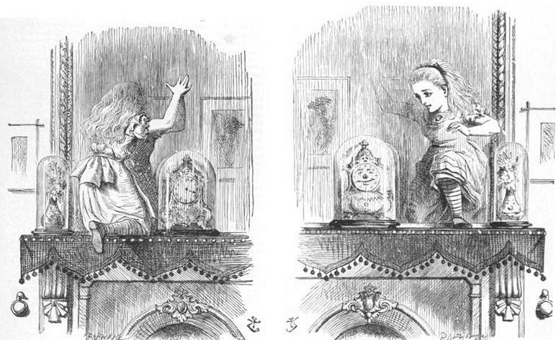
Complex exponentials
This i is the square root of -1 !!!
Advantage:
if the function is complex, can represent cleanly
don’t need to remember which is A, which B

Slide 10
Complex exponentials: compact facts
k, n integers
This minus sign matters!

Slide 11
Fourier series with complex exponentials: using fact
If:
Using the fact! (this is analogous
to an orthonormal basis in linear
algebra)

Slide 12
Fourier series with complex exponentials: issues
But this is just for a periodic function on [0, 1]
Easy to extend to other intervals
Easy to extend to the circle
But what about functions on [-infinity, infinity]?
These could wiggle often in numerous places
IDEA: use “more” basis elements
The Fourier transform

Slide 13
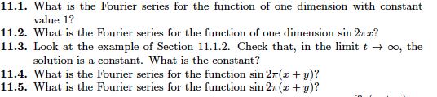
Things to think about...

