Slide 1
Quick and dirty Fourier theory - II
D.A. Forsyth
University of Illinois at Urbana Champaign

Slide 2

1D Fourier transform
Define a set of basis functions:
$$ψ_{u}\left(t\right)=e^{i2πut}, u∈(−∞,∞)$$
Compare
Integer

Slide 3
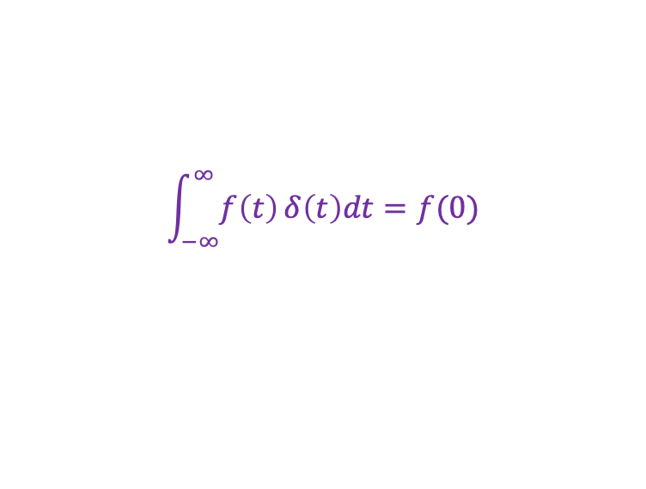
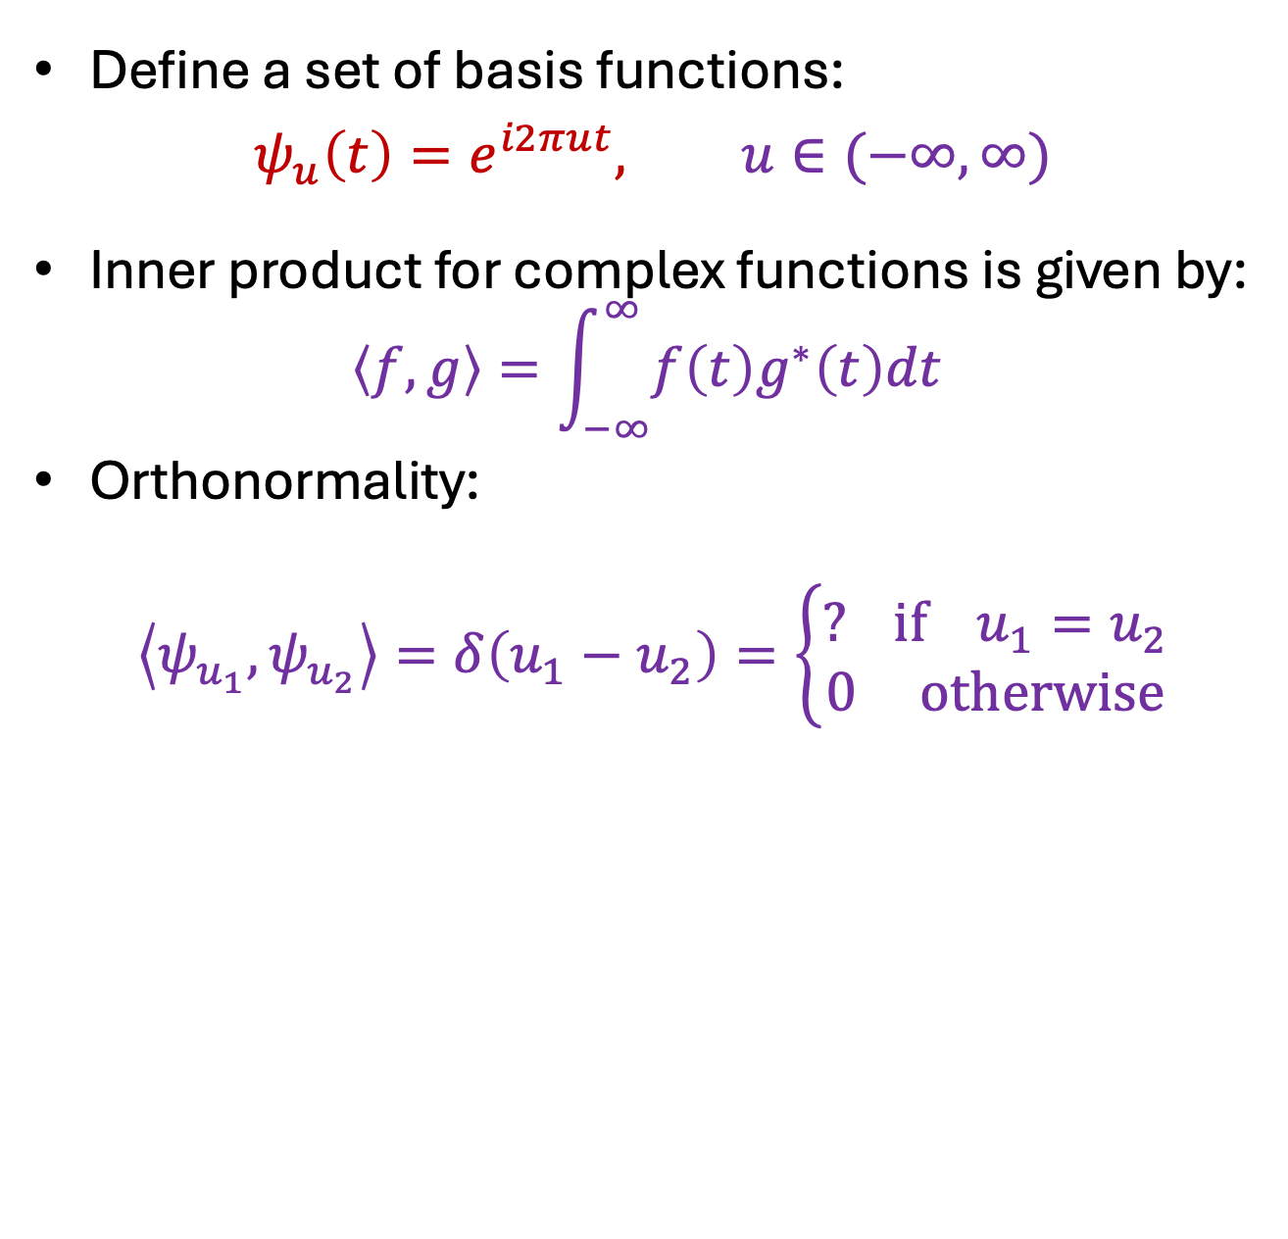
1D Fourier transform
Define a set of basis functions:
$$ψ_{u}\left(t\right)=e^{i2πut}, u∈(−∞,∞)$$
Inner product for complex functions is given by:
$$\left\langle f,g\right\rangle =\int_{−∞}^{∞}{f\left(t\right)g^{∗}\left(t\right)dt }$$
Orthonormality:
$$\left\langle ψ_{u_{1}},ψ_{u_{2}}\right\rangle =δ\left(u_{1}−u_{2}\right)=\left\{\begin{aligned}? if{ u}_{1}=u_{2} \\ 0 otherwise\end{aligned}\right.$$
$$\int_{−∞}^{∞}{f\left(t\right)}δ\left(t\right)dt=f(0)$$

Slide 4
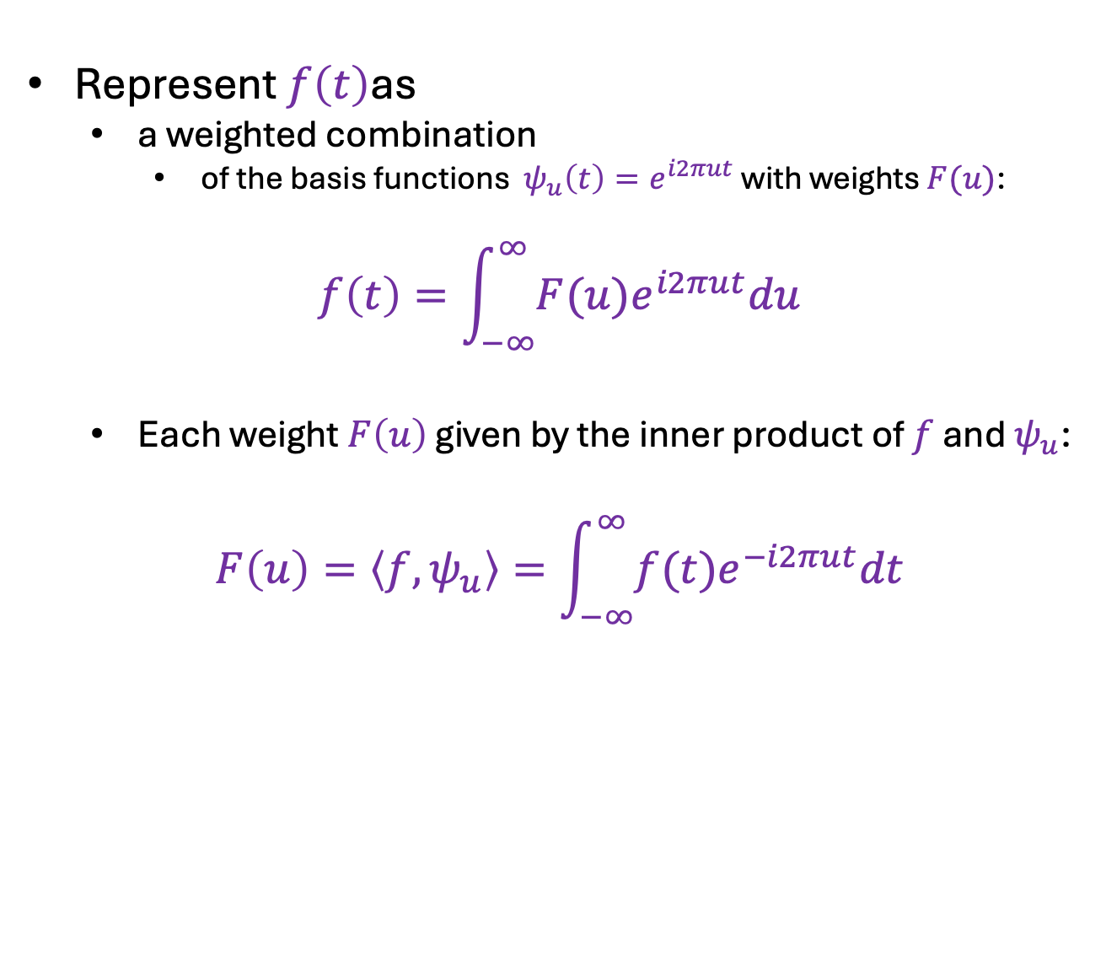
1D Fourier transform
Represent $f\left(t\right)$as
a weighted combination
of the basis functions $ψ_{u}\left(t\right)=e^{i2πut}$ with weights $F(u)$:
$$f\left(t\right)=\int_{−∞}^{∞}{F(u)e^{i2πut}du}$$
Each weight $F\left(u\right)$ given by the inner product of $f$ and $ψ_{u}$:
$$F\left(u\right)=\left\langle f,ψ_{u}\right\rangle =\int_{−∞}^{∞}{f(t)e^{−i2πut}dt}$$

Slide 5

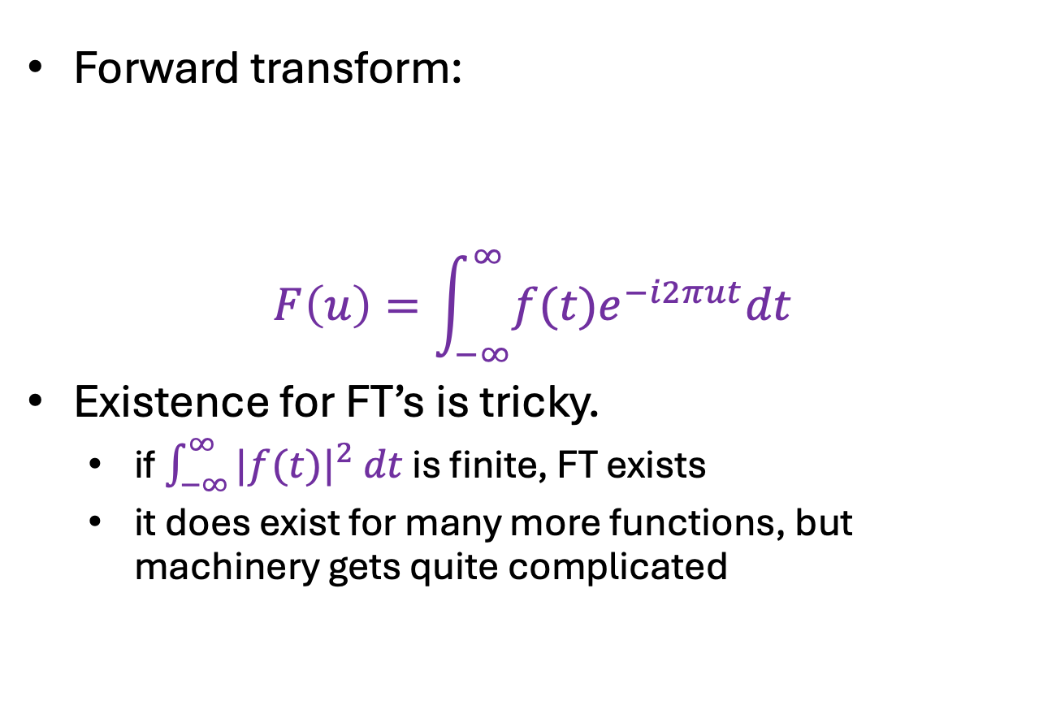


1D Fourier transform
Forward transform:
$$F\left(u\right)=\int_{−∞}^{∞}{f(t)e^{−i2πut}dt}$$
Existence for FT’s is tricky.
if $\int_{−∞}^{∞}{|f(t)|^{2} dt}$ is finite, FT exists
it does exist for many more functions, but machinery gets quite complicated
$$ℱ$$
$$f(t)$$
$$F(u)$$

Slide 6
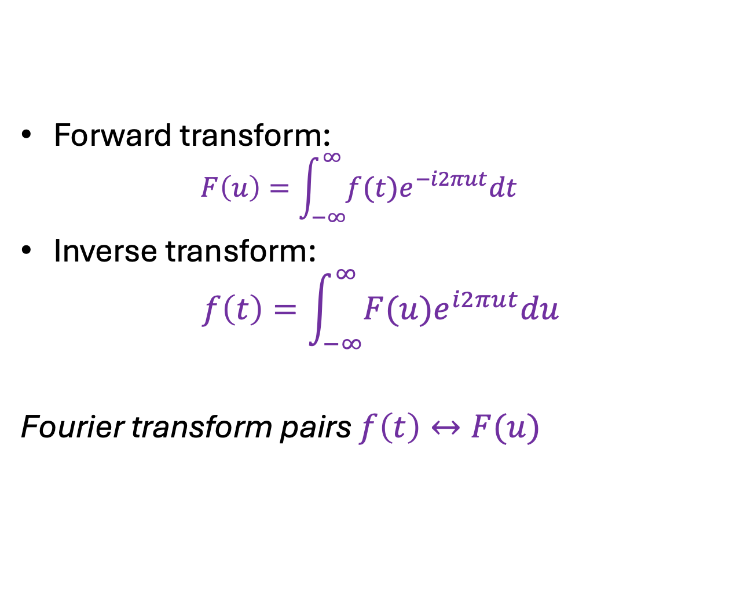
1D Fourier transform
Forward transform:
$$F\left(u\right)=\int_{−∞}^{∞}{f(t)e^{−i2πut}dt}$$
Inverse transform:
$$f\left(t\right)=\int_{−∞}^{∞}{F(u)e^{i2πut}du}$$
Fourier transform pairs $f\left(t\right)↔F(u)$

Slide 7
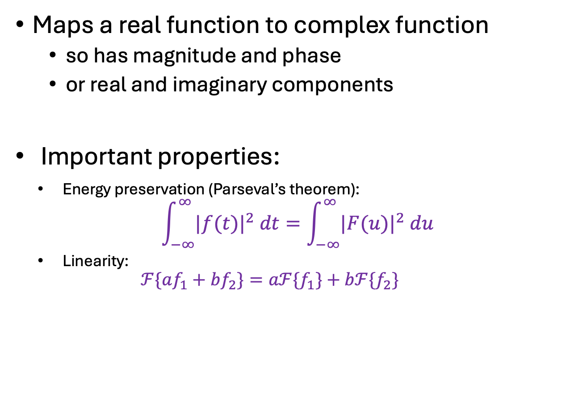
1D Fourier transform
Maps a real function to complex function
so has magnitude and phase
or real and imaginary components
Important properties:
Energy preservation (Parseval’s theorem):
$$\int_{−∞}^{∞}{|f(t)|^{2} dt}=\int_{−∞}^{∞}{|F(u)|^{2} du}$$
Linearity:
$$ℱ\{af_{1}+bf_{2}\}=aℱ{\{f}_{1}\}+bℱ{\{f}_{2}\}$$

Slide 8
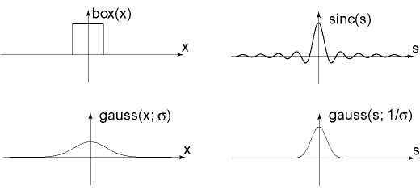








Important Fourier transform pairs
$$box(t)$$
$$sinc\left(u\right)=\frac{\sin\left(πu\right)}{πu}$$
$$−0.5$$
$$0.5$$
$$\operatorname{gauss}\left(t;σ\right)$$
$$\operatorname{gauss}\left(u;\frac{1}{σ}\right)$$
$$f\left(t\right)=1$$
$$unit impulse δ\left(u\right)$$
*The last one is formal since these functions don’t meet the mathematical requirements for FT

Slide 9
Important Fourier transform pairs
$$box(t)$$
$$sinc\left(u\right)=\frac{\sin\left(πu\right)}{πu}$$
Notice that when
f has narrower support,
FT(f) has broader, and
Vice versa!
$$−0.5$$
$$0.5$$
$$\operatorname{gauss}\left(t;σ\right)$$
$$\operatorname{gauss}\left(u;\frac{1}{σ}\right)$$
$$f\left(t\right)=1$$
$$unit impulse δ\left(u\right)$$
*The last one is formal since these functions don’t meet the mathematical requirements for FT

Slide 10

2D Fourier transform
2D basis functions:
$$ψ_{u,v}\left(x,y\right)=e^{i2πux}e^{i2πvy}$$
$=e^{i2π(ux+vy)}$
$=\cos{2π\left(ux+vy\right)}+$
$i sin 2π(ux+vy)$

Slide 11
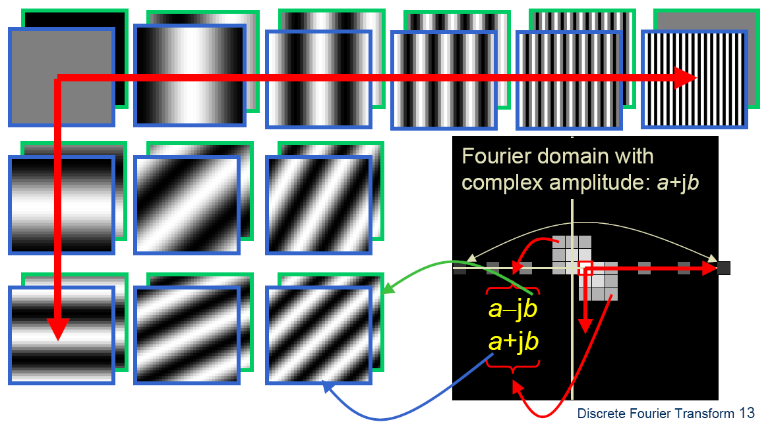



2D Fourier transform
2D basis functions are oriented sinusoidal “gratings”:
$$u$$
$(u,v)$ is the direction normal to the grating
The period is $1/\sqrt{u^{2}+v^{2}}$
$$v$$

Slide 12
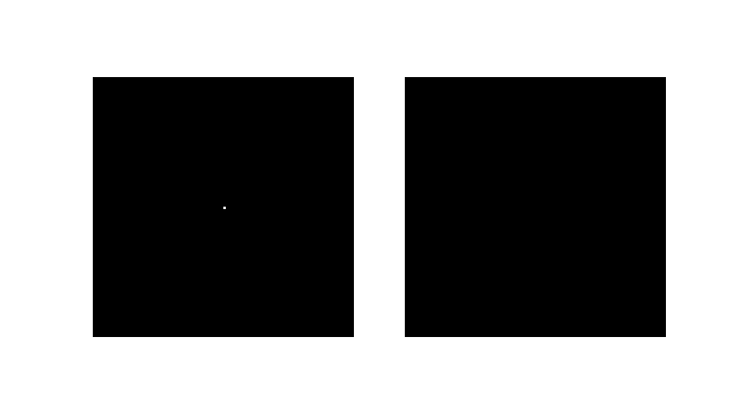

Basis function examples
Real component
$$(u,v)$$

Slide 13
Basis function examples
Real component
$$(u,v)$$

Slide 14
Basis function examples
Real component
$$(u,v)$$

Slide 15
Linear combination of basis functions
Real component
$$(u,v)$$

Slide 16
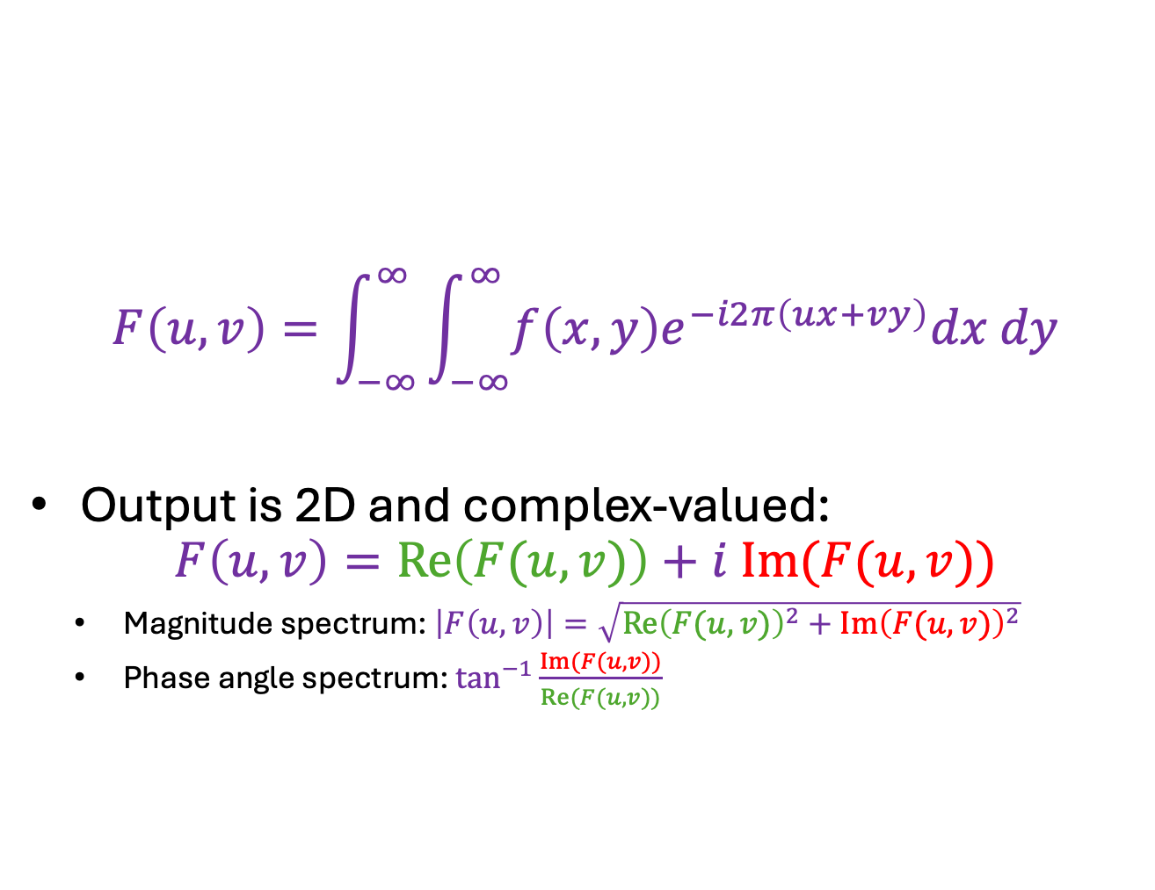
2D Fourier transform
$$F\left(u,v\right)=\int_{−∞}^{∞}{\int_{−∞}^{∞}{f\left(x,y\right)e^{−i2π\left(ux+vy\right)}dx dy}}$$
Output is 2D and complex-valued:
$$F\left(u,v\right)=Re\left(F(u,v)\right)+i Im(F(u,v))$$
Magnitude spectrum: $\left|F\left(u,v\right)\right|=\sqrt{{Re\left(F(u,v)\right)}^{2}+{Im\left(F(u,v)\right)}^{2}}$
Phase angle spectrum: $\tan^{−1}{\frac{Im(F(u,v))}{Re(F(u,v))}}$

Slide 17
2D Fourier transform
This is a linear operator applied to the function
Can get discrete approximation by:
discretize a 2D function
straighten into a vector
multiply by appropriate matrix
unstraighten vector
Matrix comes from basis functions
matrix multiplication can be made fast
FFT=Fast Fourier Transform

Slide 18
Phase vs. magnitude
Phase from one image, magnitude from another

Slide 19
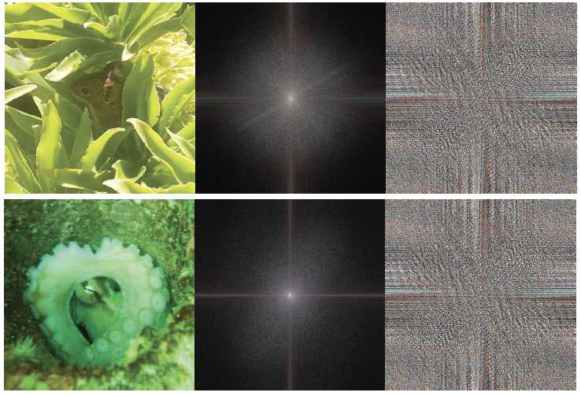
Image Log Magnitude Phase

Slide 20
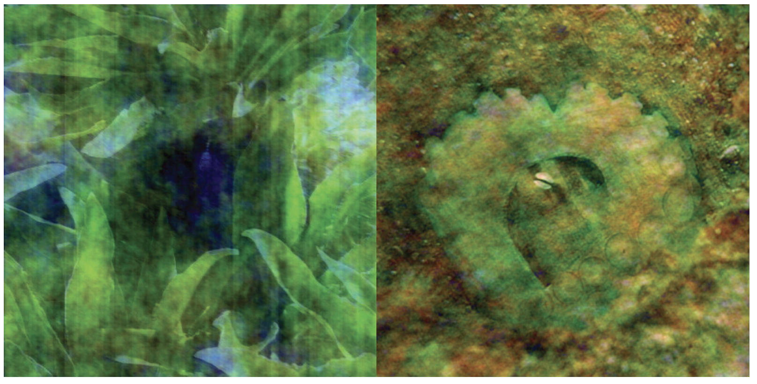
Mouse phase, octopus mag
Octopus phase, mouse mag

Slide 21
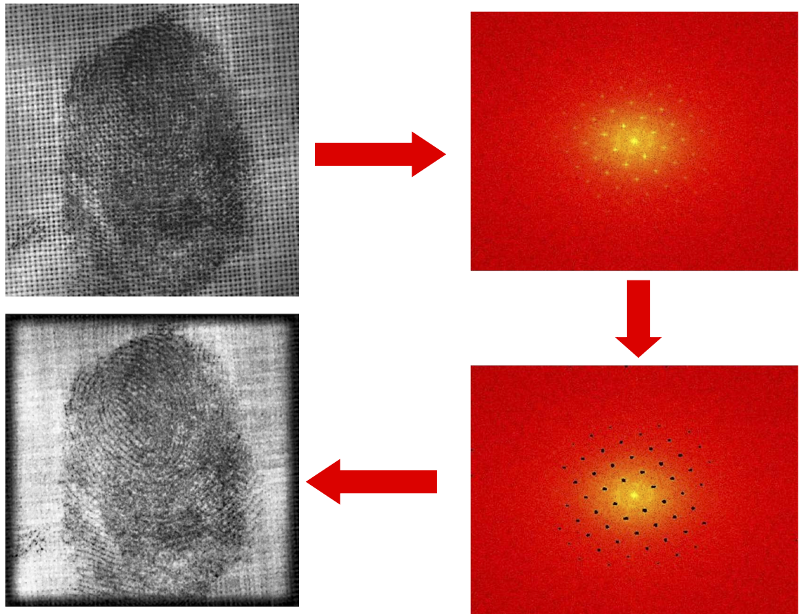
Application: Removing periodic patterns
Magnitude image
Remove peaks
Source: A. Zisserman

Slide 22
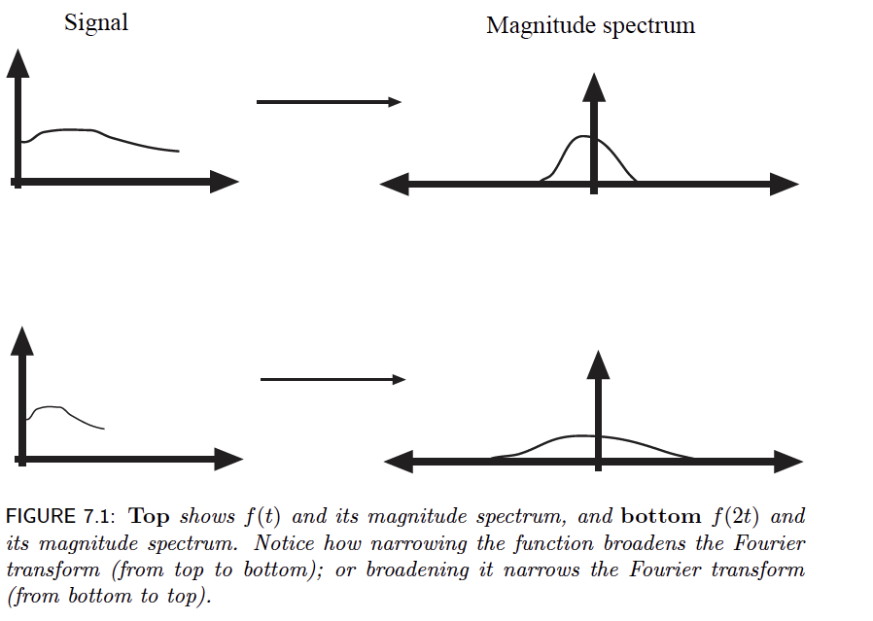
Important effect
“wider” function has “narrower” Fourier transform
“narrower” function has “wider” Fourier transform

Slide 23
Trick – low pass filter
Multiply FT magnitude by Gaussian
Inverse FT
High frequencies are suppressed

Slide 24
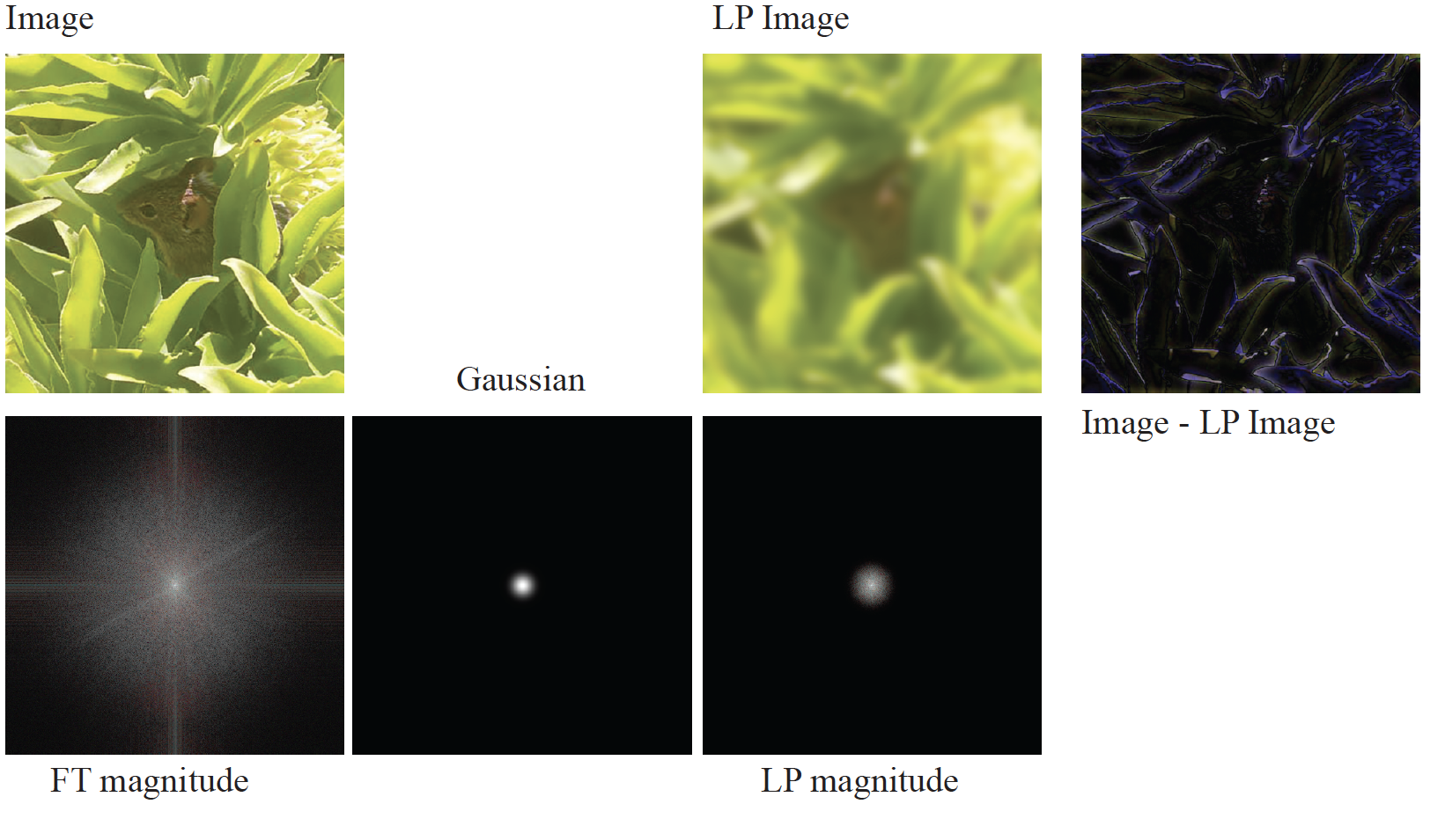
Smoothing by FT

Slide 25
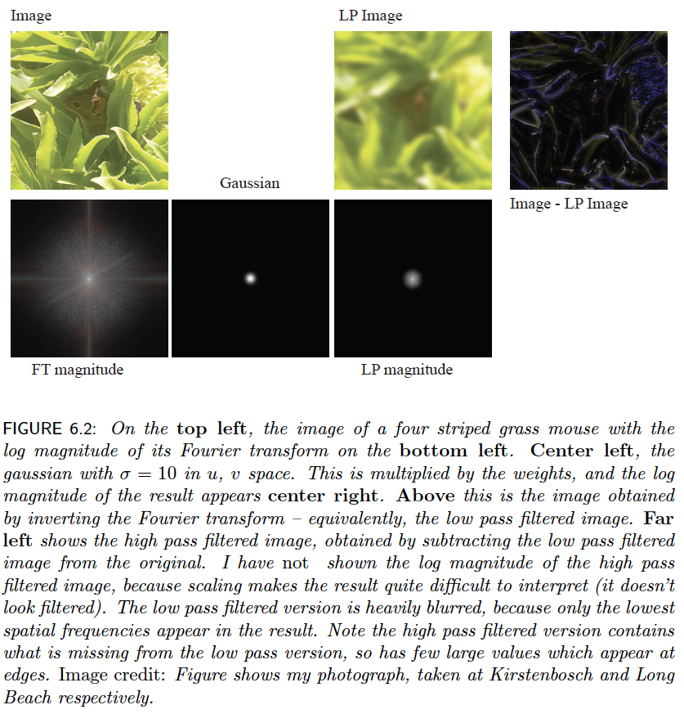

Slide 26
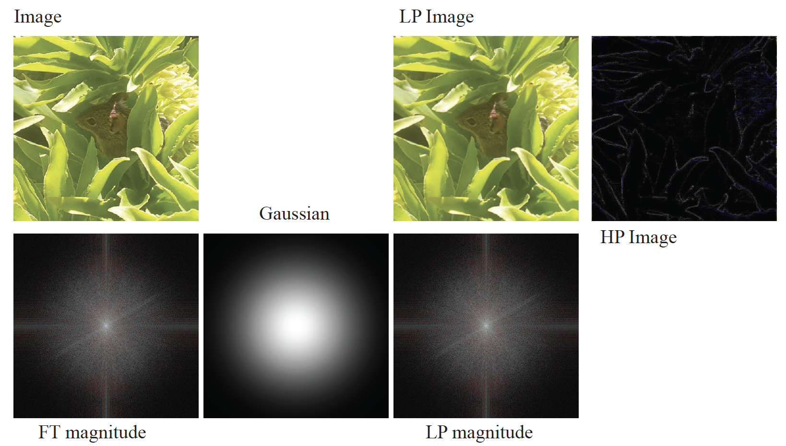
Smoothing with FT

Slide 27
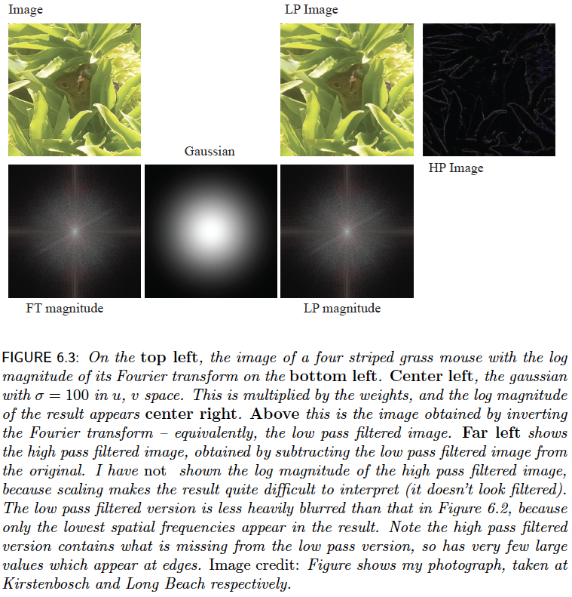

Slide 28
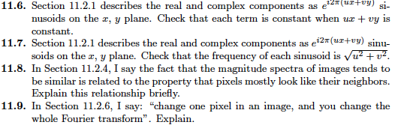
Things to think about...

