Slide 1
Geometric transformations
D.A. Forsyth,
University of Illinois at Urbana Champaign

Slide 2

Notation

Slide 3


Translation

Slide 4
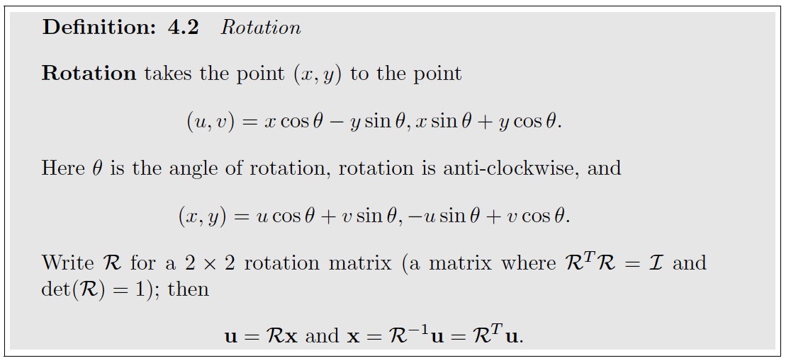


Slide 5
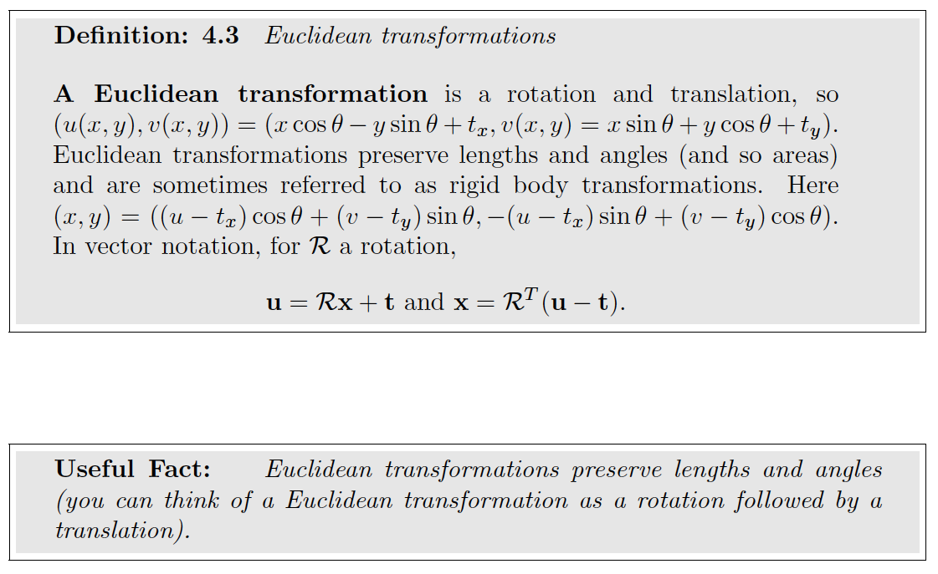

Slide 6
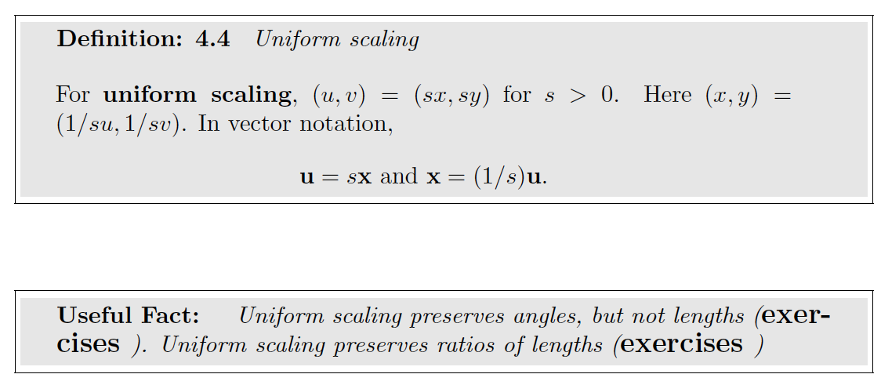

Slide 7
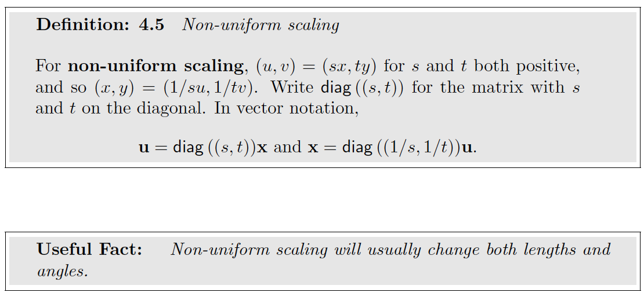

Slide 8
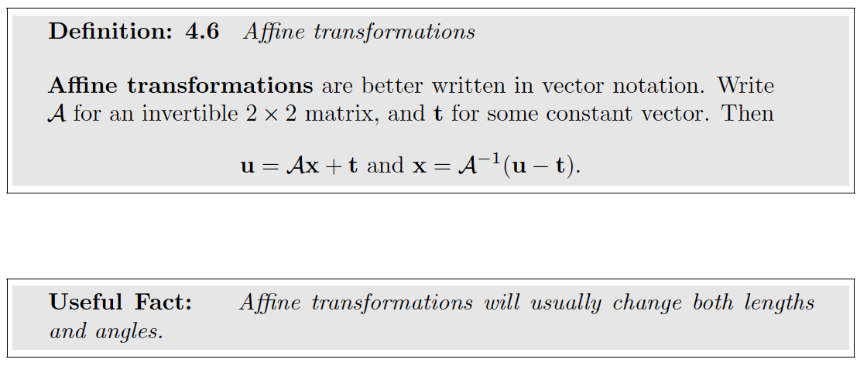

Slide 9
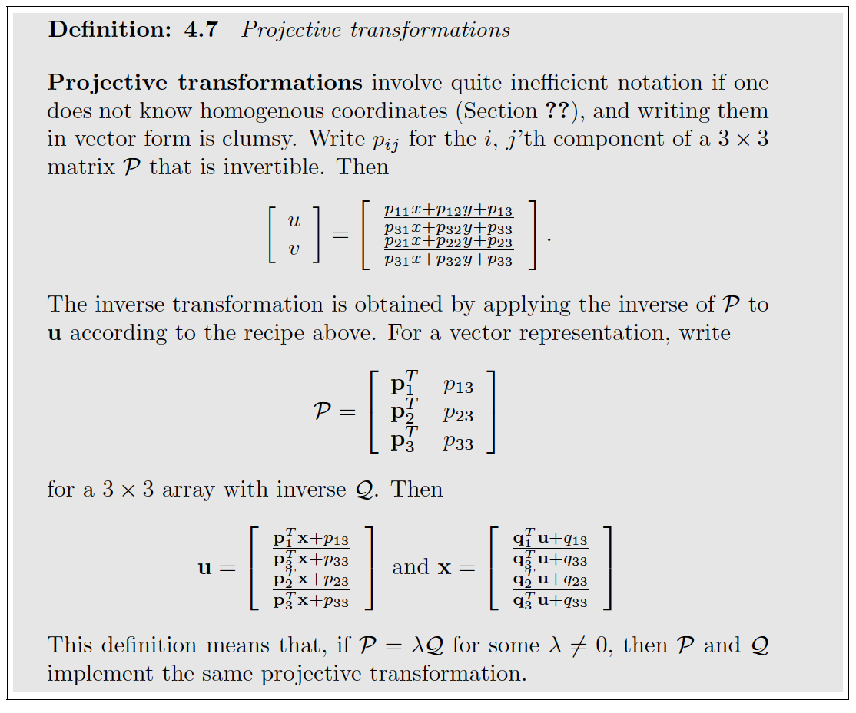

Slide 10
All the transformations are special cases of projective transformations

Slide 11
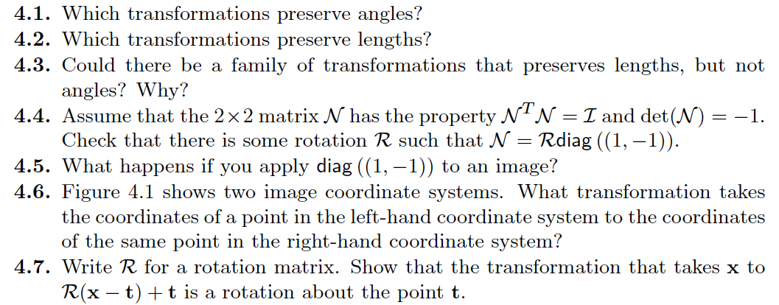
Things to think about

