Slide 1
Geometric transformations of images
D.A. Forsyth,
University of Illinois at Urbana Champaign

Slide 2
Nuisances in applying geometric tx to images
Image coordinate systems are weird
You have to *put* an image somewhere
Very often, the transformation you have in mind puts the image outside the span of the target
what to do?

Slide 3
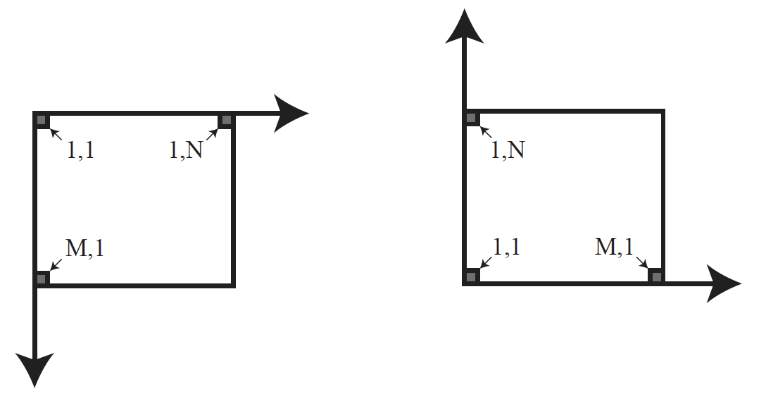
Image coordinate systems
I’ll use this one, cause everyone does
You might think in terms of this one,
though – keep them straight
To add to the fun, in some API’s images run 0..M-1 (Python, etc) and in others they run 1..M (Matlab).
Keep an eye on this point, or you will lose pixels or have code errors.

Slide 4
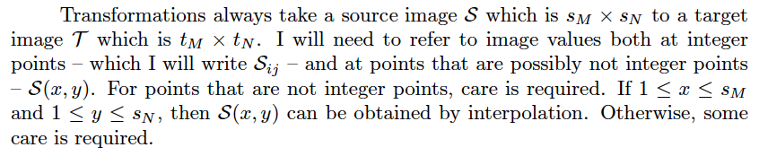
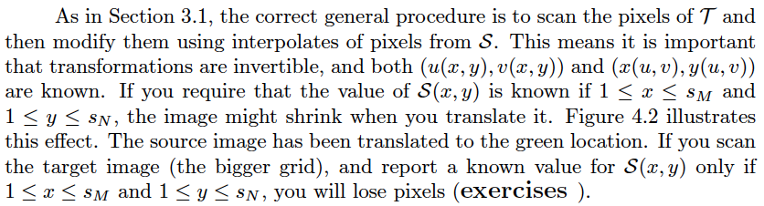
Inverse warping requires a little care...

Slide 5
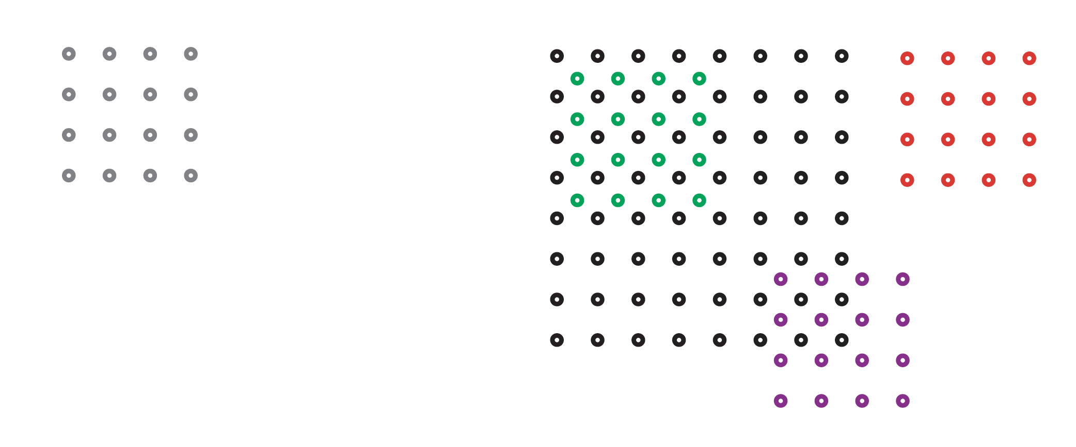
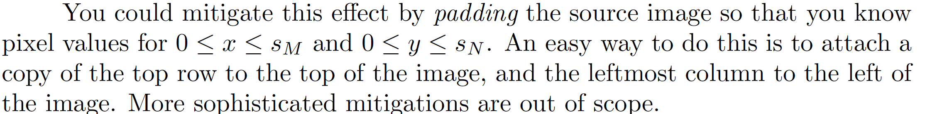
Losing pixels when inverse warping

Slide 6
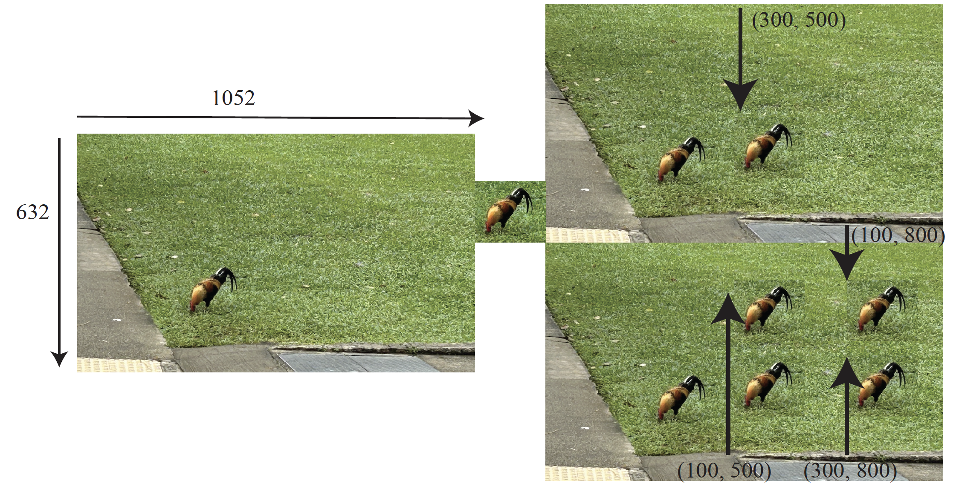
Cropping, translating and pasting

Slide 7
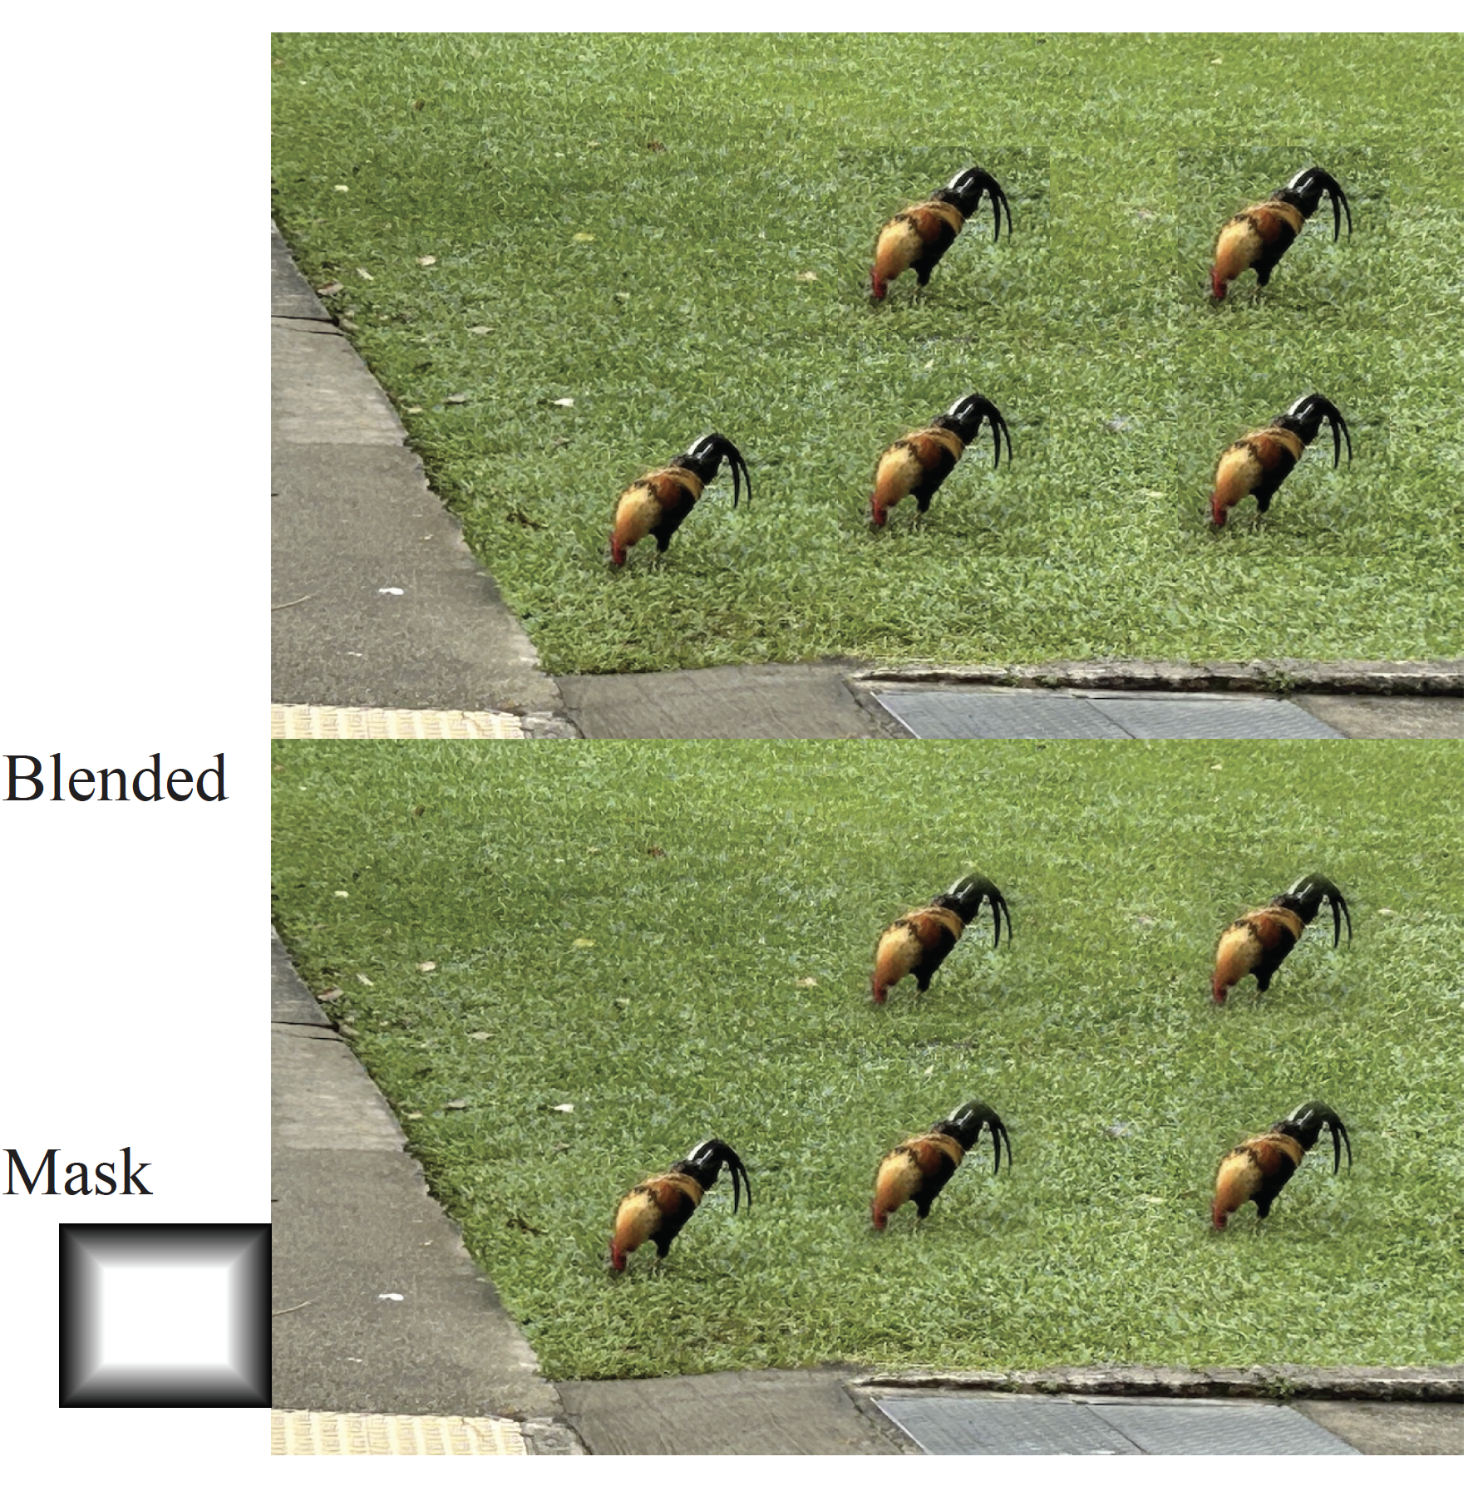
Blending
Can improve over pasting

Slide 8
Scaling
Uniform scaling
we did that!
upsampling – scale by k>1
downsampling – scale by k<1
Non uniform scaling
can be a nuisance
upsampling in one direction, downsampling in the other!

Slide 9
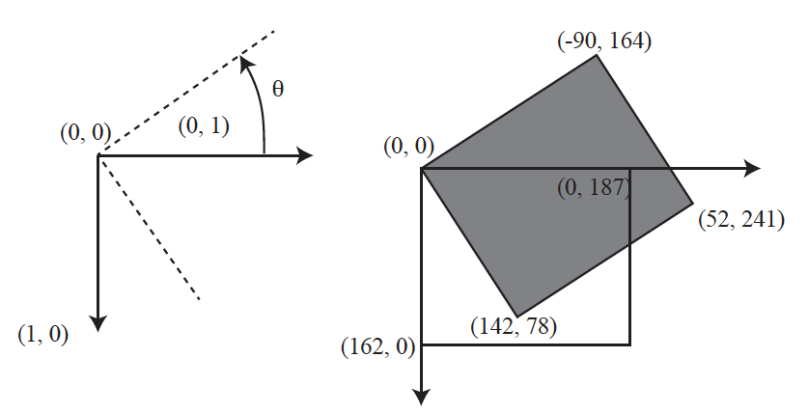
Rotation
Rotating about the origin can lead to trouble
pixels leave the span
Common fix in APIs
rotate about the center of the image
pixels still leave the span
Choices:
all (bigger image, lots of zeros)
same (crop to original)

Slide 10
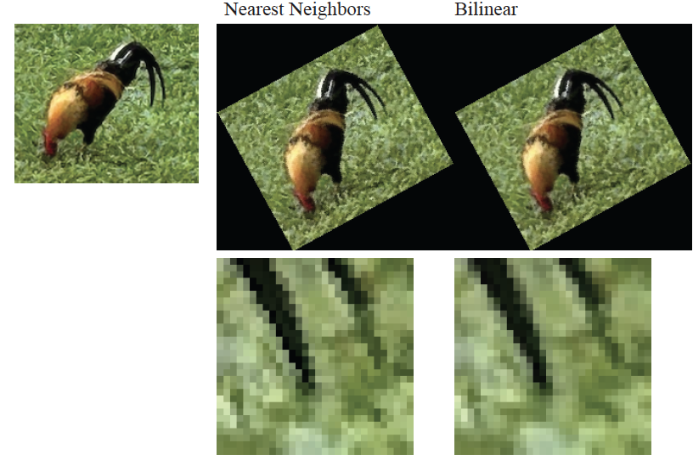
Rotation: Interpolation matters

Slide 11
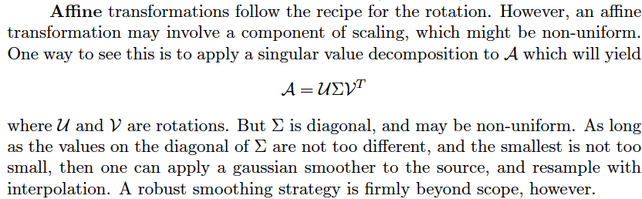
Affine transformations
Problems
There is often a non-uniform scaling inside the matrix
Image could end up outside target image range
what to do?
usually, figure out target image range from affine tx.

Slide 12
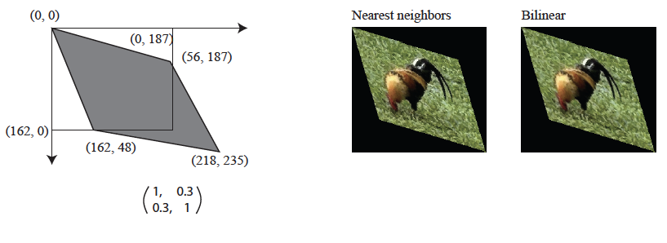
Affine transformation

Slide 13
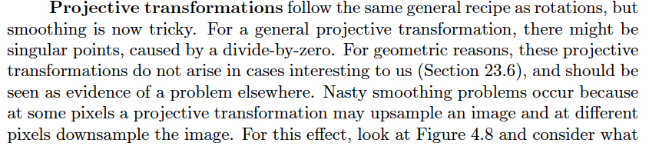
Projective transformations
Problems
There is often a non-uniform scaling inside the matrix
Possible divide by zero
Image could end up outside target image range
what to do?
usually, figure out target image range from affine tx.

Slide 14
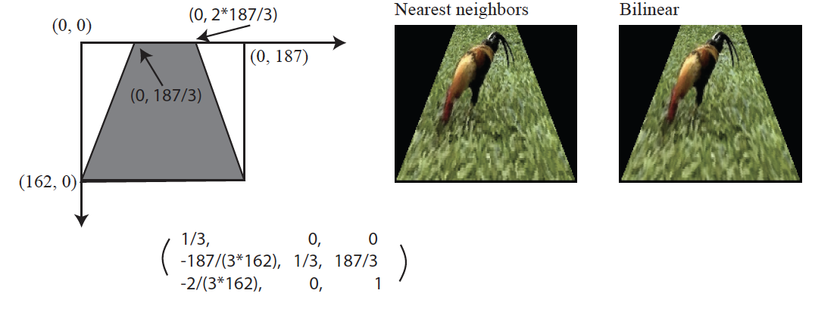
Projective transformation

Slide 15
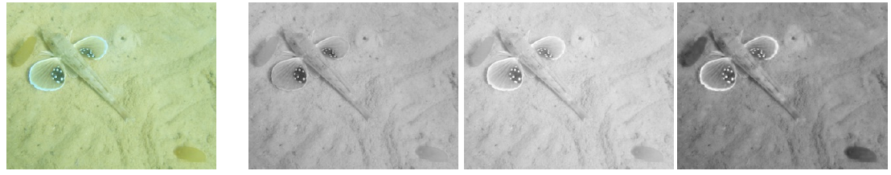
Simple registration with translation
Color separations:

Slide 16
Simple registration with translation
Fix G in place
for many (tx, ty)
slide R by tx, ty
compute C(tx, ty)
which compares overlaps
take the (tx, ty) that gives best overlap
Q:
what is cost?
other applications?
efficiency?

Slide 17
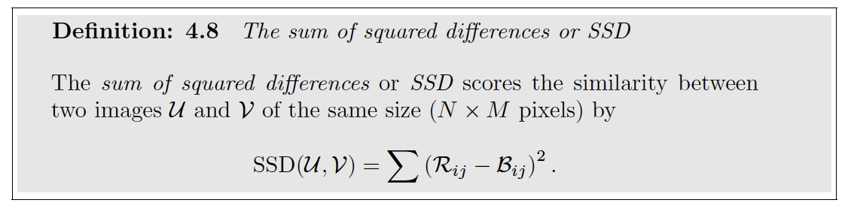
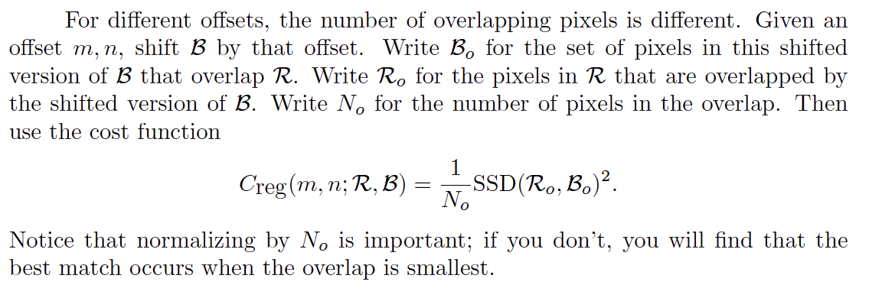
Cost functions: SSD

Slide 18
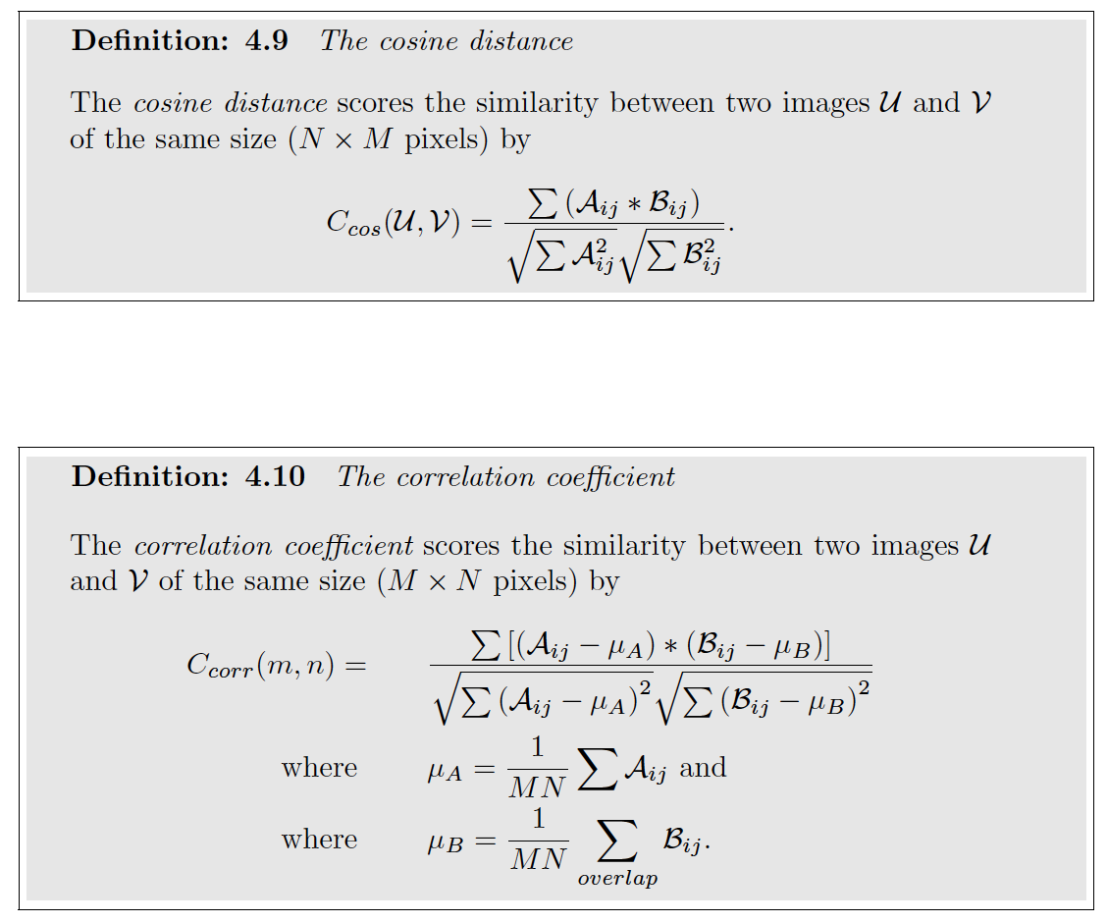
Cost functions: cosine dist and correlation
You compute these for the overlap

Slide 19
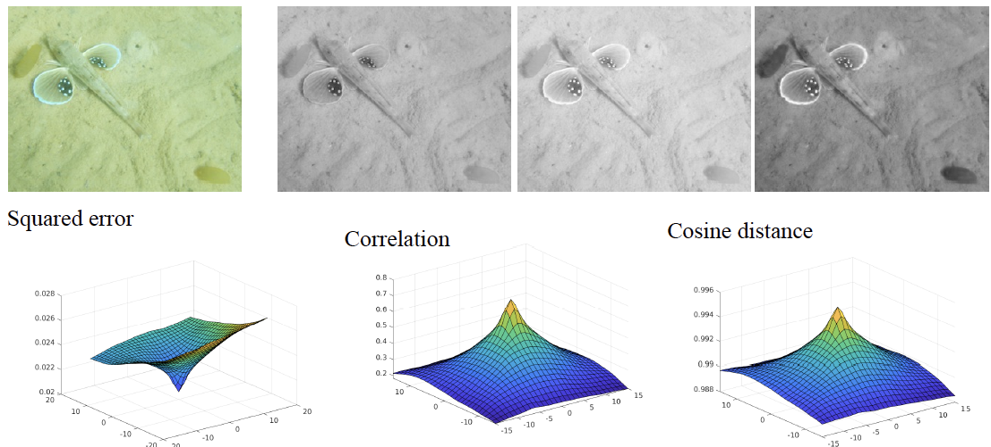
Cost functions

Slide 20
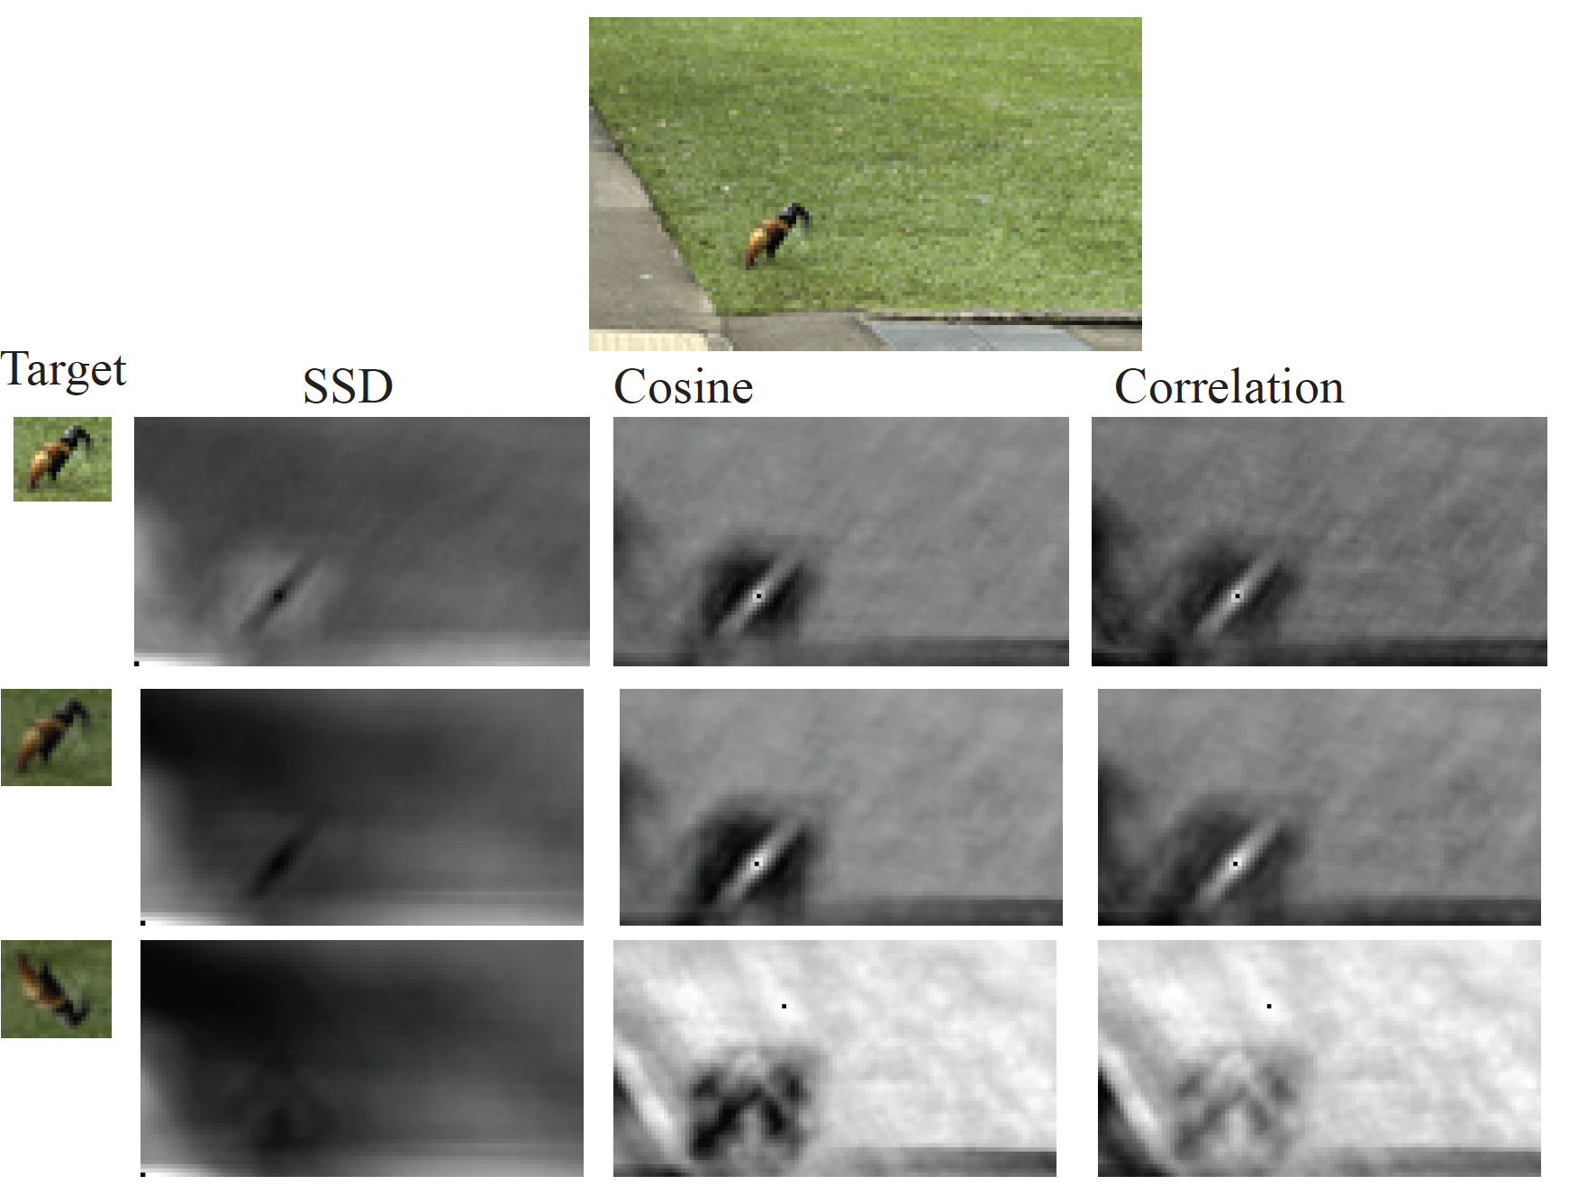
Find the chicken
Simplest object detection
not very good
can be fast

Slide 21
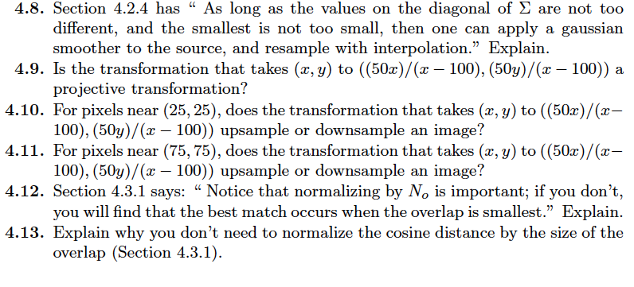
Think about this...

