Slide 1
The Hough transform
D.A. Forsyth
University of Illinois at Urbana-Champaign

Slide 2
Hough transform
Possibly the earliest voting scheme – but still useful!
Discretize parameter space into bins
For each feature point in the image, put a vote in every bin in the parameter space that could have generated this point
Find bins that have the most votes
Image space
Hough parameter space
P.V.C. Hough, Machine Analysis of Bubble Chamber Pictures, Proc. Int. Conf. High Energy Accelerators and Instrumentation, 1959

Slide 3
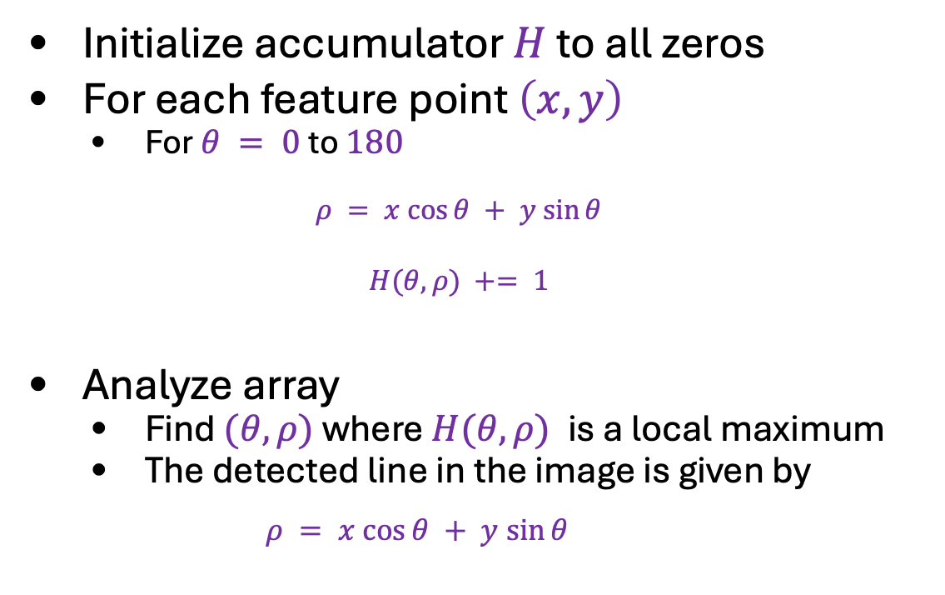


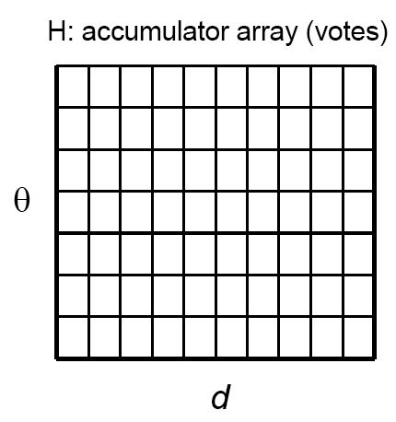
Algorithm outline
Initialize accumulator $H$ to all zeros
For each feature point $\left(x,y\right)$
For $θ = 0$to $180$
$$ρ = x cos⁡θ + y sin⁡θ$$
$$H(θ, ρ) += 1$$
Analyze array
Find $(θ, ρ)$where $H(θ, ρ)$is a local maximum
The detected line in the image is given by
$$ρ = x cos⁡θ + y sin⁡θ$$
$$ρ$$
$$θ$$

Slide 4
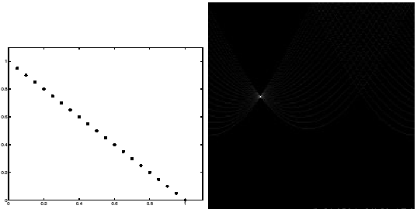
Basic illustration
features
votes
Hough transform demo
Notes:
Figure 15.1, top half. Note that most points in the vote array are very dark, because they
get only one vote.

Slide 5
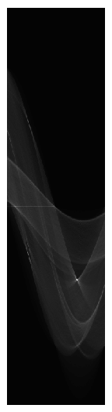
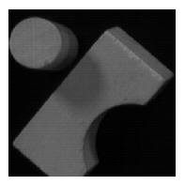
Several lines

Slide 6
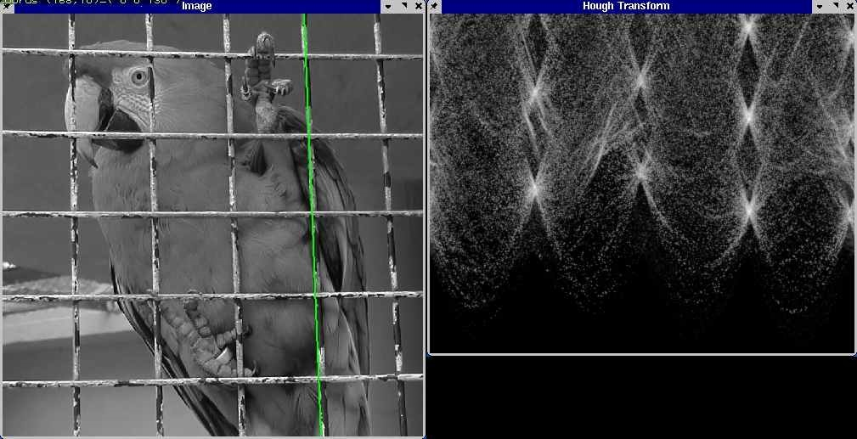
A more complicated image
Source

Slide 7
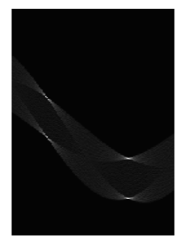
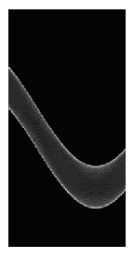
Other shapes
Square
Circle

Slide 8
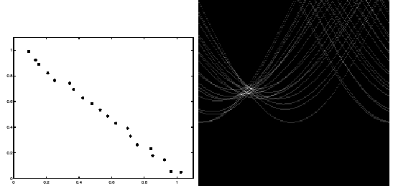
Effect of noise
features
votes
Peak gets fuzzy and hard to locate
Notes:
This is 15.1 lower half

Slide 9
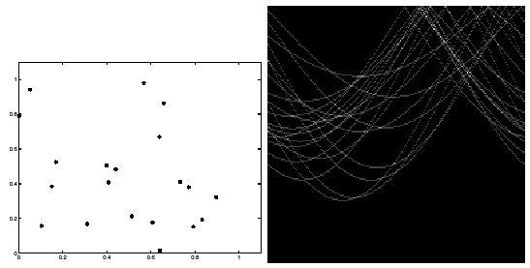
Effect of outliers
features
votes
Uniform noise can lead to spurious peaks in the array
Notes:
15.2; main point is that lots of noise can lead to large peaks in the array

Slide 10
Dealing with noise
How to choose a good grid discretization?
Too coarse: large votes obtained when too many different lines correspond to a single bucket
Too fine: miss lines because some points that are not exactly collinear cast votes for different buckets
Increment neighboring bins (smoothing in accumulator array)
Try to get rid of irrelevant features
E.g., take only edge points with significant gradient magnitude

Slide 11
Hough transform: Pros and cons
Pros
Can deal with non-locality and occlusion
Can detect multiple instances of a model
Some robustness to noise: noise points unlikely to contribute consistently to any single bin
Leads to a surprisingly general strategy for shape localization (more on this next)
Cons
Complexity increases exponentially with the number of model parameters – in practice, not used beyond three or four dimensions
Non-target shapes can produce spurious peaks in parameter space
It’s hard to pick a good grid size

Slide 12
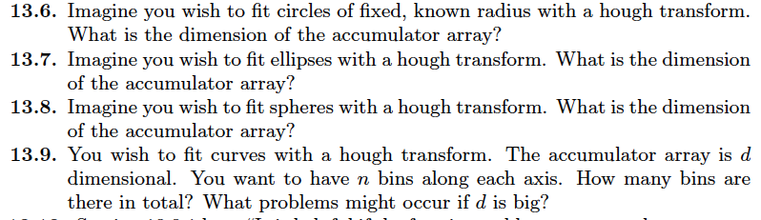
Things to think about...

