Slide 1
Unknown correspondence and ICP
D.A. Forsyth
University of Illinois at Urbana Champaign

Slide 2
General frameworks
Register two sets of points
where correspondence is known exactly
eg barcode, etc. reference points
where correspondence is estimated, but quite well
eg two images, interest points
where correspondence might be hard to estimate
but registration is possible
eg two lidar images of about the same stuff

Slide 3
What if you don’t know correspondences?
RANSAC isn’t usually enough
Issue:
volume of outliers can be extremely high
eg N points in image 1, N points in image 2
N inliers, at most
N (N-1) outliers or more
Much worse for LIDAR correspondence
because you mostly can’t do descriptors
A very important reason to care about interest points and descriptors

Slide 4
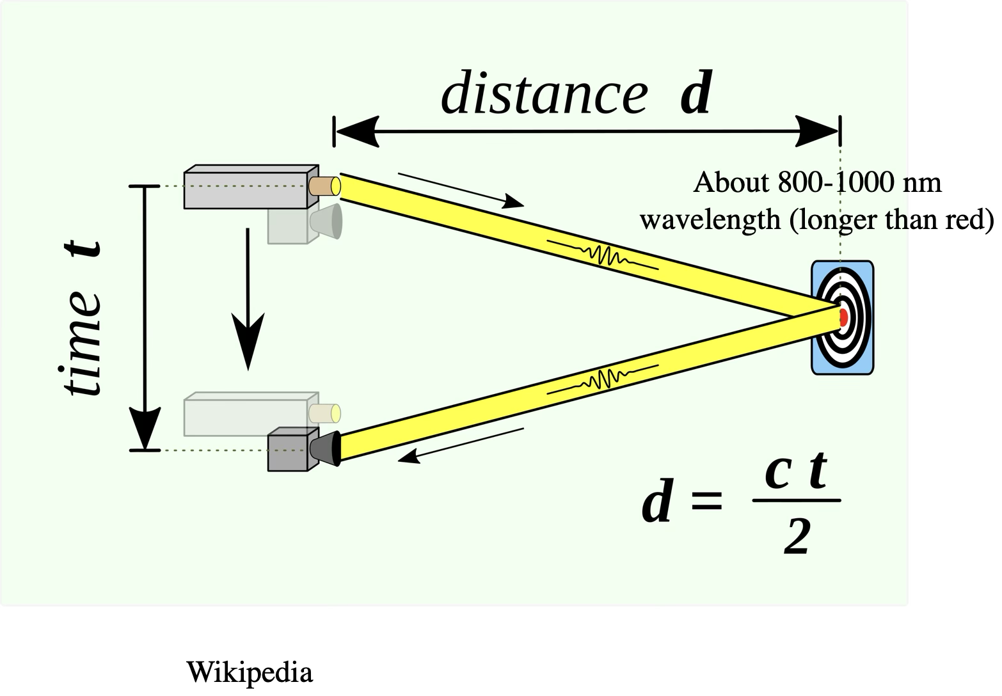
LIDAR produces point clouds

Slide 5
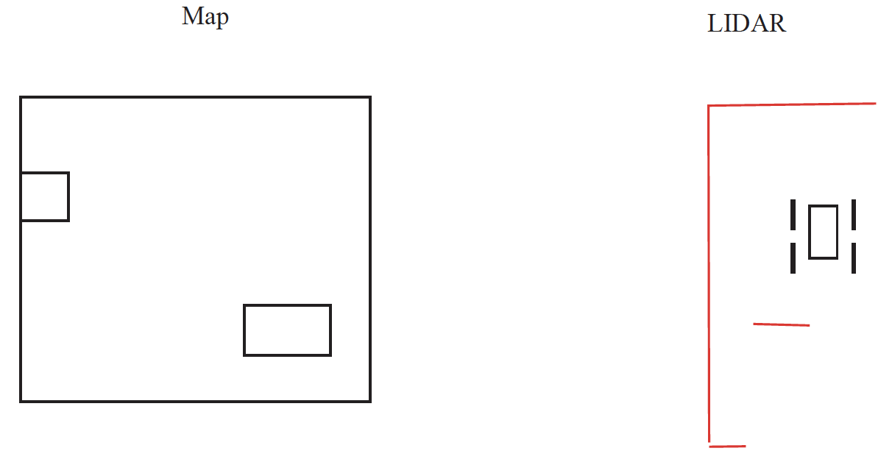
LIDAR registered to map

Slide 6
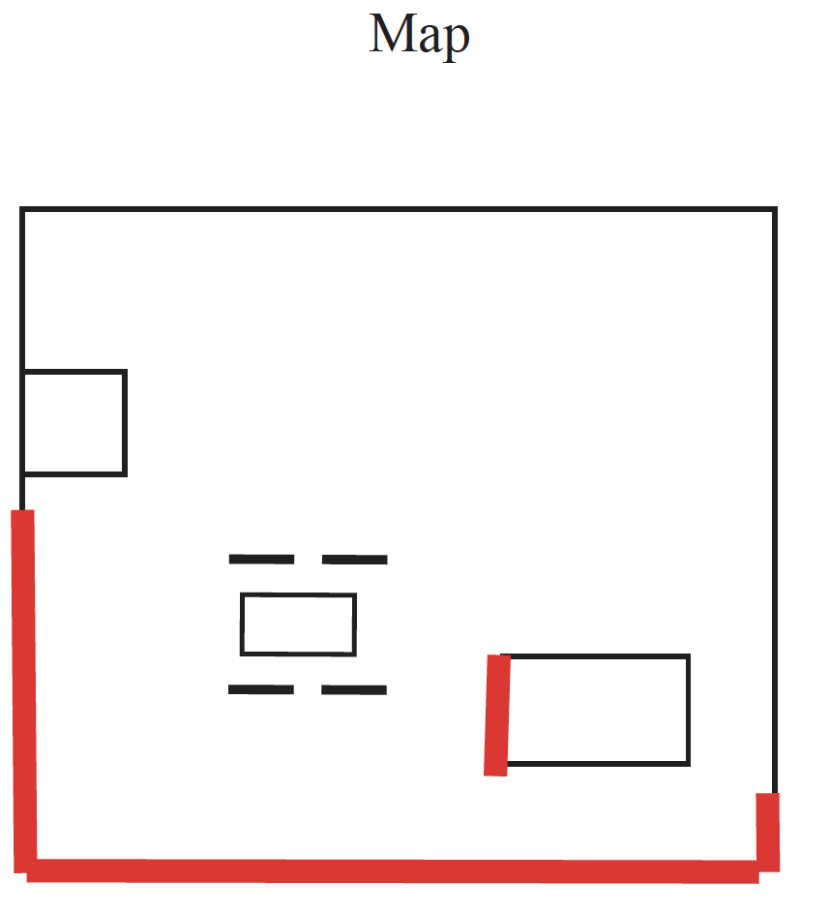
Yield your location

Slide 7
Registering meshes to LIDAR
I have a CAD model of a car
(large triangular mesh)
Where is this car in LIDAR data?
registration problem
How is a mesh a point cloud?
sample points on the mesh
vertices

Slide 8
Iterated closest points or ICP
Idea:
If the transformation is nearly the identity,
then nearest point is likely correspondence
Strategy:
Start with good transformation
Iterate:
Estimate correspondences assuming tx is right
Re-estimate tx

Slide 9
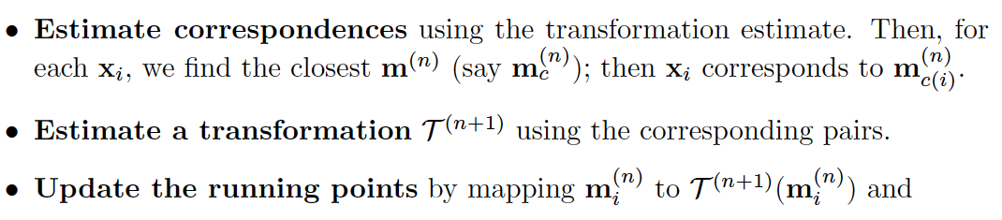
ICP

Slide 10
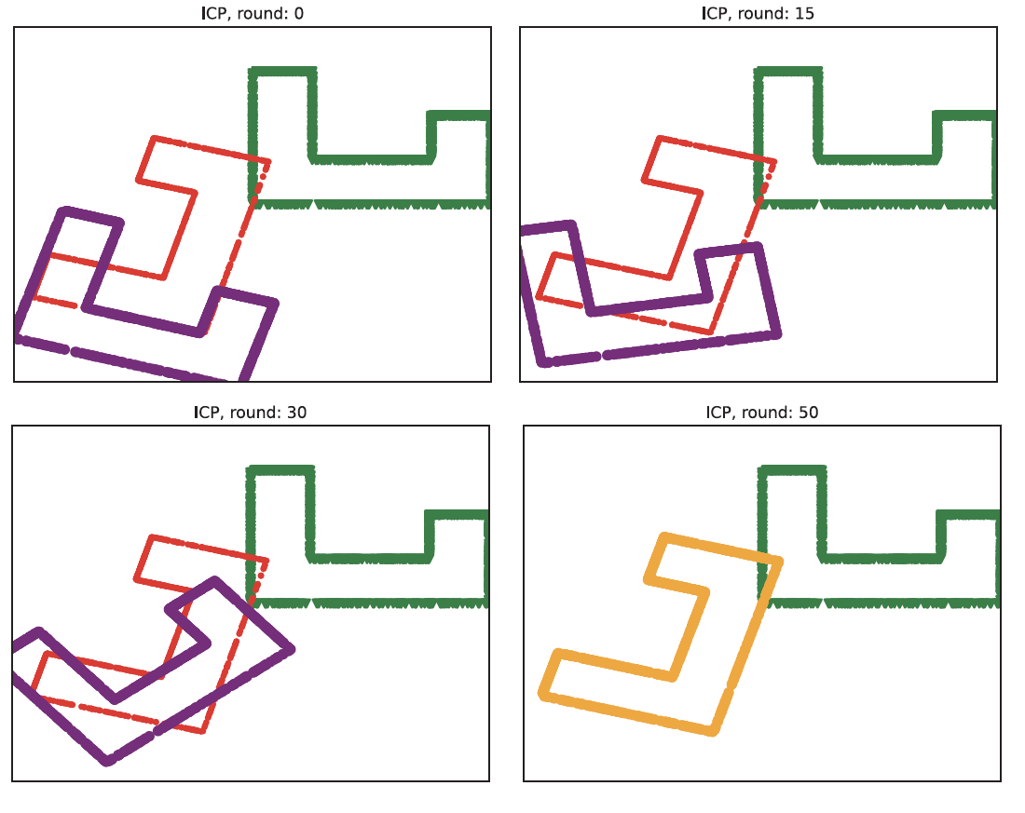
Can converge quite fast
Red – target
Green – source
Purple – running points
Green at 0 -> Purple at 0 – initial transformation

Slide 11
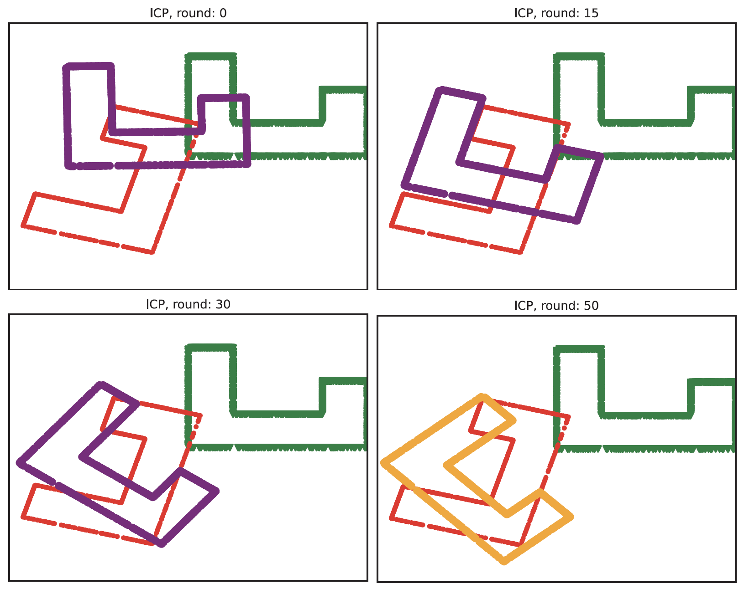
ICP doesn’t always converge
Red – target
Green – source
Purple – running points
Green at 0 -> Purple at 0 – initial transformation

Slide 12
ICP Issues
You have to do an awful lot of nearest neighbors
particularly if the point cloud is big
subsample the point cloud
approximate nearest neighbors
There are still robustness issues
Ideas:
drop correspondences for large distances
use IRLS at each round
Biased sampling can
create problems
fix problems

Slide 13
Resampling
If the two point clouds are big, resample
Choose some number N of points that is acceptable
Draw N points from point clouds
uniformly and at random
Do this with replacement, because its easier

Slide 14
Approximate nearest neighbors
ISSUE:
do you build a new tree for every iteration?
Strategies:
Space is almost always 2D or 3D, so you can grid it
It is easy to test what grid bin a point falls in
(truncate, round)
Build a big enough grid and use that

Slide 15
ICP Issues
You have to do an awful lot of nearest neighbors
particularly if the point cloud is big
subsample the point cloud
approximate nearest neighbors
There are still robustness issues
Ideas:
drop correspondences for large distances
use IRLS at each round
Biased sampling can
create problems
fix problems

Slide 16
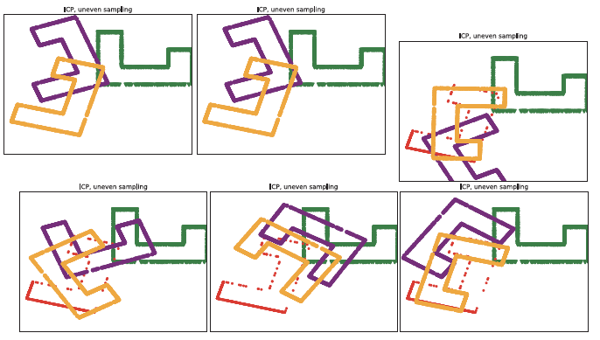
Uneven sampling -> ICP problems
Red – target
Green – source
Purple – running points
Green at 0 -> Purple at 0 – initial transformation

Slide 17
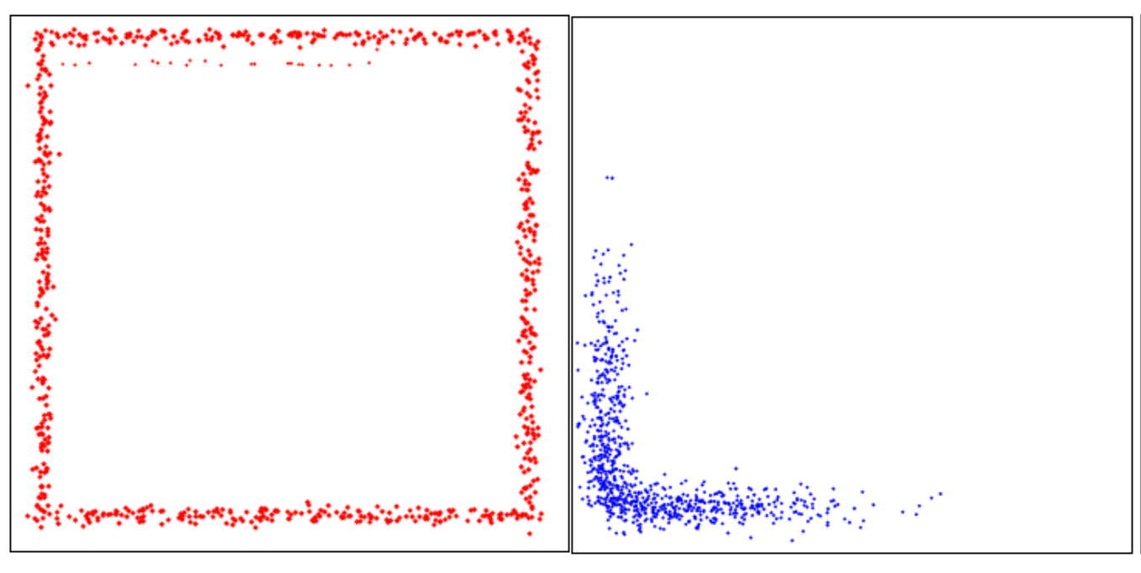
Issue for LIDAR
Map
Vehicle observations

Slide 18
Stratifying a sample
Cut the space into even bins
for example, a grid
Read points into bins
Resample by:
Iterate:
Choose a bin uniformly and at random
Choose a point from that bin uniformly and at random

Slide 19
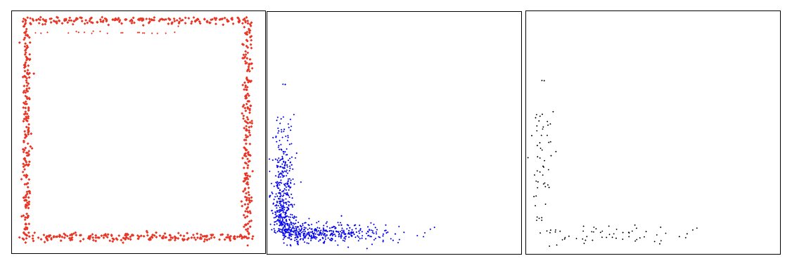
Issue for LIDAR
Map
Vehicle observations
Stratified resample of
observations

Slide 20
Biasing by normal can help
Resample the point cloud so that there are about the same number of points with each normal
How?
cut the unit sphere into bins,
read points into bins
resample by:
sample bin uniformly and at random
sample points in bin uniformly and at random

Slide 22
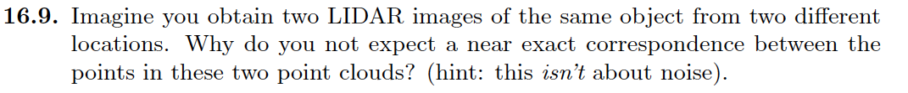
Think about this...

