Slide 1
Corners and interest points
D.A. Forsyth
University of Illinois at Urbana Champaign

Slide 2
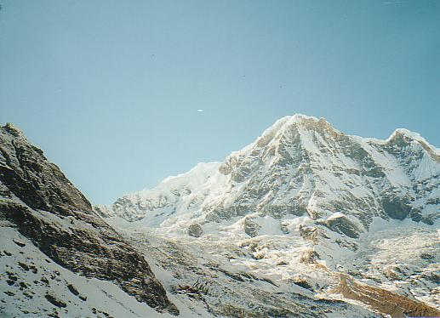
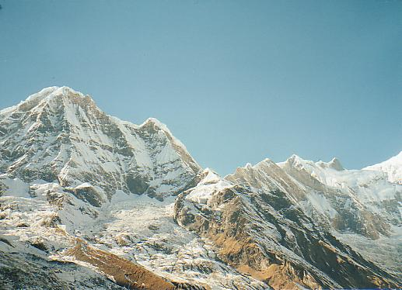
Why extract keypoints?
Motivation: image alignment
  We have two images – how do we combine them?

Slide 3
Why extract keypoints?
Motivation: image alignment
  We have two images – how do we combine them?

Slide 4
Why extract keypoints?
Motivation: image alignment
  We have two images – how do we combine them?

Slide 5
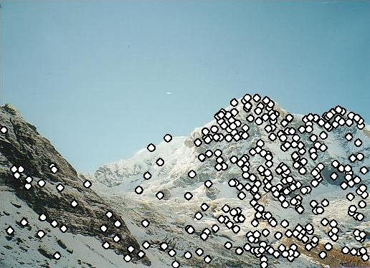
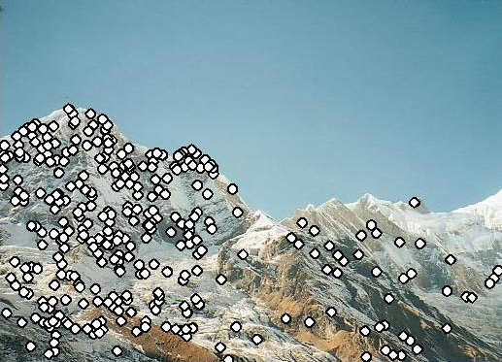
Why extract keypoints?
Motivation: image alignment
  We have two images – how do we combine them?
Step 1: extract keypoints
Step 2: match keypoint features

Slide 6
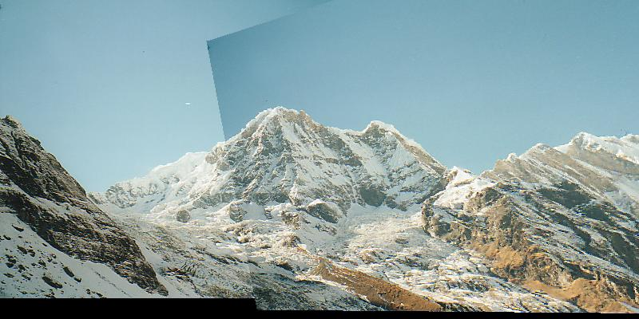
Why extract keypoints?
Motivation: image alignment
  We have two images – how do we combine them?
Step 1: extract keypoints
Step 2: match keypoint features
Step 3: align images

Slide 7
Keypoint representations support very fast methods
In some applications, GPU just isn’t available
-too heavy; too much power; etc
And there isn’t much CPU either
Idea: reduce image to keypoints, work with those

Slide 8
Need to find
Where is it:
What scale its at:
What orientation its at:
In a way that is (mostly) unaffected by
image transformations

Slide 9
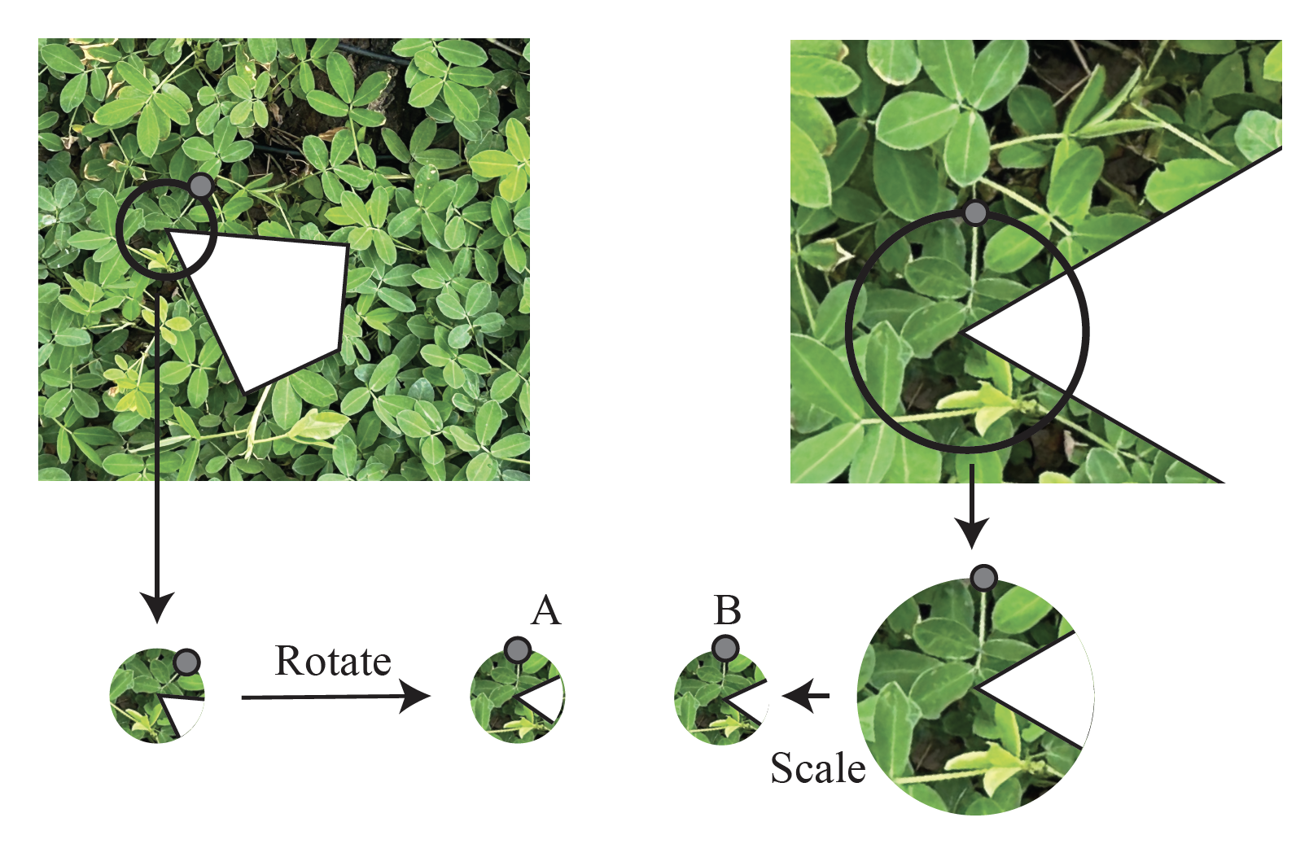

Slide 10
Need to find
Where is it:
What scale its at:
What orientation its at:
Description of contents:
In a way that is (mostly) unaffected by
image transformations

Slide 11
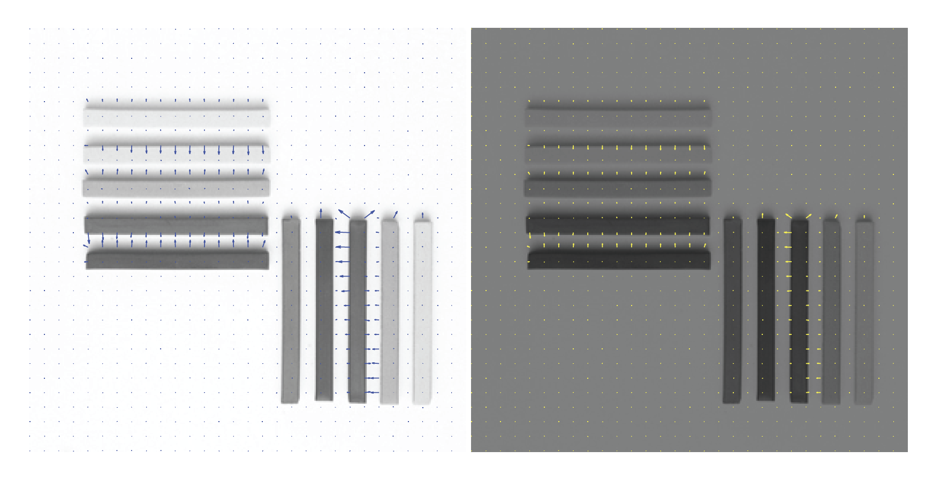

Slide 12
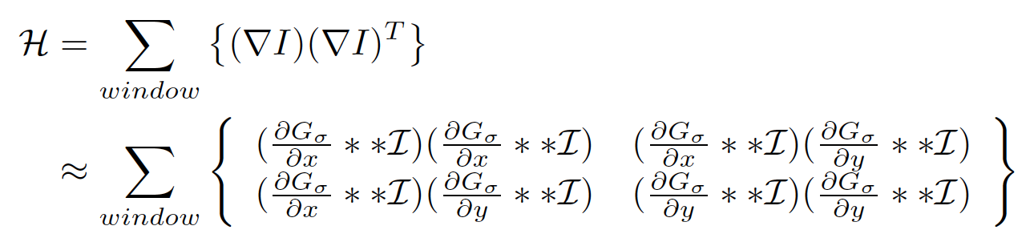
Corner detection matrix
This is very like a covariance matrix
Also, it’s a second order approximation to the image
Intensity (later slides)

Slide 13

Deriving a corner detection criterion
Basic idea: we should easily recognize the point by looking through a small window
Shifting a window in any direction should give a large change in intensity
“flat” region:
no change in all directions
“edge”:
no change along the edge direction
“corner”:
significant change in all directions

Slide 14
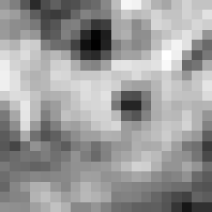

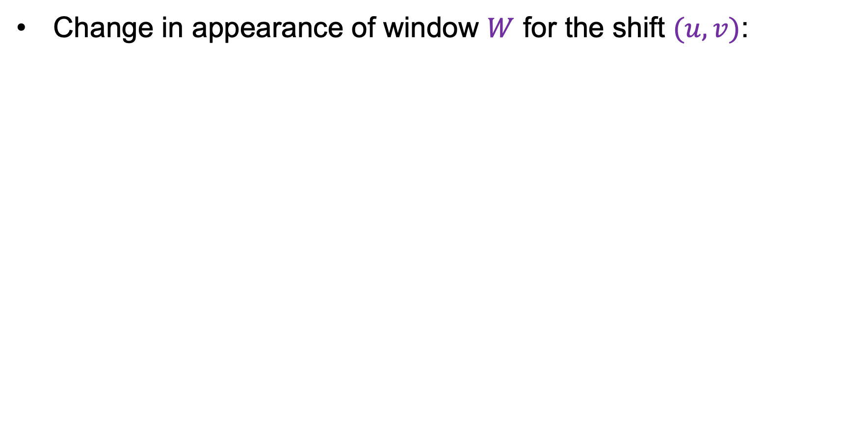

Deriving a corner detection criterion
Change in appearance of window $W$ for the shift $(u,v)$:
$$E\left(u,v\right)=\sum_{(x,y)∈W}{{\left[I\left(x+u,y+v\right)−I(x,y)\right]}^{2}}$$
I(x, y)
E(u, v)
E(3,2)

Slide 15

Deriving a corner detection criterion
Change in appearance of window $W$ for the shift $(u,v)$:
$$E\left(u,v\right)=\sum_{(x,y)∈W}{{\left[I\left(x+u,y+v\right)−I(x,y)\right]}^{2}}$$
I(x, y)
E(u, v)
E(0,0)

Slide 16

Deriving a corner detection criterion
Change in appearance of window $W$ for the shift $(u,v)$:
We want to find out how this function behaves for small shifts
$$E\left(u,v\right)=\sum_{(x,y)∈W}{{\left[I\left(x+u,y+v\right)−I(x,y)\right]}^{2}}$$
E(u, v)
Notes:
Specifically, E has to have a unique minimum at (0,0)

Slide 17
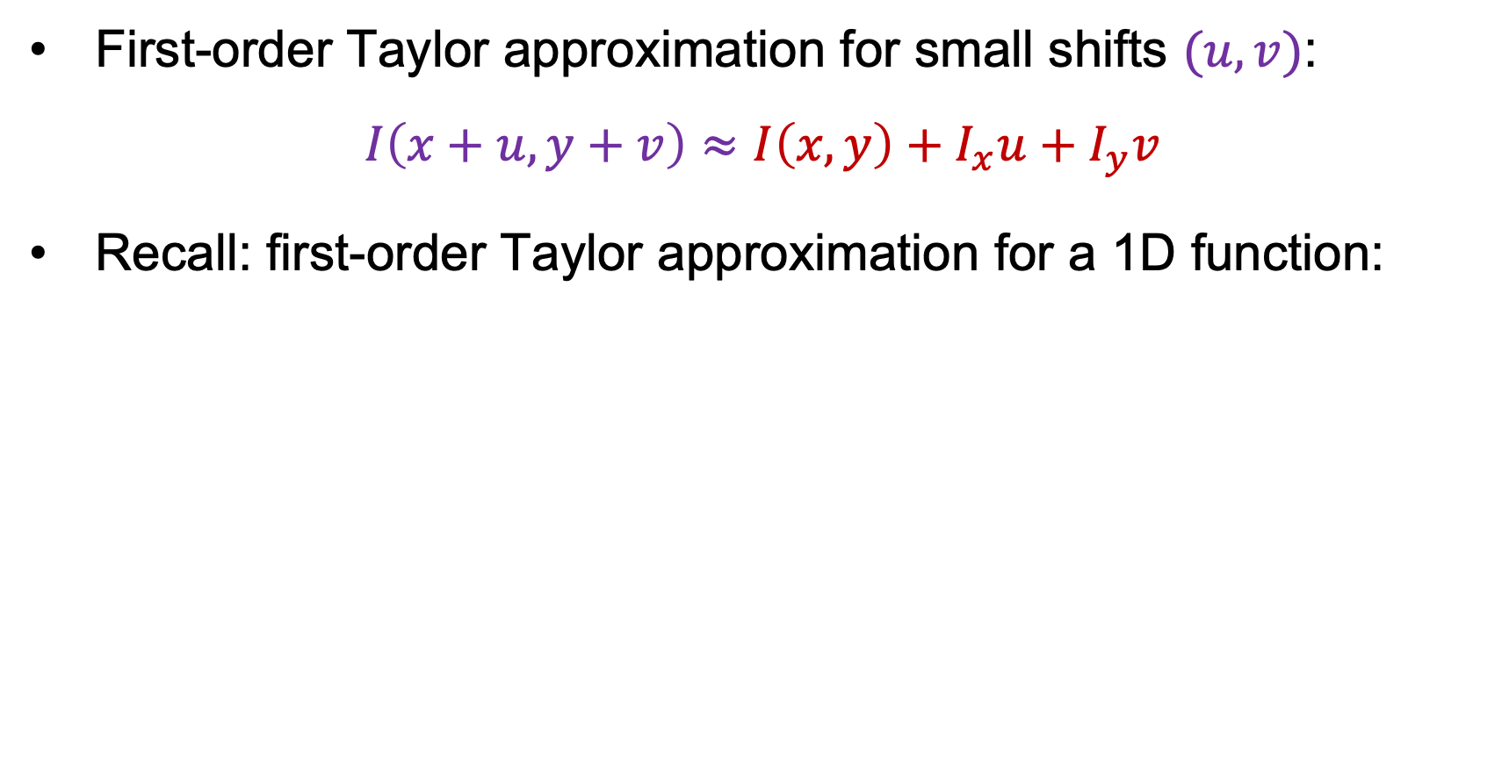



Deriving a corner detection criterion
First-order Taylor approximation for small shifts $(u, v)$:
$$I\left(x+u,y+v\right)≈I\left(x,y\right)+I_{x}u+I_{y}v$$
Recall: first-order Taylor approximation for a 1D function:
$$f\left(x+u\right)≈f\left(x\right)+f^{′}\left(x\right)u$$
$$x$$
$$x+u$$

Slide 18
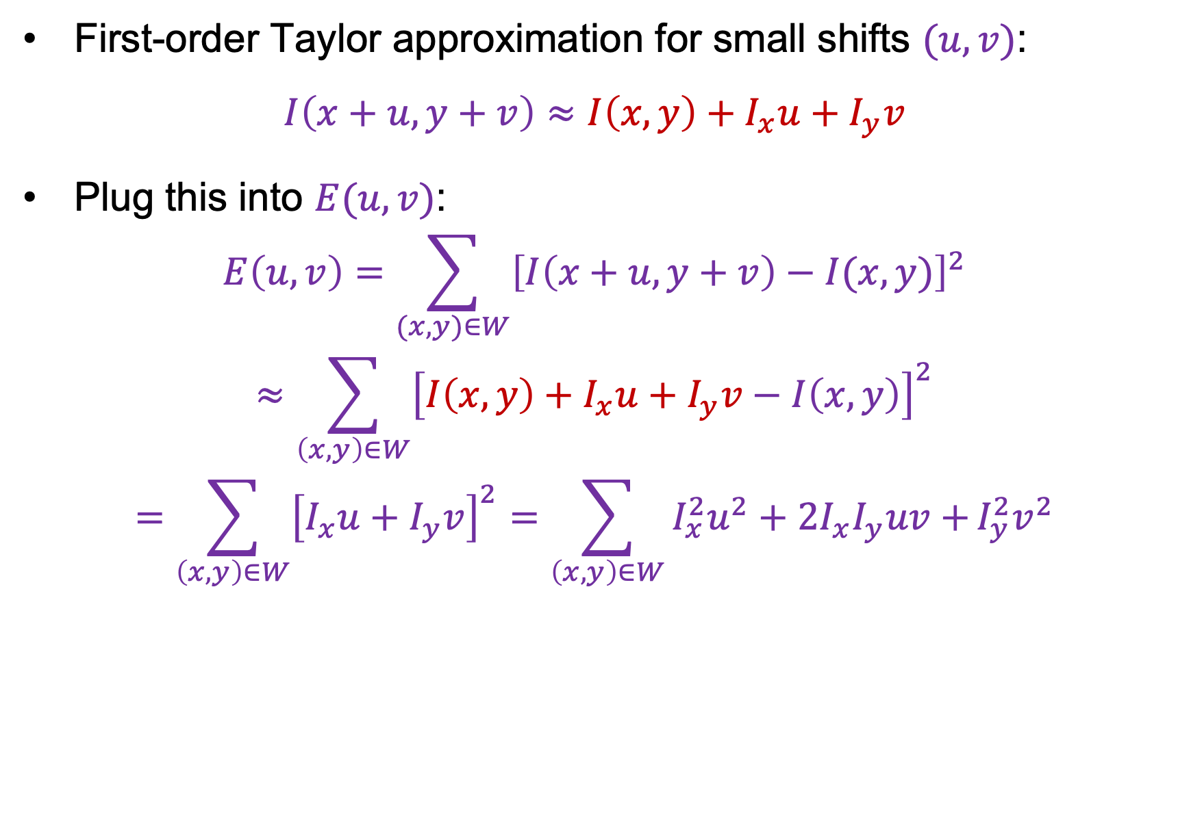
Deriving a corner detection criterion
First-order Taylor approximation for small shifts $(u, v)$:
$$I\left(x+u,y+v\right)≈I\left(x,y\right)+I_{x}u+I_{y}v$$
Plug this into $E(u,v)$:
$$E\left(u,v\right)=\sum_{(x,y)∈W}{{\left[I\left(x+u,y+v\right)−I(x,y)\right]}^{2}}$$
$$≈\sum_{\left(x,y\right)∈W}{{\left[I\left(x,y\right)+I_{x}u+I_{y}v−I\left(x,y\right)\right]}^{2}}$$
$$=\sum_{\left(x,y\right)∈W}{{\left[I_{x}u+I_{y}v\right]}^{2}}=\sum_{\left(x,y\right)∈W}{I_{x}^{2}u^{2}+2I_{x}I_{y}uv+}I_{y}^{2}v^{2}$$

Slide 19
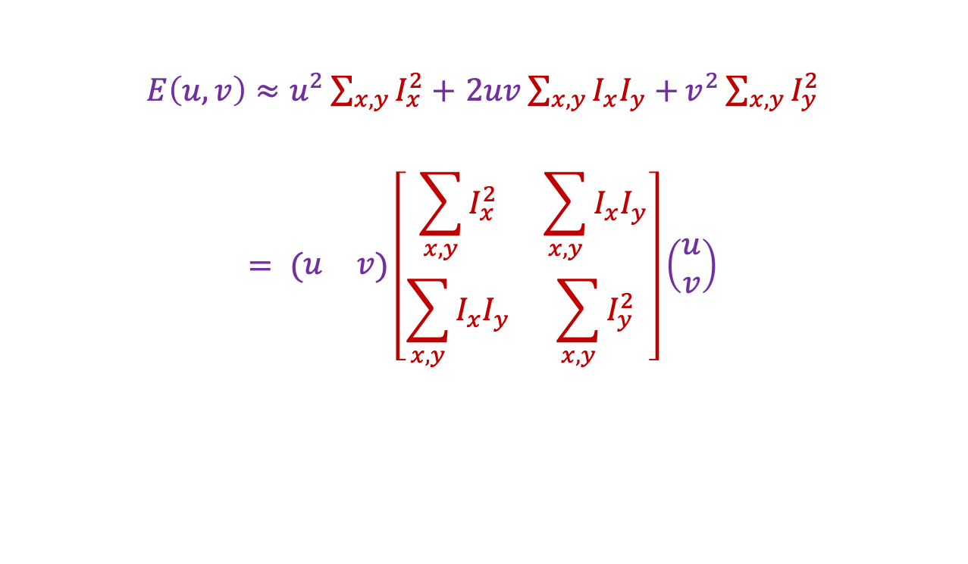

Deriving a corner detection criterion
$E\left(u,v\right)≈u^{2}\sum_{x,y}{I_{x}^{2}}+$ $2uv\sum_{x,y}{I_{x}I_{y}+}v^{2}\sum_{x,y}{I_{y}^{2}}$
$$= (\begin{matrix}u & v\end{matrix})\left[\begin{matrix}\sum_{x,y}{I_{x}^{2}} & \sum_{x,y}{I_{x}I_{y}} \\ \sum_{x,y}{I_{x}I_{y}} & \sum_{x,y}{I_{y}^{2}}\end{matrix}\right]\left(\begin{aligned}u \\ v\end{aligned}\right)$$
Second moment matrix $M$

Slide 20
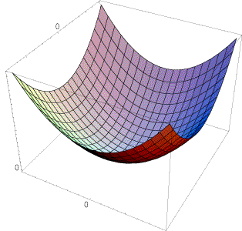
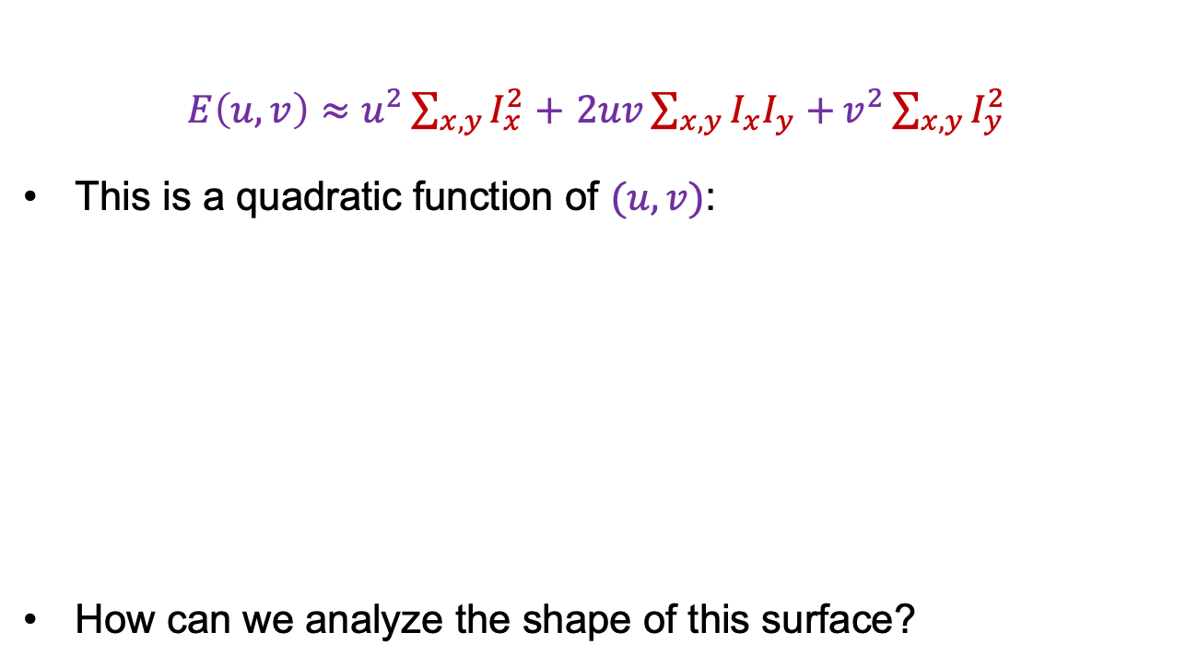

Deriving a corner detection criterion
$E\left(u,v\right)≈u^{2}\sum_{x,y}{I_{x}^{2}}+$ $2uv\sum_{x,y}{I_{x}I_{y}+}v^{2}\sum_{x,y}{I_{y}^{2}}$
This is a quadratic function of $(u,v)$:
How can we analyze the shape of this surface?
E(u, v)
$$≈$$

Slide 21
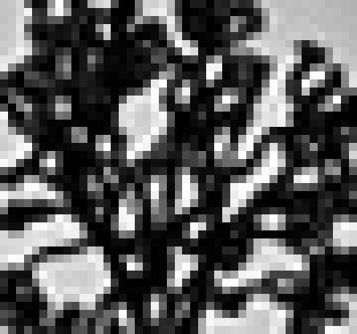
Visualization of second moment matrices

Slide 22
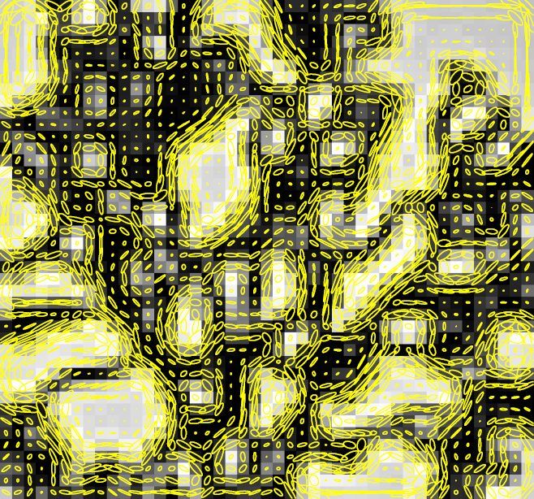
Visualization of second moment matrices
Note: axes are rescaled so ellipse areas are proportional to edge energy (i.e., bigger ellipses correspond to stronger edges)

Slide 23

Corner response function
$$R=\det\left(M\right)−α trace{\left(M\right)}^{2}=λ_{1}λ_{2}−α{(λ_{1}+λ_{2})}^{2}$$
$α$: constant (0.04 to 0.06)
“Edge”
R < 0
“Corner”
R > 0
|R| small
“Flat” region
“Edge”
R < 0

Slide 24
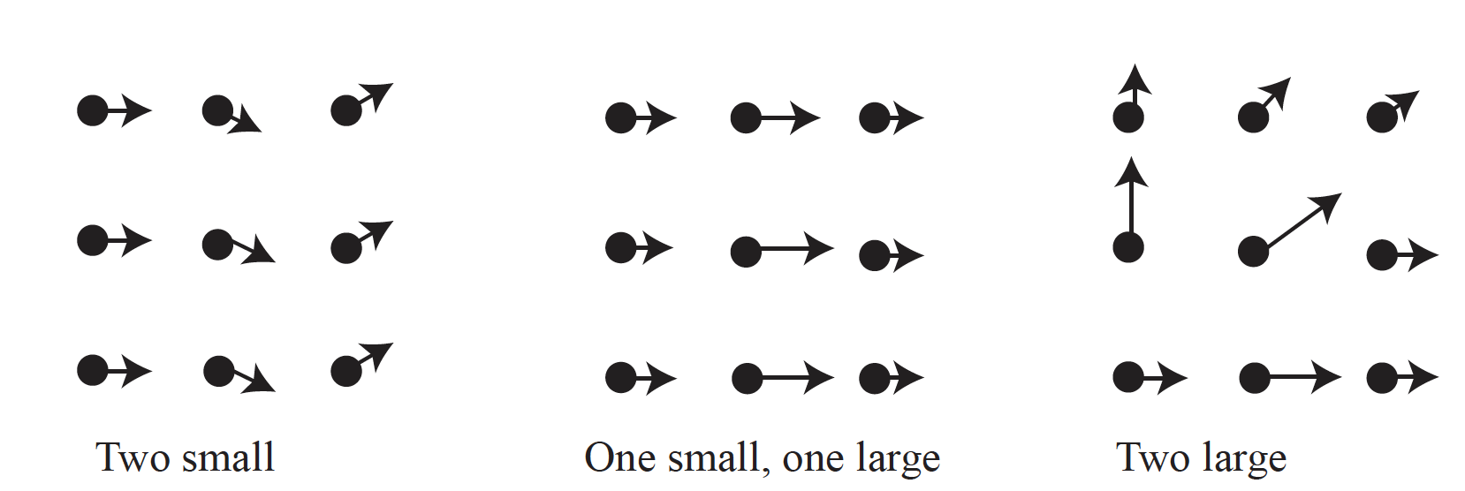

Slide 25
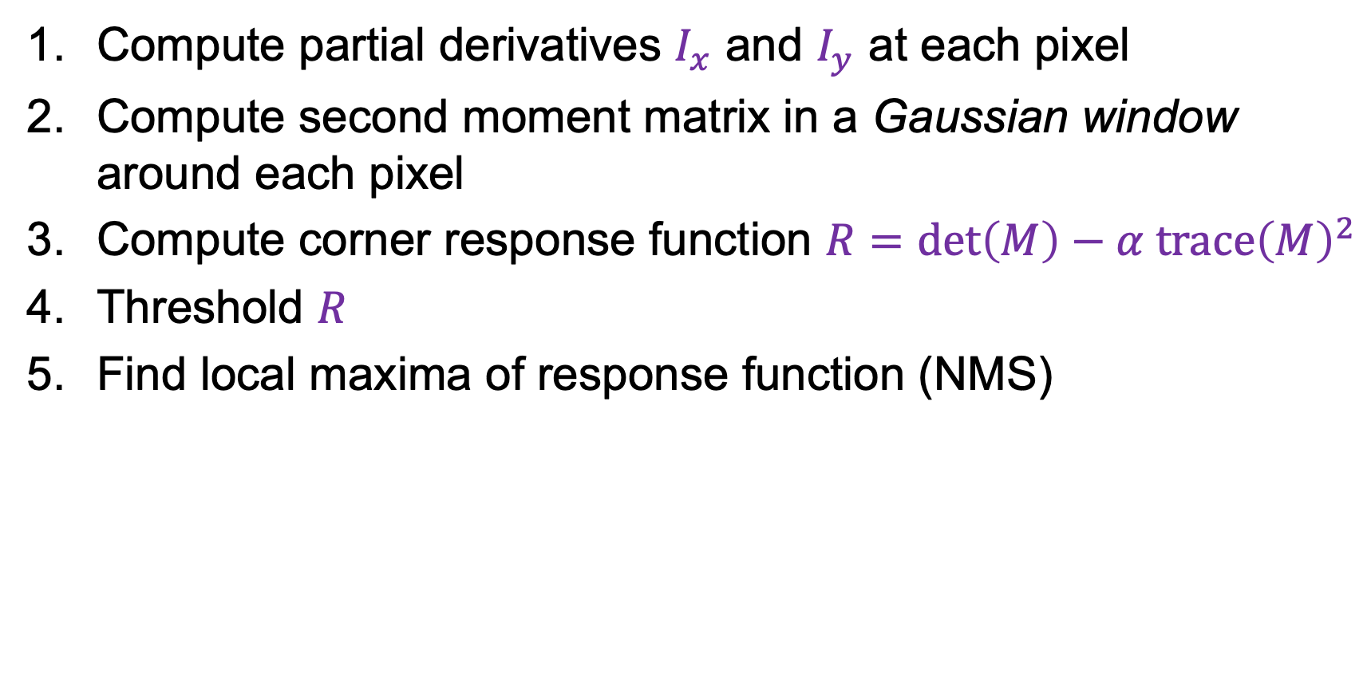
The Harris corner detector
Compute partial derivatives $I_{x}$ and $I_{y}$ at each pixel
Compute second moment matrix in a Gaussian window around each pixel
Compute corner response function $R=\det\left(M\right)−α trace{\left(M\right)}^{2}$
Threshold $R$
Find local maxima of response function (NMS)
C.Harris and M.Stephens, A Combined Corner and Edge Detector, Proceedings of the 4th Alvey Vision Conference: pages 147—151, 1988.

Slide 26
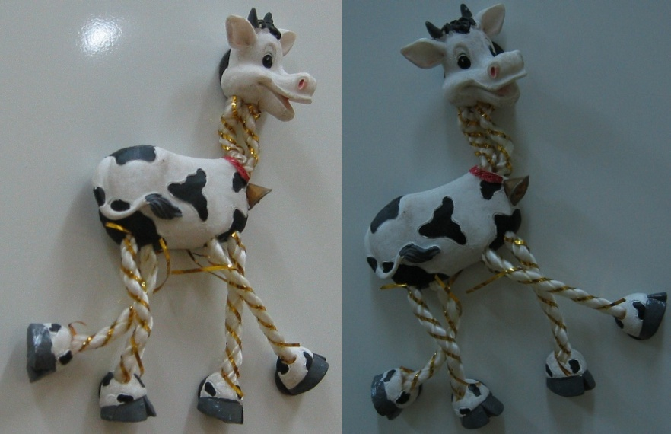
Harris Detector: Example

Slide 27
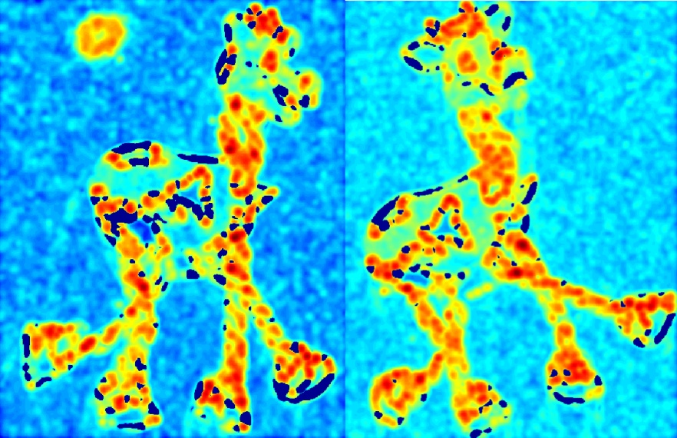

Harris Detector: Example
Compute corner response $R$

Slide 28
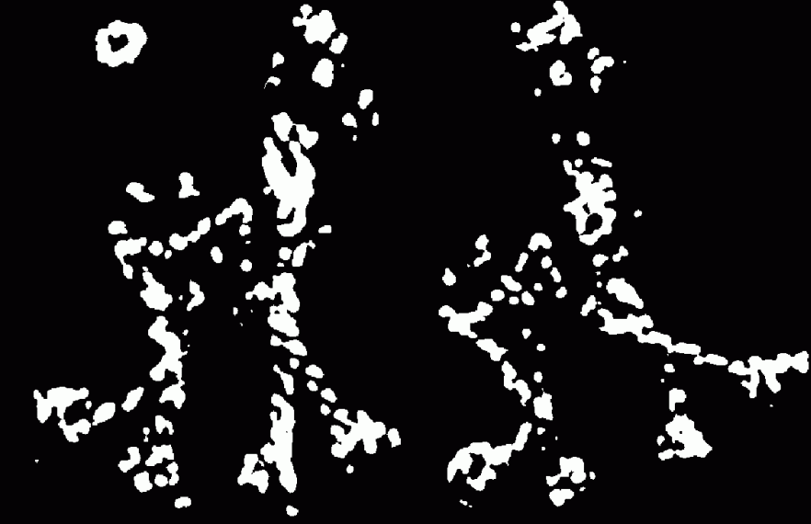
Harris Detector: Example
Find points with large corner response: $R$ > threshold

Slide 29
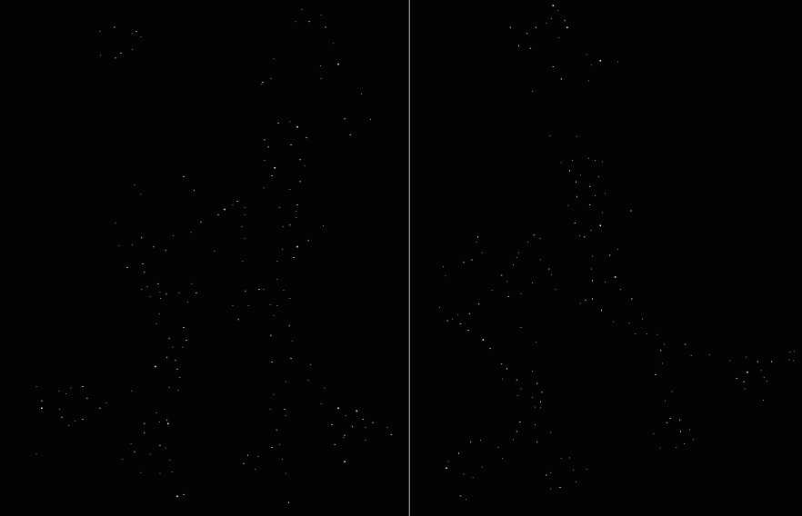

Harris Detector: Example
Take only the points of local maxima of $R$

Slide 30

Harris Detector: Example

Slide 31
Behavior w.r.t. image transformations
To be useful for image matching, “the same” corner features need to show up despite geometric and photometric transformations
We need to analyze how
the corner response function and the corner locations change in response to various transformations

Slide 32
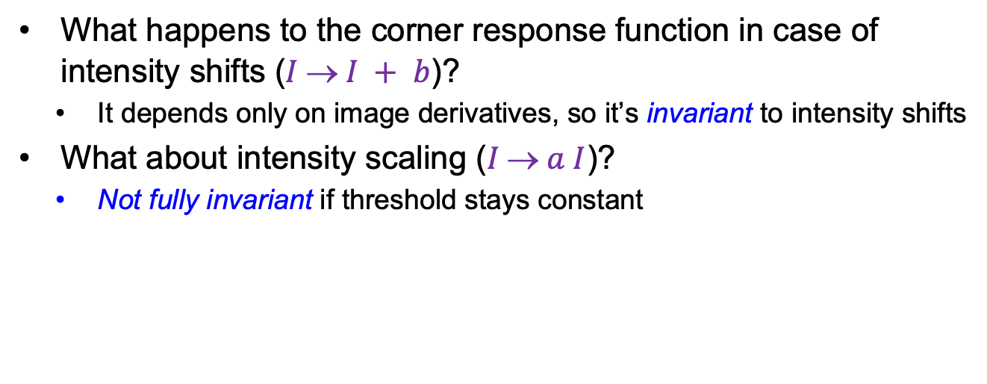

Affine intensity change
$$I  a I + b$$
What happens to the corner response function in case of intensity shifts ($I  I + b$)?
  It depends only on image derivatives, so it’s invariant to intensity shifts
What about intensity scaling ($I  a I$)?
  Not fully invariant if threshold stays constant
R
R
threshold
x (image coordinate)
x (image coordinate)

Slide 33
Image translation
How do the detected corner locations change if the image pattern is translated?
  All the ingredients of the second moment matrix are shift-invariant, and so is the corner response function
  However, the locations of the corners are equivariant (or covariant) w.r.t. shifts
Translate the image – the corners translate

Slide 34
Image rotation
How do the detected corner locations change if the image pattern is rotated?
  Assuming the second moment matrix is calculated over a circular neighborhood (and ignoring resampling issues), the rotation changes but the eigenvalues stay the same, so the response function is invariant
  The locations of the corners are equivariant (or covariant) w.r.t. rotations
Rotate the image – the corners rotate

Slide 35
Image scaling
Not corners!
Corner
How do the detected corner locations change if the image pattern is scaled?
  Assuming fixed-size neighborhoods for calculating the second moment matrix, the corner response function is not invariant and the corner locations are not equivariant w.r.t. scaling
Scale the image – lose/gain some corners (but not too bad)

Slide 36
Need to find
Where is it:
What scale its at:
What orientation its at:
Description of contents:
In a way that is (mostly) unaffected by
image transformations

Slide 37
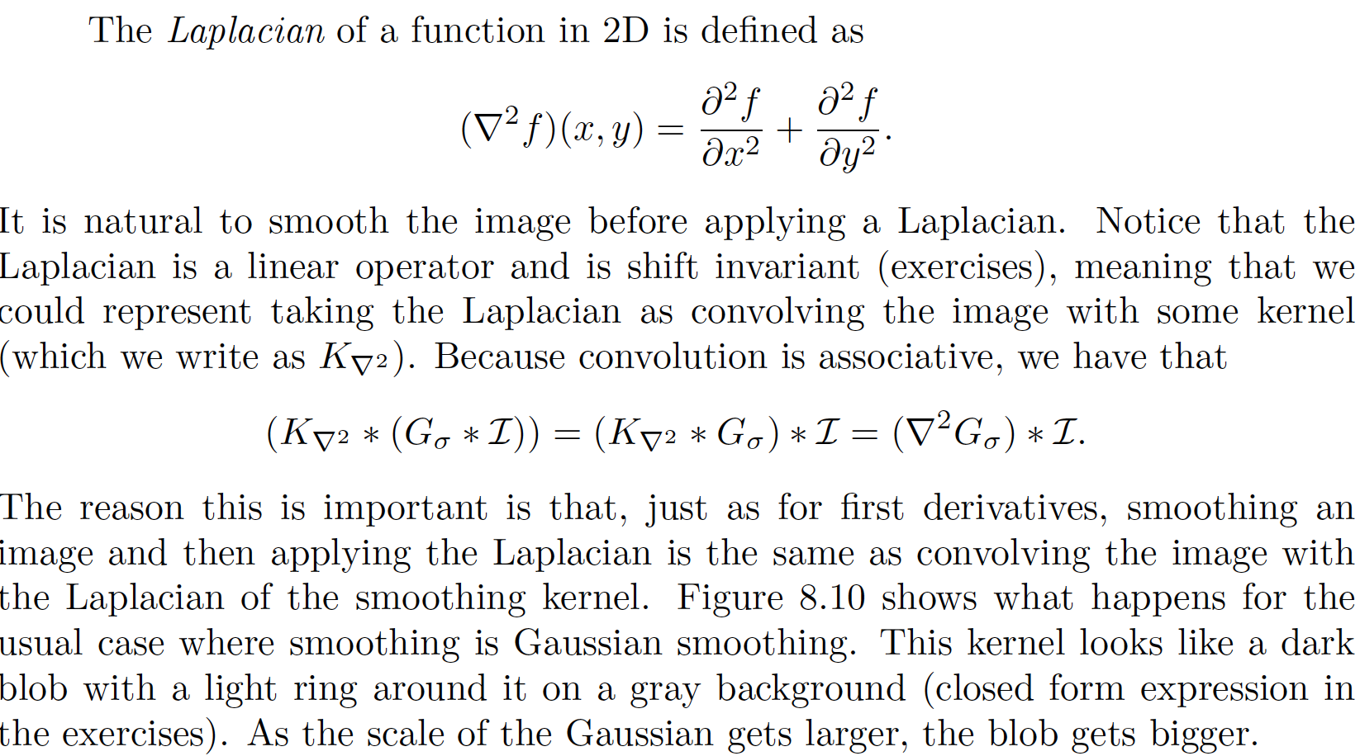
Laplacian of Gaussian

Slide 38
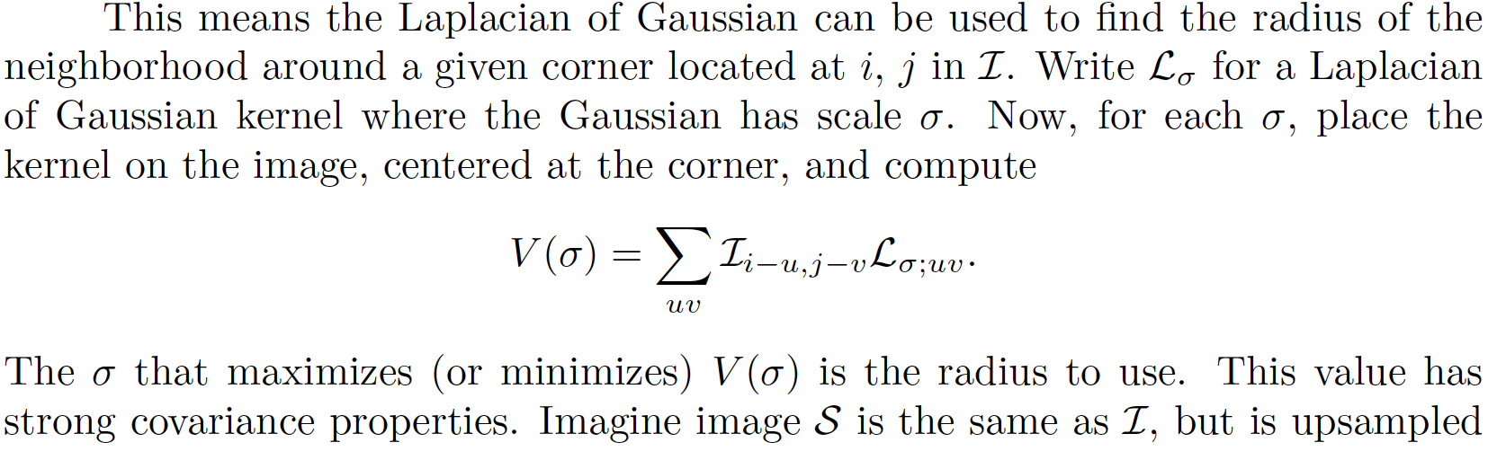
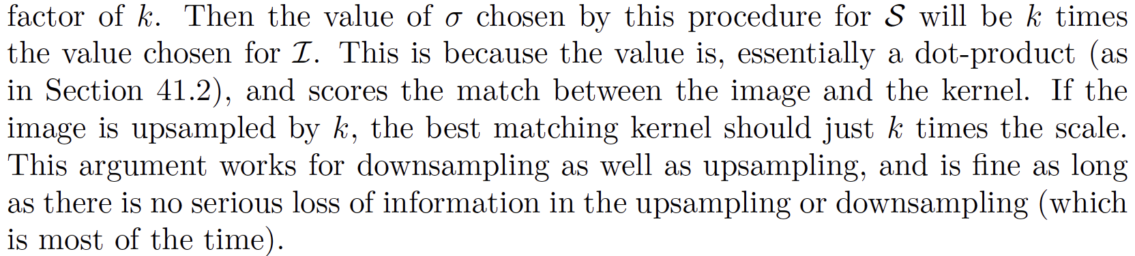

Slide 39
Need to find
Where is it:
What scale its at:
What orientation its at:
Description of contents:
In a way that is (mostly) unaffected by
image transformations

Slide 40
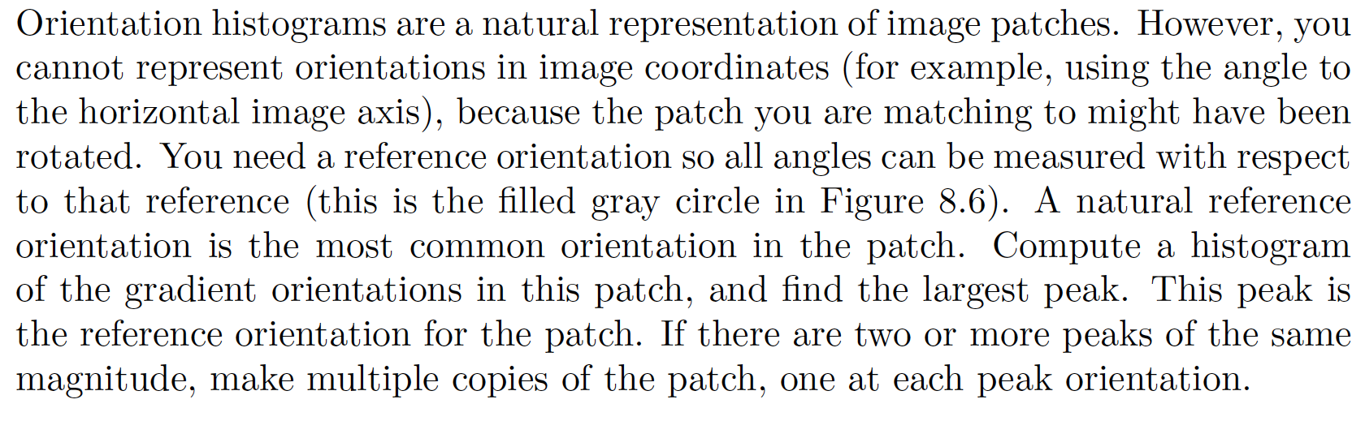
Orientation histogram peak for orientation

Slide 41
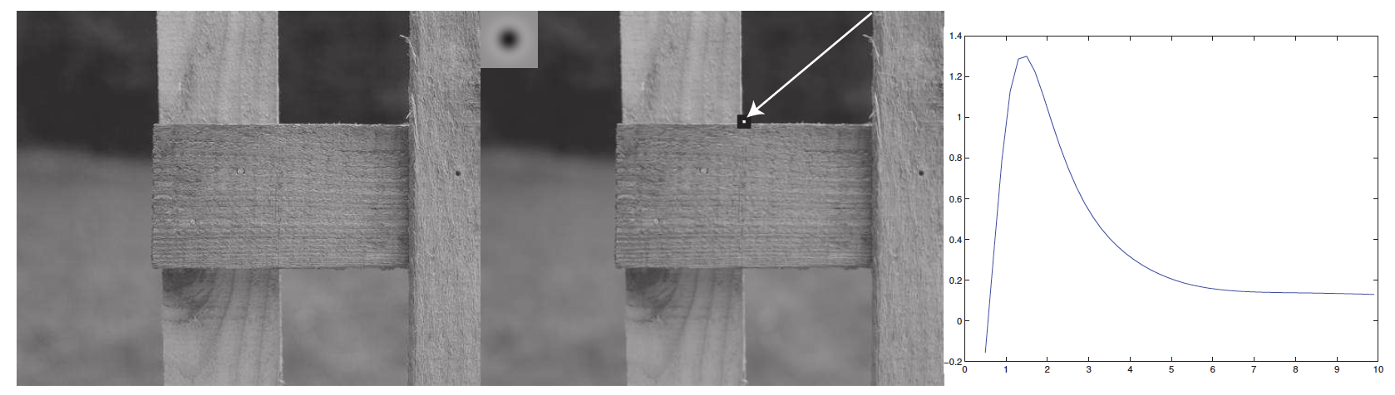
Notice how useful a Gaussian pyramid could be here

Slide 42
Need to find
Where is it:
What scale its at:
What orientation its at:
Description of contents:
In a way that is (mostly) unaffected by
image transformations

Slide 43
SIFT features
SIFT features
  SIFT=Scale Invariant Feature Transform
  Very strong record of effectiveness in matching applications
  SIFT features behave very well using nearest neighbors matching
    i.e. the nearest neighbor to a query patch is usually a matching patch

Slide 44
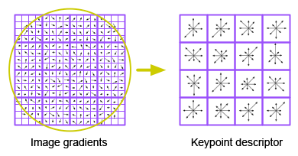
Describing a window’s contents
We want description to be:
  Invariant to changes in image brightness: - use orientations
  Robust to noise: - ignore orientations with small magnitude
  Distinctive: - use lots of local orientations
  Invariant to small errors in location:
    “bucket” the orientations in image
    Use a histogram for each bucket

Slide 46
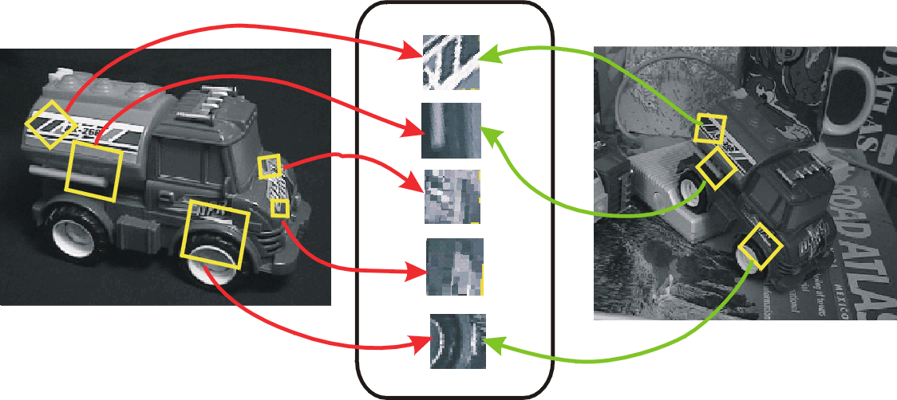
SIFT for matching
The main goal of SIFT is to enable image matching in the presence of significant transformations
  To recognize the same keypoint in multiple images, we need to match appearance descriptors or “signatures” in their neighborhoods
  Descriptors that are locally invariant w.r.t. scale and rotation can handle a wide range of global transformations

Slide 47
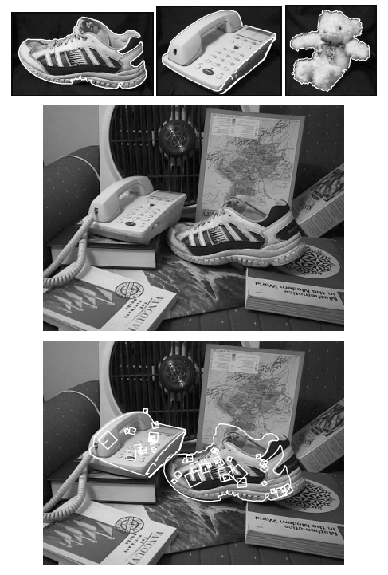
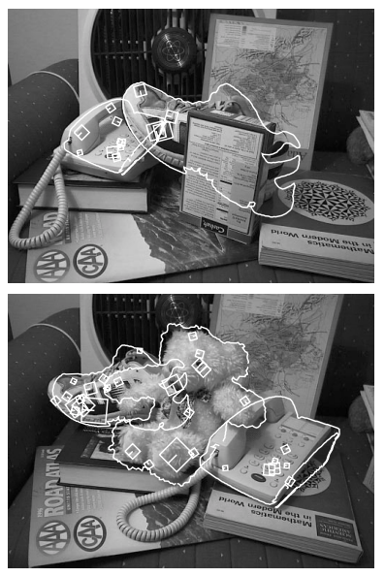
SIFT: Scale-invariant feature transform
D. Lowe. Object recognition from local scale-invariant features. ICCV 1999
D. Lowe. Distinctive image features from scale-invariant keypoints. IJCV 60 (2), pp. 91-110, 2004

Slide 48
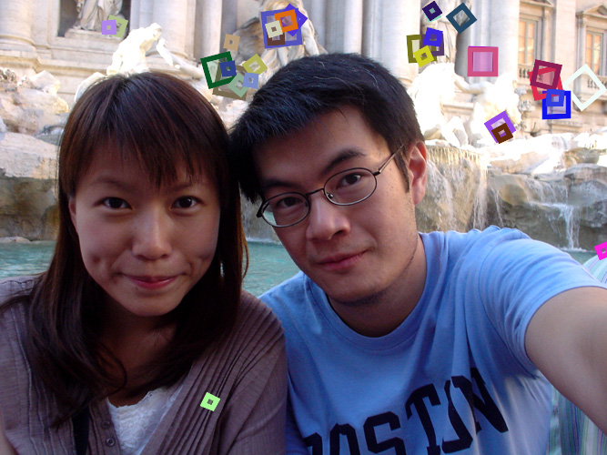
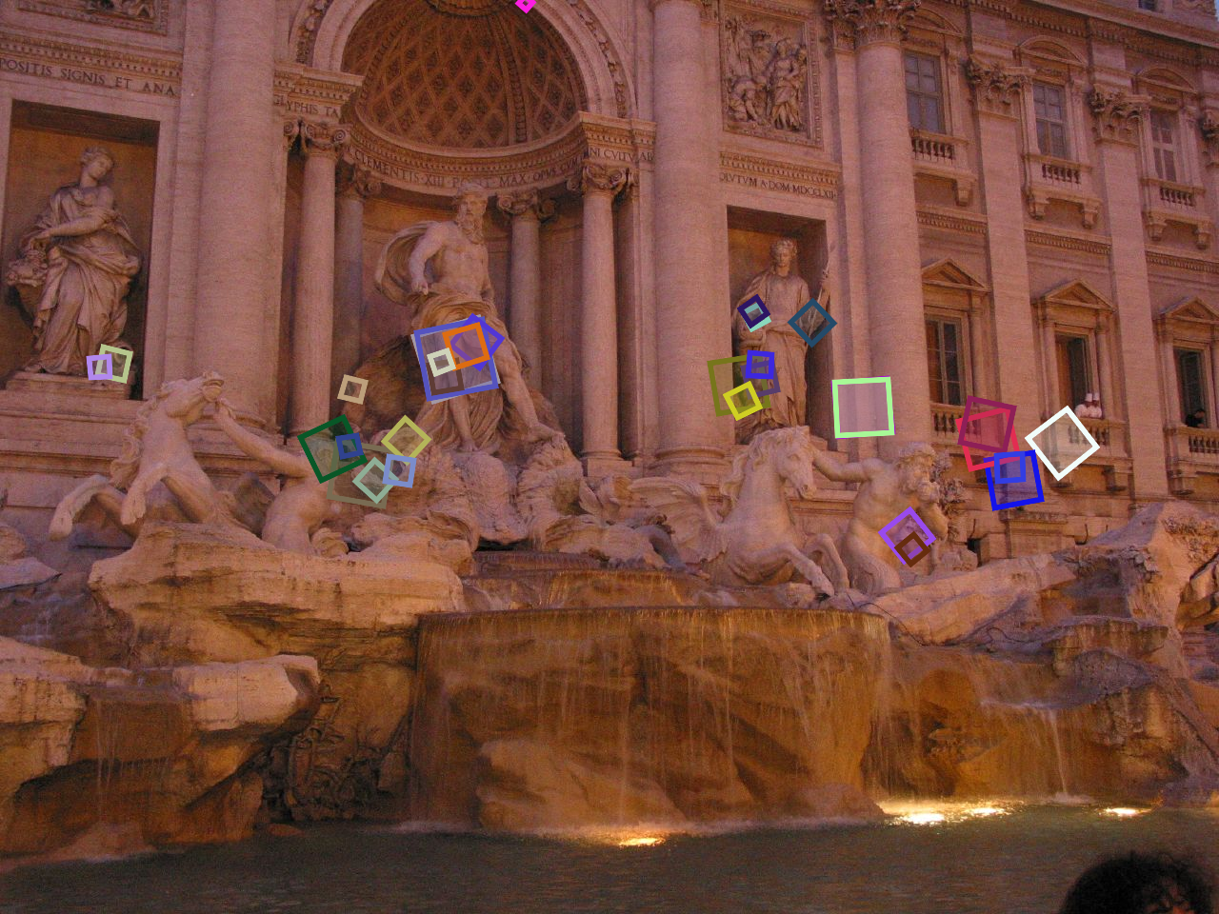
SIFT for matching
Extraordinarily robust detection and description technique
  Can handle changes in viewpoint
    Up to about 60 degree out-of-plane rotation
  Can handle significant changes in illumination
    Sometimes even day vs. night
  Fast and efficient—can run in real time
  Lots of code available
Source: N. Snavely

Slide 49
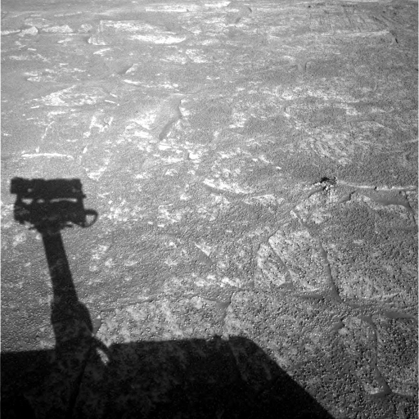
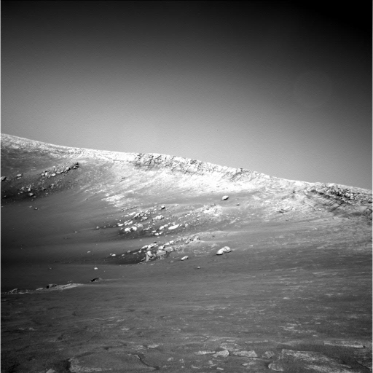
A hard matching problem
NASA Mars Rover images

Slide 50
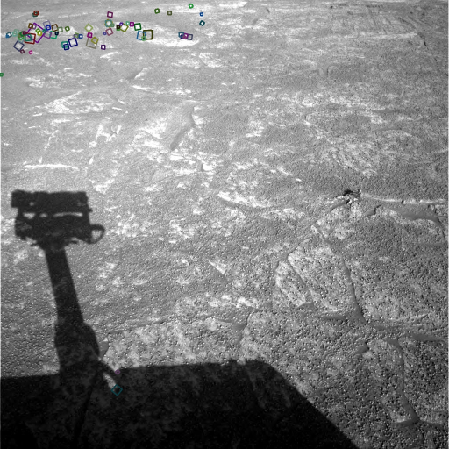
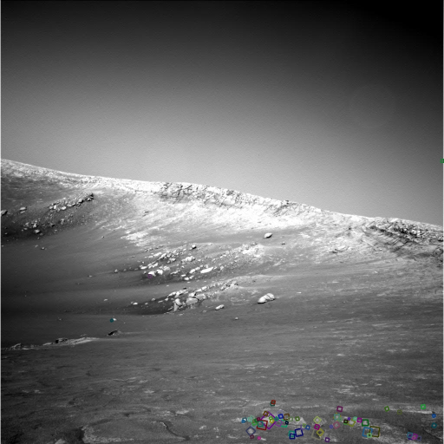
Answer below (look for tiny colored squares…)
NASA Mars Rover images
with SIFT feature matches
Figure by Noah Snavely

Slide 51
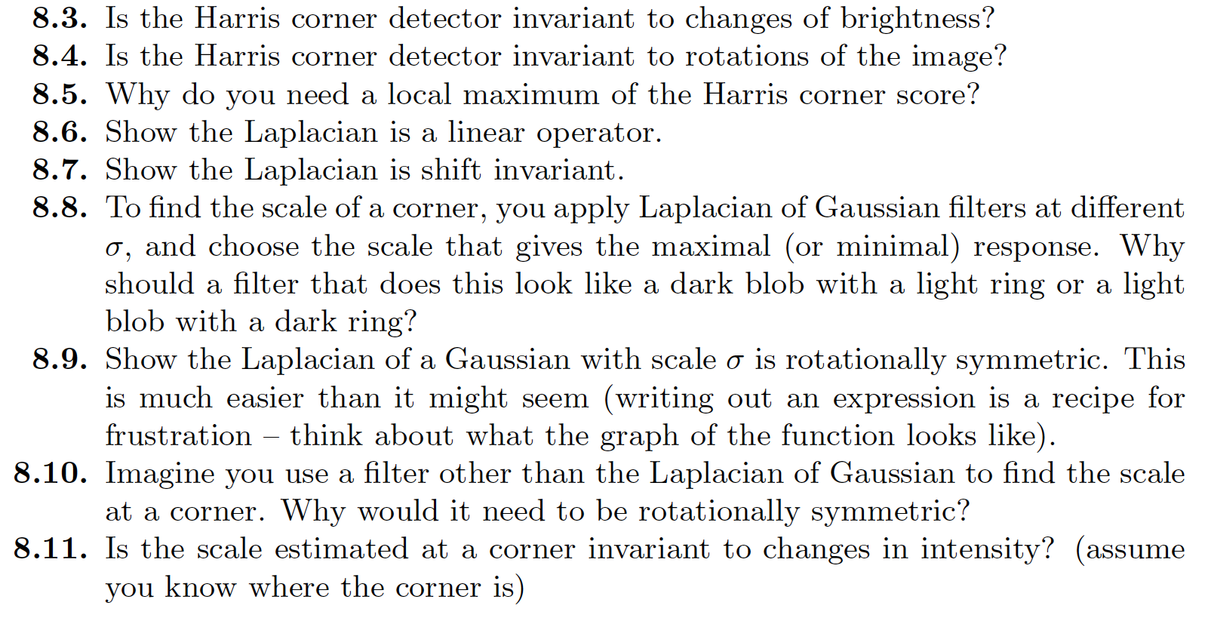
Think about this...

