Slide 1
The K-means algorithm
D.A. Forsyth,
University of Illinois at Urbana Champaign

Slide 2
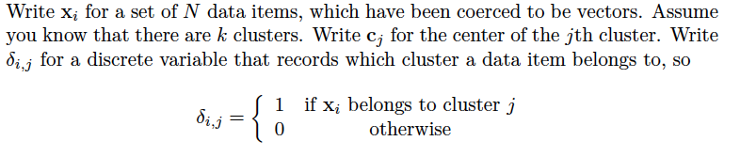
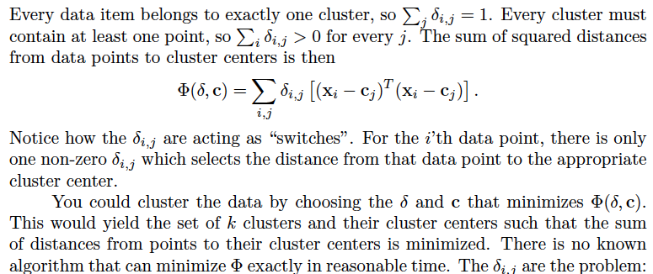
Setup

Slide 5
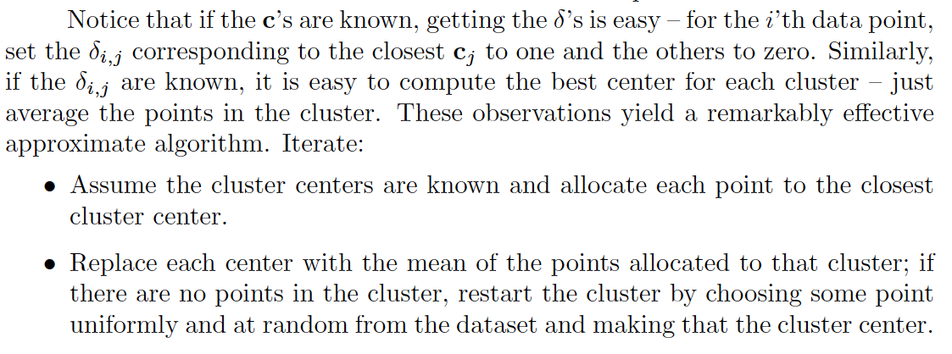
Approximation

Slide 9
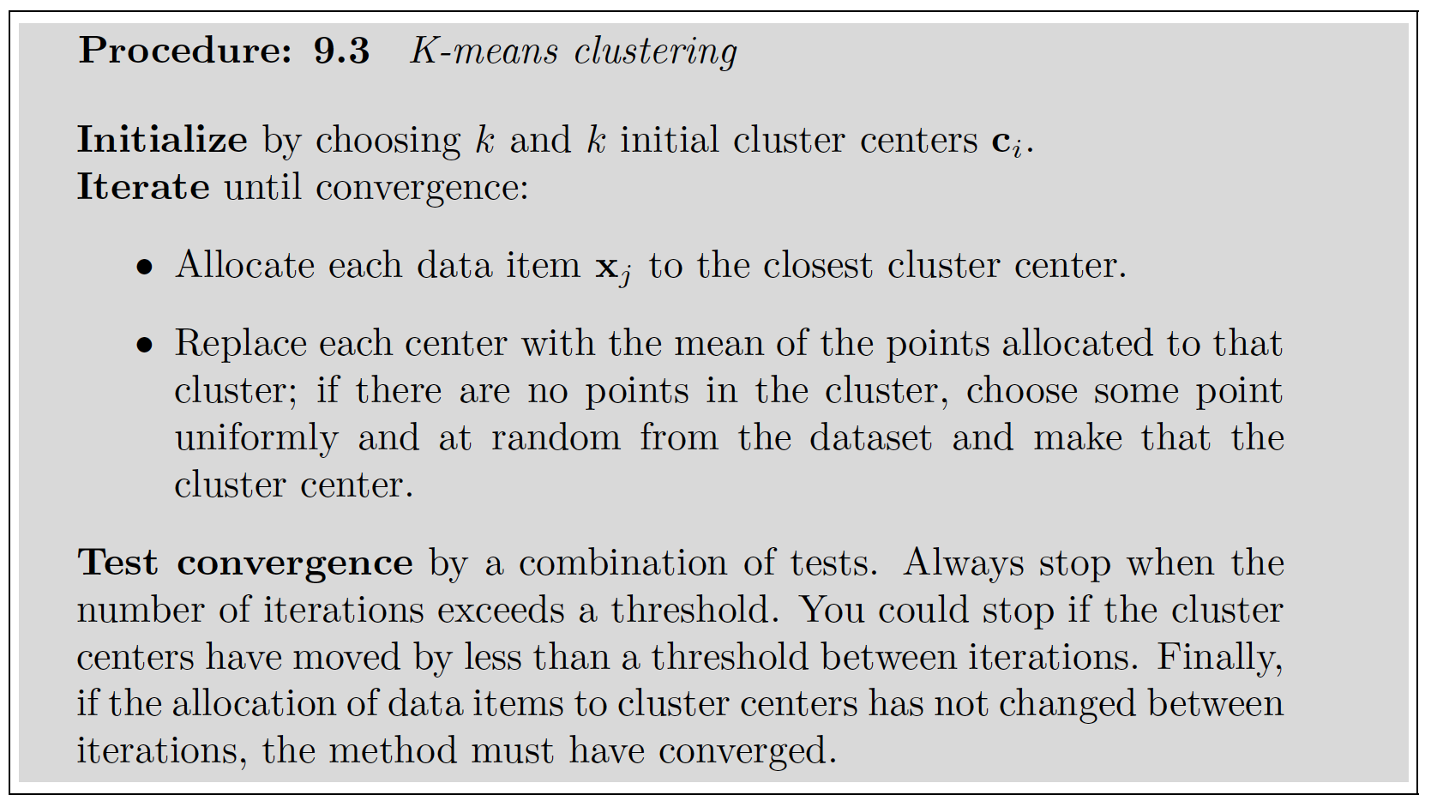

Slide 10
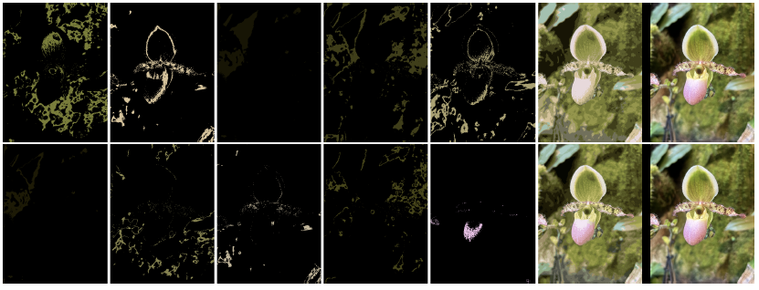
kmeans on color
top k=10, bottom k=30
Replace pixels
with cluster
center
Image

Slide 11
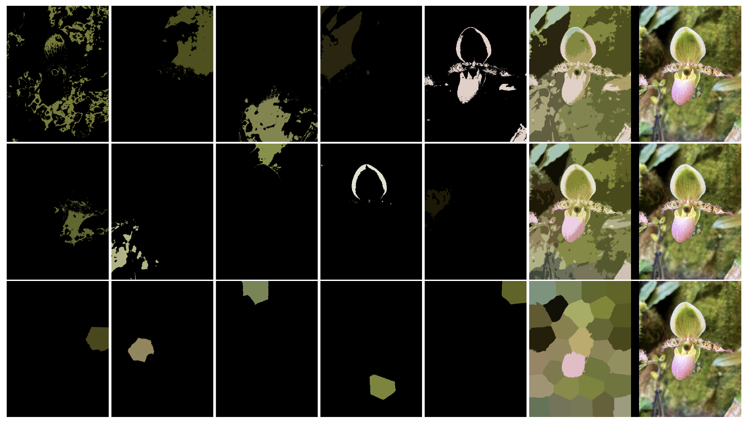
kmeans color and position
k=10, height=1
k=30, height=1
k=30, height=10

Slide 12
Issues
Initializing
random choice of cluster centers
kmeans++, notes
Empty clusters
random restart
Scattered points
junk cluster
What is k?
very hard from cluster metrics
application considerations

Slide 13
Efficiency
What if the dataset is gigantic and k is huge?
subsample data; build a tree
Hierarchical k-means

Slide 14
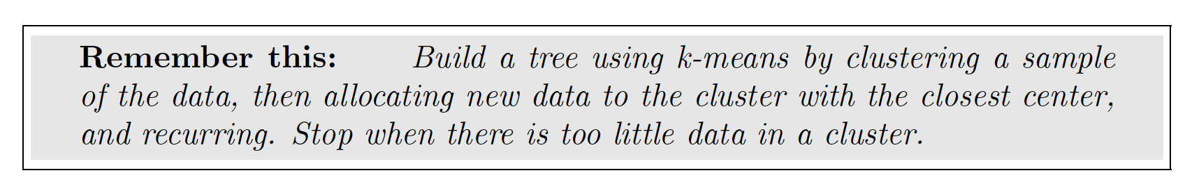
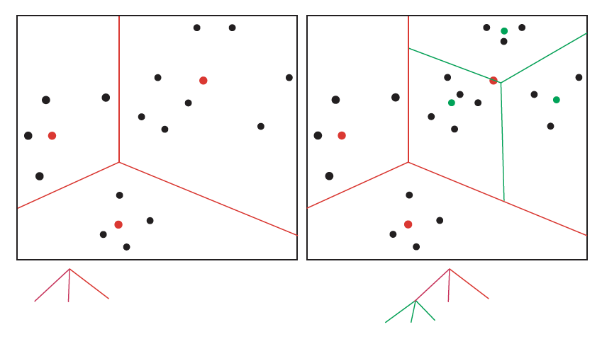
Hierarchical k-means

Slide 15
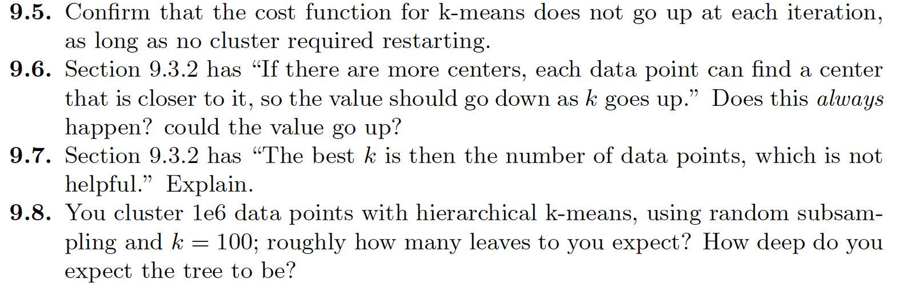
Things to think about

