Slide 1
Learning by Descent
D.A. Forsyth
University of Illinois at Urbana Champaign

Slide 2
Learning the filters
Procedure:
  find many training pairs (noisy image, clean image)
  adjust filters so that
  Decode(Encode(noisy image)) is close to clean image
    on average, over pairs
    hope that this generalizes to new images
Result:
  Denoising autoencoder
  Encoder has codes that represent images well
  Opens the door to a lot of procedures

Slide 3
Find many training pairs
No noise – system might ”cheat”
  Produce a representation that isn’t useful
What noise should you use?
  Options:
    Gaussian (but a fairly simple filter will deal with this)
    Poisson (median filter)
    knock out blocks of pixels (more challenging, and helpful)
    blurring (ditto)
    etc.

Slide 4
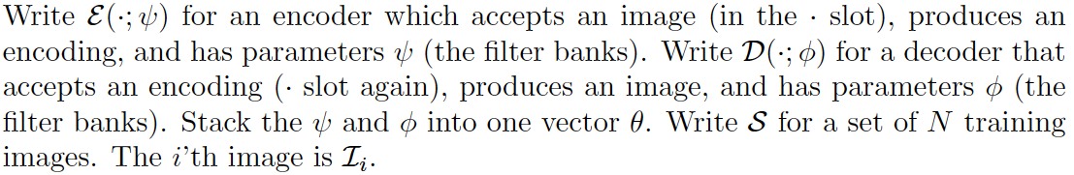
Adjusting the filters: notation

Slide 5
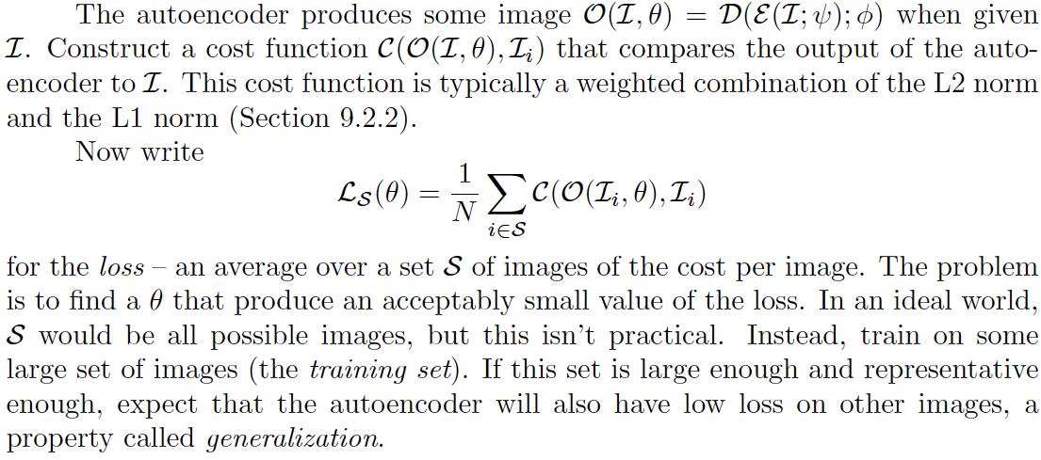
Adjusting the filters: loss

Slide 6

Adjusting the filters: optimization problem, but weird
Issues:
  The cost function is very hard to evaluate (N is big)
  There are lots of parameters (millions-billions)
    so no newton’s method
  You don’t actually want an optimum
    you want a set of filters that works well on other images

Slide 7
Stochastic gradient descent
Loss is a population mean
  you can estimate this quite well with a sample mean
  draw a small batch, average over that

Slide 8
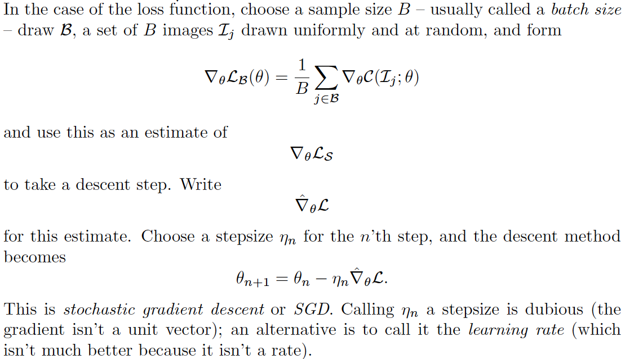
Stochastic gradient descent

Slide 9
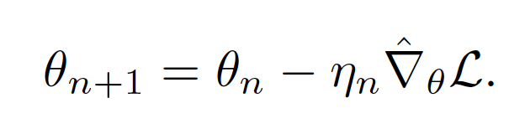
Stochastic gradient descent
How big a step?
  Line search
    you can’t – N is too big
  Fixed length
    too big (doesn’t settle down)
    too small (no progress)
  Learning rate schedule
    start biggish, take steps, make smaller
    how big is biggish? try

Slide 10
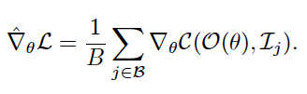
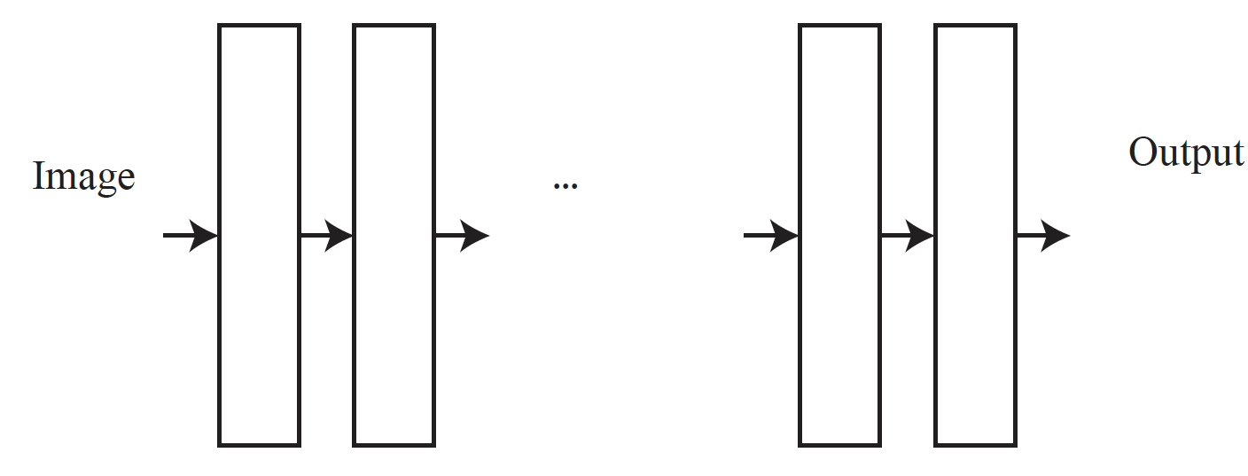
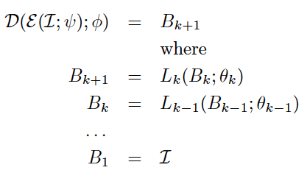
Evaluating the gradient

Slide 11
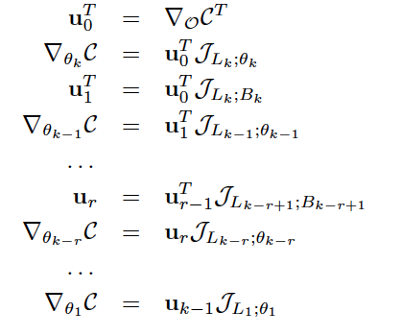
Recursion from chain rule (Backpropagation)
Derivatives of layer outputs
with respect to parameters
Derivatives of layer outputs
with respect to inputs

Slide 12
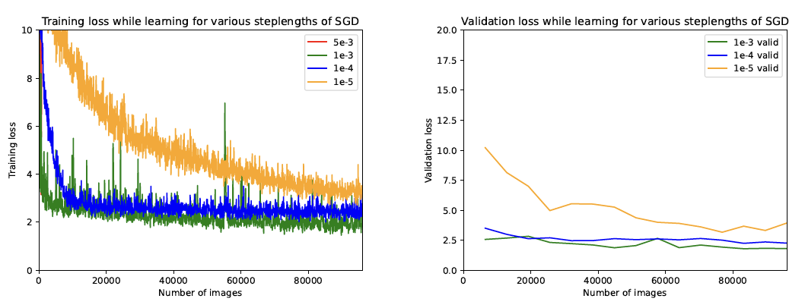
Stochastic gradient descent
Choice of steplength matters
  more later

Slide 13
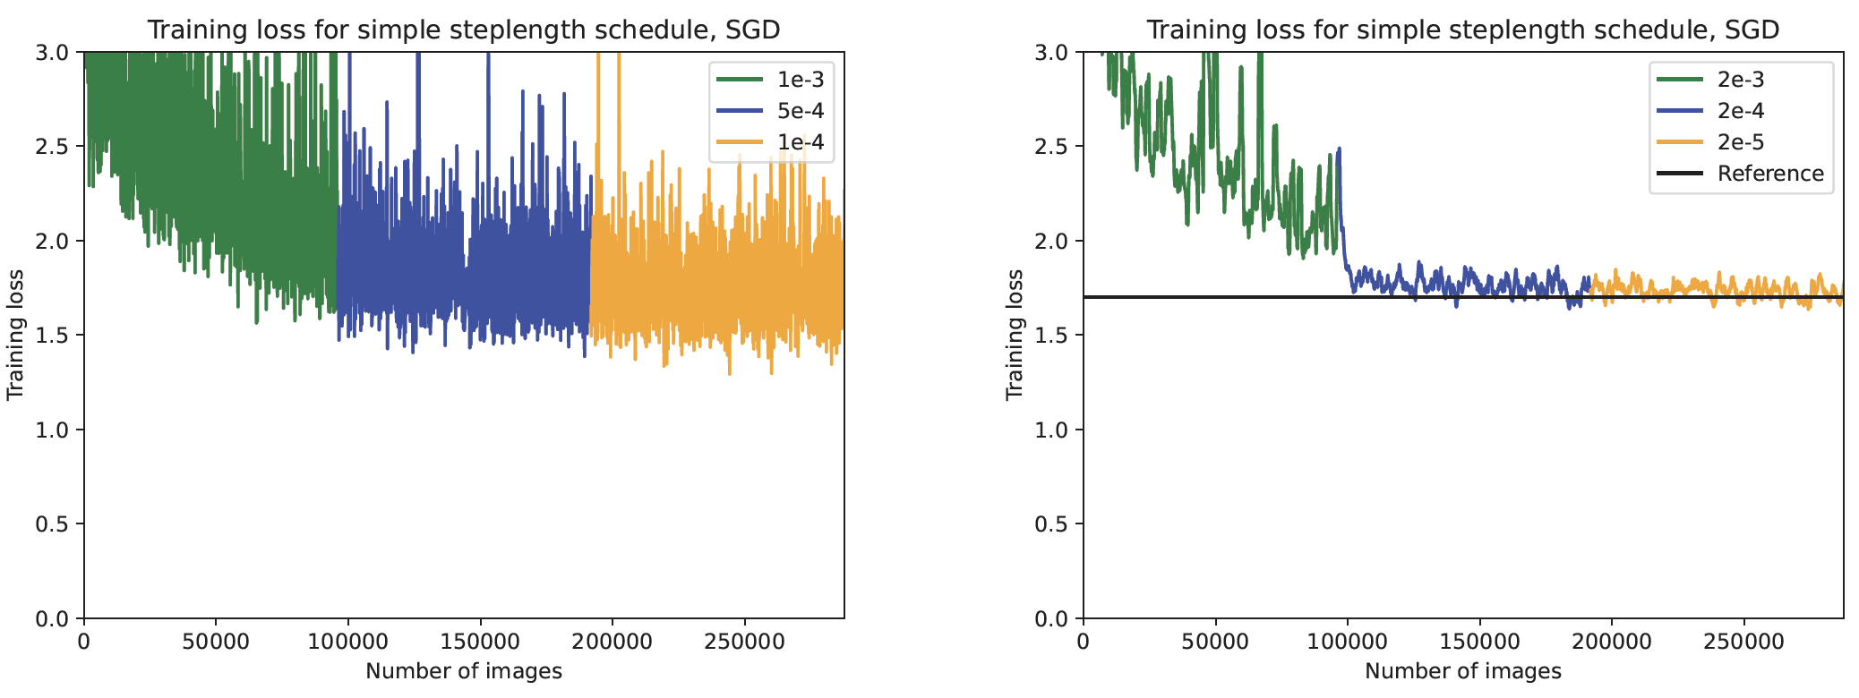
Stochastic gradient descent
Steplength scheduling can help
  more later

Slide 14
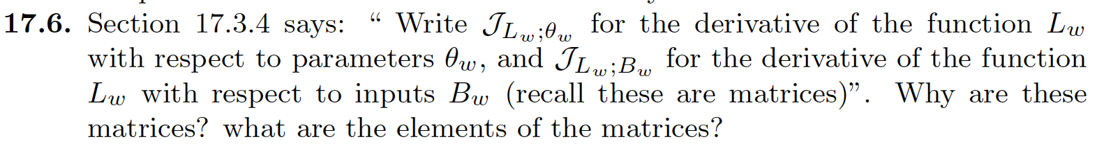
Things to think about...

