Slide 1
Fitting a line
D.A. Forsyth
University of Illinois at Urbana Champaign

Slide 2
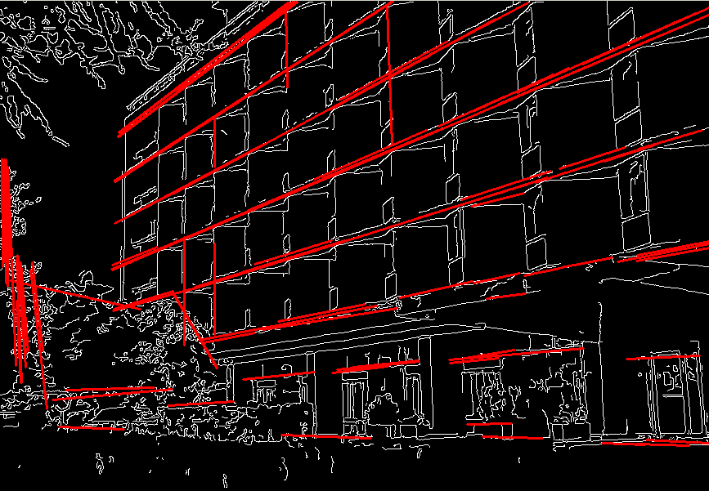
Fitting
Form a higher level, more compact representation of the image features
Model case:
fit a line

Slide 3
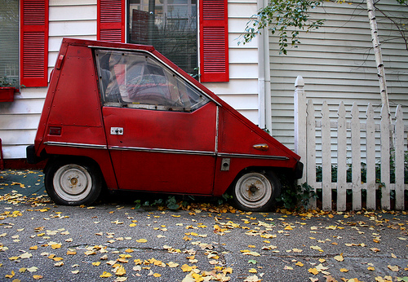
Fitting: Challenges
Case study: Line detection
Noise in the measured feature locations
Extraneous data: clutter (outliers), multiple lines
Missing data: occlusions

Slide 4
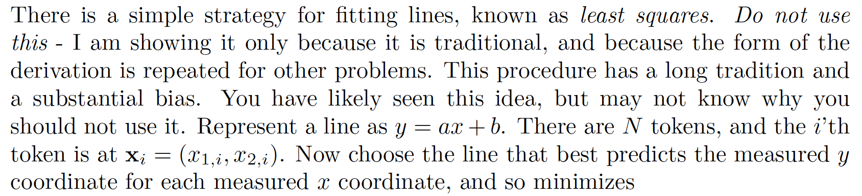
DON’T DO THIS!

Slide 5
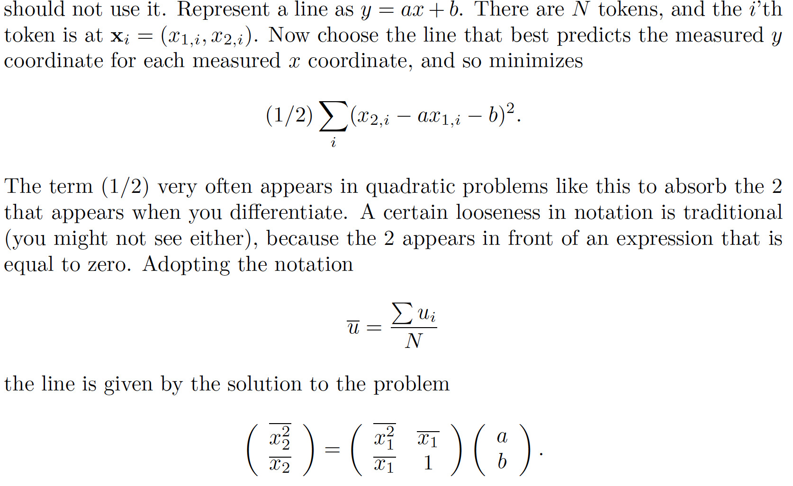
Really, just DON’T

Slide 6
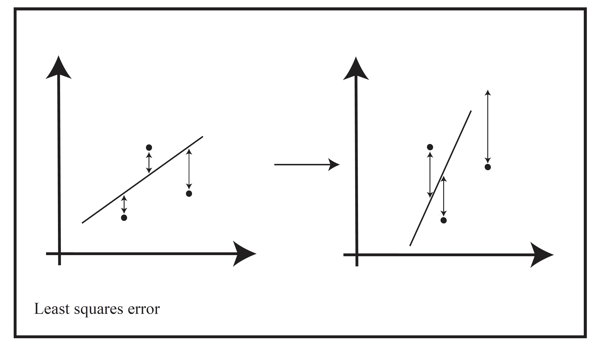
Because

Slide 7
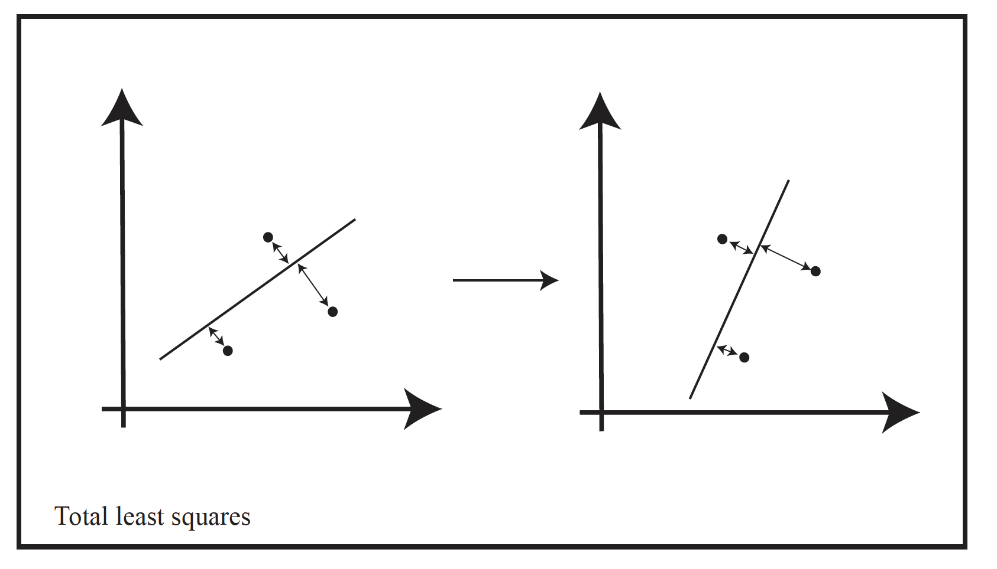
Total least squares

Slide 8
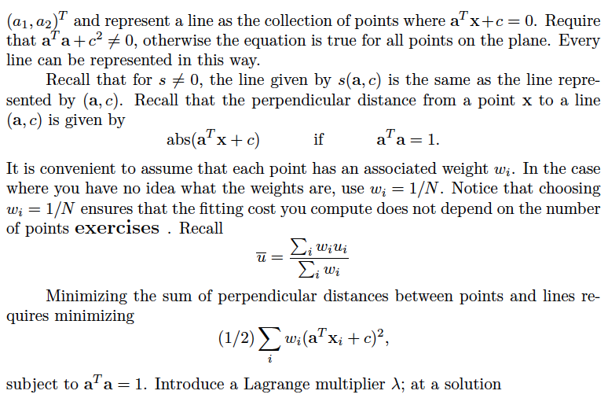
Total least squares

Slide 9
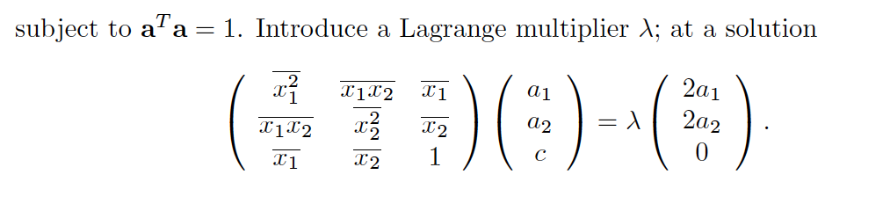
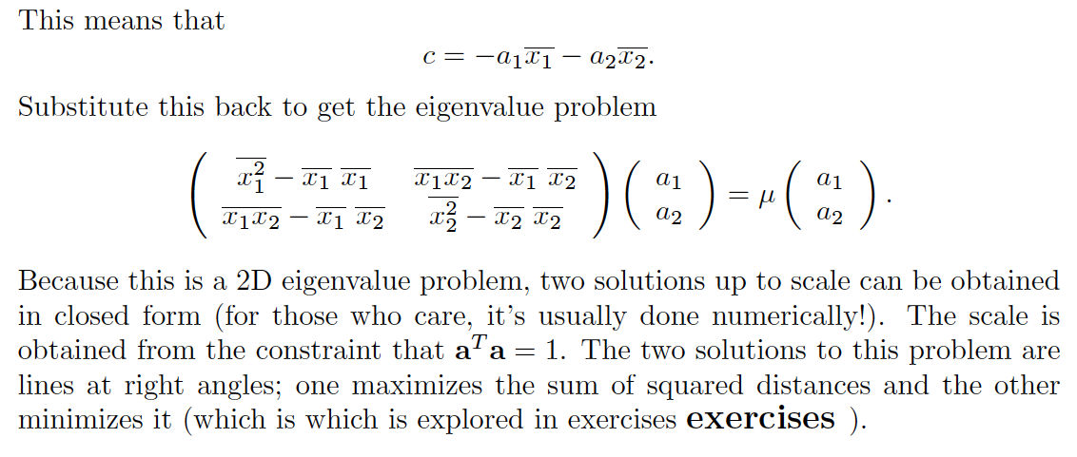
Total least squares

Slide 10
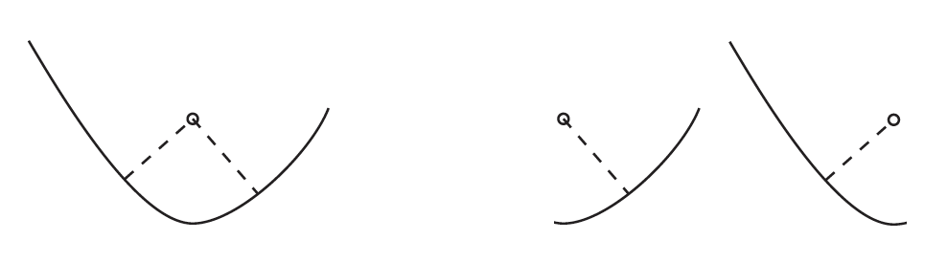
Fitting curved shapes is hard

Slide 11
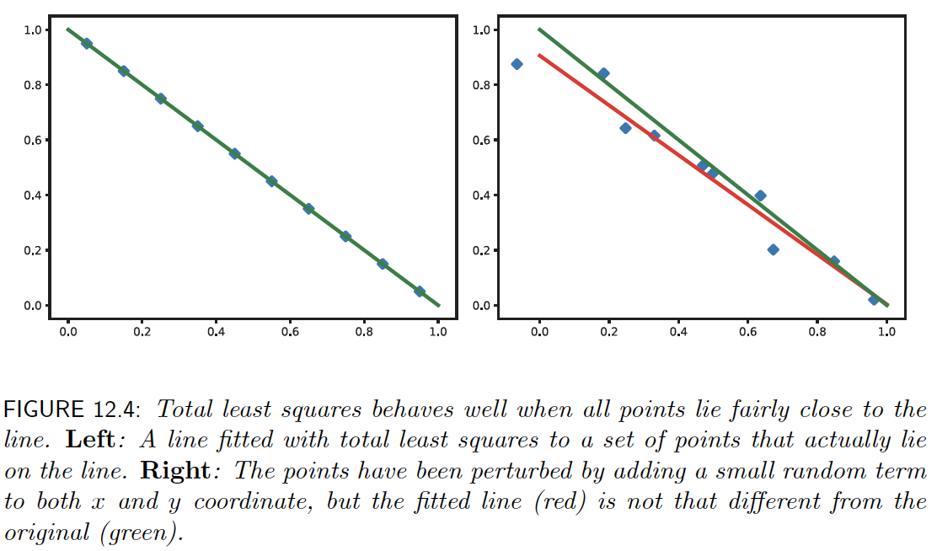
Points close to line -> TLS behaves well

Slide 12
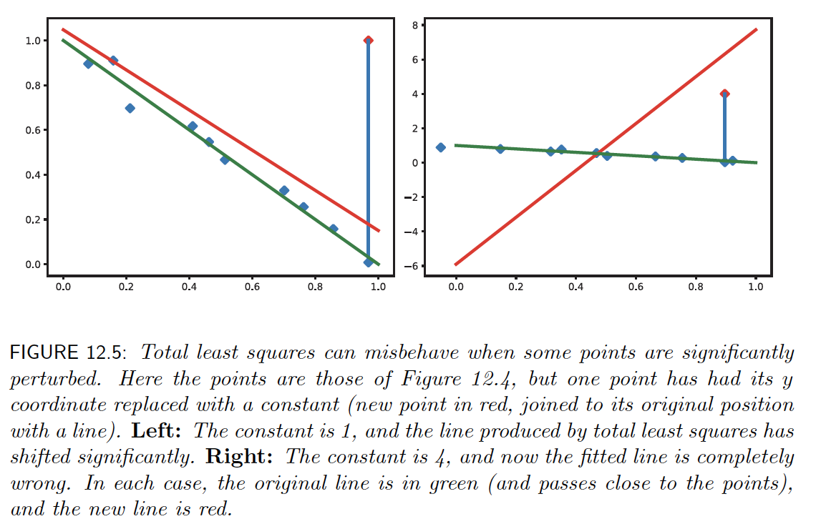
Large errors – TLS behaves badly

Slide 13
Things to think about...

