Slide 1
Representing lines and planes
D.A. Forsyth,
University of Illinois at Urbana Champaign

Slide 2
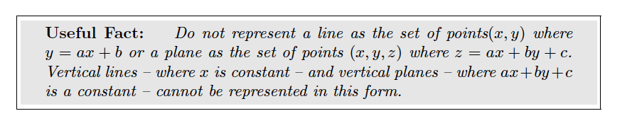
Never do this without good reason
There are missing lines!

Slide 3
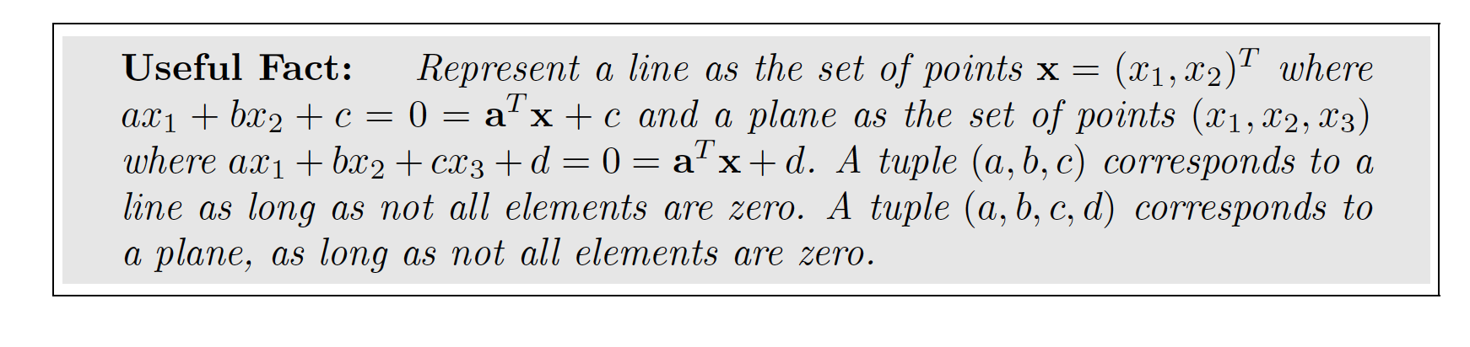
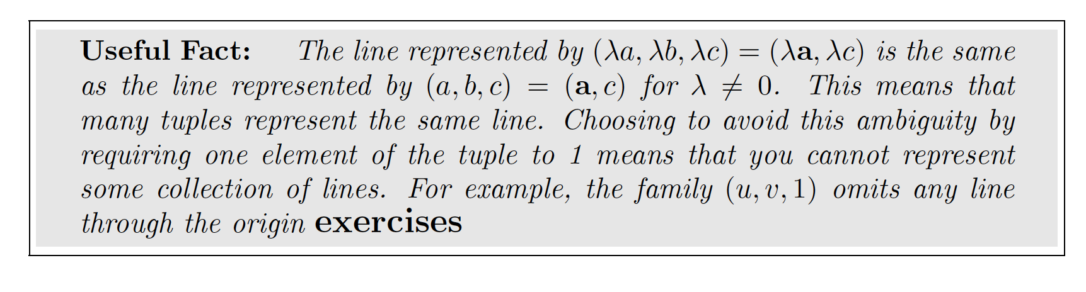
Lines and planes

Slide 4
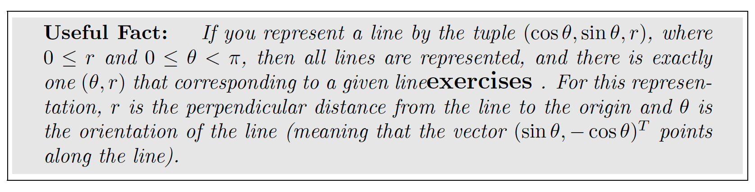
A convenient repn for lines

Slide 5
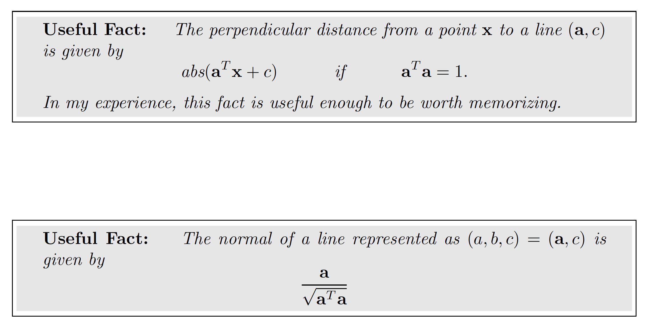
Distance to a line, normal

Slide 6
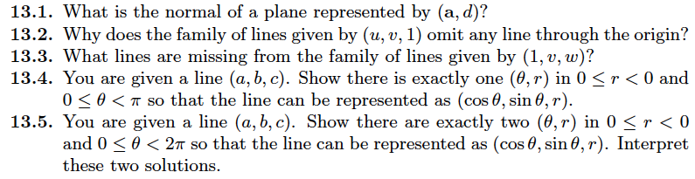
Things to think about...

