Slide 1
Losses and generalization
D.A. Forsyth
University of Illinois at Urbana Champaign

Slide 2
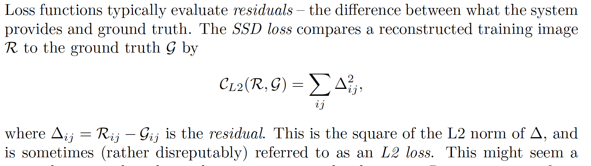
Losses – the L2 loss

Slide 3
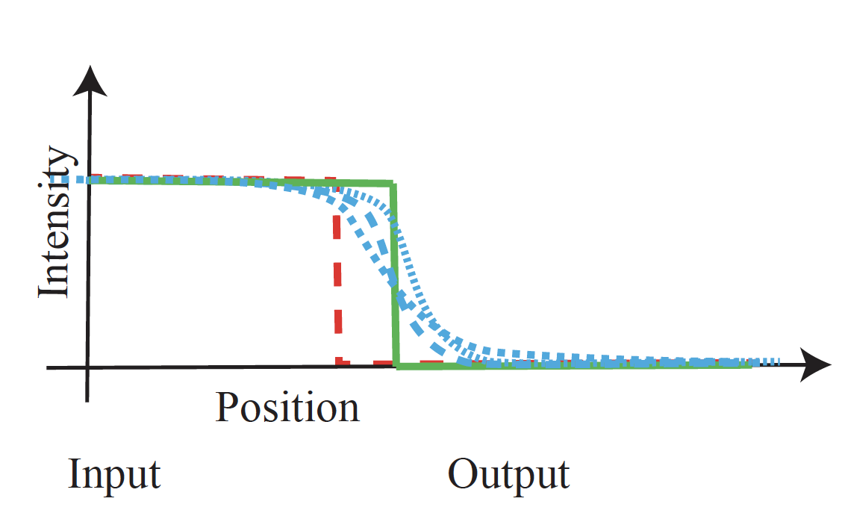
L2 loss creates blur
Sharp edge in the wrong place (red) is expensive
Compared to blurry edge in about the right place (blue)

Slide 4
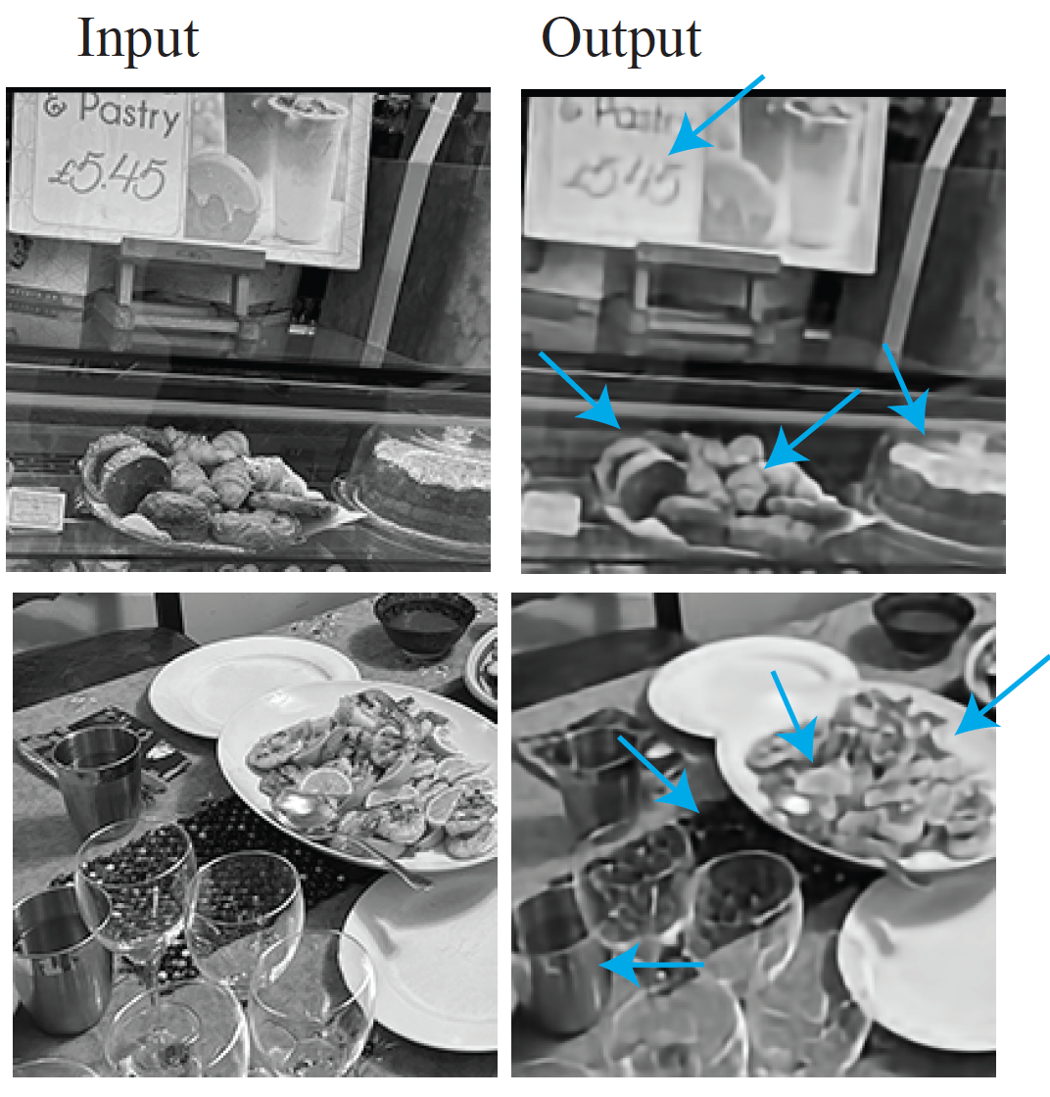

Slide 5
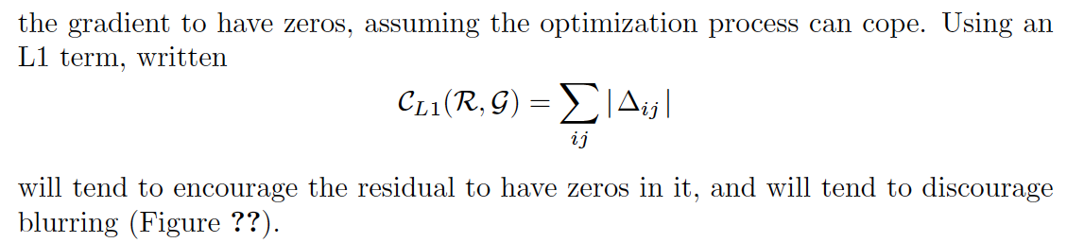
L1 loss
Idea:
  penalize absolute value of residual
We saw the L1 norm in denoising
Square of a small number is very small; absolute value of small number isn’t
Tends to discourage blurring

Slide 6
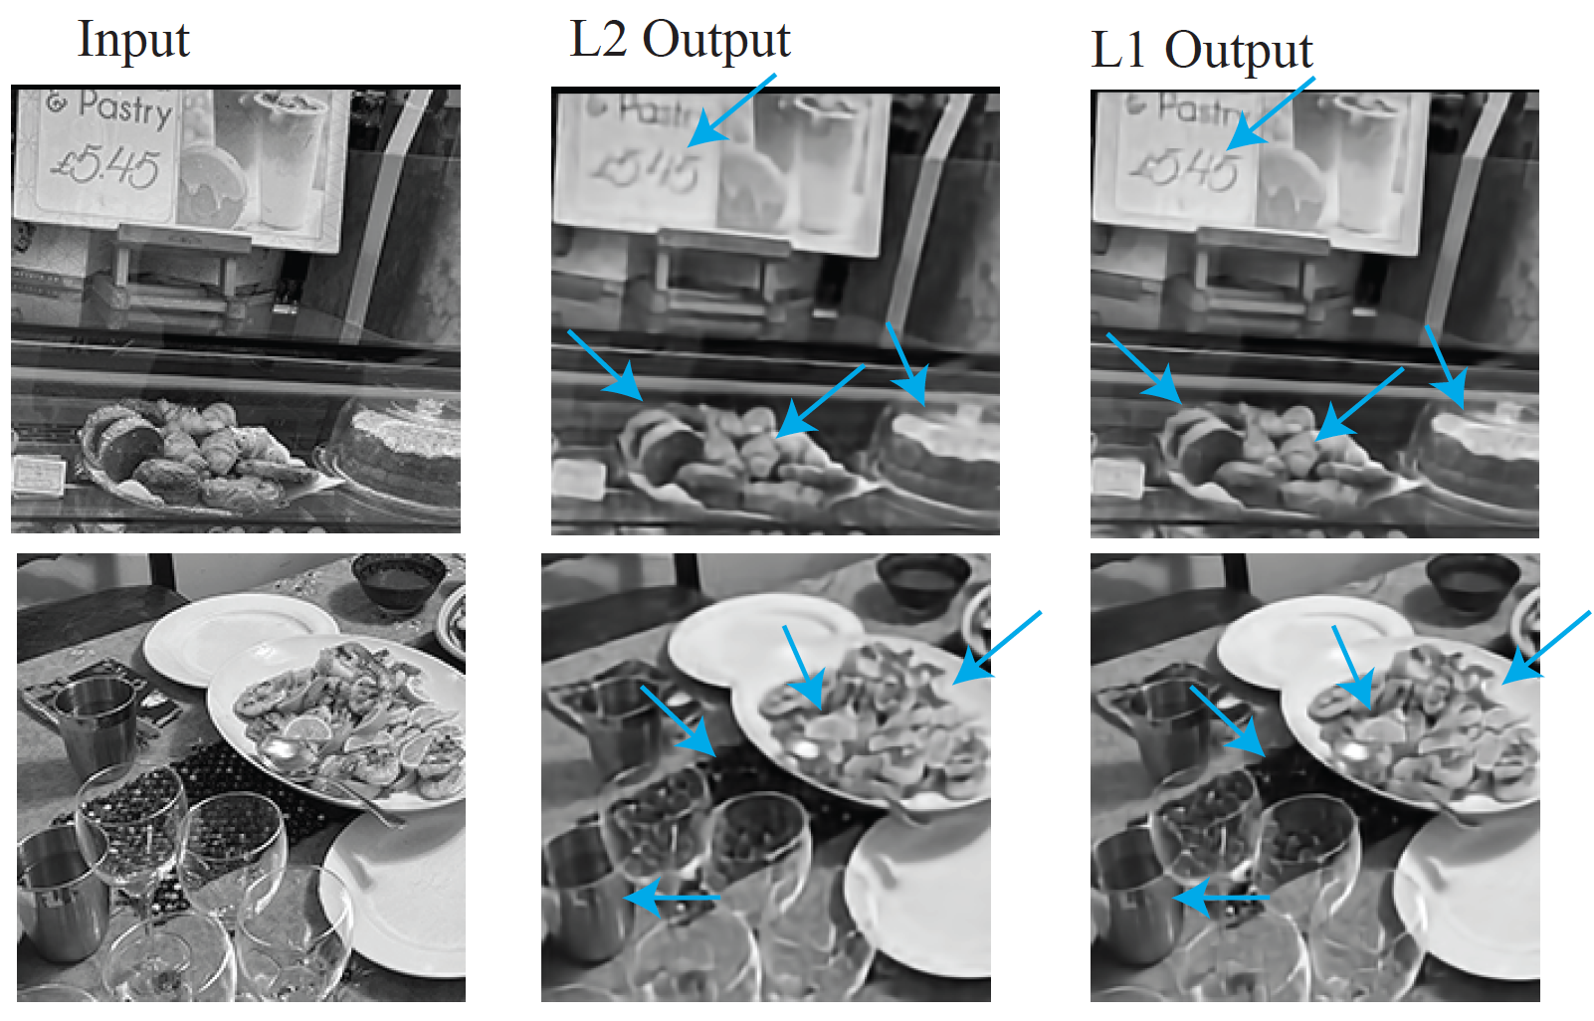
L1 loss

Slide 7
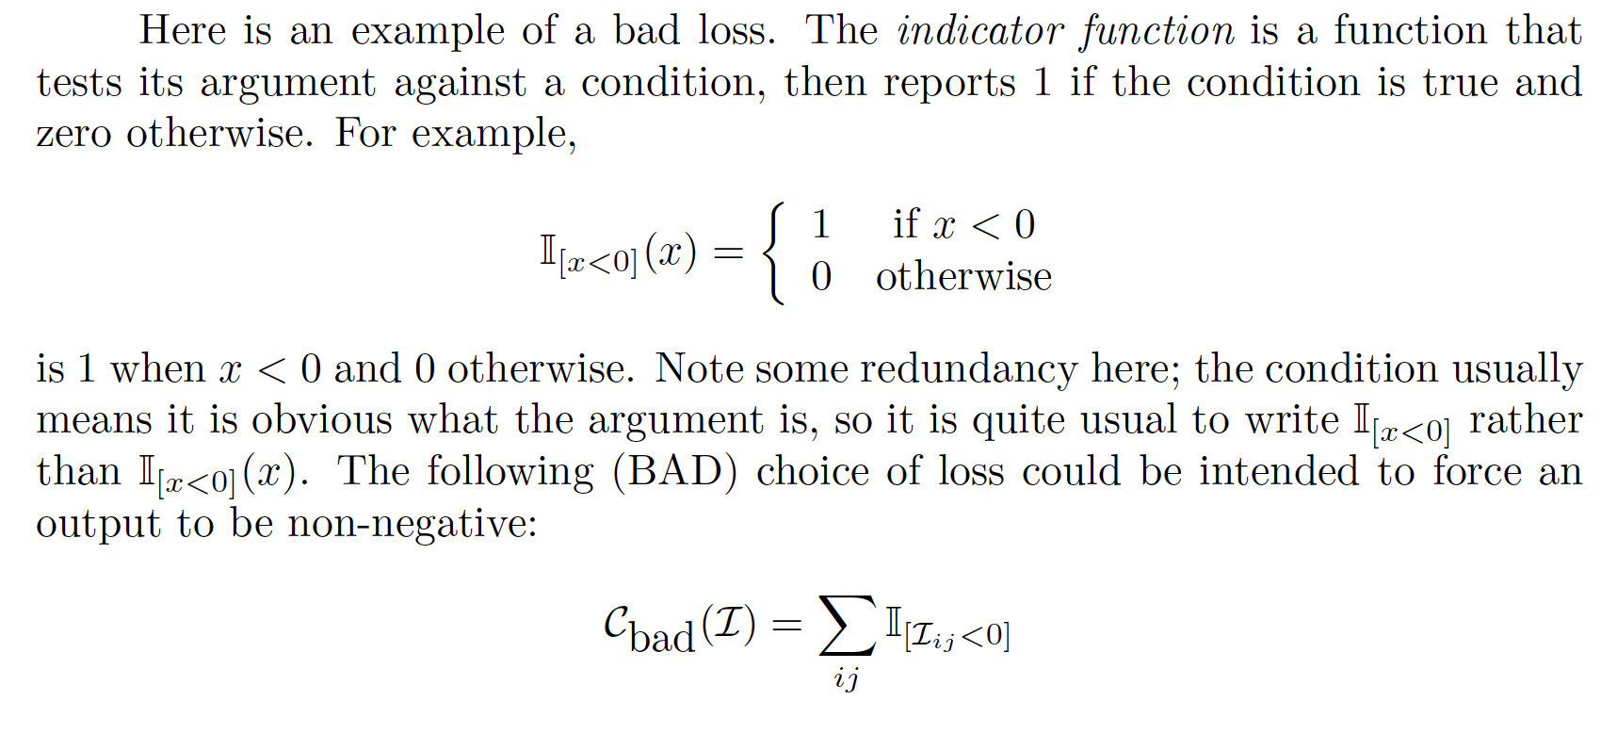
Losses and Gradients
Notice that L1 loss, L2 loss DON’T:
  Force values to be non-negative
  Force values to be less than 1
(VERY BAD) Idea:

Slide 8
Losses and Gradients
Bad, because it supplies no gradient
  Pixel is +ve: loss and gradient are zero
  Pixel is –ve: loss is 1, gradient is zero – no information about how to change filters
CF L1 loss:
  Pixel value too large: gradient pushes it down
  Pixel value too small: gradient pushes it up
  Pixel value just right: non-differentiability doesn’t matter
    never happens
    choose -1<= gradient <=1: everything works fine

Slide 9
General ideas: Cheating
SGD is a very effective search
  Astonishing, but true
  It might find a solution you don’t expect and don’t want
Example:
  train an autoencoder with (clean, clean) pairs
  it will cheat, and pass on pixels
  even if it has a complicated architecture
  symptoms:
    can’t denoise
    meaningless image representation

Slide 10
General ideas: Cheating
Cheating example above won’t denoise
It is important to train representation to denoise images
(Noisy, clean) pairs will produce something useful
(clean, clean) pairs won’t!

Slide 11
General ideas: Generalization
No interest in denoising training images
We want to denoise new images
Options:
  Data augmentation: make training dataset look bigger
  Regularization: make it hard to choose filters that are specialized

Slide 12
General ideas: Data Augmentation
Applies to many learned systems
For now:
  A left/right flipped image is still an image
  An up/down flipped image is still an image
  An image crop is still an image
  Etc
When forming a batch, randomly
  crop, flip, etc. images

Slide 13
General ideas: Regularization
Prefer small coefficients to large coeffs.
  A filter with large coeffs that works well on training data might produce an unexpected large response on new data
Discourage filters with large coeffs by penalizing loss
  (cost of error on batch) + scale*(penalty for large coeffs)
Known as weight decay
  API will do this for you if you ask

Slide 14
General ideas: Regularization
How to choose scale?
Train for many different choices
Evaluate each on held out data to choose
Now re-train using the best value
Evaluate the result on new dataset

Slide 15
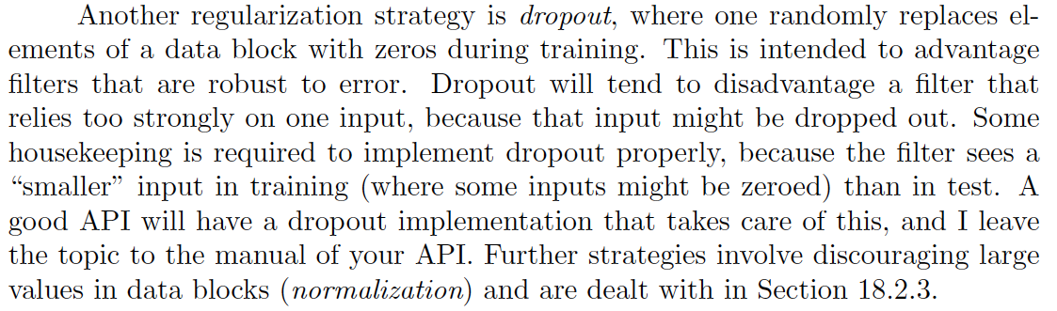
General ideas: dropout
This is a form of regularization

Slide 16
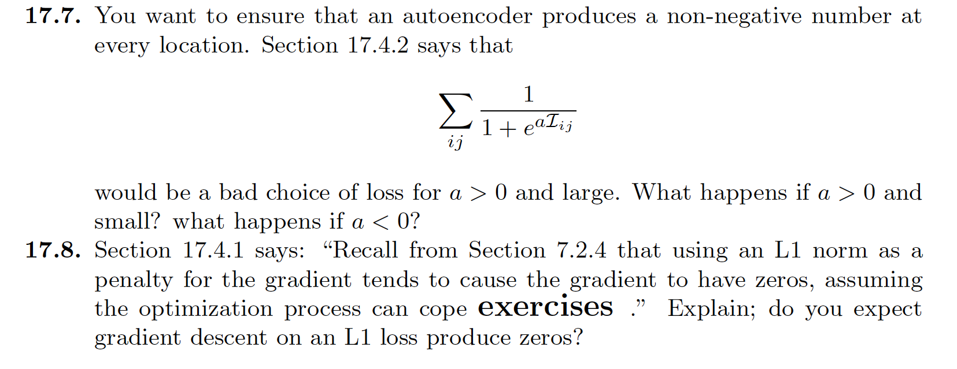
Things to think about...

