Slide 1
Simple mosaics
D.A. Forsyth
University of Illinois at Urbana Champaign

Slide 2
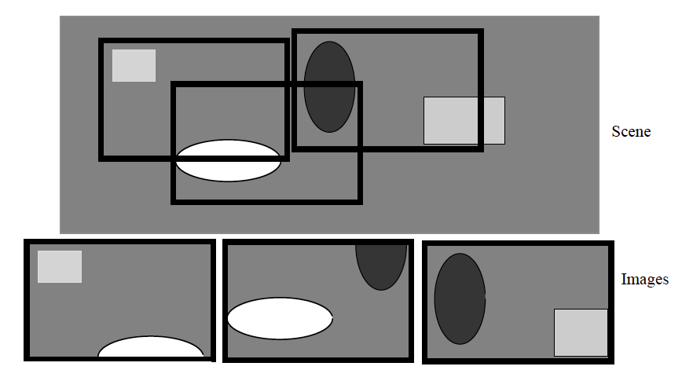
Forming Mosaics of Images
Idea:
Given multiple images of a big thing, transform the images so matching bits lie on top of one another
Combine these images to a single image

Slide 3
Currently
We know how to translate
(eg color separation exercises)
later, other transformations

Slide 4
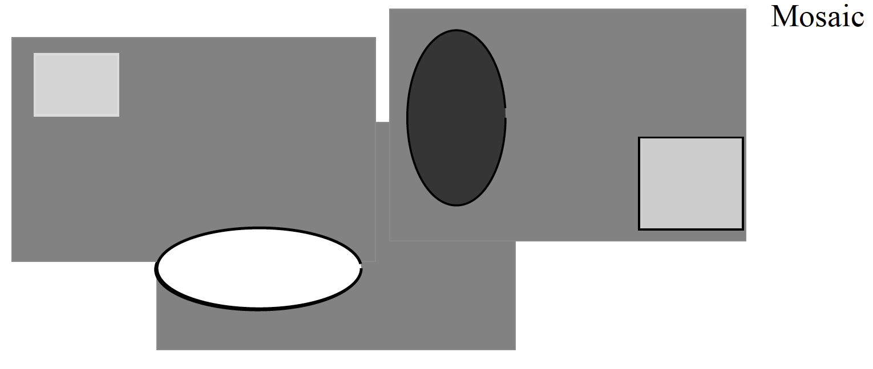

Slide 5
Procedure
Start:
Choose a root image (it isn’t translated)
and set mosaic to contain root only
All others get offset of zero
Iterate:
Choose image that overlaps image already in the mosaic
Search for offset with best overlap
Insert into mosaic at that offset
Summarize registered images into a single image

Slide 6
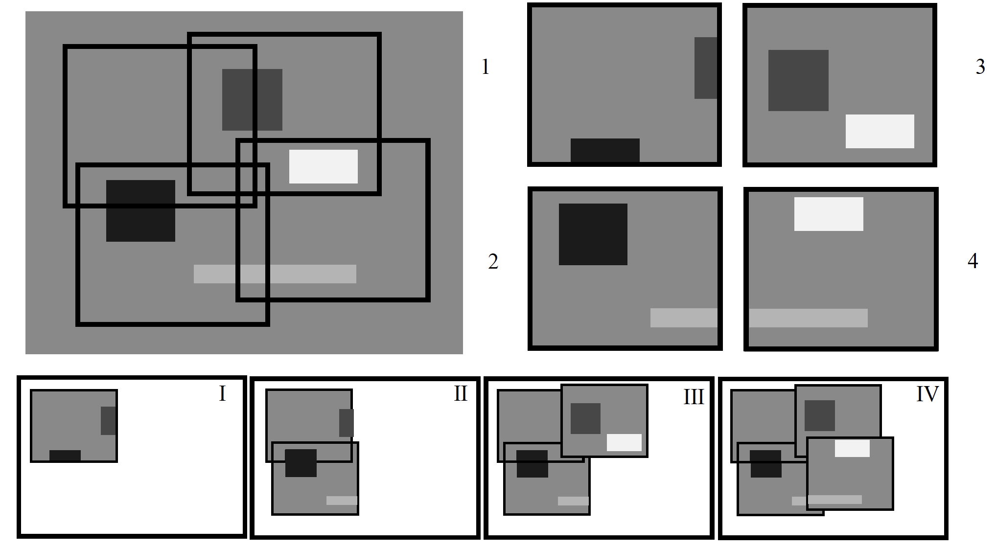

Slide 7
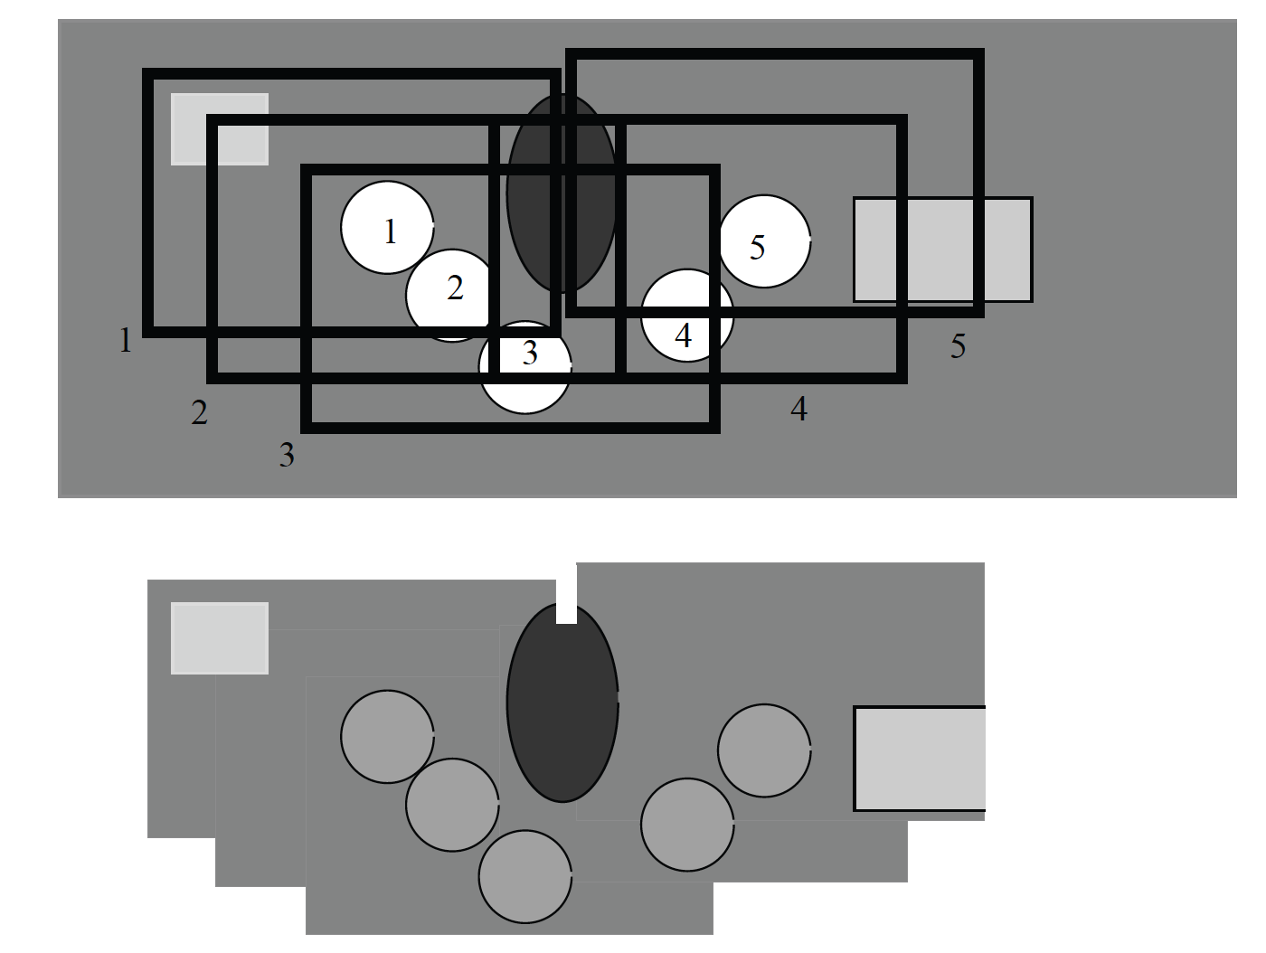
A mean gives ghostly trails

Slide 8
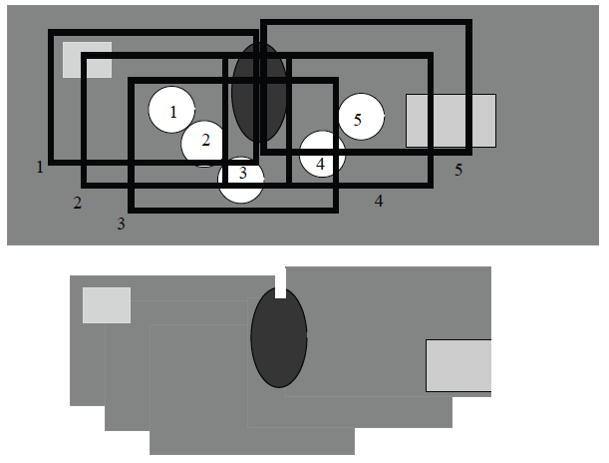
A median removes moving objects

Slide 9
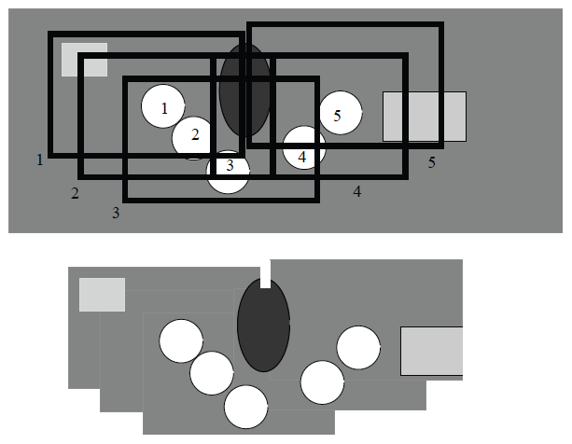
Most different from median shows moving objects

Slide 10
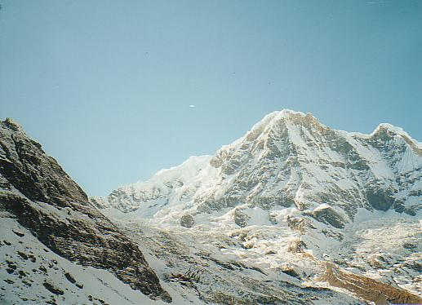
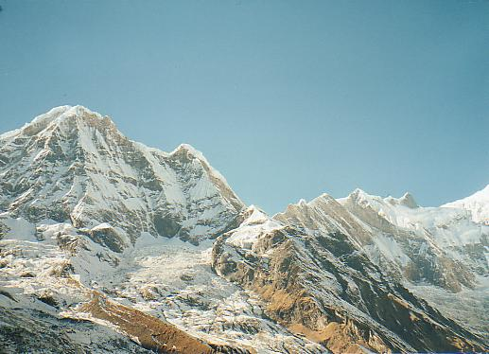
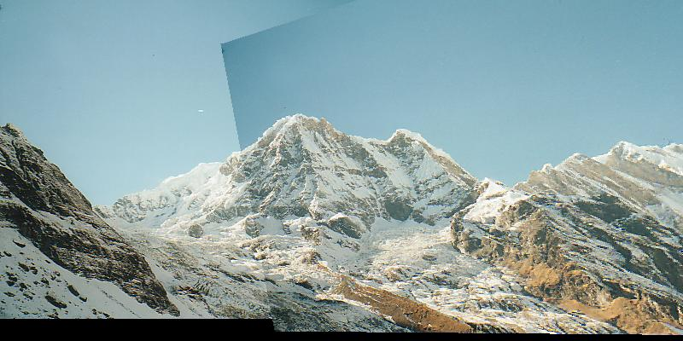
Important variants
If you interpolate the cost function, you could register with sub-pixel accuracy (bilinear won’t work)
Wider range of transformations
but how to estimate tx?

Slide 11
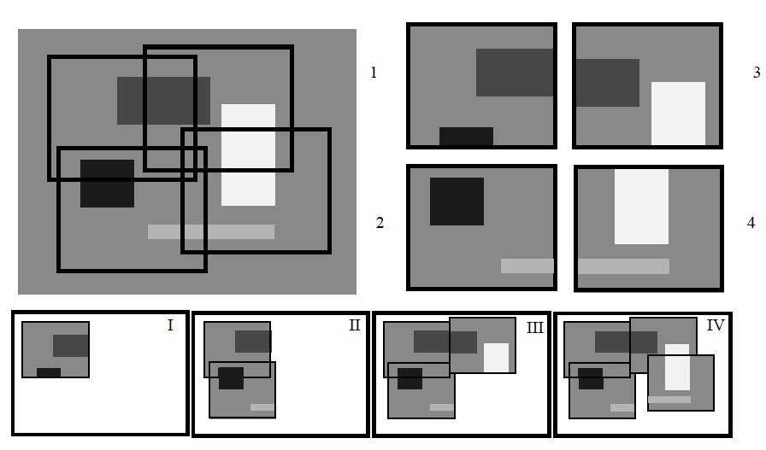
Bundle adjustment
Example: Register II to I, III to II, IV to III
and discover IV doesn’t register well with II
Loop does not close

Slide 12
Why is there a problem?
Error = Cost(I, II)+Cost(I, III)+Cost(I, IV)+Cost(II, III)+Cost(II, IV)+Cost(III, IV)
Procedure DOESN’T deal with Cost(I, IV) or Cost(II, IV)
Idea:
Build mosaic
Now adjust one image at a time to improve
Not ideal, more complex strategies may be needed.

Slide 13
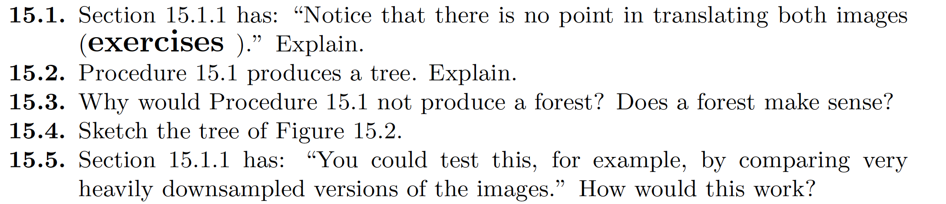
Think about this...

