Slide 1
Sampling and Nyquist’s theorem
D.A. Forsyth
University of Illinois at Urbana Champaign

Slide 2
Mystery 2
Why can downsampling sometimes lead to aliasing?

Slide 3
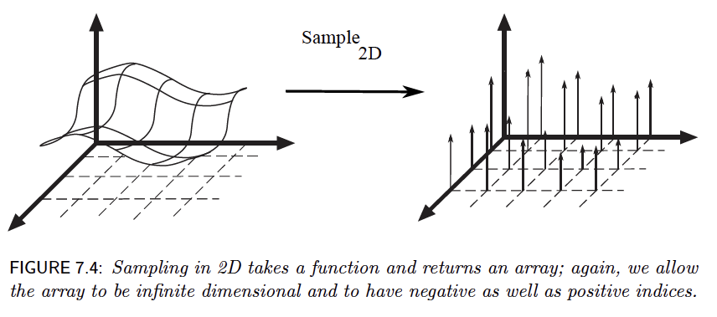
Sampling in 2D

Slide 4
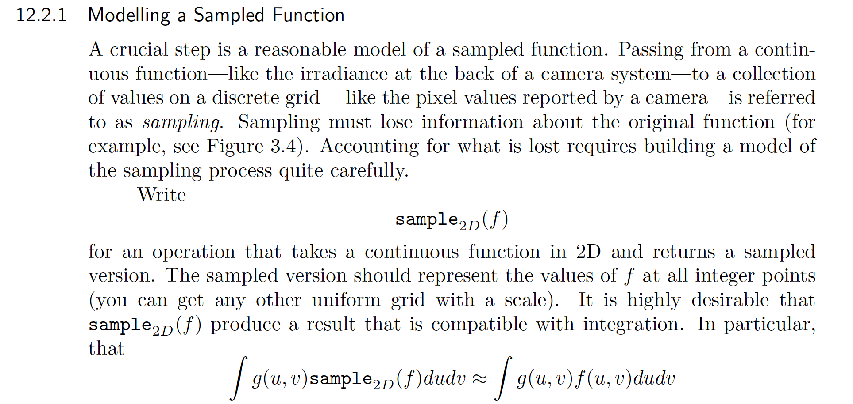
Modelling a sampled function

Slide 5
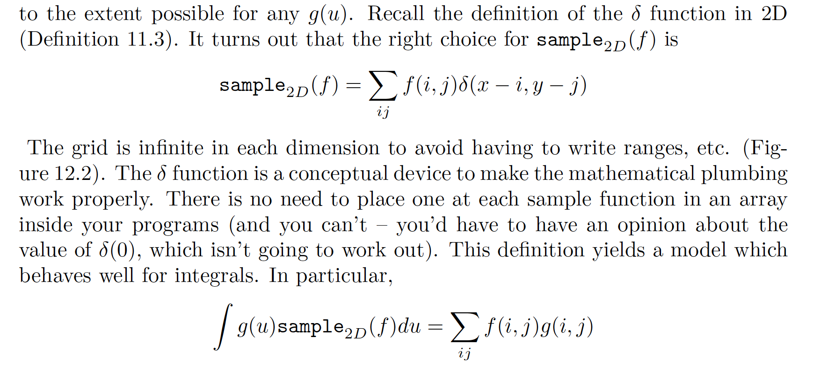
Modelling a sampled function

Slide 6
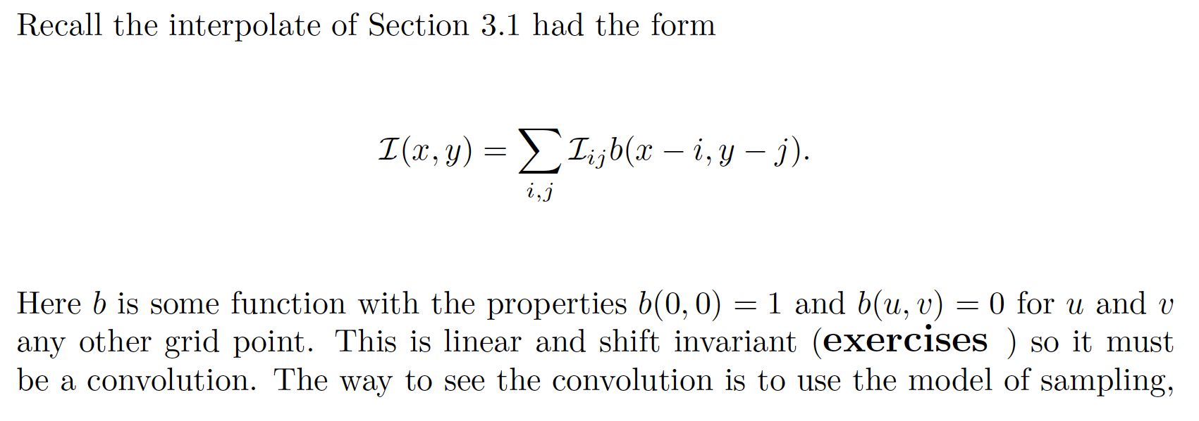
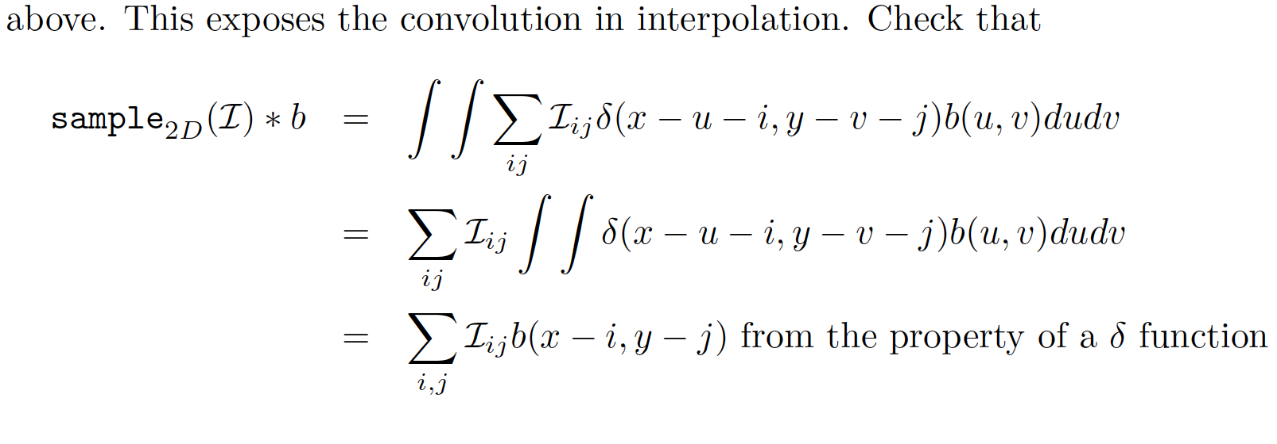
Interpolation is by convolution

Slide 7
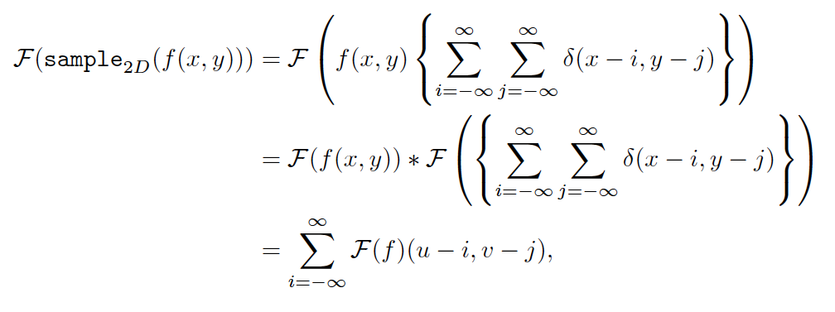
The FT of a sampled signal

Slide 8
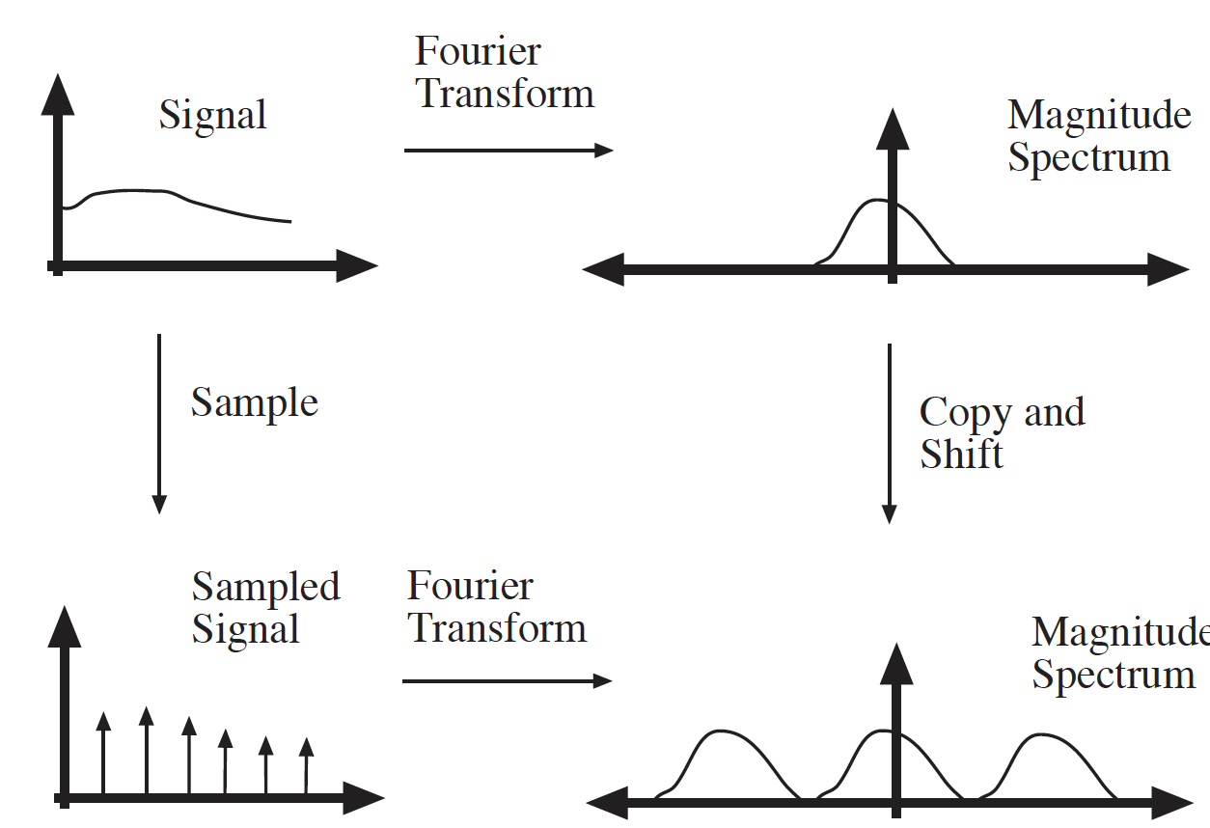
The FT of a sampled signal

Slide 9
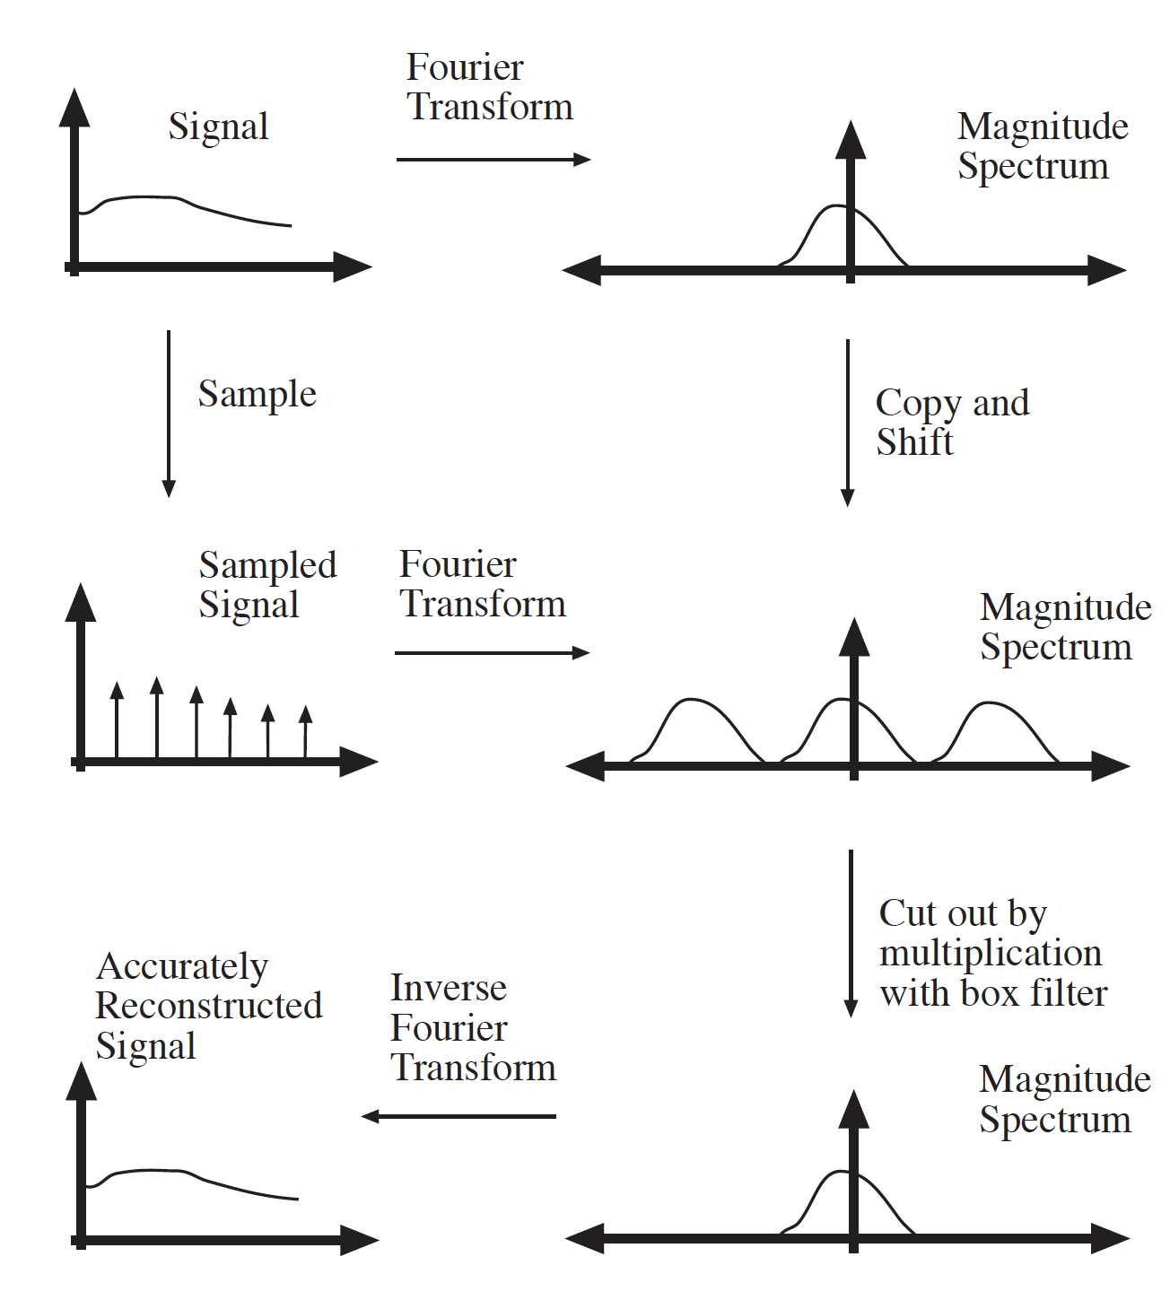
Sampling
If the magnitude blobs don’t overlap, you can reconstruct from samples
Just cut out the blob in FT space with a box filter, inverse FT

Slide 10
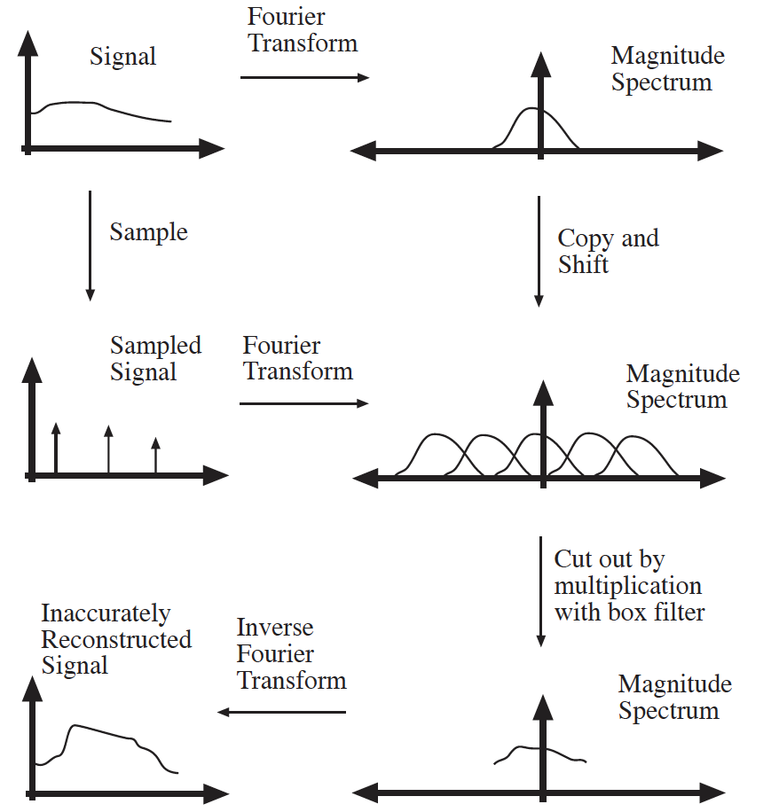
Sampling
If the magnitude blobs overlap, you can’t reconstruct from samples
Cutting out won’t work – you’ll get some information from a different frequency that aliases
Nyquist’s theorem

Slide 11
Consequences
Nyquist limits aren’t really viable
Apply the convolution theorem
A box in FT magnitude space is a filter with infinite support (and you can’t make one of those)
You’re forced to choose a filter that is low pass, but isn’t perfect
the choice has consequences
Gaussian is such a filter

Slide 12
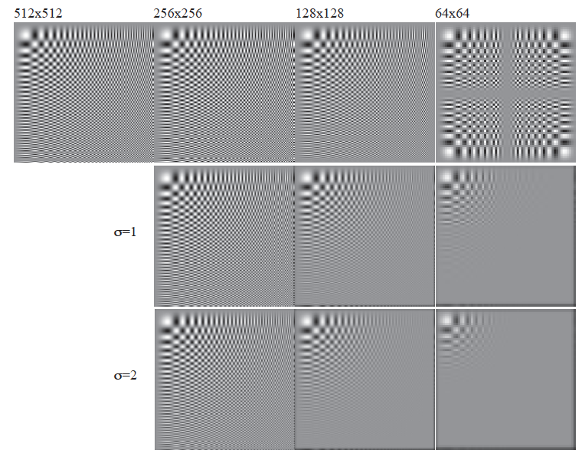

Slide 13
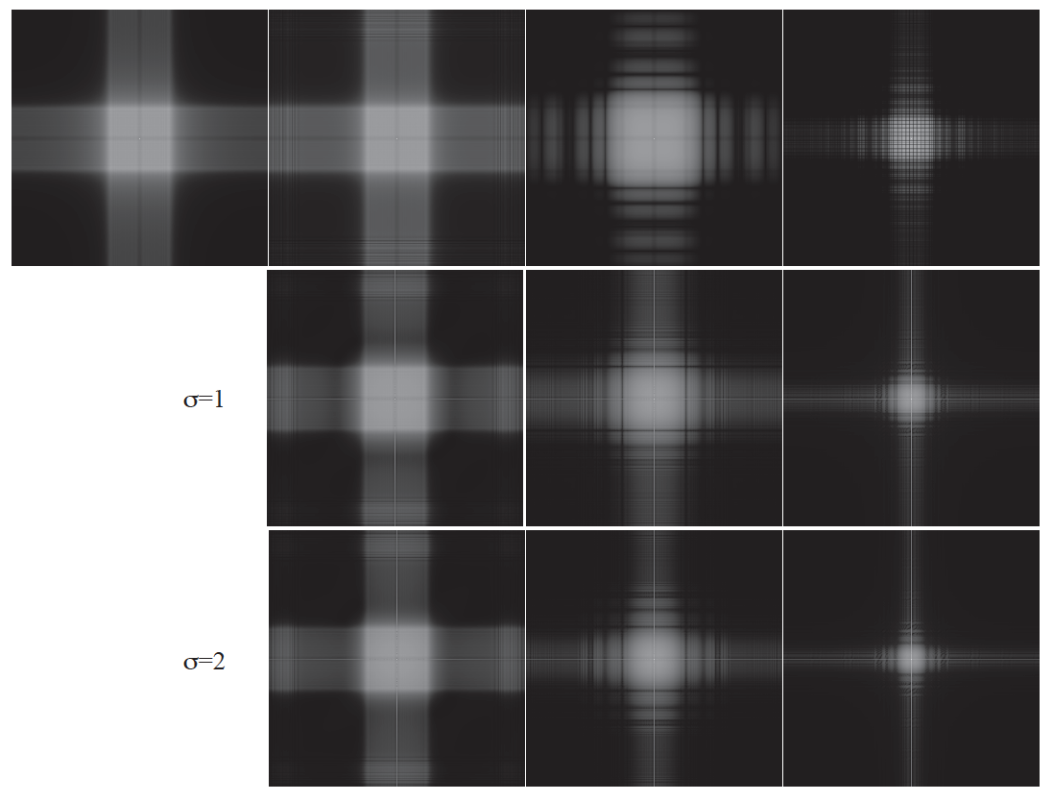

Slide 14
Mystery 2
Why can downsampling sometimes lead to aliasing?
The downsampling mangles the Fourier Transform magnitude
spectrum UNLESS you smooth by enough; and if you do, you lose
some information

Slide 15
Analyzing interpolation methods
Perfect reconstruction requires convolution with a sinc filter in the spatial domain,
which is bad because sinc has infinite support
Instead, simpler reconstruction (interpolation) methods are typically used

Slide 16
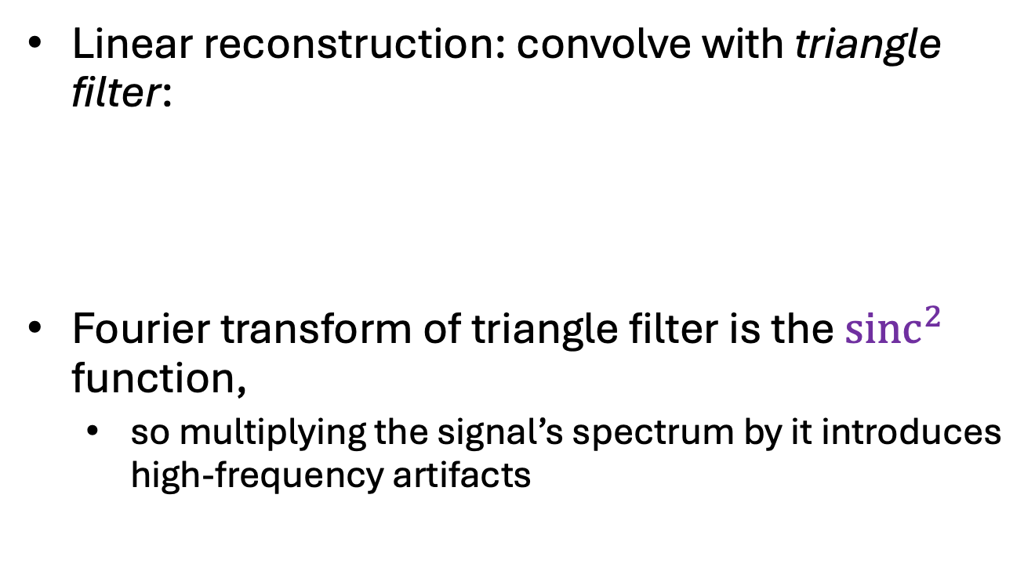


Analyzing interpolation methods
Linear reconstruction: convolve with triangle filter:
Fourier transform of triangle filter is the ${sinc}^{2}$ function,
so multiplying the signal’s spectrum by it introduces high-frequency artifacts
$$∗$$
$$=$$
Image source

Slide 17

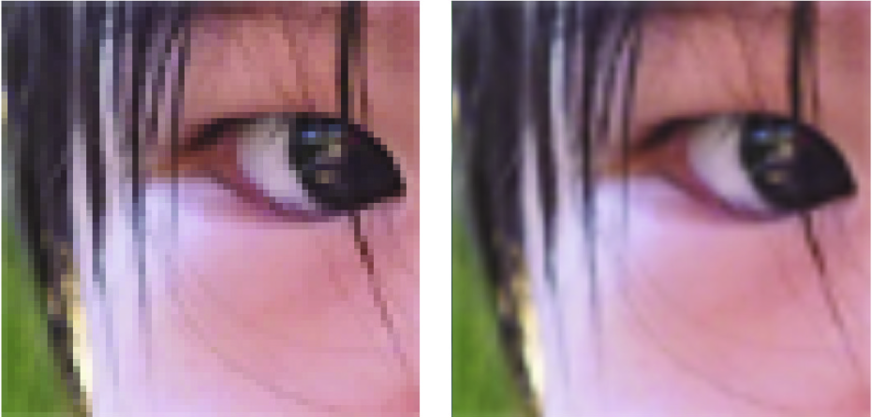
Bilinear interpolation closeup
Image source

Slide 18
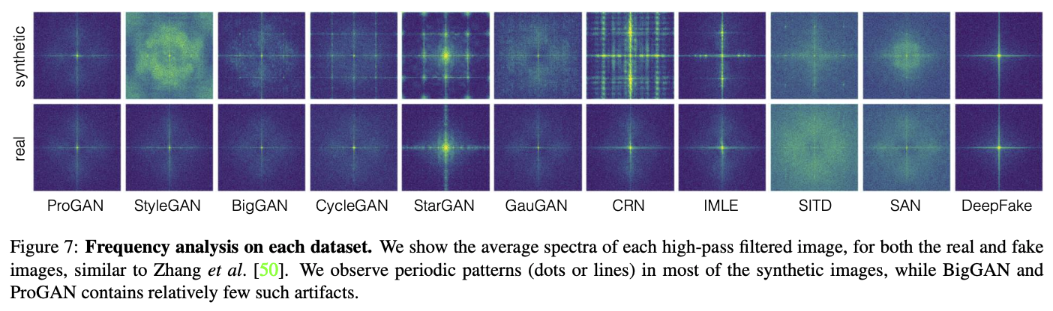
Why else should you care?
S.-Y. Wang et al. CNN-generated images are surprisingly easy to spot... for now. CVPR 2020

Slide 19
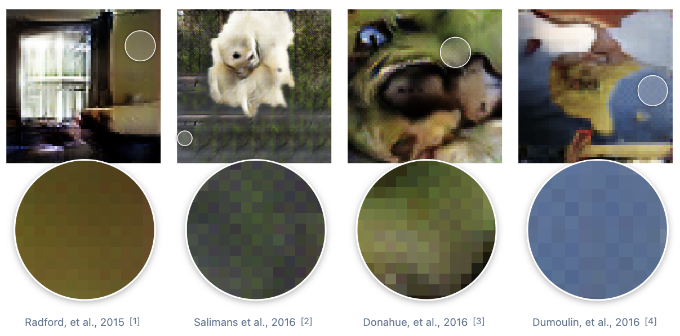
Why else should you care?
Checkerboard and repetition artifacts in GAN-generated images
https://distill.pub/2016/deconv-checkerboard/

Slide 20
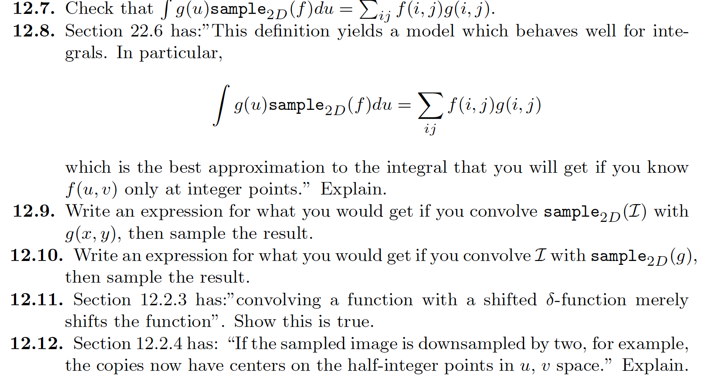
Things to think about...

