Slide 1
Line fitting with RANSAC
D.A. Forsyth
University of Illinois at Urbana Champaign

Slide 2
RANSAC
Random sample consensus:
very general framework
Outline:
Randomly choose a small initial subset of points
Fit a model to that subset
Find all inlier points that are “close” to the model and reject the rest as outliers
Do this many times and choose the model with the most inliers
M. Fischler and R. Bolles. Random Sample Consensus: A Paradigm for Model Fitting with Applications to Image Analysis and Automated Cartography. Comm. of the ACM, Vol 24, pp 381-395, 1981

Slide 3
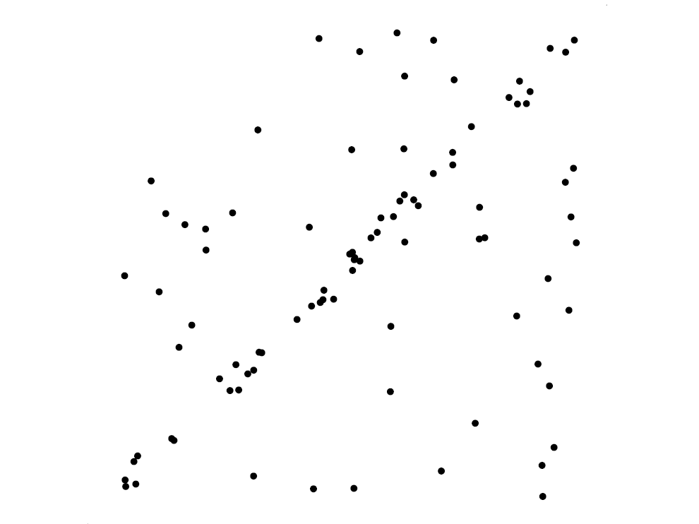
Voting schemes
let each point vote for all compatible models
Hopefully, outliers will not vote consistently for any single model
The model that receives the most votes is the best fit

Slide 4
RANSAC for line fitting example
Source: R. Raguram

Slide 5
RANSAC for line fitting example
Least-squares fit
Source: R. Raguram

Slide 6
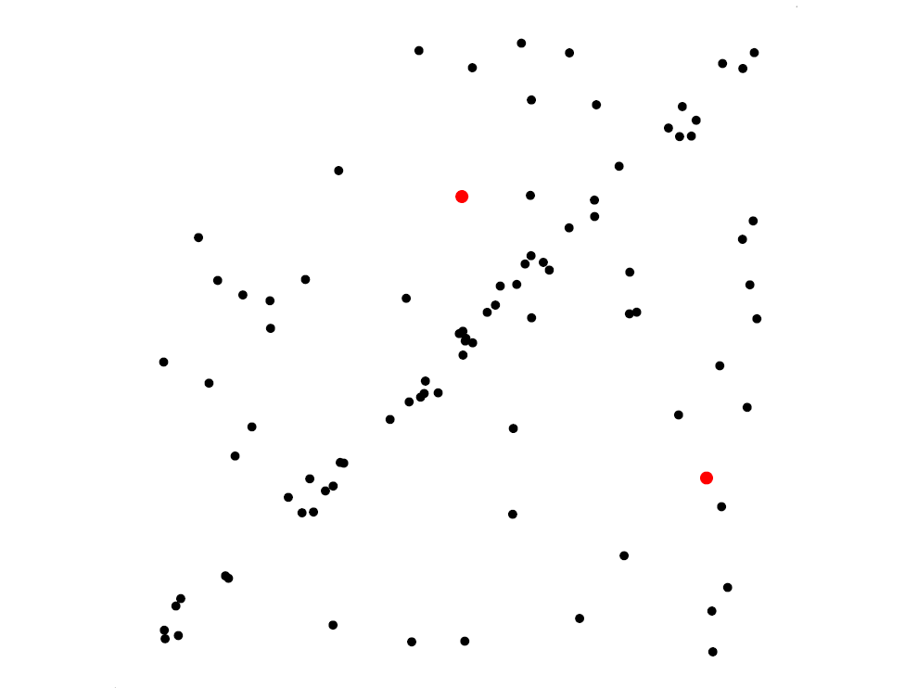
RANSAC for line fitting example
Randomly select minimal subset of points
Source: R. Raguram

Slide 7
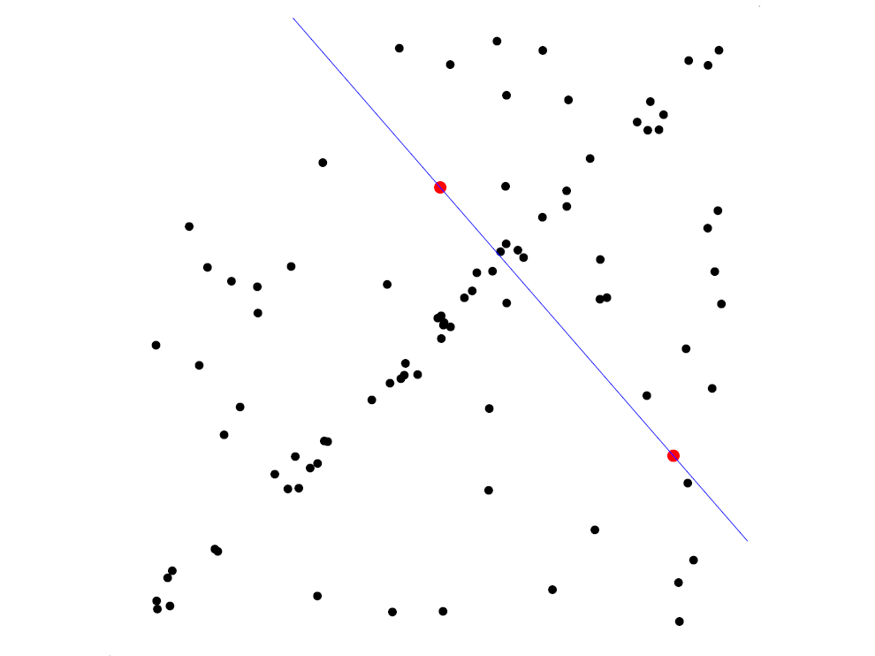
RANSAC for line fitting example
Randomly select minimal subset of points
Hypothesize a model
Source: R. Raguram

Slide 8
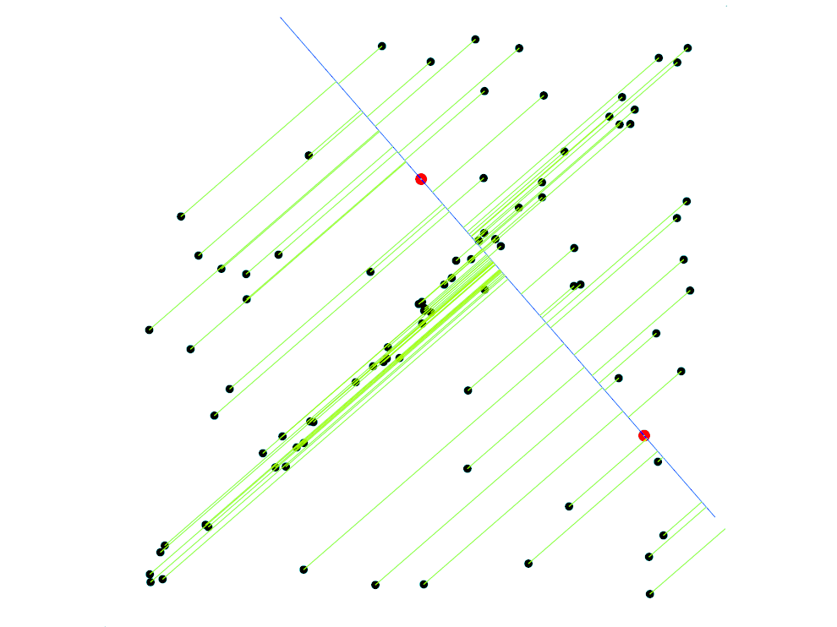
RANSAC for line fitting example
Randomly select minimal subset of points
Hypothesize a model
Compute error function
Source: R. Raguram

Slide 9
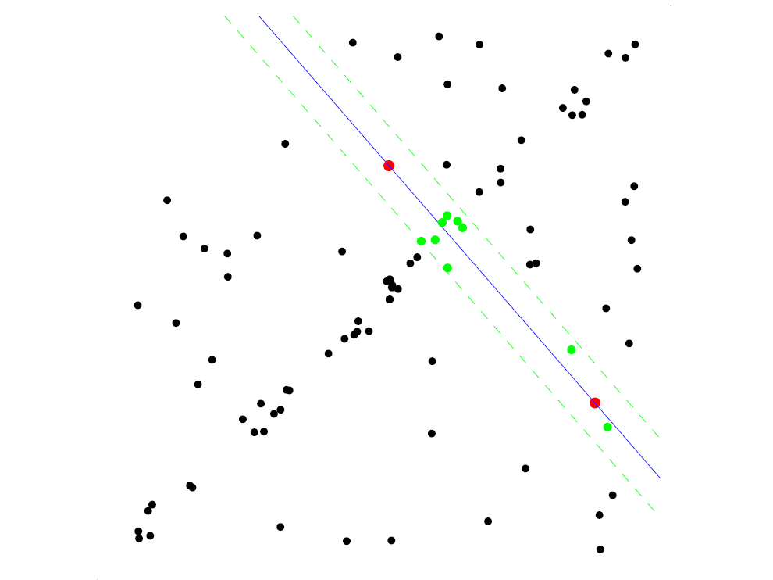
RANSAC for line fitting example
Randomly select minimal subset of points
Hypothesize a model
Compute error function
Select points consistent with model
Source: R. Raguram

Slide 10
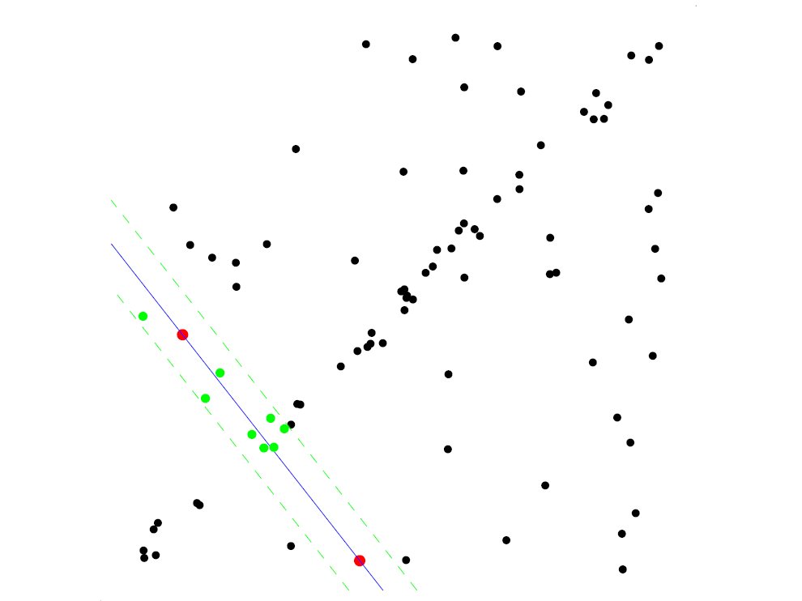
RANSAC for line fitting example
Randomly select minimal subset of points
Hypothesize a model
Compute error function
Select points consistent with model
Repeat hypothesize-and-verify loop
Source: R. Raguram

Slide 11
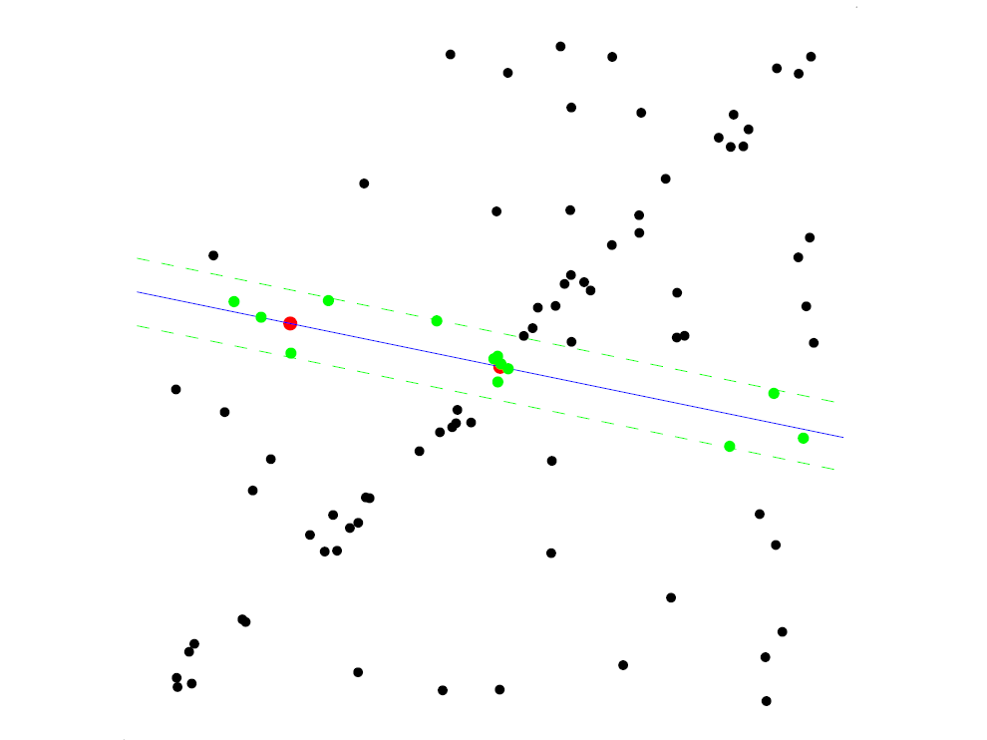
RANSAC for line fitting example
Randomly select minimal subset of points
Hypothesize a model
Compute error function
Select points consistent with model
Repeat hypothesize-and-verify loop
Source: R. Raguram

Slide 12
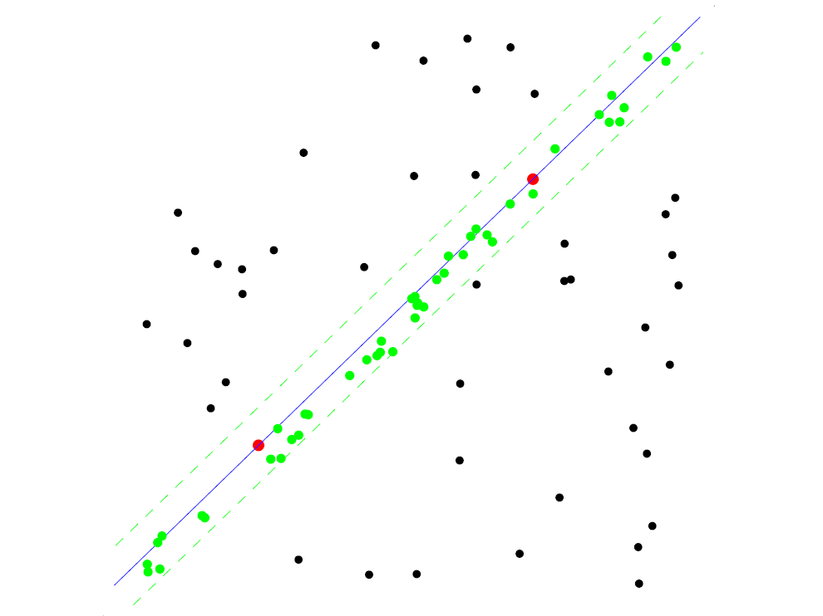
RANSAC for line fitting example
Uncontaminated sample
Randomly select minimal subset of points
Hypothesize a model
Compute error function
Select points consistent with model
Repeat hypothesize-and-verify loop
Source: R. Raguram

Slide 13
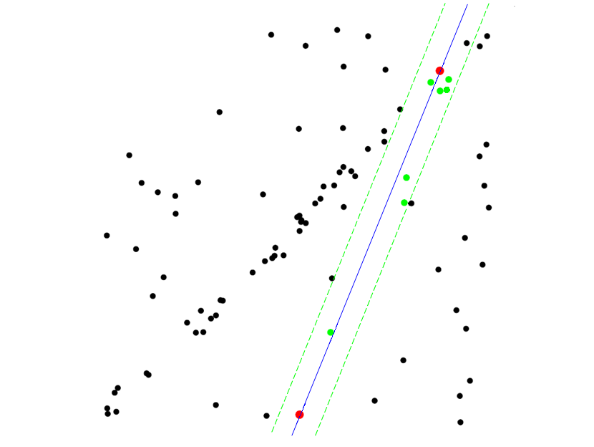
RANSAC for line fitting example
Randomly select minimal subset of points
Hypothesize a model
Compute error function
Select points consistent with model
Repeat hypothesize-and-verify loop
Source: R. Raguram
Notes:
13

Slide 14
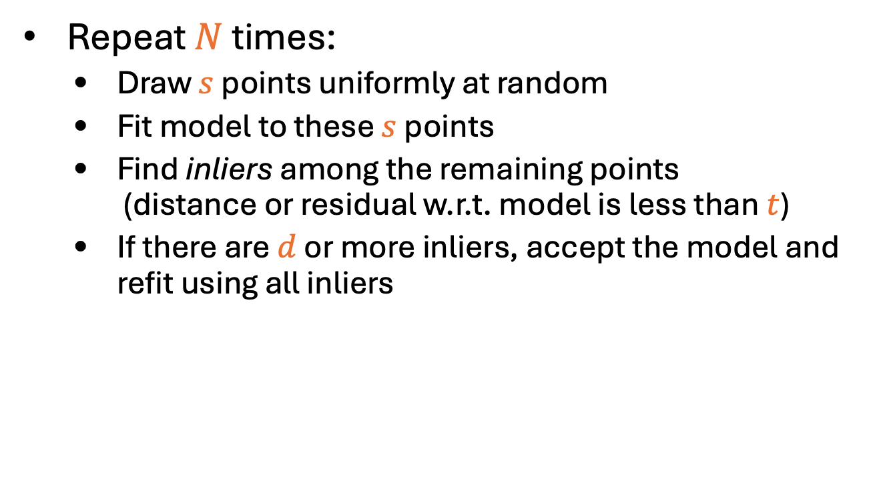
RANSAC loop
Repeat $N$ times:
Draw $s$ points uniformly at random
Fit model to these $s$ points
Find inliers among the remaining points (distance or residual w.r.t. model is less than $t$)
If there are $d$ or more inliers, accept the model and refit using all inliers

Slide 15
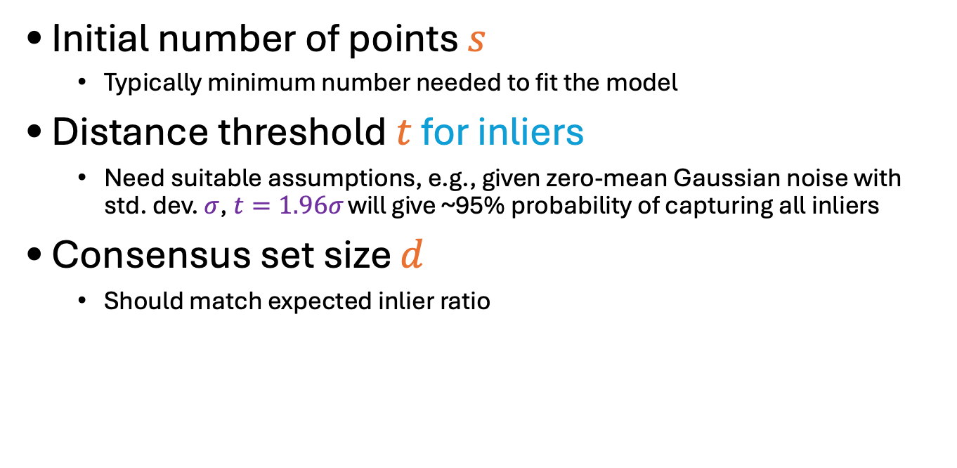
RANSAC: Choosing the parameters
Initial number of points $s$
Typically minimum number needed to fit the model
Distance threshold $t$ for inliers
Need suitable assumptions, e.g., given zero-mean Gaussian noise with std. dev. $σ$, $t=1.96σ$ will give ~95% probability of capturing all inliers
Consensus set size $d$
Should match expected inlier ratio
Adapted from M. Pollefeys

Slide 16
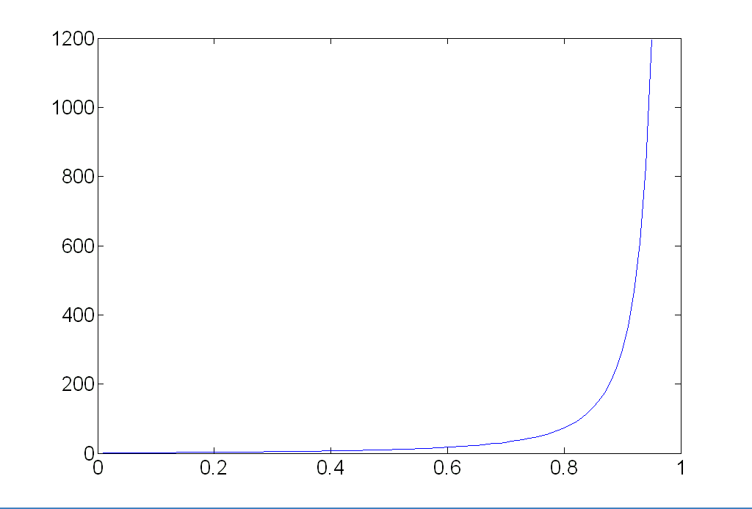
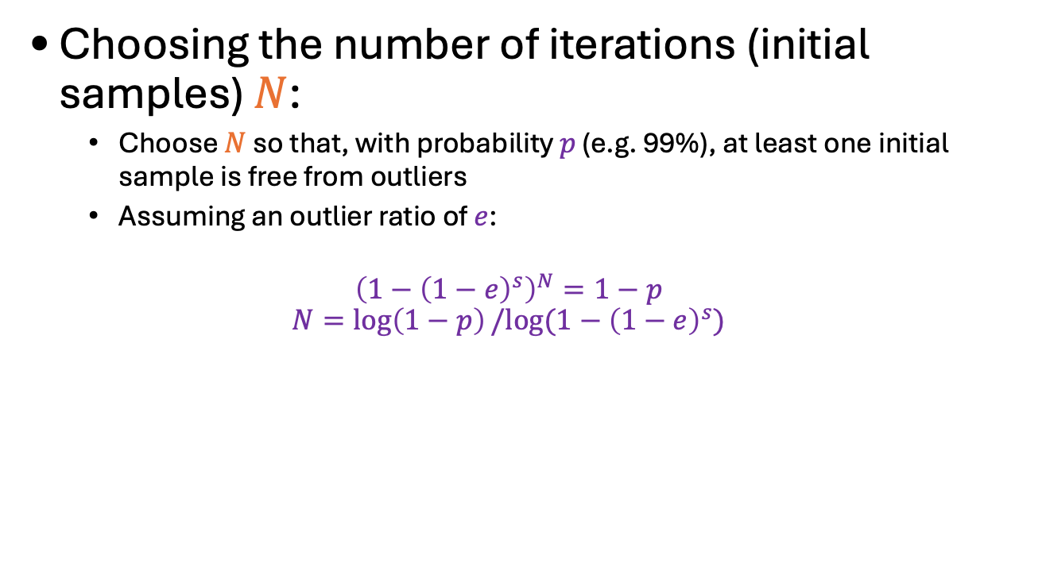
RANSAC: Choosing the parameters
Choosing the number of iterations (initial samples) $N$:
Choose $N$ so that, with probability $p$ (e.g. 99%), at least one initial sample is free from outliers
Assuming an outlier ratio of $e$:
$${\left(1−{\left(1−e\right)}^{s}\right)}^{N}=1−p$$
$$N=\log\left(1−p\right)/log⁡(1−{\left(1−e\right)}^{s})$$
 | proportion of outliers e
s | 5% | 10% | 20% | 25% | 30% | 40% | 50%
2 | 2 | 3 | 5 | 6 | 7 | 11 | 17
3 | 3 | 4 | 7 | 9 | 11 | 19 | 35
4 | 3 | 5 | 9 | 13 | 17 | 34 | 72
5 | 4 | 6 | 12 | 17 | 26 | 57 | 146
6 | 4 | 7 | 16 | 24 | 37 | 97 | 293
7 | 4 | 8 | 20 | 33 | 54 | 163 | 588
8 | 5 | 9 | 26 | 44 | 78 | 272 | 1177
Source: M. Pollefeys

Slide 17
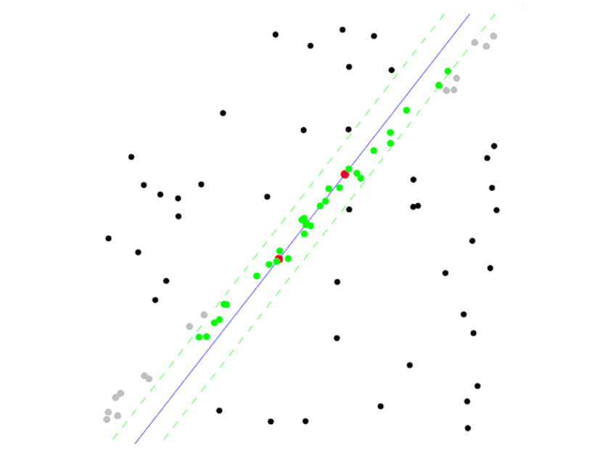
RANSAC pros and cons
Pros
Simple and general
Applicable to many different problems
Often works well in practice
Cons
Lots of parameters to set
Number of iterations grows exponentially as outlier ratio increases
Can’t always get a good initialization of the model based on the minimum number of samples

Slide 18
Incremental RANSAC
To fit many lines to a dataset:
Iterate:
Fit a line with RANSAC using IRLS (crucial!)
Remove inliers from dataset
Q: when to stop?
A:
when you have the right number of lines
when too little data is left
when the last line has few inliers

Slide 19
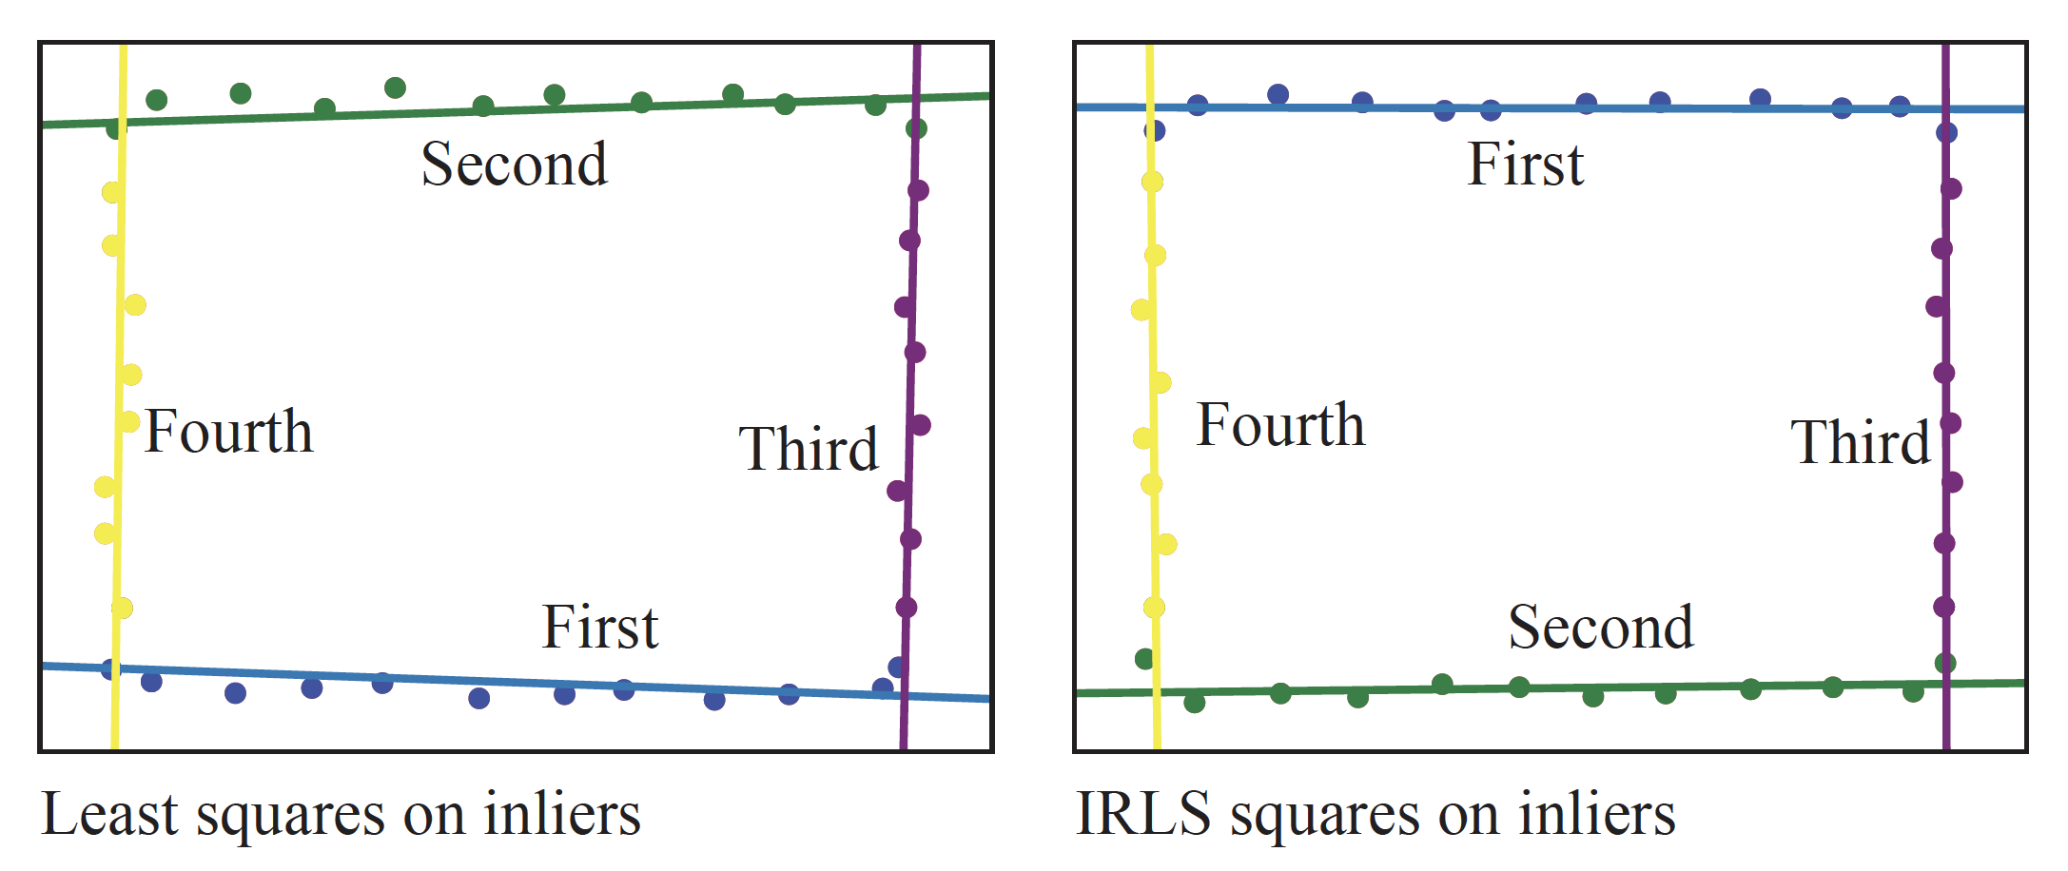
IRLS matters…

Slide 20
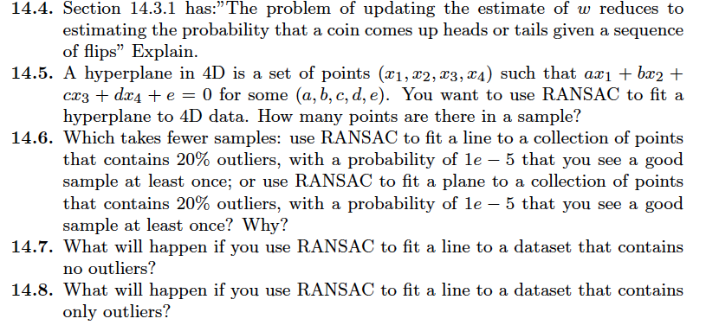
Things to think about...

