Slide 1
Basic registration
D.A. Forsyth
University of Illinois at Urbana Champaign

Slide 2
General frameworks
Register two sets of points
where correspondence is known exactly
eg barcode, etc. reference points
where correspondence is estimated, but quite well
eg two images, interest points
where correspondence might be hard to estimate
but registration is possible
eg two lidar images of about the same stuff

Slide 3
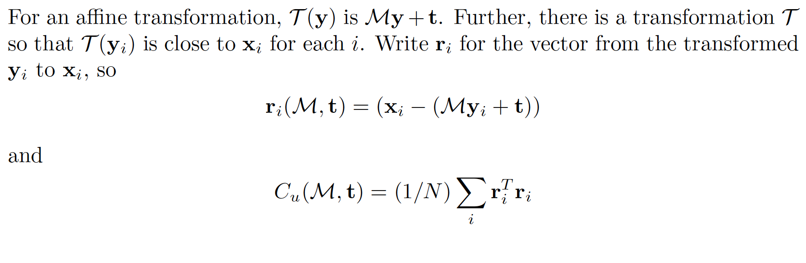
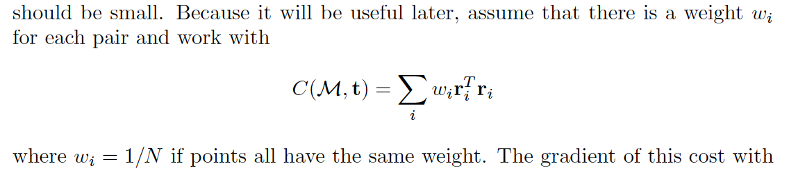
Setup for affine tx

Slide 4
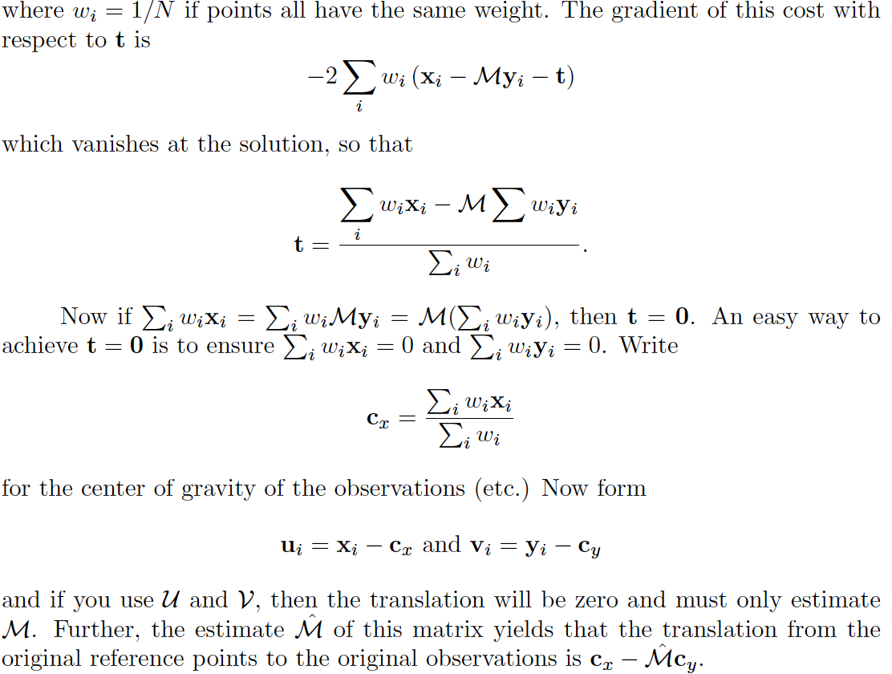
Translation term

Slide 5
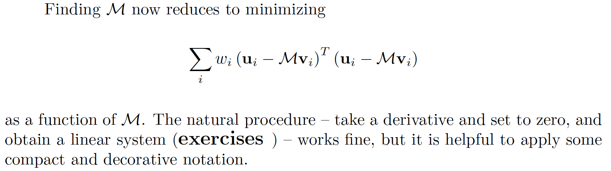
Finding M (compact form)

Slide 6
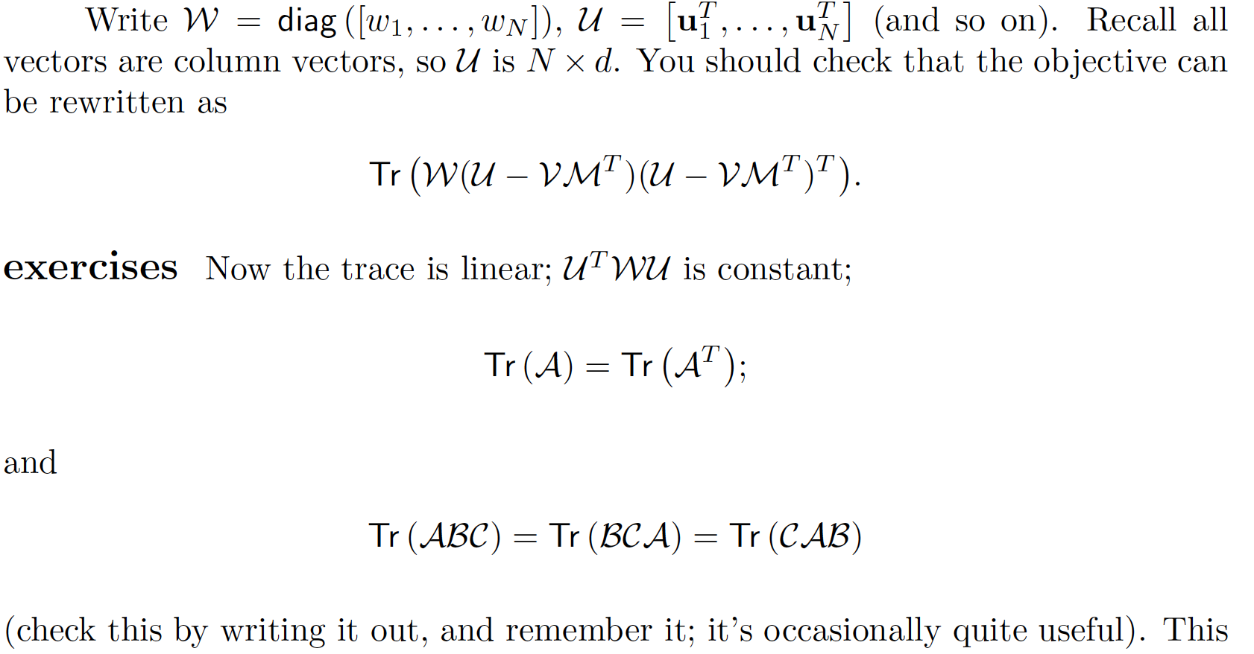
Finding M (long form)

Slide 7
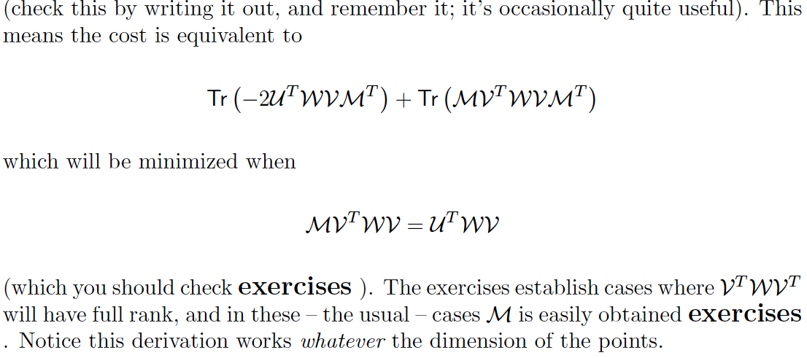
Finding M (long form)

Slide 8
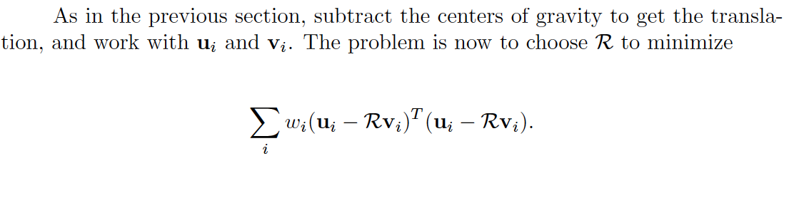
Euclidean motion
Most interesting in 2D or 3D
The matrix is a rotation matrix
You can do this in closed form (not widely known)
Use centers of gravity, as above.

Slide 9
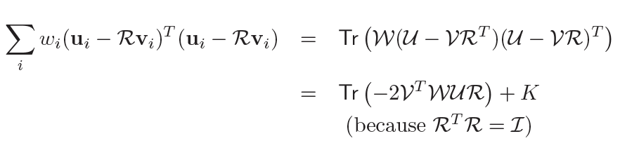
Euclidean motion
Terms not involving R, so of no interest

Slide 10

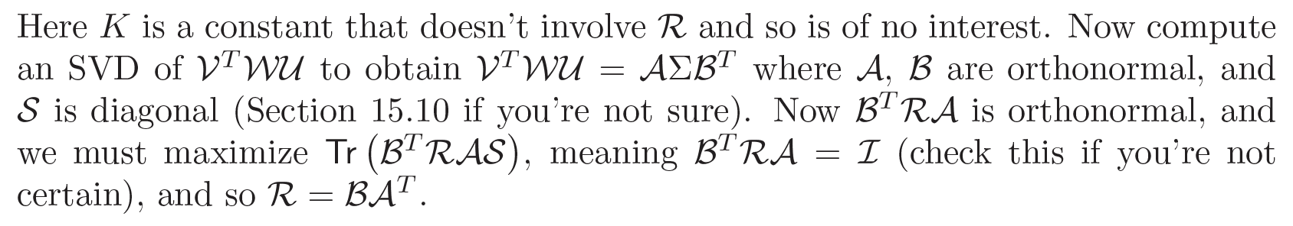
Euclidean motion

Slide 11
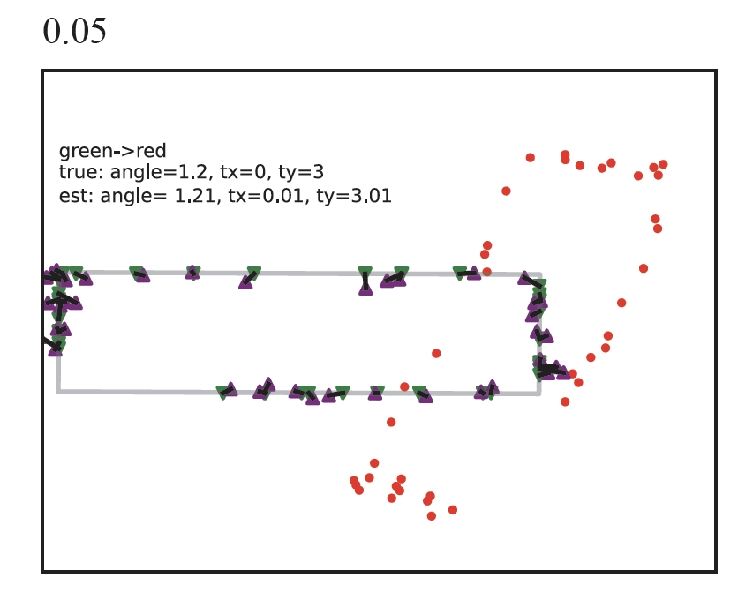
Euclidean est. well behaved under noise
Green triangles – target pts lying on gray rectangle
Red dots – source
(target points transformed, then noise added)
Purple triangles – apply estimated transformation to red points
Gray rectangle – transformation applied to true rectangle underlying red points
Notice:
transformation is about right, not massively disrupted by noise

Slide 12
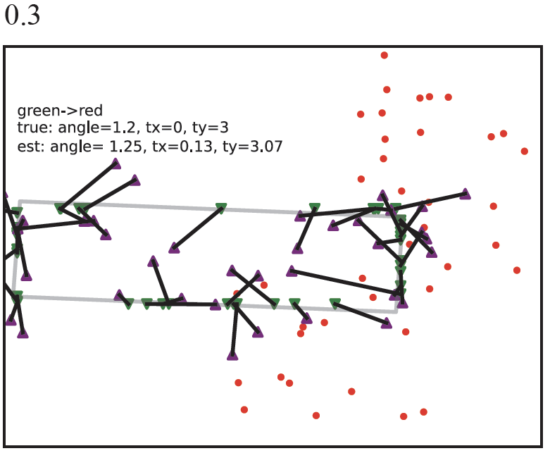
Euclidean est. well behaved under noise
Green triangles – target pts lying on gray rectangle
Red dots – source
(target points transformed, then noise added)
Purple triangles – apply estimated transformation to red points
Gray rectangle – transformation applied to true rectangle underlying red points
Notice:
transformation is about right, not massively disrupted by noise

Slide 13
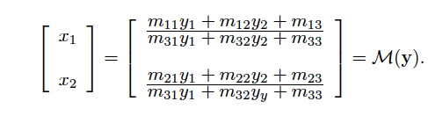
Projective transformations
In 2D

Slide 14
Homographies == Projective tx
The mapping from a pattern on a plane in 3D to a pattern in an image is a projective transformation
This means you can rectify by registration
eg see what you know to be a square in image
use vertices to register
recover pattern

Slide 15
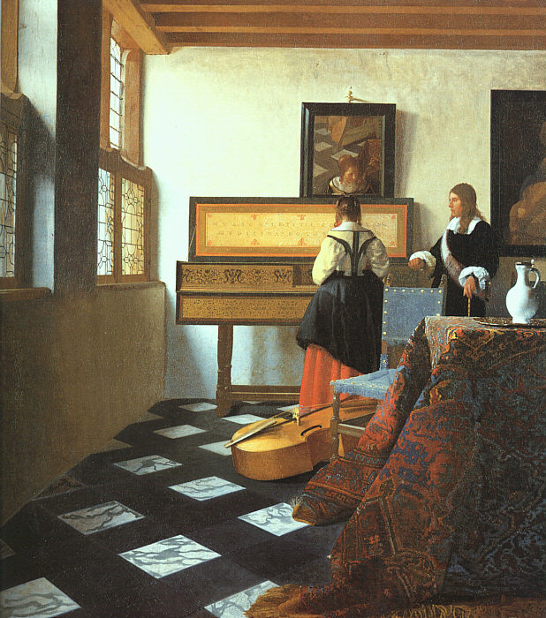
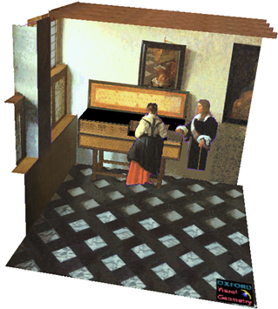
A. Criminisi et al. Bringing Pictorial Space to Life: computer techniques for the analysis of paintings, Proc. Computers and the History of Art, 2002

Slide 16
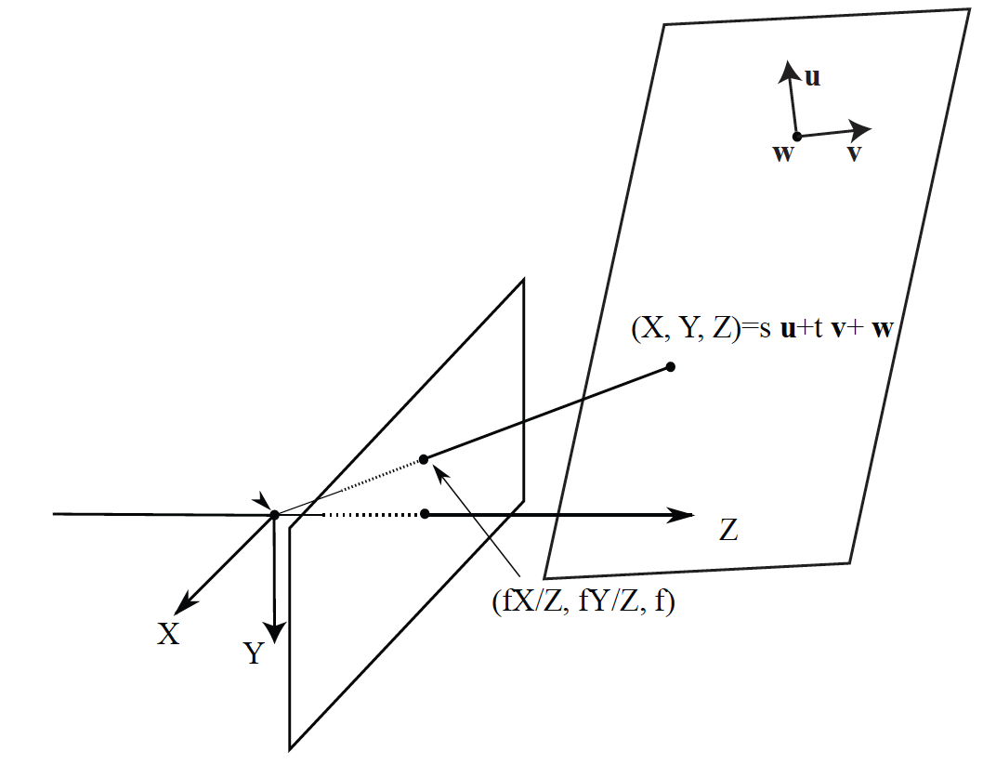
Homographies == Projective tx

Slide 17
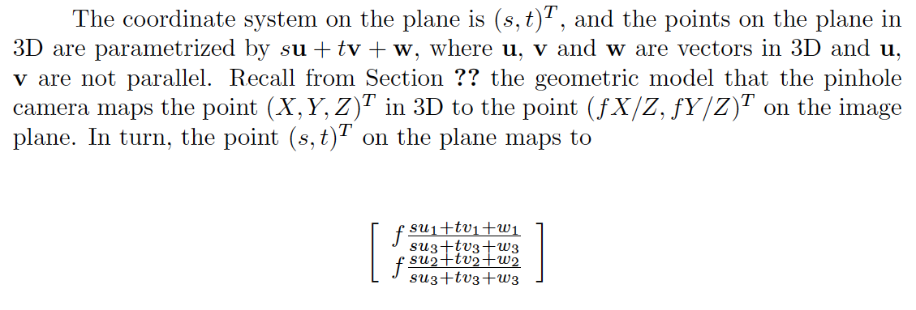
Homographies == Projective tx

Slide 18
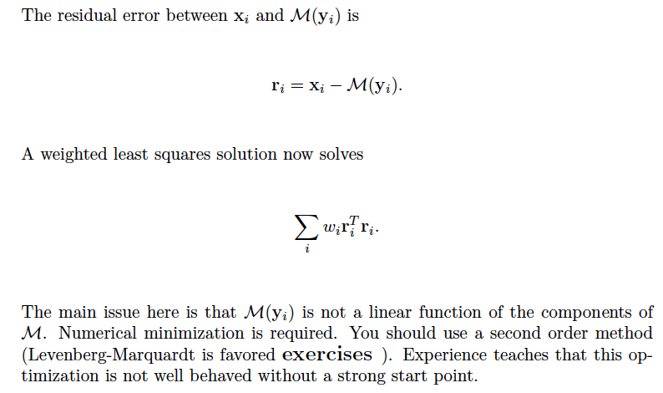
Minimizing the residual

Slide 19
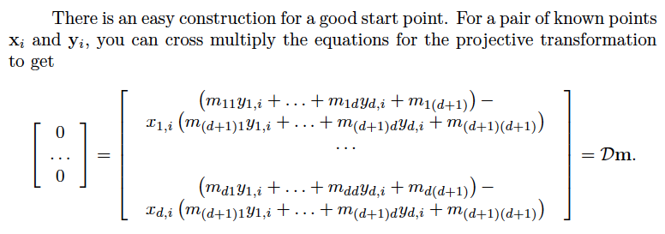
Getting a start point

Slide 20
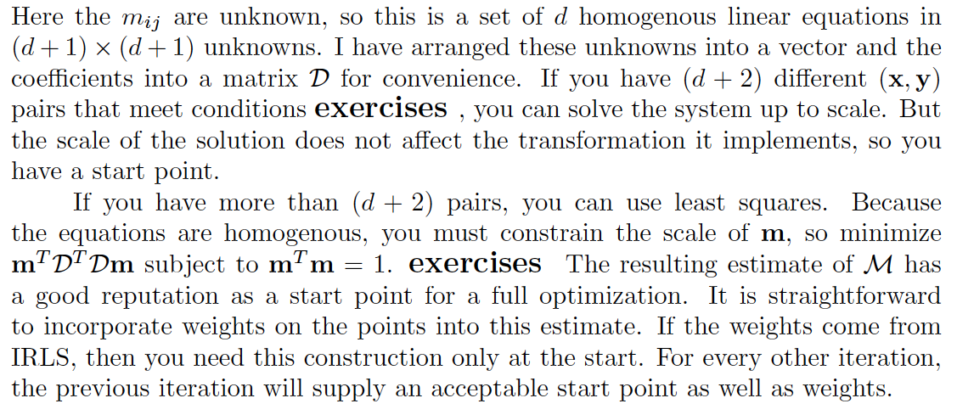
Getting a start point

Slide 21
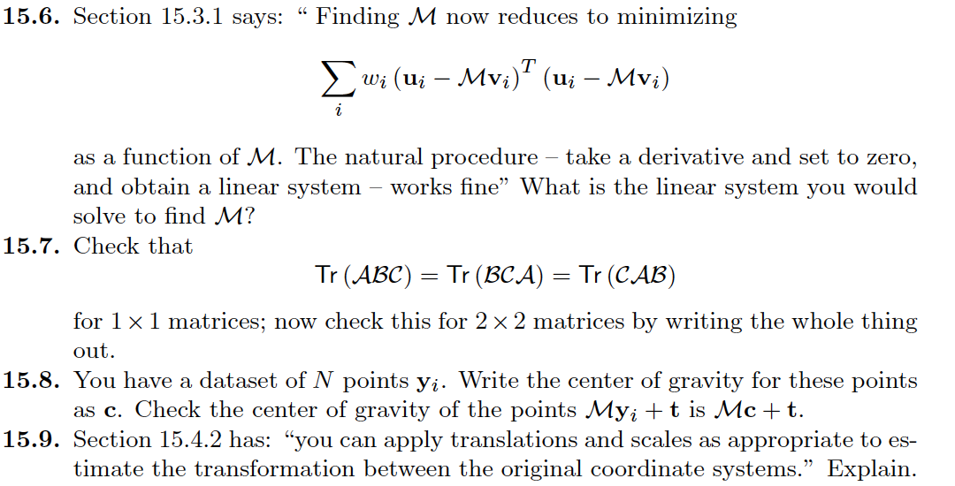
Things to think about...

