Slide 1
Robust line fitting with IRLS
D.A. Forsyth,
University of Illinois at Urbana Champaign

Slide 2
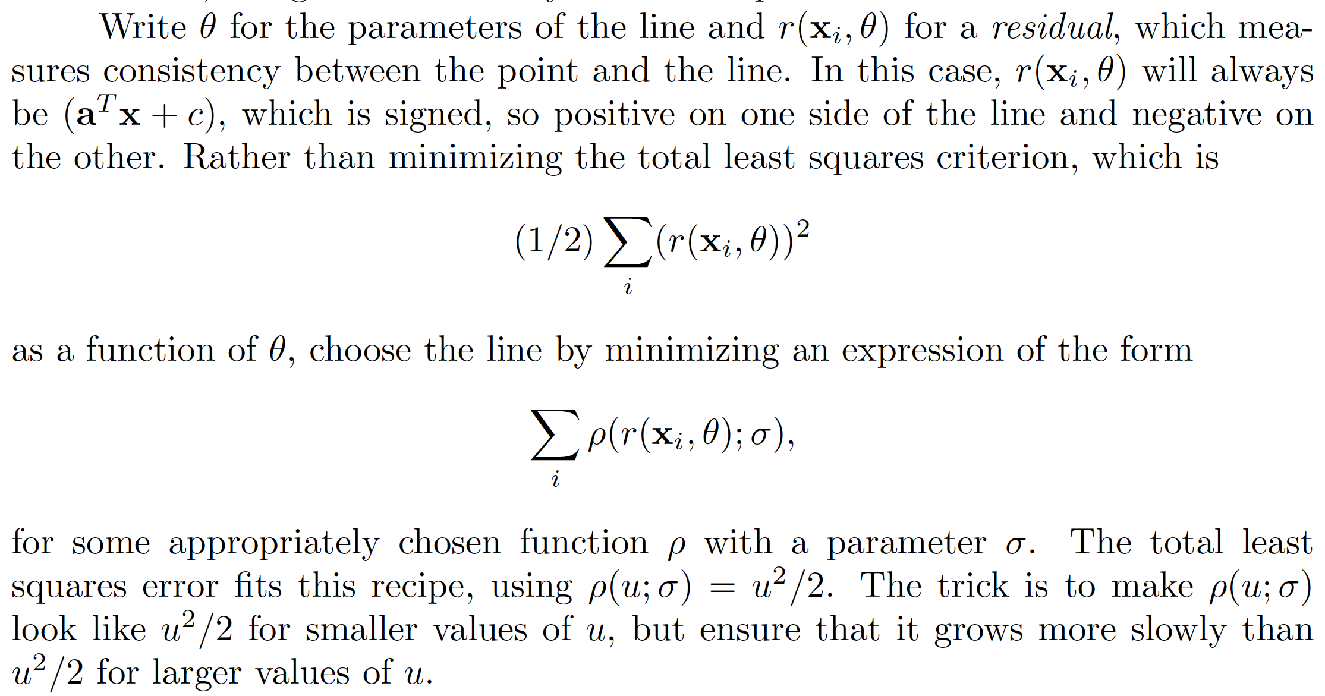
Robust estimators

Slide 3
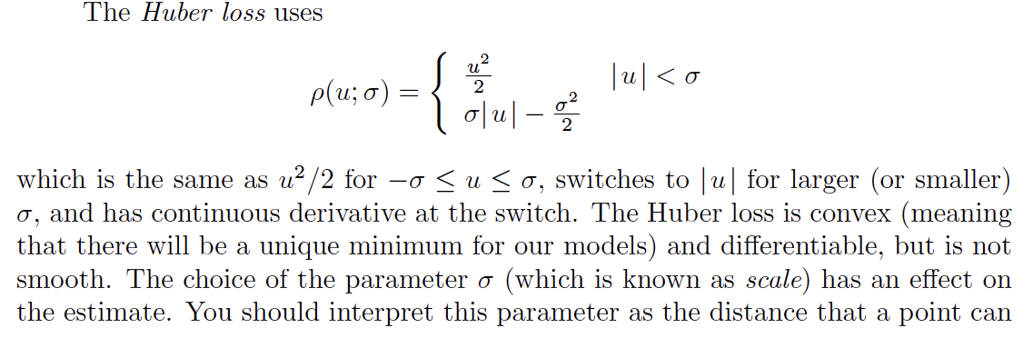
The Huber loss
Scale

Slide 4
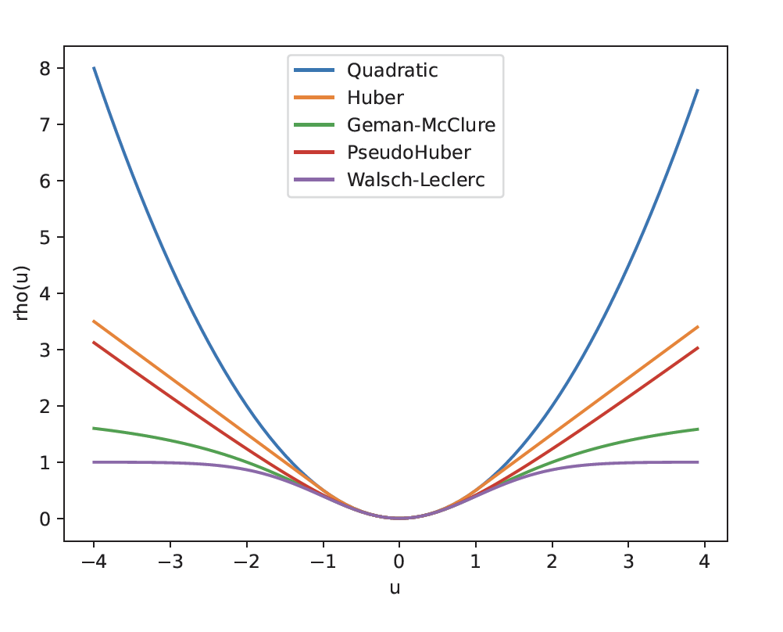
Robust estimators

Slide 5
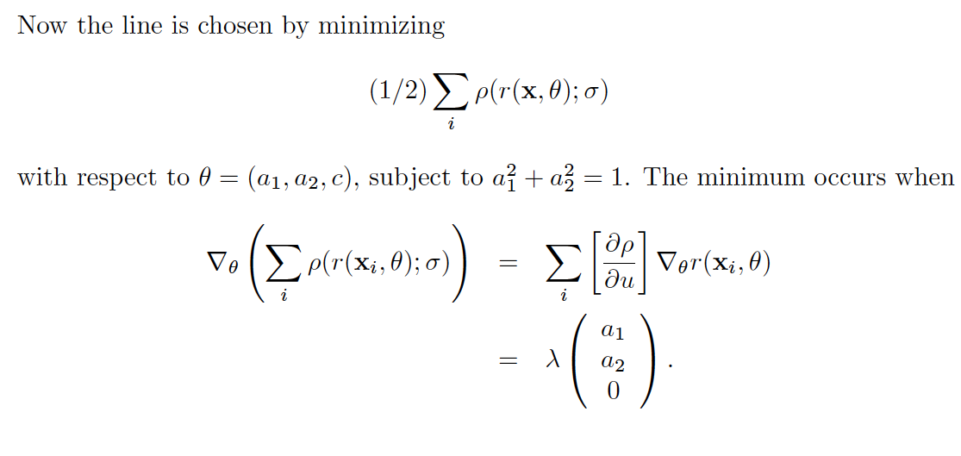
Finding the line

Slide 6
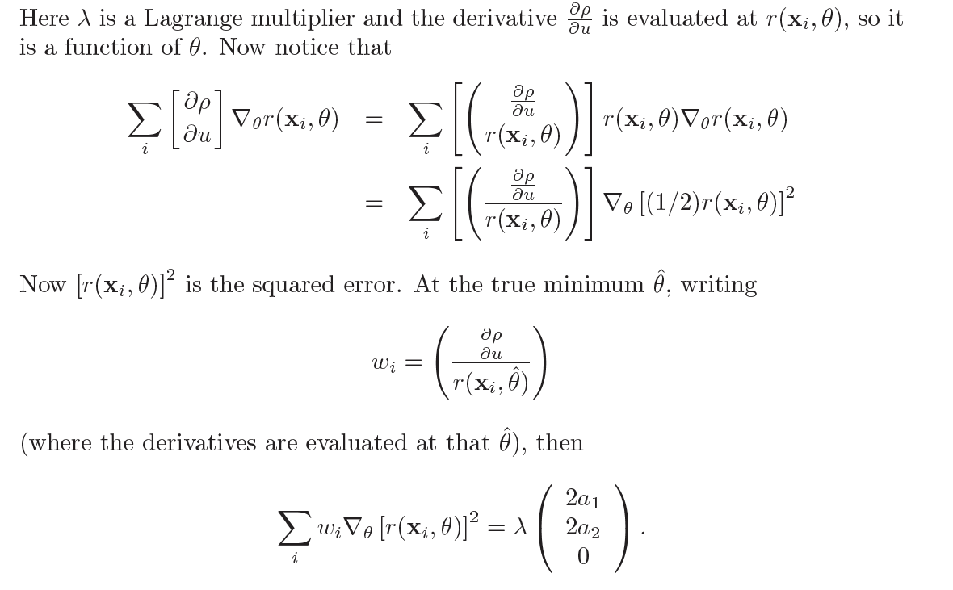
Finding the line - II

Slide 7
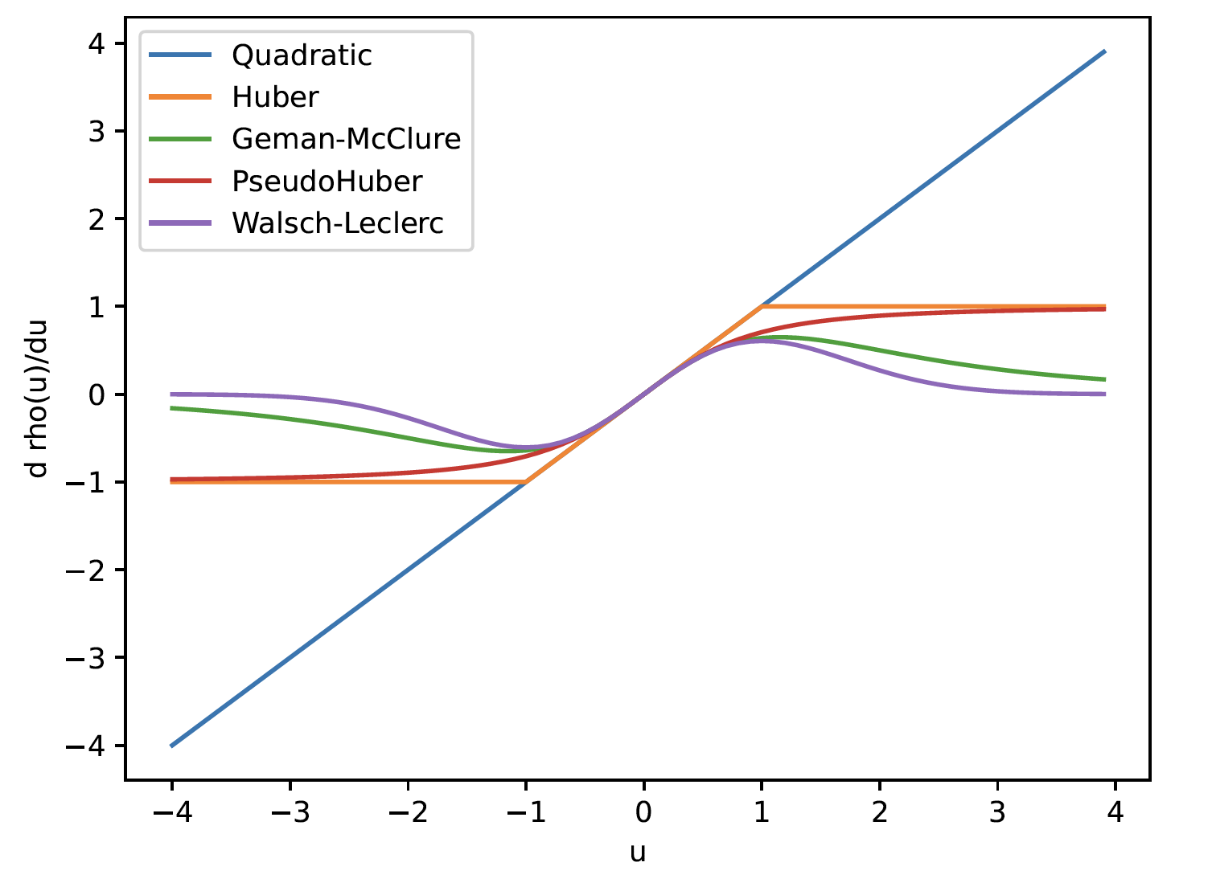
Influence functions

Slide 8
Idea – iteratively reweighted least squares
Start with initial line
  get weights, scale from line
Iterate:
  estimate line using weights, scale
  estimate scale using line
  estimate weights using scale, line
We *know* that one stationary point is the true minimum
No other guarantees I’m aware of, but quite well behaved

Slide 9
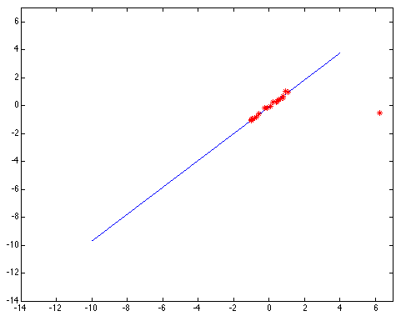
Choosing the scale: Just right
The effect of the outlier is minimized
Notes:
Fit to earlier data with an appropriate choice of s

Slide 10
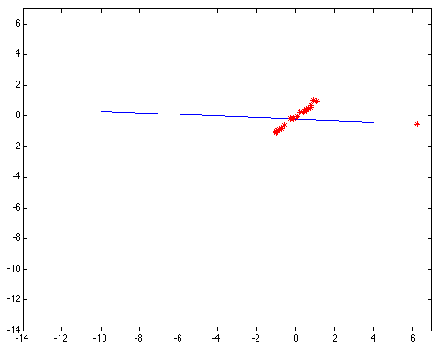
Choosing the scale: Too small
The error value is almost the same for every
point and the fit is very poor

Slide 11
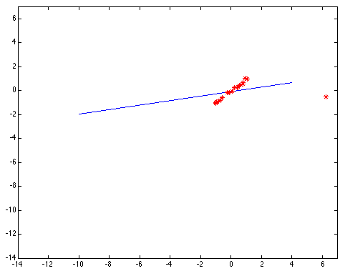
Choosing the scale: Too large
Behaves much the same as least squares

Slide 12
Starting IRLS
Iterate:
  Initial line:
    Draw two points at random from dataset
    Pass line through them
  Fit line with IRLS
Use the best you encounter

Slide 13
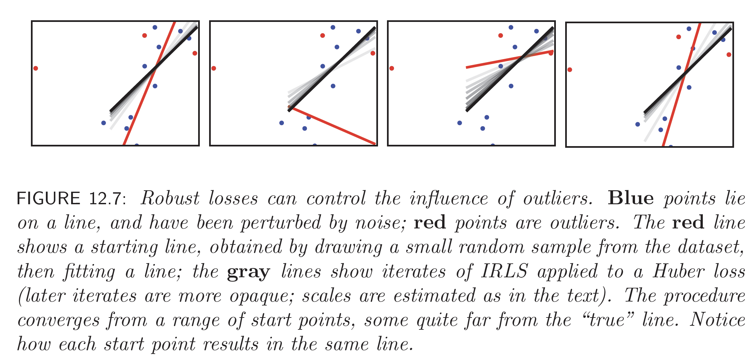
IRLS

Slide 14
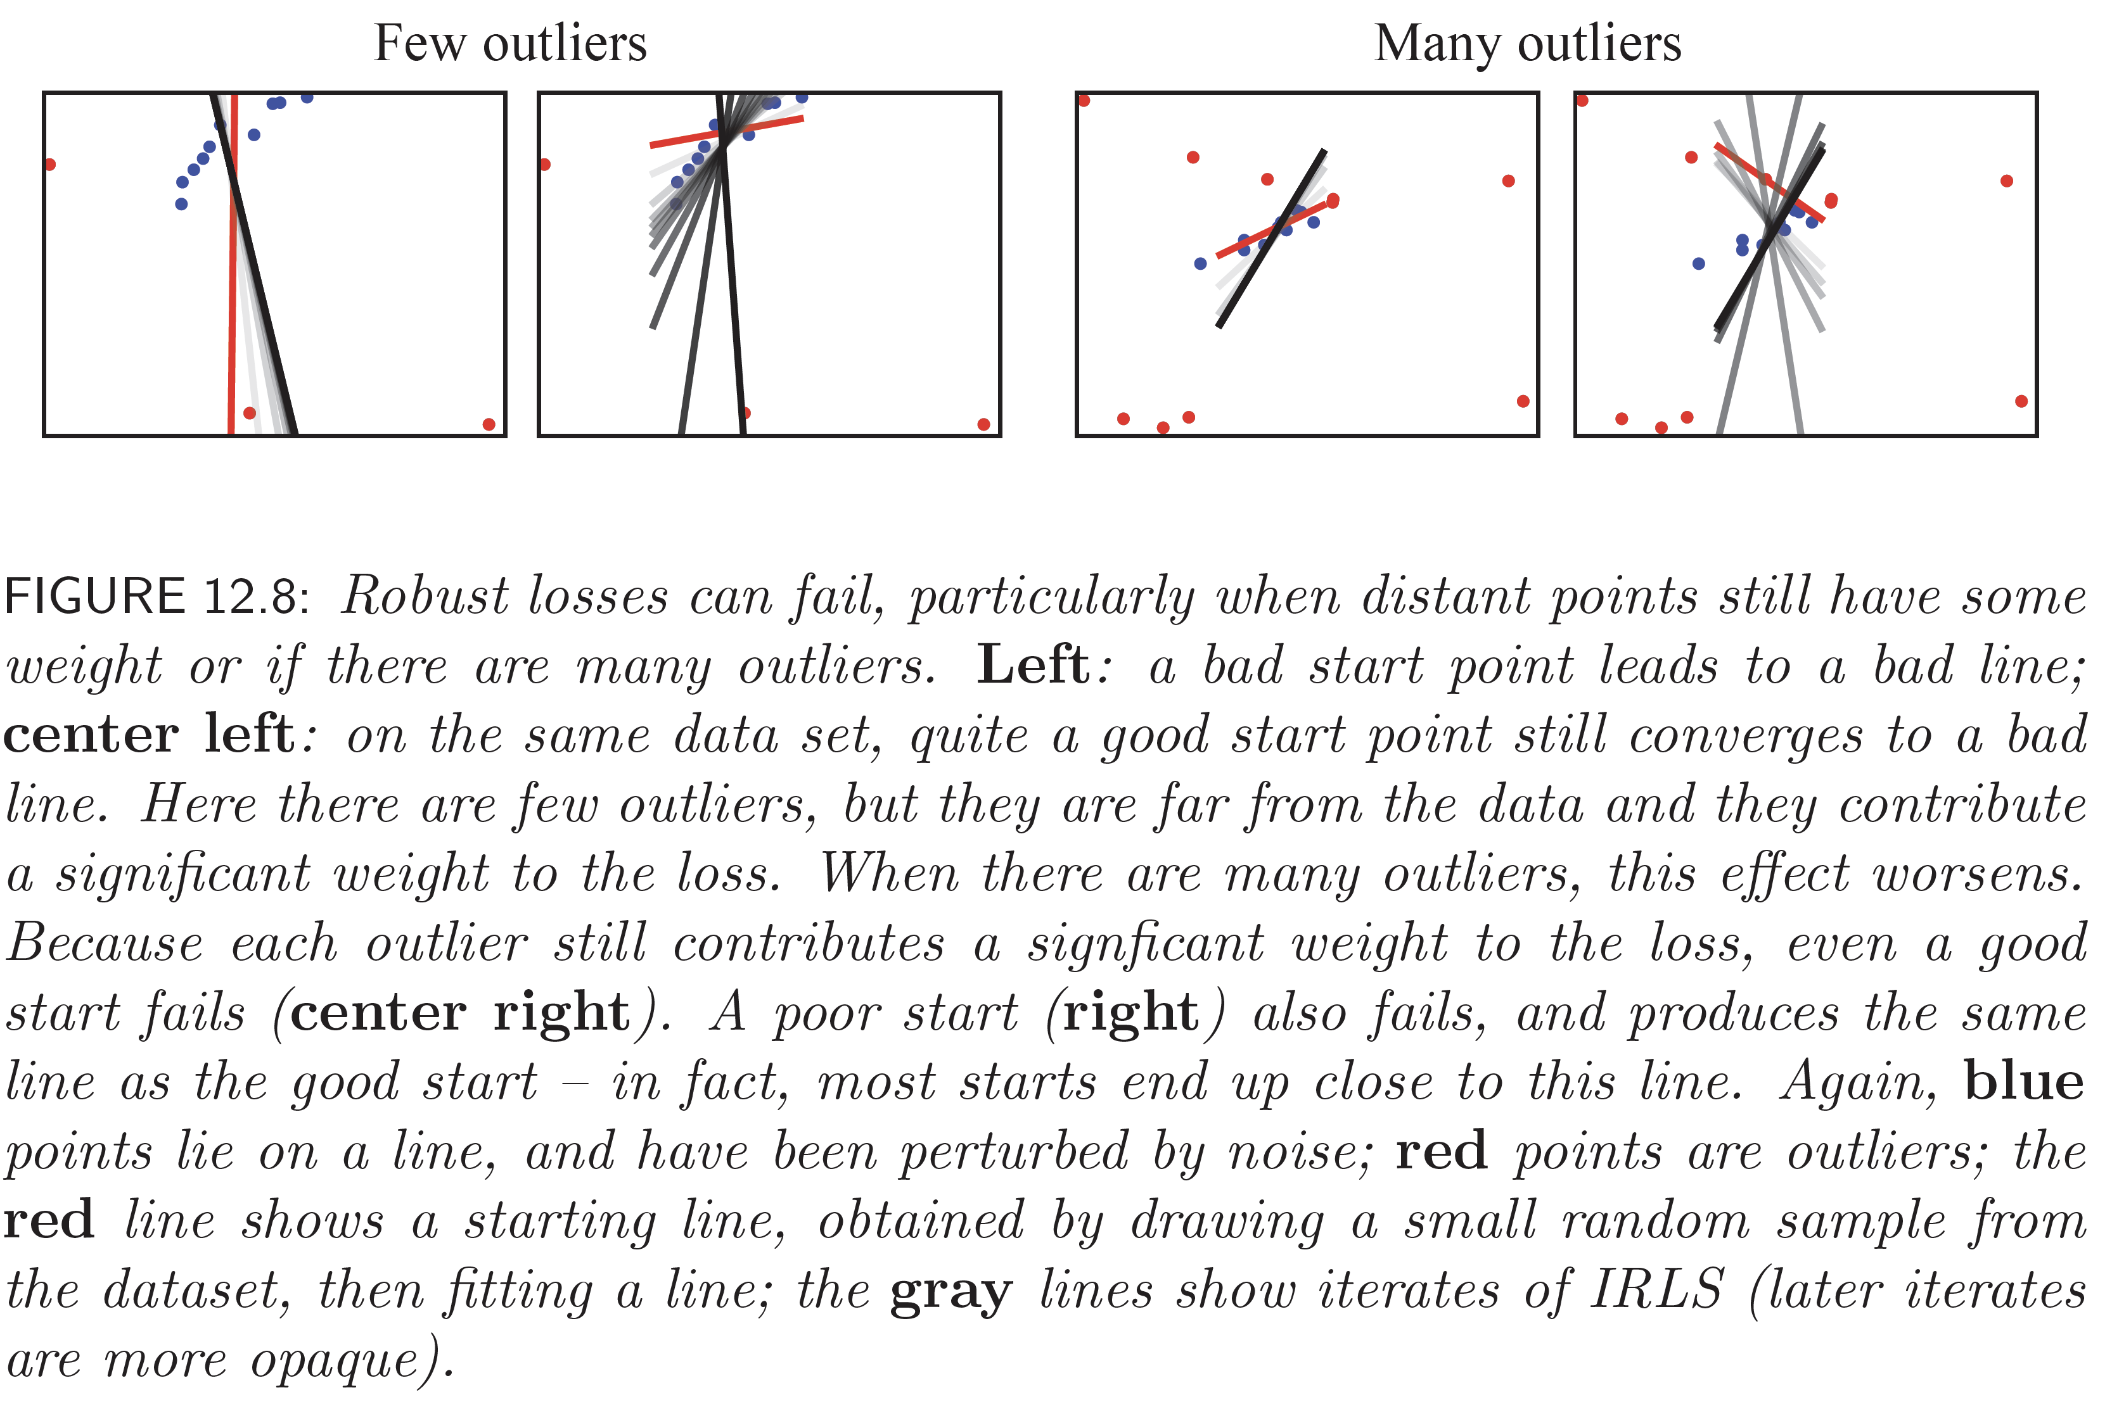
IRLS isn’t perfect…

Slide 15
Things to think about...

