Slide 1
Robust registration with IRLS and RANSAC
D.A. Forsyth
University of Illinois at Urbana Champaign

Slide 2
General frameworks
Register two sets of points
where correspondence is known exactly
eg barcode, etc. reference points
where correspondence is estimated, but quite well
eg two images, interest points
where correspondence might be hard to estimate
but registration is possible
eg two lidar images of about the same stuff

Slide 3
Application: image mosaics
Find interest points in image A and image B
Build correspondences:
For each a in A find best matching b in B using descriptor
For each b in B find best matching a in A using descriptor
For consistent pairs, if descriptors are sufficiently similar
declare correspondence
Notice: you should get many correspondences BUT some are wrong

Slide 4
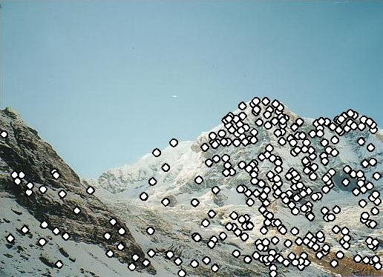
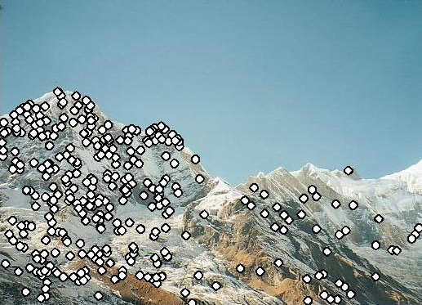
Recall…

Slide 5
General remarks
Very like line fitting and line fitting recipes apply
The objects we are working with are now corresponding pairs
(point in A, point in B)
Outliers are usually correspondences that are wrong
there could be lots

Slide 6
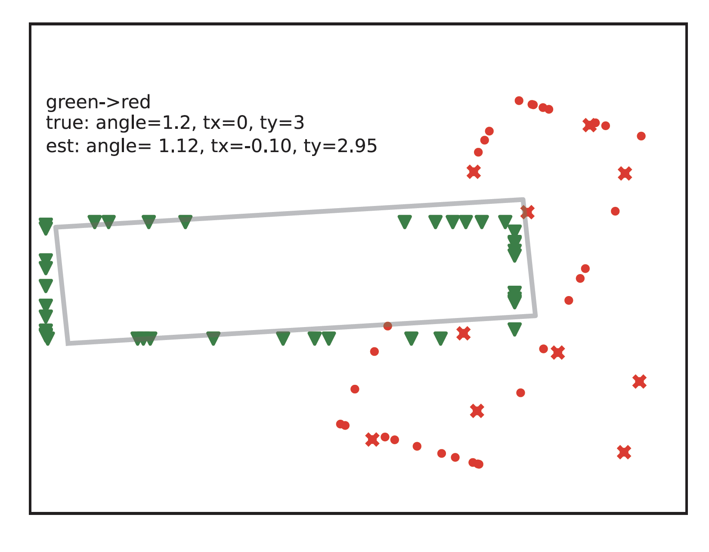
Outliers affect least squares
Green triangles – target pts lying on gray rectangle
Red dots – source
(target points transformed, then noise added)
Red x – outliers on source
Gray rectangle – transformation applied to true rectangle underlying red points
Notice:
transformation is disrupted by outliers

Slide 7
IRLS
Start with initial transformation
get weights, scale from transformation
Iterate:
estimate transformation using weights, scale
estimate scale using transformation
estimate weights using scale, transformation
We *know* that one stationary point is the true minimum
No other guarantees I’m aware of, but quite well behaved

Slide 8
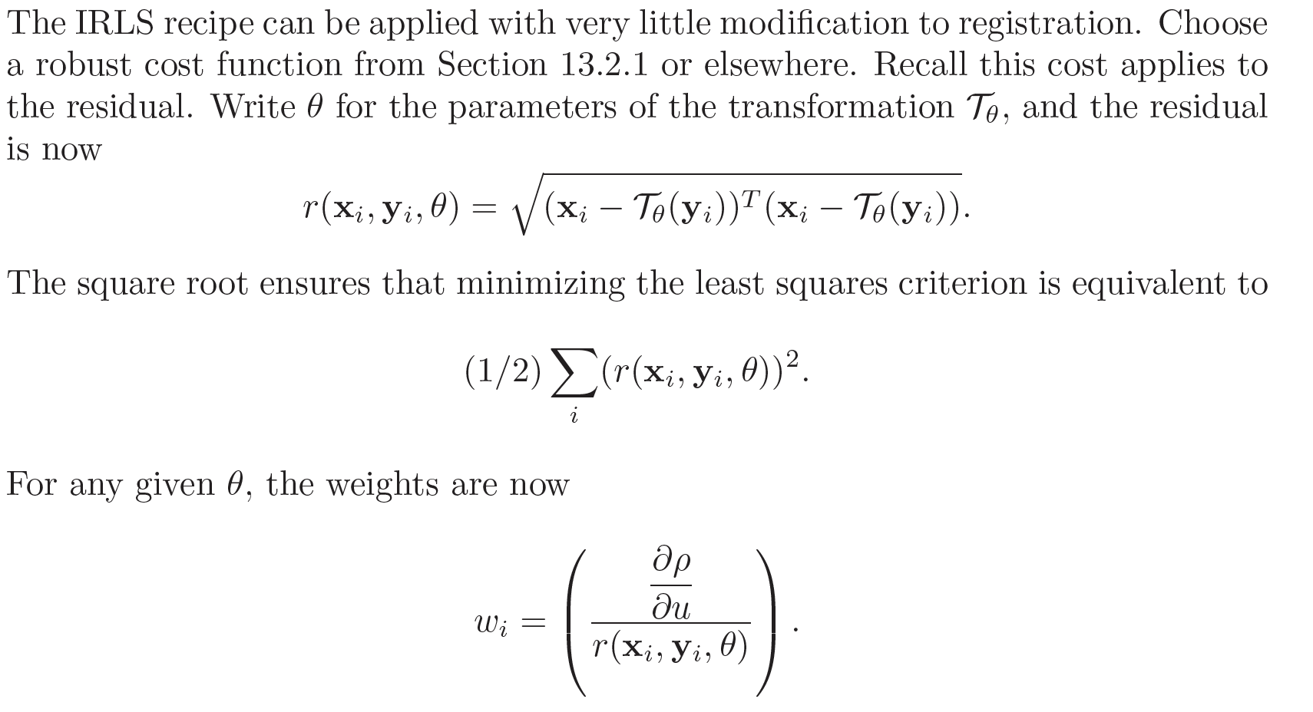
IRLS applies

Slide 9
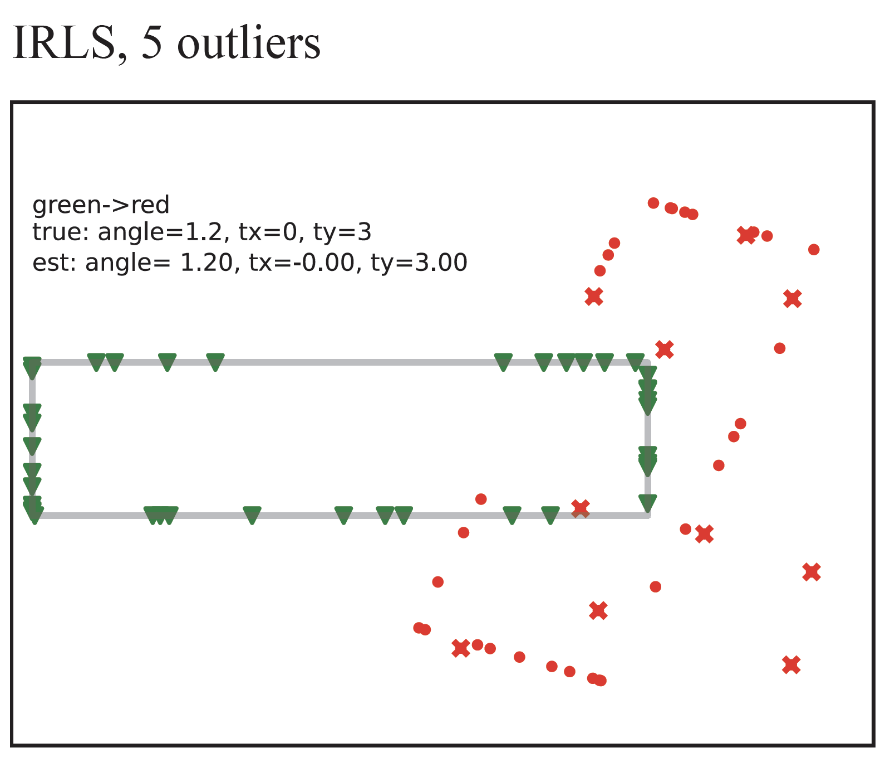
IRLS handles few outliers
Green triangles – target pts lying on gray rectangle
Red dots – source
(target points transformed, then noise added)
Red x – outliers on source
Gray rectangle – transformation applied to true rectangle underlying red points
Notice:
transformation is NOT disrupted by outliers

Slide 10
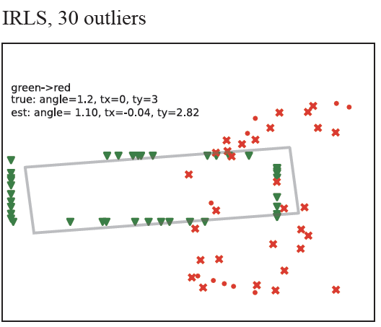
IRLS can’t do many outliers
Green triangles – target pts lying on gray rectangle
Red dots – source
(target points transformed, then noise added)
Red x – outliers on source
Gray rectangle – transformation applied to true rectangle underlying red points
Notice:
transformation IS
disrupted by outliers

Slide 11
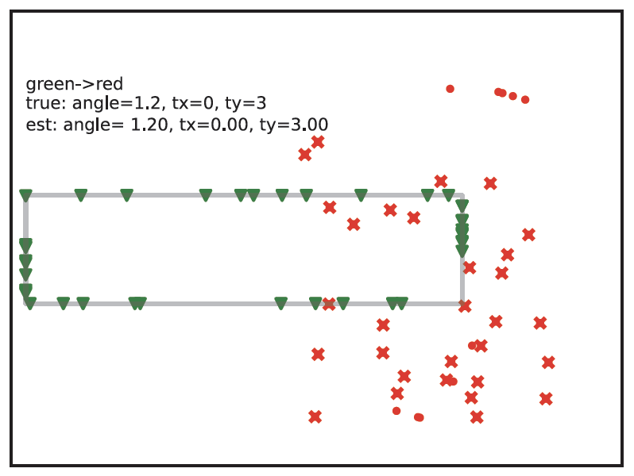
RANSAC to the rescue
Green triangles – target pts lying on gray rectangle
Red dots – source
(target points transformed, then noise added)
Red x – outliers on source
Gray rectangle – transformation applied to true rectangle underlying red points
Notice:
transformation IS
disrupted by outliers

Slide 12
RANSAC
Affine transformation:
d+1 correspondences in d dim
Projective transformation:
d+2 correspondences in d dim
Euclidean:
use 2 for plane (2D)
use 3 for 3D
BUT some such are obvious outliers
Key Issue: there can be a lot of outliers

Slide 13
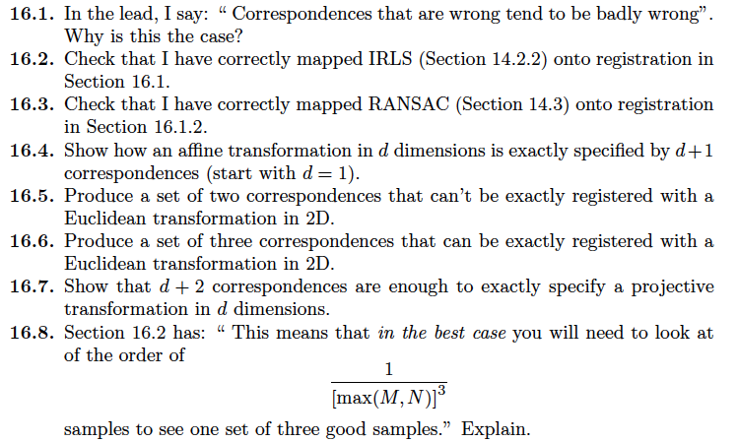
Think about this...

