Slide 1
Tracking by Detection
D.A. Forsyth
University of Illinois at Urbana-Champaign

Slide 2
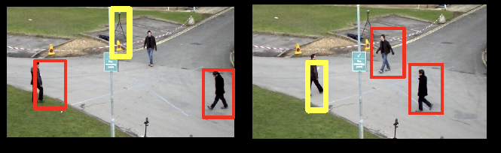
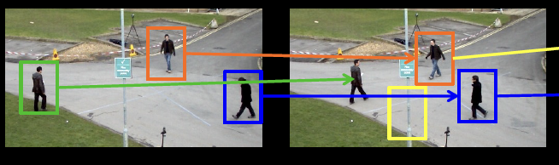
Multi-object tracking

Slide 3
Tracking – Why?
Motion capture
build models of moving people from video
Recognition from motion
eg cyclists move differently than runners
Surveillance
who is doing what?
for security (eg keep people out of sensitive areas in airports)
for HCI (eg kinect, eyetoy, etc.)

Slide 4
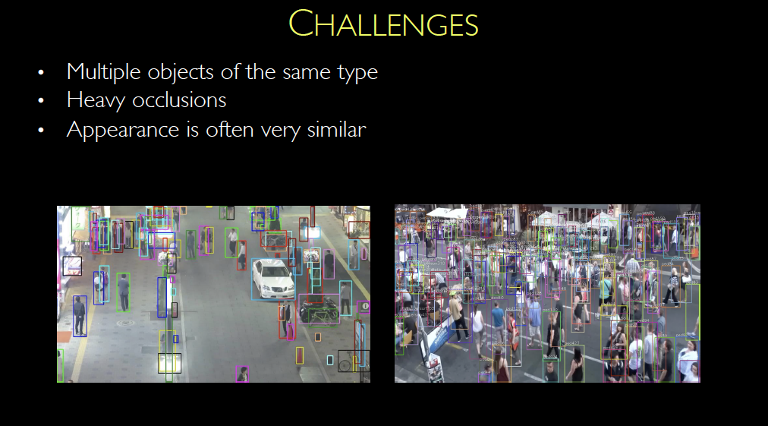
Multiple slides lifted from L. Leal-Taixe’s slides at ICVSS 2022

Slide 5
Tracking - What
Establish state of object using time sequence
state could be:
position; position+velocity; position+velocity+acceleration
or more complex, eg all joint angles for a person
Biggest problem -- Data Association
which image pixels are informative, which are not?
Key ideas
Tracking by detection
if we know what an object looks like, that selects the pixels to use
Tracking through flow
if we know how an object moves, that selects the pixels to use

Slide 6
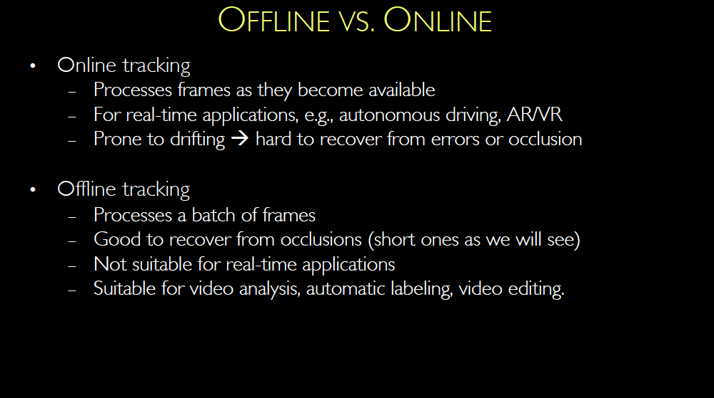

Slide 7
Tracking by detection
Assume
a reliable detector
detections that are well spaced in images
(or have distinctive properties)
e.g. news anchors; heads in public
Link detects across time
weighted bipartite matching
Image i
Image i+1

Slide 8
Point tracks reveal public behaviour
Yan+Forsyth, 04

Slide 9
Some detections might fail…
Match measurements to abstract “tracks”
Strategy
detect in each frame
link detects to tracks using matching algorithm
measurements with no track? create new track
tracks with no measurement? wait, then reap
(perhaps) join tracks over time with global considerations
Link detects to tracks

Slide 11
TBD (to date)
Questions:
can we use dynamics to simplify matching?
how do we represent similarity?

Slide 12
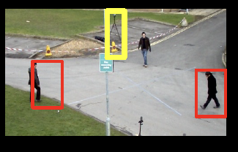
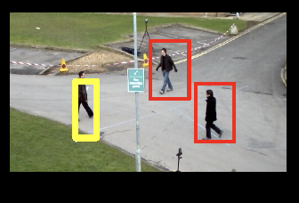
Recall Kalman Filter story
Have:
Mean and covariance of posterior
after i-1’th measurement
Construct:
This predicts where
Boxes might be in
Next frame
Mean and covariance of predictive
distribution just before i’th measurement
Measurement arrives:
Now construct:
Mean and covariance of posterior
distribution just after i’th measurement
posterior mean is weighted combo
of prior mean and measurement

Slide 13
Attaching a Kalman filter
Use filter to represent, update tracks
one filter to manage state for each track
Associate measurements to tracks with WBM
Now update filter
usually, a constant velocity model is enough
sometimes, velocity is zero and noise is large

Slide 14
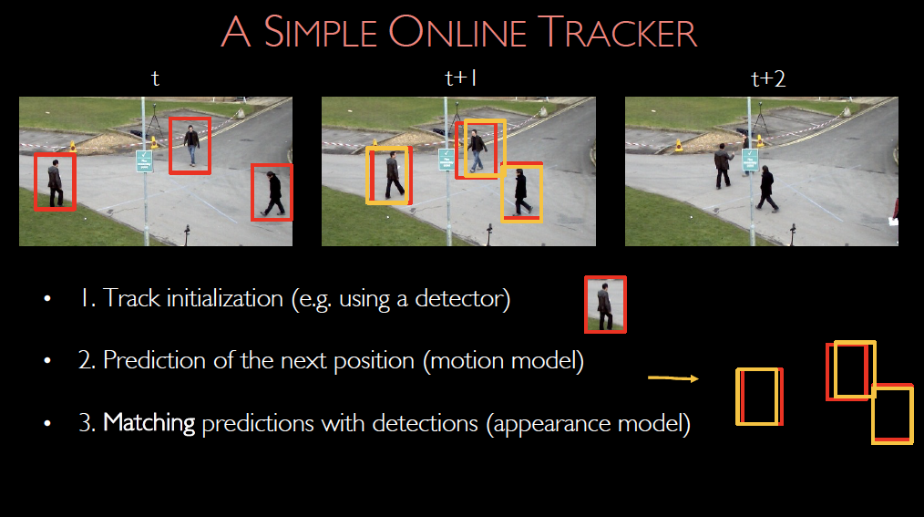

Slide 15
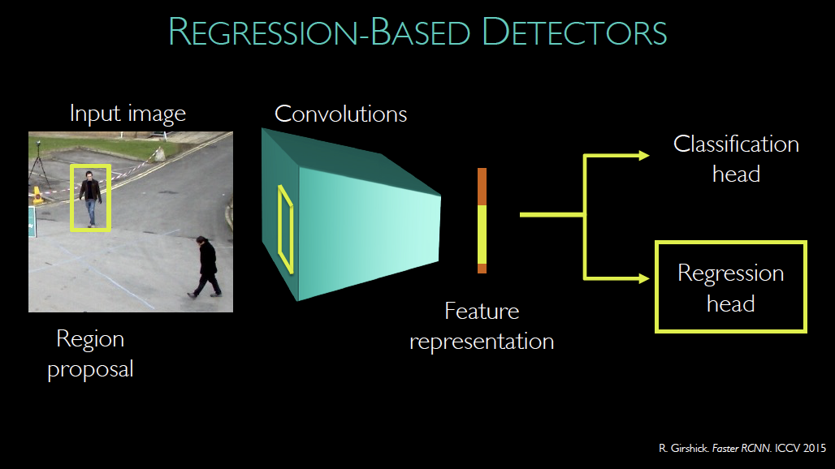
Recall Faster RCNN

Slide 16
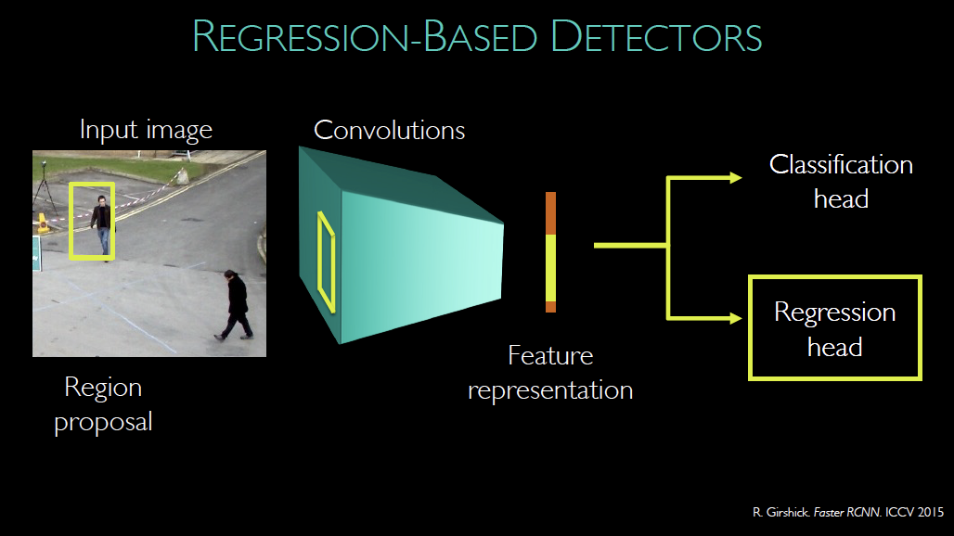

Slide 17


Slide 18
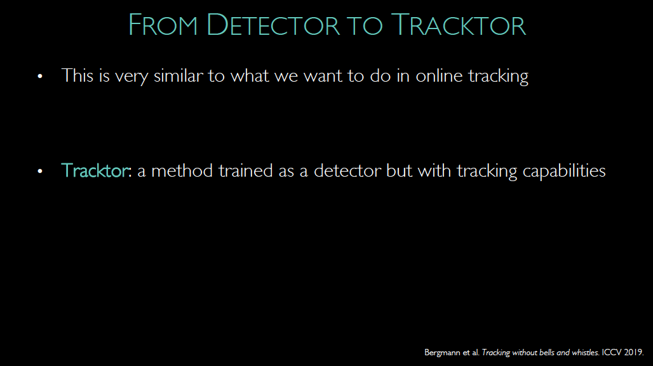

Slide 20
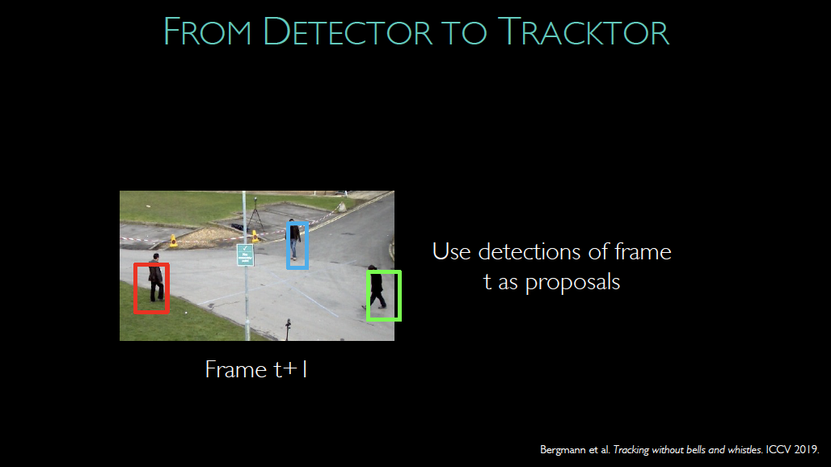

Slide 21
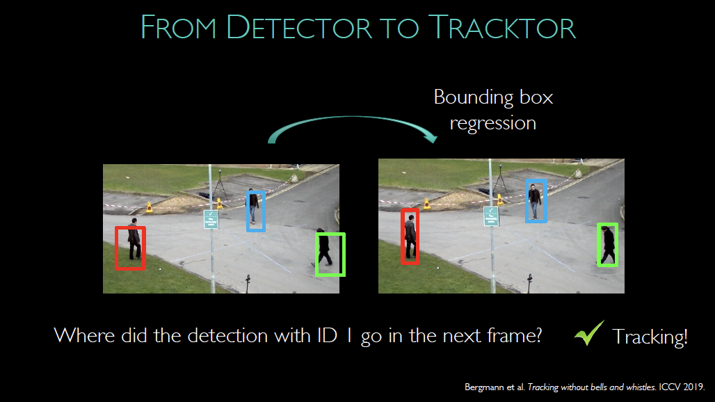

Slide 22
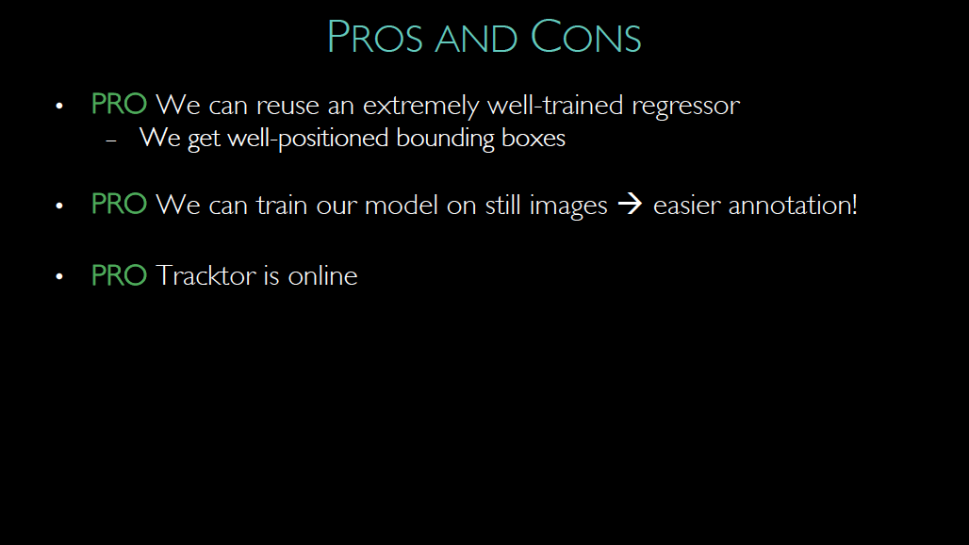

Slide 23
