Slide 1
Transformers
D.A. Forsyth,
University of Illinois at Urbana Champaign

Slide 2
Transformers
Originally an NLP idea
Transformers map streams of tokens to streams of tokens
  Tokens come in
  Tokens interact
    various forms of attention
      attention, self attention, multi-headed self-attention, etc.
  Tokens go out
    to various kinds of decoder

Slide 3
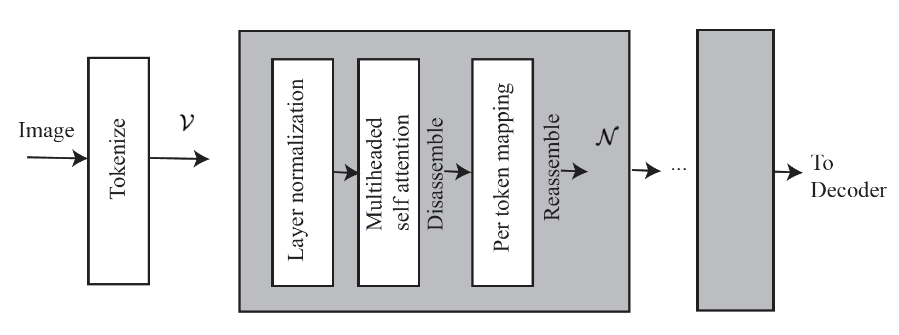
Tokenizing
Work with images of fixed size
  Fixed size token stream simplifies, but isn’t mandatory
Tokenize by:
  cut into pxp non-overlapping patches
    on fixed grid
  scan in fixed order
  straighten each into (3 p^2) x 1 vector
  apply learnable linear operator
    which could be convolution
  attach learnable positional encoding
    different for each grid location
      to get ((3 p^2)+e_p) x 1 vector
  attach one more, learnable, token

Slide 4
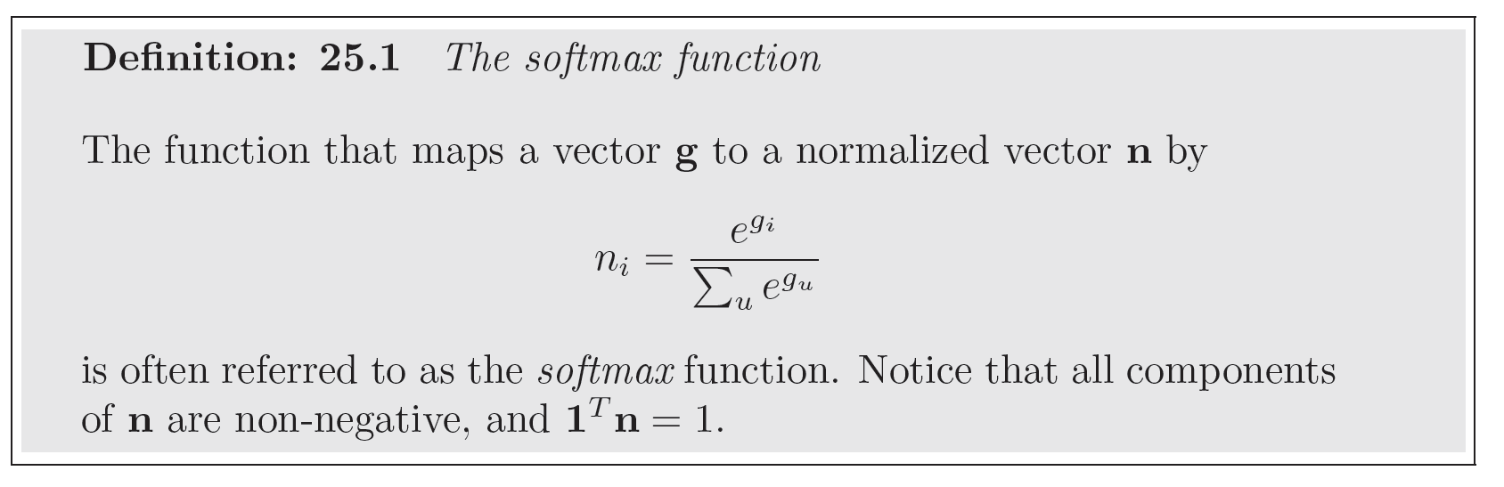
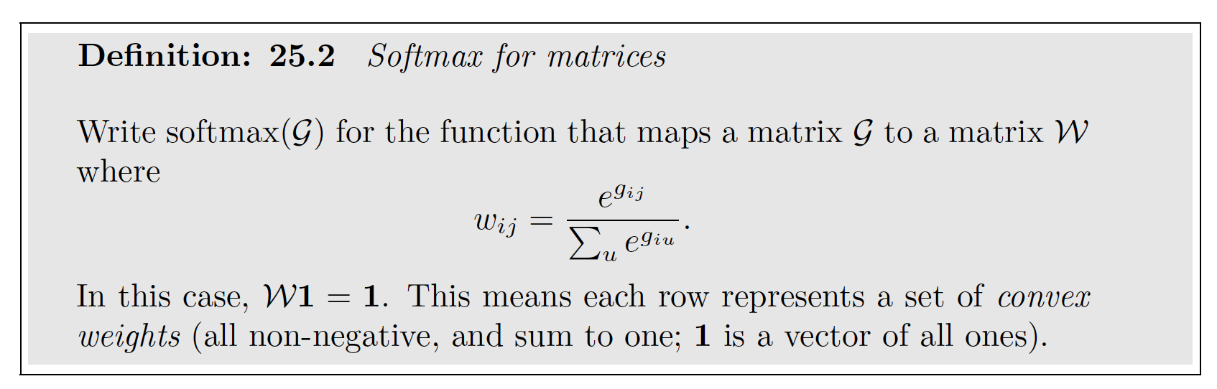
Softmax

Slide 6
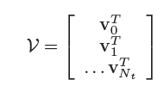
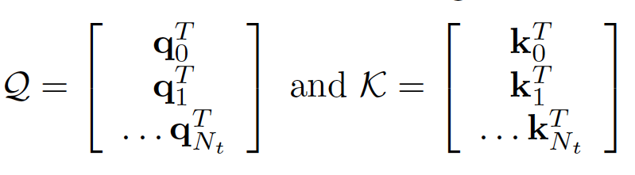
Tokens, keys and queries
Tokens
  e_t dimensional vectors
  stack into matrix
Keys and Queries
  d_k dimensional vectors
    There are N_t+1 of them
      there are a variety of places they could come from
  Stack into matrices

Slide 7
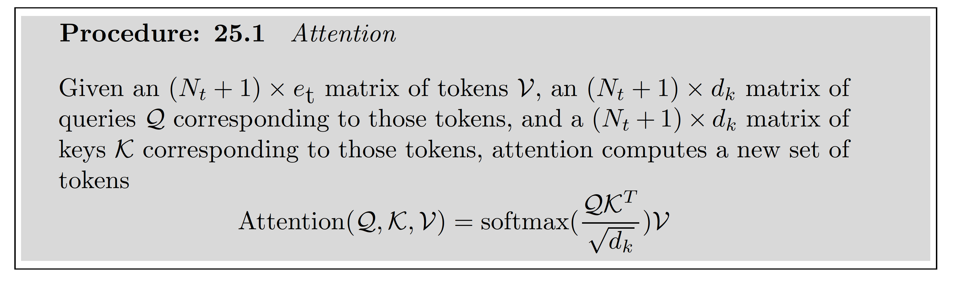
Attention
This is an N_t+1 x N_t+1 non-negative matrix.
Rows sum to one.

Slide 8
Attention
Result is an N_t+1 x e_t matrix - another matrix of tokens.
Each new token has received a contribution from all others.
Contributions are larger when key and query are similar, smaller when they
are different.

Slide 9
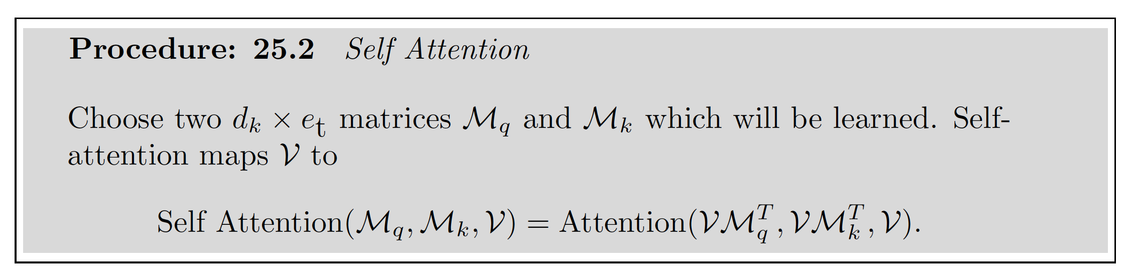
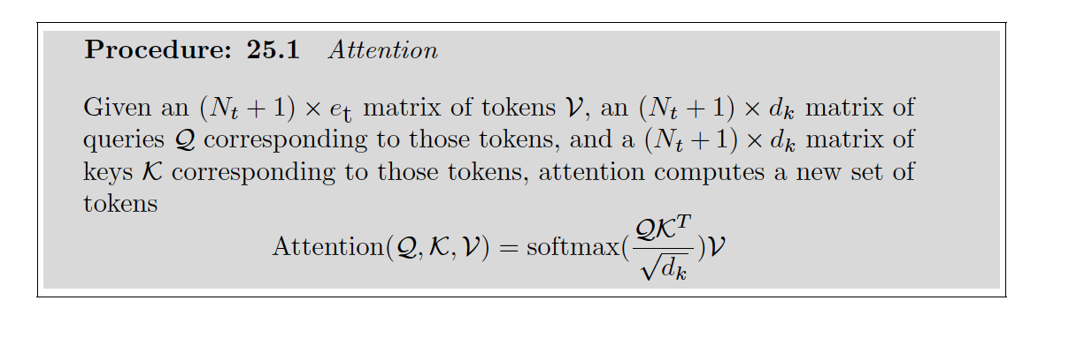
Self-attention

