Slide 1
Upsampling images
D.A. Forsyth,
University of Illinois at Urbana Champaign

Slide 2
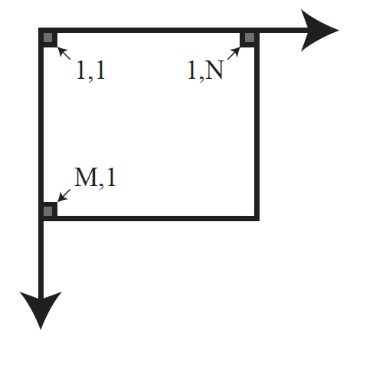
Key idea
Sampled images have values on an integer grid
We know
  I_{1, 1}, I_{1, 2} and so on
  First coordinate runs 1...M, second 1..N

Slide 3
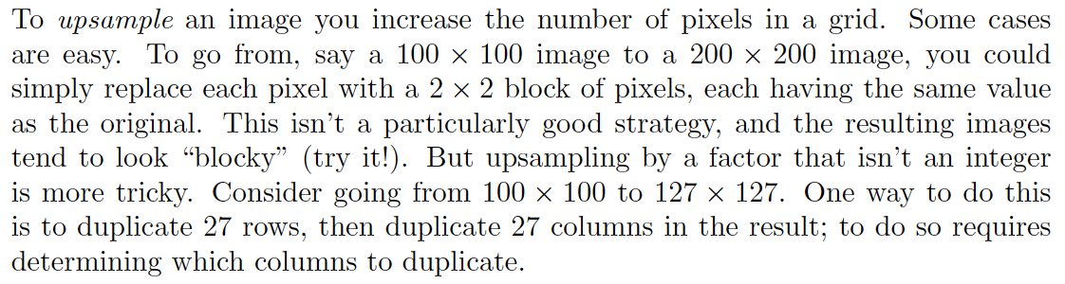
The simplest strategies ...
Big issue:
  what is the value of a pixel at a non-integer location?

Slide 4
Forward warping
Scan the source image S and place each pixel in appropriate location in the target image T
BUT
  if you’re upsampling, there will be holes!
    actually, mostly holes
Never do this
  or hardly ever; there may be some cases...

Slide 5
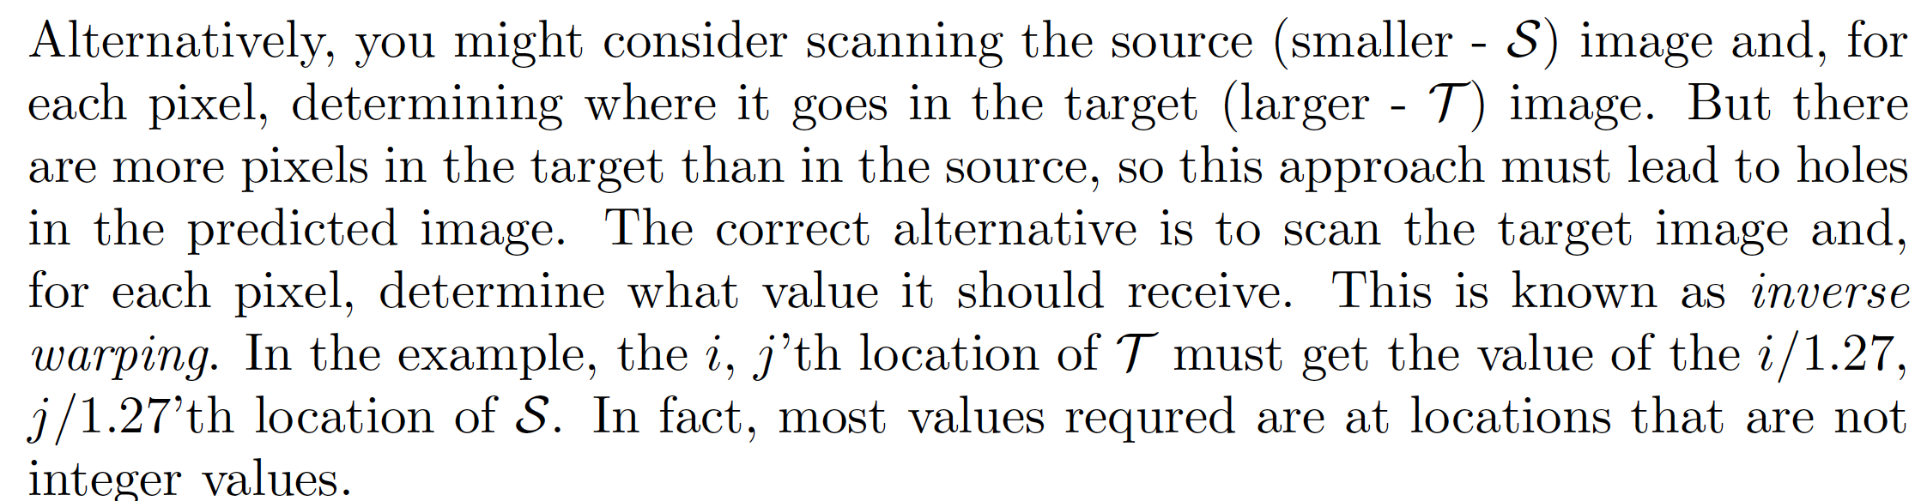
Inverse warping

Slide 6
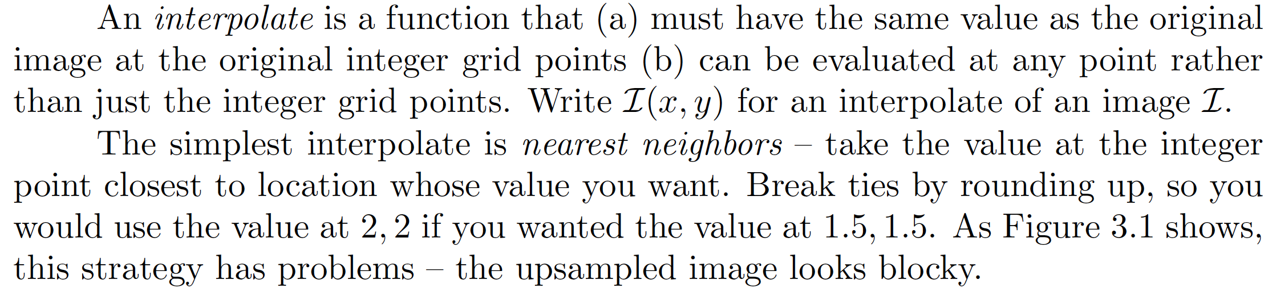
Interpolation

Slide 7
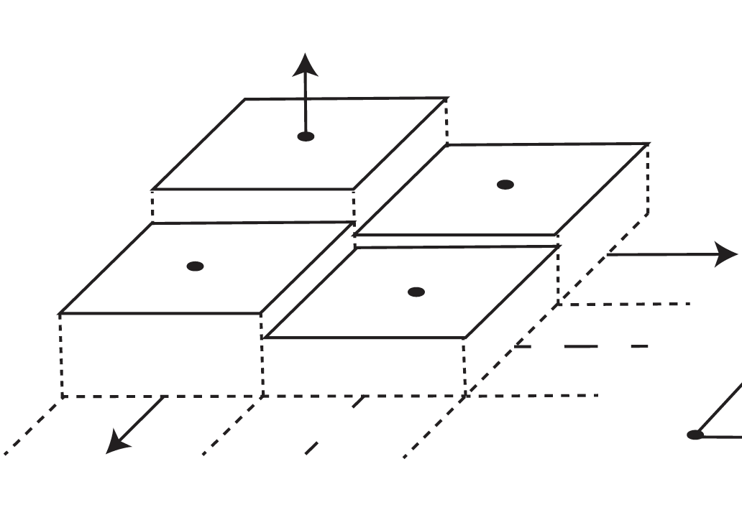
Nearest neighbors interpolation
Source image goes from samples at grid points to function that looks like

Slide 8
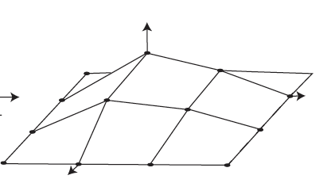
An alternate – bilinear interpolation
Source image goes from samples at grid points to function that looks like

Slide 9
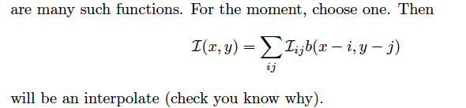
Interpolation mechanics

Slide 10
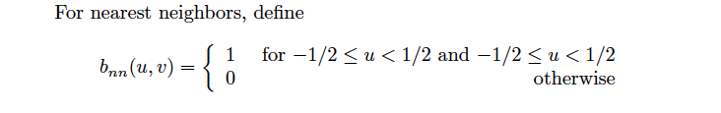
Nearest neighbors interpolation

Slide 11
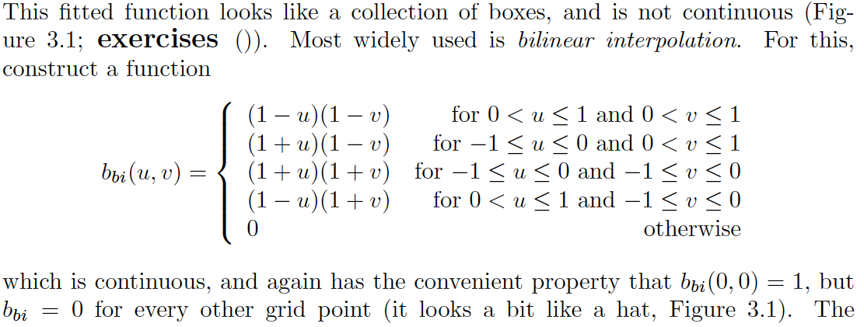
An alternate – bilinear interpolation

Slide 12
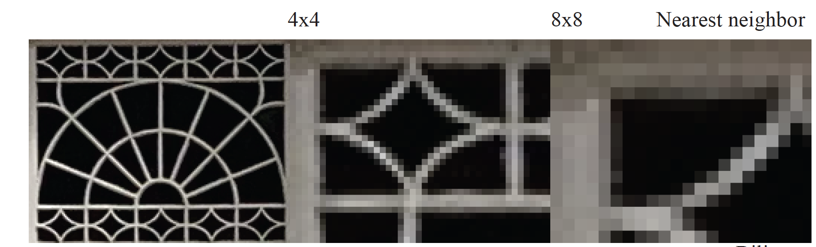
Choice of interpolate makes a difference

Slide 13
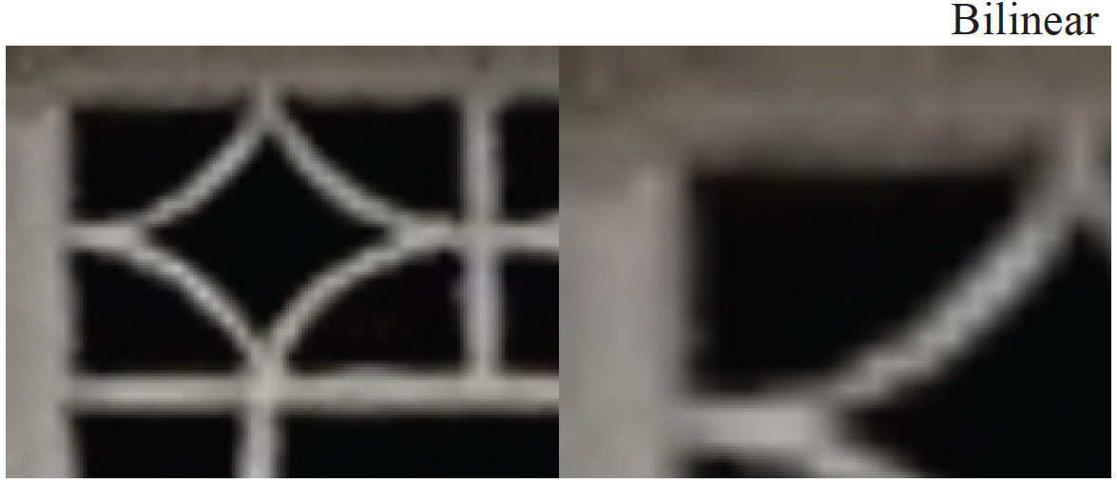
Choice of interpolate makes a difference

Slide 14
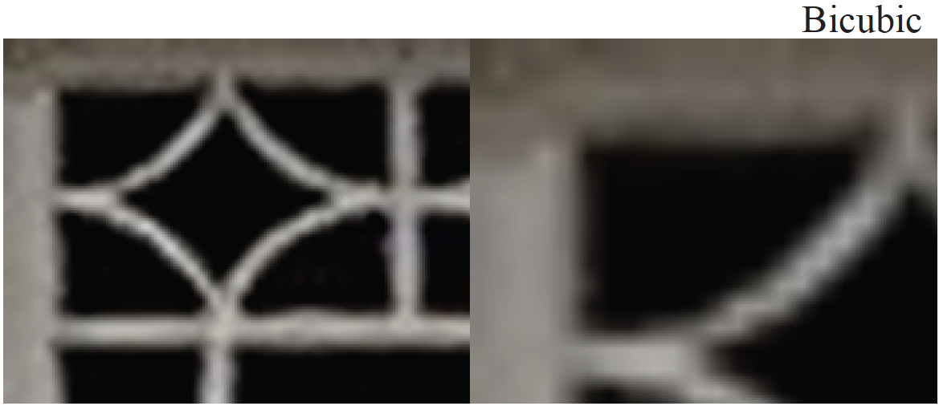
Choice of interpolate makes a difference

Slide 15
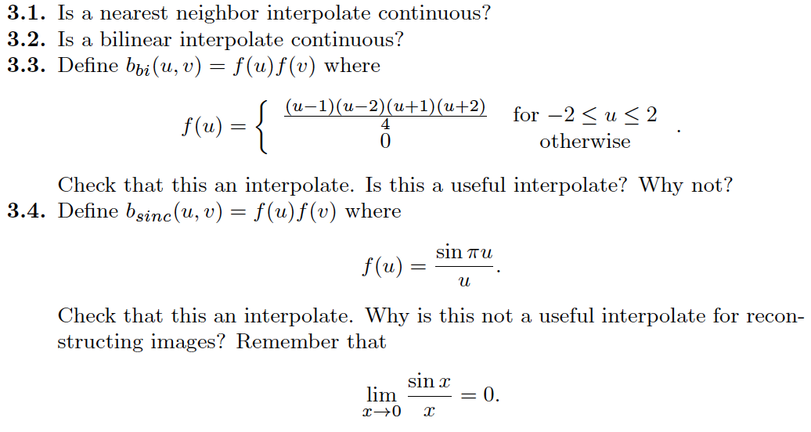
Things to think about...

