Slide 1
Further applications of voting
D.A. Forsyth
University of Illinois at Urbana Champaign

Slide 2
Big point about hough transform
Hough transform:
points try to agree on what the line is
Mostly, not best way to find lines
but can be useful to get line segments to join up
Forcing hypotheses to agree can be helpful

Slide 3
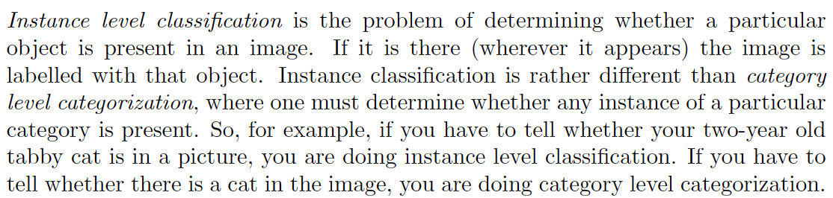
Instance level classification (and detection)

Slide 4
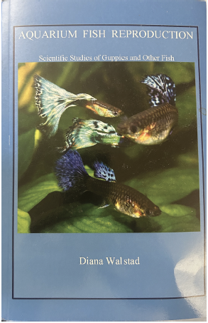
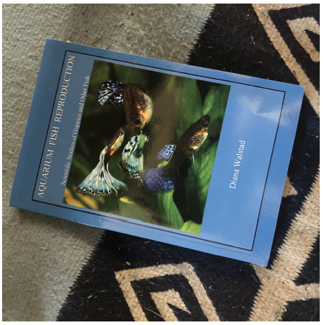
Example: Find the book
Get pictures of book covers, and attach book name
Now find the book cover in some other image

Slide 5
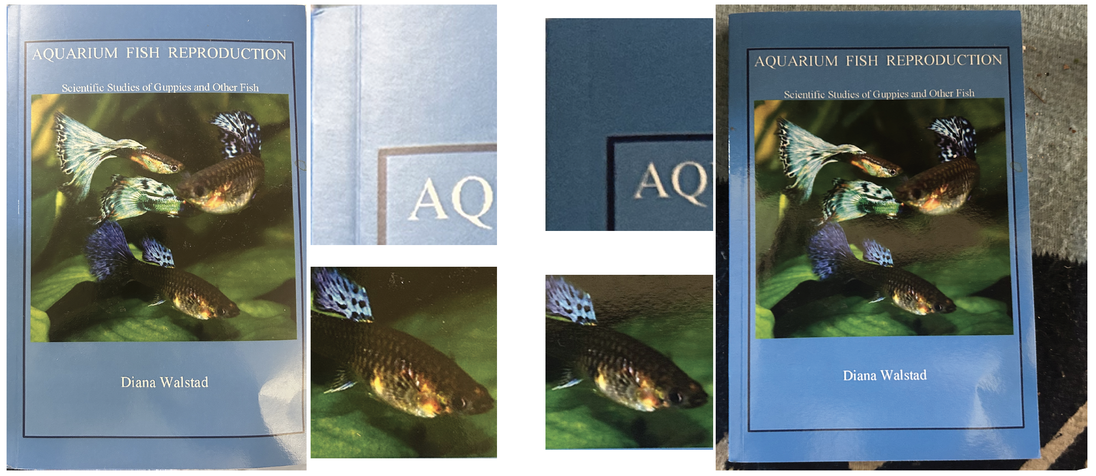
Can’t do this with SSD
Changes in color caused by changes in lighting

Slide 6
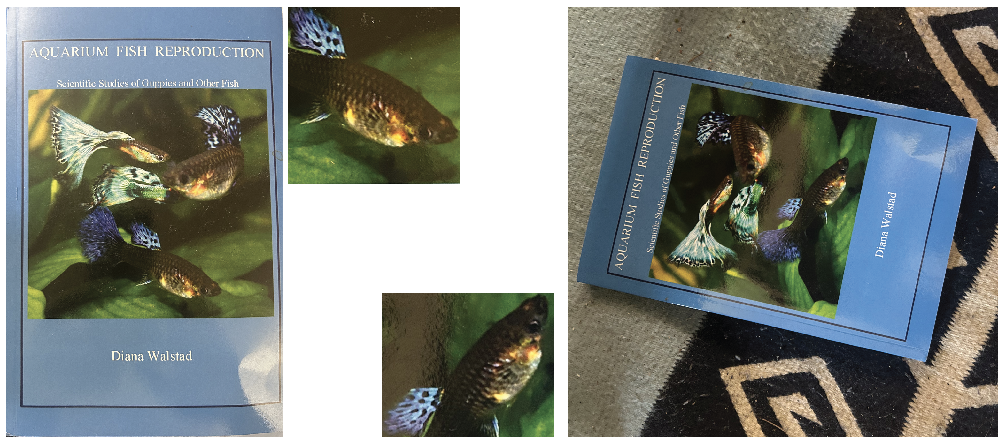
Can’t do this with SSD
Changes in appearance caused by rotation

Slide 7
Using interest points
Make a tree of cover image interest points (with labels)
using hierarchical k-means
You can do this cause interest point descriptors are vectors of fixed length. They’re nearby when interest points are similar.
Recall:
if you walk an interest point down the tree, it should arrive at a leaf where most interest points are nearby
Idea:
those interest points should know the label
vote using them

Slide 8
Using interest points
Make a tree of cover image interest points (with labels)
You can do this cause interest point descriptors are vectors of fixed length. They’re nearby when interest points are similar.
For test image, pass interest points down tree, vote
Vote how?:
most common book in leaf
one vote for each book in leaf
vote for ANN interest point label
Issues:
every patch votes, so there must be junk votes (easily fixed)
tree not built for labelling, may not be efficient

Slide 9
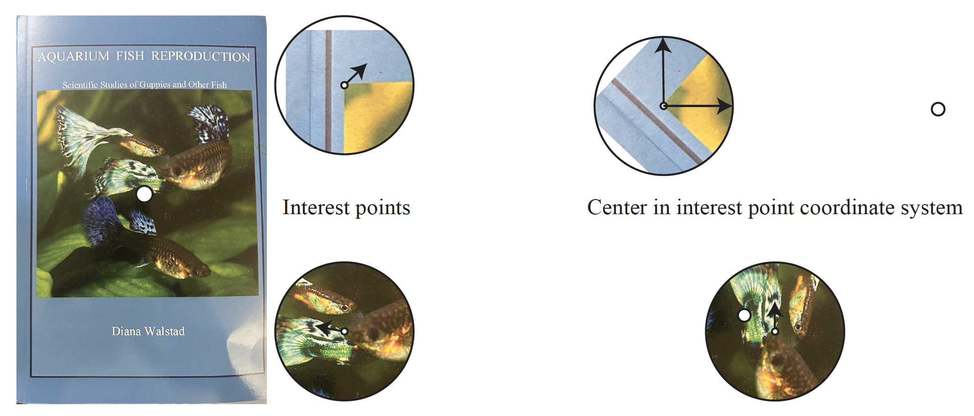
Generalized Hough transform
Each interest point has a coordinate system,
so it “knows” where the center of the book is

Slide 10
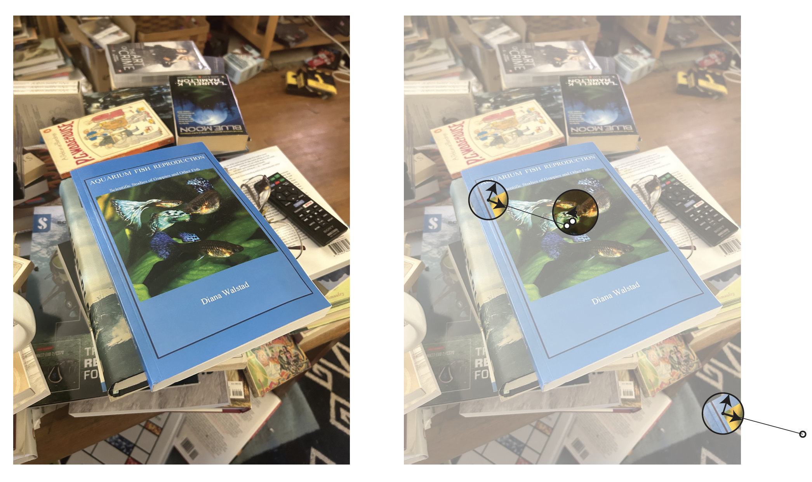
Generalized Hough transform
Allow an interest point to vote for a book only if another one agrees with center

Slide 11
Generalized Hough transform
Allow an interest point to vote for a book only if another one agrees with center
How?
build an accumulator array for book centers,
accumulate votes
scan it to check for “big” votes – do they agree on book label?

Slide 12
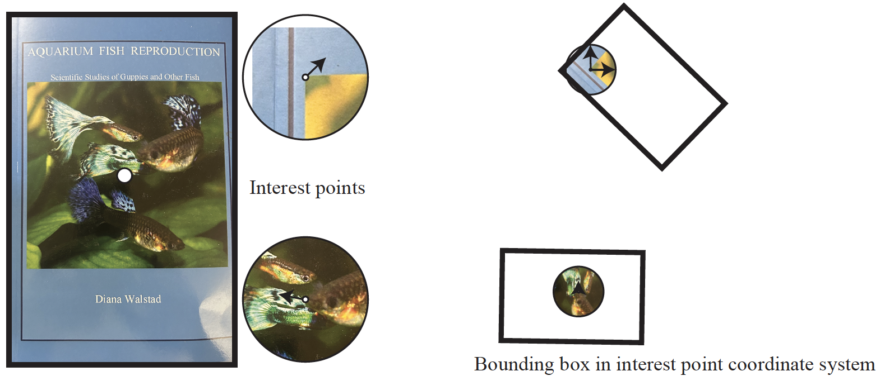
Generalized Hough transform
Interest points know other stuff – the outline of the book

Slide 13
We now have…
A primitive classifier
What book is in this image?
A primitive detector
What books are in this image, and where are they?
There are more accurate technologies,
tend to be slower, require more compute
This one is extremely fast and very efficient,
particularly with an improved tree

Slide 14
The tree
Current construction:
Hierarchical k-means
This breaks up each node into leaves whose elements are close to one another.
But this isn’t what we want
Decision tree:
Break each node into leaves where leaves are “informative” about label
eg in binary tree, labels on the left are all different from labels on the right

Slide 15
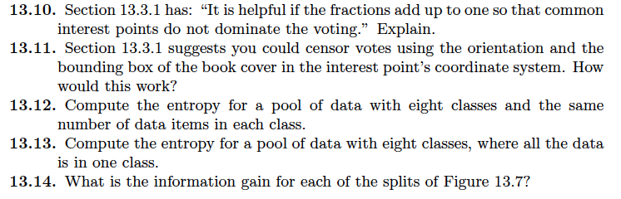
Things to think about...

