Slide 1
Building Intelligent Systems
CS498

Slide 2
Hello!
Instructors:
David Forsyth – daf@illinois.edu
Paris Smaragdis – paris@ilinois.edu
Prof. X
And you are …

Slide 3
Intelli-what?
What is an intelligent system?
Any takers?

Slide 4
What is this class about?
How do we construct intelligent systems?
Note the emphasis!

Slide 5
Why intelligent systems?
What’s special about intelligent systems?
Why bother with this class?

Slide 6
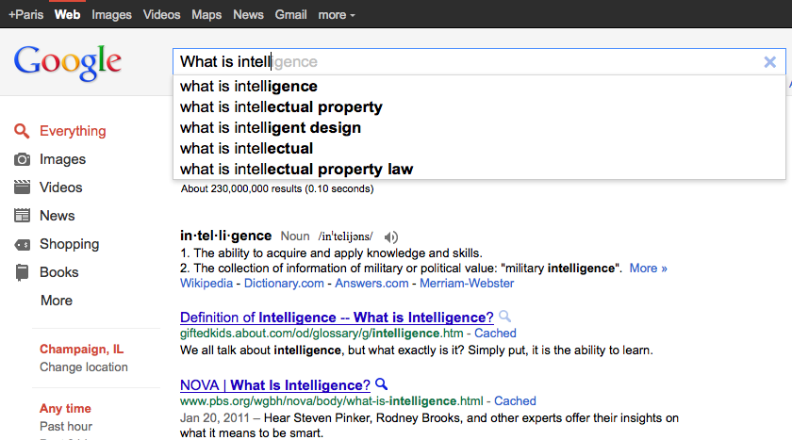
Examples of intelligent systems

Slide 7
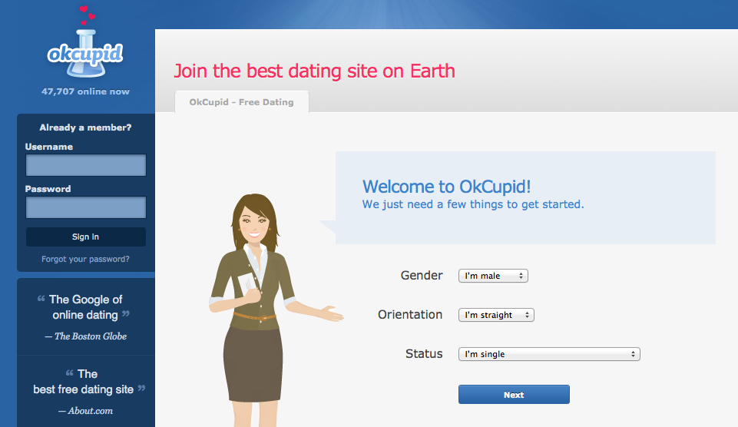
Examples of intelligent systems

Slide 8
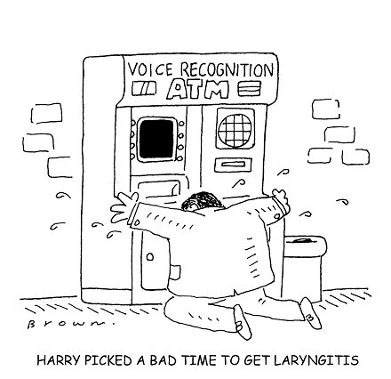
Examples of intelligent systems

Slide 9
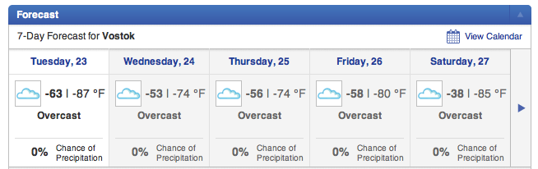
Examples of intelligent systems

Slide 10
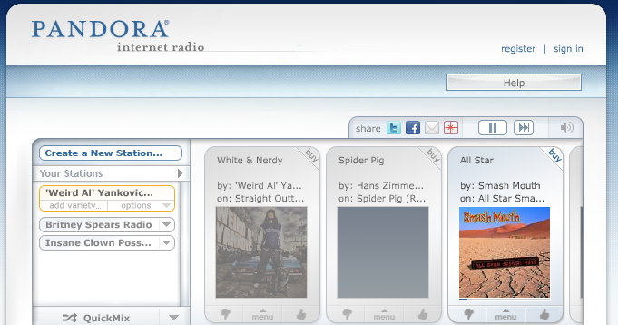
Examples of intelligent systems

Slide 11
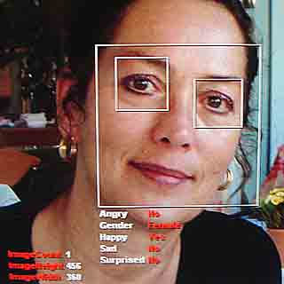
Examples of intelligent systems

Slide 12
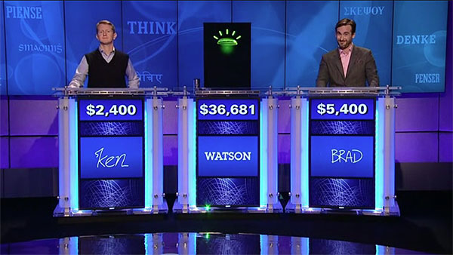
Examples of intelligent systems

Slide 13
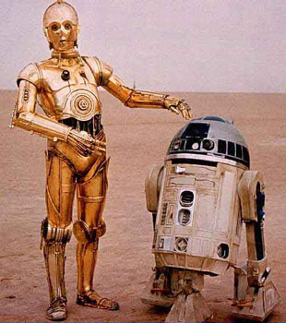
Examples of intelligent systems

Slide 14
Case study: Intelligent audio
“Machine Listening”
Making machines that understand sound

Slide 15
Making sense of sound
Huh?

Slide 16
Things we can do
Audio classifiers
Train in example sounds
“Teach” a computer
Use to detect learned sounds
Many applications

Slide 17


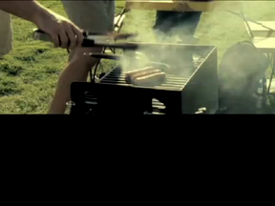
Video Content Analysis
Audio is a strong cue for detecting various events in video
Classify sounds to perform semantic analysis on video
Specific subclasses for type of broadcast (e.g. for news we use male and female speech, for sports use cheering, etc)
Build in high-end Mitsubishi PVRs, TV sets and “HDTV cell phones”
Was there a goal?
Real-time movie sound parsing
Sad or funny clip?

Slide 18
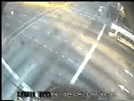

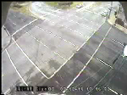

Traffic Monitoring
Detect incidents by recognizing sounds
Normal crash
Hard-to-see crash
Near crash
Notable (?) event

Slide 19

Security Surveillance
Detect sounds in elevators
Normal speech, excited speech, footsteps, thumps, door open/close, screams
When detecting suspicious sounds we can raise an alert
96% accuracy in elevator test recordings with actors
Elevators are a dark environment with
poor visual analysis prospects
Audio analysis can provide optimal
detection of distress sounds

Slide 20
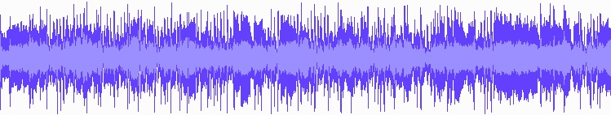
More things to do
Make systems that resolve mixtures and figure out objects in a recording
What’s in here??

Slide 21
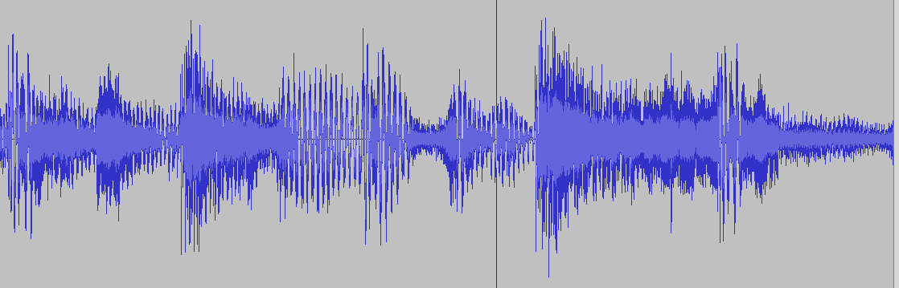

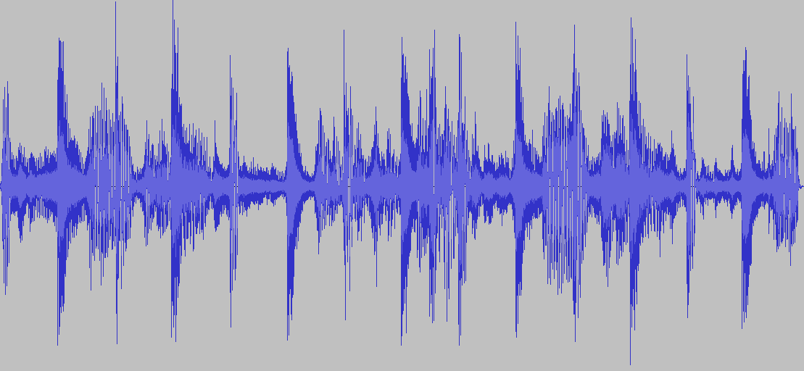
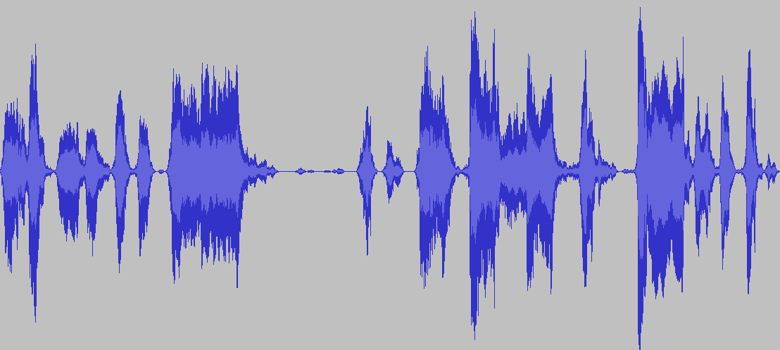
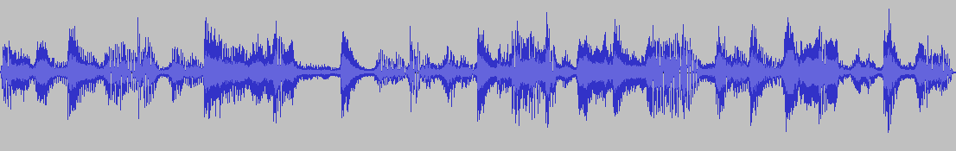
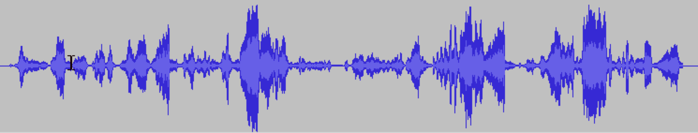
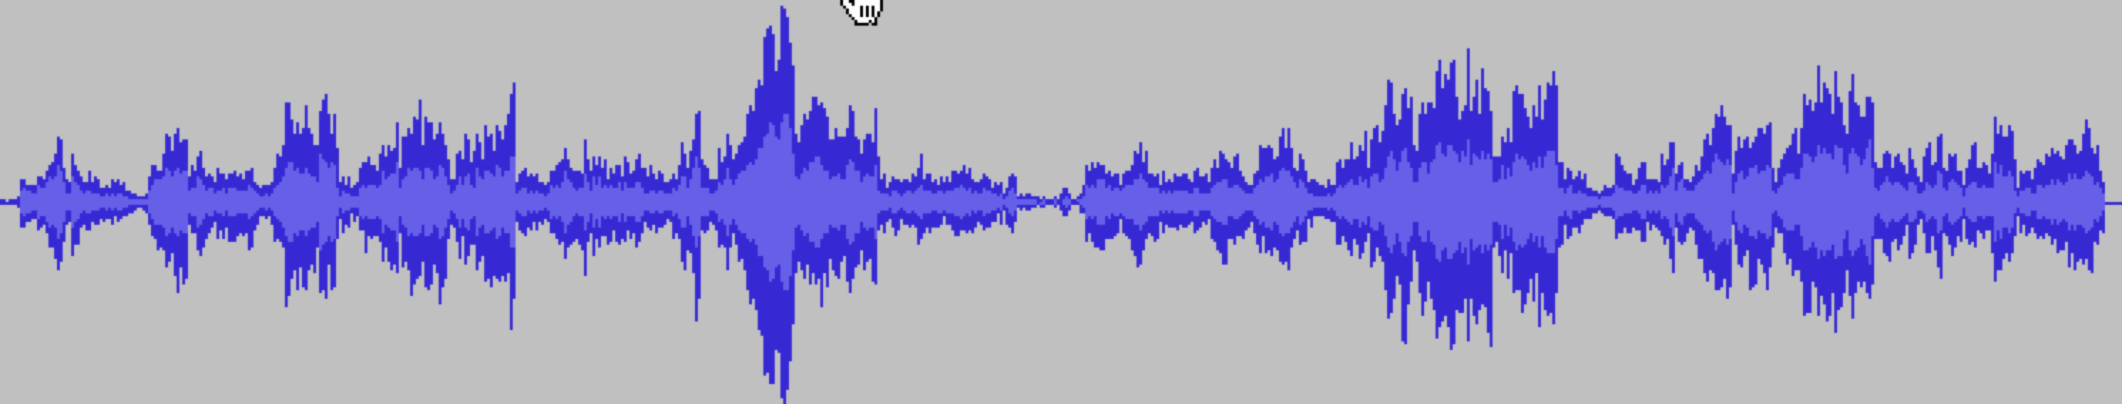
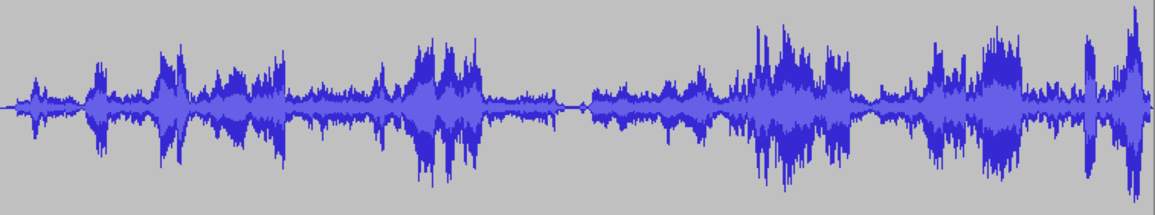
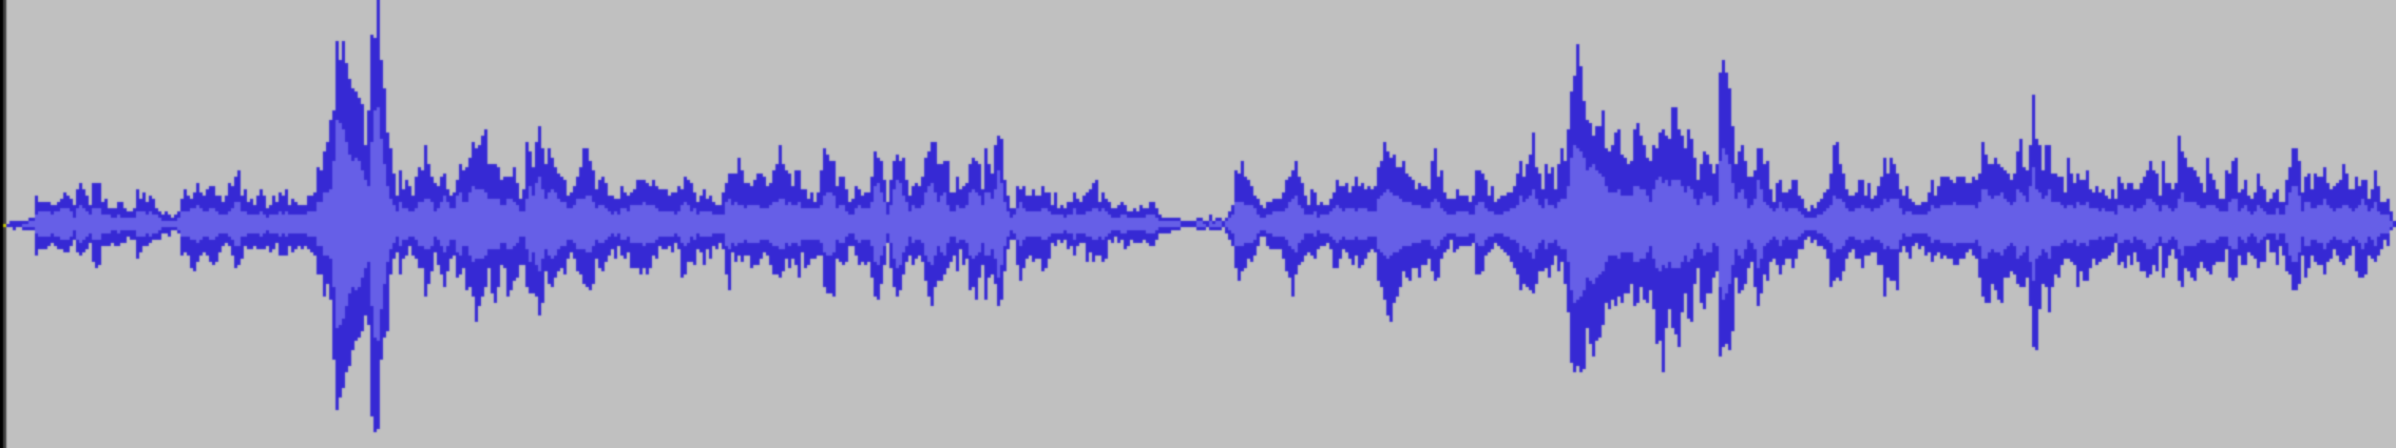
Intelligent audio editing
Original drum loop
Extracted layers
Music layer
No tambourine
No congas
Voice layer
Congas!
Remixer
Selective pitch shifting
Soprano layer
Piano + Soprano
Remixed layers
Piano layer

Slide 22

User-guided sound selection

Slide 23
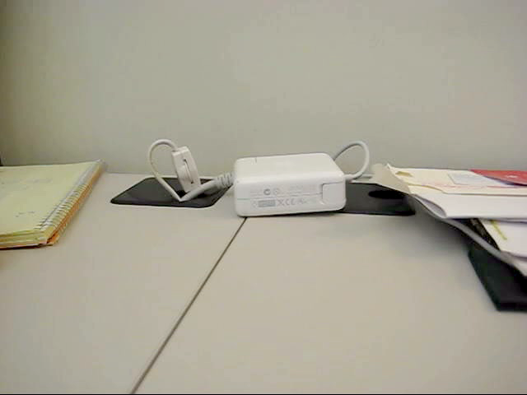
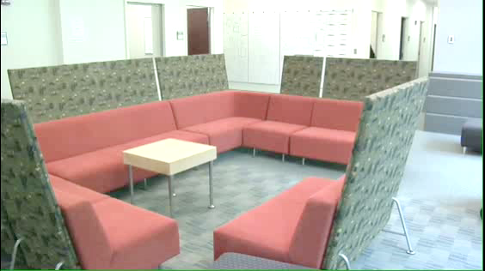
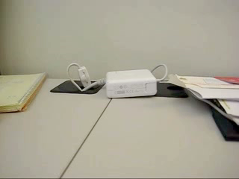
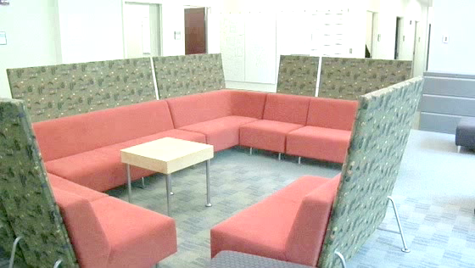
Audio/visual object editing
Input sequences
Output sequences

Slide 24
Many more applications
Intelligent audio editing
City grid state
Dublin City Traffic Authority
Cambridge, MA (more later)
Machine Monitoring
Mitsubishi Heavy Industries
Automotive monitors
Building-wide sensor networks
Home security surveillance
Smart phone sensing
Medical listening/surveilance (heart, lungs, speech, ICU)
…

Slide 25
So what does intelligence require?
An ability to translate our thoughts to a programming formula
Much harder than it sounds
Let me demonstrate …
But it is also simpler than it sounds!

Slide 26
Tools we will use
A bit of math
A bit of artificial intelligence (AI)
Plenty of coding

Slide 27
The bit of math
Some linear algebra
Some probability
Some optimization
Used as needed, we’ll skip the fluff
Don’t be scared!

Slide 28
The bit of AI
Machine learning
Making classifiers
Clustering data
Making sense of huge data sets

Slide 29
Domain-specific AI
Natural language processing
Computer vision
Speech and audio recognition
…

Slide 30
Coding
Plenty of projects
We want this to be a hands-on class
You are free to pick your poison here

Slide 31
Class goals
Overall understanding of the problems in AI-ish areas
*Know how to classify data
*Know how to cluster data
Understand how to represent text, audio, images, video data
Understand probabilistic reasoning
Have basic understanding of the following processes:
How Google works
*How collaborative filtering works (e.g. Netflix, dating sites, etc)
*How face detection or character recognition works
*How speech recognition works
*How text mining works (e.g. language detection, document clustering, sentiment analysis)

Slide 32
Projects to try
Automatically organize your PDF/source code collections
Automatically organize your video/music collection
Find faces in pictures or movies
Make an automated call center
Find cliques of friends from social graphs
Make a dating site
Predict NFL/NBA/MLB outcomes
Track a finger on a touch interface
Categorize physiological data, predict user emotions
Categorize network traffic or OS activity
…

Slide 33
The rules
We want you to learn, not suffer!
Please engage, don’t just sit back
Grades are determined through the MPs

Slide 34
The good (or bad!) news
This is the first iteration of this class
Tell us what you want to learn!
What’s your domain of interest?
What amazing task do you want to do?

Slide 35
Questions?
Email us:
daf@illinois.edu
paris@illinois.edu

