Slide 1
Last block:
Classify an image into one of two classes by
Stack some pooling, FC layers on an encoder
Adjust result into a vector
Pass to linear classifier
Learn all parameters with SGD and various losses
get training examples right
Idea:
exploit this machinery to improve training
exploit this machinery to segment image

Slide 2
Improving a denoiser with a classifier
Idea:
if a classifier can tell the difference between a denoised image and a real one, the denoiser isn’t working right
use the classifier to improve the denoiser
Easy to state, quite delicate in practice

Slide 3
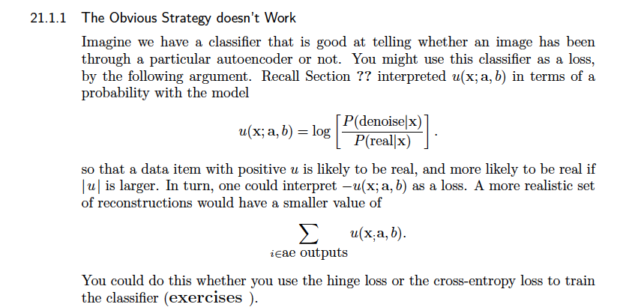
Obvious strategy that DOESN’T WORK -I

Slide 4
Obvious strategy that DOESN’T WORK -II
Strategy:
train autoencoder, fix
make a lot of denoised images
train classifier to spot denoised images
continue to train autoencoder, using loss from previous slide

Slide 5
Obvious strategy that DOESN’T WORK -III
Fails (easy – try it!)
Fails because:
Classifier is good at spotting some error that is characteristic of the autoencoder; if the autoencoder learns NOT TO MAKE THAT ERROR, it’ll be fine – but it could make some other, new error.
But the classifier can’t spot that!

Slide 6
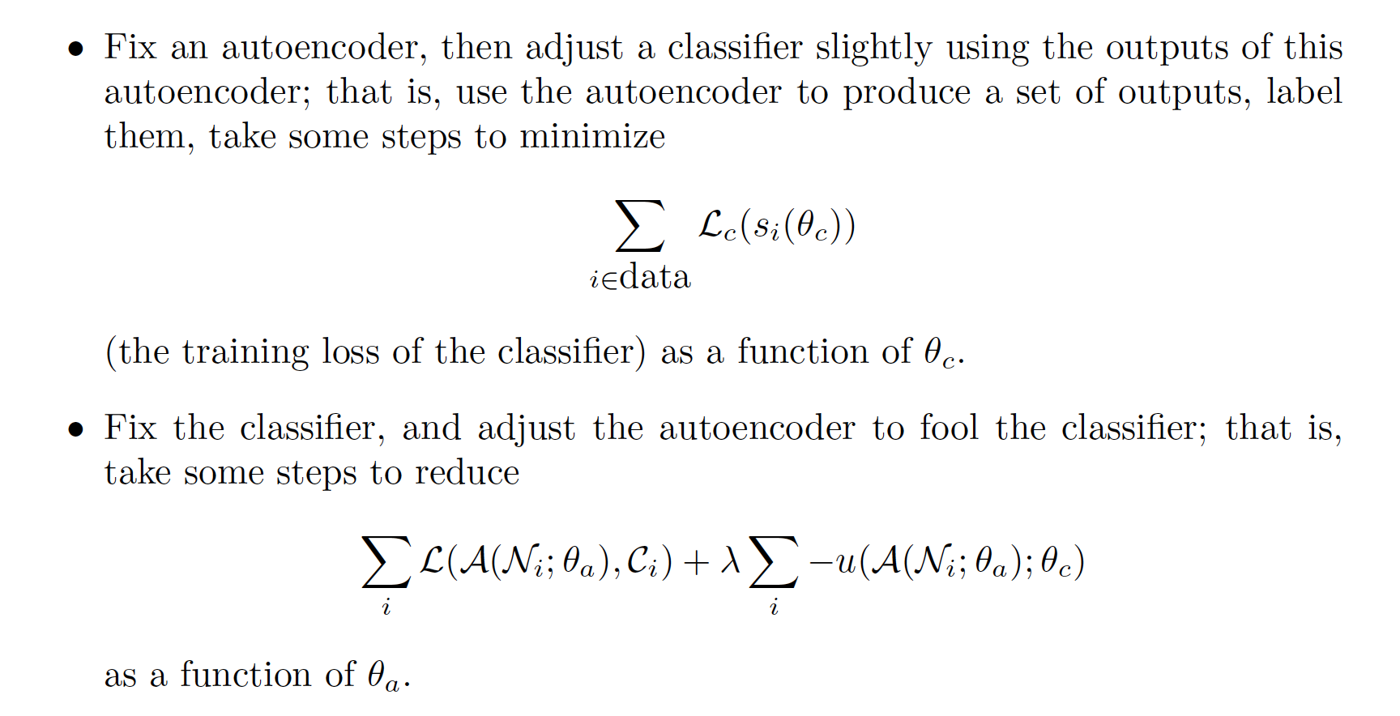
More effective strategy
Repeat:

Slide 7
More effective strategy
Notice the classifier isn’t really producing a loss
because each time you improve the autoencoder, you are using a slightly different classifier
But it does give you a gradient...
The classifier is often referred to as an adversary
The value it makes is an adversarial loss

Slide 8
Tricky to get right, but very good when it does work
Issues:
Goldilocks problem:
if the classifier is “too stupid”, the gradient is no use
autoencoder beats classifier
if the classifier is ”too smart”, the gradient is no use
classifier beats autoencoder
How much training should classifier/autoencoder get?

Slide 9
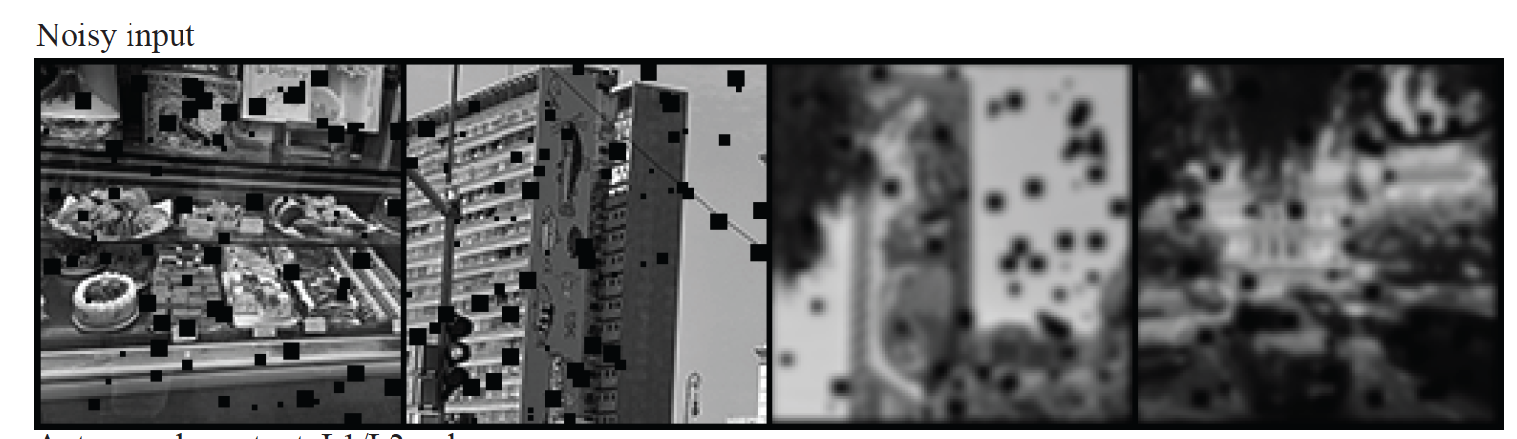
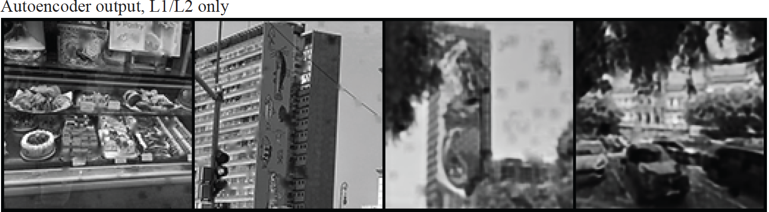

Slide 10
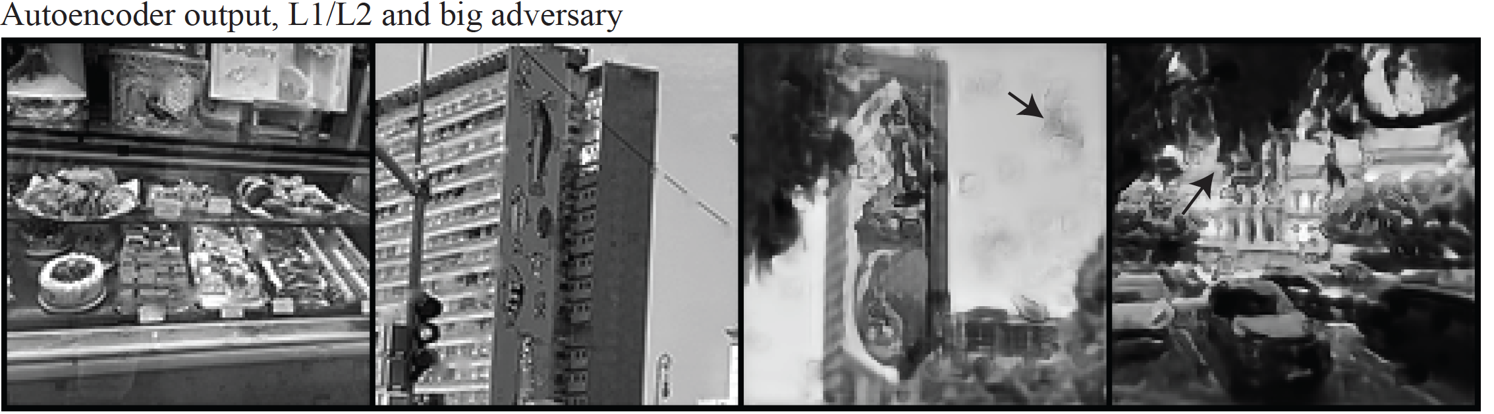

Slide 11
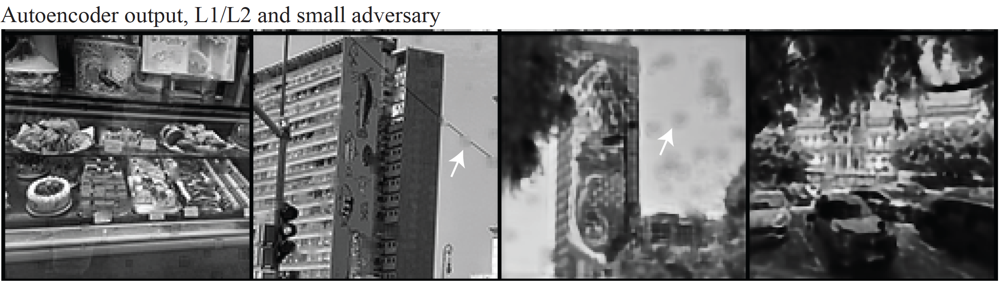

Slide 12
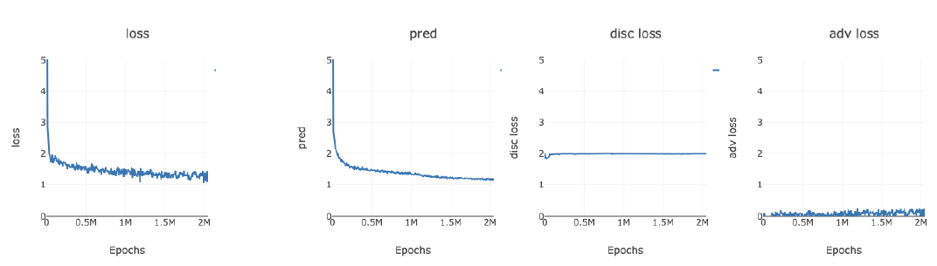

Slide 13
Producing image representations with classification
Examples:
Two class:
edges
Multi-class:
interest points
semantic segmentation

Slide 14
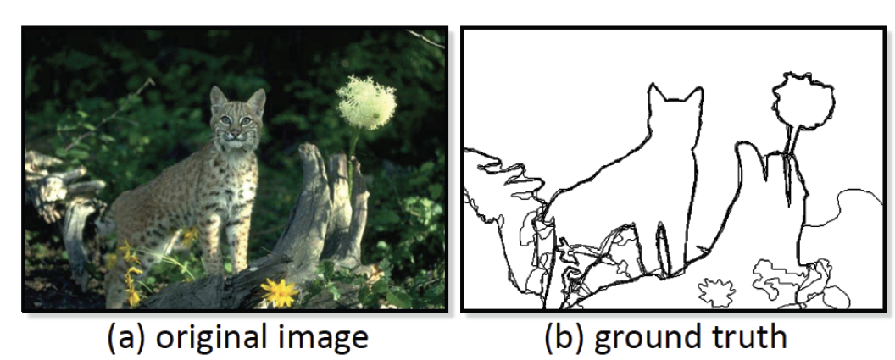
Edges
Training is tricky
No ”true” ground truth!
Berkeley segmentation data set:
get numerous people to mark boundaries in images

Slide 15
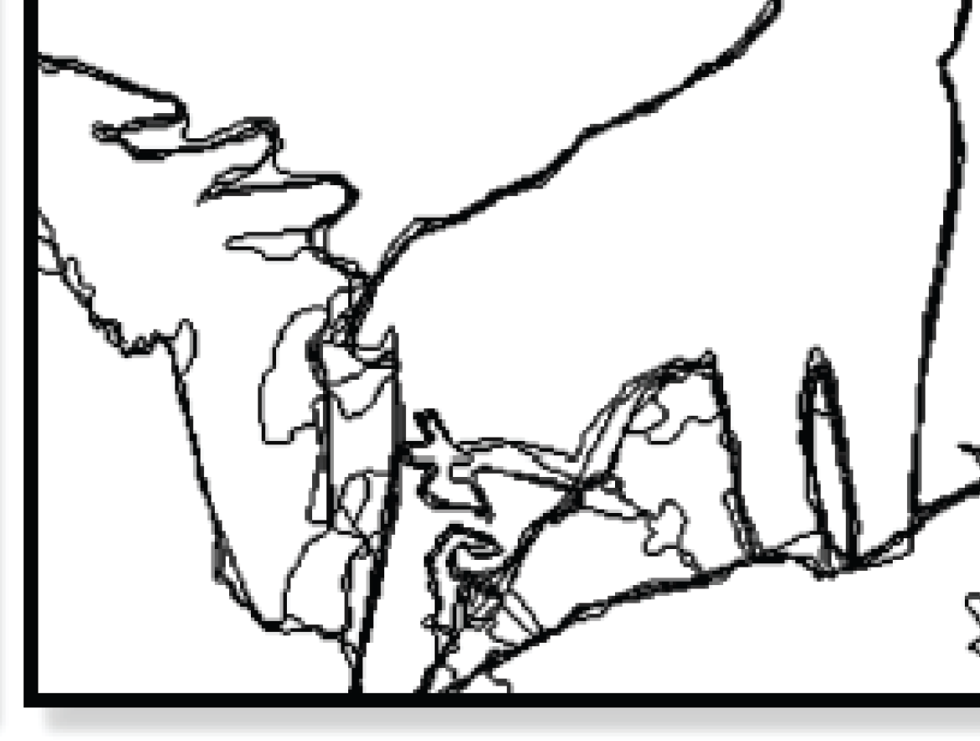
Zoom on ground truth – multiple ground truths!

Slide 16
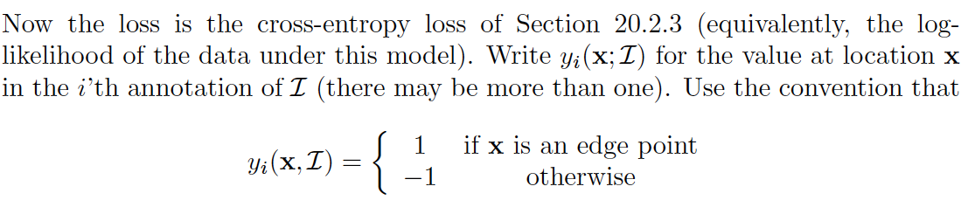
Using the data

Slide 17
Edge points using classification ideas
At a high level, straightforward
construct decoder to produce a score at each pixel
interpret the score as
network
parameters
score
location in image
image

Slide 18
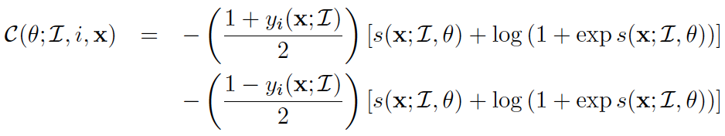
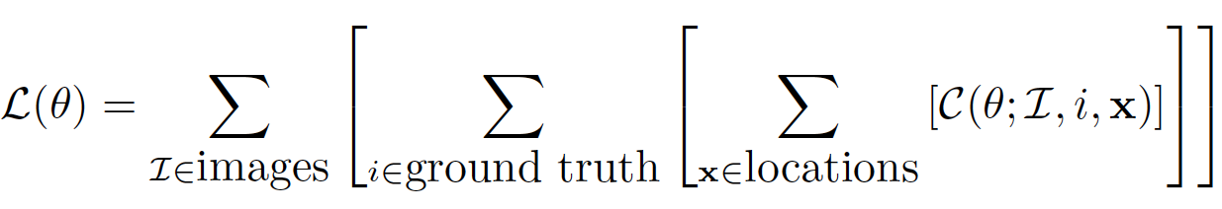
Edge points using classification ideas
At a high level, straightforward
Loss at a particular location for a particular example
Loss for network:
sum over all locations of all markups of all examples

Slide 19
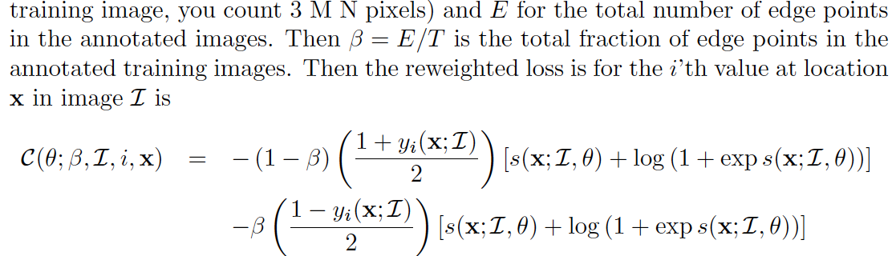
Works badly
Edge points are rare
it is hard to beat just saying there aren’t any
Idea:
reweight loss (high weight on edge points, low on non-edge)

Slide 20
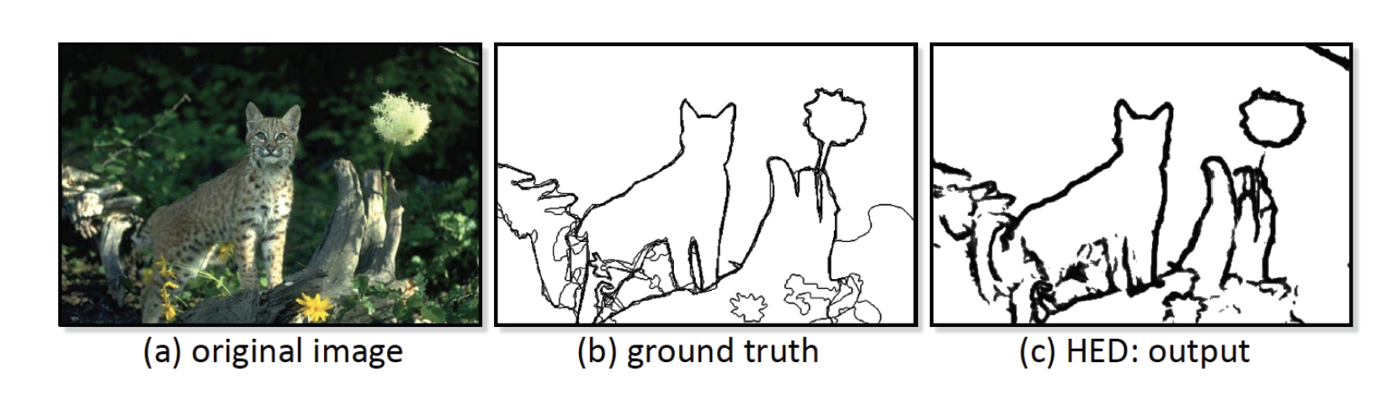
Works fine, but
evaluation is quite tricky (notes)
essentially, putting an edge point close to the right location should have some value
scoring appropriately requires care

Slide 21
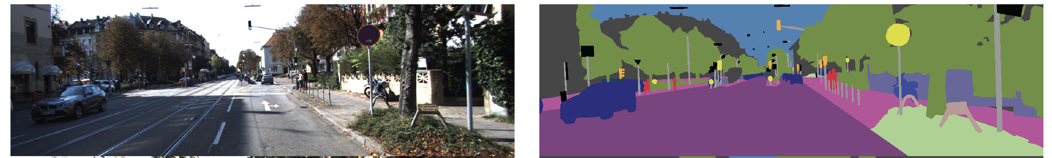
Multi-class classification
Example:
Attach a label to each pixel in the image
Label is chosen from k alternatives
eg: road, car, sky, lamppost, tree, sidewalk, pedestrian,
unknown

Slide 22
Multiclass classification
Attach a one-hot vector to each example
k dimensional, all entries zero except one which is one
corresponding to true class
Produce one score per class
per location

Slide 23
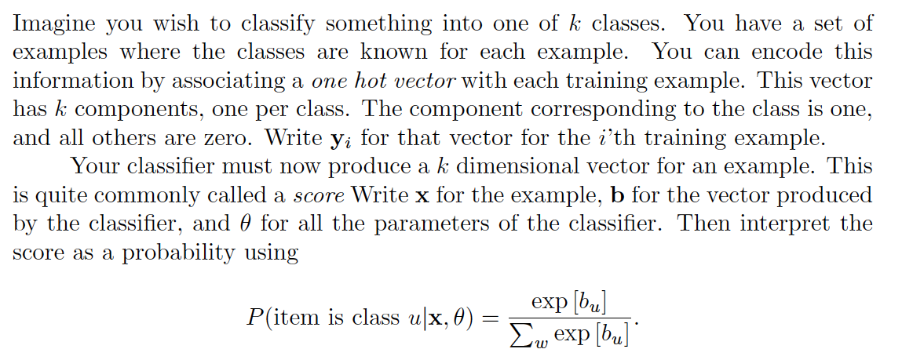
Multi-class classification

Slide 24
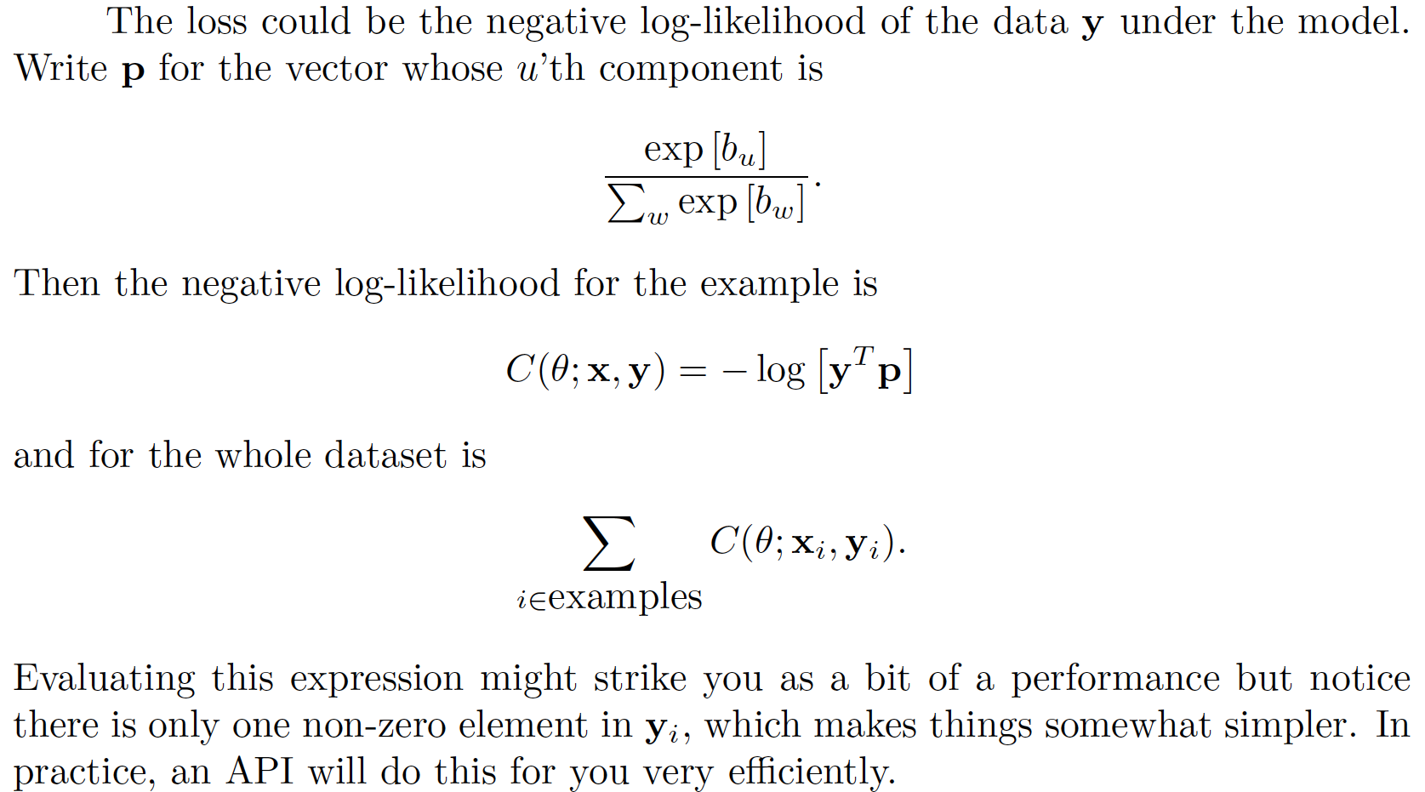
Loss for multi-class classification

Slide 25
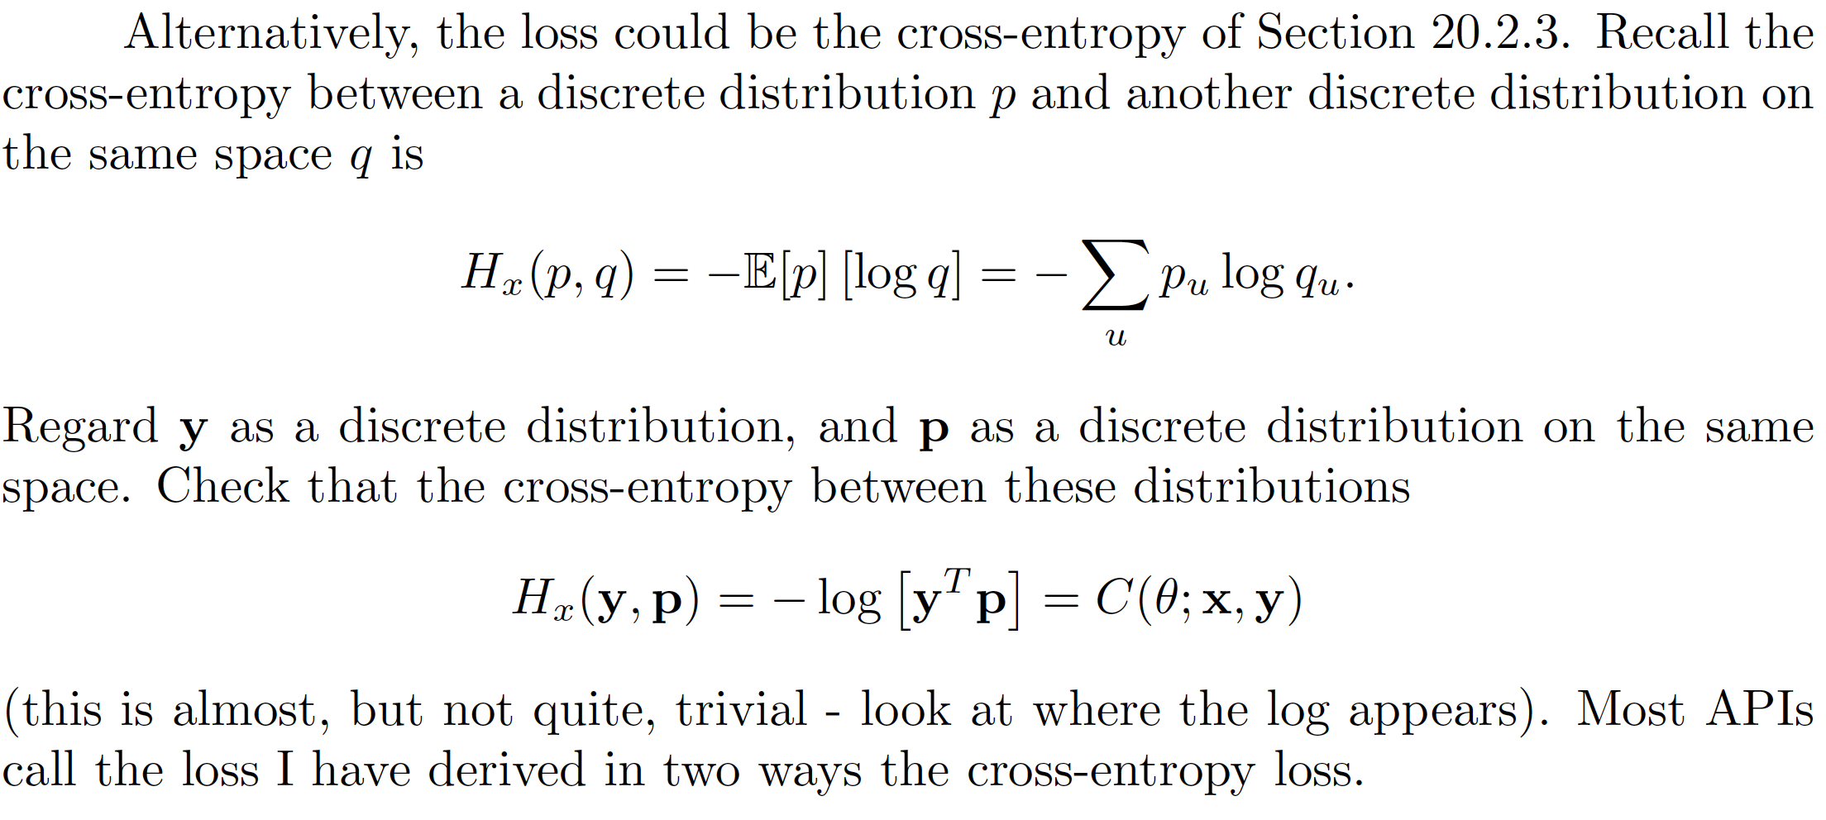
This is also a cross-entropy

Slide 26
Some more detail...
Achieve this by constructing decoder to have k-dim vector at each location

Slide 27
Interest points: Finding interest points
Superpoint:
Break 8M X 8N image into 8x8 windows
Classify each window into 65 classes:
64 locations and one “no-interest point in this window”
so decoder produces 65 X M X N block
[This can be refined...]
Training:
First, make a lot of synthetic images with known corner locations
then train purely discriminatively (you know where the corners are!)

Slide 28
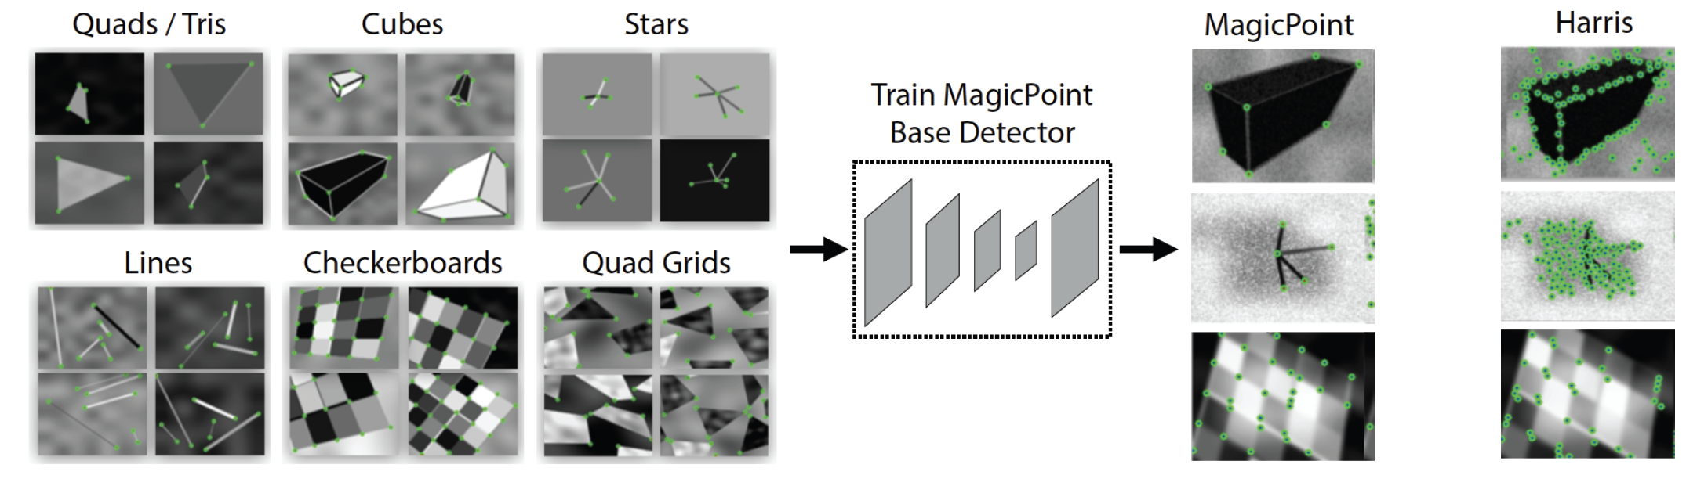
Yields MagicPoint
But you can do better...

Slide 29
Heatmaps
Take the 65 x M x N block, compute the probabilities,
drop the “no interest point” score to get a 64 x M x N block of scores
These don’t sum to one, cause one option is missing.
Turn this into a 1 x (8 M) x (8 N) “image” – each pixel has a value that indicates the ”probability” of an interest point at that location

Slide 30
Using MagicPoint heatmaps to train ....
Now take a natural image , form a heatmap
Apply an affine transform A, to get A(I) and H(A(I))
should be the same as where they overlap!
Idea:
get a collection of random affine transformations A_n
Now compute an average of
Second, use this as a target distribution for training

Slide 31
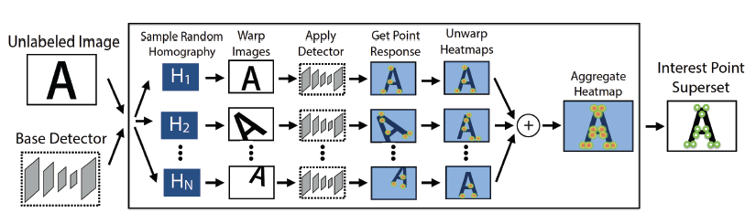
SuperPoint
Target heatmap

Slide 32
Locating the interest points
Take the scores from the trained decoder, threshold
interest points at locations where the score>threshold
These are on 8M x 8N grid

Slide 33
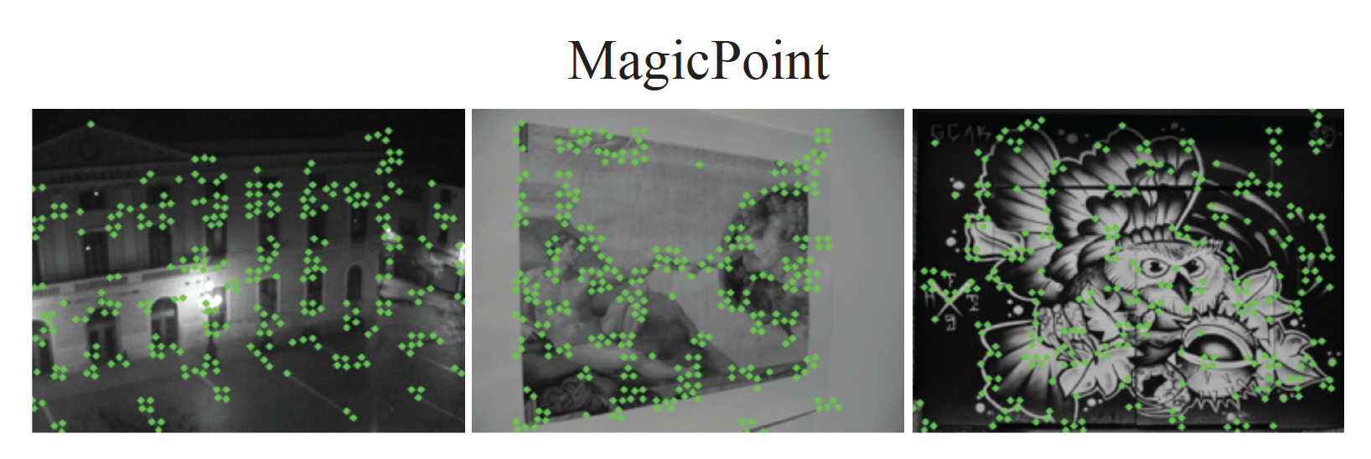
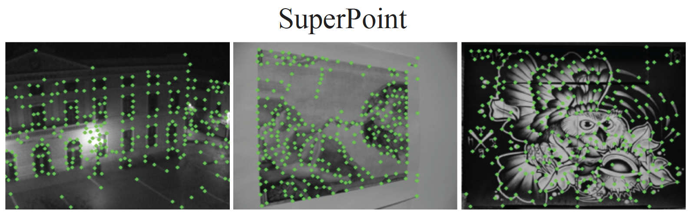
Real improvements from heatmap

Slide 34
Learning to describe the interest point
Add a second decoder.
This decodes to a d x M x N block of descriptors
(but the interest point locations are on (8M x8N)
grid – upsample and interpolate)
Now use a version of the affine trick
For image I and image A(I) you know which pairs of tiles correspond

Slide 35
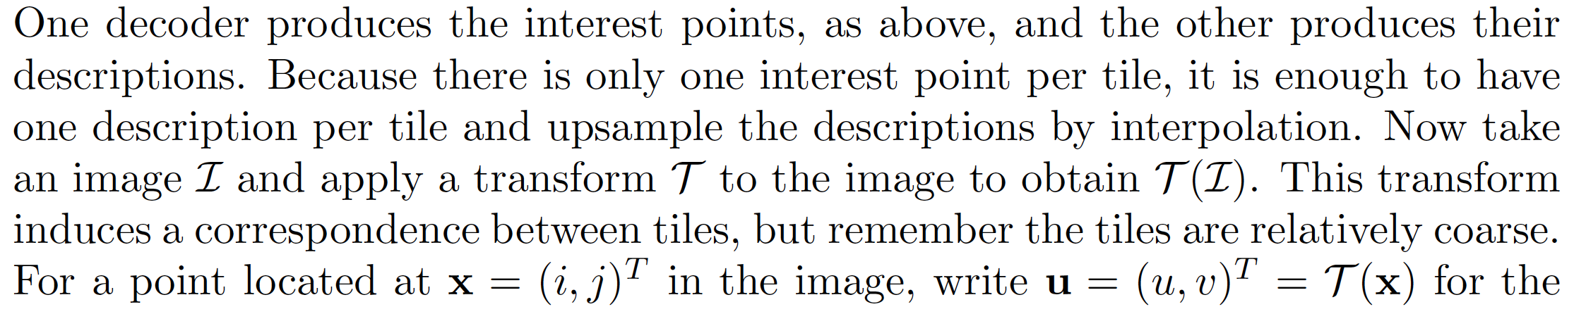
Tiles

Slide 36
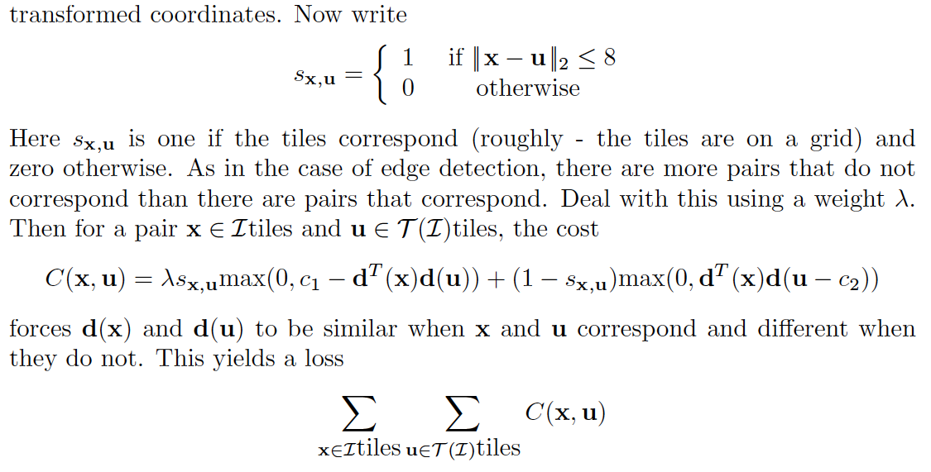
Tile correspondences

Slide 37
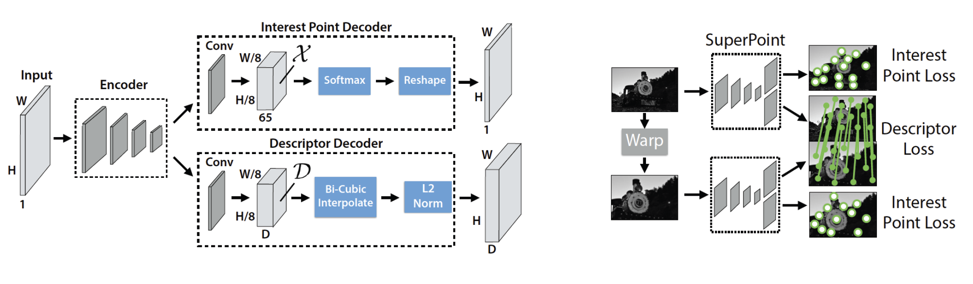

Slide 38
Semantic segmentation
Label pixels in images with labels taken from a vocabulary
Notice there are two kinds of label
“things” == count nouns == what you can count
car, pedestrian, bike, dog, ...
“stuff” == mass nouns == others
grass, sky, water, cloud, ...

Slide 39
Semantic segmentation
A number of variants
? - thing labels only
? - stuff labels only
Instance segmentation – distinguish between individual objects, so car 1, car 2, pedestrian 1, pedestrian 2
Panoptic segmentation – every pixel gets a label

Slide 40
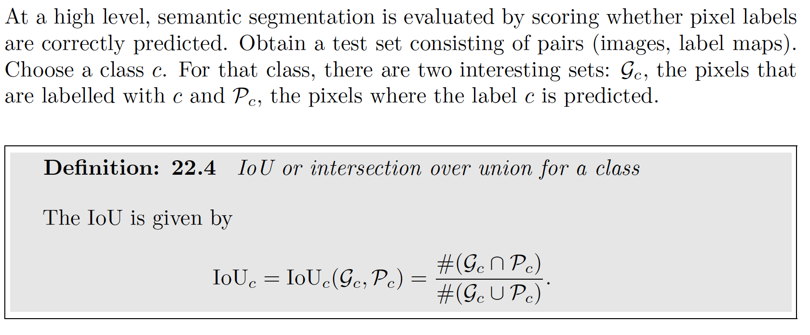
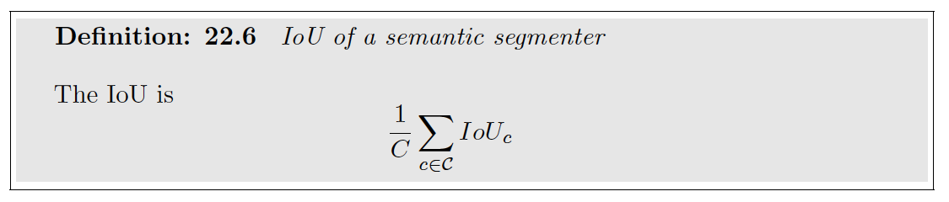
Evaluation

Slide 41
Variants
Some labels are class labels (‘car’, ‘bicycle’),
some are category labels (‘vehicle’)
IoU per class
0.76 on Kitti leaderboard
IoU per category
0.9 on Kitti leaderboard

Slide 42
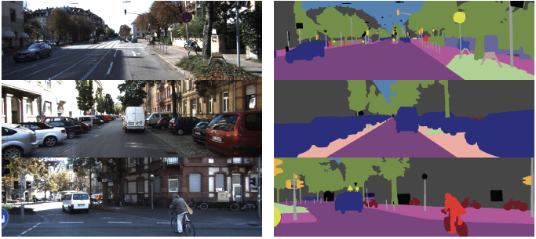
Semantic segmentation on Kitti (labelled data)

Slide 43
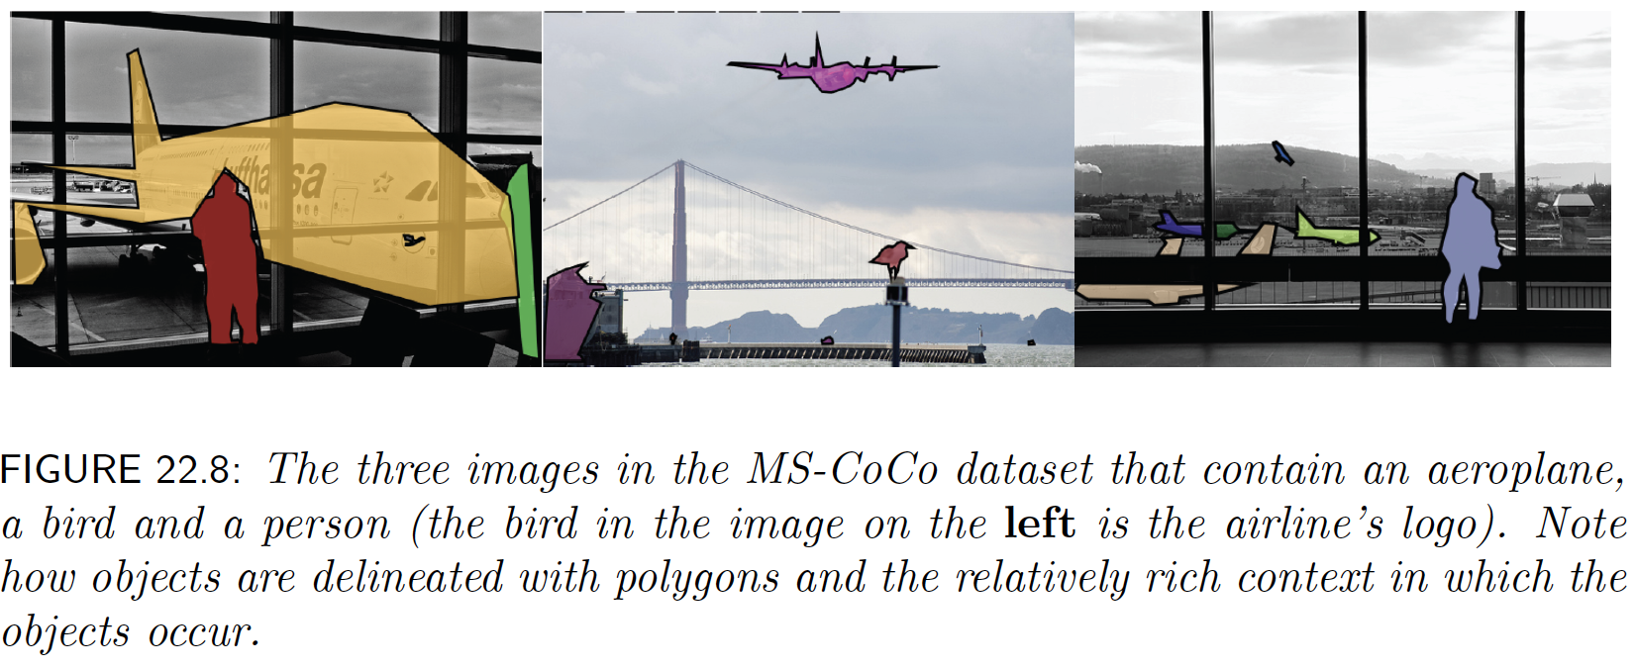
MS-CoCo dataset

Slide 44
Resources
Datasets in text
Numerous segmenters online

