Slide 1
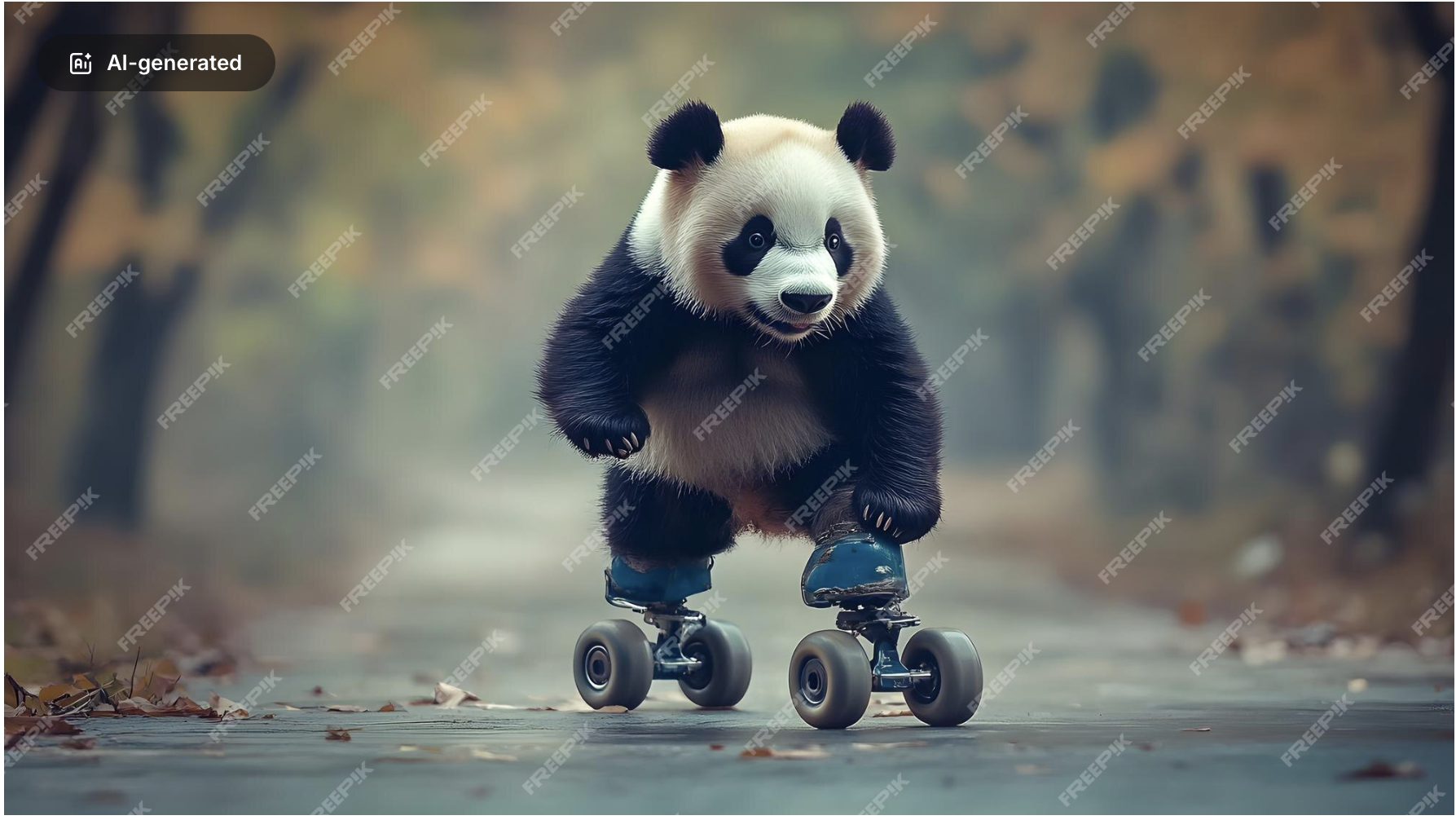
Applications: make commercial art cheaper

Slide 2
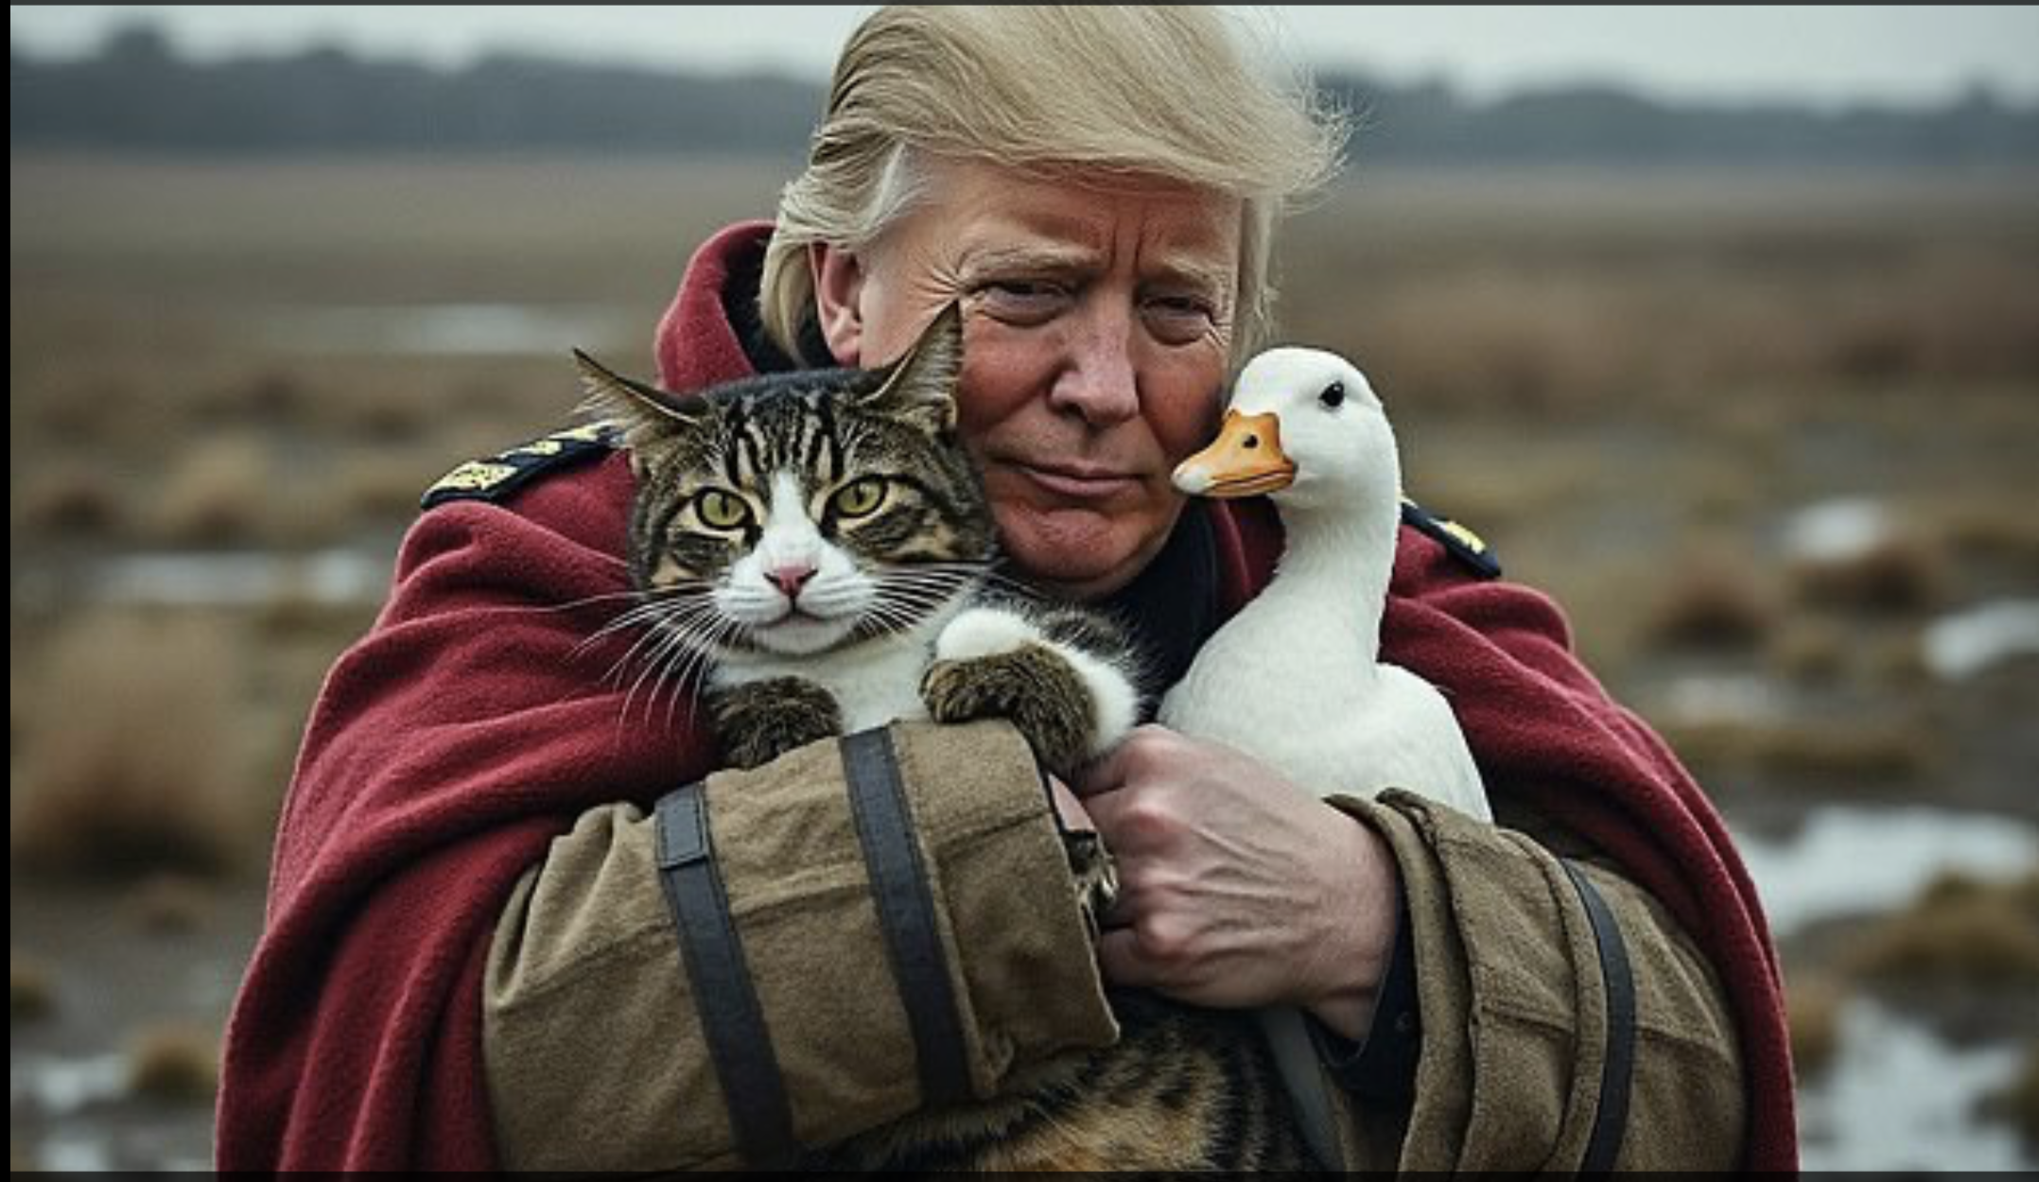
and political discourse nastier

Slide 3
Articles of faith
There is a probability distribution on all images
A diffusion model produces a fair sample from that dist
Articles of faith because:
they’re believed in the face of inconvenient facts
obvious falsification below
you can’t do two-sample testing in high dimensions and get the answer right
metrics: absurd (FID); ineffectual (ask people); inaccurate (ask VLMs)
bad things might happen to unbelievers

Slide 4
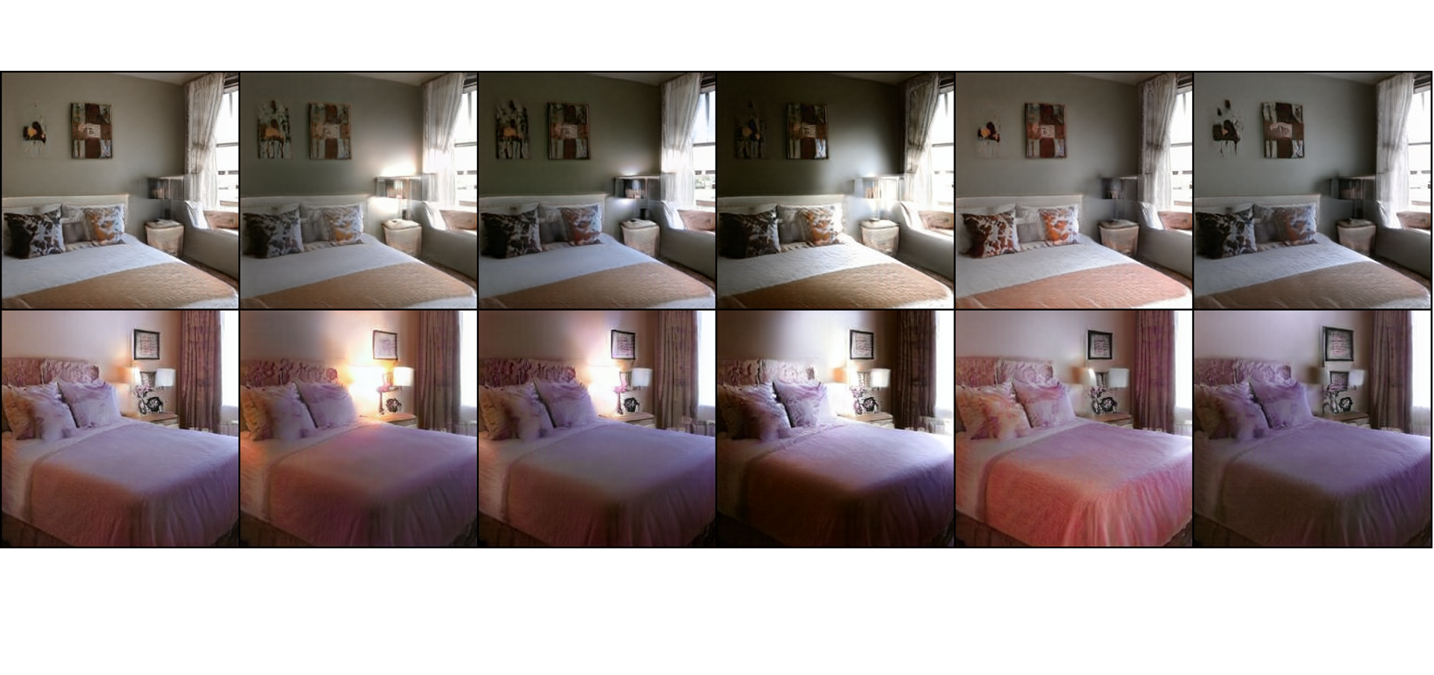
Relightings are realistic
Bhattad et al, 23, 24: StyLitGAN: Prompting StyleGAN to Produce New Illumination Conditions

Slide 5
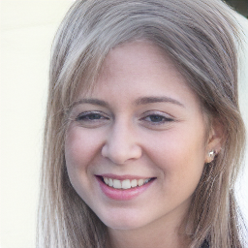
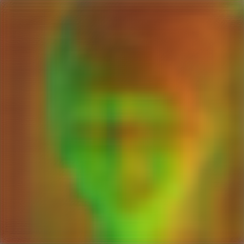
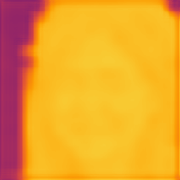
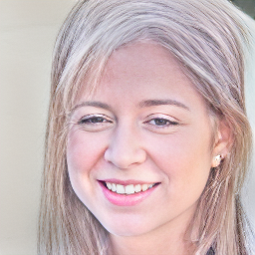
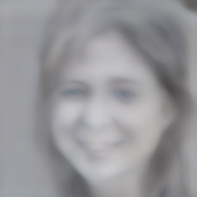
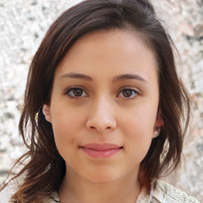
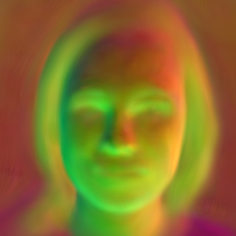
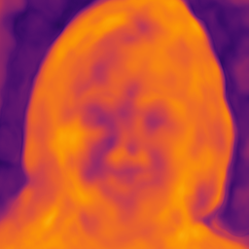
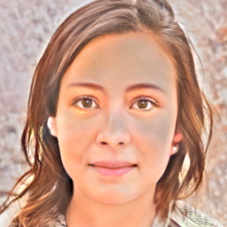
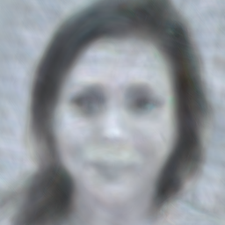
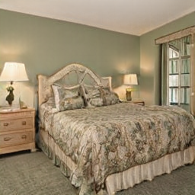
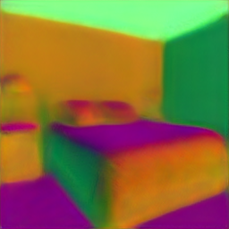
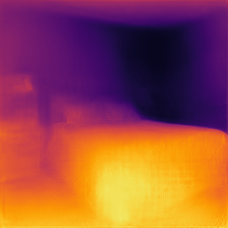
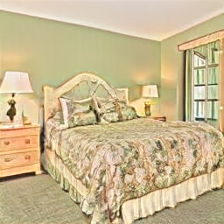
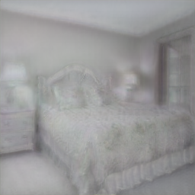
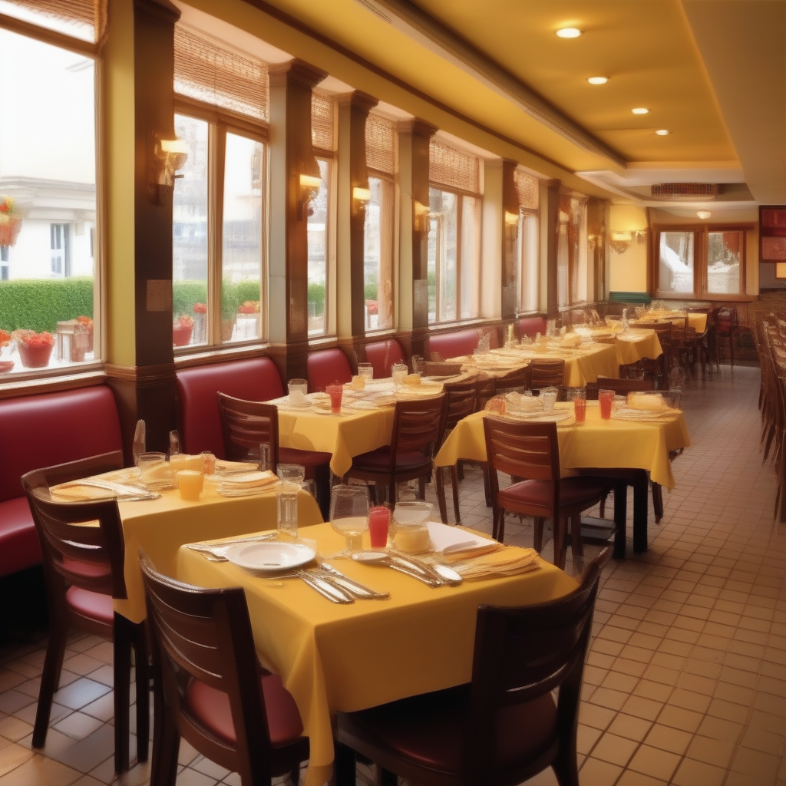
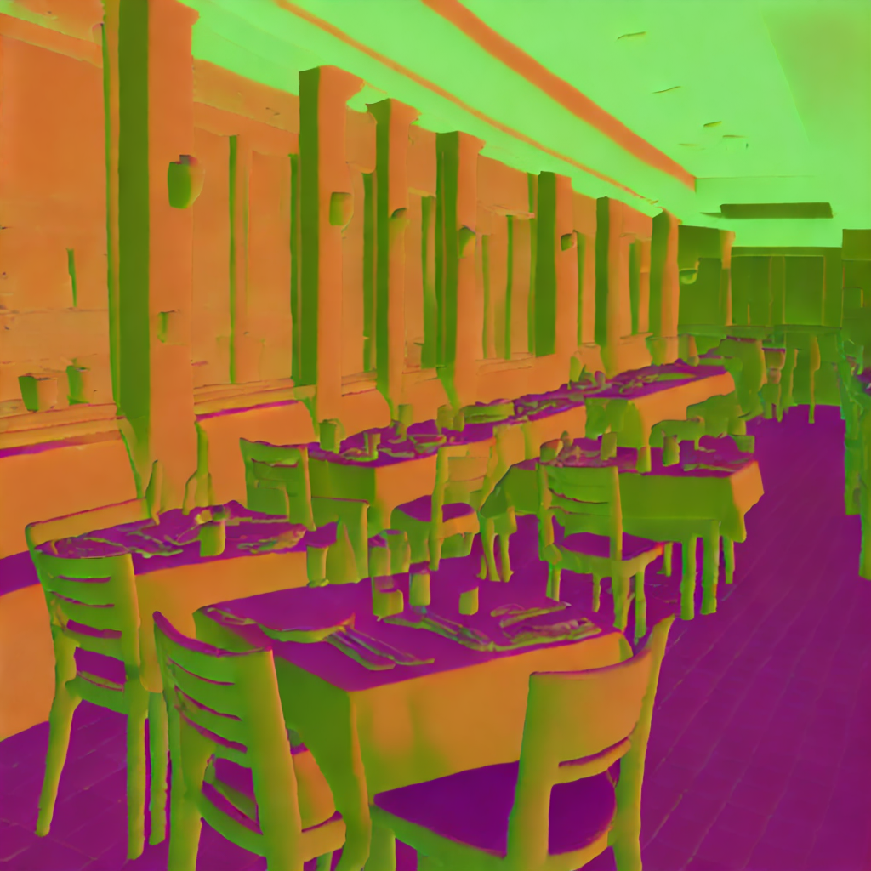
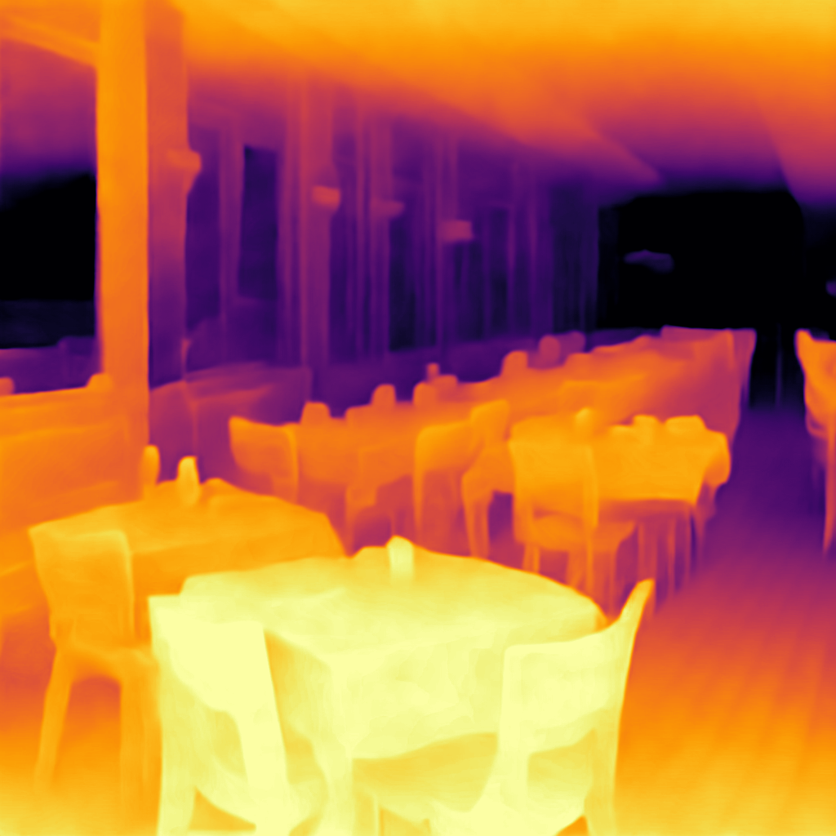
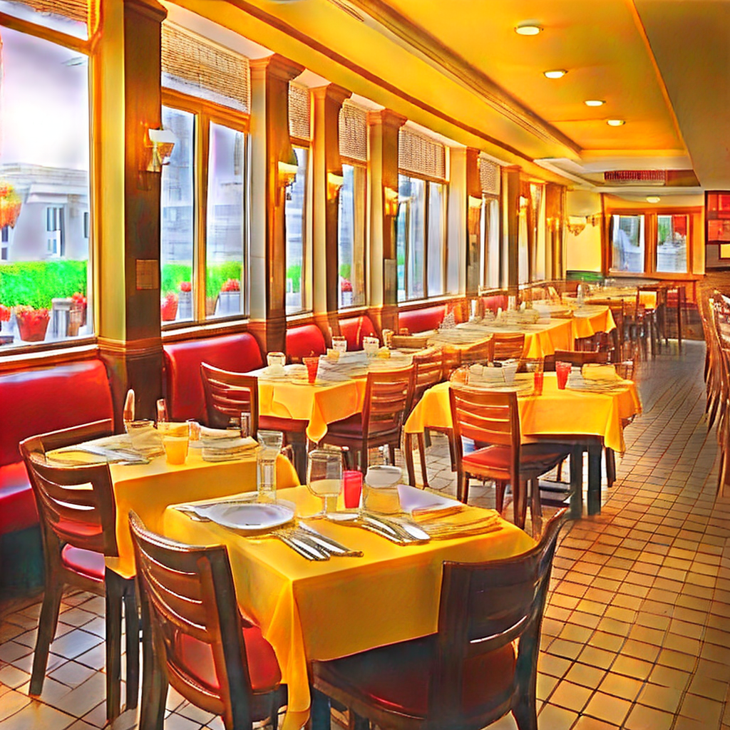
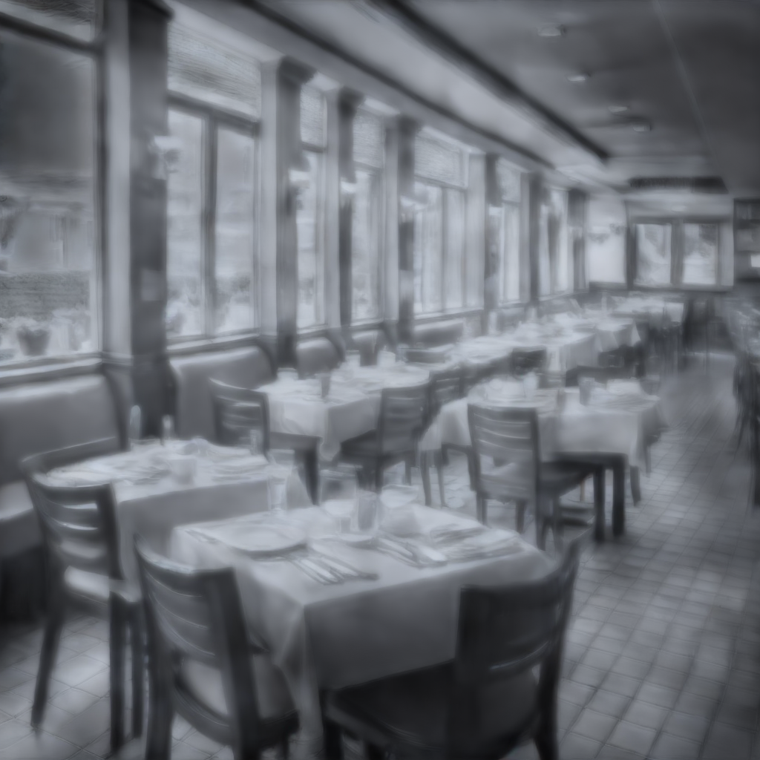
Image
Normals
Depth
Albedo
Shading
Image
Normals
Depth
Albedo
Shading
VQGAN FFHQ (Autoregressive)
StyleGAN-XL FFHQ (GAN)
Image
Normals
Depth
Albedo
Shading
StyleGAN-v2 LSUN Bedroom (GAN)
Image
Normals
Depth
Albedo
Shading
Du, … , Bhattad. CVPR-W 2024
Stable Diffusion 2.1 (Diffusion)

Slide 6
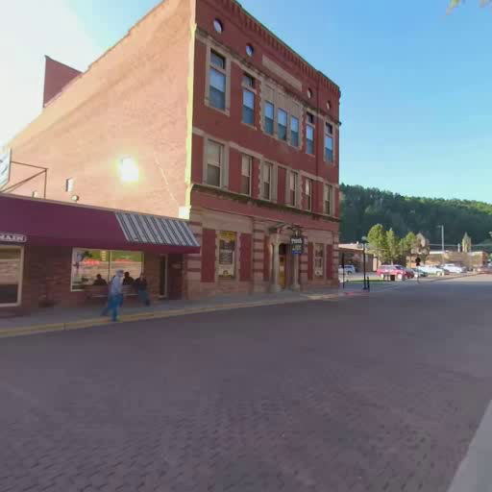
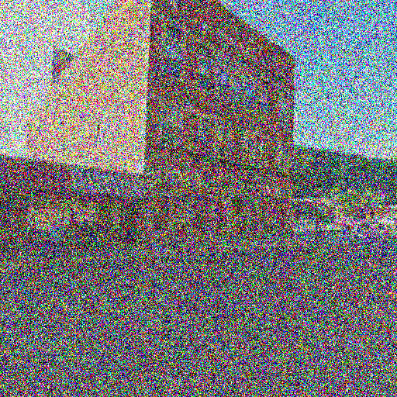
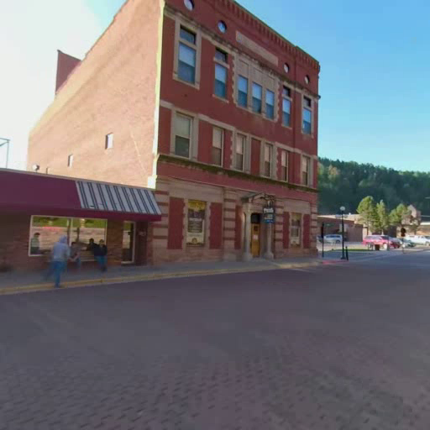
Idea
Translate: Forward 5m, Right 10m
Rotate: 20° left, 5° Upward
Generative Model
Latent Diffusion Model
Starting Image
Camera Transformation
Noisy Target
Target
Wallingford, Bhattad et al. NeurIPS 2024 360-1M: Learning to Imagine the world from 1M 360 videos

Slide 7
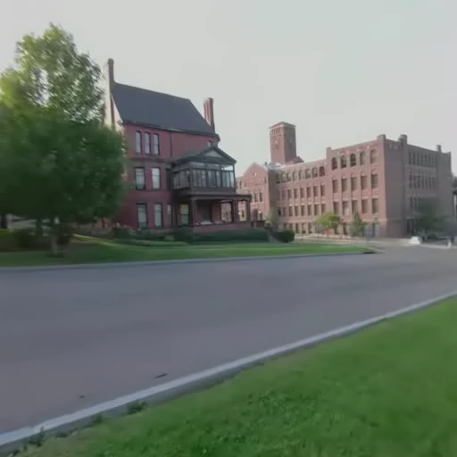

Slide 8
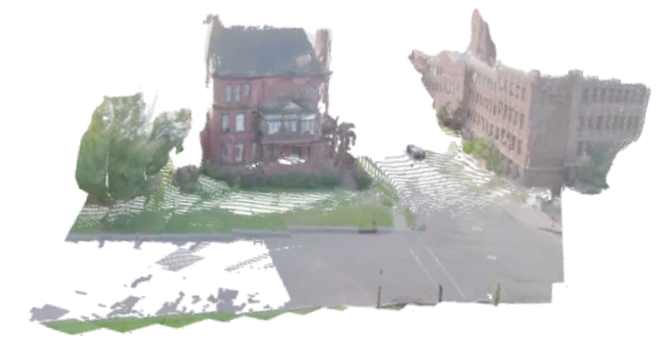

Slide 9
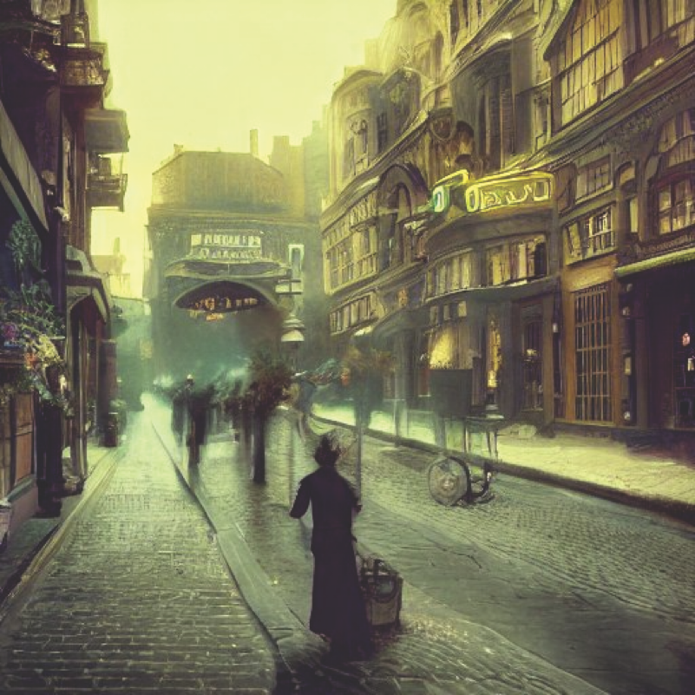
Iffy projective geometry
https://huggingface.co/spaces/stabilityai/stable-diffusion/discussions/1593

Slide 10
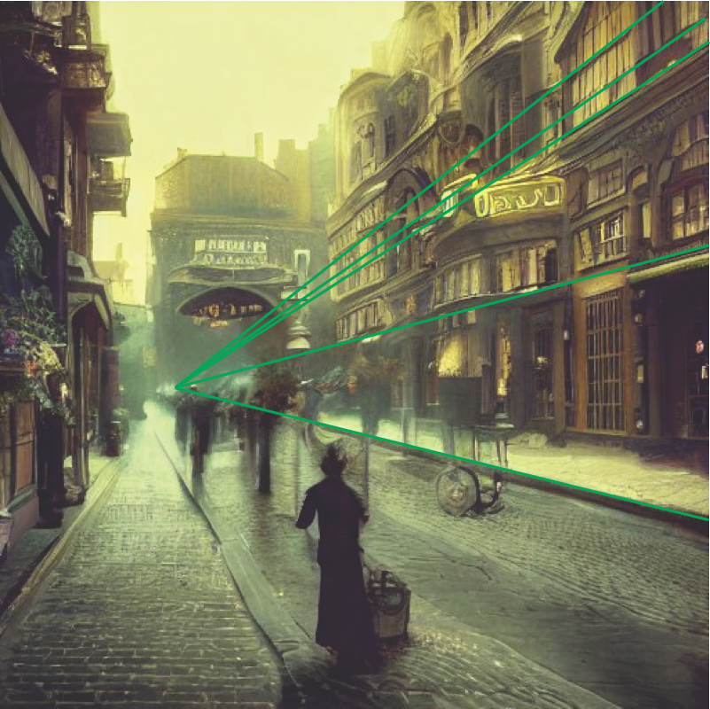
Iffy projective geometry
https://huggingface.co/spaces/stabilityai/stable-diffusion/discussions/1593

Slide 11
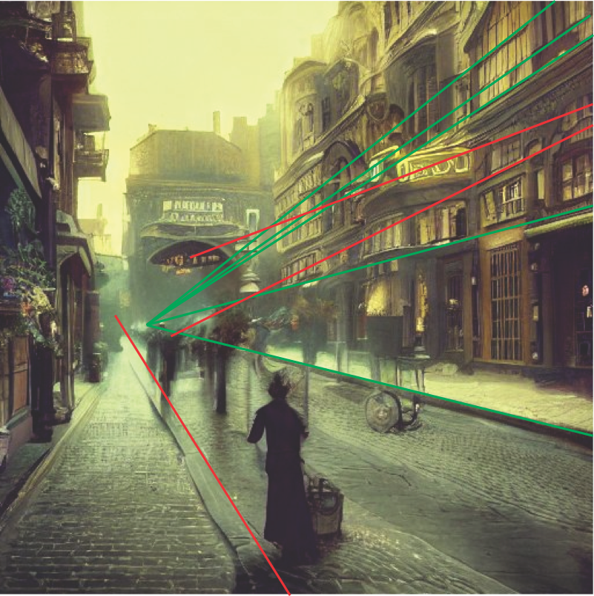
Iffy projective geometry
https://huggingface.co/spaces/stabilityai/stable-diffusion/discussions/1593

Slide 12
Real or generated?

Slide 13
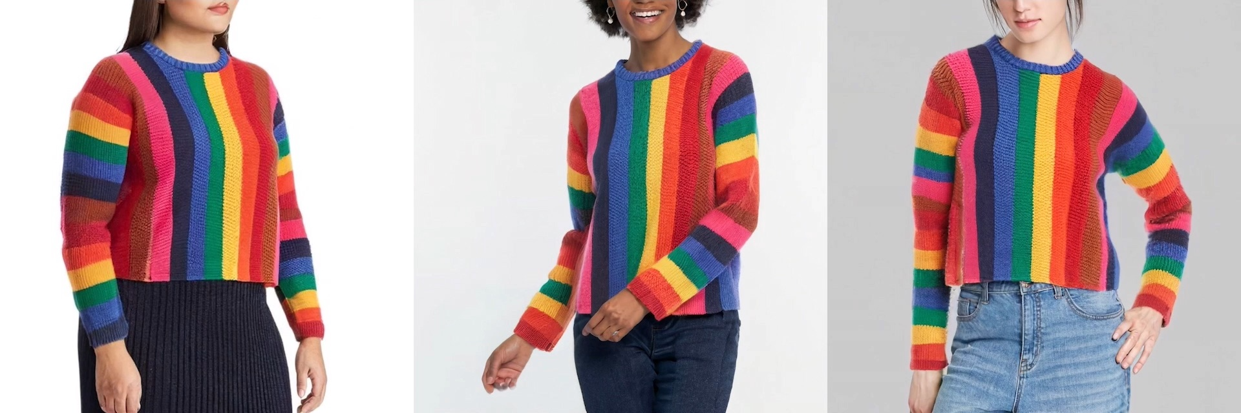
Synthesizing clothing
Zhu et al 23: Tryondiffusion: A tale of two unets

Slide 14
Zhu et al 23: Tryondiffusion: A tale of two unets

Slide 15
Scale
relative to
bear

Slide 16
He’s got
someone
else’s nose!
Scale
relative to
politician

