Slide 1
Last blocks:
Build an encoder and a decoder to:
Accept noisy image, produce clean version
By:
Constructing loss
Applying SGD to get minimal loss on training data
Using various tricks to get good behavior

Slide 2
Order
UNET
Depth prediction
Depth and normal are related
Normal Prediction
Equivariance
Other predictors

Slide 3
Now change what the decoder does…
An ”image like” thing
may have the same resolution as the image
continuous
lots of examples
can be predicted from an image (but how do we know?)
Examples:
depth
normal
defogged image
superresolution
lots of others..

Slide 4
New recipe, depth case
Procedure:
find many training pairs (image, depth)
adjust filters so that
Decode(Encode(image)) is close to depth
on average, over pairs
hope that this generalizes to new images
Result:
Single image depth predictor

Slide 5
The U-Net
Originally
a particular architecture
Increasingly
an encoder followed by a decoder

Slide 6
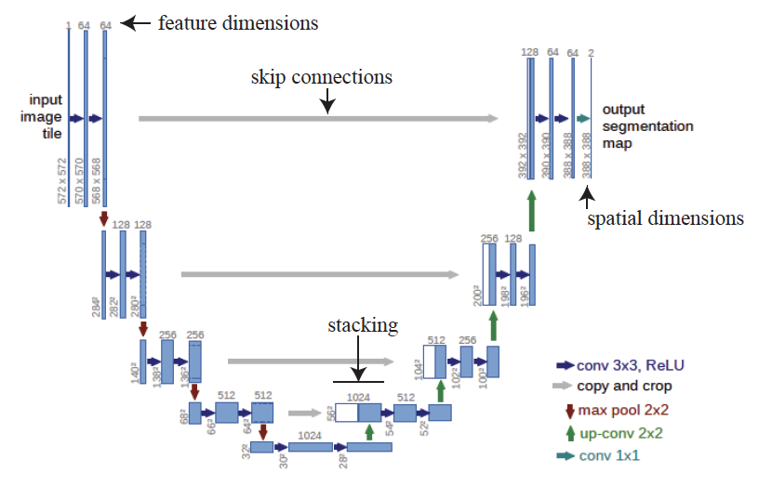
The original U-net
This doesn’t
have to be a
segmentation

Slide 7
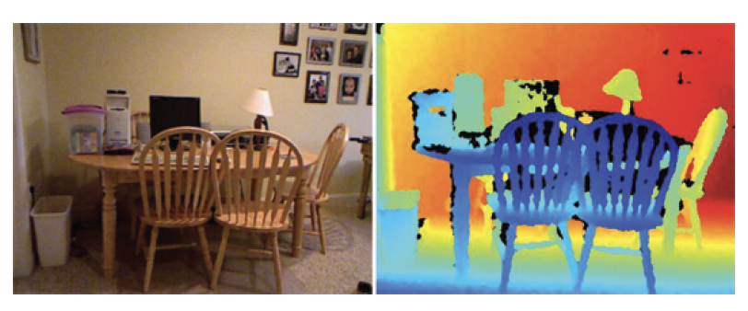
Image and depth
Data example from NYUV2

Slide 8
What should a depth predictor predict?
Absolute depth:
Might be very difficult to get right
compare:
zoomed picture of a doll-house room
picture of real room
Relative depth:
depth up to per-image scale
more likely to get this right, but harder to use

Slide 9
Scale and error
Nearby objects are more interesting than distant ones
you collide with them first
Want smaller error in small depths than in large depths
squared error tends to yield small errors in large predictions
Relative error = error/(true value)
Want smaller relative error in small depths, too

Slide 10
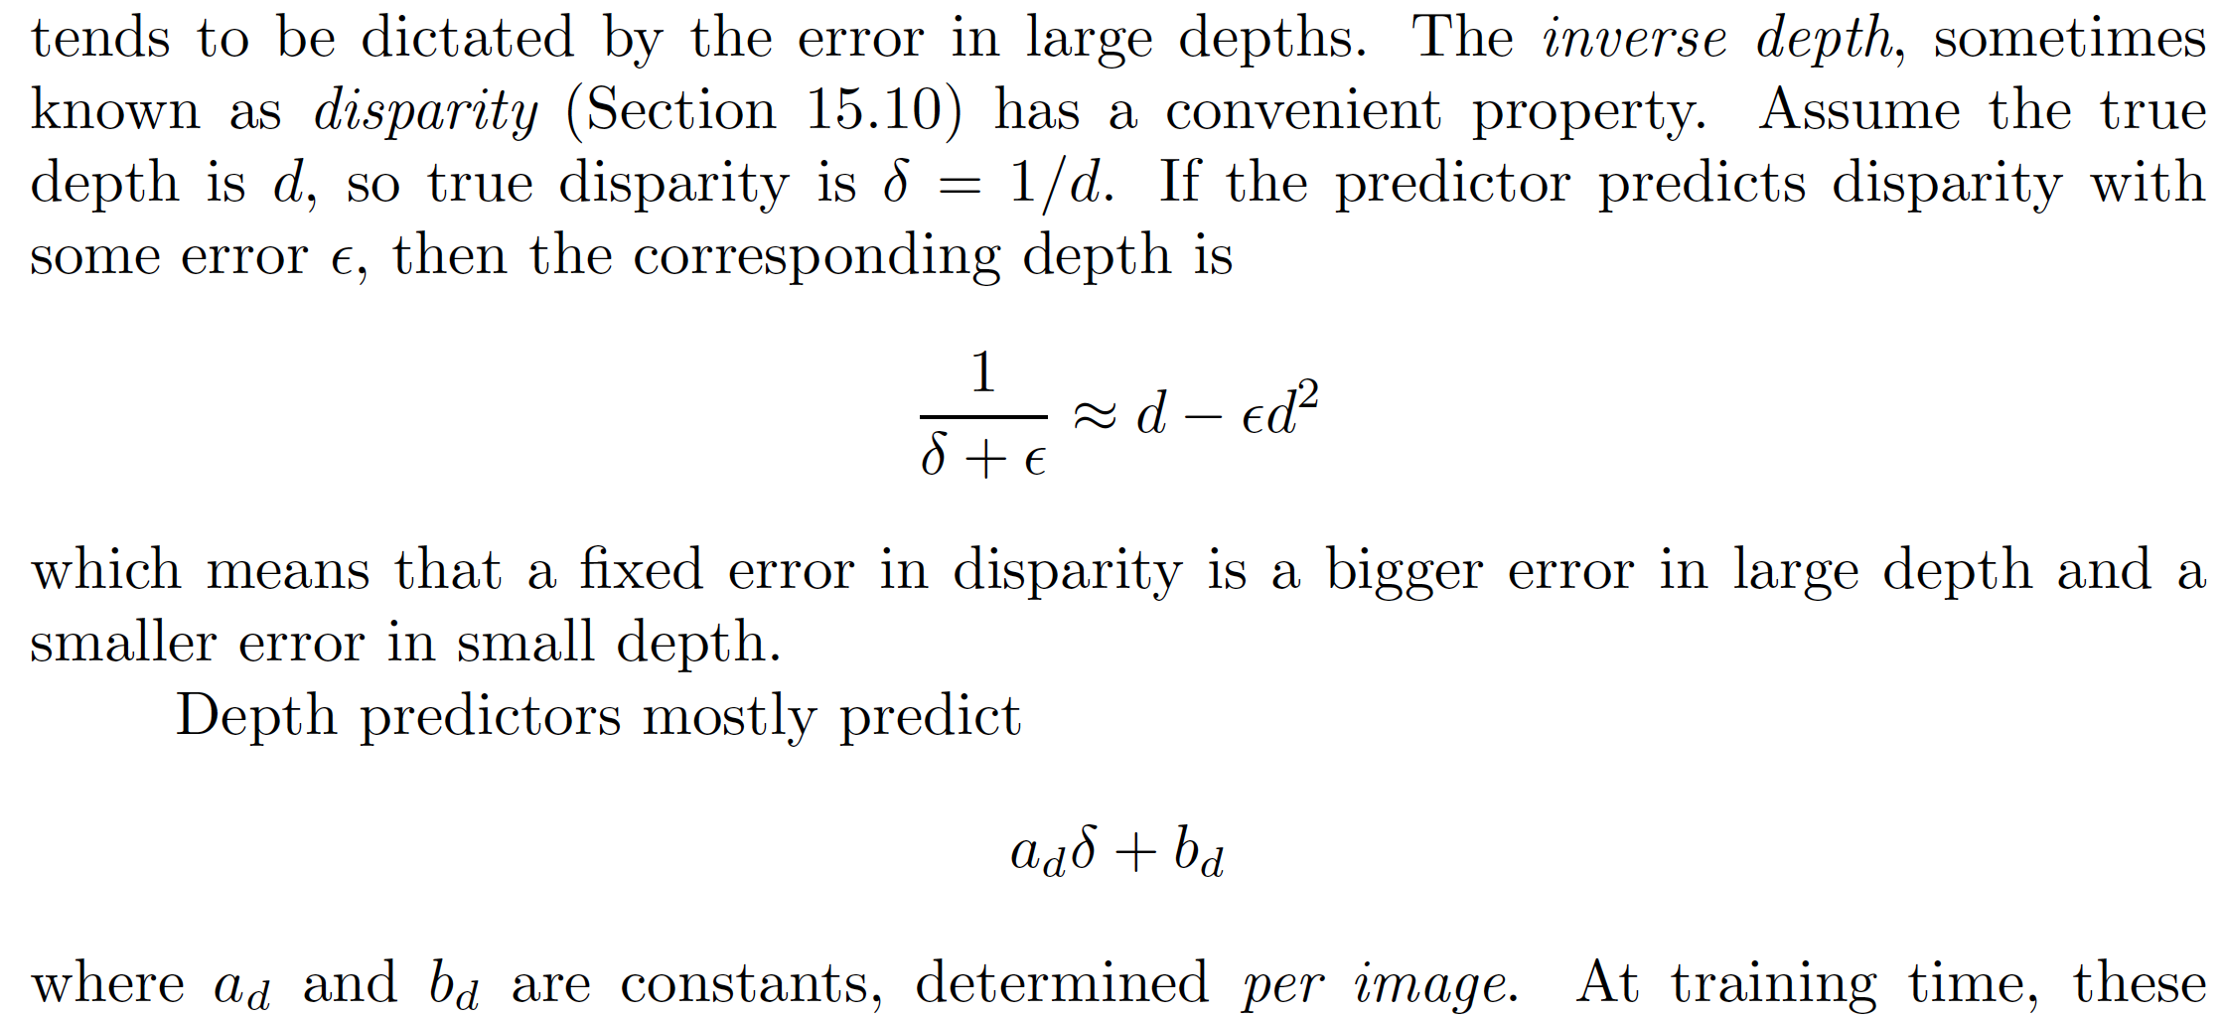
What should a depth predictor predict?
Disparity = (1/depth)

Slide 11
Losses

Slide 12
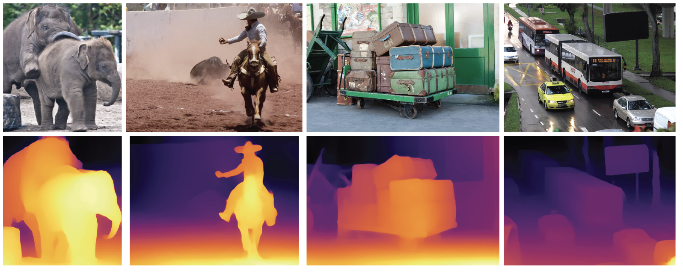
Depth predictors work really well

Slide 13
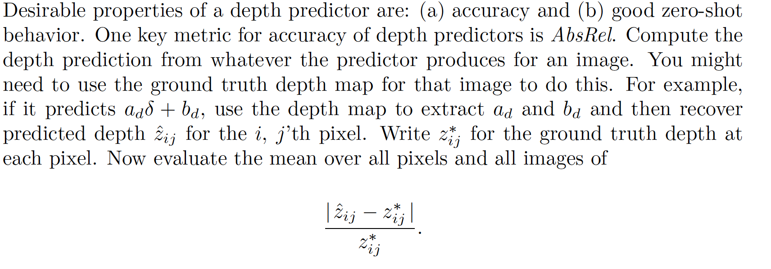
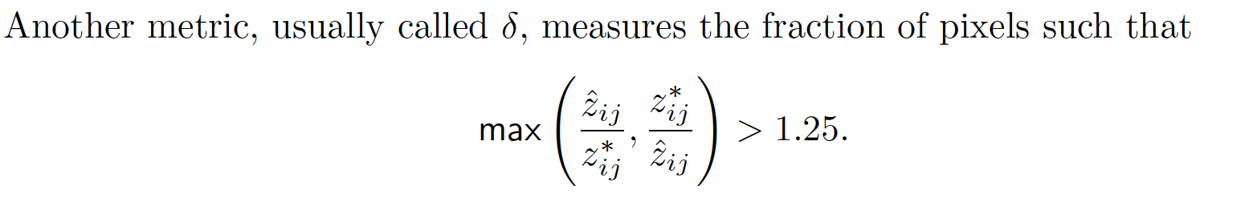
Evaluating depth predictions
Absrel
Delta

Slide 14
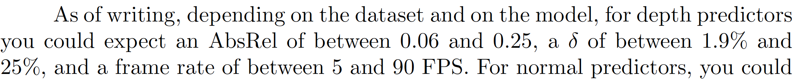
Rough SOTA
Generally, faster is less accurate
(good sign that payoff makes sense)

Slide 15
New recipe, normal case
Procedure:
find many training pairs (image, normal)
adjust filters so that
Decode(Encode(image)) is close to normal
on average, over pairs
hope that this generalizes to new images
Result:
Single image normal predictor

Slide 16
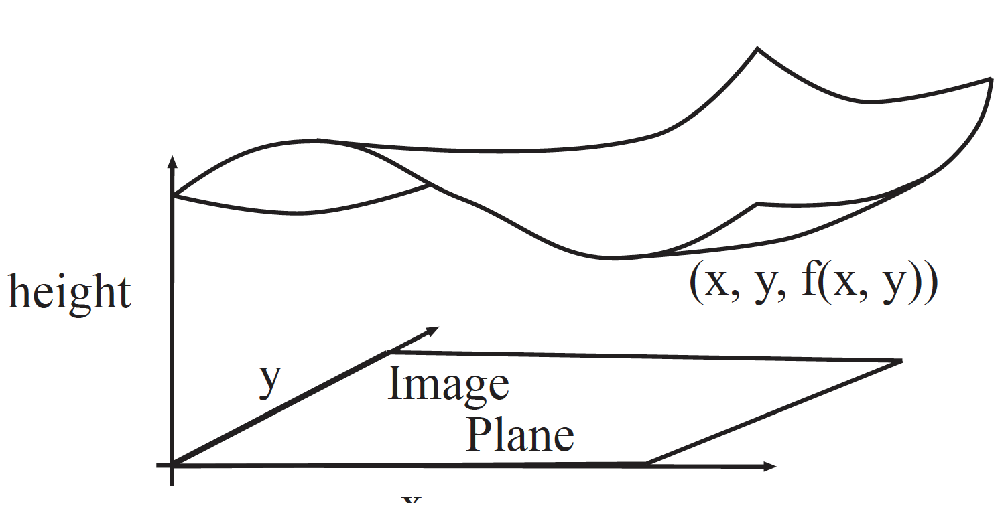
Geometrical model (for now)
At (x, y) in image, depth is f(x, y)
We see a surface (x, y, f(x, y))

Slide 17
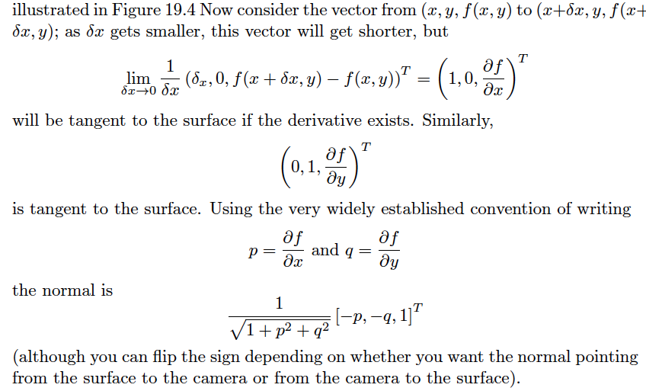
Normal from depth

Slide 18
Normal from depth
Notice that derivatives => noise problems => smoothing
Alternative:
If you have depth data, fit a plane locally
use the plane’s normal
Notice also that there is noise in measured depths
(property of depth cameras)

Slide 19
Image and depth
Data example from NYUV2

Slide 20
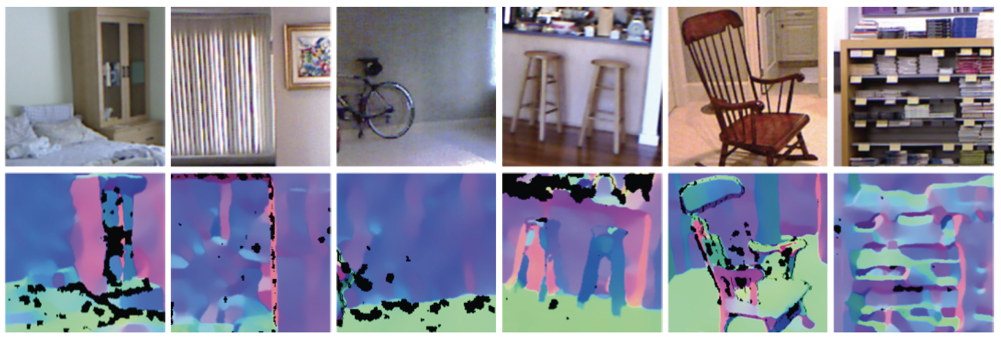
Normal estimates from depth data can be shaky

Slide 21
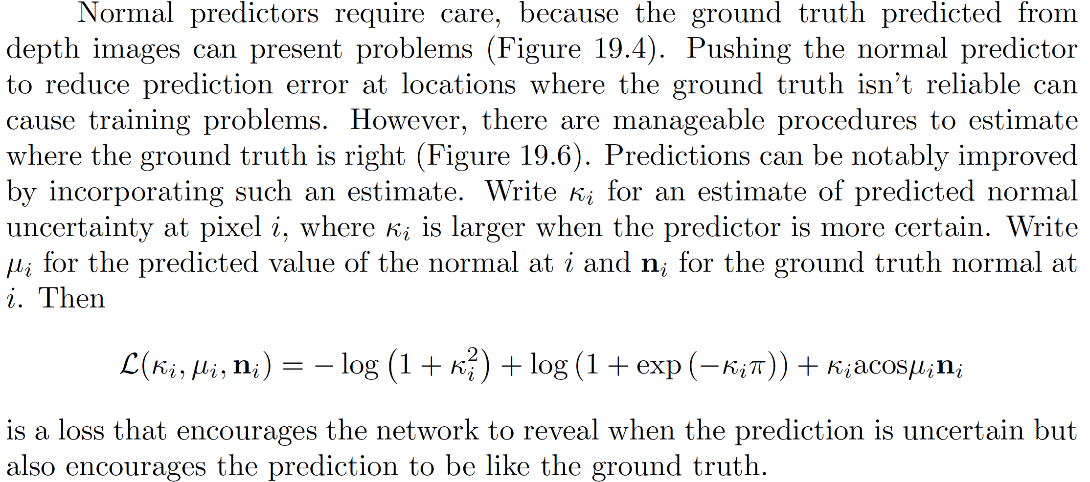
Loss – building in a confidence score

Slide 22
Rough story
If normals associated with similar patches are similar
k can be big
If they’re not
k must be small
Result: you can estimate k

Slide 23
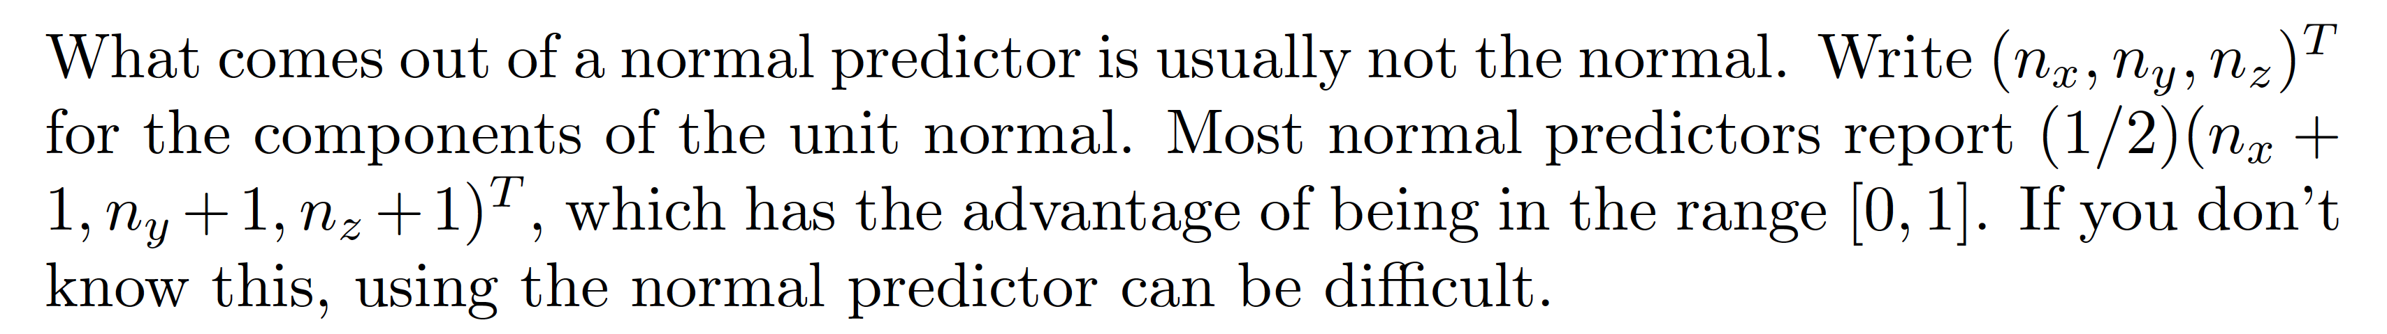
What normal predictors predict

Slide 24
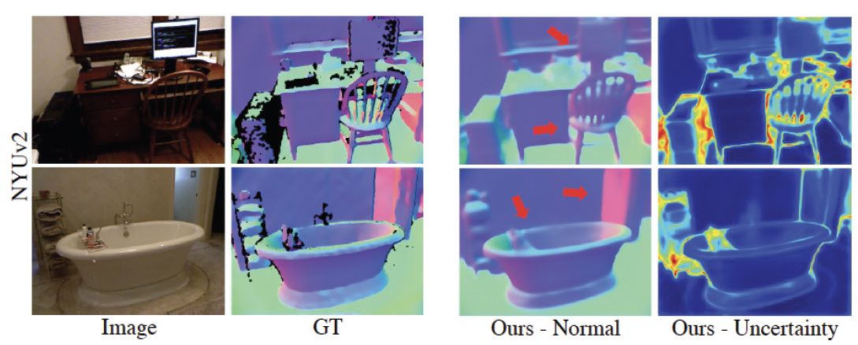
Normal predictors work really well too

Slide 25
Evaluating normal predictors

Slide 26
SOTA

Slide 27
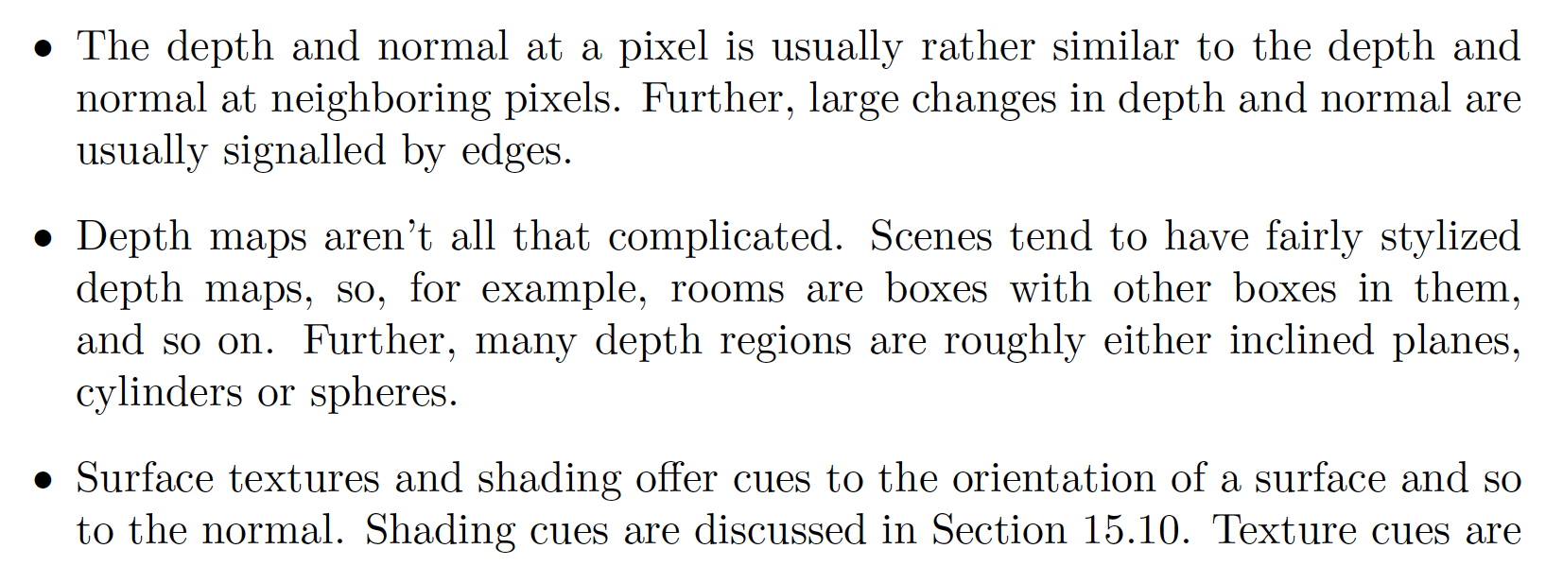
Why does all this work? I

Slide 28
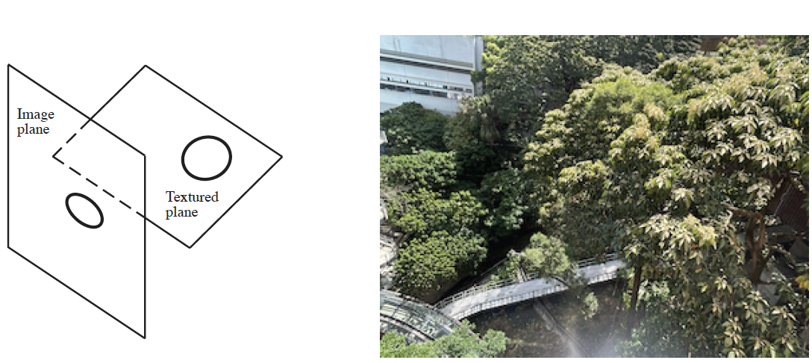
Why does all this work? II
Texture deformations are a cue to normals
(archaic term: shape from texture)

Slide 29
Depth and normal are linked
You can predict normal from depth
You can predict depth from normal (next slide)
Idea:
train depth and normal predictors together
with a consistency loss
improvements manifest

Slide 30
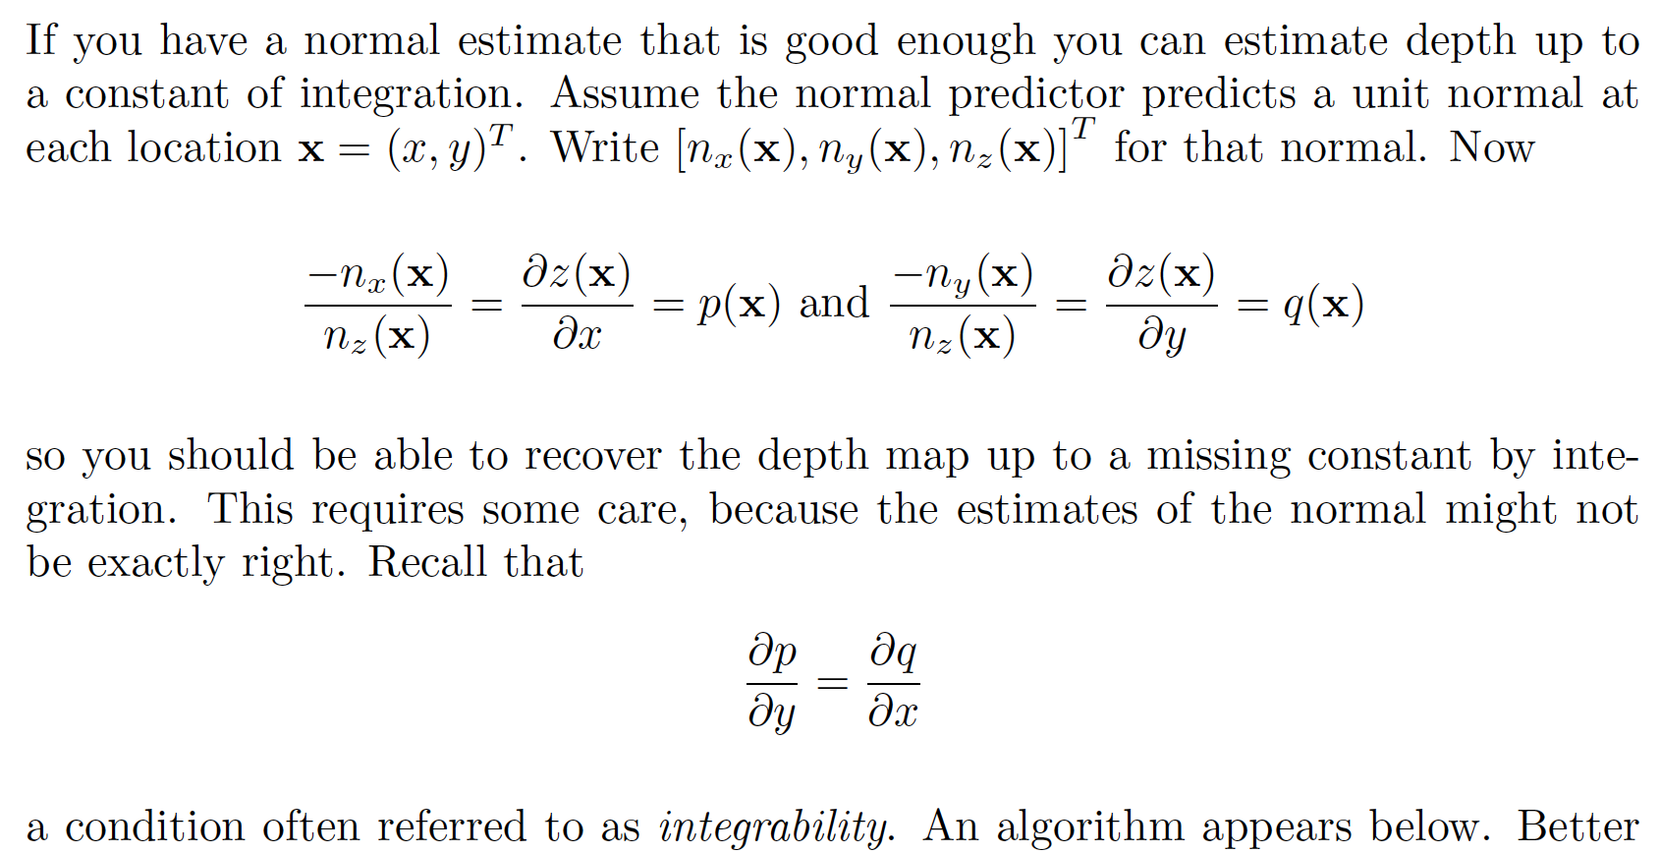
Depth from normal

Slide 31
Curiosities
The U-Net is fully convolutional
is this a good thing?
Equivariance
harder than it looks
Other encoders are possible
but not now

Slide 32
This U-net is fully convolutional
Consists of convolutional layers, pooling layers, upsampling layers, ReLU’s
Consequence:
You can pass in images of variable size
(as long as they’re big enough)
Advantage:
Images have variable size in real life
Issue:
This can make some problems very hard.

Slide 33
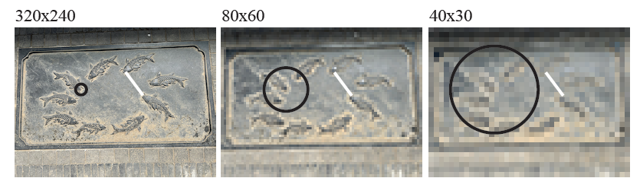
Consequence
The same network feature depends on a different spatial scale in the image for different size images
This can present problems, but doesn’t usually
training data seems to deal with this

Slide 34
Curiosities
The U-Net is fully convolutional
is this a good thing?
Equivariance
harder than it looks
Other encoders are possible
but not now

Slide 35
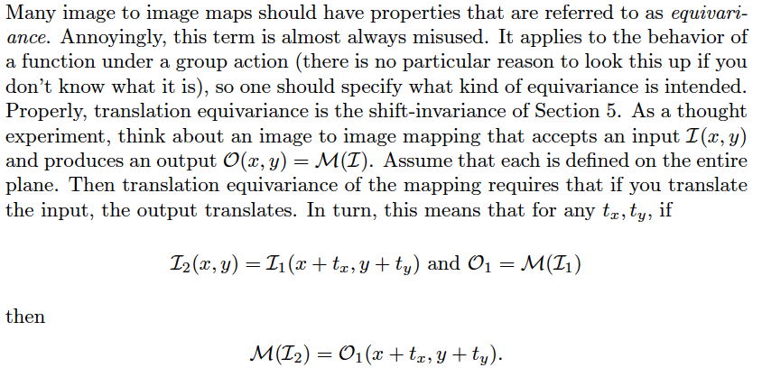
Equivariance
What you want, but
can’t get

Slide 36
You can only get this property if you don’t pad
Which is almost always impractical
Padding makes up for the fact the image isn’t infinite
but means that when you shift, you see new pixels

Slide 37
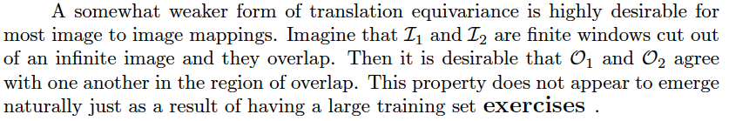
What you might be able to get
In practice, this property doesn’t just appear, and requires special training.
Most SOTA image-image mappers don’t have it!

Slide 38
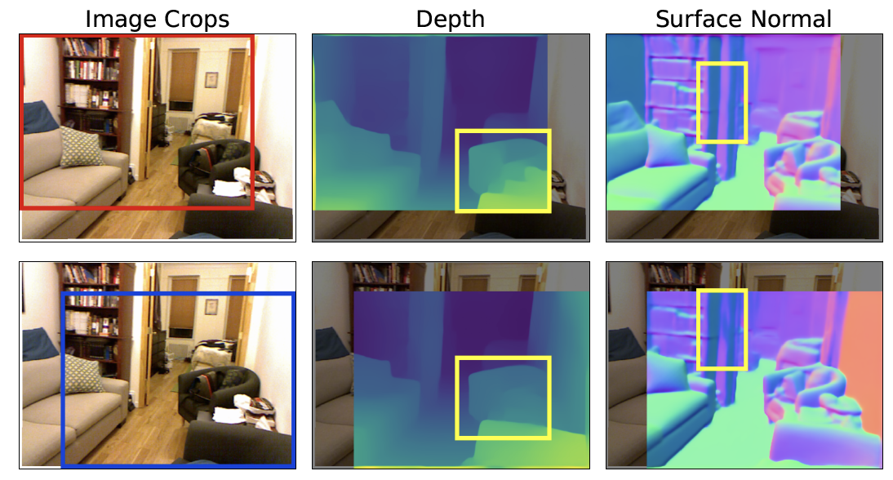

Slide 39
Curiosities
The U-Net is fully convolutional
is this a good thing?
Equivariance
harder than it looks
Other encoders are possible
but not now

Slide 40
Further image to image mapping
Generally, it’s worth trying anything with
image in – image like thing out
Cases here:
Denoising (did this); superresolution; defogging
Other possibilities:
Fix underwater pix; derain; fix color balance; change lighting (?)
Recipe needs changing for...
Edges; semantic segmentation (coming up)

Slide 41
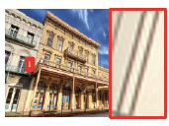
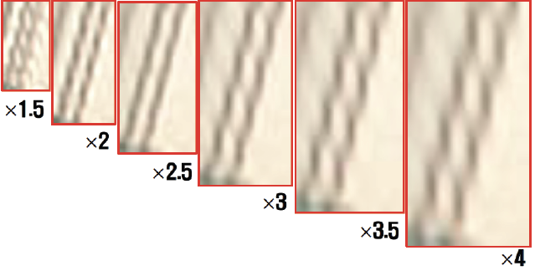
Superresolution
Take low res image, make high res image:
Baseline: upsample and interpolate
Possibly:
Build network for each of 1.5xupsample, 2xupsample, etc.
Ideally, network ”doesn’t know”
by how much you are upsampling
Fully convolutional u-net helps
This was trained for
2x upsampling

Slide 42



Superresolution
In:
Upsampled, interpolated low resolution image
Out:
estimated residual
True high-res image-upsampled interpolated low res
Est true image:

Slide 43
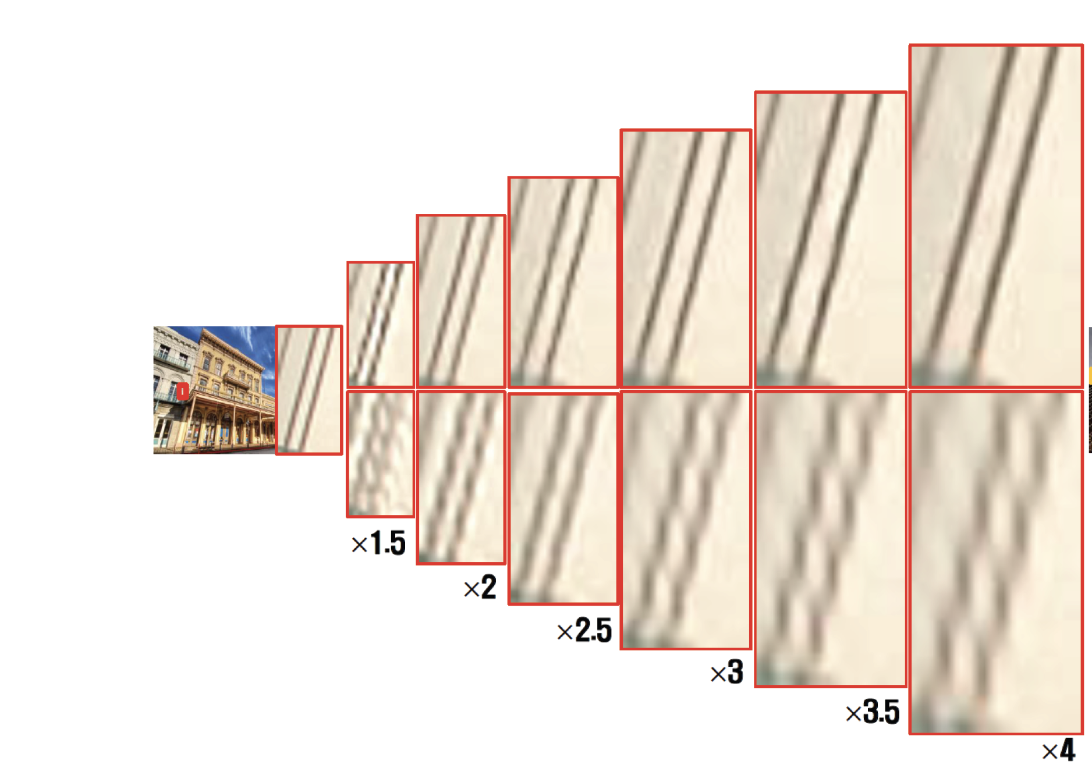
Superresolution works

Slide 44
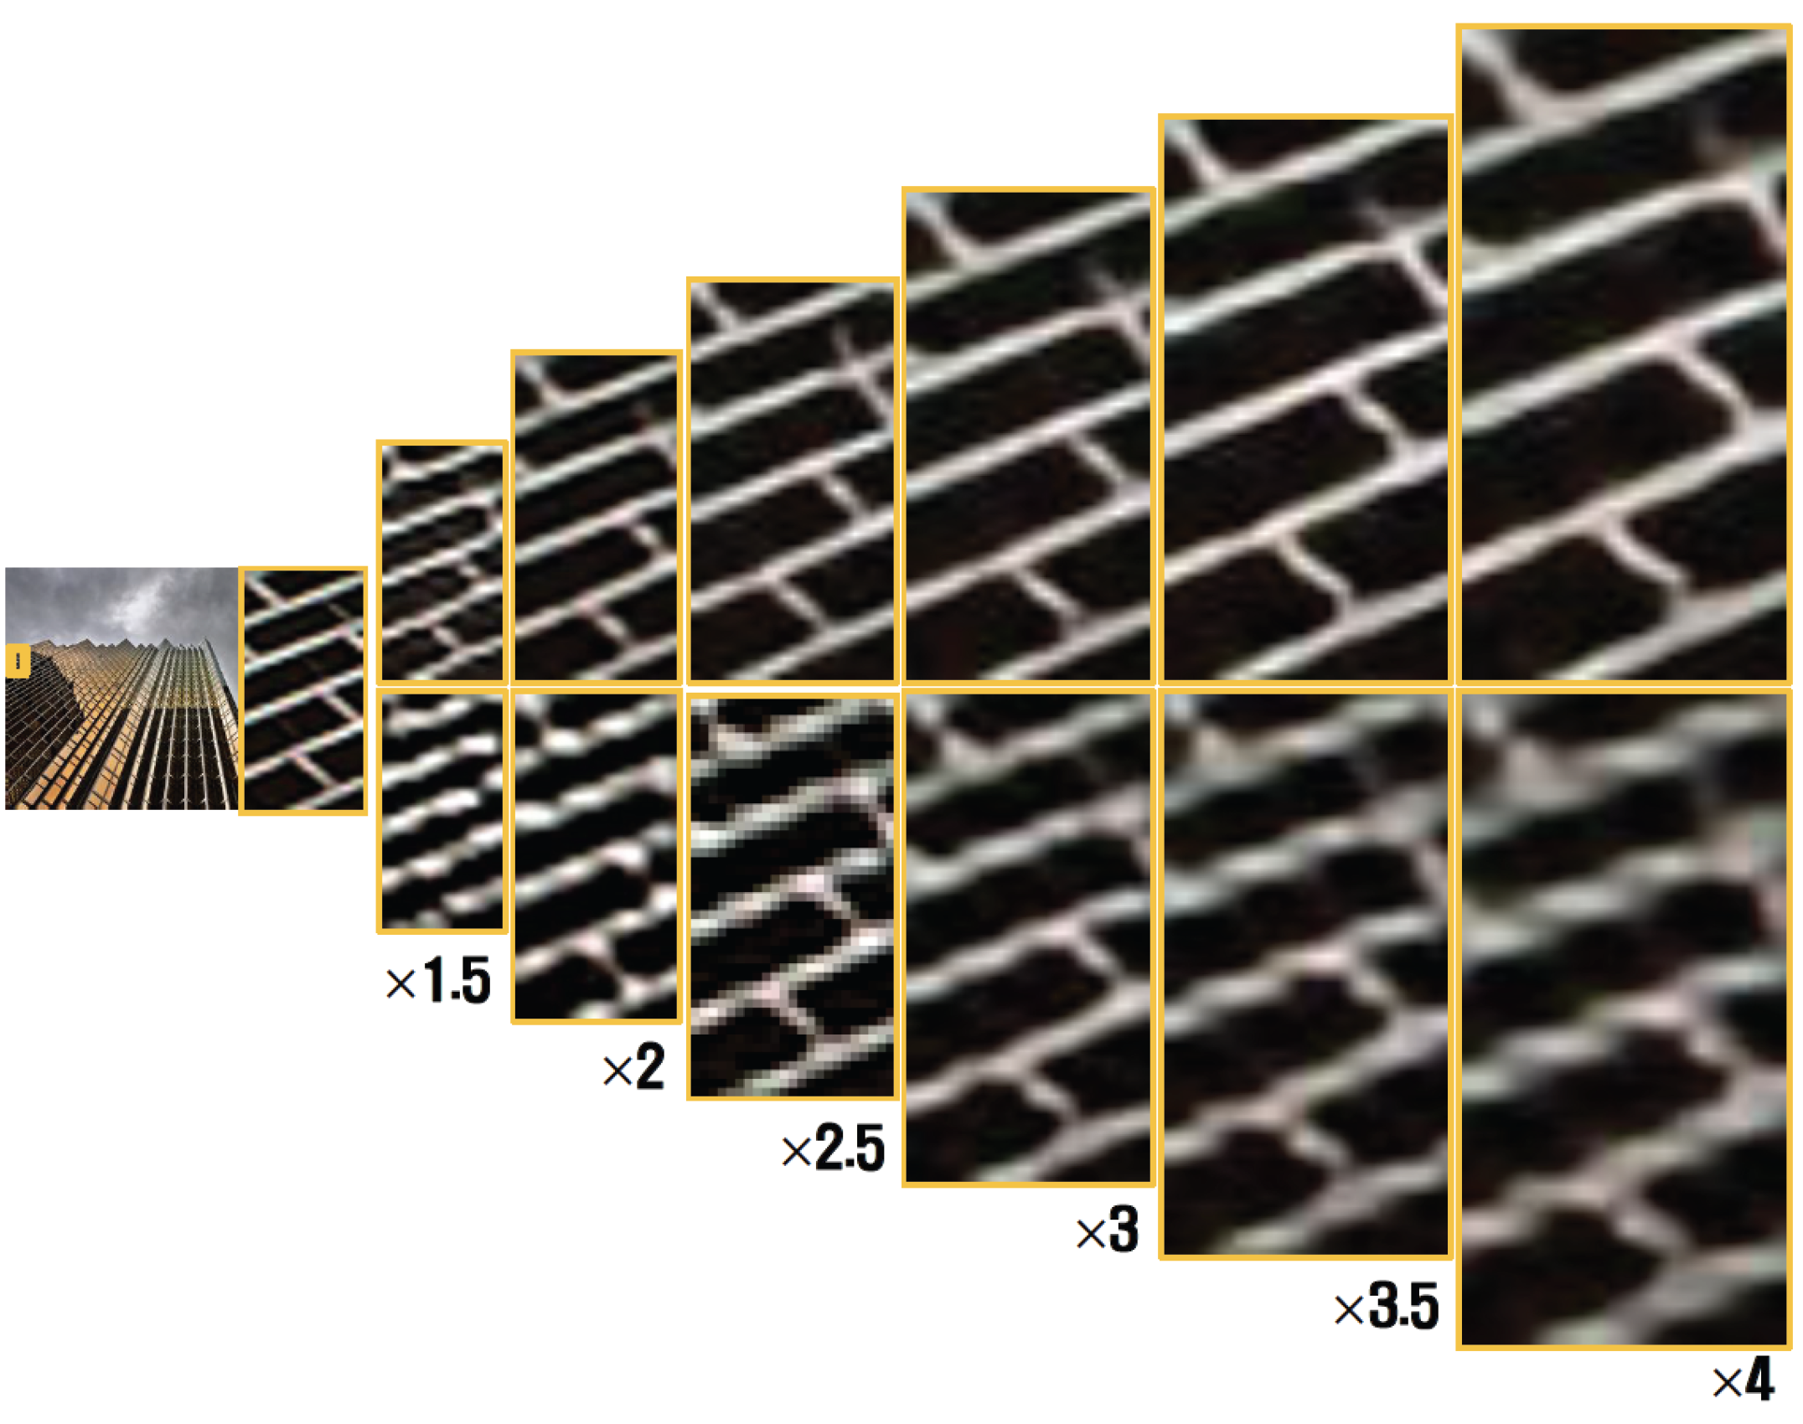
Superresolution works

Slide 45

Training and evaluation
Train on L1/L2 loss
perhaps some more stuff, later...

Slide 46
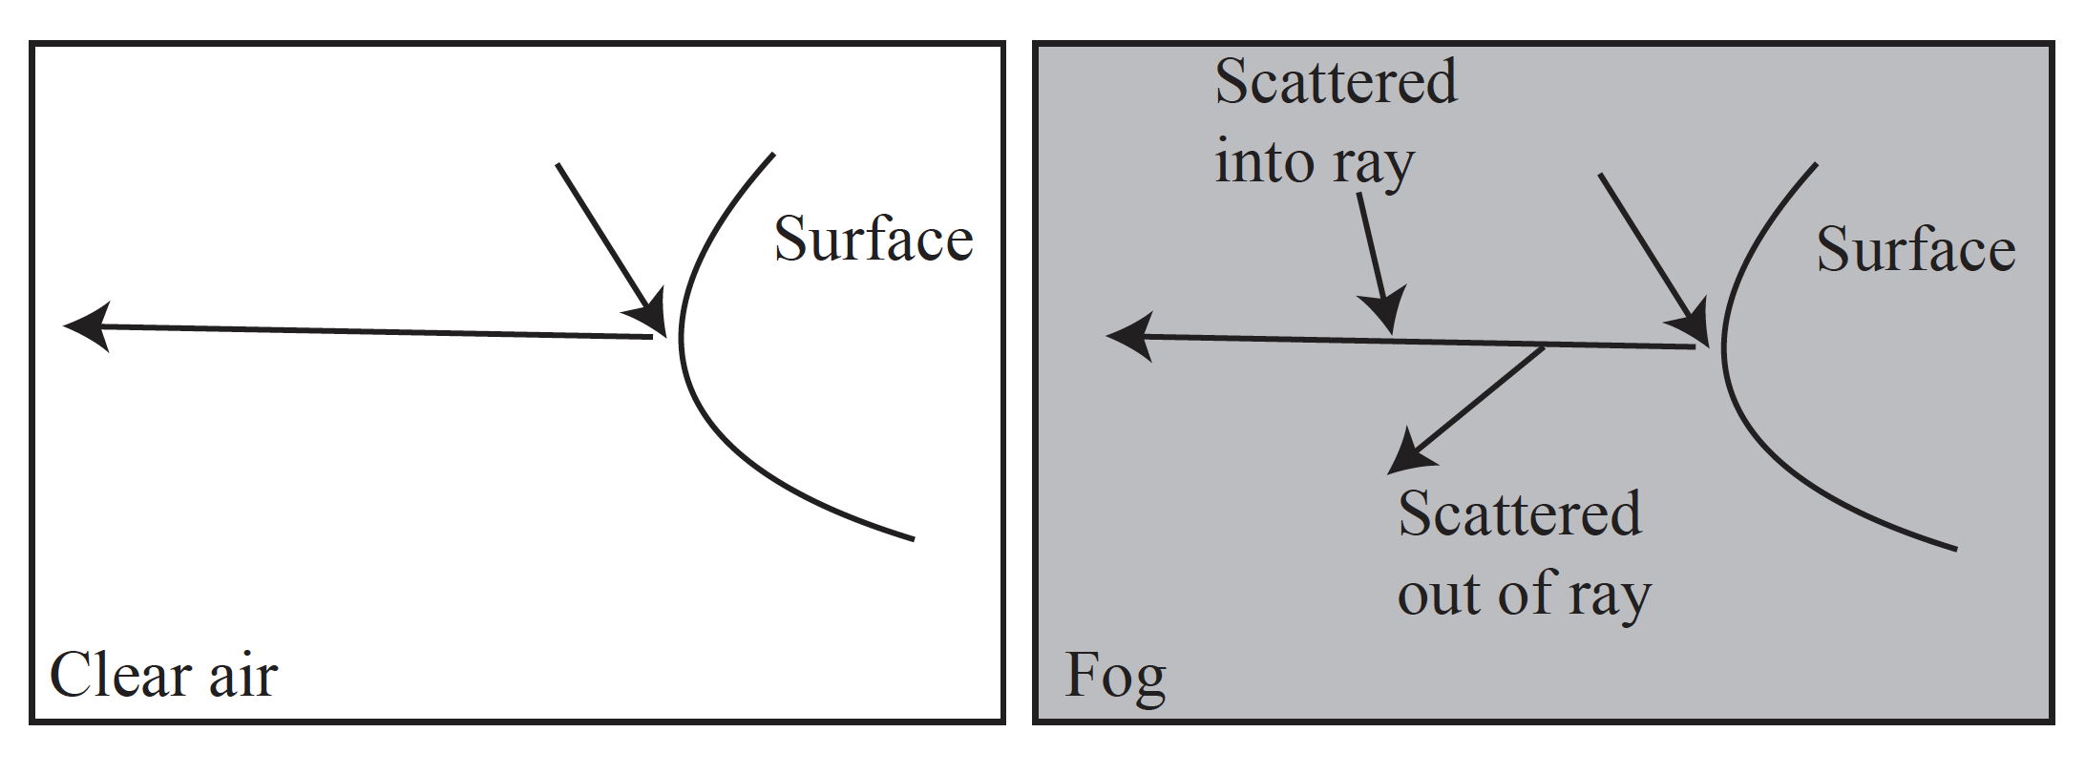
Defogging
Fog scatters light out of and into the ray from surface to eye
results:
distant surfaces experience color shift, depending on depth
image is blurred, blurring depends on depth

Slide 47

Model of defogging
(Doesn’t cover blurring, but..)

Slide 48
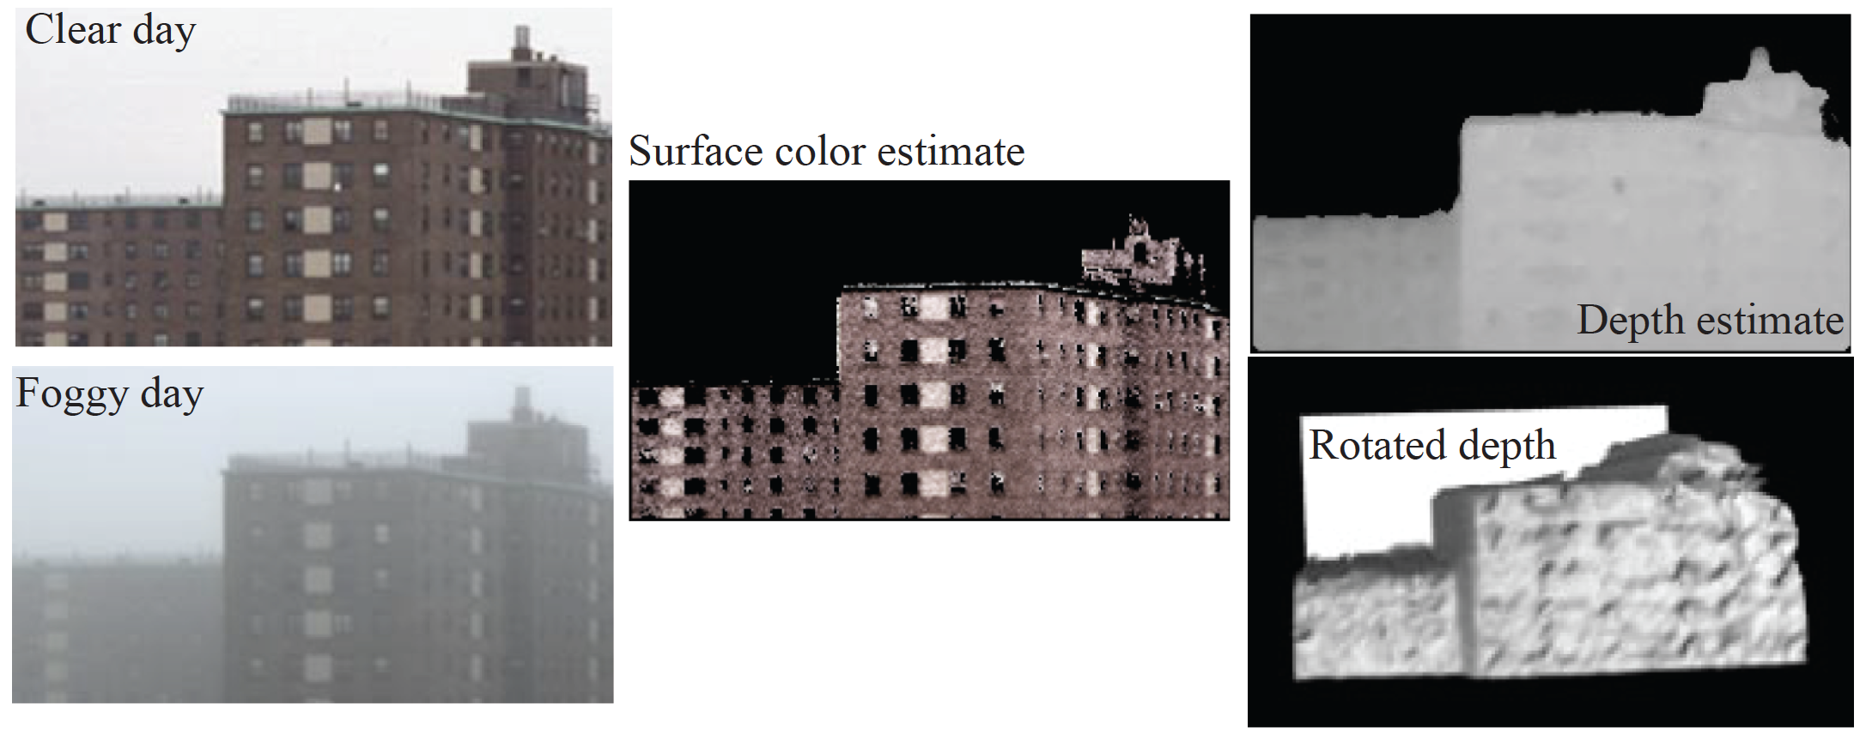
Amusing fact – you can recover depth from fog

Slide 49
Data is hard!
(image of real scene with no fog, image of same scene w/fog)
is very hard to get.
you can get them, but hard to get one and very hard to get many
Simulation is straightforward
(image no fog, image with sim fog)
is easy to get, and works
Evaluation
usually, PSNR on simulated images, sometimes PSNR on real

Slide 50
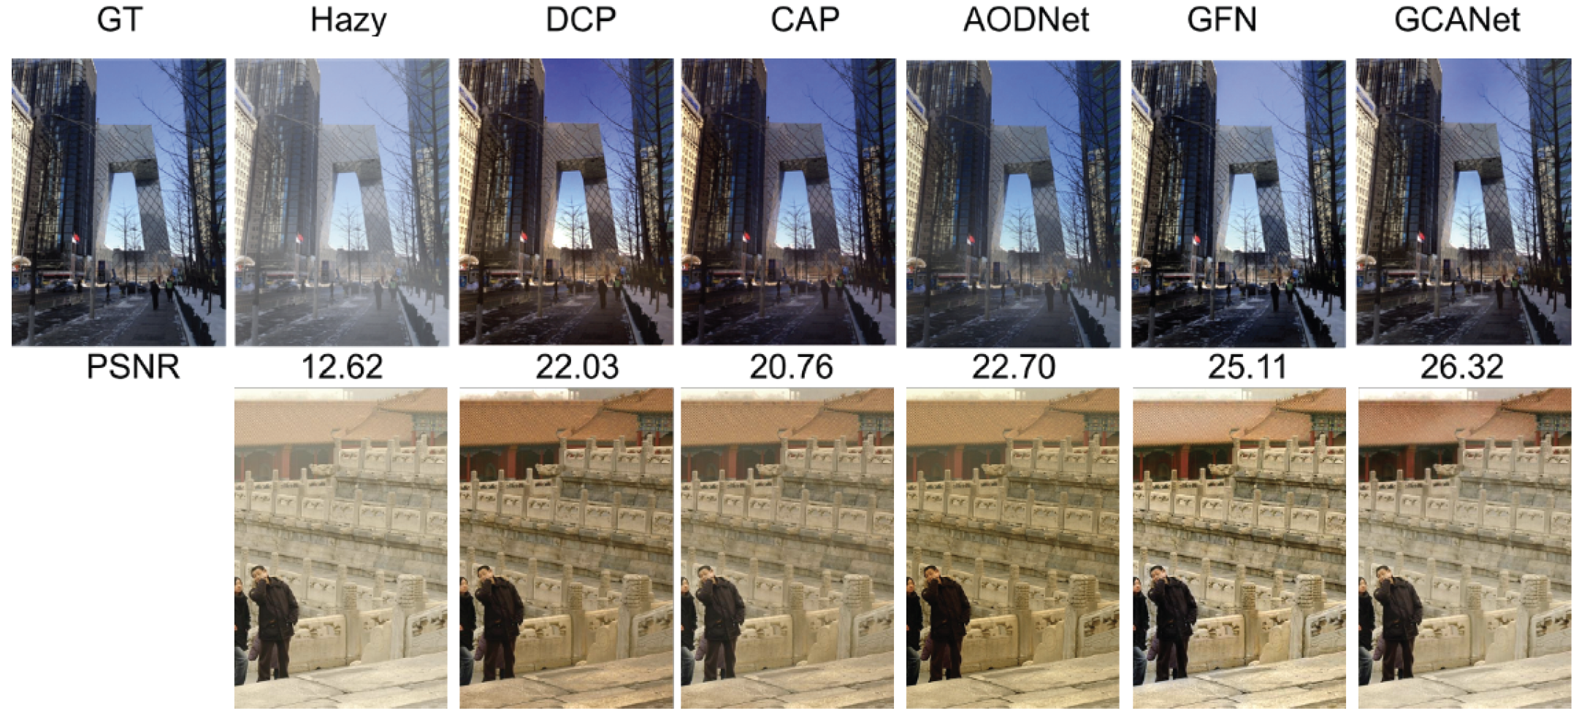
Defogging
This is real foggy
image so original
is unknown

