Slide 2
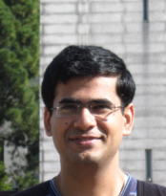
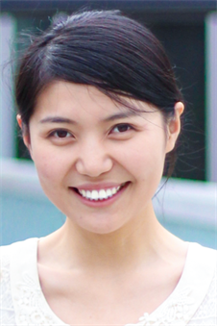
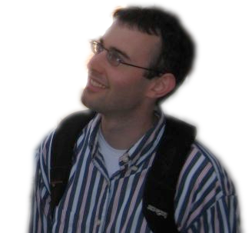
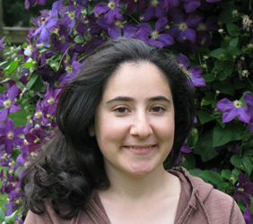
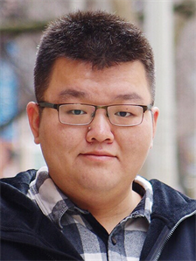
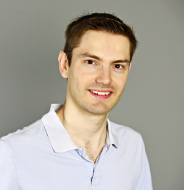
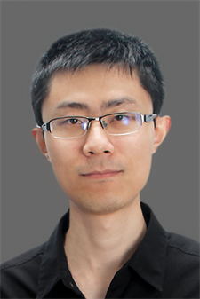
Vision group at Illinois
David Forsyth
Marr prize, 1993; 2 ex students with Marr prizes; IEEE Tech. Achievement, Fellow; ACM Fellow; EIC IEEE TPAMI
Derek Hoiem
best paper, CVPR 2006; ACM Doctoral Dissertation honorable mention; Sloan Fellow;PAMI-TC Young Researcher
Lana Lazebnik
Microsoft Faculty Fellow; Sloan Fellow; Koenderink Prize (2016)
Alex Schwing
Visual learning, segmentation and GAN models
Saurabh Gupta
Linking visual sensing to motion
Liangyan Gui
Understanding human movement
Shenlong Wang
Simulation and sensing for autonomous vehicles
Yuxiong Wang
Learning to detect and classify with very little data

Slide 3
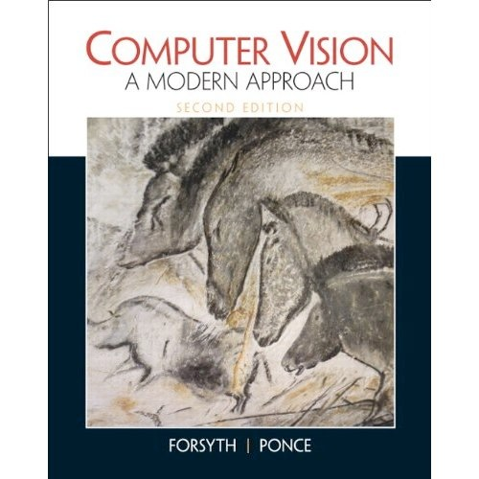
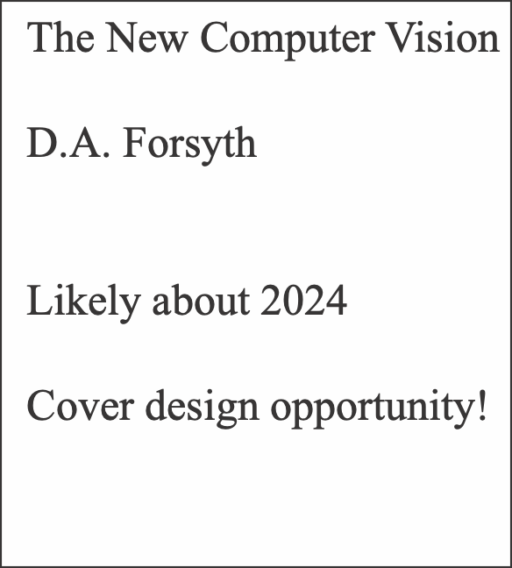
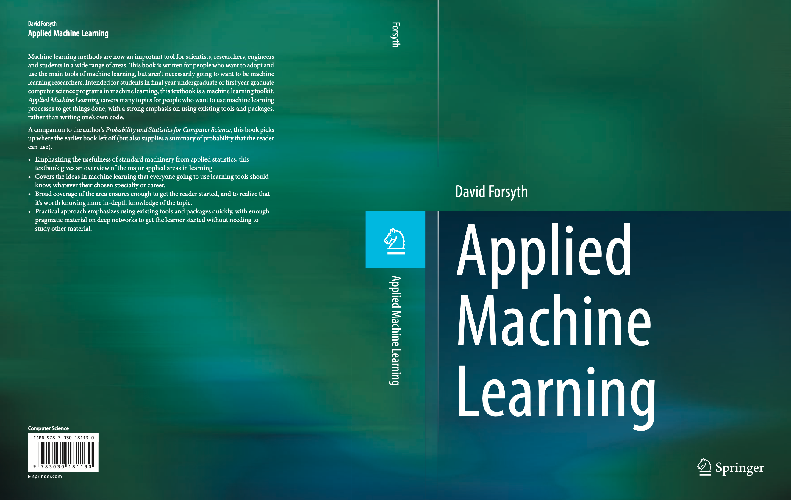
Vision group
Well-known ex-students:
Lana Lazebnik (UIUC)
Tamara Berg (UNC)
Pinar Duygulu (Hacettepe U.)
Ian Endres
Ali Farhadi (UW)
Varsha Hedau
Nazli Ikizler (Hacettepe U.)
Brett Jones
Kevin Karsch
Zicheng Liao
Deva Ramanan (CMU)
Raj Sodhi
Gang Wang (now Alibaba)
Amin Sadeghi
Zicheng Liao (Zhejiang U.)
Startups:
Lightform
Revery.ai
Reconstruct
Depix

Slide 5
Vision
Vision
Vision

