Slide 1
Regression
We must make image-like things from images
Examples:
depth map from image
normal map from image
derained image from rainy image
defogged image from foggy image
Train with pairs (image, depth)
or (image, normal), etc
Loss
Squared error +abs value of error+other terms as required

Slide 2
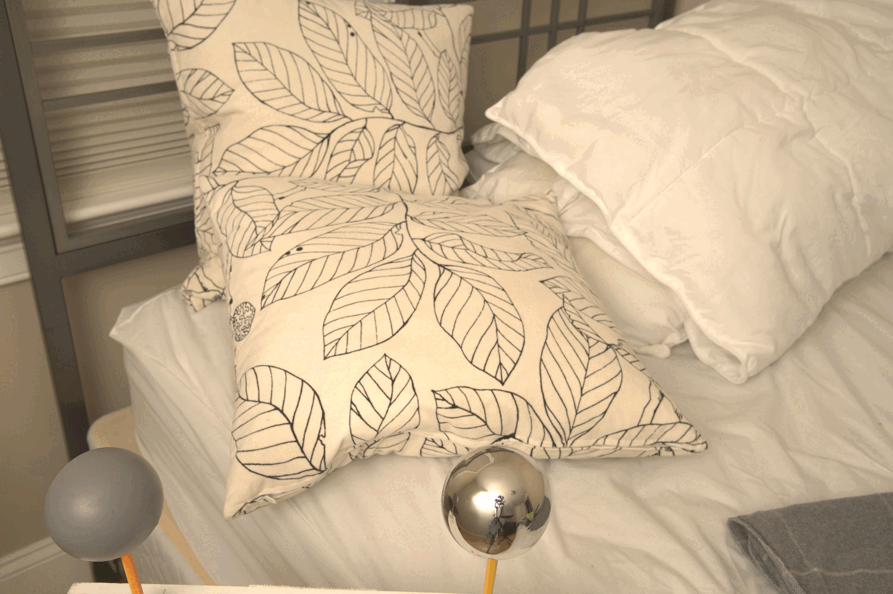
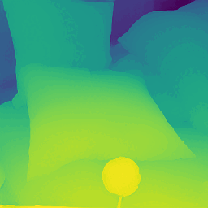
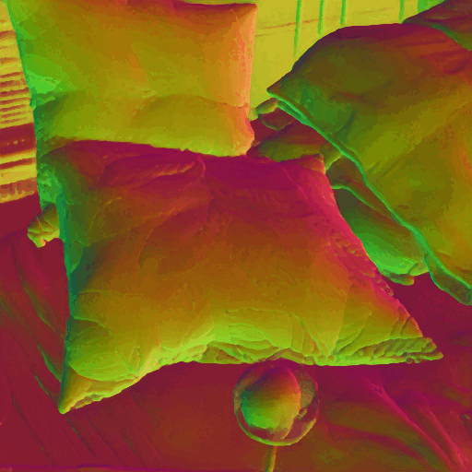
Examples
Depth (omnimap, current best depth est)
Normal (omnimap, current best normal est)

