Slide 1
Two and more cameras:
Stereo, Optic Flow and
Structure from Motion
D.A. Forsyth, UIUC

Slide 2
Stereopsis
Generically:
recover depth map from two images of scene
cameras may be calibrated/uncalibrated
may have large/small baseline
if uncalibrated, recover from fundamental matrix, above
do so by
finding correspondences
constructing depth map using correspondences
Huge literature, with multiple important tricks, etc.
I’ll mention a small set

Slide 3
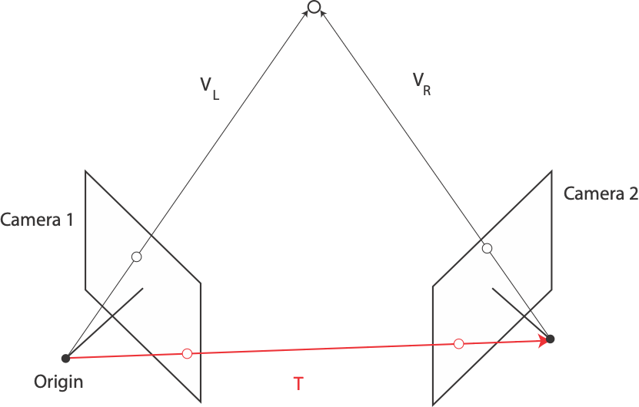
Camera translation
Camera rotation

Slide 4
But the unknown constant is unknown…
Antisymmetric
Orthonormal
Unknown constant
Different values of k will lead to different scales
of S - equivalently, different scales of translation
between cameras - you need extra information to
sort this out.

Slide 5
What we have
Can determine
the rotation between two cameras
the translation *up to scale*
From this, we can recover 3D points
up to scale

Slide 6
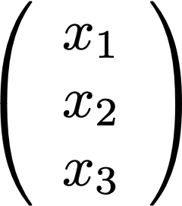
What we have
3D points:
normalized image points:
And
Original point in camera two’s coordinate system

Slide 7
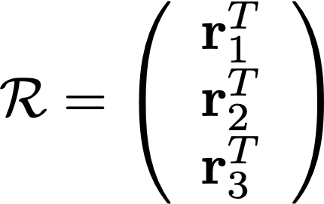
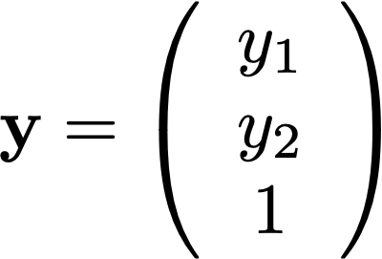
Recovering the point in 3D
Write
Then
And we have everything in 3D!

Slide 8
The effect of scale
If we know R, t, we can reconstruct point in 3D
IF we can match points across more than two cameras

Slide 9
Disparity
Assume camera 2 is translated wrt camera 1, both are calibrated
=(X, Y, Z)
B
Disparity
Baseline
Depth

Slide 11
Pragmatics
Issue
Match points
Strategy
correspondences occur only along relevant epipolar line
represent points with local representation
color + surface smoothness; filters; some kind of deep feature
Issue
some points don’t have correspondences (occlusion)
Match left to right, then right to left
if they don’t agree, break match

Slide 12
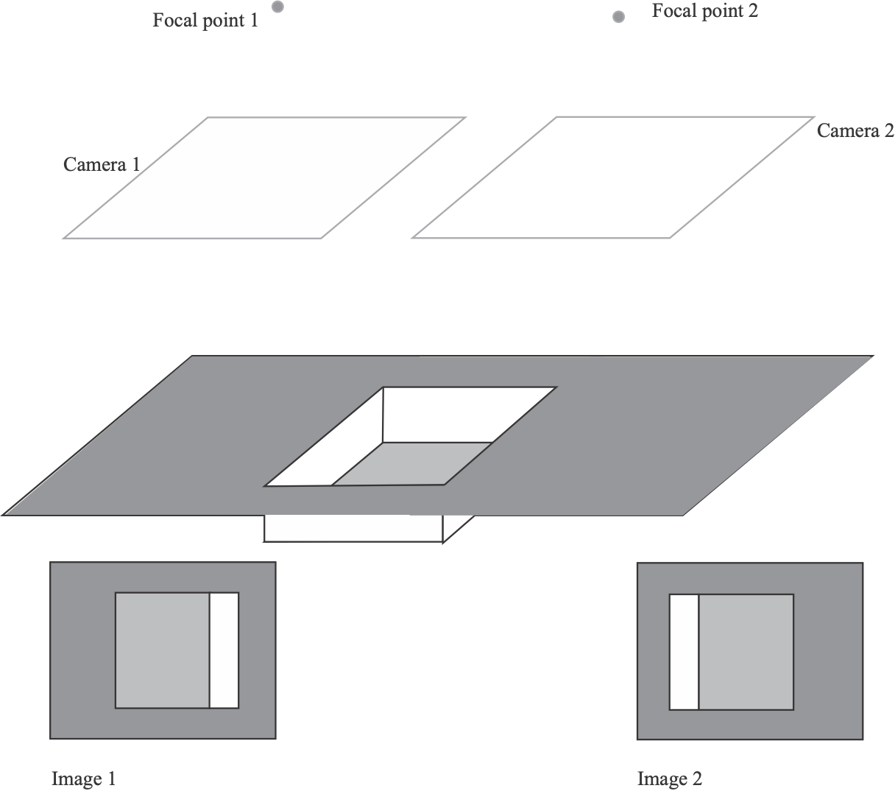
Some points don’t have matches

Slide 13
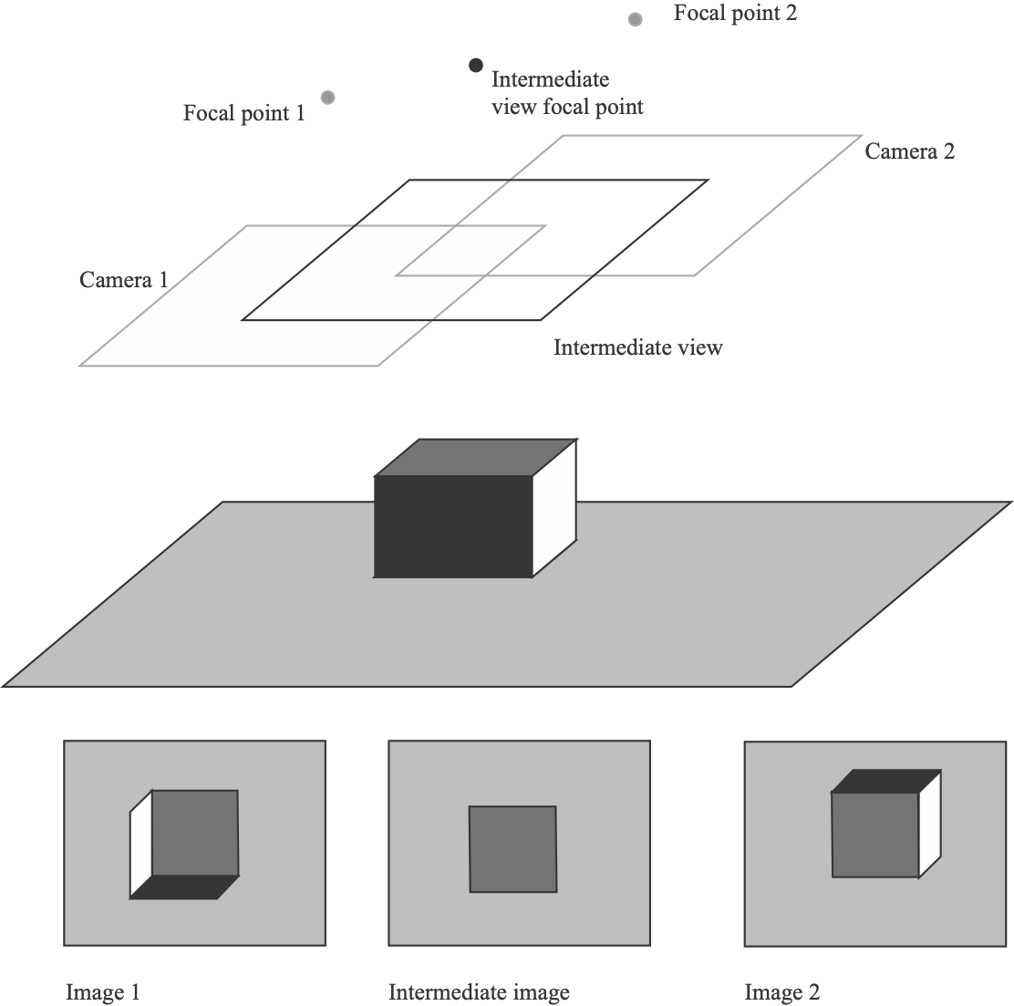
Some points don’t have matches

Slide 14
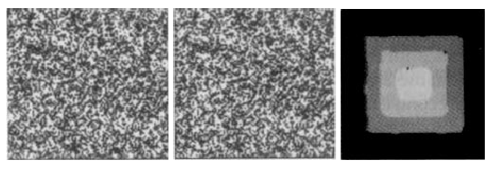
From Jones and Malik, “A computational framework for determining
Stereo correspondences from a set of linear spatial filters

Slide 15
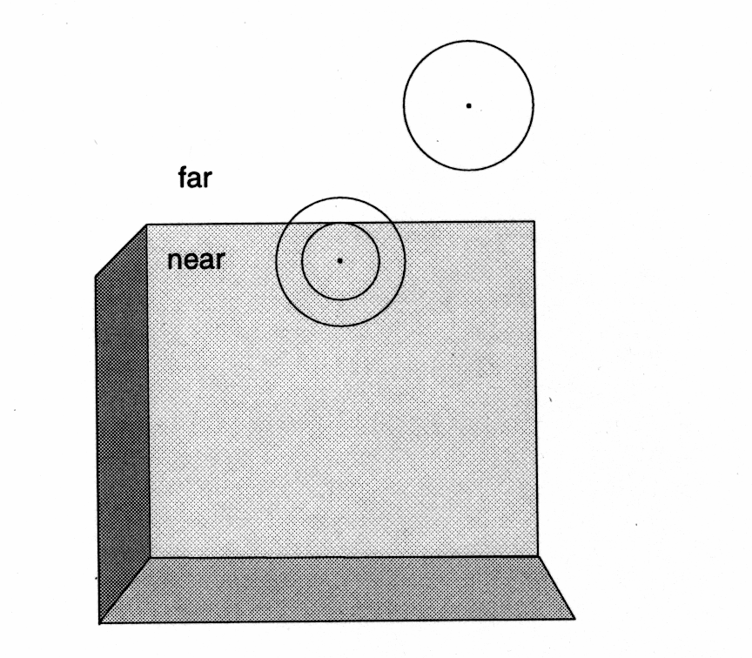
From Jones and Malik, “A computational framework for determining
Stereo correspondences from a set of linear spatial filters

Slide 16
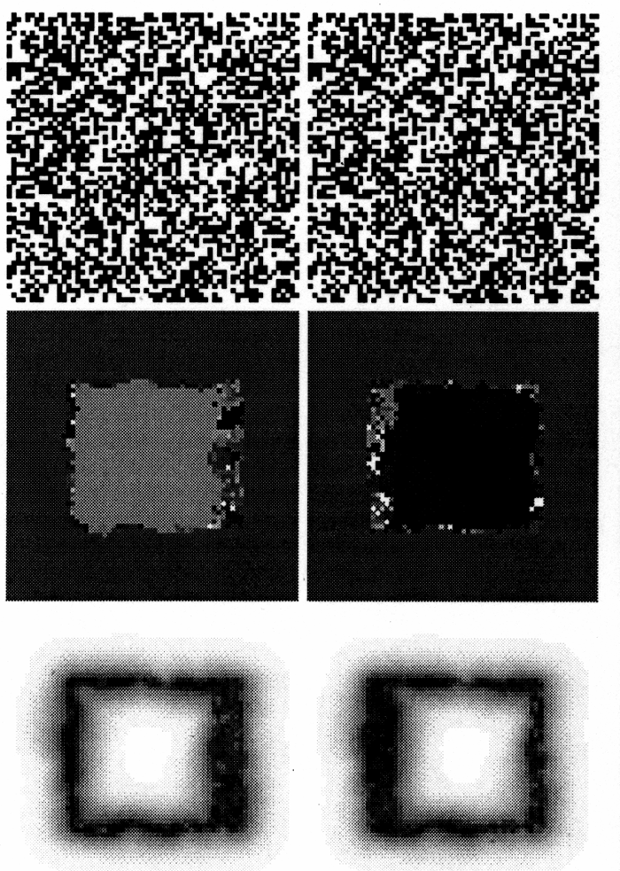
From Jones and Malik, “A computational framework for determining
Stereo correspondences from a set of linear spatial filters

Slide 17
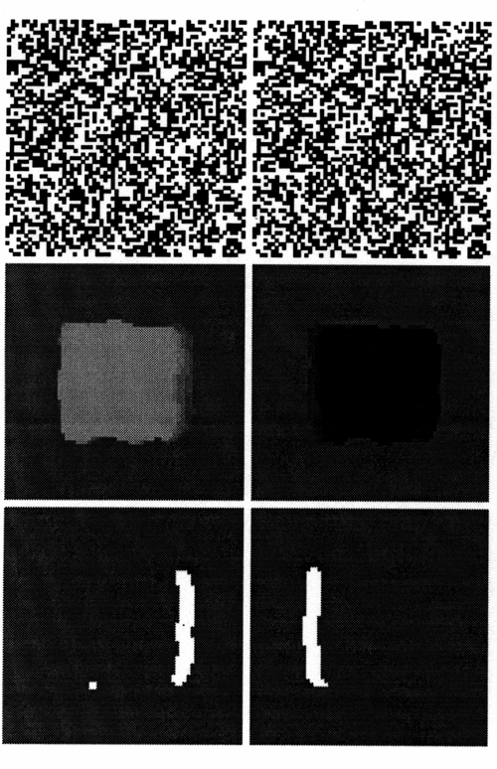
From Jones and Malik, “A computational framework for determining
Stereo correspondences from a set of linear spatial filters

Slide 18
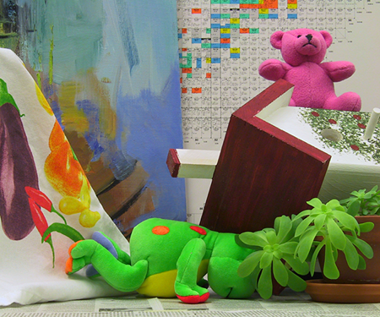
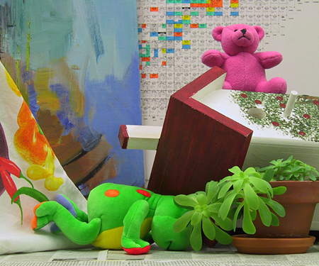
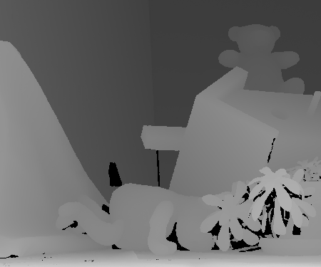
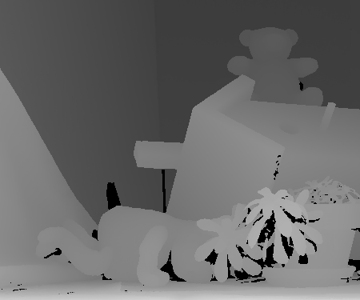

Slide 19
Stereo as an optimization problem
Original:
find q, q’ that match, and infer depth
Now:
choose value of depth at q; then quality of match at q’ is cost
optimize this

Slide 20
Stereo as an optimization problem
Assume camera 2 is translated wrt camera 1, both are calibrated
IF you choose the right depth for x_1, then:
you know disparity, so you know x_2
and you can optimize
||color(x_1)-color(x_2(d))||^2
or something like it
=(X, Y, Z)
B
Disparity
Baseline
Depth

Slide 21
Stereo as an optimization problem
Typically:
quantize depth to a fixed number of levels
two costs:
compare x_1, x_2(d) — unary cost
color match (photometric consistency constraint)
it can be helpful to match intensity gradients, too
compare x_1, x_1’
typically, smoothness constraint on recovered depths
eg depth gradient not too big, etc.
massive discrete quadratic program

Slide 22
Discrete Quadratic Programs
Minimize:
x^T A x + b^t x
subject to: x is a vector of discrete values
Summary:
turn up rather often in early vision
from Markov random fields; conditional random fields; etc.
variety of cases:
some instances are polynomial
most are NP hard
but have extremely efficient, fast approximation algorithms
typically based on graph cuts, qv

Slide 23
Stereo as an optimization problem (II)
Segment images into regions
NOT semantic; small, constant color+texture
Each region is assumed to have a linear disparity
d(x, y)=a x + b y+c
Find a quantized “vocabulary” of such disparities
eg by initial disparity, incremental fitting
For each region, choose the “best” in the “vocabulary”
This is a discrete optimization problem
It’s quadratic
unary term - does the chosen vocab item “agree” with color data?
binary term - are neighboring pairs of models “similar” on boundary?

Slide 24
Stereo resources
Datasets and evaluations:
Middlebury stereo page has longstanding
datasets
evaluations with leaderboards
datasets with groundtruth
refs to other such collections
(but this is the best known, by a long way)
https://vision.middlebury.edu/stereo/

Slide 25
Optic flow
Generically:
a “small” camera movement yields image 2 from image 1
determine where points in image 1 move
Assume we’re moving rigidly in a stationary environment
then points will move along their epipolar lines
where the epipolar lines follow from fundamental matrix
so from camera movement
Main point of contrast with stereo
Images are not usually simultaneous
so objects might have moved

Slide 26
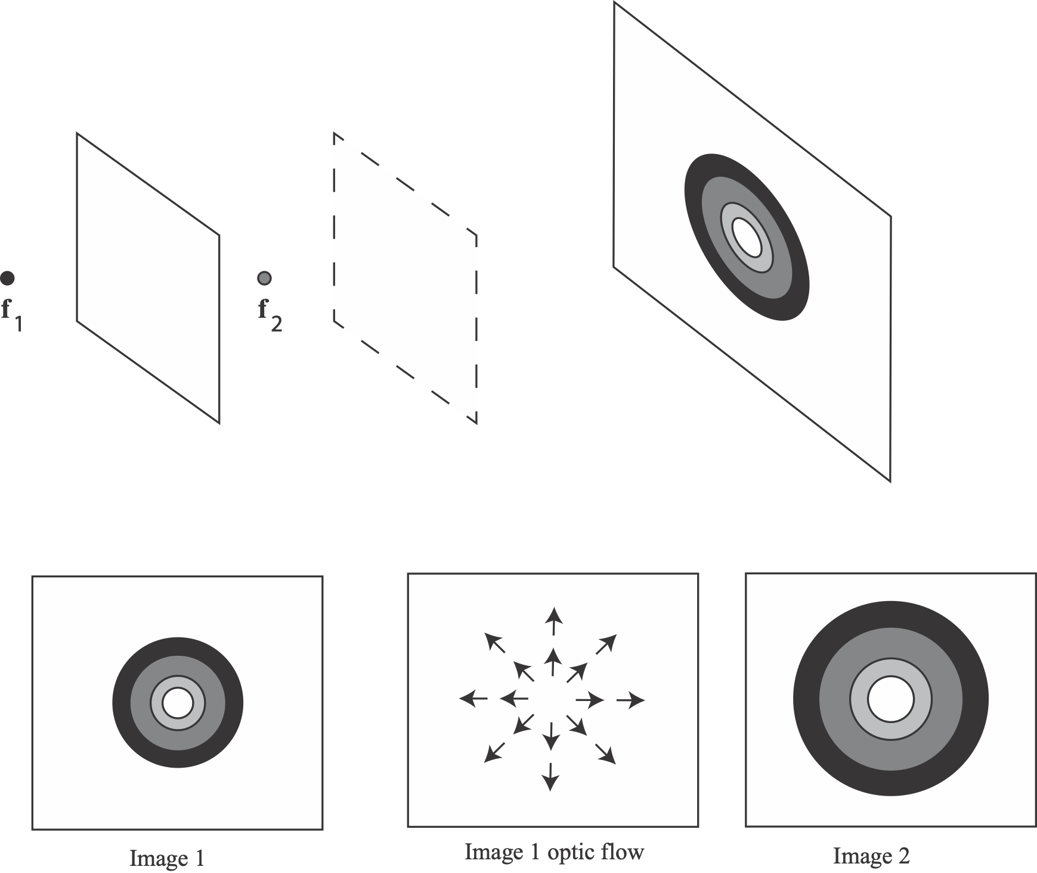

Slide 27
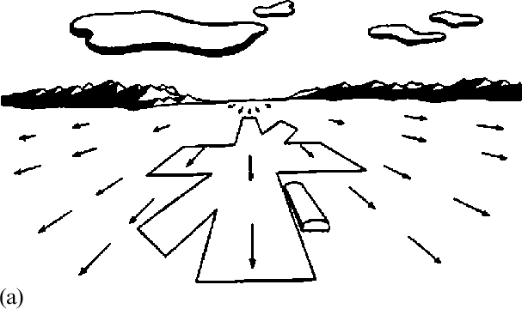

Slide 28
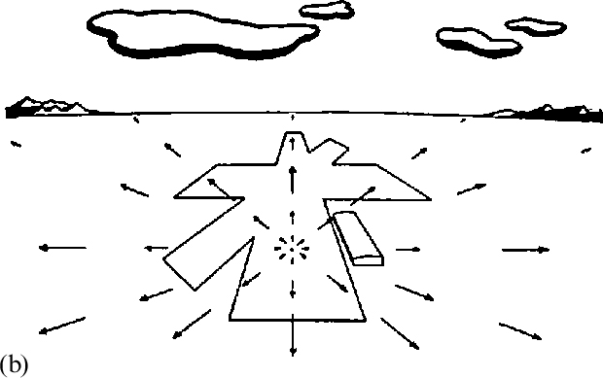

Slide 29
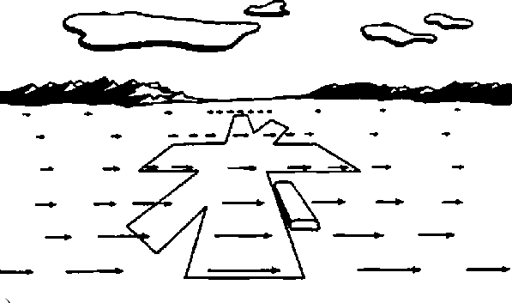

Slide 30
Optical flow
Generically:
a “small” camera movement yields image 2 from image 1
determine where points in image 1 move
Assume we’re moving rigidly in a stationary environment
then points will move along their epipolar lines
where the epipolar lines follow from fundamental matrix
so from camera movement
As we saw, HOW FAR they move is determined by depth
and by their movement!!!

Slide 31
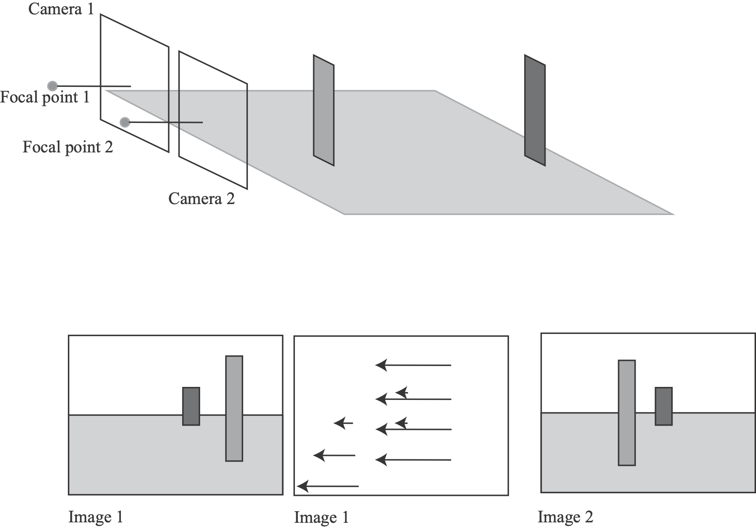

Slide 32
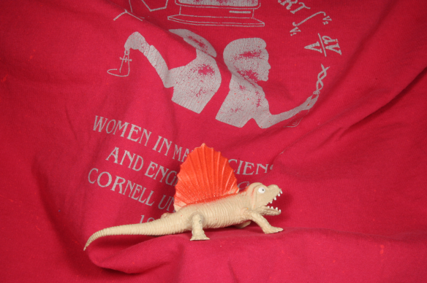
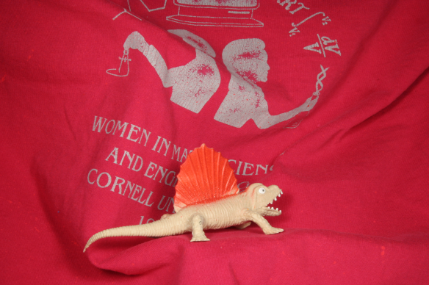

Slide 33
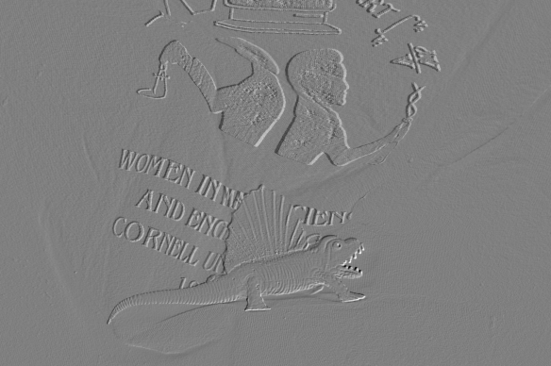
There is flow here!
For camera motions in a rigid scene, you can determine ground truth.
Evaluation is then by comparison to ground truth.

Slide 34
Recovering optic flow
Image gradients
Huge literature
Initial strategy:
Assume
Flow (which is unknown)

Slide 35
Recovering optic flow
Strategies:
find u(x, y), v(x, y) that minimizes some smoothness cost
subject to constraint on flow
what smoothness cost?
how to impose constraint?
assume flow has some parametric form within windows (eg. constant)
choose parameters to minimize error in window
what parametric model?
what windows?
If few or no objects move
impose a parametric depth model, and use that

Slide 36
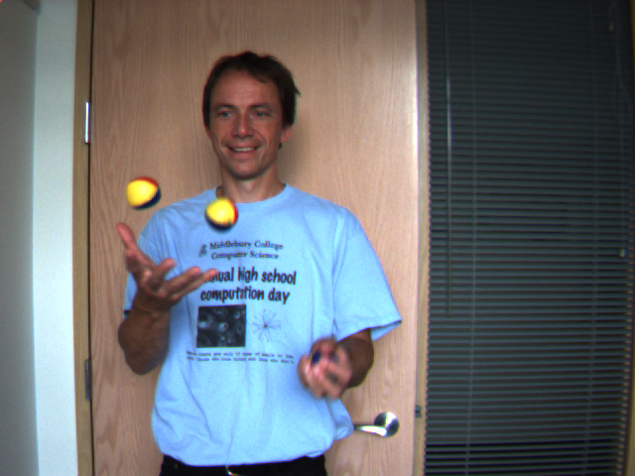
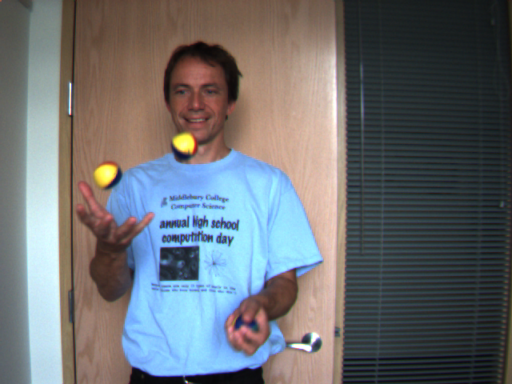

Slide 37
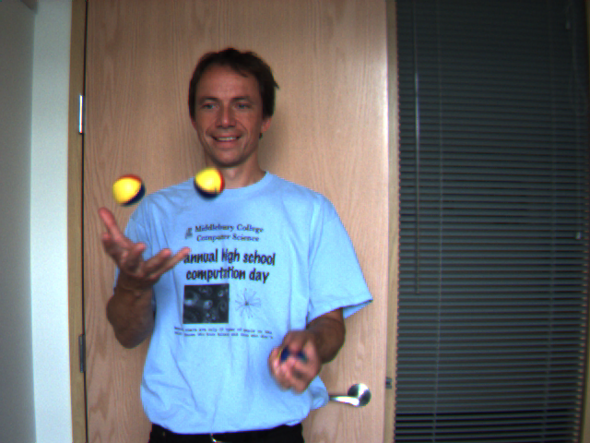
If objects are moving, much harder
to determine ground truth.
IDEA: Interpolate flow to get
intermediate frame.
Evaluation is then by comparing interpolate
to ground truth frame.

Slide 38
Brox et al 09

Slide 39
Strategy
Segment into regions, estimate region correspondences
use to inform flow estimate
Brox et al 09

Slide 40
Optical flow resources
Datasets and evaluations:
Middlebury optical flow page has longstanding
datasets
evaluations with leaderboards
datasets with groundtruth
refs to other such collections
(but this is the best known, by a long way)
https://vision.middlebury.edu/flow/

Slide 41
Camera and structure from motion
Assume:
a moving camera views a static scene
the camera is orthographic OR
weak perspective applies with one scale for all
all points can be seen in all views AND all correspondences are known
Can get:
the positions of all points in the scene
the configuration of each camera
Applications
Reconstruction: Build a 3D model out of the reconstructed points
Mapping: Use the camera information to figure out where you went
Object insertion: Render a 3D model using the cameras, then composite the videos

Slide 42
M. Pollefeys, L. Van Gool, M. Vergauwen, F. Verbiest, K. Cornelis, J. Tops, R. Koch, Visual modeling with a hand-held camera, International Journal of Computer Vision 59(3), 207-232, 2004

Slide 43
Rendering and compositing
Rendering:
take camera model, object model, lighting model, make a picture
very highly developed and well understood subject
many renderers available; tend to take a lot of skill to use (Luxrender)
Compositing:
place two images on top of one another
new picture using some pixels from one, some from the other
example:
green screening
take non-green pixels from background, non-bg pixels from top

Slide 46
Simple case in some detail
Cameras are calibrated scaled orthographic cameras
We see points that don’t move
All points are seen in all views
All correspondences are known
Actually
all these constraints can be relaxed
any camera OK
point motion tricky, but do-able
all points in all views isn’t required
can make correspondences relatively easily

Slide 47
Scaled orthographic projection - II

Slide 49
Scaled Orthographic camera matrix
And this becomes (for the relevant group of points)
We will see further simplifications soon
Intrinsics: Hide the scale in here
Extrinsics - rotation and translation
wrt world coords

Slide 50
Scaled orthographic cameras
Alternatively
the camera film plane has
two axes, u and v
an origin, at (tx, ty)
axes are at right angles
axes are the same length
point in 3D is
equation:

Slide 51
Simplify
Now place the 3D origin at center of gravity of points
ie mean of x over all points is zero, mean of y is zero, mean of z is zero
Camera origin at center of gravity of image points
we see all of them, so we can compute this
this is the projection of 3D center of gravity
Now camera becomes
Index for points, views

Slide 52
Multiple views
More notation:
write for the first (x) coordinate of the i’th picture of the j’th point
write for the second (y) coordinate of the i’th picture of the j’th point
We had:
Rewrite:

Slide 53
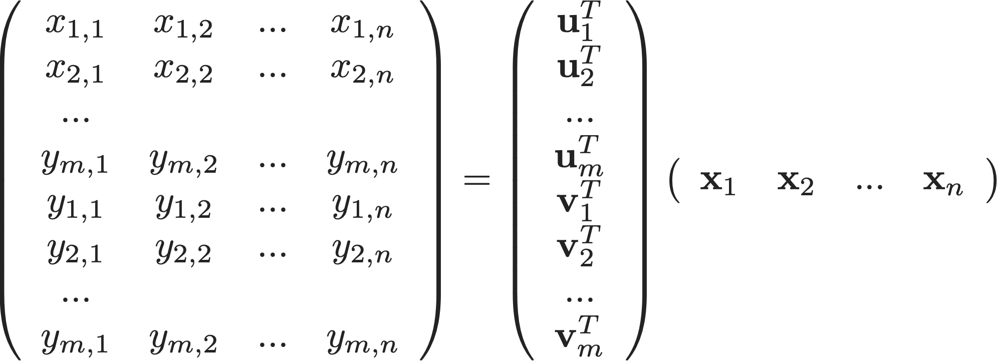
Multiple views
Point
Data matrix
Picture

Slide 54
Multiple views
Data - observed!

Slide 55
Multiple views
The data matrix has rank 3!
so we can factor it into an mx3 factor and a 3xn factor
(tall+thin)x(short+fat)
so we know what to do; SVD -> factors
recall SVD from IRLS!
These factors are not unique
assume A is 3x3 with rank 3, we get symmetry below

Slide 56
Camera and reconstruction
Can choose factors uniquely
recall v_i, u_i are
at right angles
same length
Algorithm
form D
factor
now choose A so that v_i, u_i are at right angles, same length
by numerical optimization
What if there are missing points?
Fairly simple optimization trick, following slides

Slide 57
Factoring without all points
Write D for the data matrix, W for a mask matrix
W_ij=0 if that entry of D is unknown, =1 if it is known
Strategy:
choose S, T to minimize
now multiply these S, T - the result is the whole of D
i.e. holes are filled in
we expect this to work even if D has many holes in it because
there are few parameters in S, T

Slide 58
Factors with missing points
How to minimize? set the gradient to zero
gradient with respect to T_uv is
gradient with respect to S_uv is

Slide 59
Notice there are TWO products here
Points in 3D
Estimates of camera rotation
What happened to translation?

Slide 60
State of the art (ish)
Reconstructions at extremely large scales
scale=large city
from “scattered” pictures
very fine metric accuracy
“Symmetries” can create serious problems
eg indoor corridors, etc
Low feature environments are a nuisance
Very little impact of deep learning (so far)
mostly, major changes in the type of 3D reconstruction recovered.

Slide 61
Software
Colmap
open source SFM at very large scale
backbone of many other projects
https://demuc.de/colmap/
MicMac
scale photogrammetry software from French national geographic inst.
https://micmac.ensg.eu/index.php/Accueil
OpenSFM
open source SFM at very large scale
https://opensfm.org

