Slide 1
A gentle introduction to Fourier analysis
Image source
Many slides borrowed from S. Seitz, A. Efros, D. Hoiem, B. Freeman, A. Zisserman

Slide 2
Mystery 1
Why can downsampling sometimes lead to aliasing?

Slide 3


Mystery 2
Why does filtering with a Gaussian give a nice smooth image, but filtering with a box filter gives artifacts?
Gaussian
Box filter
Notes:
Things we can’t understand without thinking in frequency
3

Slide 4



Mystery 3
How do hybrid images work?
“Low frequencies”
“High frequencies”
A. Oliva, A. Torralba, P.G. Schyns, Hybrid Images, SIGGRAPH 2006

Slide 5
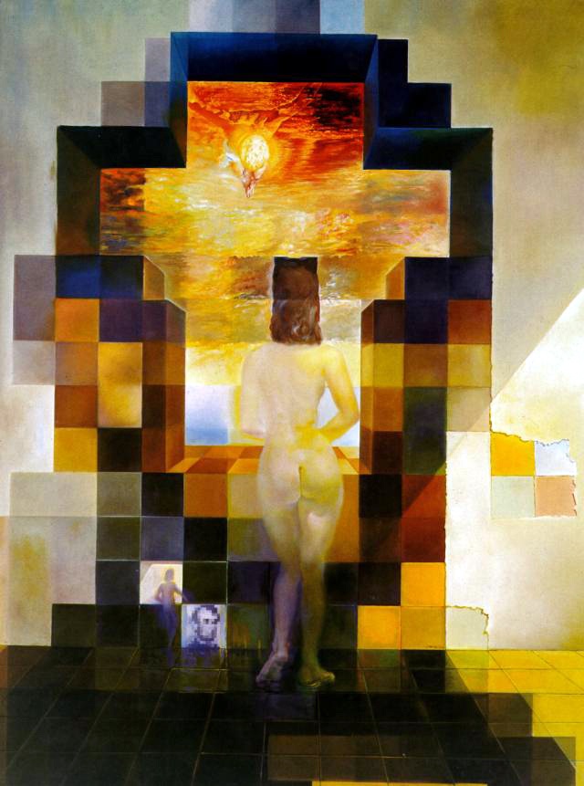
Salvador Dali
“Gala Contemplating the Mediterranean Sea,
which at 30 meters becomes the portrait
of Abraham Lincoln”, 1976

Slide 6
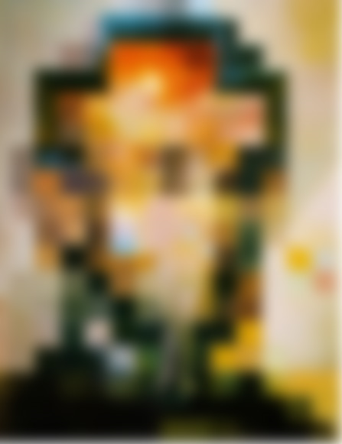

Slide 8
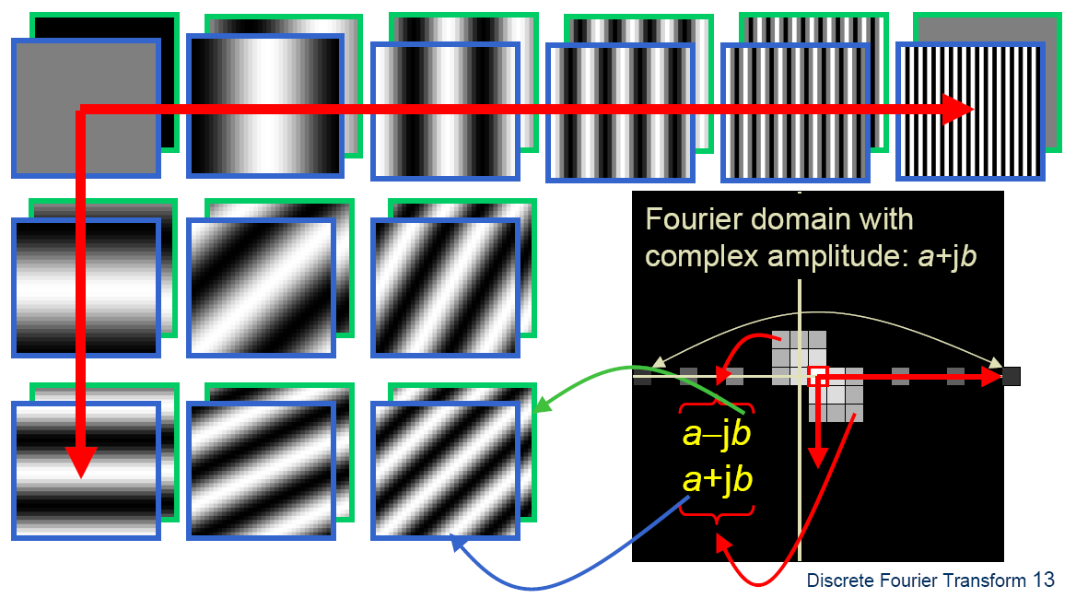

Fourier analysis
To understand such phenomena, we need a representation of images that allows us to tease apart slow and fast changes

Slide 9
Outline
1D Fourier transform
  Definition and properties
  Discrete Fourier transform
2D Fourier transform
  Definition
  Examples and properties
Convolution theorem
Understanding the sampling theorem

Slide 10
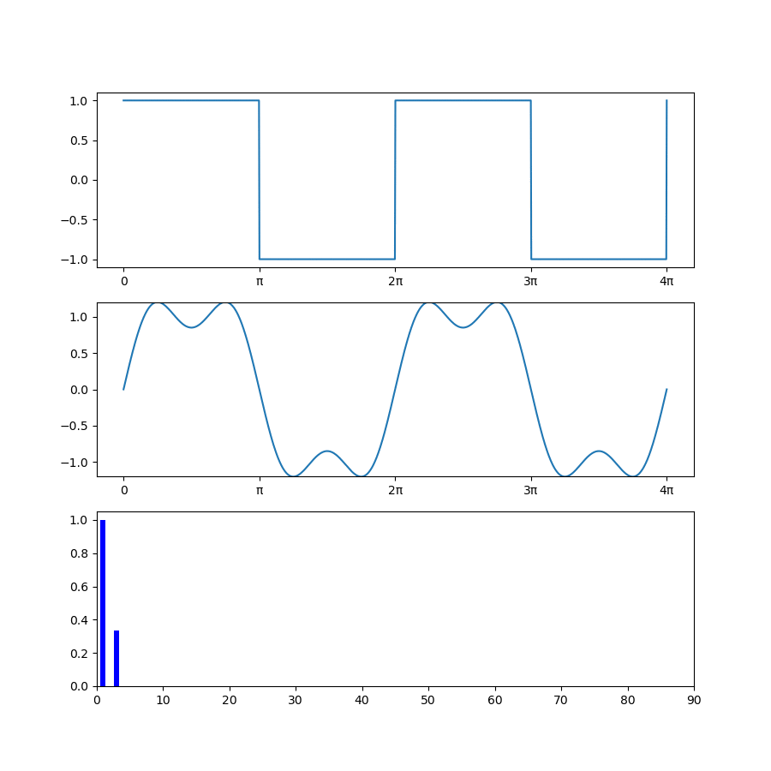
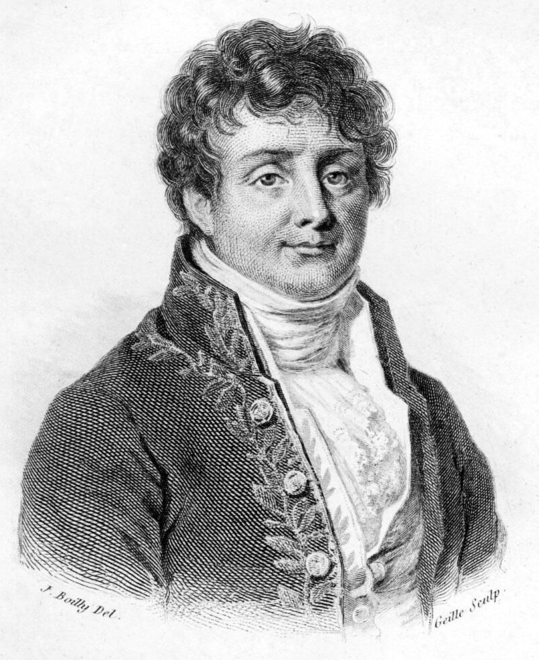

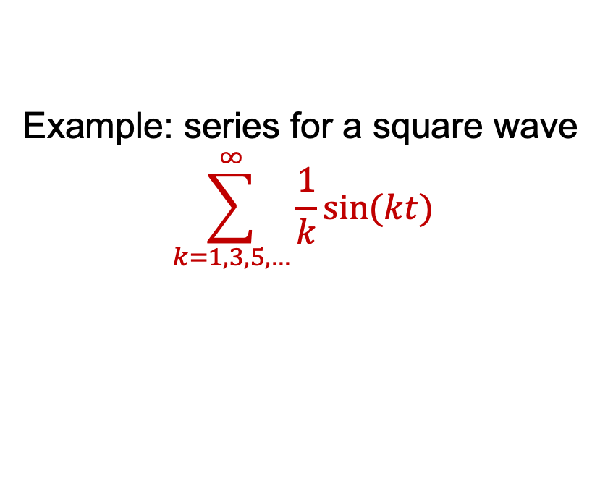
Fourier analysis
Any(**) univariate function can be expressed as a weighted sum of sinusoids of different frequencies (1807)
Example: series for a square wave
$$\sum_{k=1,3,5,…}^{∞}{\frac{1}{k}sin⁡(kt)}$$
Jean-Baptiste Joseph Fourier (1768-1830)
Frequency $k$

Slide 11
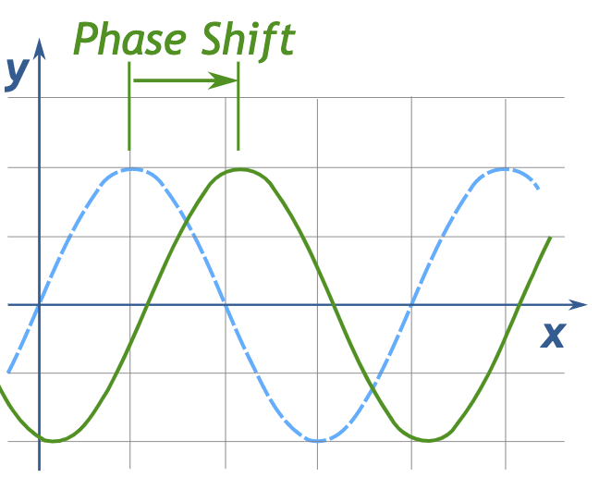

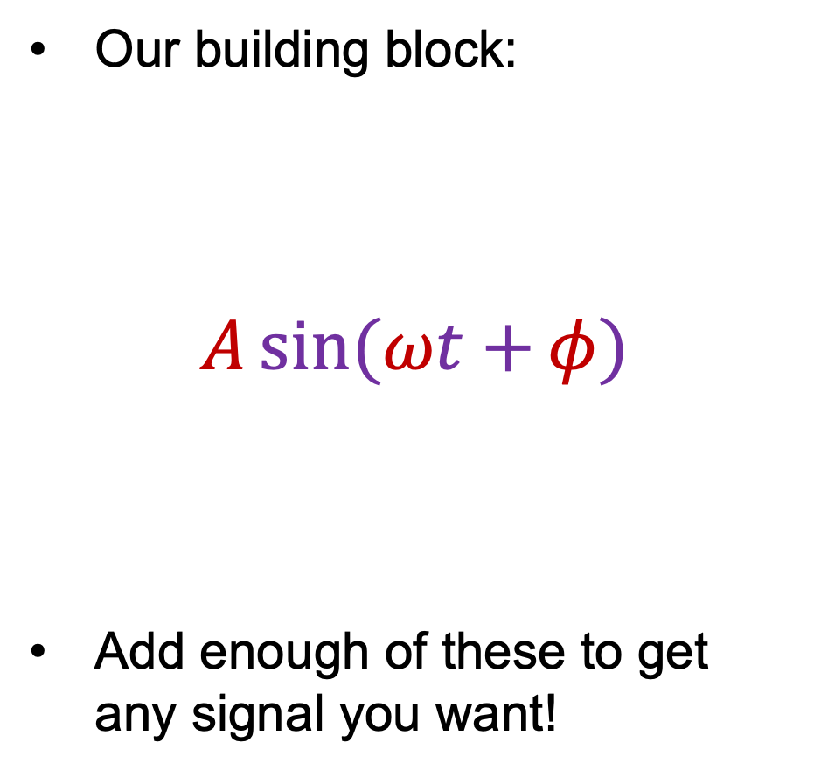


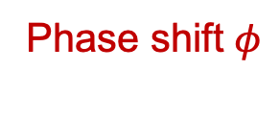
Fourier analysis
Our building block:
$$A\sin{(ωt+}φ)$$
Add enough of these to get any signal you want!
Frequency
Phase shift $φ$
Amplitude $A$
Amplitude
Phase
$$t$$
Period $\frac{2π}{ω}$

Slide 12
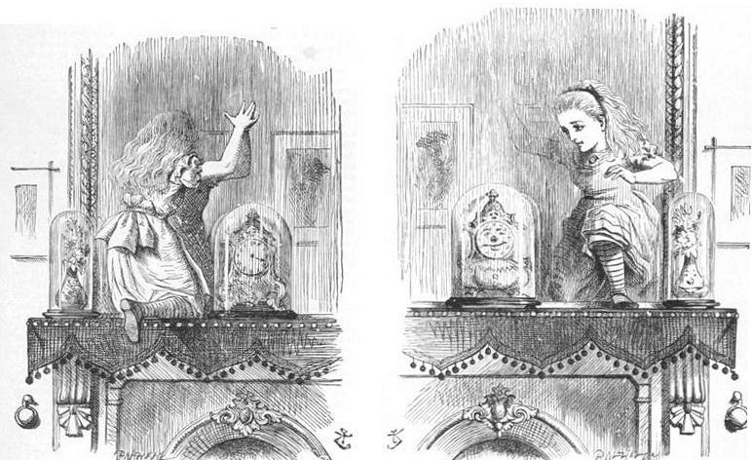

1D Fourier transform
Let’s define an (overcomplete) set of basis functions:
$$ψ_{u}\left(t\right)=e^{i2πut}, u∈(−∞,∞)$$
Time to enter the strange world of complex exponentials…

Slide 13
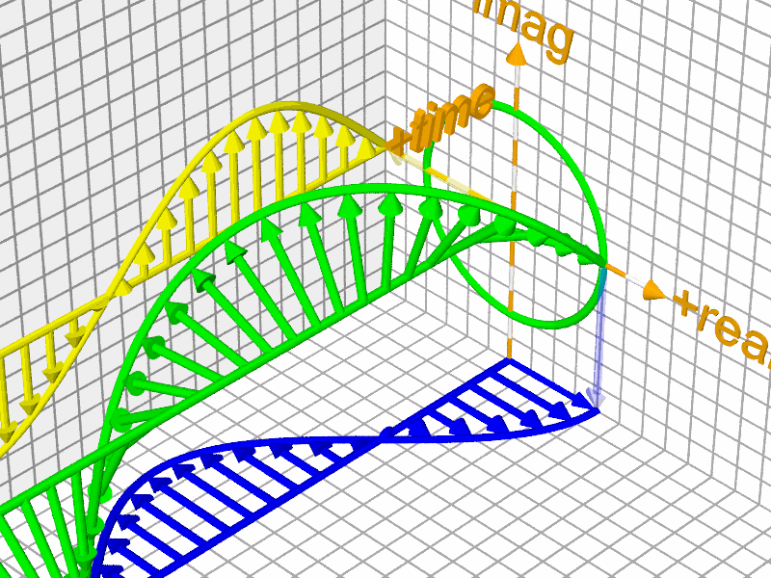









1D Fourier transform
Let’s define an (overcomplete) set of basis functions:
$$ψ_{u}\left(t\right)=e^{i2πut}, u∈(−∞,∞)$$
Euler’s formula: $e^{iθ}=\cos{θ}+i sin θ$
$$Im$$
$$i$$
$$e^{iθ}$$
$$\sin{θ}$$
$$θ$$
$$Re$$
Image source
$$\cos{θ}$$
$$1$$

Slide 14
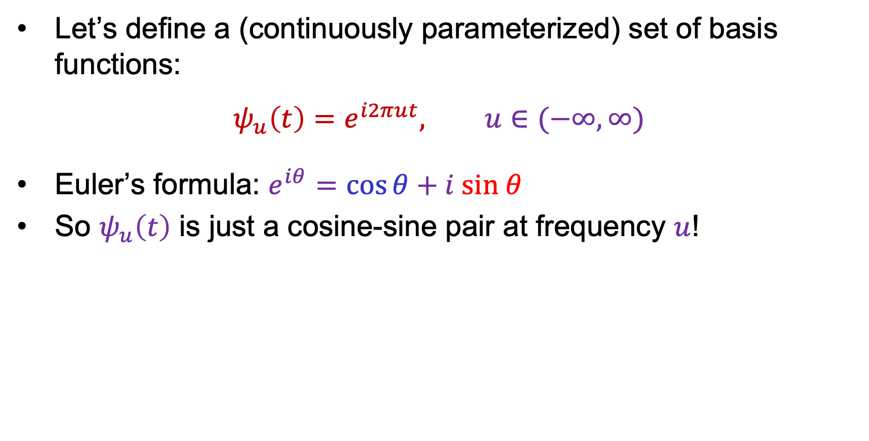
1D Fourier transform
Let’s define a (continuously parameterized) set of basis functions:
$$ψ_{u}\left(t\right)=e^{i2πut}, u∈(−∞,∞)$$
Euler’s formula: $e^{iθ}=\cos{θ}+i sin θ$
So $ψ_{u}\left(t\right)$ is just a cosine-sine pair at frequency $u$!

Slide 15
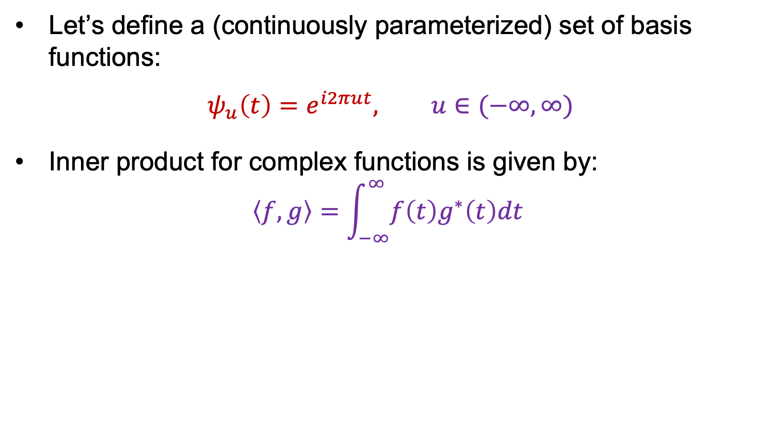
1D Fourier transform
Let’s define a (continuously parameterized) set of basis functions:
$$ψ_{u}\left(t\right)=e^{i2πut}, u∈(−∞,∞)$$
Inner product for complex functions is given by:
$$\left\langle f,g\right\rangle =\int_{−∞}^{∞}{f\left(t\right)g^{∗}\left(t\right)dt }$$
Complex conjugate:
real part stays the same,
imaginary part is flipped

Slide 16
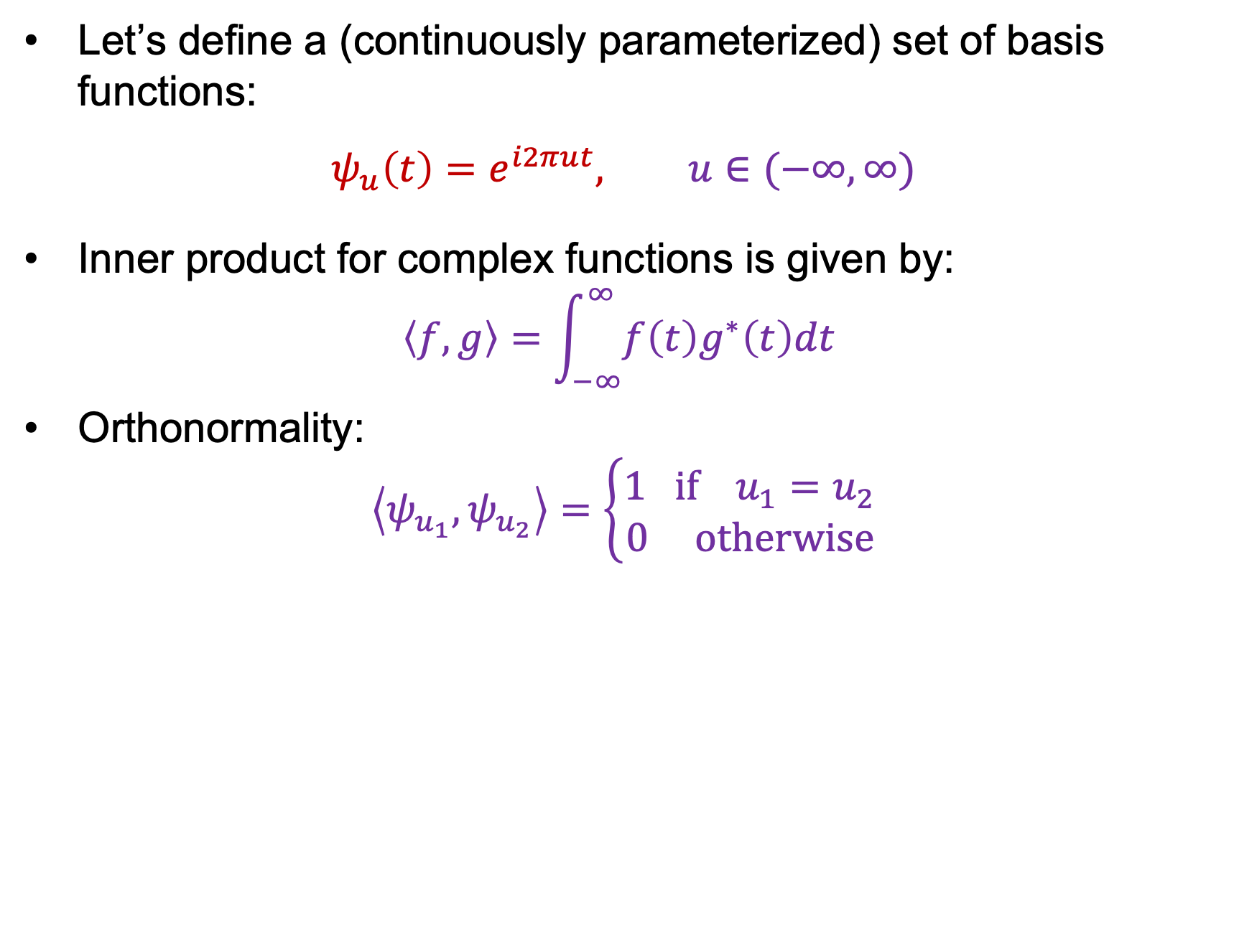
1D Fourier transform
Let’s define a (continuously parameterized) set of basis functions:
$$ψ_{u}\left(t\right)=e^{i2πut}, u∈(−∞,∞)$$
Inner product for complex functions is given by:
$$\left\langle f,g\right\rangle =\int_{−∞}^{∞}{f\left(t\right)g^{∗}\left(t\right)dt }$$
Orthonormality:
$$\left\langle ψ_{u_{1}},ψ_{u_{2}}\right\rangle =\left\{\begin{aligned}1 if{ u}_{1}=u_{2} \\ 0 otherwise\end{aligned}\right.$$

Slide 17
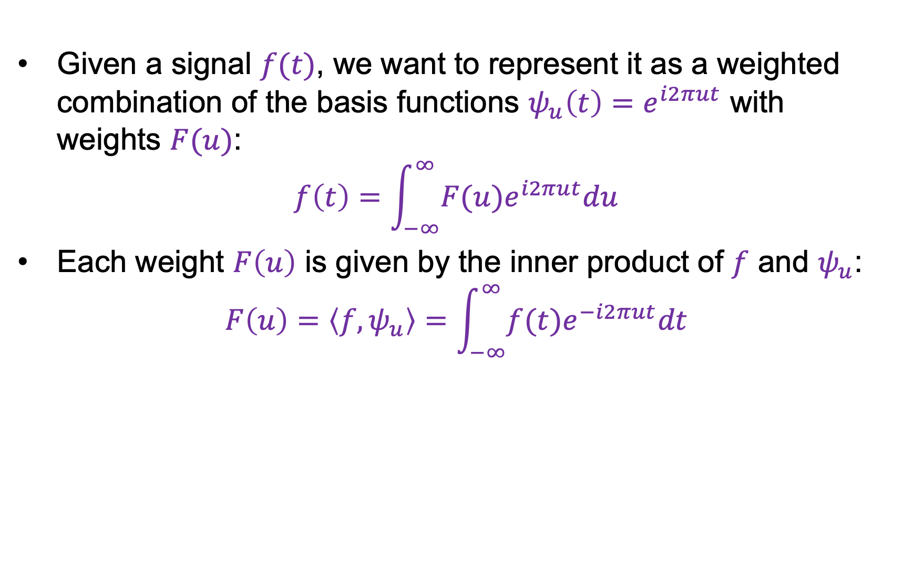
1D Fourier transform
Given a signal $f(t)$, we want to represent it as a weighted combination of the basis functions $ψ_{u}\left(t\right)=e^{i2πut}$ with weights $F(u)$:
$$f\left(t\right)=\int_{−∞}^{∞}{F(u)e^{i2πut}du}$$
Each weight $F\left(u\right)$ is given by the inner product of $f$ and $ψ_{u}$:
$$F\left(u\right)=\left\langle f,ψ_{u}\right\rangle =\int_{−∞}^{∞}{f(t)e^{−i2πut}dt}$$

Slide 18
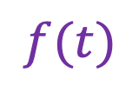
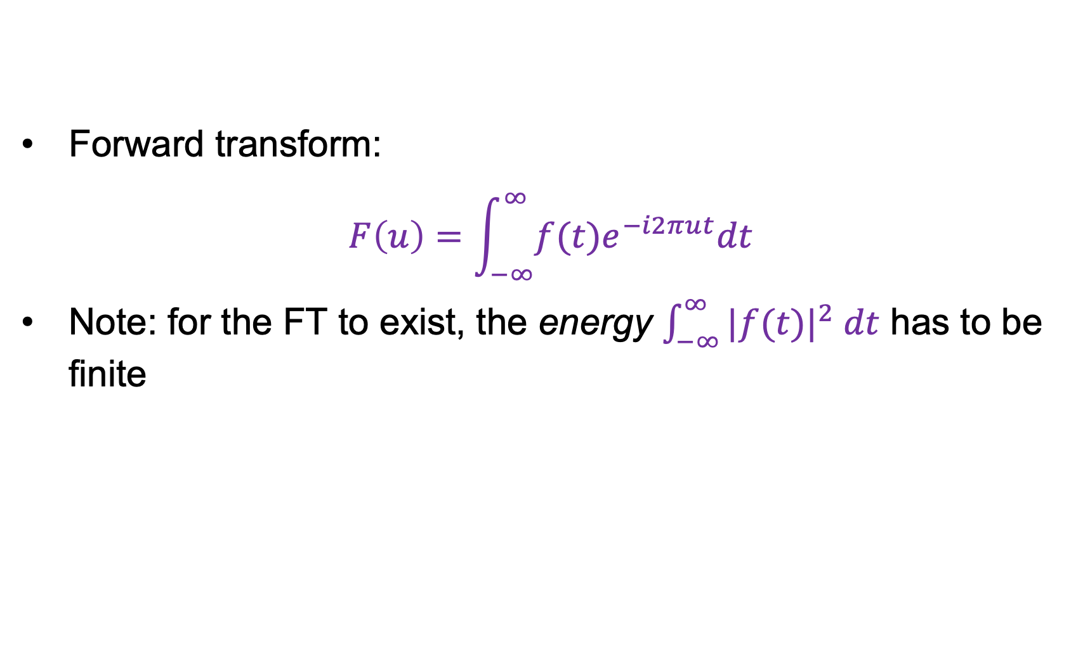

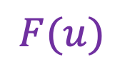
1D Fourier transform
$$ℱ$$
$$f(t)$$
Forward transform:
$$F\left(u\right)=\int_{−∞}^{∞}{f(t)e^{−i2πut}dt}$$
Note: for the FT to exist, the energy $\int_{−∞}^{∞}{|f(t)|^{2} dt}$ has to be finite
$$F(u)$$

Slide 19
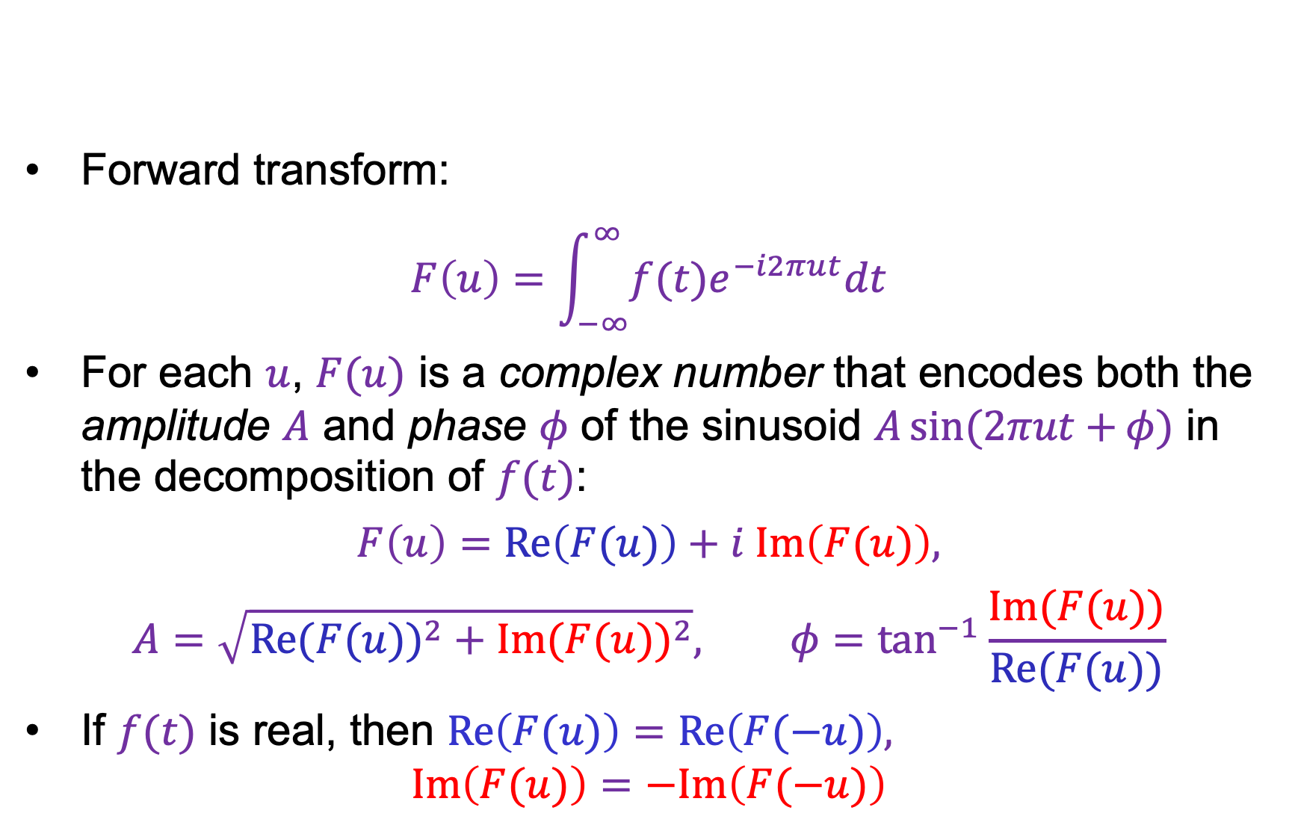
1D Fourier transform
$$ℱ$$
$$f(t)$$
Forward transform:
$$F\left(u\right)=\int_{−∞}^{∞}{f(t)e^{−i2πut}dt}$$
For each $u$, $F(u)$ is a complex number that encodes both the amplitude $A$ and phase $φ$ of the sinusoid $A\sin{(2πut+}φ)$ in the decomposition of $f(t)$:
$$F\left(u\right)=Re\left(F(u)\right)+i Im\left(F(u)\right),$$
$$A=\sqrt{{Re(F(u))}^{2}+{Im(F(u))}^{2}}, φ=\tan^{−1}{\frac{Im(F(u))}{Re(F(u))}}$$
If $f(t)$ is real, then $Re\left(F(u)\right)=Re\left(F(−u)\right),$
$Im\left(F(u)\right)=−Im\left(F(−u)\right)$
$$F(u)$$

Slide 20
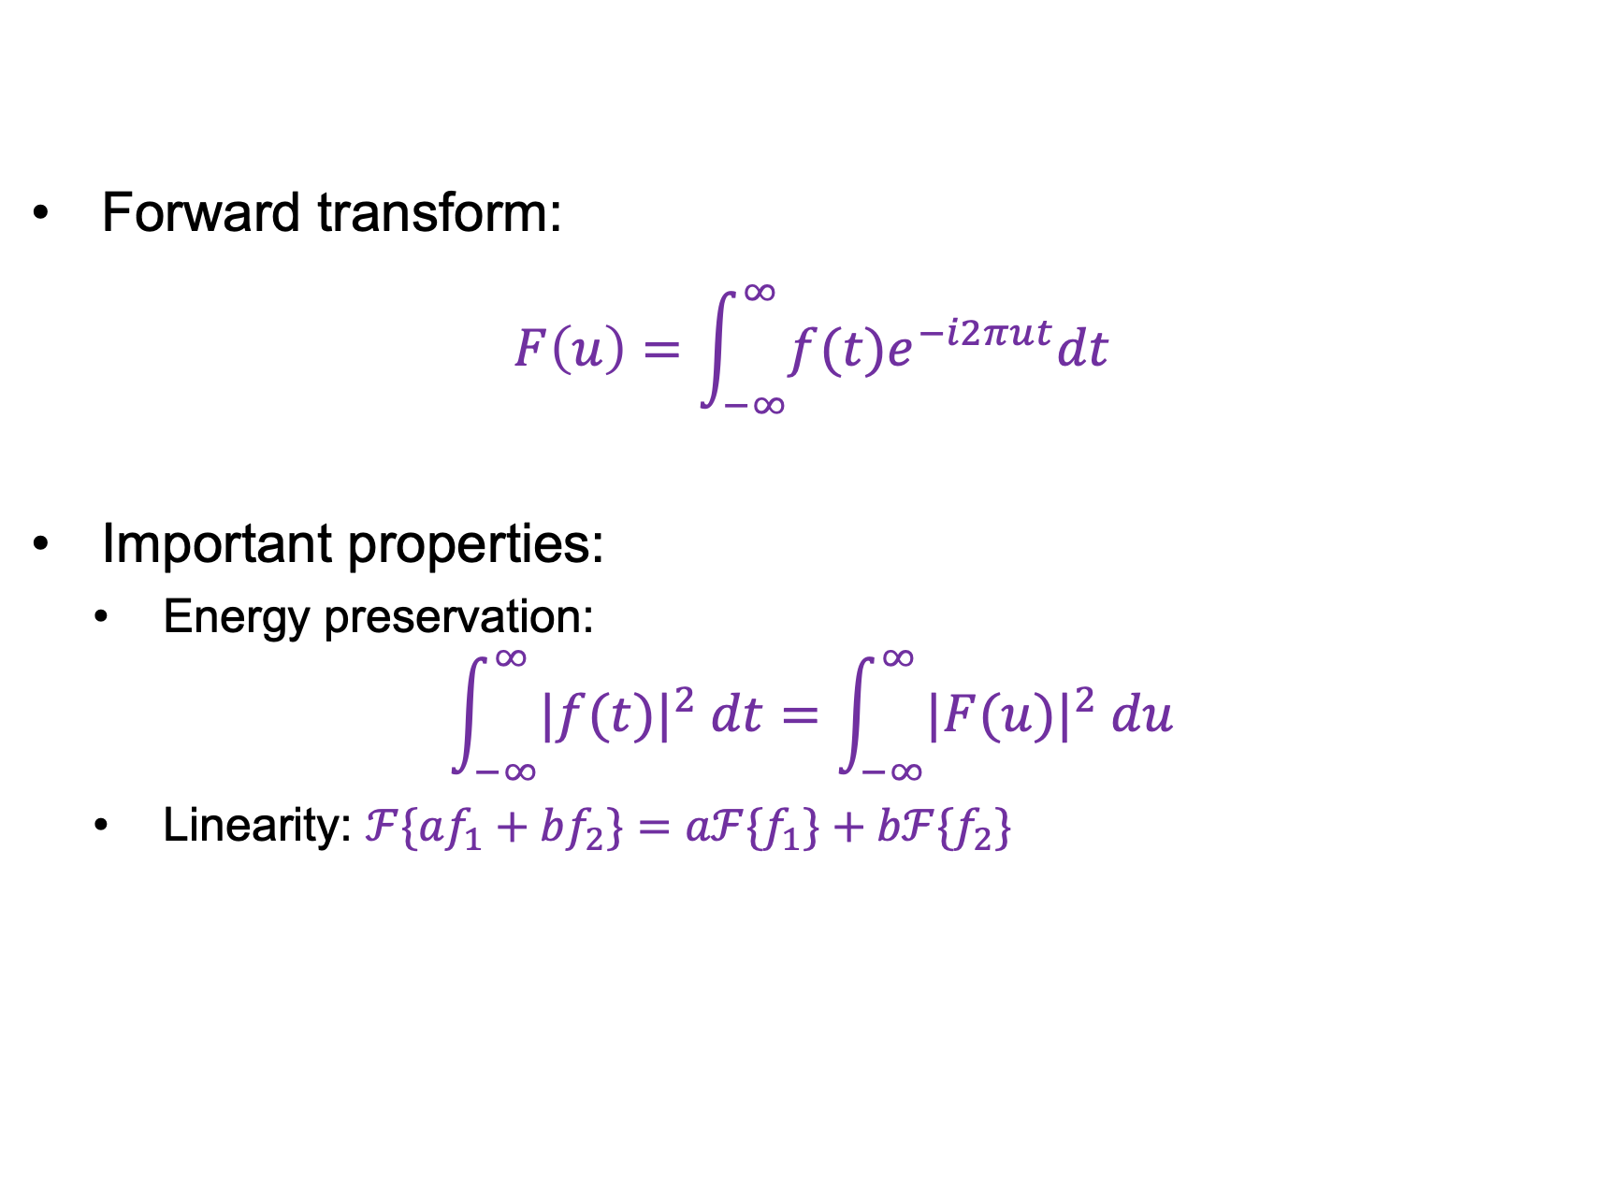
1D Fourier transform
$$ℱ$$
$$f(t)$$
Forward transform:
$$F\left(u\right)=\int_{−∞}^{∞}{f(t)e^{−i2πut}dt}$$
Important properties:
  Energy preservation:
$$\int_{−∞}^{∞}{|f(t)|^{2} dt}=\int_{−∞}^{∞}{|F(u)|^{2} du}$$
  Linearity: $ℱ\{af_{1}+bf_{2}\}=aℱ{\{f}_{1}\}+bℱ{\{f}_{2}\}$
$$F(u)$$

Slide 21

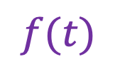
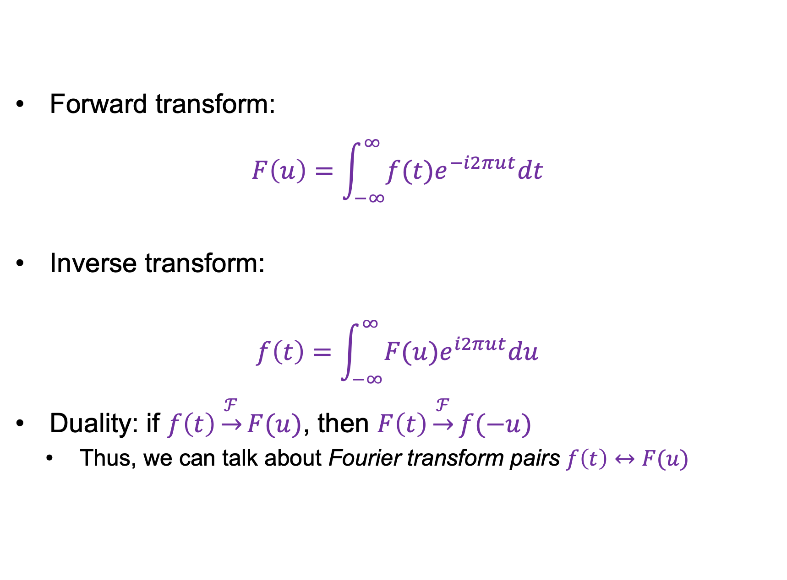

1D Fourier transform
$$ℱ$$
$$f(t)$$
Forward transform:
$$F\left(u\right)=\int_{−∞}^{∞}{f(t)e^{−i2πut}dt}$$
Inverse transform:
$$f\left(t\right)=\int_{−∞}^{∞}{F(u)e^{i2πut}du}$$
Duality: if $f\left(t\right)\underset{→}{ℱ}F(u)$, then $F\left(t\right)\underset{→}{ℱ}f(−u)$
  Thus, we can talk about Fourier transform pairs $f\left(t\right)↔F(u)$
$$F(u)$$
$$ℱ^{−1}$$
$$F(u)$$
$$f(t)$$

Slide 22
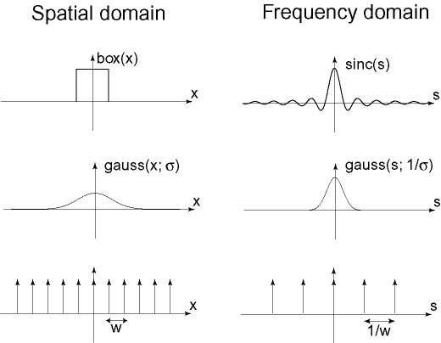



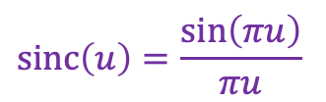
Important Fourier transform pairs
$$box(t)$$
$$sinc\left(u\right)=\frac{\sin\left(πu\right)}{πu}$$
$$−0.5$$
$$0.5$$

Slide 23


Important Fourier transform pairs
$$box(t)$$
$$sinc\left(u\right)=\frac{\sin\left(πu\right)}{πu}$$
$$−0.5$$
$$0.5$$
$$\operatorname{gauss}\left(u;\frac{1}{σ}\right)$$
$$\operatorname{gauss}\left(t;σ\right)$$

Slide 24


Important Fourier transform pairs
$$box(t)$$
$$sinc\left(u\right)=\frac{\sin\left(πu\right)}{πu}$$
$$−0.5$$
$$0.5$$
$$\operatorname{gauss}\left(u;\frac{1}{σ}\right)$$
$$\operatorname{gauss}\left(t;σ\right)$$
$$f\left(t\right)=1$$
$$unit impulse δ\left(u\right)$$
*The last one is formal since these functions don’t meet the mathematical requirements for FT

Slide 25
Outline
1D Fourier transform
  Definition and properties
  Discrete Fourier transform

Slide 26





Discrete Fourier transform (DFT)
Now suppose our signal consists of $N$ samples $f\left(n\right)$,
$n=0,…, N−1$
We can also discretize frequencies to $k/N$, $k=0,…, N−1$
($k$ cycles per $N$ samples)
$$f(n)$$
$$|F\left(k\right)|$$
$$n$$
$$k$$
Image source

Slide 27
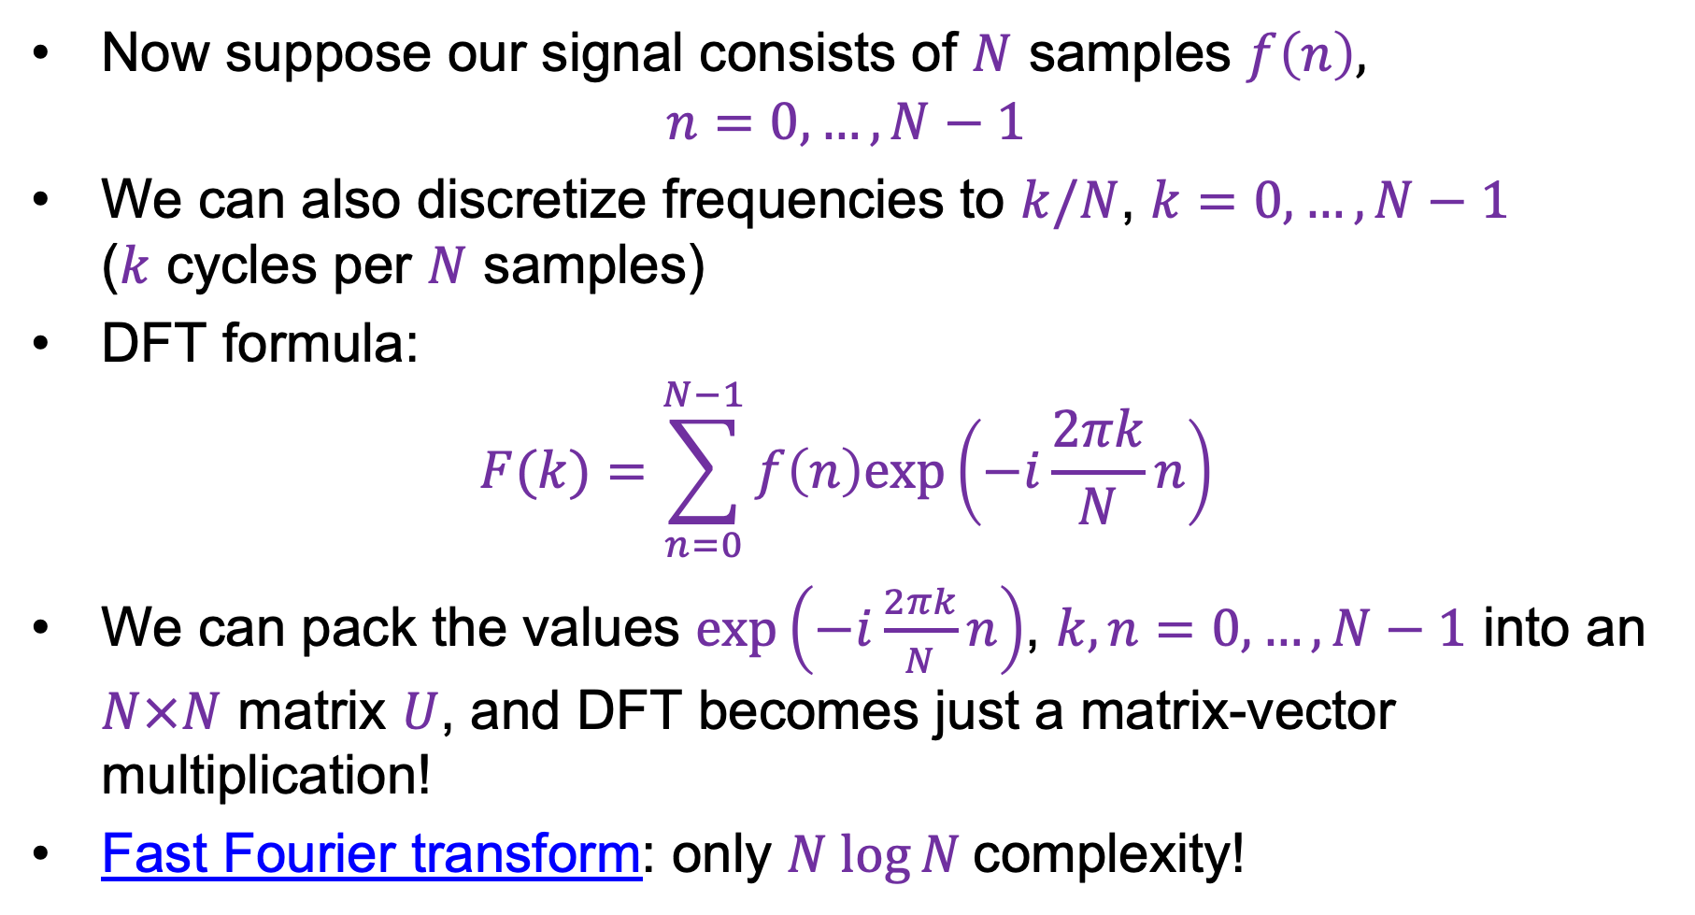
Discrete Fourier transform (DFT)
Now suppose our signal consists of $N$ samples $f\left(n\right)$,
$n=0,…, N−1$
We can also discretize frequencies to $k/N$, $k=0,…, N−1$
($k$ cycles per $N$ samples)
DFT formula:
$$F(k)=\sum_{n=0}^{N−1}{f\left(n\right)exp\left(−i\frac{2πk}{N}n\right)}$$
We can pack the values $exp\left(−i\frac{2πk}{N}n\right)$, $k,n=0,…, N−1$ into an $N×N$ matrix $U$, and DFT becomes just a matrix-vector multiplication!
Fast Fourier transform: only $N log⁡N$complexity!
Image source

Slide 28
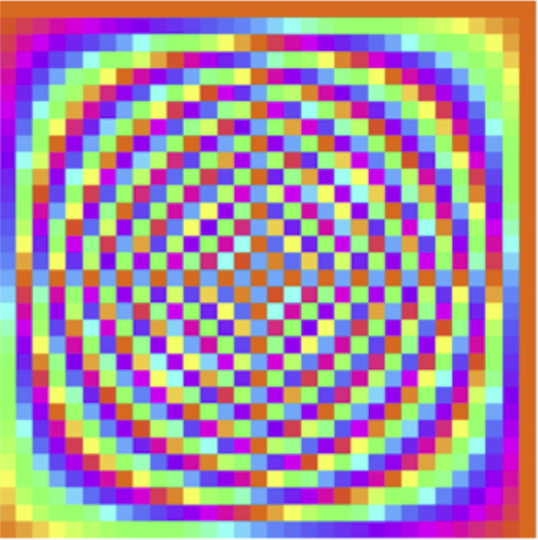
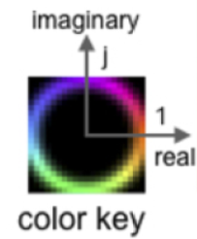


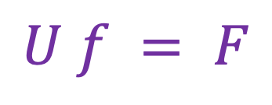


DFT: Just a change of basis!
$$U f = F$$
$$=$$
$$U$$
$$f$$
$$F$$
Source

Slide 29
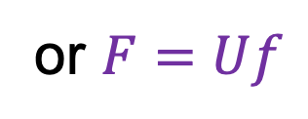

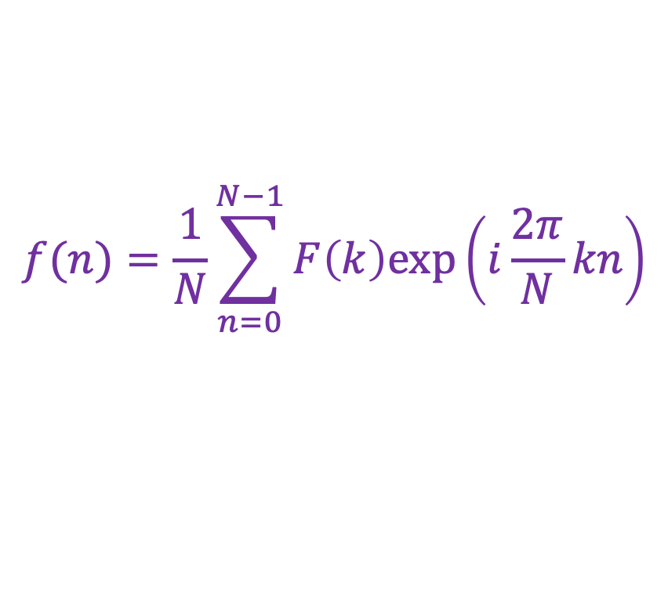
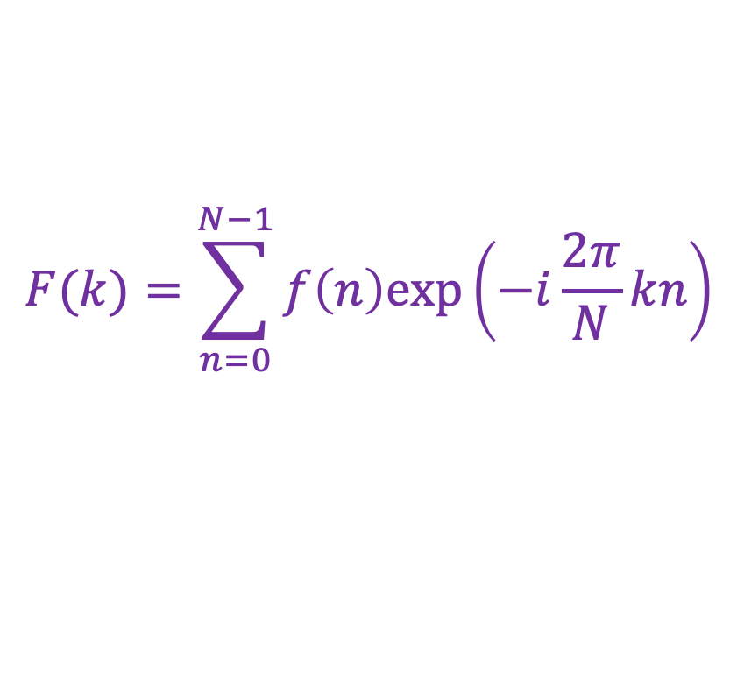
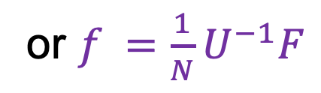
Inverse DFT
Forward DFT:
Inverse DFT:
where $U^{−1}$ is the transpose of the complex conjugate of $U$
$$F(k)=\sum_{n=0}^{N−1}{f\left(n\right)exp\left(−i\frac{2π}{N}kn\right)}$$
or $F=Uf$
$$f(n)=\frac{1}{N}\sum_{n=0}^{N−1}{F\left(k\right)exp\left(i\frac{2π}{N}kn\right)}$$
or $f =\frac{1}{N}U^{−1}F$

Slide 30
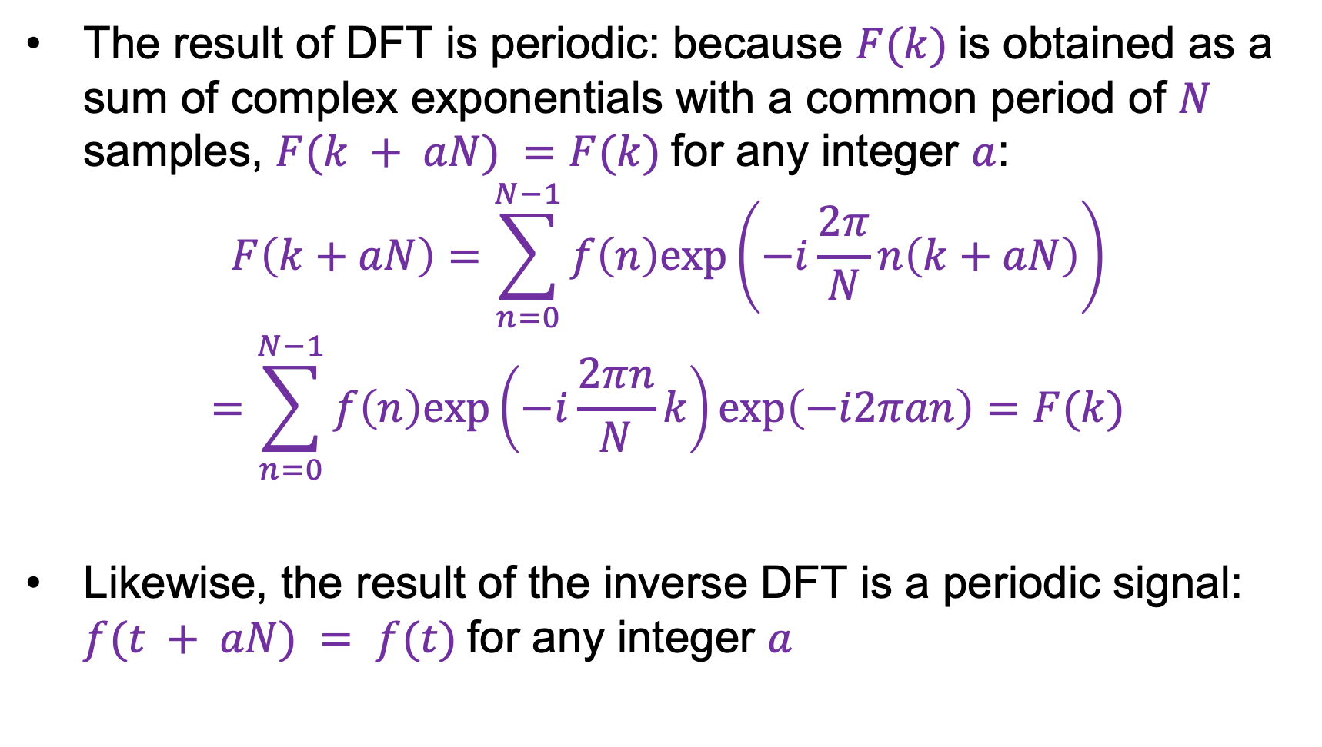
Periodicity of DFT and inverse DFT
The result of DFT is periodic: because $F(k)$is obtained as a sum of complex exponentials with a common period of $N$ samples, $F(k + aN) =F(k)$for any integer $a$:
$$F\left(k+aN\right)=\sum_{n=0}^{N−1}{f\left(n\right)exp\left(−i\frac{2π}{N}n\left(k+aN\right)\right)}$$
$$=\sum_{n=0}^{N−1}{f\left(n\right)exp\left(−i\frac{2πn}{N}k\right)exp\left(−i2πan\right)}=F(k)$$
Likewise, the result of the inverse DFT is a periodic signal: $f(t + aN) = f(t)$for any integer $a$

Slide 31
Outline
1D Fourier transform
  Definition and properties
  Discrete Fourier transform
2D Fourier transform

Slide 32
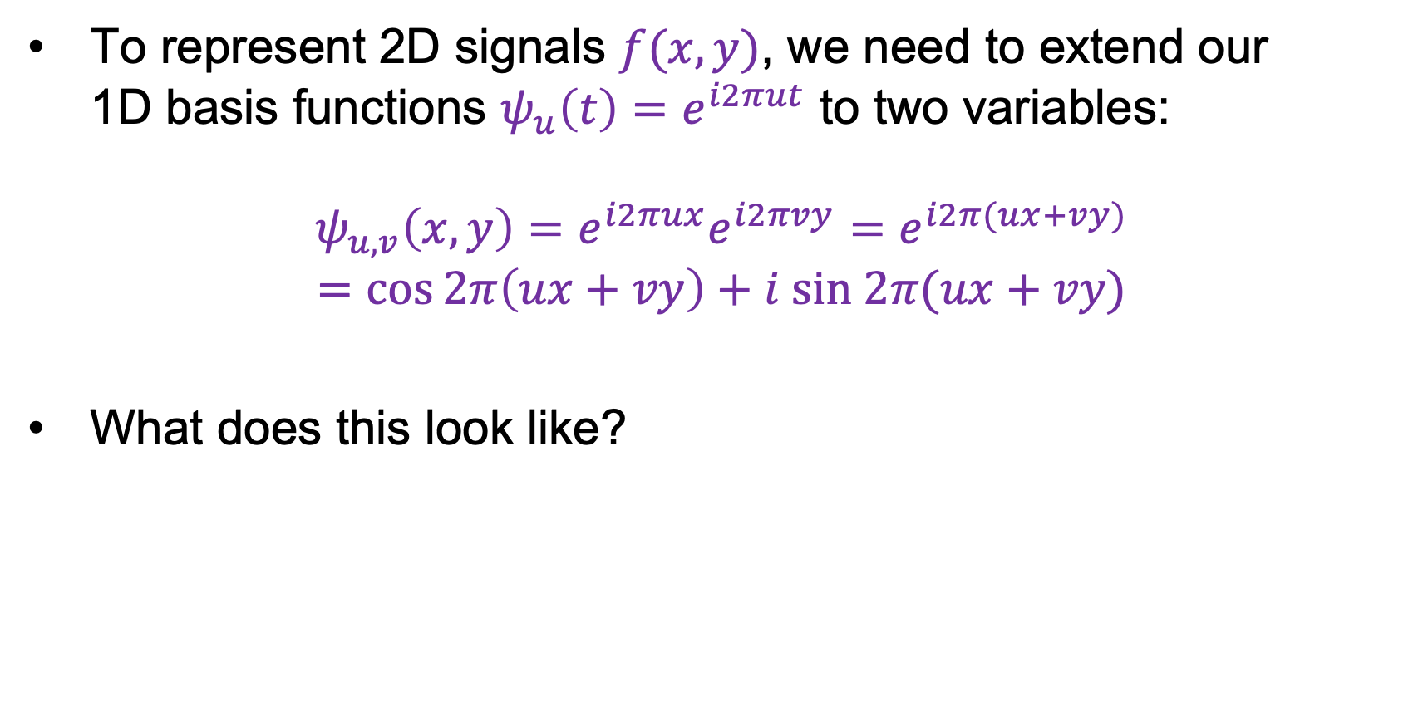
2D Fourier transform
To represent 2D signals $f(x,y)$, we need to extend our
1D basis functions $ψ_{u}\left(t\right)=e^{i2πut}$ to two variables:
$$ψ_{u,v}\left(x,y\right)=e^{i2πux}e^{i2πvy}=e^{i2π(ux+vy)}$$
$$=\cos{2π\left(ux+vy\right)}+i sin 2π(ux+vy)$$
What does this look like?

Slide 33
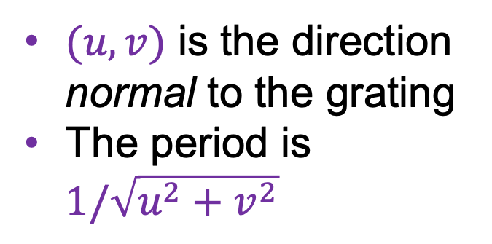


2D Fourier transform
2D basis functions are oriented sinusoidal “gratings”:
$$u$$
$(u,v)$ is the direction normal to the grating
The period is $1/\sqrt{u^{2}+v^{2}}$
$$v$$

Slide 34


Basis function examples
Real component
$$(u,v)$$

Slide 35
Basis function examples
Real component
$$(u,v)$$

Slide 36
Basis function examples
Real component
$$(u,v)$$

Slide 37
Linear combination of basis functions
Real component
$$(u,v)$$

Slide 38
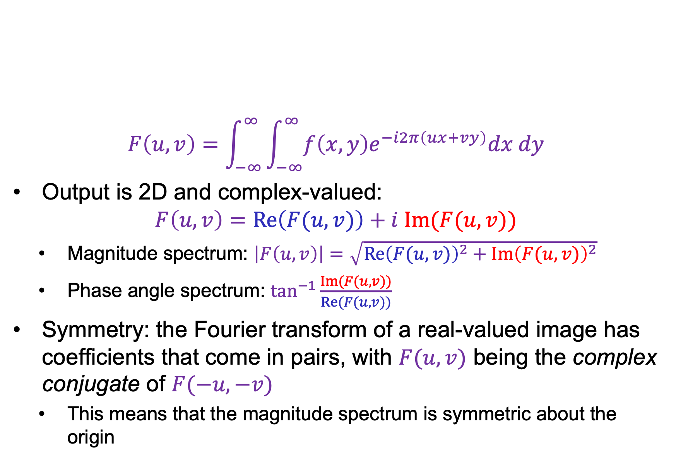
2D Fourier transform
$$F\left(u,v\right)=\int_{−∞}^{∞}{\int_{−∞}^{∞}{f\left(x,y\right)e^{−i2π\left(ux+vy\right)}dx dy}}$$
Output is 2D and complex-valued:
$$F\left(u,v\right)=Re\left(F(u,v)\right)+i Im(F(u,v))$$
  Magnitude spectrum: $\left|F\left(u,v\right)\right|=\sqrt{{Re\left(F(u,v)\right)}^{2}+{Im\left(F(u,v)\right)}^{2}}$
  Phase angle spectrum: $\tan^{−1}{\frac{Im(F(u,v))}{Re(F(u,v))}}$
Symmetry: the Fourier transform of a real-valued image has coefficients that come in pairs, with $F(u, v)$ being the complex conjugate of $F(−u, −v)$
  This means that the magnitude spectrum is symmetric about the origin

Slide 39
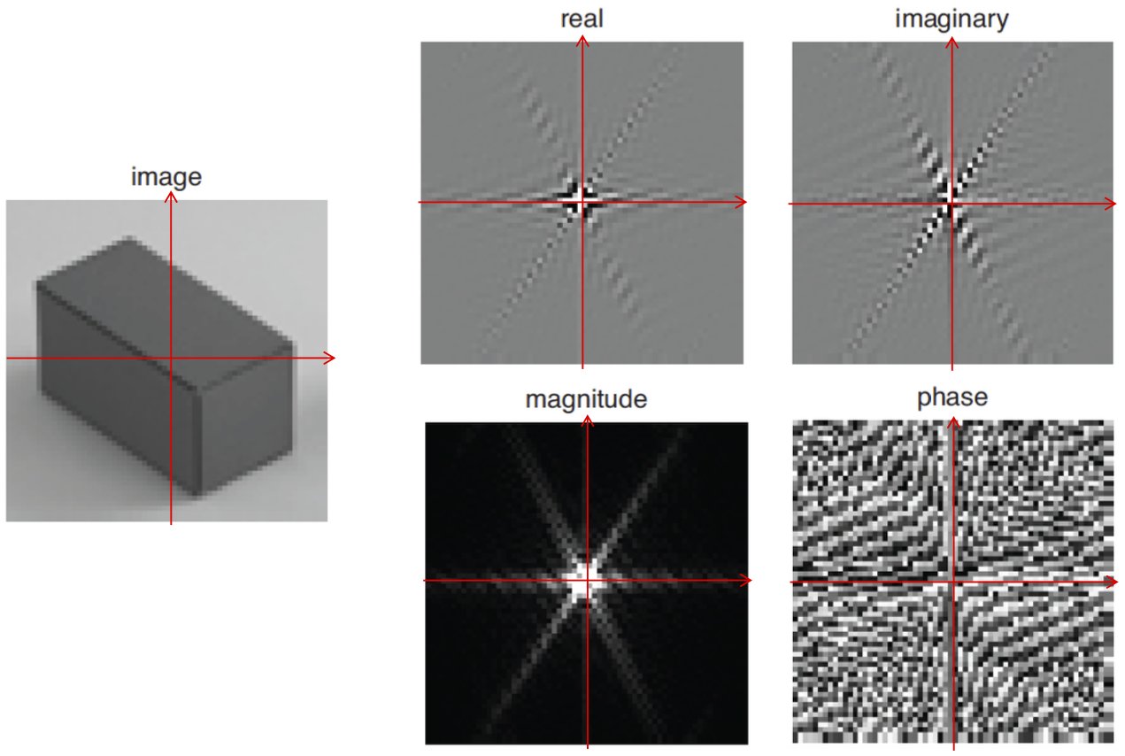

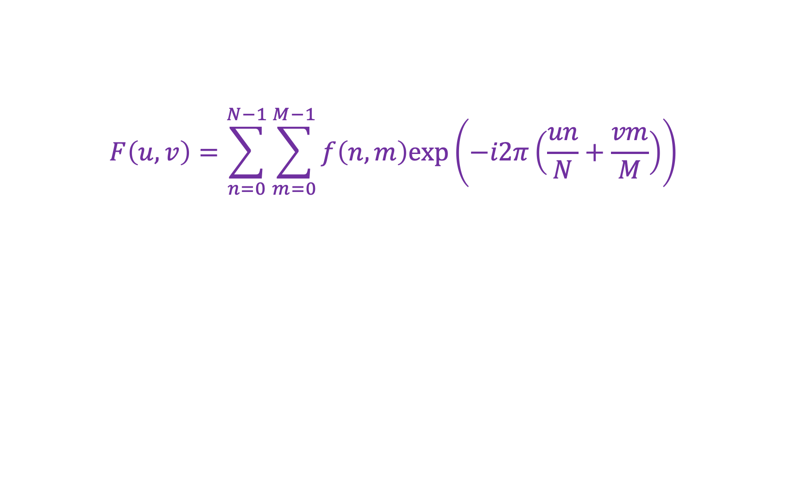



2D discrete Fourier transform
$$F\left(u,v\right)=\sum_{n=0}^{N−1}{\sum_{m=0}^{M−1}{f\left(n,m\right)exp\left(−i2π\left(\frac{un}{N}+\frac{vm}{M}\right)\right)}}$$
$$Re(F\left(u,v\right))$$
$$Im(F\left(u,v\right))$$
$$|F\left(u,v\right)|$$
$$\tan^{−1}{Im(F(u,v))/Re(F(u,v))}$$
Source: B. Freeman

Slide 40
Real image examples

Slide 41
Real image examples

Slide 42
Which image goes with which spectrum?

Slide 43
Phase vs. magnitude
Which has more information, the phase or the magnitude?
Let’s take the phase from one image and combine it with the magnitude from another image

Slide 44
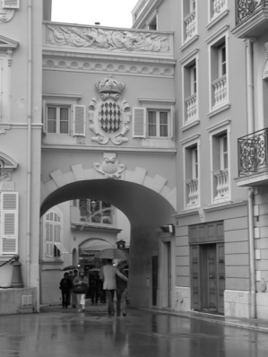
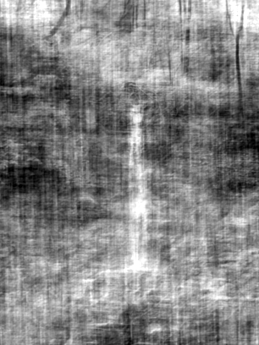
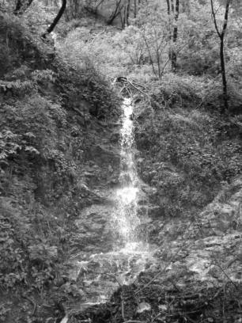
Magnitude
Phase

Slide 45
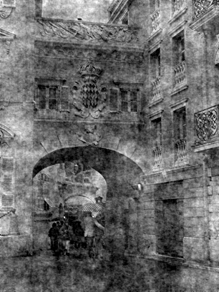
Phase
Magnitude

Slide 46
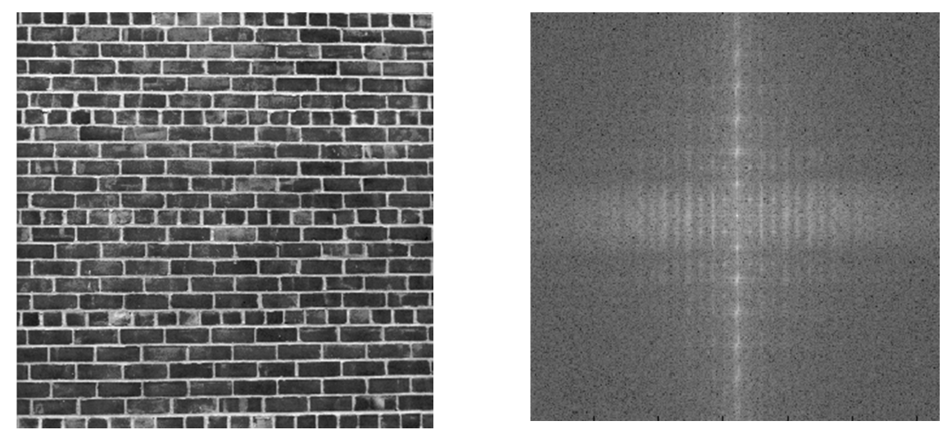
Images with periodic patterns
The magnitude image has peaks corresponding to the frequencies of repetition
Image
Magnitude image
Source: A. Zisserman

Slide 47
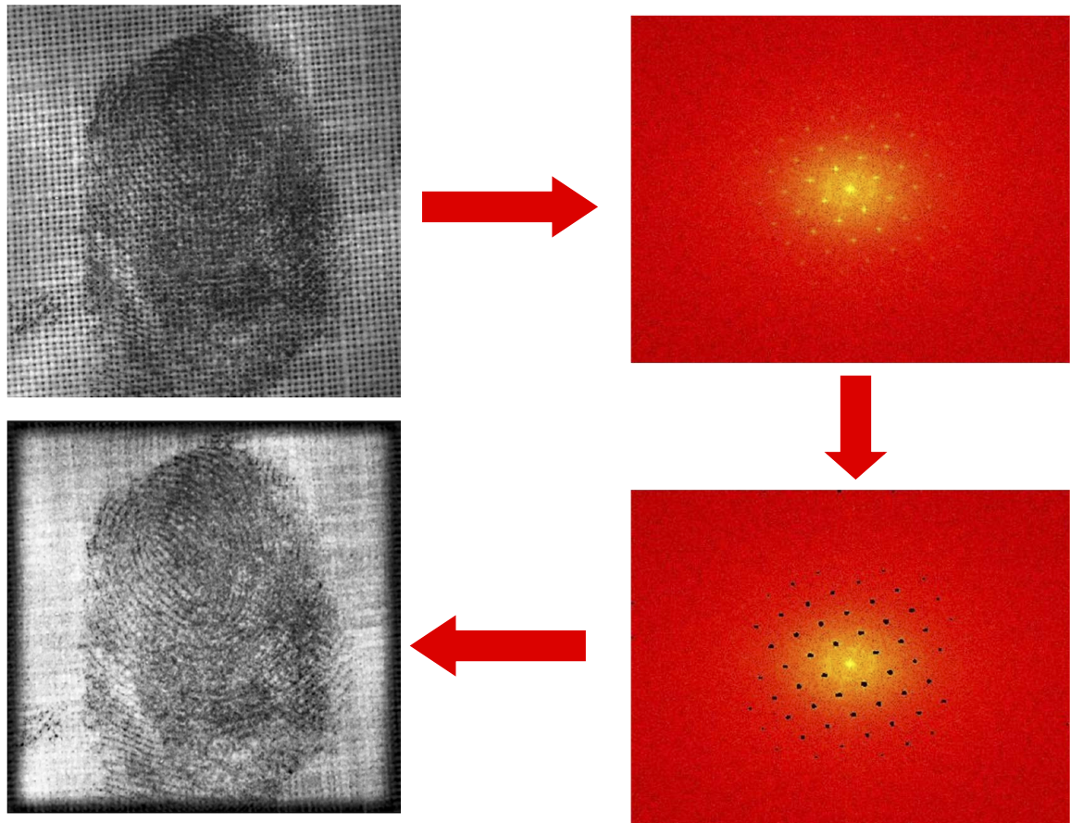
Application: Removing periodic patterns
Magnitude image
Remove peaks
Source: A. Zisserman

Slide 48
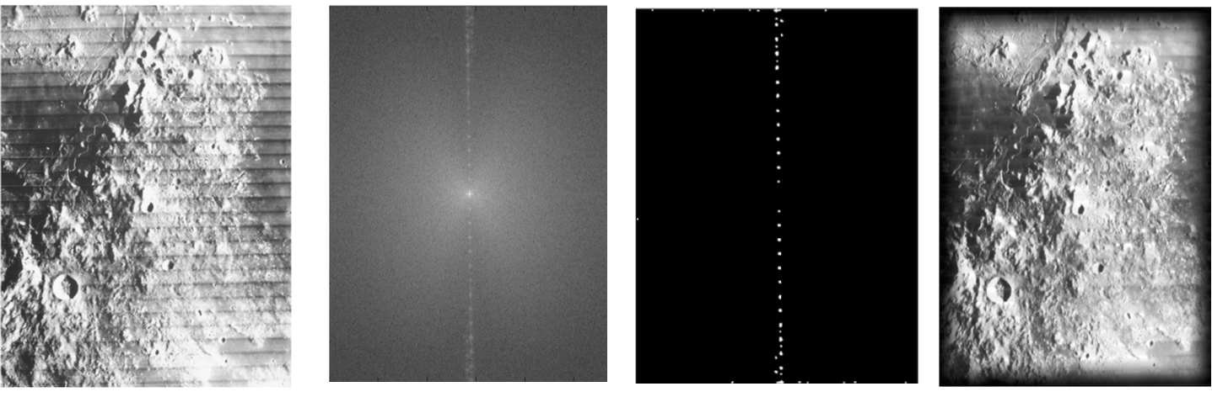

Application: Removing periodic patterns
Lunar orbital image (1966)
Magnitude image
Remove peaks
Join lines removed
Remove peaks
Source: A. Zisserman

Slide 49


Image transformations
How does the FT change when the image is scaled?
Scaled by the inverse factor!

Slide 50


Image transformations
How does the FT change when the image is rotated?
Rotates the same way!

Slide 51
Image transformations
How does the FT change when the image is rotated?
Caution: in real images this is not always the case because of edge artifacts (recall that DFT treats images as periodically tiled)
Image source

Slide 52
Image transformations
How does the FT change when the image is translated?
Magnitude spectrum doesn’t change, phase gets modulated

Slide 53
Outline
1D Fourier transform
  Definition and properties
  Discrete Fourier transform
2D Fourier transform
  Definition
  Examples and properties
Convolution theorem

Slide 54

Convolution theorem
Convolution in the spatial domain translates to multiplication in the frequency domain (and vice versa)
The Fourier transform of the convolution of two functions is the product of their Fourier transforms:
$$ℱ\{f∗g\}=ℱ\{f\} ℱ\{g\}$$
The inverse Fourier transform of the product of two Fourier transforms is the convolution of the two inverse Fourier transforms:
$$ℱ^{−1}\{FG\}=ℱ^{−1}\{F\}∗ℱ^{−1}\{G\}$$

Slide 55









2D convolution theorem example
Image
Filter
Filtered image
$$=$$
*
FT(Image)
FT(Filter)
FT(Filtered image)
$$×$$
$$=$$

Slide 56

Convolution theorem
Suppose $f$ and $g$ both consist of $N$ pixels
What is the complexity of computing $f∗g$ in the spatial domain?
  $O(N^{2})$
And what is the complexity of computing $ℱ^{−1}\left\{ℱ\left\{f\right\}ℱ\left\{g\right\}\right\}$?
  $O(N\log{N})$ using FFT
Thus, convolution of an image with a large filter can be more efficiently done in the frequency domain

Slide 57
Understanding the behavior of filtering
Why does filtering with a Gaussian give a nice smooth image, but filtering with a box filter gives artifacts?
Gaussian
Box filter
Notes:
Things we can’t understand without thinking in frequency
57

Slide 58
Recall: Fourier transform pairs
$$box(t)$$
$$sinc\left(u\right)=\frac{\sin\left(πu\right)}{πu}$$
$$−0.5$$
$$0.5$$
$$\operatorname{gauss}\left(u;\frac{1}{σ}\right)$$
$$\operatorname{gauss}\left(t;σ\right)$$

Slide 59
Filtering with a Gaussian

Slide 60
Filtering with a box filter

Slide 61

Low-pass and high-pass filtering
Image
Low-pass filtered
High-pass filtered
Demo
Source: A. Zisserman

Slide 62
Closer look at low-pass filtering
Do we like this low-pass filtering result?
No – it causes ringing artifacts in the image (why?)
  Recall: it’s equivalent to convolving with a sinc function in the spatial domain
This is why Gaussian filtering is preferred
Image
Low-pass filtered

Slide 63

Hybrid images in the frequency domain
Source

Slide 64

Human contrast sensitivity curve
Depending on viewing distance, peak sensitivity will occur at different frequencies
Notes:
64

Slide 65
Outline
1D Fourier transform
  Definition and properties
  Discrete Fourier transform
2D Fourier transform
  Definition
  Examples and properties
Convolution theorem
Understanding the sampling theorem

Slide 66
Understanding sampling and aliasing

Slide 67


Recall: Nyquist-Shannon sampling theorem
When sampling a signal at discrete intervals, the sampling frequency must be at least twice the maximum frequency of the input signal to allow us to reconstruct the original perfectly from the sampled version
bad
good
https://en.wikipedia.org/wiki/Nyquist-Shannon_sampling_theorem

Slide 68









Understanding the sampling theorem
Suppose we have a continuous function $f(t)$ and we want to sample it at discrete intervals with a spacing of $T$
This can be accomplished by multiplying it by the comb function or impulse train:
$$comb\left(t\right)=\sum_{n=−∞}^{∞}{δ(t−nT)}$$
$$f(t)$$
$$×$$
$$=$$
$$f_{s}\left(t\right)=\sum_{n=−∞}^{∞}{f(t)δ(t−nT)}$$
$$T$$
Source: A. Zisserman

Slide 69





Understanding the sampling theorem
Let’s (formally) take the Fourier transform:
$$F\left(u\right)$$
$$F_{s}\left(u\right)=F\left(u\right) ∗ \frac{1}{T}comb\left(t;\frac{1}{T}\right)$$
$$f_{s}\left(t\right)=f\left(t\right) × comb(t;T)$$
*Officially, the FT of the comb function doesn’t exist since it’s periodic, and since $δ$ is a weird function
Source: A. Zisserman

Slide 70



Understanding the sampling theorem
Let’s (formally) take the Fourier transform:
$$F\left(u\right)$$
$$F_{s}\left(u\right)=F\left(u\right) ∗ \frac{1}{T}comb\left(t;\frac{1}{T}\right)$$
$$f_{s}\left(t\right)=f\left(t\right) × comb(t;T)$$
$$=$$
Source: A. Zisserman
Replicated copies of $F(u)$!

Slide 71





Understanding the sampling theorem
How do we reconstruct $f(t)$?
Let’s apply a box filter in the
frequency domain (equivalent to
convolving with a sinc function
in the original domain)
When will this succeed?
  When the sampling frequency $1/T$exceeds
  twice the greatest frequency contained in $F\left(u\right)$!
$$1/T$$
$$f(t)$$
$$F\left(u\right)$$
Source: A. Zisserman

Slide 72

Understanding the sampling theorem
If the sampling frequency is too small, frequencies above the Nyquist limit are “folded back” onto smaller frequencies, resulting in aliasing
Source: A. Zisserman

Slide 73






Sampling theorem in 2D
If the Fourier transform of a continuous function $f(x,y)$ is zero for all frequencies beyond $u_{b}$ and $v_{b}$, i.e., if the Fourier transform is band-limited, then $f(x,y)$ can be completely reconstructed from its samples as long as the sampling distances $w$and $h$ along the $x$ and $y$ directions are such that $w≤\frac{1}{2u_{b}}$ and $h≤\frac{1}{2v_{b}}$
$$h$$
$$h$$
Source: A. Zisserman
$$w$$
$$w$$

Slide 74
Aside: Analyzing interpolation methods
Perfect reconstruction of the subsampled signal requires convolution with a sinc filter in the spatial domain, which is bad because sinc has infinite support
Instead, simpler reconstruction (interpolation) methods are typically used

Slide 75



Aside: Analyzing different interpolation methods
Linear reconstruction can be done by convolving the sampled signal with a triangle filter:
However, the Fourier transform of the triangle filter is the ${sinc}^{2}$ function, so multiplying the signal’s spectrum by it introduces high-frequency artifacts
$$∗$$
$$=$$
Image source

Slide 76


Bilinear interpolation closeup
Image source

Slide 77

Why else should you care about Fourier analysis?
S.-Y. Wang et al. CNN-generated images are surprisingly easy to spot... for now. CVPR 2020

Slide 78

Why else should you care about Fourier analysis?
Checkerboard and repetition artifacts in GAN-generated images
https://distill.pub/2016/deconv-checkerboard/

