Slide 1
Simple registration and mosaics
D.A. Forsyth, UIUC

Slide 2
Idea:
To photograph a “spectacular big thing”:
take many photographs
slide over one another to get overlaps right
Result:
one big picture (mosaic)
Useful representation for many purposes
Q: how to slide?

Slide 3
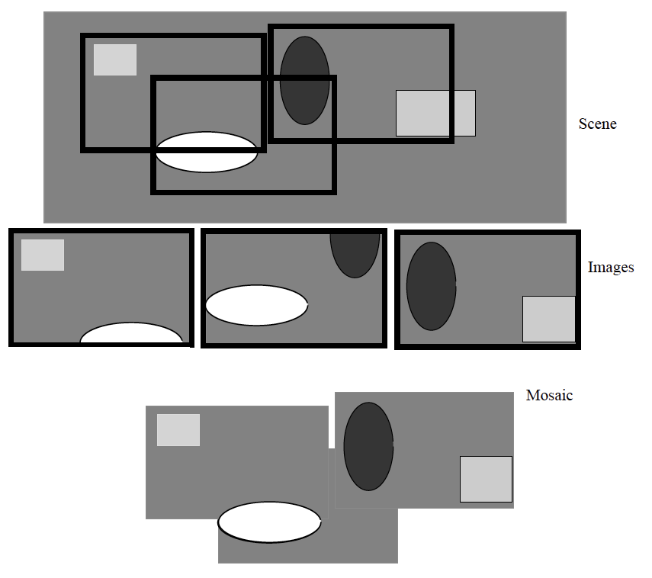

Slide 4
How to register
Idea:
compute some cost; find translation that gives min

Slide 5
Important: overlaps will differ in size
Mean squared error (MSE)
Indexing ensures pixels that overlap
Are compared

Slide 6
Finding the translation
Simplest case:
Blank search:
choose a range of translations
compute the value for each
choose the best
AAARGH: slow
Insight:
overlap for smoothed and resampled images should be a good guide to true overlap - details to follow!

Slide 7
Building a simple mosaic
AARGH – sorry!

Slide 8
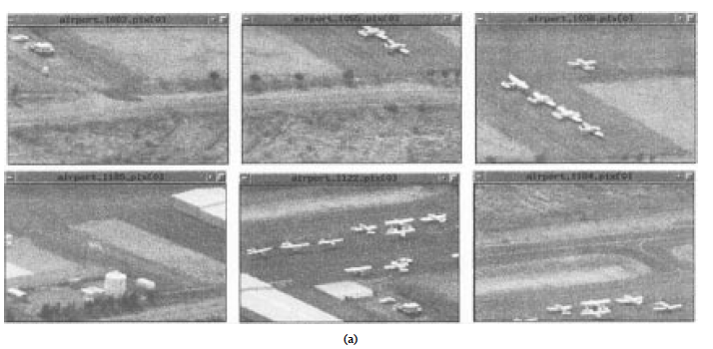
Some pictures….
Irani +Anandan, 98

Slide 9
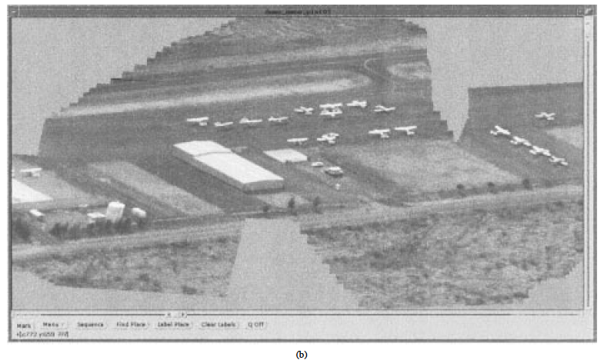
Lead to a mosaic.
Irani +Anandan, 98

Slide 10
Application
Registering color separations
Early color photography took 3 different images
red filter, green filter, blue filter
These won’t overlap perfectly (slight camera shake)
Register them by translating
Gurnard
Red
Green
Blue

Slide 11
BUT
Red, Green and Blue aren’t all that similar
so mean squared error may not be a great idea
Gurnard
Red
Green
Blue

Slide 12
Alternatives: The Cosine Distance

Slide 13
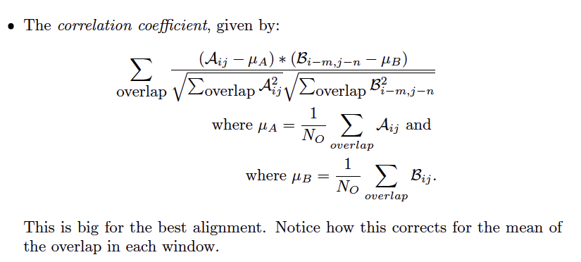
Alternatives: Correlation

Slide 14
Distances
Gurnard
Red
Green
Blue

Slide 15
Registering a zebra to itself
overlap for smoothed and resampled images should be a good guide to true overlap - details to follow!

Slide 16
The Gaussian Pyramid

Slide 17
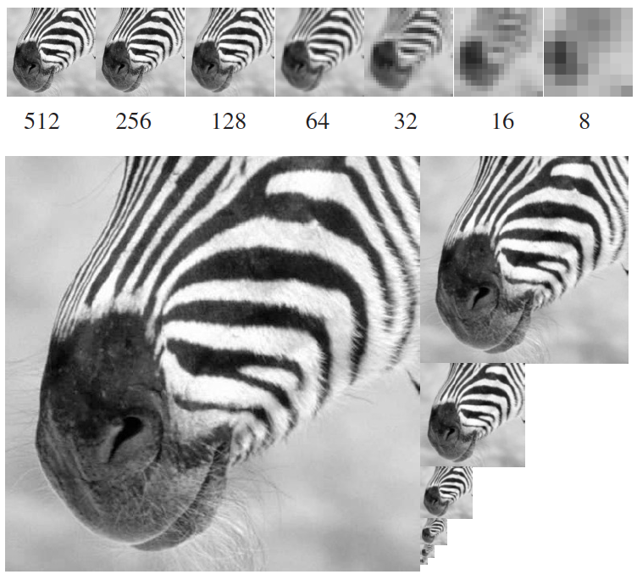
The Gaussian Pyramid

Slide 18
The Gaussian Pyramid
This was by 2 in example; could be others (sqrt(2) is common)

Slide 21
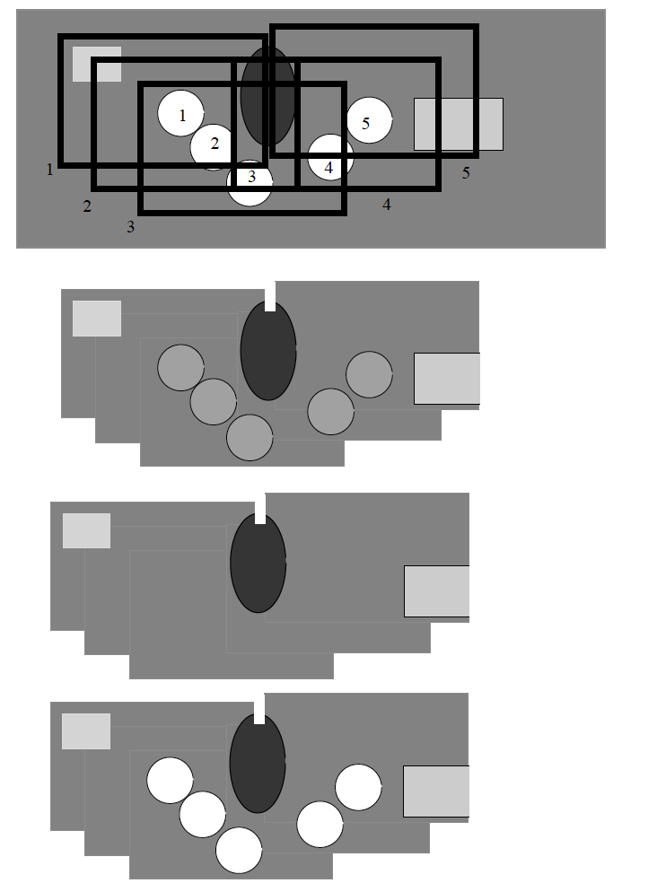
Scene, with moving circle; numbers show where
it is for frame k
Registered, then take the mean
Registered, then take the median
Registered, then take the pixel most different from
median

Slide 22
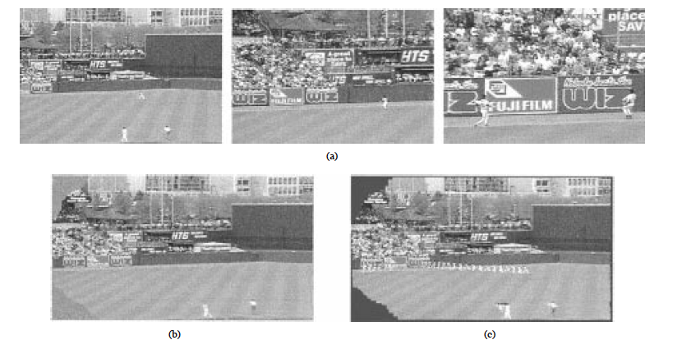
Video summaries
Irani +Anandan, 98

Slide 23
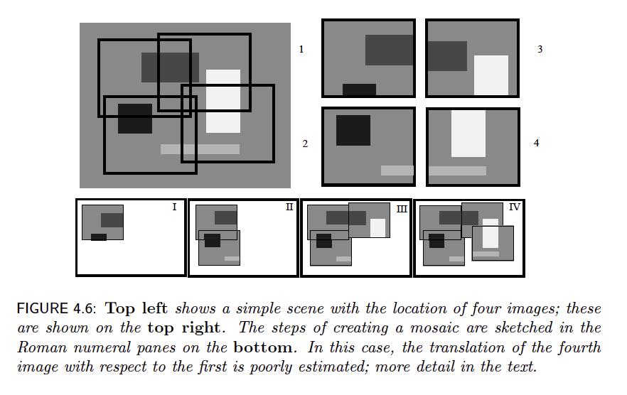
Registration problems….

Slide 24
Registration problems….

Slide 25
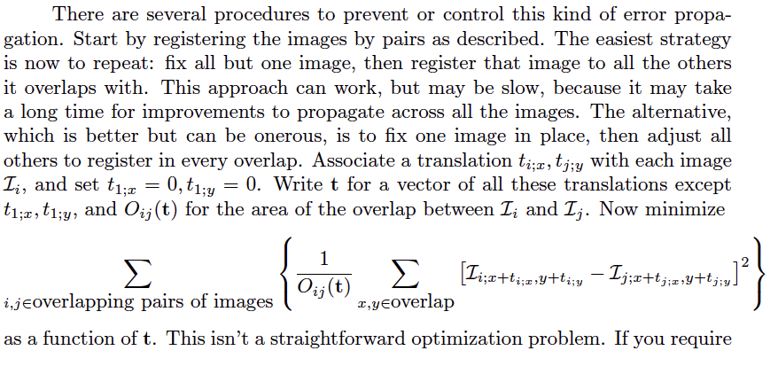
Rough sketch of bundle adjustment

