Slide 1
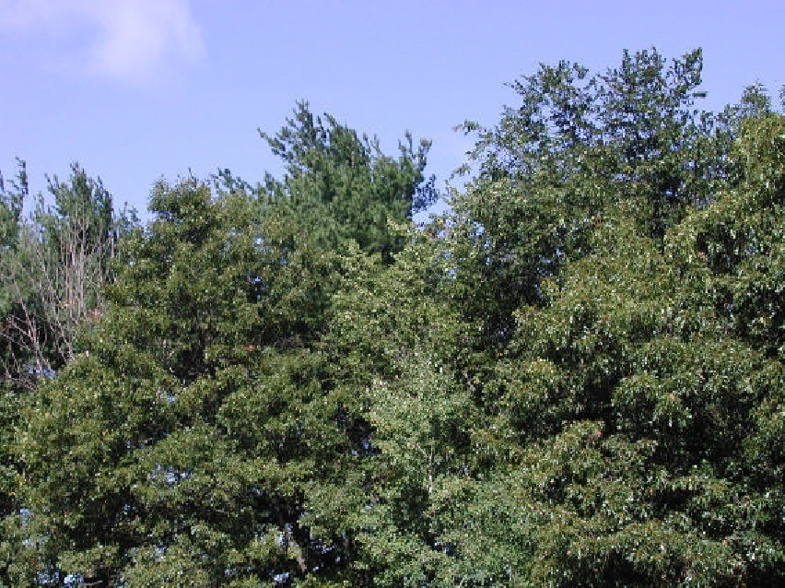
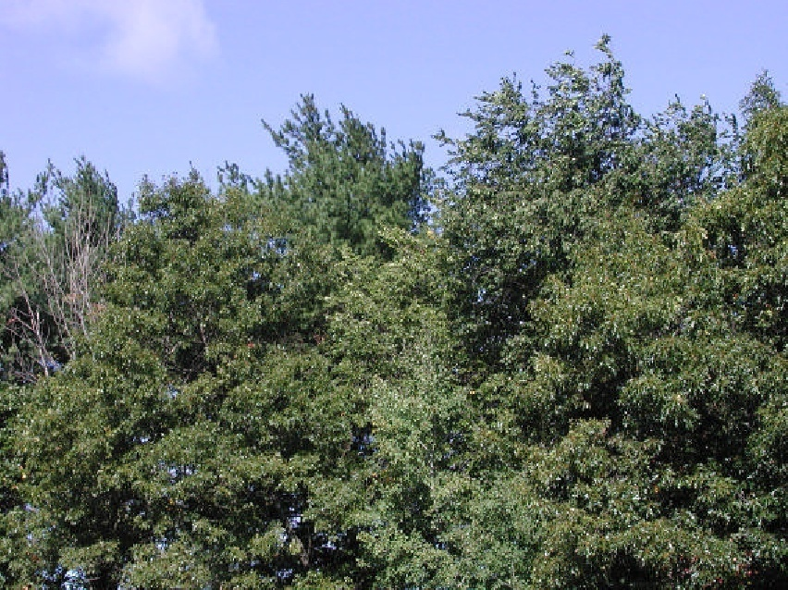
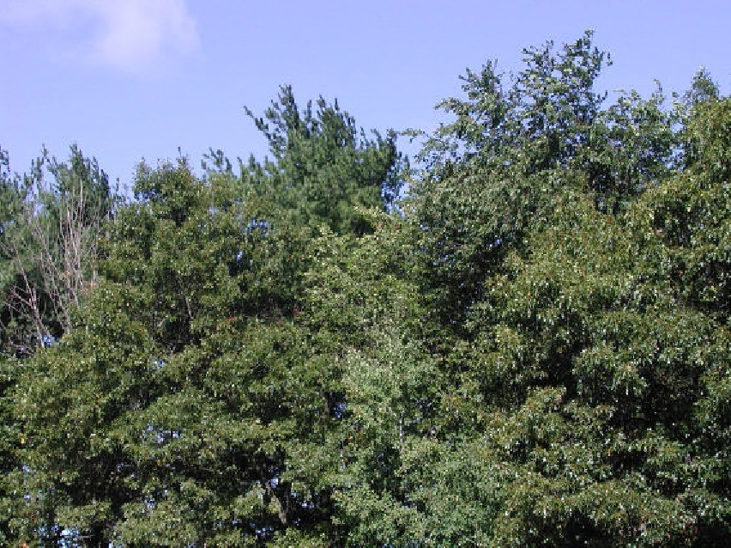
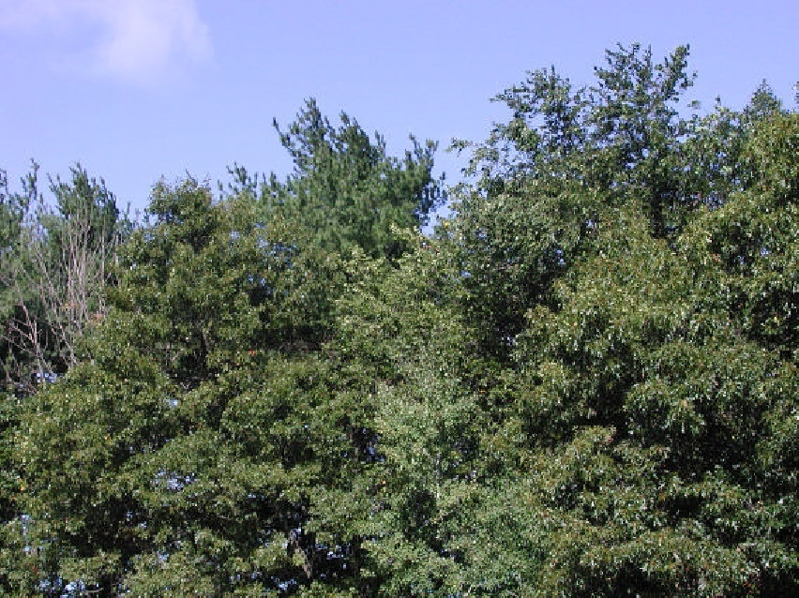
Optical flow
Many slides adapted from S. Seitz, R. Szeliski, M. Pollefeys

Slide 2
Outline
Motion: motivation
Brightness constancy constraint, aperture problem
Estimating optical flow (Lucas-Kanade)
Beyond basic flow estimation
Applications

Slide 3
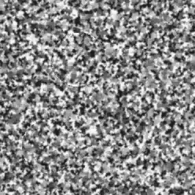
Motion is a powerful perceptual cue
Sometimes, it is the only cue

Slide 4
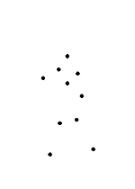
Motion is a powerful perceptual cue
Even “impoverished” motion data can evoke a strong percept
G. Johansson, “Visual Perception of Biological Motion and a Model For Its Analysis", Perception and Psychophysics 14, 201-211, 1973.

Slide 5
Motion is a powerful perceptual cue
Even “impoverished” motion data can evoke a strong percept
G. Johansson, “Visual Perception of Biological Motion and a Model For Its Analysis", Perception and Psychophysics 14, 201-211, 1973.

Slide 6
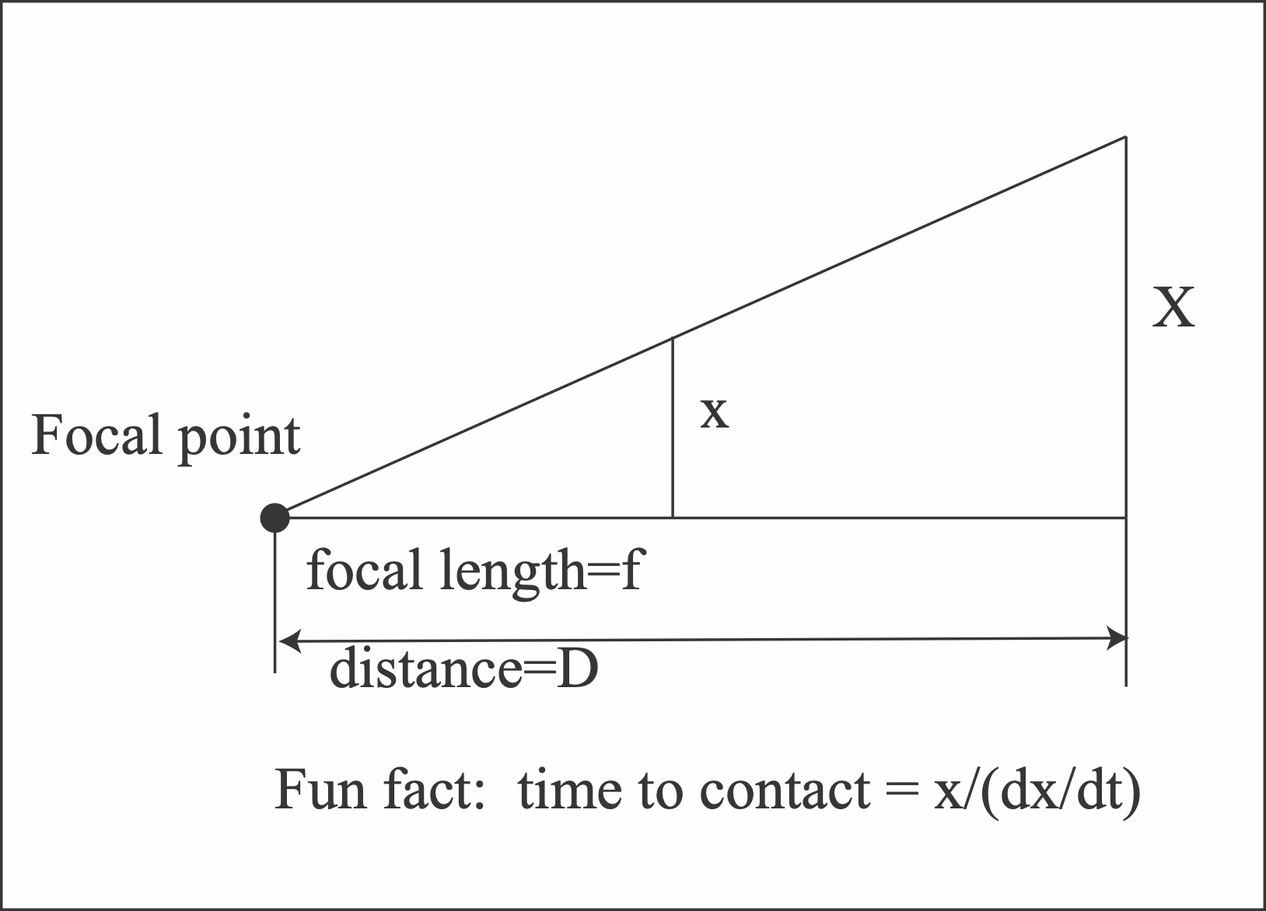
Motion gives time-to-contact cues

Slide 7


Slide 11
Rich source of reflexes in animals
x/(dx/dt) big = problem soon!

Slide 12
Another amusing motion reflex (two eyes!)
Left eye
Right eye

Slide 13
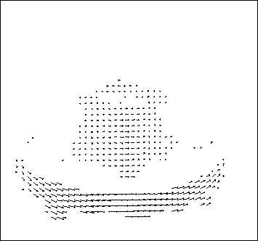
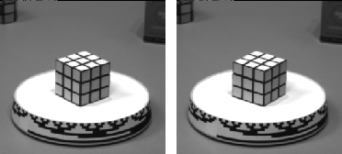
Motion field vs. optical flow
The motion field is the projection of the 3D scene motion into the image

Slide 14
Motion field vs. optical flow
The motion field is the projection of the 3D scene motion into the image
Optical flow is the apparent motion of brightness patterns in the image
Are optical flow and motion field the same?
  Apparent motion can be caused by lighting changes without any actual motion. E.g., consider a uniform rotating sphere under fixed lighting vs. a stationary sphere under moving illumination

Slide 15
Optical flow
Optical flow is the apparent motion of brightness patterns in the image
  Can be caused by camera motion, object motion, or changes of lighting in the scene
Image source
Image source

Slide 16
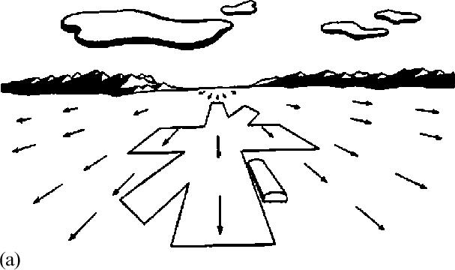

Slide 17
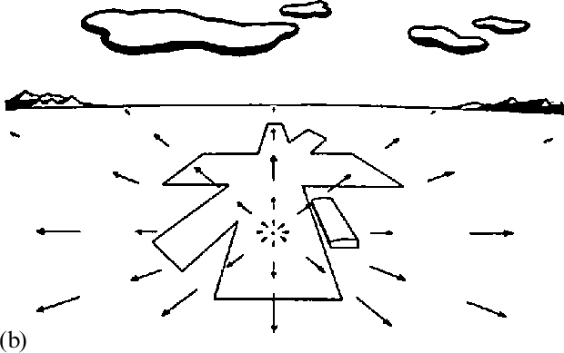

Slide 18
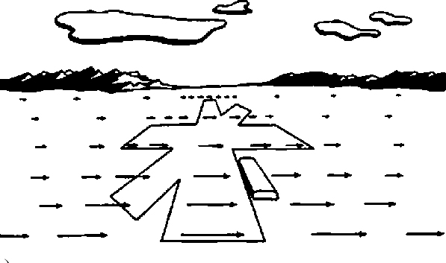

Slide 19
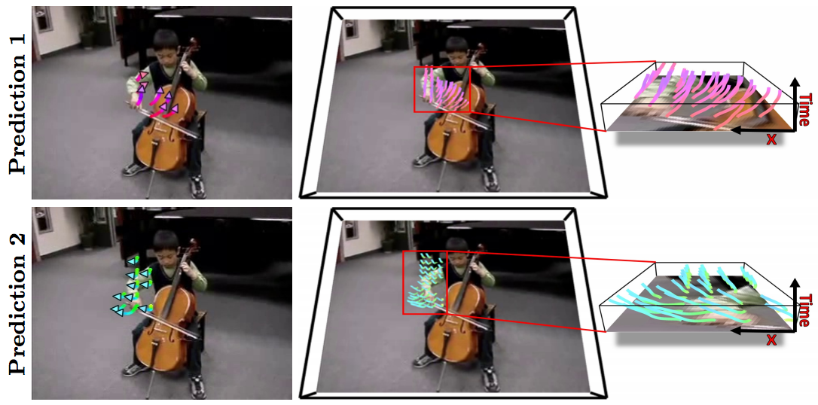
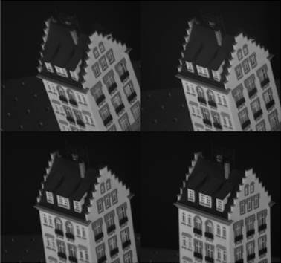
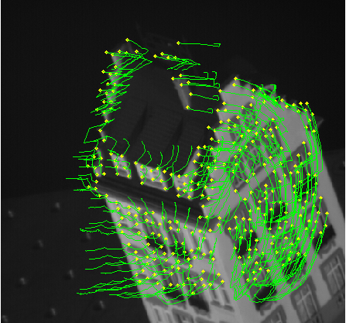
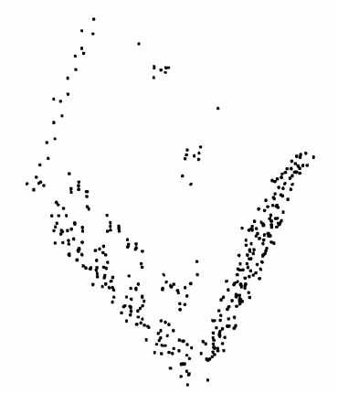
Uses of optical flow in computer vision
Video analysis and enhancement (stabilization, shot boundary detection, motion magnification, etc.)
Object tracking and segmentation in videos
Structure from motion, stereo matching
Event and activity recognition
Self-supervised and predictive learning
Source: Tomasi & Kanade
Source: Walker et al.

Slide 20
Outline
Motion: motivation
Brightness constancy constraint, aperture problem

Slide 21
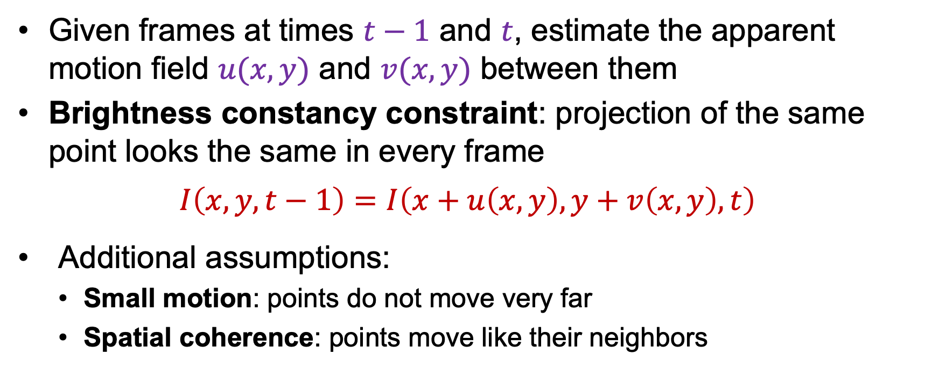




Estimating optical flow
$$I(x,y,t−1)$$
$$I(x+u,y+v,t)$$
$$t−1$$
$$t$$
Given frames at times $t−1$ and $t$, estimate the apparent motion field $u(x,y)$ and $v(x,y)$ between them
Brightness constancy constraint: projection of the same point looks the same in every frame
$$I\left(x,y,t−1\right)=I\left(x+u\left(x,y\right),y+v\left(x,y\right),t\right)$$
Additional assumptions:
  Small motion: points do not move very far
  Spatial coherence: points move like their neighbors

Slide 22
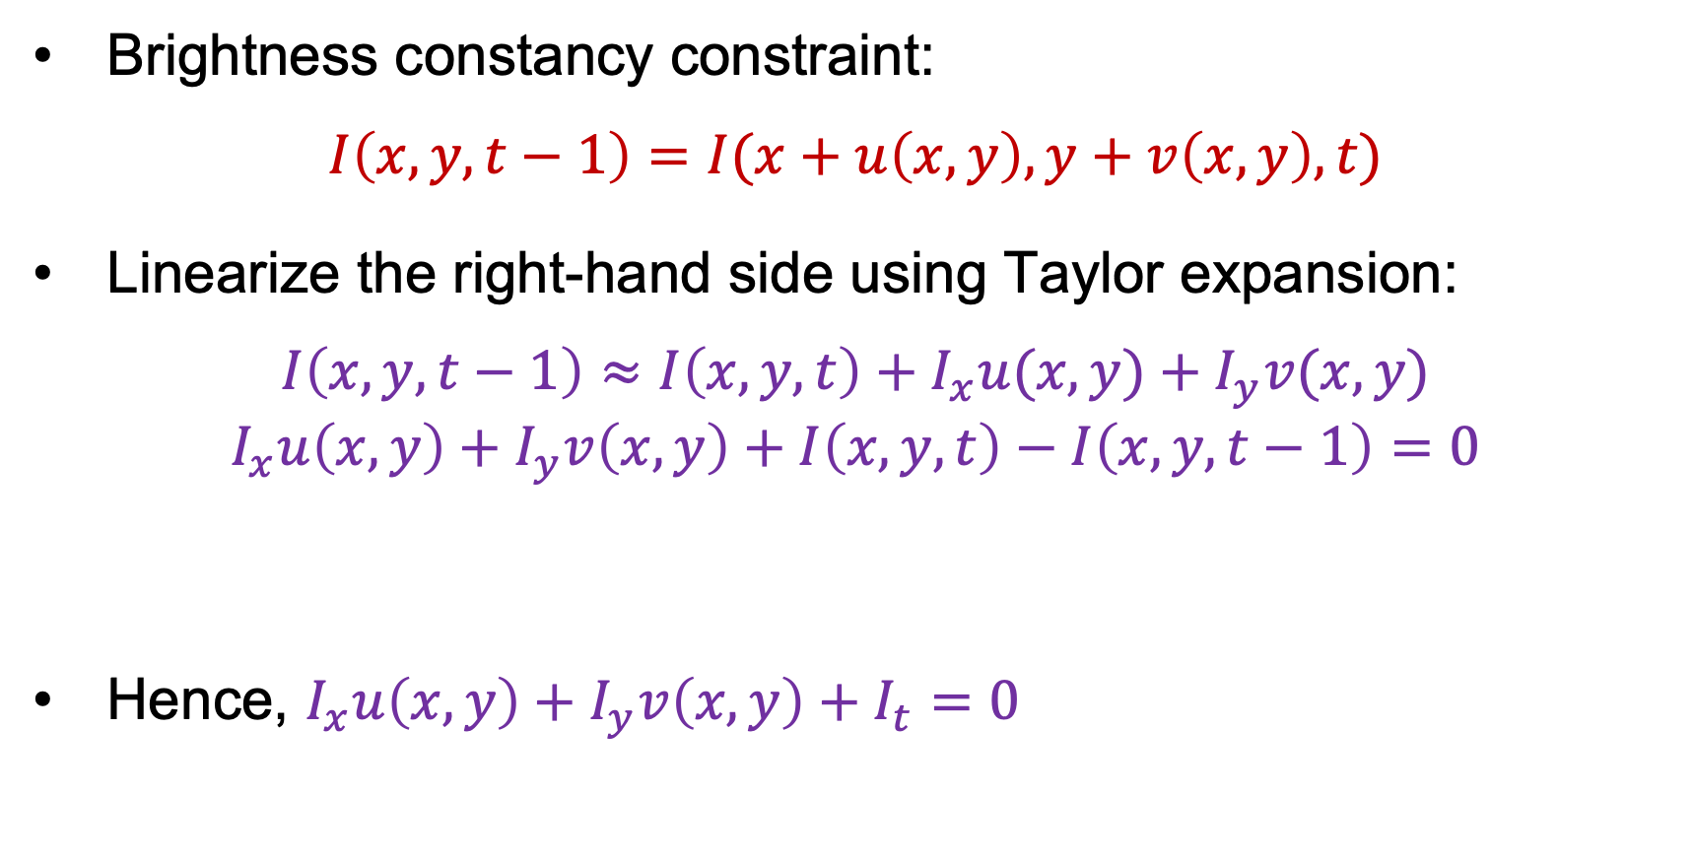
Estimating optical flow
Brightness constancy constraint:
$$I\left(x,y,t−1\right)=I(x+u\left(x,y\right),y+v\left(x,y\right),t)$$
Linearize the right-hand side using Taylor expansion:
$$I\left(x,y,t−1\right)≈I\left(x,y,t\right)+I_{x}u(x,y)+I_{y}v(x,y)$$
$$I_{x}u\left(x,y\right)+I_{y}v\left(x,y\right)+I\left(x,y,t\right)−I\left(x,y,t−1\right)=0$$
Hence, $I_{x}u\left(x,y\right)+I_{y}v\left(x,y\right)+I_{t}=0$
What could this be?

Slide 23
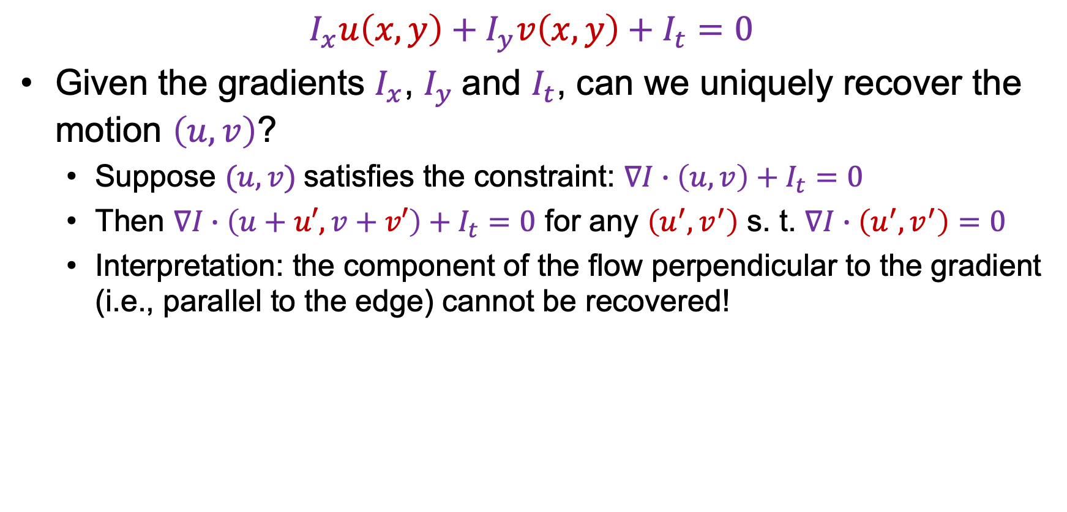




The brightness constancy constraint
$$I_{x}u\left(x,y\right)+I_{y}v\left(x,y\right)+I_{t}=0$$
Given the gradients $I_{x}$, $I_{y}$and $I_{t}$, can we uniquely recover the motion $\left(u,v\right)$?
  Suppose $(u, v)$satisfies the constraint: $∇I∙\left(u,v\right)+I_{t}=0$
  Then $∇I∙\left(u+u′,v+v′\right)+I_{t}=0$ for any $\left(u^{′},v^{′}\right)$ s. t. $∇I∙\left(u^{′},v^{′}\right)=0$
  Interpretation: the component of the flow perpendicular to the gradient (i.e., parallel to the edge) cannot be recovered!
$$∇I$$
$$(u,v)$$
$$(u′,v′)$$
$$(u+u′,v+v′)$$
edge

Slide 24
The aperture problem
Perceived motion

Slide 25
The aperture problem
Actual motion

Slide 26

The barber pole illusion
http://en.wikipedia.org/wiki/Barberpole_illusion

Slide 27

The barber pole illusion
http://en.wikipedia.org/wiki/Barberpole_illusion

Slide 28
Outline
Motion: motivation
Motion field and optical flow definition
Brightness constancy constraint, aperture problem
Estimating optical flow (Lucas-Kanade)

Slide 29
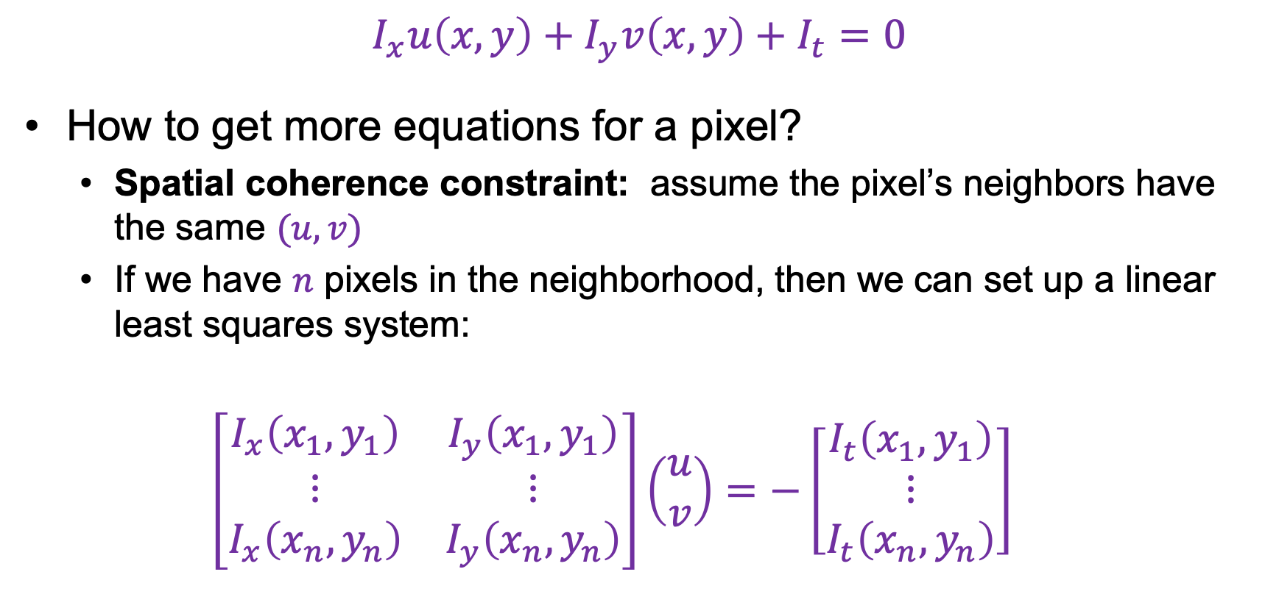
Solving the aperture problem
$$I_{x}u\left(x,y\right)+I_{y}v\left(x,y\right)+I_{t}=0$$
How to get more equations for a pixel?
  Spatial coherence constraint: assume the pixel’s neighbors have the same $(u,v)$
  If we have $n$ pixels in the neighborhood, then we can set up a linear least squares system:
  $$\left[\begin{matrix}I_{x}\left(x_{1},y_{1}\right) & I_{y}\left(x_{1},y_{1}\right) \\ ⋮ & ⋮ \\ I_{x}\left(x_{n},y_{n}\right) & I_{y}\left(x_{n},y_{n}\right)\end{matrix}\right]\left(\begin{aligned}u \\ v\end{aligned}\right)=−\left[\begin{matrix}I_{t}\left(x_{1},y_{1}\right) \\ ⋮ \\ I_{t}\left(x_{n},y_{n}\right)\end{matrix}\right]$$

Slide 30







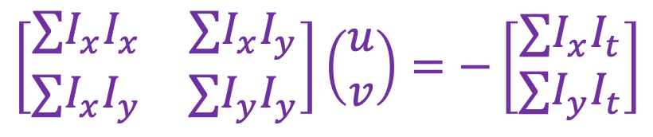

Estimating optical flow
$$\left[\begin{matrix}I_{x}\left(x_{1},y_{1}\right) & I_{y}\left(x_{1},y_{1}\right) \\ ⋮ & ⋮ \\ I_{x}\left(x_{n},y_{n}\right) & I_{y}\left(x_{n},y_{n}\right)\end{matrix}\right]\left(\begin{aligned}u \\ v\end{aligned}\right)=−\left[\begin{matrix}I_{t}\left(x_{1},y_{1}\right) \\ ⋮ \\ I_{t}\left(x_{n},y_{n}\right)\end{matrix}\right]$$
Solution:
$$A$$
$$d$$
$$b$$
$$\left[\begin{matrix}∑I_{x}I_{x} & ∑I_{x}I_{y} \\ ∑I_{x}I_{y} & ∑I_{y}I_{y}\end{matrix}\right]\left(\begin{aligned}u \\ v\end{aligned}\right)=−\left[\begin{matrix}∑I_{x}I_{t} \\ ∑I_{y}I_{t}\end{matrix}\right]$$
$$A^{T}A$$
$$d$$
$$A^{T}b$$
What does $A^{T}A$remind you of?
When is the system solvable?

Slide 31
Recall: second moment matrix
Estimation of optical flow is well-conditioned precisely for regions with high “cornerness”:
λ₂
“Edge”
λ₂ >> λ₁
“Corner”
λ₁ and λ₂ are large,
λ₁ ~ λ₂
λ₁ and λ₂ are small
“Flat” region
“Edge”
λ₁ >> λ₂
λ₁

Slide 32
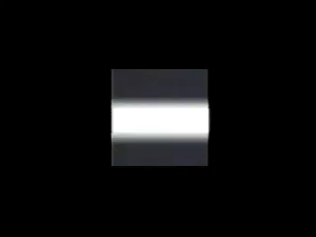
Conditions for solvability
“Bad” case: single straight edge

Slide 33
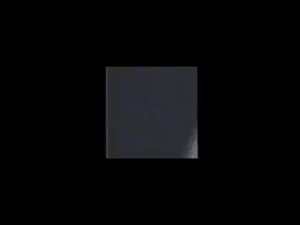
Conditions for solvability
“Good” case

Slide 34
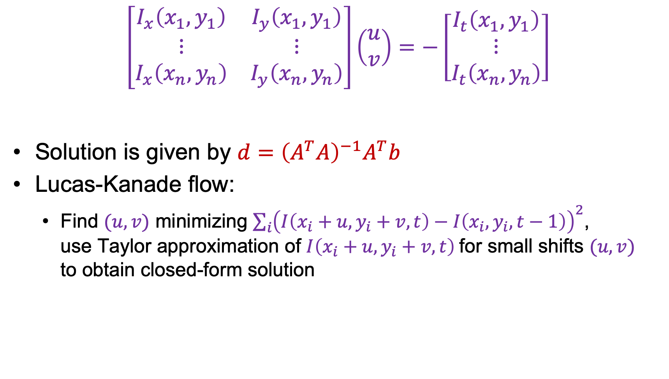

Lucas-Kanade flow
$$\left[\begin{matrix}I_{x}\left(x_{1},y_{1}\right) & I_{y}\left(x_{1},y_{1}\right) \\ ⋮ & ⋮ \\ I_{x}\left(x_{n},y_{n}\right) & I_{y}\left(x_{n},y_{n}\right)\end{matrix}\right]\left(\begin{aligned}u \\ v\end{aligned}\right)=−\left[\begin{matrix}I_{t}\left(x_{1},y_{1}\right) \\ ⋮ \\ I_{t}\left(x_{n},y_{n}\right)\end{matrix}\right]$$
Solution is given by $d={\left(A^{T}A\right)}^{−1}A^{T}b$
Lucas-Kanade flow:
  Find $(u,v)$ minimizing $\sum_{i}{{\left(I\left(x_{i}+u,y_{i}+v,t\right)−I\left(x_{i},y_{i},t−1\right)\right)}^{2}}$,
  use Taylor approximation of $I\left(x_{i}+u,y_{i}+v,t\right)$for small shifts $(u,v)$
  to obtain closed-form solution
$$A$$
$$d$$
$$b$$
B. Lucas and T. Kanade. An iterative image registration technique with an application to stereo vision.
In Proceedings of the International Joint Conference on Artificial Intelligence, pp. 674–679, 1981

Slide 35
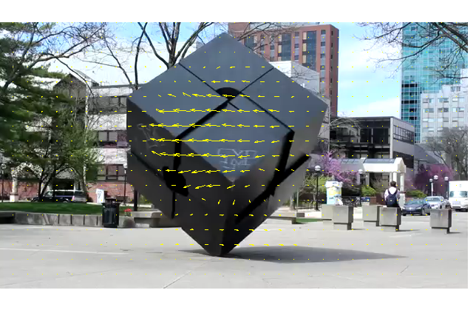
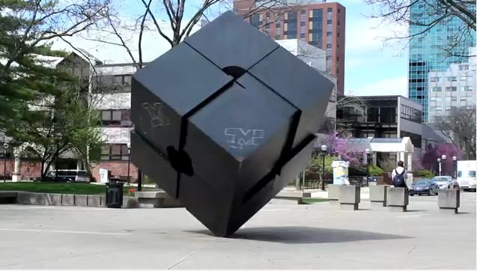

Lucas-Kanade flow example
Input frames
Output
Source: MATLAB Central File Exchange

Slide 36
Outline
Motion: motivation
Motion field and optical flow definition
Brightness constancy constraint, aperture problem
Estimating optical flow (Lucas-Kanade)
Beyond basic flow estimation

Slide 37
When does Lucas-Kanade fail?
The motion is large (larger than a pixel)
A point does not move like its neighbors
Brightness constancy does not hold
Notes:
Iterative refinement:
Estimate velocity at each pixel using one iteration of Lucas and Kanade estimation
Warp one image toward the other using the estimated flow field
Refine estimate by repeating the process

Slide 38
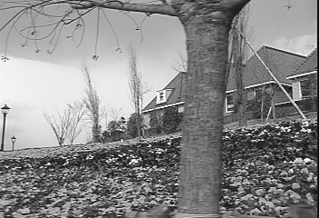
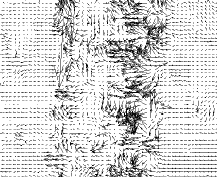
Fixing the errors in Lucas-Kanade
The motion is large
Notes:
Iterative refinement:
Estimate velocity at each pixel using one iteration of Lucas and Kanade estimation
Warp one image toward the other using the estimated flow field
Refine estimate by repeating the process

Slide 39
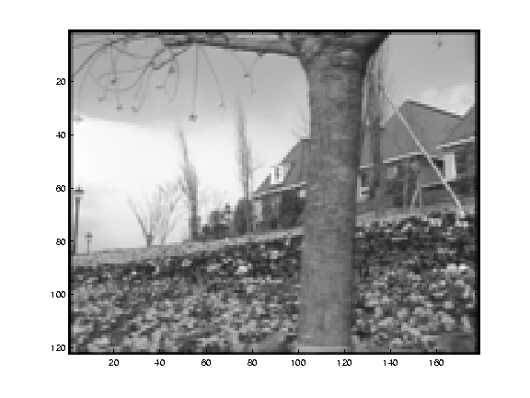
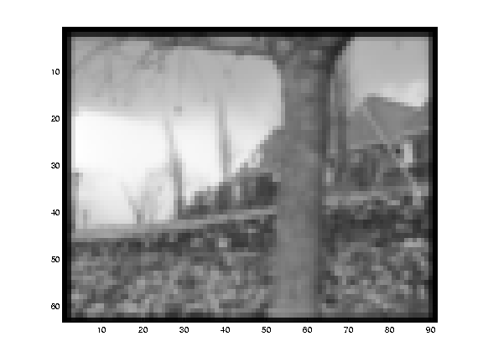
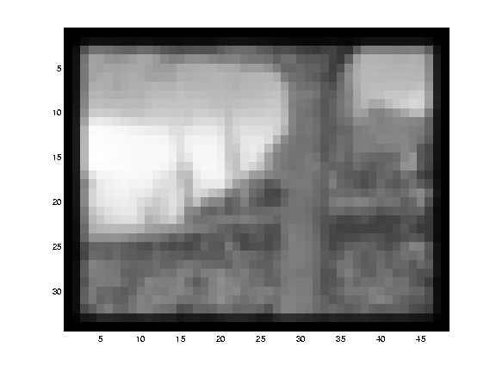
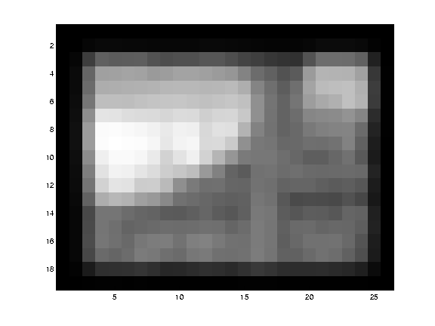
Fixing the errors in Lucas-Kanade
The motion is large
  Multi-resolution estimation, iterative refinement
Notes:
Iterative refinement:
Estimate velocity at each pixel using one iteration of Lucas and Kanade estimation
Warp one image toward the other using the estimated flow field
Refine estimate by repeating the process

Slide 40
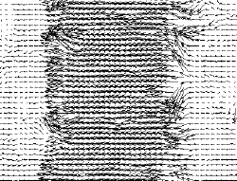
Fixing the errors in Lucas-Kanade
The motion is large
  Multi-resolution estimation, iterative refinement
Notes:
Iterative refinement:
Estimate velocity at each pixel using one iteration of Lucas and Kanade estimation
Warp one image toward the other using the estimated flow field
Refine estimate by repeating the process

Slide 41
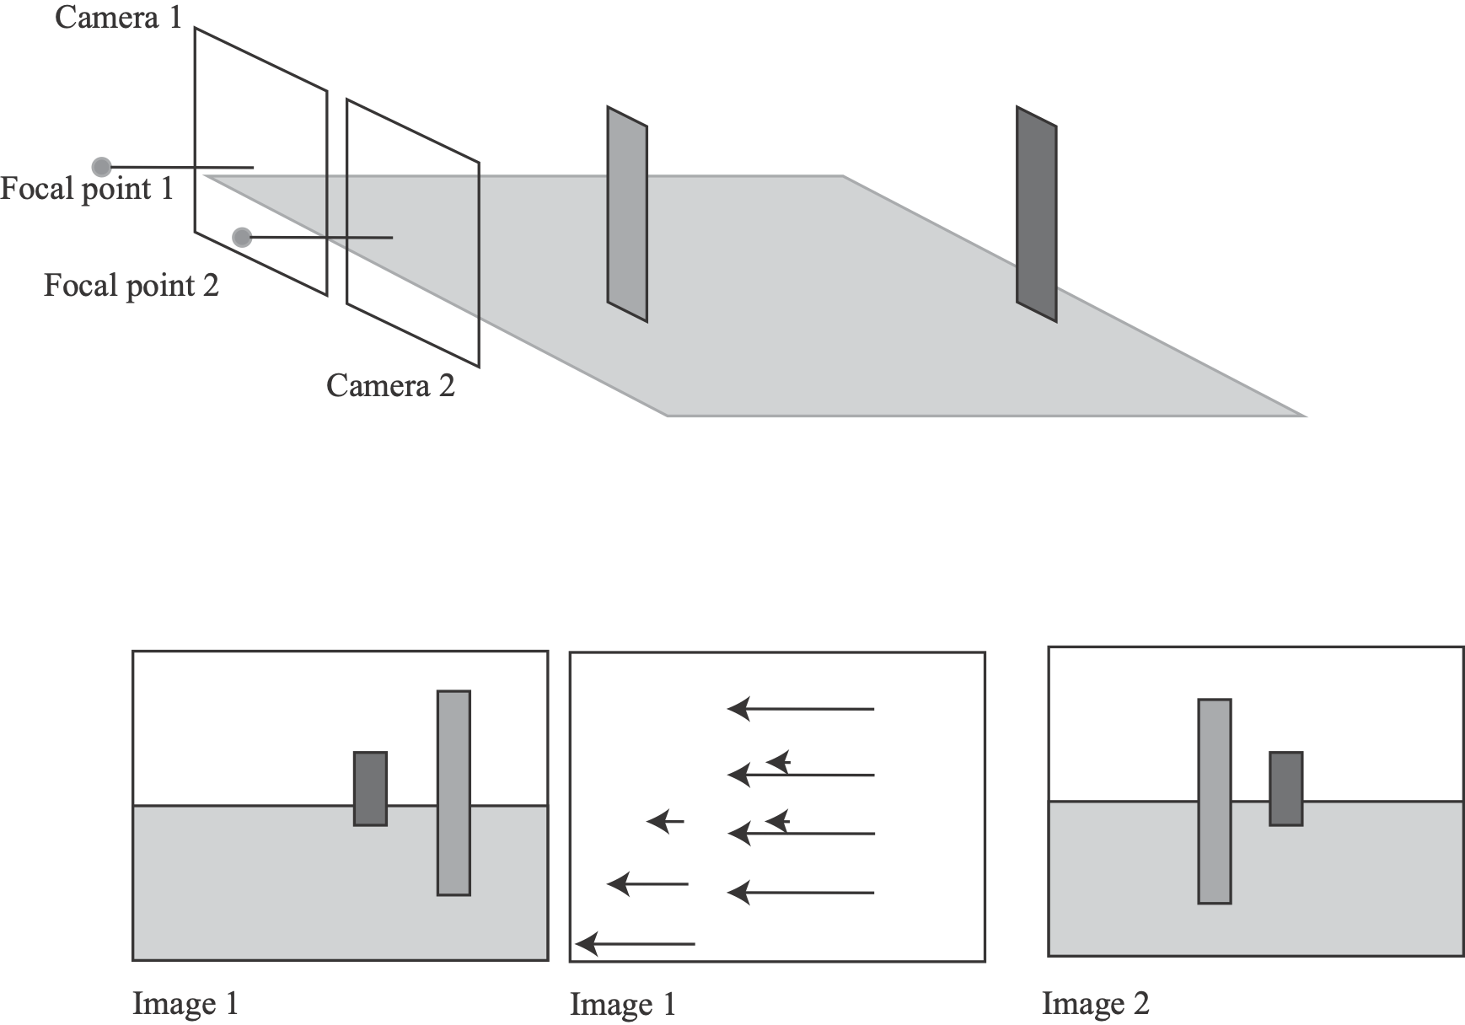

Slide 42
Parametric flow models
Divide image into regions; in each region, flow is:
Flow
parameters
functions of pixel position

Slide 43
Examples

Slide 44
Examples

Slide 45
Estimating
This is a clustering problem:
we have k regions, k flow models
If we knew the regions, we could estimate the flow
(eg compute a Lucas-Kanade soln, fit a flow model
with least squares)
If we knew the flow models, we could estimate the regions
(eg, for each pixel, apply flow models, choose best)

Slide 46
Roughly
Initialize regions
Repeat:
Estimate flow from regions
Estimate regions from flow
Product:
k flow fields AND k regions

Slide 47
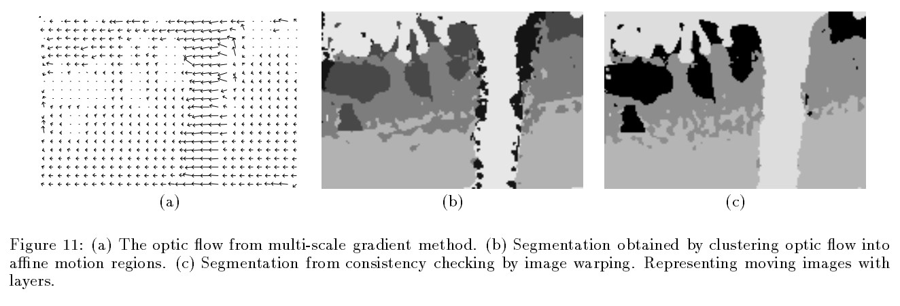
Fixing the errors in Lucas-Kanade
The motion is large (larger than a pixel)
A point does not move like its neighbors
  Motion segmentation
J. Wang and E. Adelson, Representing Moving Images with Layers, IEEE Transactions on Image Processing, 1994
Notes:
Iterative refinement:
Estimate velocity at each pixel using one iteration of Lucas and Kanade estimation
Warp one image toward the other using the estimated flow field
Refine estimate by repeating the process

Slide 48
Fixing the errors in Lucas-Kanade
The motion is large (larger than a pixel)
A point does not move like its neighbors
Brightness constancy does not hold
  Feature matching (e.g., SIFT) or tracking
Notes:
Iterative refinement:
Estimate velocity at each pixel using one iteration of Lucas and Kanade estimation
Warp one image toward the other using the estimated flow field
Refine estimate by repeating the process

Slide 49
Last time: Optical flow
Motion: motivation
Motion field and optical flow definition
Brightness constancy constraint, aperture problem
Estimating optical flow (Lucas-Kanade)
Beyond basic flow estimation

Slide 50
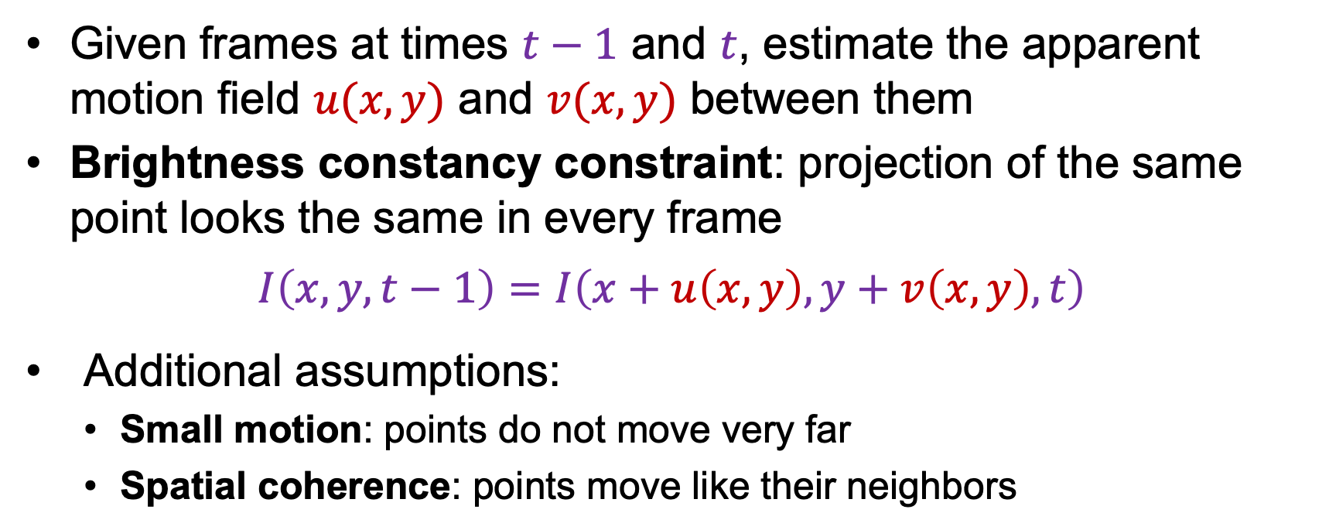


Review: Estimating optical flow
$$I(x,y,t−1)$$
$$I(x+u,y+v,t)$$
$$t−1$$
$$t$$
Given frames at times $t−1$ and $t$, estimate the apparent motion field $u(x,y)$ and $v(x,y)$ between them
Brightness constancy constraint: projection of the same point looks the same in every frame
$$I\left(x,y,t−1\right)=I\left(x+u\left(x,y\right),y+v\left(x,y\right),t\right)$$
Additional assumptions:
  Small motion: points do not move very far
  Spatial coherence: points move like their neighbors

Slide 51
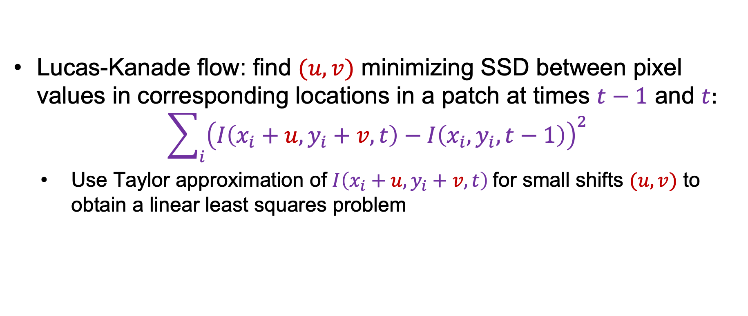

Review: Estimating optical flow
$$I(x,y,t−1)$$
$$I(x+u,y+v,t)$$
$$t−1$$
$$t$$
Lucas-Kanade flow: find $(u,v)$ minimizing SSD between pixel values in corresponding locations in a patch at times $t−1$ and $t$:
$$\sum_{i}{{\left(I\left(x_{i}+u,y_{i}+v,t\right)−I\left(x_{i},y_{i},t−1\right)\right)}^{2}}$$
  Use Taylor approximation of $I\left(x_{i}+u,y_{i}+v,t\right)$for small shifts $(u,v)$ to obtain a linear least squares problem
B. Lucas and T. Kanade. An iterative image registration technique with an application to stereo vision.
In Proceedings of the International Joint Conference on Artificial Intelligence, pp. 674–679, 1981

Slide 52
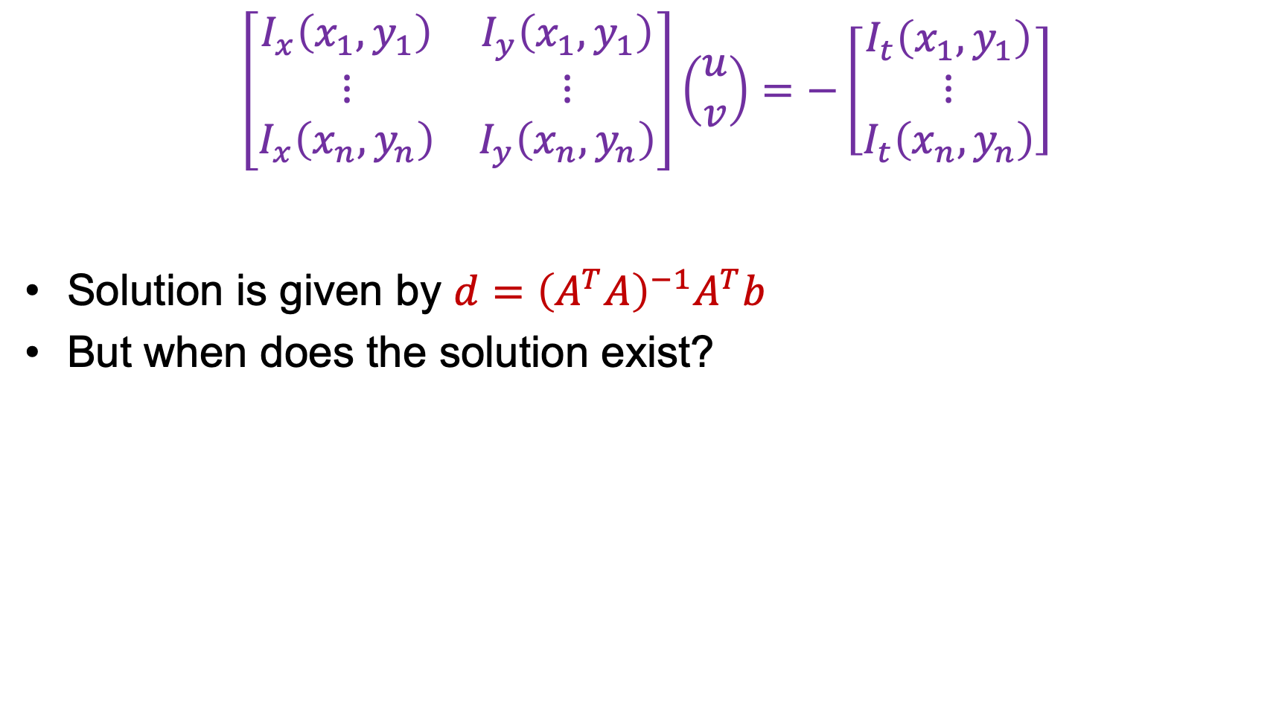
Review: Lucas-Kanade flow
$$\left[\begin{matrix}I_{x}\left(x_{1},y_{1}\right) & I_{y}\left(x_{1},y_{1}\right) \\ ⋮ & ⋮ \\ I_{x}\left(x_{n},y_{n}\right) & I_{y}\left(x_{n},y_{n}\right)\end{matrix}\right]\left(\begin{aligned}u \\ v\end{aligned}\right)=−\left[\begin{matrix}I_{t}\left(x_{1},y_{1}\right) \\ ⋮ \\ I_{t}\left(x_{n},y_{n}\right)\end{matrix}\right]$$
Solution is given by $d={\left(A^{T}A\right)}^{−1}A^{T}b$
But when does the solution exist?
$$A$$
$$d$$
$$b$$
B. Lucas and T. Kanade. An iterative image registration technique with an application to stereo vision.
In Proceedings of the International Joint Conference on Artificial Intelligence, pp. 674–679, 1981

Slide 53
Shi-Tomasi feature tracker
Find good features using eigenvalues of second-moment matrix
  Key idea: “good” features to track are the ones whose motion can be estimated reliably
From frame to frame, track with Lucas-Kanade
  This amounts to assuming a translation model for frame-to-frame feature movement
Check consistency of tracks by affine registration to the first observed instance of the feature
  Affine model is more accurate for larger displacements
  Comparing to the first frame helps to minimize drift
J. Shi and C. Tomasi. Good Features to Track. CVPR 1994.

Slide 54
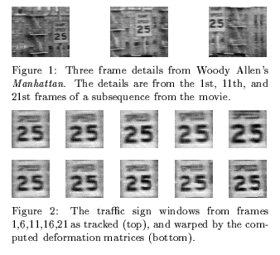
Tracking example
J. Shi and C. Tomasi. Good Features to Track. CVPR 1994.

Slide 55
Outline
Motion: motivation
Motion field and optical flow definition
Brightness constancy constraint, aperture problem
Lucas-Kanade flow estimation
Beyond basic flow estimation
Current approaches, applications

Slide 56
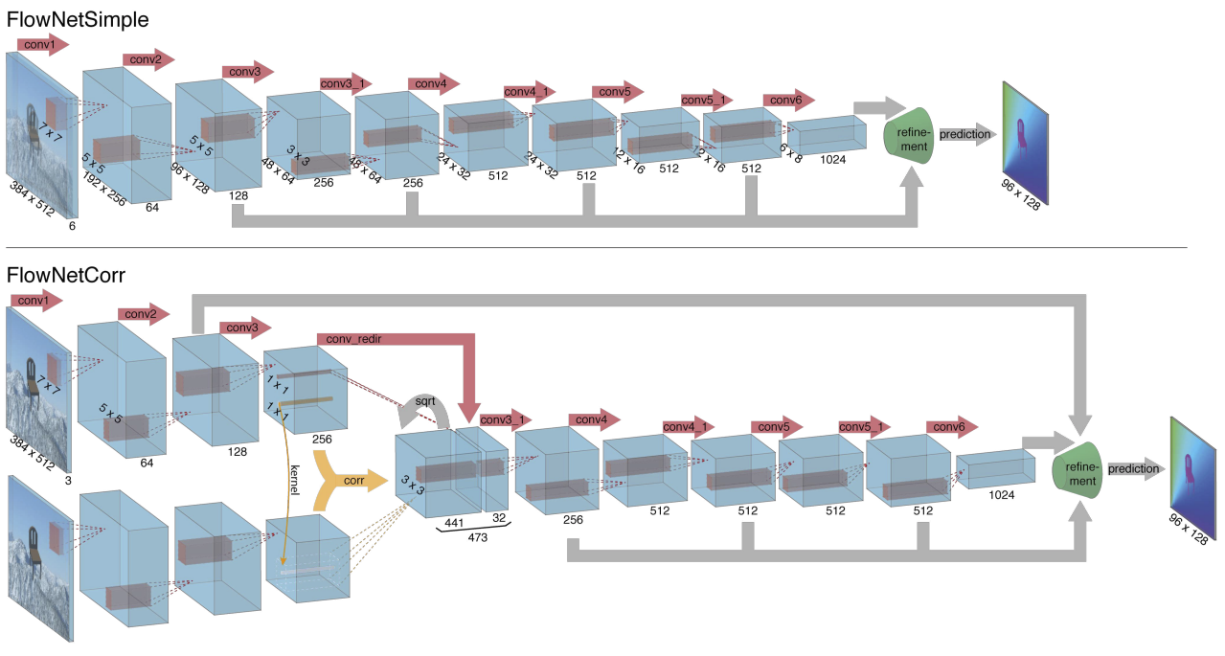
State-of-the-art optical flow estimation
Current best methods are learned (often on synthetic data)
A. Dosovitskiy et al., FlowNet: Learning Optical Flow with Convolutional Networks, ICCV 2015

Slide 57
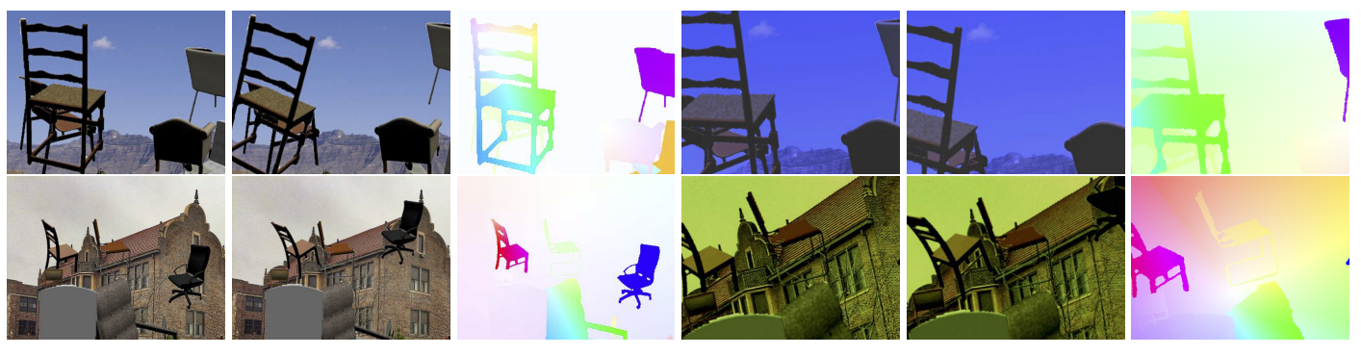
State-of-the-art optical flow estimation
Current best methods are learned (often on synthetic data)
Synthetic dataset: Flying Chairs
A. Dosovitskiy et al., FlowNet: Learning Optical Flow with Convolutional Networks, ICCV 2015

Slide 58
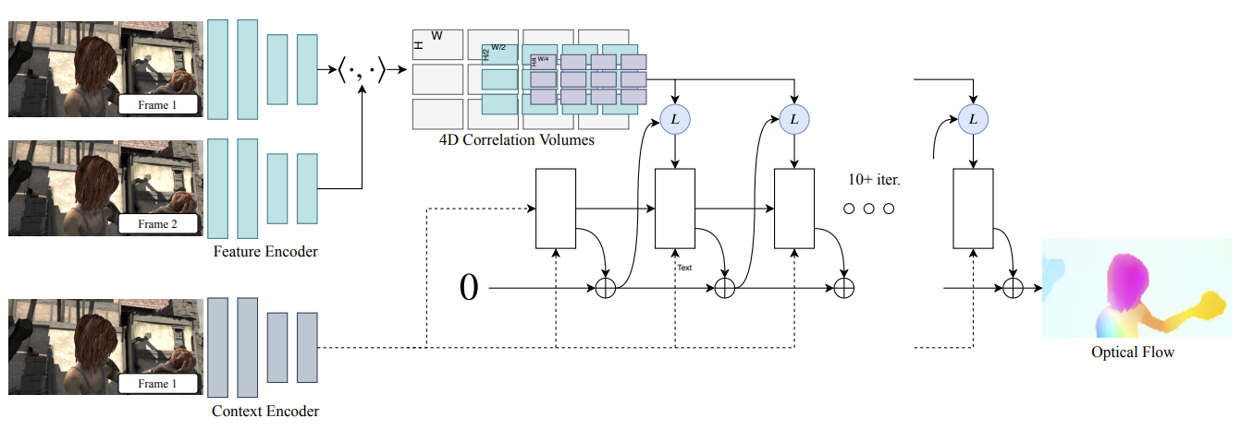
State-of-the-art optical flow estimation
Current best methods are learned (often on synthetic data)
Z. Teed and J. Deng. RAFT: Recurrent All-Pairs Field Transforms for Optical Flow. ECCV 2020 (Best Paper Award)
Notes:
RAFT consists of 3 main components: (1) A feature encoder that extracts per-pixel features from both input images, along with a context encoder that extracts features from only I1. (2) A correlation layer which constructs a 4D W × H × W × H correlation volume by taking the inner product of all pairs of feature vectors. The last 2-dimensions of the 4D volume are pooled at multiple scales to construct a set of multi-scale volumes. (3) An update operator which recurrently updates optical flow by using the current estimate to look up values from the set of correlation volumes.

Slide 59
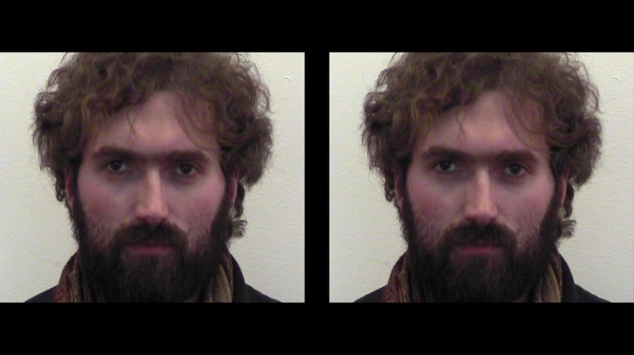
Motion magnification
Idea: take flow, magnify it
C. Liu et al., Motion Magnification, SIGGRAPH 2005
Source: D. Fouhey and J. Johnson

Slide 60
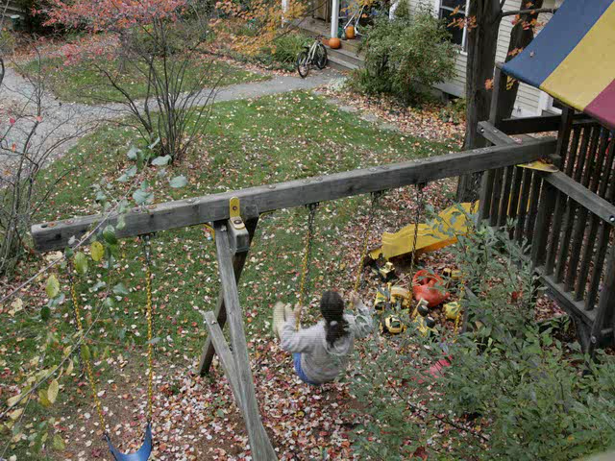
Motion magnification
C. Liu et al., Motion Magnification, SIGGRAPH 2005
Source: D. Fouhey and J. Johnson
Notes:
To find small motions in a video and magnify them, we model the appearance of the input video as translations of the pixel intensities observed in a reference frame. Naively, this sounds like one might (a) compute the translation from one pixel to the next in each frame, and (b) re-render the video with small motions amplified. Unfortunately, such an approach would lead to artificial transitions between amplified and unamplified pixels within a single structure. Most of the steps of motion magnification relate to reliably estimating motions, and to clustering pixels whose motions should be magnified as a group. Below we motivate and summarize each step of the motion magnification processing.

Slide 61
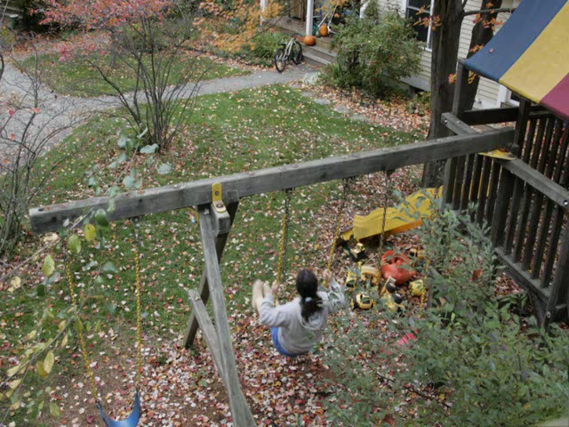
Motion magnification
C. Liu et al., Motion Magnification, SIGGRAPH 2005
Source: D. Fouhey and J. Johnson
Notes:
To find small motions in a video and magnify them, we model the appearance of the input video as translations of the pixel intensities observed in a reference frame. Naively, this sounds like one might (a) compute the translation from one pixel to the next in each frame, and (b) re-render the video with small motions amplified. Unfortunately, such an approach would lead to artificial transitions between amplified and unamplified pixels within a single structure. Most of the steps of motion magnification relate to reliably estimating motions, and to clustering pixels whose motions should be magnified as a group. Below we motivate and summarize each step of the motion magnification processing.

Slide 62
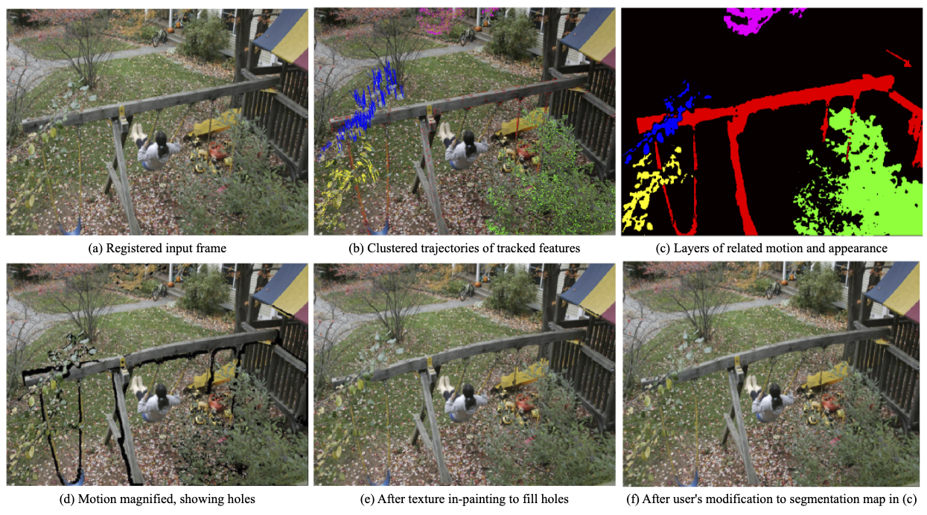
Motion magnification
C. Liu et al., Motion Magnification, SIGGRAPH 2005
Source: D. Fouhey and J. Johnson
Notes:
To find small motions in a video and magnify them, we model the appearance of the input video as translations of the pixel intensities observed in a reference frame. Naively, this sounds like one might (a) compute the translation from one pixel to the next in each frame, and (b) re-render the video with small motions amplified. Unfortunately, such an approach would lead to artificial transitions between amplified and unamplified pixels within a single structure. Most of the steps of motion magnification relate to reliably estimating motions, and to clustering pixels whose motions should be magnified as a group. Below we motivate and summarize each step of the motion magnification processing.

Slide 63
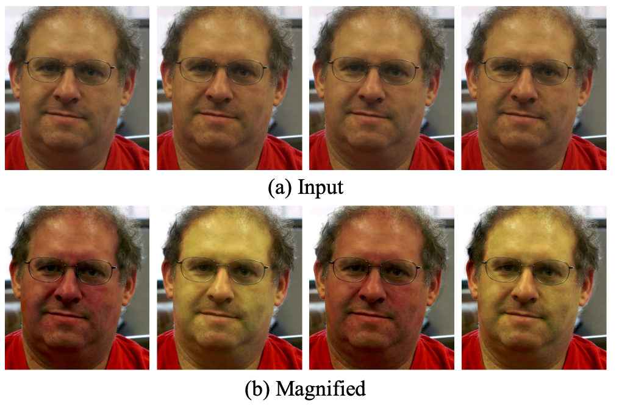
Motion magnification
H. Wu et al. Eulerian Video Magnification for Revealing Subtle Changes in the World. SIGGRAPH 2012

Slide 64
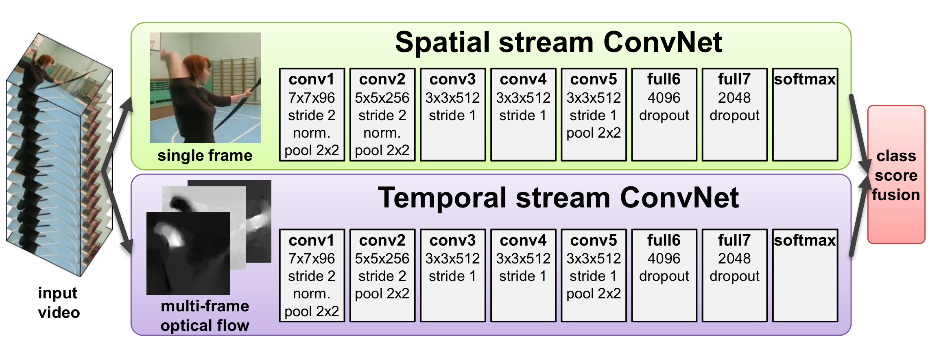
Activity recognition
Optical Flow is commonly used as an input feature for video classification with CNNs
K. Simonyan and A. Zisserman. Two-Stream Convolutional Networks for Action Recognition in Videos. NeurIPS 2014
Source: D. Fouhey and J. Johnson

