Slide 1
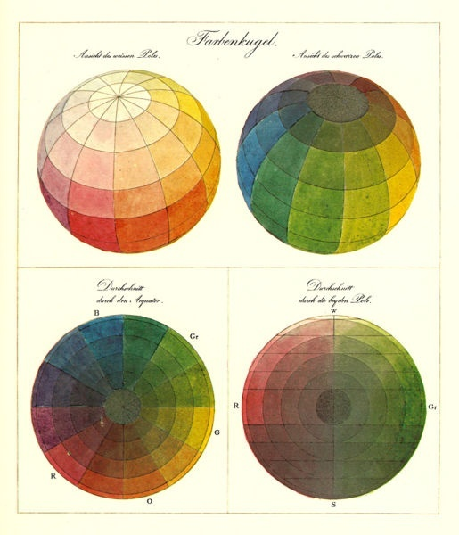
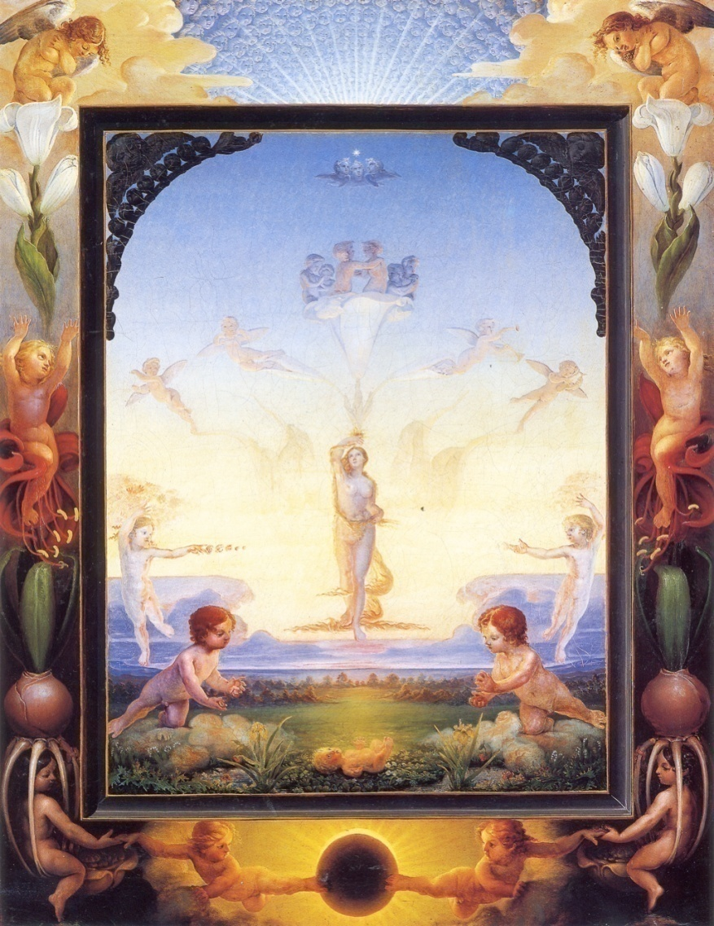
Color
Phillip Otto Runge (1777-1810)

Slide 2
Outline
Physical origin of color
Spectra of sources and surfaces
Physiology of color vision
Quantifying color perception
Color spaces
Color constancy, white balance

Slide 3
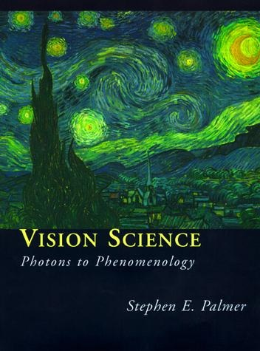
What is color?
Color is the result of interaction between physical light in the environment and our visual system
“Color is a psychological property of our visual experiences when we look at objects and lights, not a physical property of those objects or lights”
-- S. Palmer, Vision Science: Photons to Phenomenology

Slide 4
Causes of color
The sensation of color is occurs in the brain
You can get this sensation in a variety of ways
  Dreaming
  Hallucination
  Pressure on the eyelids
Most usual
  Response of sensors in the eye to light with different amounts of energy at different wavelengths

Slide 5
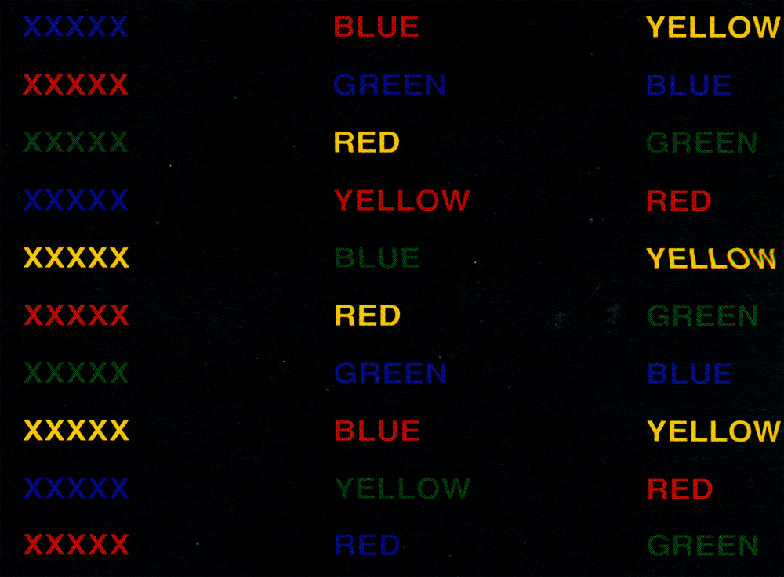

Slide 6
Stroop effect
Color perception affects all sorts of other perceptual phenomena
You name colors slowly IF the word is a different color name!

Slide 7
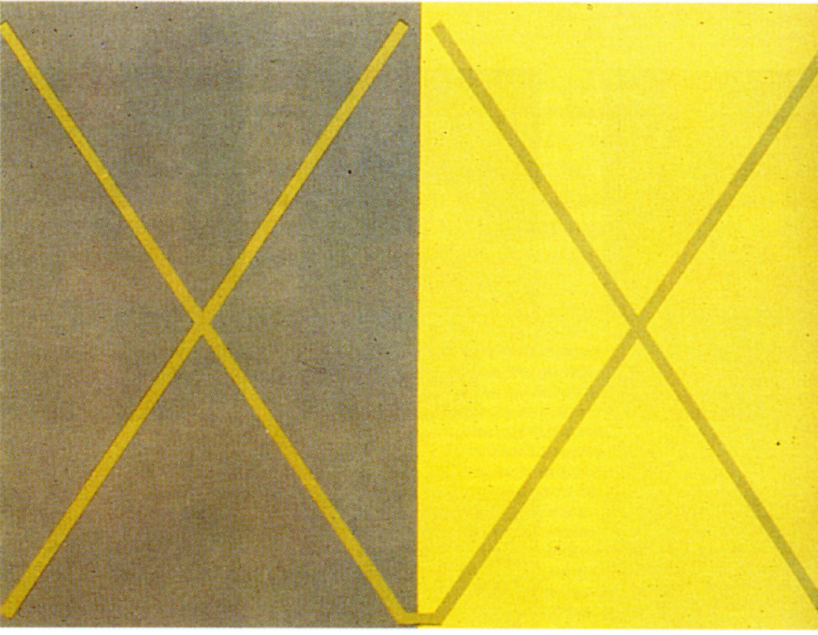

Slide 8
Your perception of color is relative to other colors

Slide 9
Different amounts of energy at different wavelengths
Light could be
  emitted with wavelengths absent (flourescent light vs. incandescent light)
  differentially reflected - e.g. paint on a surface
  differentially refracted - e.g. Newton’s prism
  subject to wavelength dependent specular reflection (most metals).
  Flourescence -
    invisible wavelengths absorbed and reemitted at visible wavelengths.
  Phosphorescence (ditto, energy, longer timescale)

Slide 10
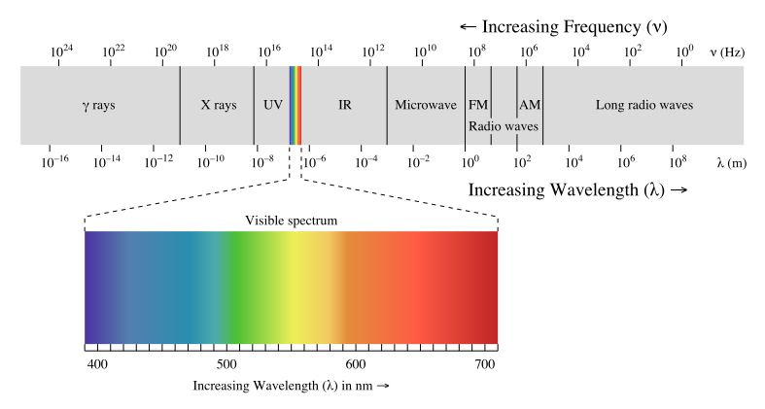
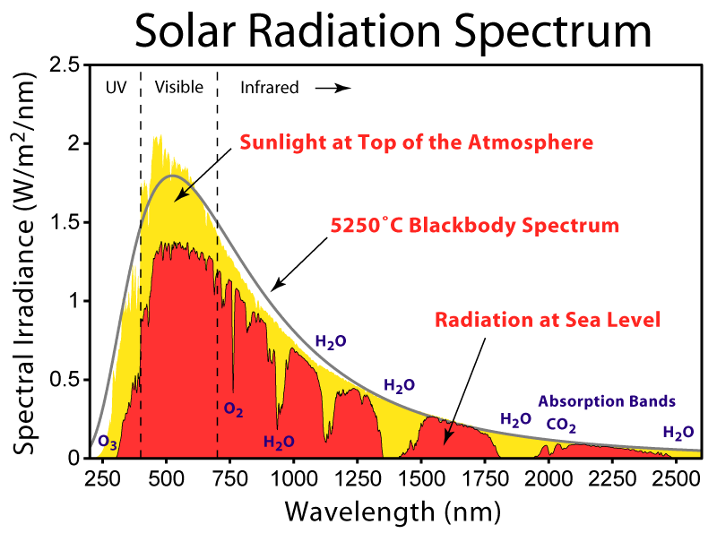

Electromagnetic spectrum
Human Luminance Sensitivity Function

Slide 11
The Physics of Light
Any source of light can be completely described
physically by its spectrum: the amount of energy emitted
(per time unit) at each wavelength 400 - 700 nm.
Relative
spectral
power
© Stephen E. Palmer, 2002

Slide 12
Spectra of Light Sources
Some examples of the spectra of light sources
Rel. power
Rel. power
Rel. power
Rel. power
© Stephen E. Palmer, 2002

Slide 13
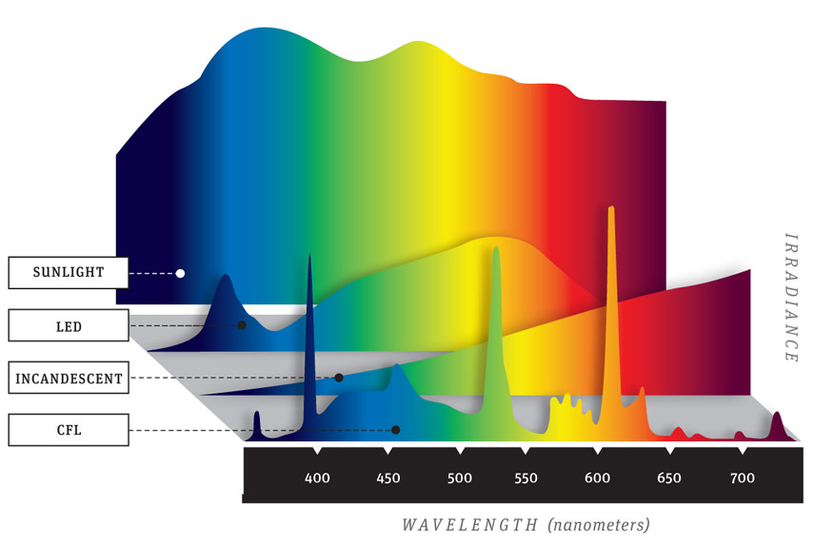
Spectra of light sources
Source: Popular Mechanics

Slide 14
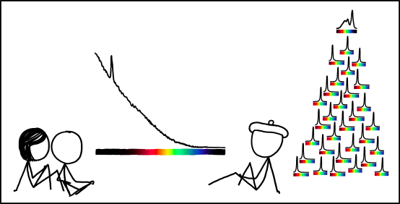
Spectra of light sources
https://www.xkcd.com/1308/
Notes:
From Explain XKCD: The spike toward the left hand side of the spectrum is likely the 4.3 µm resonance wavelength of hot CO2 characteristic of burning hydrocarbons

Slide 15
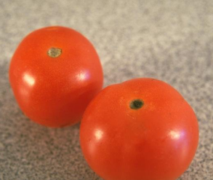
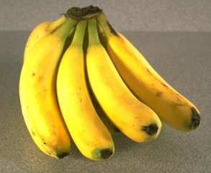
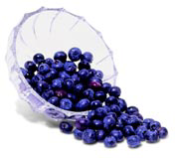
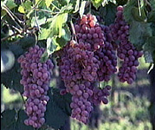
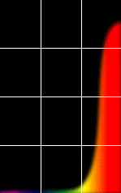
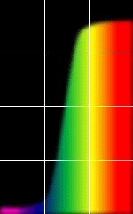
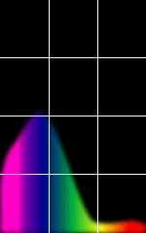
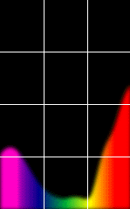
Reflectance Spectra of Surfaces
Some examples of the reflectance spectra of surfaces
Red
Yellow
Blue
Purple
% Light Reflected
400 700
400 700
400 700
400 700
Wavelength (nm)
© Stephen E. Palmer, 2002

Slide 16
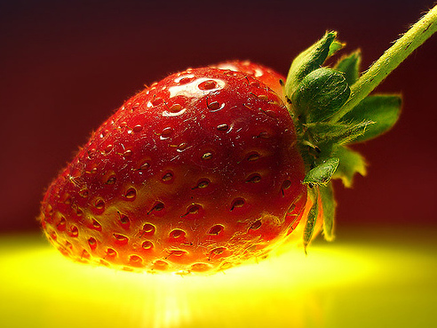
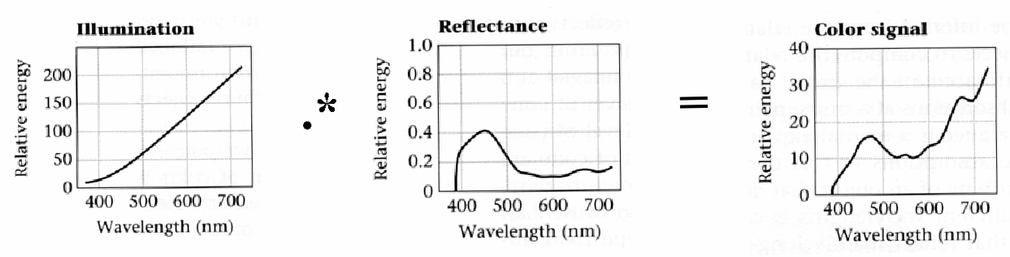
Interaction of light and surfaces
Reflected color is the result of interaction of light source spectrum with surface reflectance

Slide 17
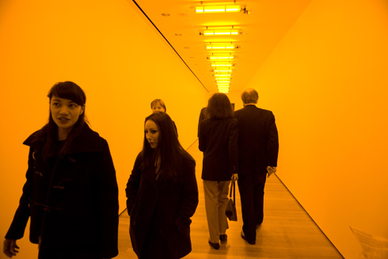
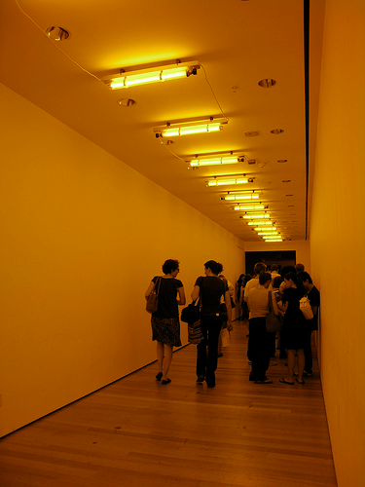
Interaction of light and surfaces
What is the observed color of any surface under monochromatic light?
Olafur Eliasson, Room for one color

Slide 18
Outline
Physical origin of color
Spectra of sources and surfaces
Physiology of color vision

Slide 19
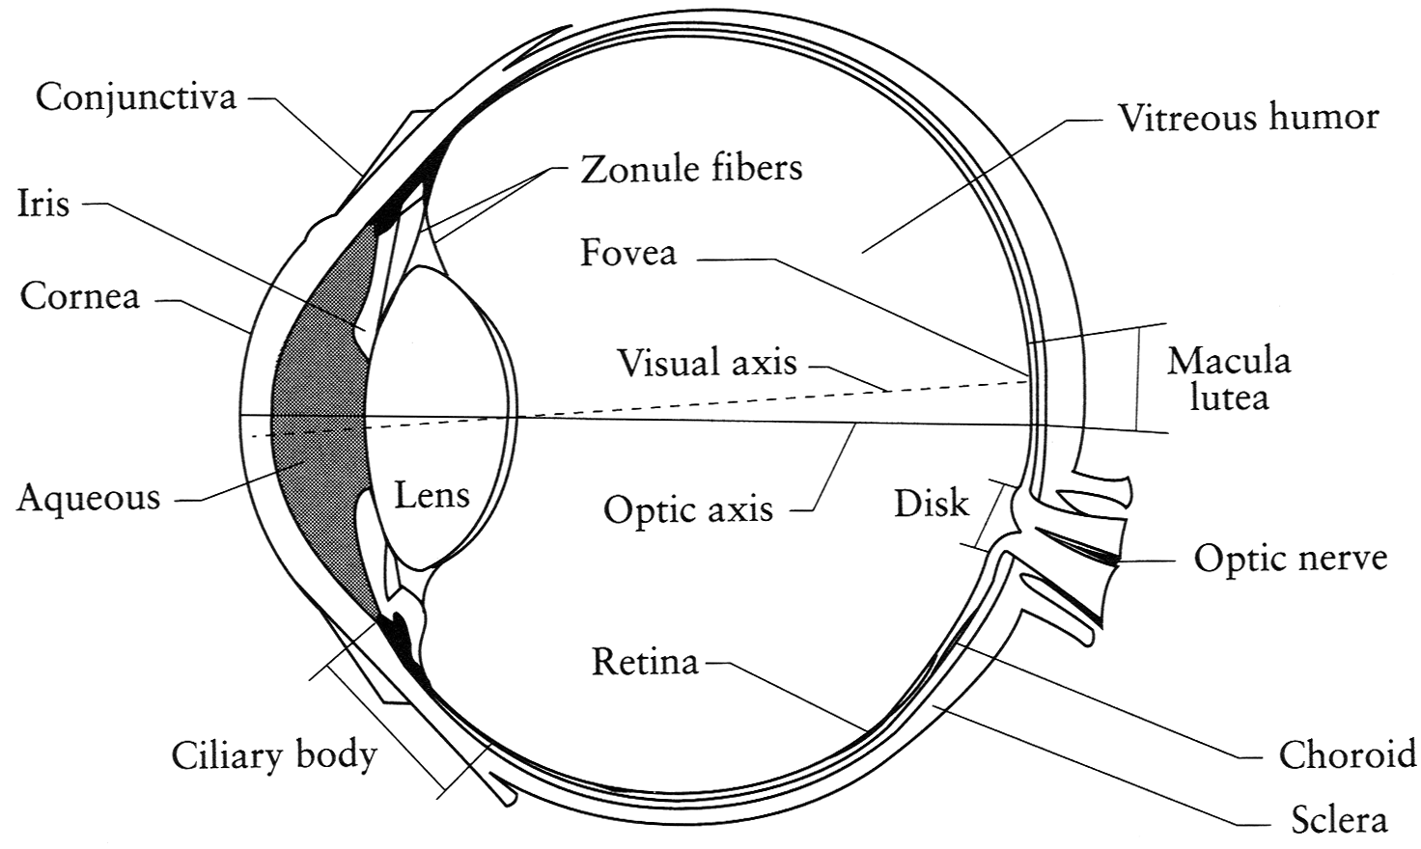
The Eye
The human eye is a camera (sort of)
  Lens - changes shape by using ciliary muscles (to focus on objects at different distances)
  Pupil - the hole (aperture) whose size is controlled by the iris
  Iris - colored annulus with radial muscles
  Retina - photoreceptor cells
Slide by Steve Seitz

Slide 20
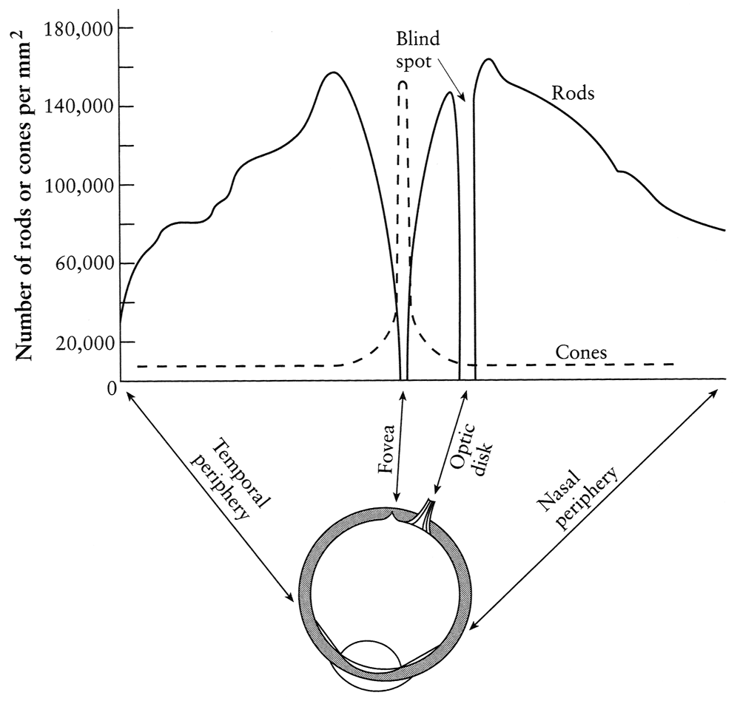
Rods and cones, fovea
pigment
molecules
Rods are responsible for intensity, cones for color perception
Rods and cones are non-uniformly distributed on the retina
  Fovea - Small region (1 or 2°) at the center of the visual field containing the highest density of cones – and no rods
Slide by Steve Seitz

Slide 21
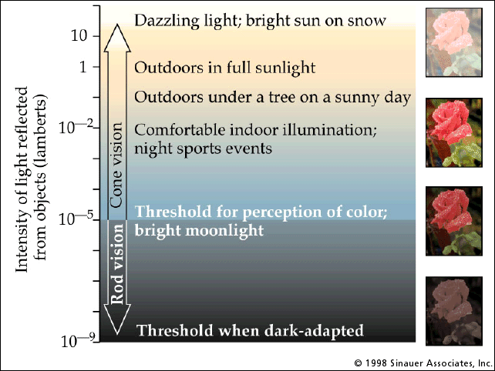
Rod / cone sensitivity
Why can’t we read in the dark?
Slide by A. Efros

Slide 22
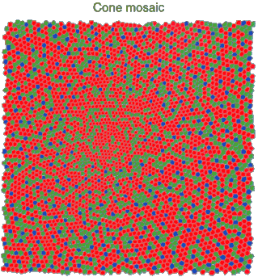
Physiology of Color Vision
Three kinds of cones:
Ratio of L to M to S cones: approx. 10:5:1
Almost no S cones in the center of the fovea
© Stephen E. Palmer, 2002

Slide 23
Physiology of color vision: Fun facts
Some animals have one (night animals), two (e.g., dogs), four (fish, birds), five (pigeons, some reptiles/amphibians), or even 12 (mantis shrimp) types of cone
http://en.wikipedia.org/wiki/Color_vision
Adapted from D. Hoiem

Slide 24






Color perception
Color receptors act as filters on the spectrum
  Let $t(λ)$ be the target spectrum and $c_{1}(λ)$, $c_{2}(λ)$, and $c_{3}(λ)$ be the response curves of the three types of cones
  Then the total response of each type of cone is:
Target spectrum $t(λ)$
$$c_{3}(λ)$$
$$c_{2}(λ)$$
$$c_{1}(λ)$$
$$λ$$

Slide 25
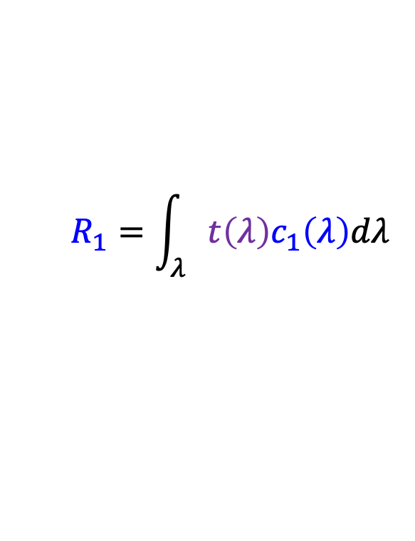
Color perception
Color receptors act as filters on the spectrum
  Let $t(λ)$ be the target spectrum and $c_{1}(λ)$, $c_{2}(λ)$, and $c_{3}(λ)$ be the response curves of the three types of cones
  Then the total response of each type of cone is:
$$R_{1}=\int_{λ}{{t\left(λ\right)c}_{1}\left(λ\right)dλ}$$
$$c_{1}(λ)$$
$$λ$$

Slide 26
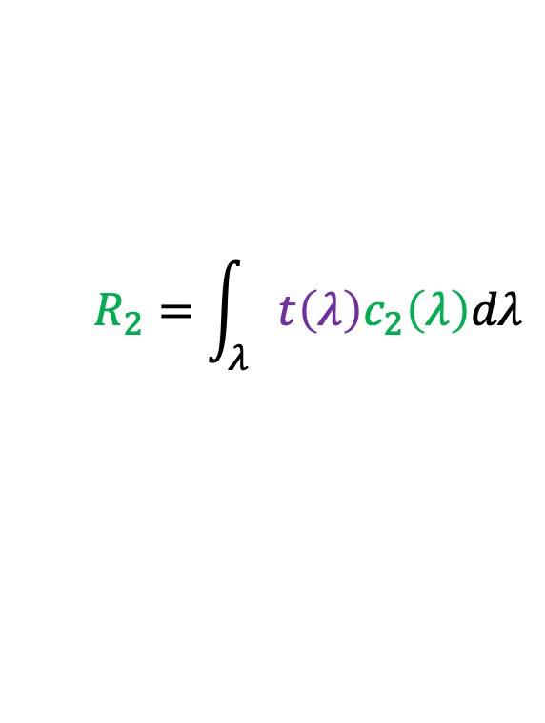
Color perception
Color receptors act as filters on the spectrum
  Let $t(λ)$ be the target spectrum and $c_{1}(λ)$, $c_{2}(λ)$, and $c_{3}(λ)$ be the response curves of the three types of cones
  Then the total response of each type of cone is:
$$R_{1}=\int_{λ}{{t\left(λ\right)c}_{1}\left(λ\right)dλ}$$
$$R_{2}=\int_{λ}{{t\left(λ\right)c}_{2}\left(λ\right)dλ}$$
$$c_{2}(λ)$$
$$λ$$

Slide 27
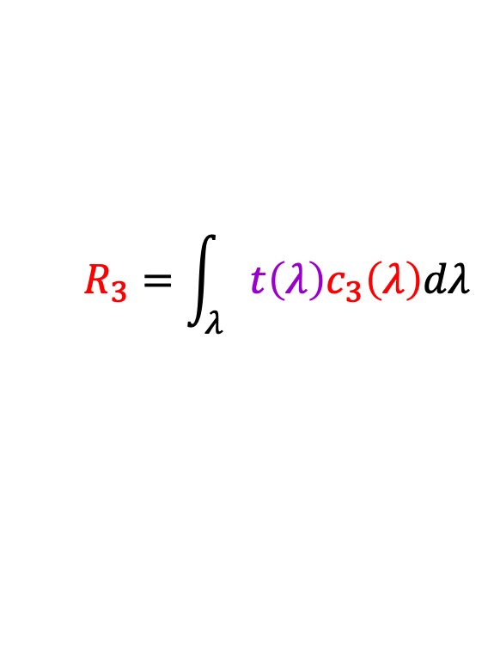
Color perception
Color receptors act as filters on the spectrum
  Let $t(λ)$ be the target spectrum and $c_{1}(λ)$, $c_{2}(λ)$, and $c_{3}(λ)$ be the response curves of the three types of cones
  Then the total response of each type of cone is:
$$R_{1}=\int_{λ}{{t\left(λ\right)c}_{1}\left(λ\right)dλ}$$
$$R_{2}=\int_{λ}{{t\left(λ\right)c}_{2}\left(λ\right)dλ}$$
$$R_{3}=\int_{λ}{{t\left(λ\right)c}_{3}\left(λ\right)dλ}$$
$$c_{3}(λ)$$
$$λ$$

Slide 28
Color perception
Color receptors act as filters on the spectrum
  Each type of cone returns one number
How can we represent an entire spectrum with three numbers?
  We can’t – most of the information is lost!
Target spectrum $t(λ)$
$$c_{3}(λ)$$
$$c_{2}(λ)$$
$$c_{1}(λ)$$
$$λ$$

Slide 29
Metamers: Spectra that appear indistinguishable

Slide 30
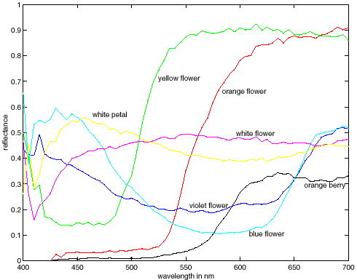
Metamers: Spectra that appear indistinguishable
metamers

Slide 31
Color: Outline
Physical origin of color
Spectra of sources and surfaces
Physiology of color vision
Quantifying color perception

Slide 32
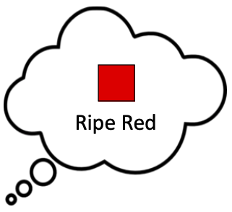
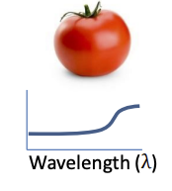
Quantifying color perception
Spectral distributions go through a “black box” (human visual system) and are perceived as color
The only way to quantify the “black box” is to perform a human study
Spectral distribution
“Black box”
Source: M. Brown

Slide 33
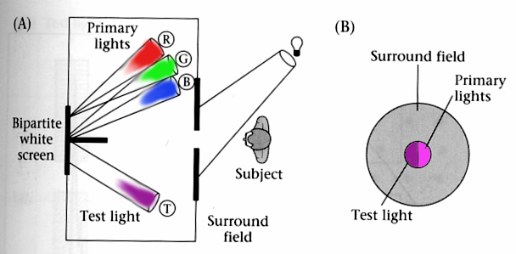
Color matching experiments
We would like to understand which spectra produce the same color sensation in people under similar viewing conditions
Wandell, Foundations of Vision, 1995

Slide 34
Color matching experiment 1
Source: W. Freeman

Slide 35
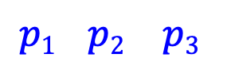
Color matching experiment 1
$$p1 p2 p3$$
Source: W. Freeman

Slide 36
Color matching experiment 1
$$p1 p2 p3$$
Source: W. Freeman

Slide 37
Color matching experiment 1
The primary color amounts needed for a match
$$p1 p2 p3$$
Source: W. Freeman

Slide 38
Color matching experiment 2
Source: W. Freeman

Slide 39
Color matching experiment 2
$$p1 p2 p3$$
Source: W. Freeman

Slide 40
Color matching experiment 2
$$p1 p2 p3$$
Source: W. Freeman

Slide 41
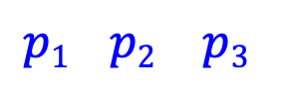
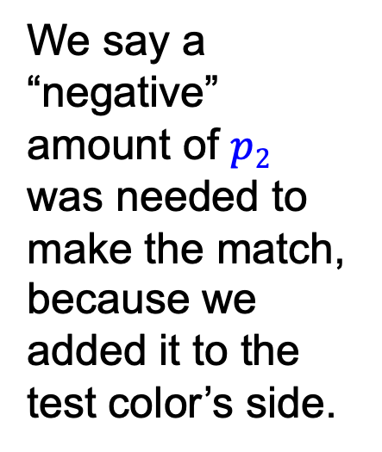
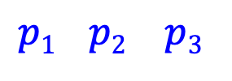
Color matching experiment 2
The primary color amounts needed for a match:
We say a “negative” amount of $p2$ was needed to make the match, because we added it to the test color’s side.
$$p1 p2 p3$$
$$p1 p2 p3$$
$$p1 p2 p3$$
Source: W. Freeman

Slide 42
Empirical properties of color matching
Trichromacy:
  Most* people can match any given test light with three independent primaries
  For the same light and primaries, most* people select the same weights
  Thus, three numbers are sufficient for encoding color
  This observation dates back to Thomas Young in the 18th century

Slide 43
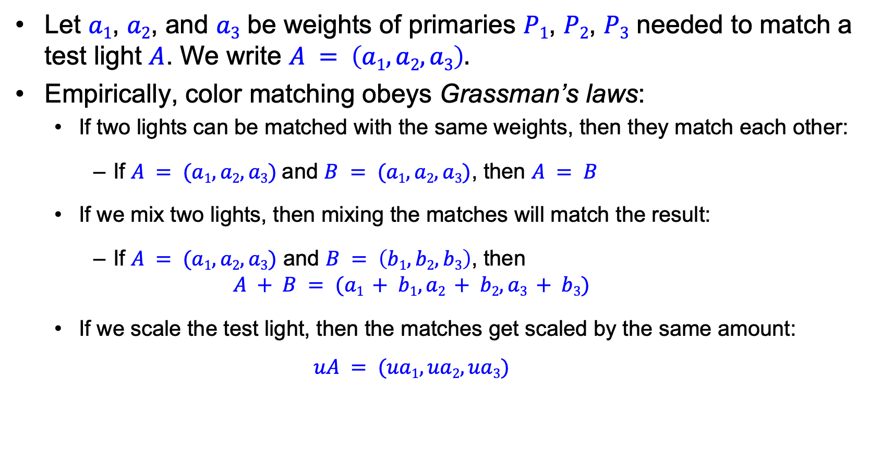
Color matching is linear
Let $a1$, $a2$, and $a3$ be weights of primaries $P1$, $P2$, $P3$ needed to match a test light $A$. We write $A = \left(a1, a2, a3\right).$
Empirically, color matching obeys Grassman’s laws:
  If two lights can be matched with the same weights, then they match each other:
    If $A = (a1, a2, a3)$and $B = (a1, a2, a3)$, then $A = B$
  If we mix two lights, then mixing the matches will match the result:
    If $A = (a1, a2, a3)$ and $B = \left(b1, b2, b3\right)$, then
    $$A + B = (a1 + b1, a2 + b2, a3 + b3)$$
  If we scale the test light, then the matches get scaled by the same amount:
    $$uA = (ua1, ua2, ua3)$$

Slide 44
If’s, and’s and but’s
Some people do NOT match according to Grassman’s laws
Various causes
  Missing a cone type -> dichromats
    Usually L or M cone is missing
      “Red-green color blindness”
      About 8% of males; 0.5% of females
    S cone missing
      rare
  Missing two cone types -> monochromats
    Rare
  Missing all cone types -> monochromats
    Rare
  All cones present, but still doesn’t see color -> central achromatopsia
    Very rare

Slide 45
If’s, and’s and but’s
Some people match according to Grassman’s laws
  But use unusual sets of weights
  Their cone sensitivities are different from that of others
  Anomalous trichromats
All this is tightly linked to genetics
  Variant cone sensitivities <-> variants in genes encoding cone proteins
  L, M cone genes are on x-chromosome, hence the gender link
  Mild evidence suggests there may be females who can match with four primaries
All this is tightly linked to mortality
  Color deficient spider monkeys die young, on average
  Color deficient humans may die younger, on average

Slide 46

Color matching is linear
Fix primaries $P1$, $P2$, $P3$ and let $a1$, $a2$, $a3$ and $b1$, $b2$, $b3$ be the weights of primaries needed to match test lights $A$ and $B$. I.e., $A = \left(a1, a2, a3\right)$ and $B = \left(b1, b2, b3\right)$
Empirically, color matching is linear: for scalar coefficients $u$ and $v$, $uA + vB = (ua1 + vb1, ua2 + vb2, ua3 + vb3)$

Slide 47
Outline
Physical origin of color
Spectra of sources and surfaces
Physiology of color vision
Quantifying color perception
Color spaces

Slide 48
Why specify color numerically?
Accurate color reproduction is commercially valuable
  e.g. Kodak yellow, painting a house.
Of the order of 10 color names are widely recognized by English speakers - other languages have fewer/more, but not much more.
  There’s a great deal of structure to the way colour is spoken about (Berlin-Kay), but not much precision
Color reproduction problems increased by prevalence of digital imaging - eg. digital libraries of art.
  Choosing pixel values to reproduce/evoke experiences, e.g. an architectural model.
  Consistency in user interfaces, monitor-printer consistency, monitor-lino consistency, etc.

Slide 49
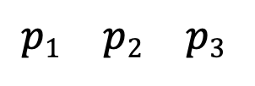
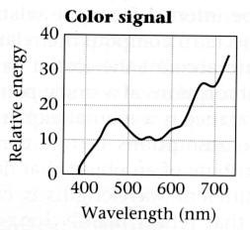
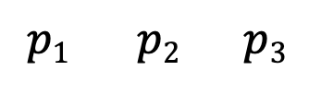
Linear color spaces
Fixing three primaries defines a linear color space in which the coordinates of a color are given by the weights of the primaries used to match it
How can we find the coordinates of an arbitrary color signal?
We need color matching functions, or amounts of each primary needed to match monochromatic sources at each wavelength
?
$$p1 p2 p3$$
$$p1 p2 p3$$

Slide 50


Linear color spaces
Let $t(λ)$ be the spectrum of the target signal and $c_{1}(λ)$, $c_{2}(λ)$, and $c_{3}(λ)$ the color matching functions
Target signal $t(λ)$
$$c_{3}(λ)$$
$$c_{2}(λ)$$
$$c_{1}(λ)$$
$$λ$$

Slide 51

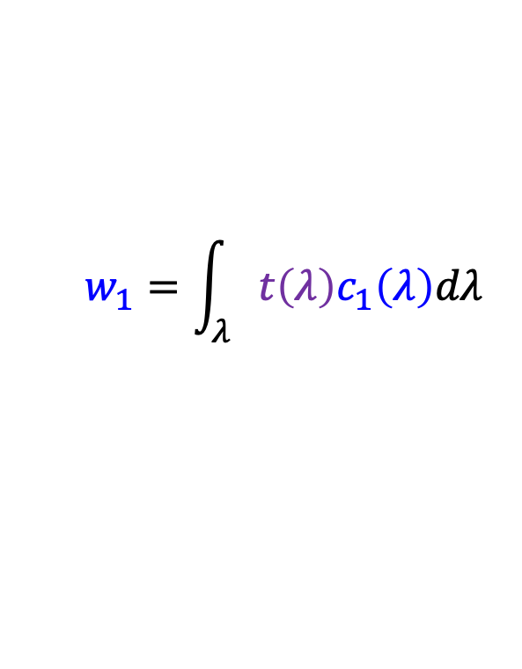
Linear color spaces
Let $t(λ)$ be the spectrum of the target signal and $c_{1}(λ)$, $c_{2}(λ)$, and $c_{3}(λ)$ the color matching functions
Then the weights of the primaries needed to match $t(λ)$ are:
$$w_{1}=\int_{λ}{{t\left(λ\right)c}_{1}\left(λ\right)dλ}$$
Target signal $t(λ)$
$$c_{1}(λ)$$
$$λ$$

Slide 52

Linear color spaces
Let $t(λ)$ be the spectrum of the target signal and $c_{1}(λ)$, $c_{2}(λ)$, and $c_{3}(λ)$ the color matching functions
Then the weights of the primaries needed to match $t(λ)$ are:
$$w_{1}=\int_{λ}{{t\left(λ\right)c}_{1}\left(λ\right)dλ}$$
$$w_{2}=\int_{λ}{{t\left(λ\right)c}_{2}\left(λ\right)dλ}$$
Target signal $t(λ)$
$$c_{2}(λ)$$
$$λ$$

Slide 53
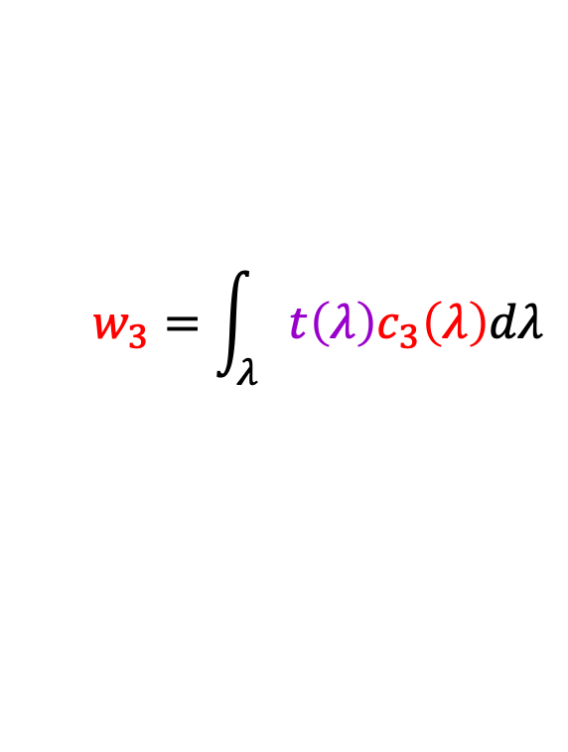
Linear color spaces
Let $t(λ)$ be the spectrum of the target signal and $c_{1}(λ)$, $c_{2}(λ)$, and $c_{3}(λ)$ the color matching functions
Then the weights of the primaries needed to match $t(λ)$ are:
$$w_{1}=\int_{λ}{{t\left(λ\right)c}_{1}\left(λ\right)dλ}$$
$$w_{2}=\int_{λ}{{t\left(λ\right)c}_{2}\left(λ\right)dλ}$$
$$w_{3}=\int_{λ}{{t\left(λ\right)c}_{3}\left(λ\right)dλ}$$
Target signal $t(λ)$
$$c_{3}(λ)$$
Matching functions act as filters on the target spectrum, like response curves of color receptors!
$$λ$$

Slide 54

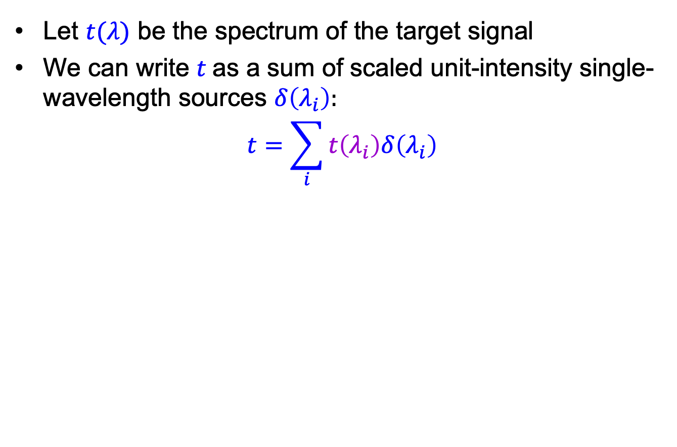


Finding coordinates in a linear space
Let $t(λ)$ be the spectrum of the target signal
We can write $t$as a sum of scaled unit-intensity single-wavelength sources $δ\left(λ_{i}\right)$:
$$t=\sum_{i}{t\left(λ_{i}\right)δ\left(λ_{i}\right)}$$
Target signal $t$
$$t\left(λ_{i}\right)δ\left(λ_{i}\right)$$
λ
$$λ_{i}$$

Slide 55
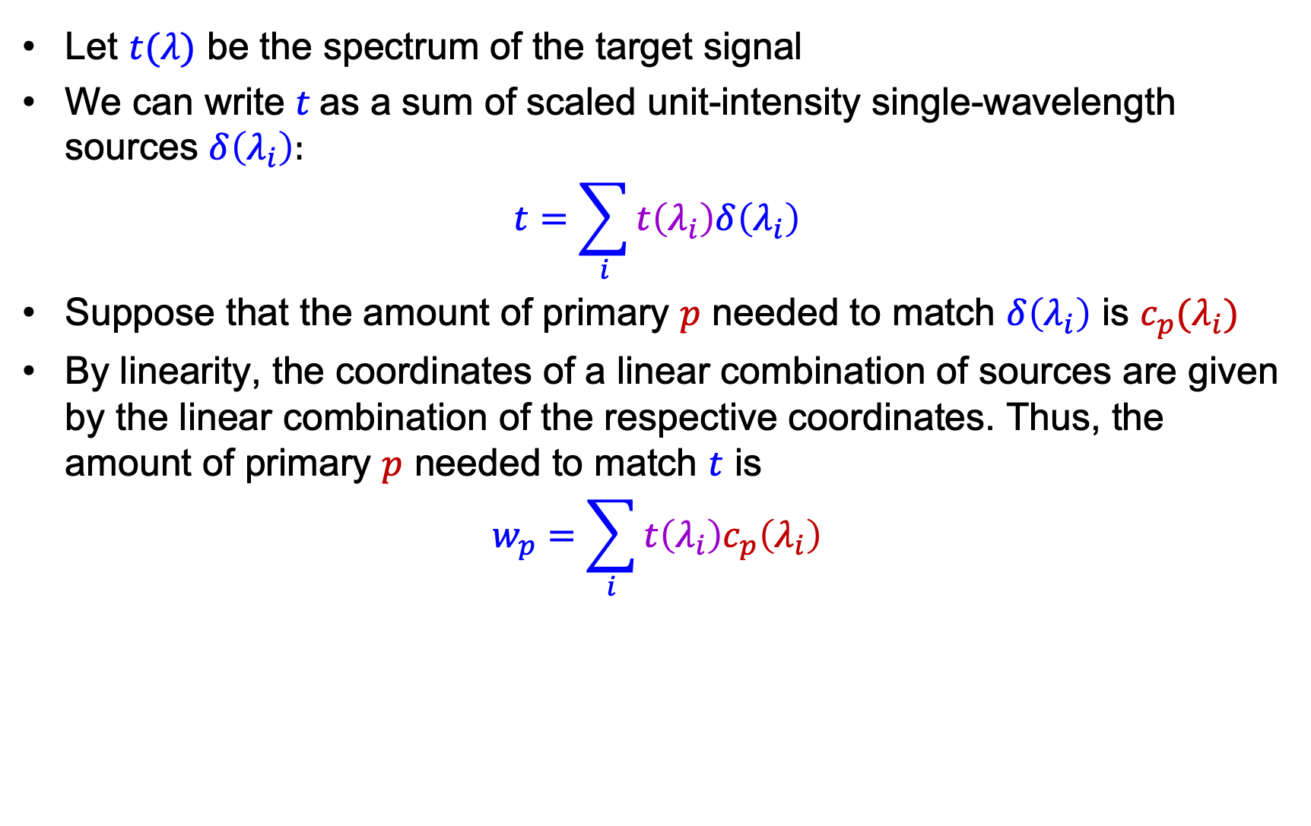
Finding coordinates in a linear space
Let $t(λ)$ be the spectrum of the target signal
We can write $t$as a sum of scaled unit-intensity single-wavelength sources $δ\left(λ_{i}\right)$:
$$t=\sum_{i}{t\left(λ_{i}\right)δ\left(λ_{i}\right)}$$
Suppose that the amount of primary $p$ needed to match $δ\left(λ_{i}\right)$ is $c_{p}(λ_{i})$
By linearity, the coordinates of a linear combination of sources are given by the linear combination of the respective coordinates. Thus, the amount of primary $p$ needed to match $t$ is
$$w_{p}=\sum_{i}{t\left(λ_{i}\right)c_{p}\left(λ_{i}\right)}$$

Slide 56

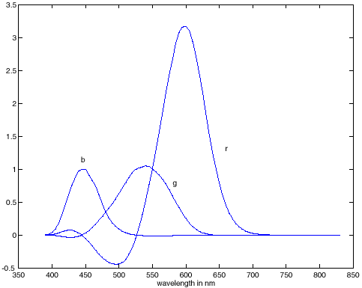
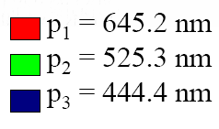
RGB color space
Primaries are single-wavelength sources, matching functions for R and G have negative values for parts of the spectrum
RGB matching functions
RGB primaries

Slide 57

Comparison of RGB matching functions with best 3x3 linear transformation of cone responses
Wandell, Foundations of Vision, 1995

Slide 58




Linear color spaces: CIE XYZ
Primaries are imaginary, but matching functions are everywhere positive
The $Y$ parameter corresponds to brightness or luminance
Matching functions
2D visualization:
$x = X/(X+Y+Z)$, $y = Y/(X+Y+Z)$
http://en.wikipedia.org/wiki/CIE_1931_color_space

Slide 59

Linear color spaces: CIE XYZ
CIE XYZ is based on color matching experiments carried out in late 1920s by W. David Wright (Imperial College) and John Guild (National Physical Laboratory, London)
The experiments used 17 “standard observers” (10 by Wright, 7 by Guild)
Source: M. Brown

Slide 60



Uniform color spaces
Unfortunately, differences in $x,y$ coordinates do not reflect perceptual color differences
CIE $u′v′$ is a projective transform of $x,y$ to make the ellipses more uniform
McAdam ellipses: Just noticeable differences in color

Slide 61



Nonlinear color spaces: HSV
Perceptually meaningful dimensions:
Hue, Saturation, Value (Intensity)
RGB cube on its vertex

Slide 62
Outline
Physical origin of color
Spectra of sources and surfaces
Physiology of color vision
Quantifying color perception
Color spaces
Color constancy, white balance

Slide 63

Color perception
Color/lightness constancy
  The ability of the human visual system to perceive the intrinsic reflectance properties of the surfaces despite changes in illumination conditions
J. S. Sargent, The Daughters of Edward D. Boit, 1882

Slide 64
Chromatic adaptation
The visual system changes its sensitivity depending on the luminances prevailing in the visual field
  The exact mechanism is still not fully understood
Adapting to different brightness levels
  Changing the size of the iris opening (i.e., the aperture) changes the amount of light that can enter the eye
  Think of walking into a building from full sunshine
Adapting to different color temperature
  The receptive cells on the retina change their sensitivity
  For example: if there is an increased amount of red light, the cells receptive to red decrease their sensitivity until the scene looks white again
  We actually adapt better in brighter scenes: this is why candlelit scenes still look yellow
http://www.schorsch.com/kbase/glossary/adaptation.html

Slide 65

Checker shadow illusion
https://en.wikipedia.org/wiki/Checker_shadow_illusion

Slide 66

Checker shadow illusion
Possible explanations: simultaneous contrast, reflectance vs. illumination edges
https://en.wikipedia.org/wiki/Checker_shadow_illusion

Slide 67

This strawberry cake has no red pixels!
https://www.digitaltrends.com/photography/non-red-strawberries/
Notes:
From the website: When the brain sees the blueish tint to the photograph, it assumes the blue is not from the objects but from the light source and subtracts that blue as an automatic color correction. “Your brain says, ‘the light source that I am viewing these strawberries under has some blue component to it, so I’m going to subtract that automatically from every pixel.’ And when you take gray pixels and subtract out the blue bias, you end up with red,” the National Eye Institute’s Bevil Conway told Motherboard.

Slide 68
Lightness Constancy
Lightness constancy
  how light is the surface, independent of the brightness of the illuminant
  issues
    spatial variation in illumination
    absolute standard
  Human lightness constancy is very good
Assume
  frontal 1D “Surface”
  slowly varying illumination
  quickly varying surface reflectance

Slide 69


Slide 70


Slide 72
Karsch et al in review 10

Slide 73
Stage lighting
From Koenderink slides on image texture and the flow of light

Slide 74

What color is the dress?
https://www.wired.com/2015/02/science-one-agrees-color-dress/

Slide 75


White balance
Analogous to color constancy mechanisms in human vision, cameras have mechanisms to adapt to the illumination in the environment so that neutral (white or gray) objects look neutral
Incorrect white balance
Correct white balance
http://www.cambridgeincolour.com/tutorials/white-balance.htm

Slide 76

White balance
Film cameras:
  Different types of film or different filters for different illumination conditions
Digital cameras:
  Automatic white balance
  White balance settings corresponding to
  several common illuminants
  Custom white balance using a reference
  object
http://www.cambridgeincolour.com/tutorials/white-balance.htm

Slide 77


White balance
Von Kries adaptation: Multiply each channel by a gain factor
Best way: gray card
  Take a picture of a neutral object (white or gray)
  If the object is recorded as $rw, gw, bw$use weights $1/rw, 1/gw, 1/bw$

Slide 78

White balance
Without gray cards: we need to “guess” which pixels correspond to white objects
Gray world assumption
  The image average $\overline{r}, \overline{g}, \overline{b}$ is gray
  Use weights $1/\overline{r}, 1/\overline{g}, 1/\overline{b}$
Brightest pixel assumption
  Highlights usually have the color of the light source
  Use weights inversely proportional to the values of the brightest pixels
Gamut mapping
  Gamut: convex hull of all pixel colors in an image
  Find the transformation that matches the gamut of the image to the gamut of a “typical” image under white light
Use image statistics, learning techniques

Slide 79


Is white balance solved?
New College, Oxford, September 2022

Slide 80

Is white balance solved?
https://petapixel.com/2020/09/10/smartphones-are-ruining-wildfire-sky-photos-with-auto-white-balance/

Slide 81


Is white balance solved?
When there are several types of illuminants in the scene, different reference points will yield different results
Reference: moon
Reference: stone
http://www.cambridgeincolour.com/tutorials/white-balance.htm

Slide 82



Is white balance solved?
When there are several types of illuminants in the scene, different reference points will yield different results
Possible solution: spatially varying white balance
Input
Alpha map
Output
E. Hsu, T. Mertens, S. Paris, S. Avidan, and F. Durand, Light Mixture Estimation for Spatially Varying White Balance, SIGGRAPH 2008

Slide 83


Uses of color in computer vision

