Slide 1
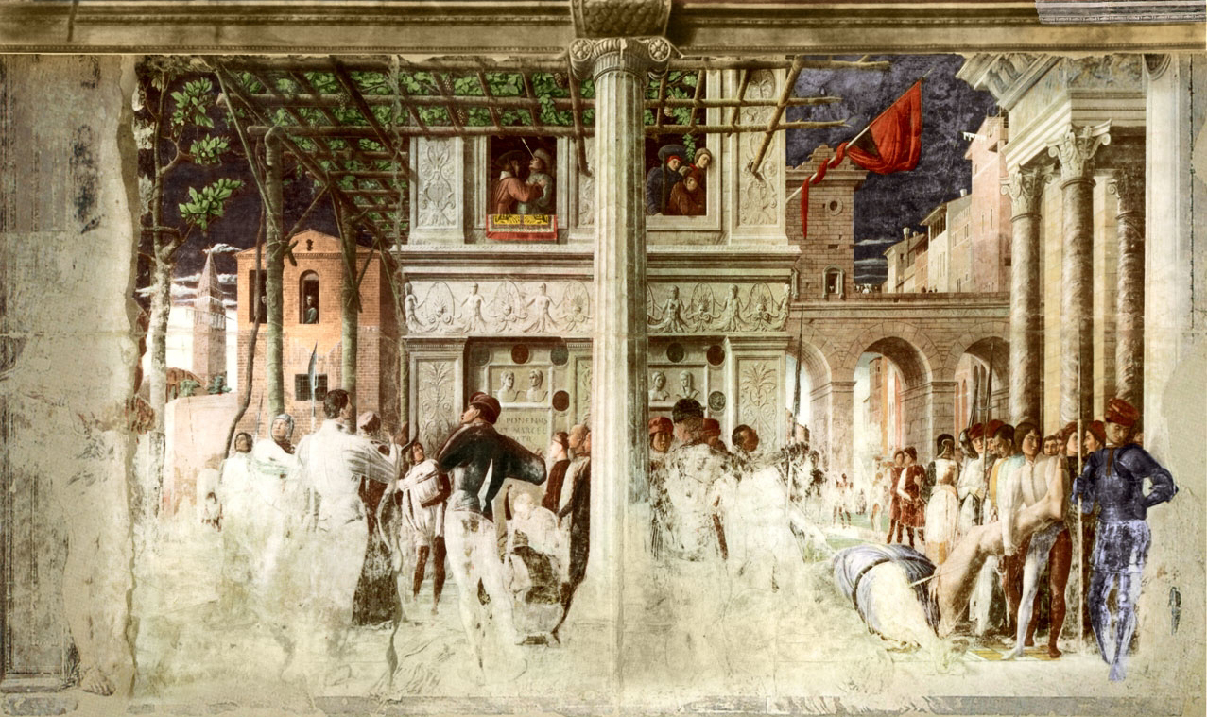
Perspective projection
A. Mantegna, Martyrdom of St. Christopher, c. 1450

Slide 2
Overview
Motivation: recovery of 3D structure
Pinhole projection model
Properties of projection
Perspective projection matrix
Orthographic projection

Slide 3

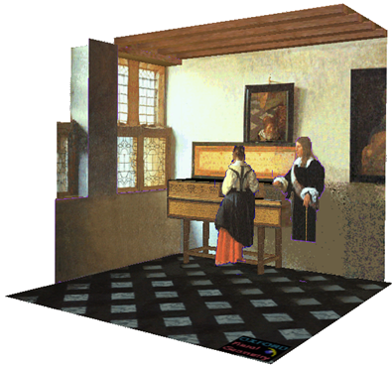
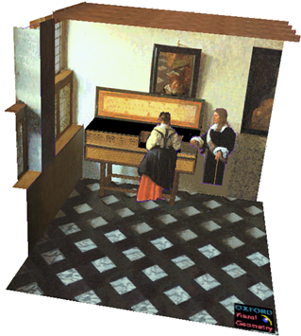
Given an image, can we recover 3D structure?
J. Vermeer, Music Lesson, 1662
A. Criminisi, M. Kemp, and A. Zisserman, Bringing Pictorial Space to Life: computer techniques for the analysis of paintings, Proc. Computers and the History of Art, 2002

Slide 4
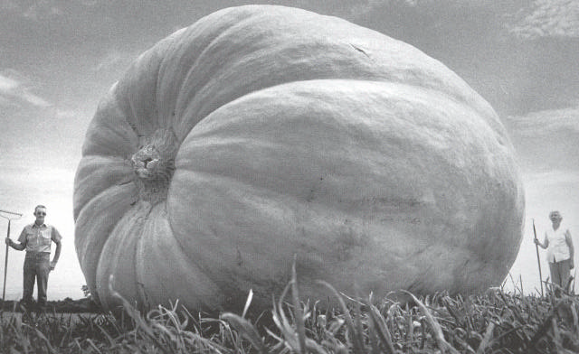
Things aren’t always as they appear…

Slide 5


Single-view ambiguity
$X$?
$X$?
$X$?
$$x$$

Slide 6
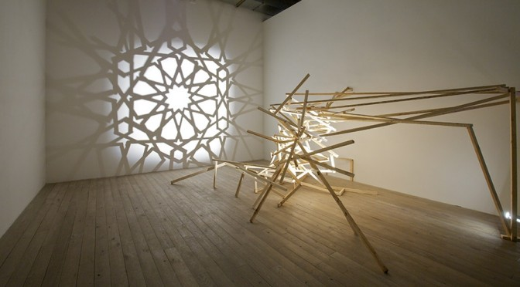
Single-view ambiguity
Rashad Alakbarov shadow sculptures

Slide 7
Anamorphic perspective
Image source

Slide 8


Anamorphic perspective
H. Holbein The Younger, The Ambassadors, 1533
https://en.wikipedia.org/wiki/Anamorphosis

Slide 9
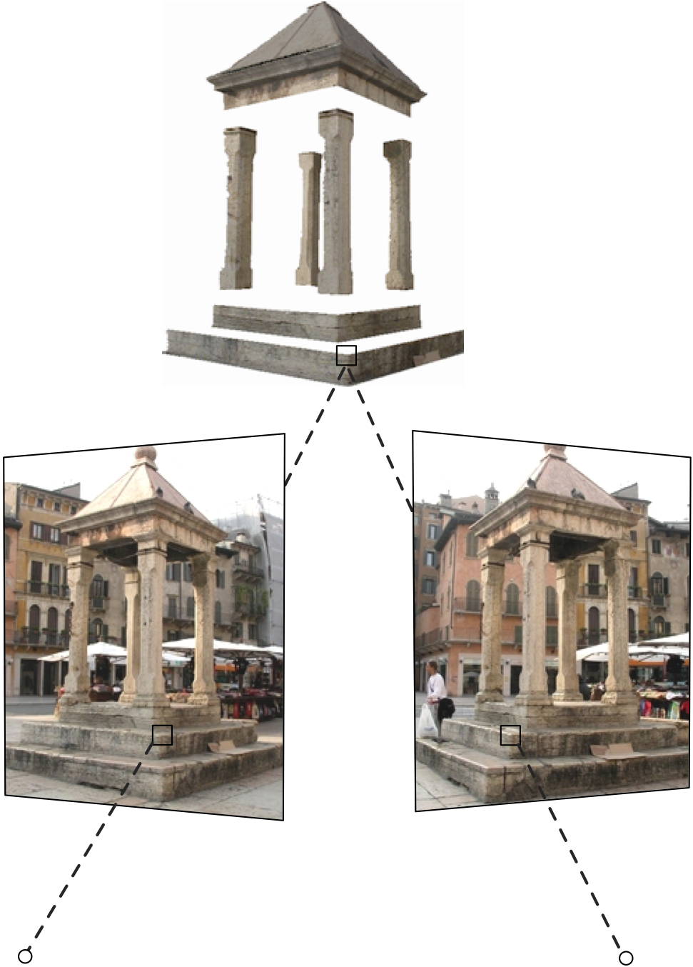

Our goal: Recovery of 3D structure
When certain assumptions hold, we can recover structure from a single view
In general, we need multi-view geometry
Image source
But first, we need to understand the geometry of a single camera…

Slide 10
Overview
Motivation: recovery of 3D structure
Pinhole projection model

Slide 11


Review: Perspective projection equations
$$P$$
$$P′$$

Slide 12
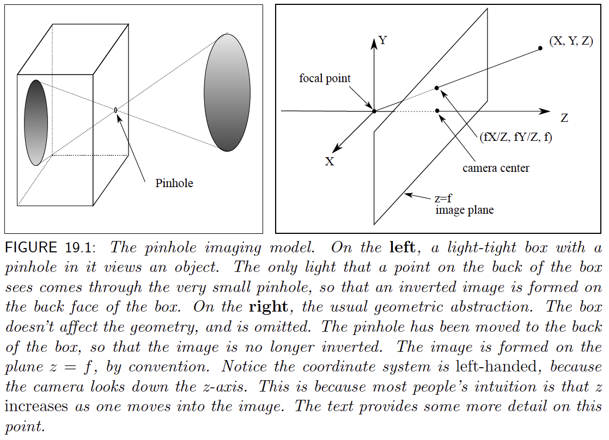
Review: Perspective projection equations

Slide 13

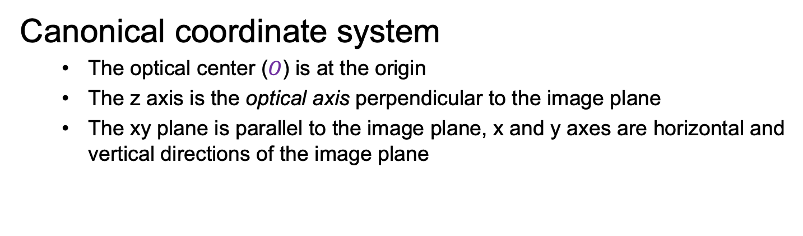



Review: Perspective projection equations
$$P$$
$$y$$
$$z$$
$$O$$
$$x$$
$$P′$$
Canonical coordinate system
  The optical center ($O$) is at the origin
  The z axis is the optical axis perpendicular to the image plane
  The xy plane is parallel to the image plane, x and y axes are horizontal and vertical directions of the image plane

Slide 14




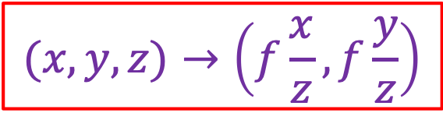

Review: Perspective projection equations
$$P$$
$$y$$
$$f$$
$$z$$
$$=f\frac{y}{z}$$
$$O$$
$$y^{′}$$
$$P′$$
$$(x,y,z)→\left(f\frac{x}{z},f\frac{y}{z}\right)$$

Slide 15
Review: Perspective projection equations
Note: instead of dealing with an image that is upside down, most of the time we will pretend that the image plane is in front of the camera center
This will get us a minus sign in these coordinates {(X, Y, Z)-> (-fX/Z, -fY/Z)}

Slide 16
Overview
Motivation: recovery of 3D structure
Pinhole projection model
Properties of projection
  What happens to:
    Lines
    Planes
    General 3D shapes

Slide 17
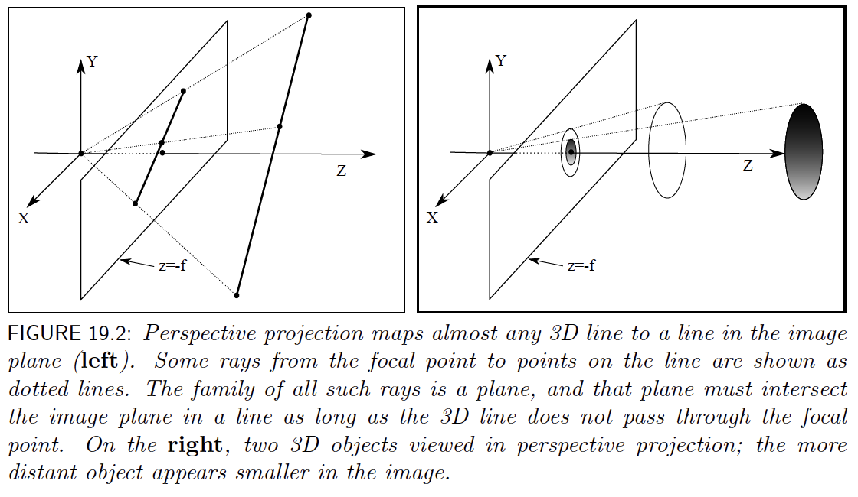
Lines project to lines; distant objects are smaller

Slide 18
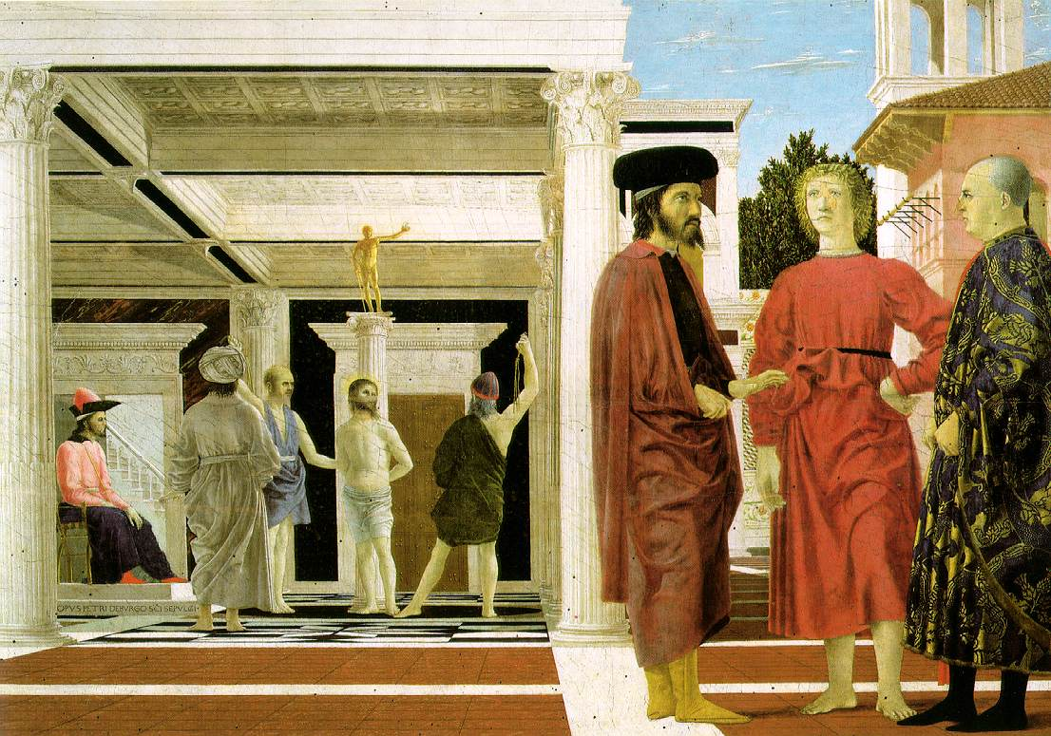
Projection of lines
Piero della Francesca, Flagellation of Christ, 1455-1460

Slide 19
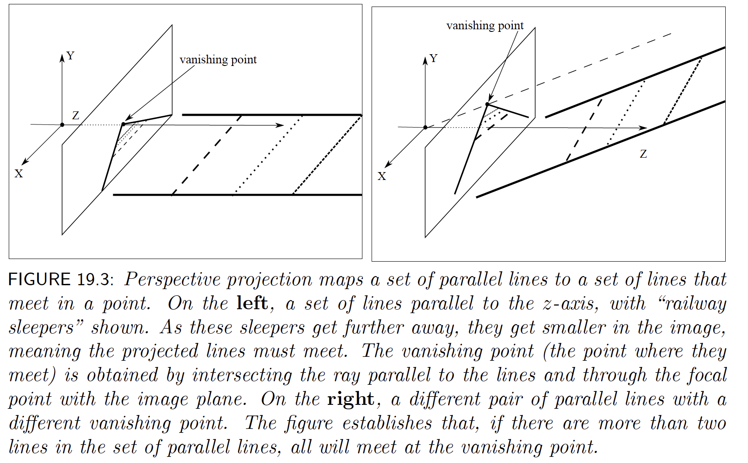
Parallel lines have a vanishing point

Slide 20
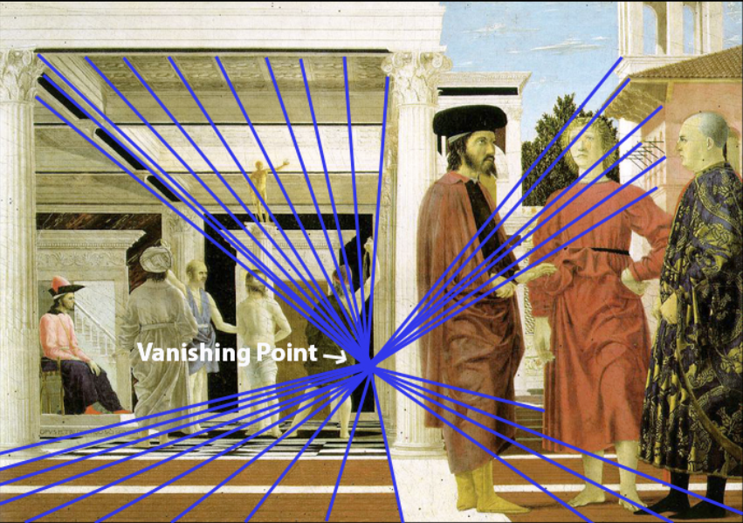
Projection of lines
Parallel lines meet at a vanishing point
Image source
Piero della Francesca, Flagellation of Christ, 1455-1460

Slide 21
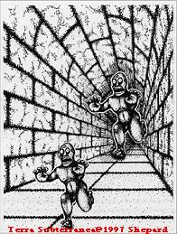
Converging lines are a powerful perspective cue
Slide by Steve Seitz

Slide 22

Constructing the vanishing point of a line
image plane
vanishing point$v$
line in the scene
camera
center
What about another line going in the same direction?
Adopted from S. Seitz

Slide 23
Projection of lines
Do all parallel lines converge to a vanishing point?
Piero della Francesca, Flagellation of Christ, 1455-1460

Slide 24
Projection of lines
  Parallel lines that are also parallel to the image plane converge to a point “at infinity”
Piero della Francesca, Flagellation of Christ, 1455-1460

Slide 25
Projection of planes
  What happens to planar patterns?
Piero della Francesca, Flagellation of Christ, 1455-1460

Slide 26
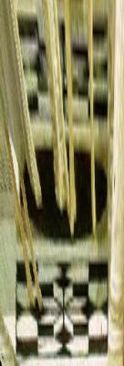
Projection of planes
  Patterns on non-fronto-parallel planes are distorted by
  a 2D homography
Piero della Francesca, Flagellation of Christ, 1455-1460

Slide 27
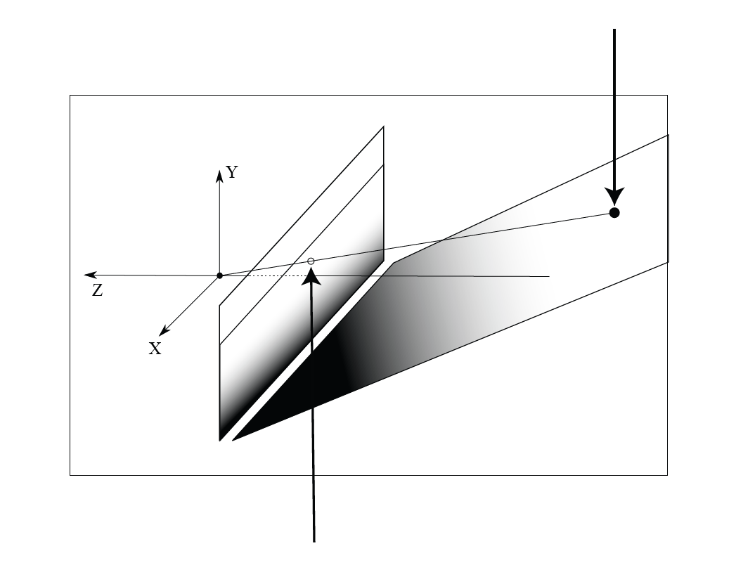
A plane pattern is transformed by a homography
Here s, t are coordinates on the plane

Slide 28
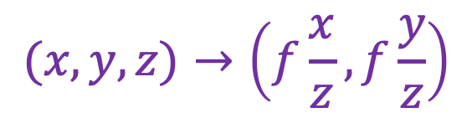

Projection of planes
What about patterns on fronto-parallel planes?
  All points on a fronto-parallel plane are at a fixed depth $z$
  The pattern gets scaled by a factor of $f / z$, but angles and ratios of lengths/areas are preserved
$$(x,y,z)→\left(f\frac{x}{z},f\frac{y}{z}\right)$$
Piero della Francesca, Flagellation of Christ, 1455-1460

Slide 29
Projection of planes
Non-fronto-parallel planes have vanishing lines
Vanishing line of the ground plane
Piero della Francesca, Flagellation of Christ, 1455-1460

Slide 30
Vanishing lines of planes
Each family of parallel planes is associated with a vanishing line (=horizon) in the image
Sets of lines parallel to that plane have vanishing points on that horizon

Slide 31
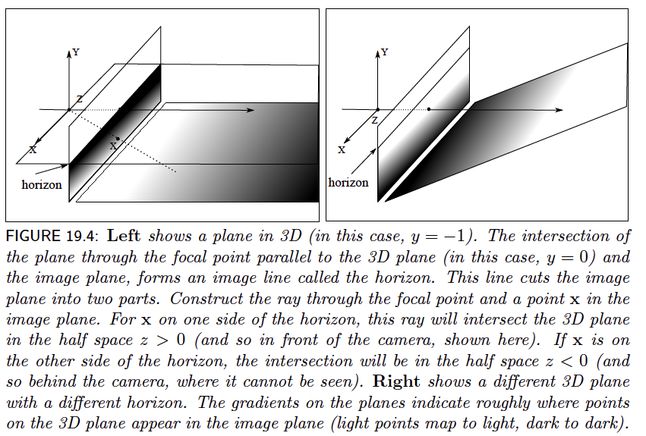
Horizons (= vanishing lines)

Slide 32
Vanishing lines of planes
Each family of parallel planes is associated with a vanishing line in the image
How can we construct the vanishing line of a plane?
camera
center
plane in the scene
Figure source: S. Seitz

Slide 33
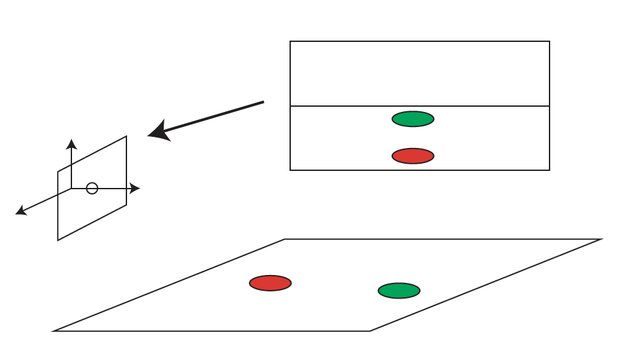
Horizons are informative - I

Slide 34

Horizons are informative - II
camera
center
ground plane
Image source: S. Seitz
Notes:
Is this parachutist higher or lower than the person taking this picture?
Lower—he is below the horizon

Slide 35
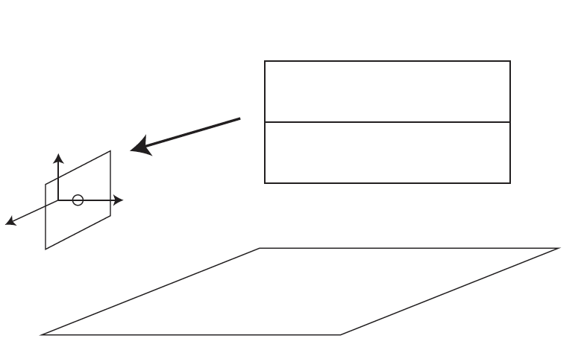
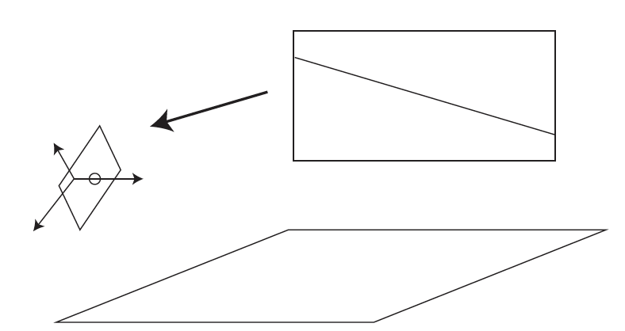
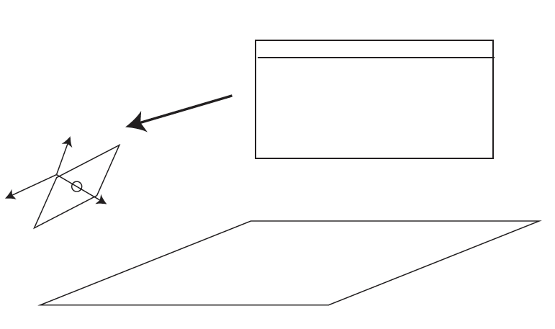
Horizons are informative, III

Slide 36
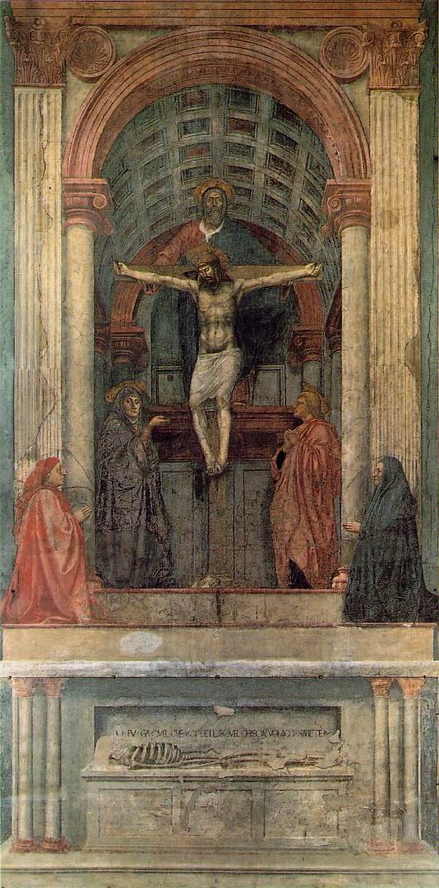
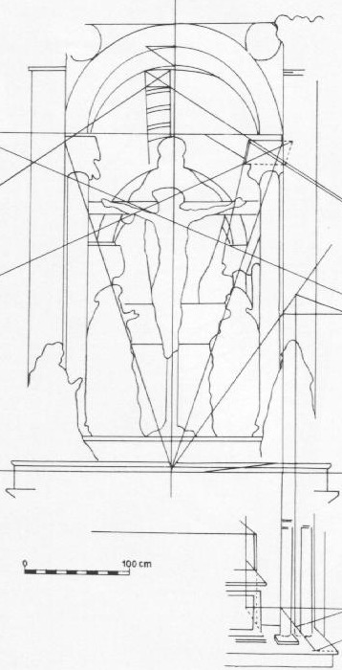
Symbolic use of vanishing points and lines
Masaccio, Trinity, Santa Maria Novella, Florence, 1425-28
One of the first consistent uses of perspective in Western art

Slide 37
Projection of 3D shapes
What is are the relationships between the geometric properties of general 3D surfaces and their 2D projections?
Barbara Hepworth sculpture

Slide 38
Projection of 3D shapes
What is the shape of the projection of a sphere?
Image source: F. Durand

Slide 39
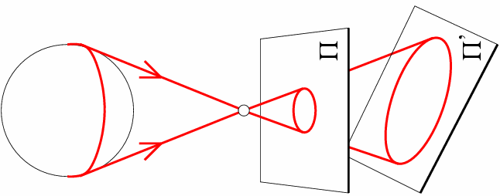
Projection of 3D shapes
What is the shape of the projection of a sphere?

Slide 40
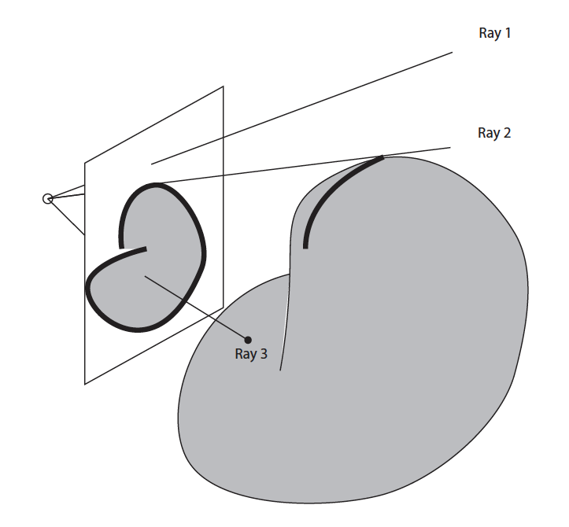
Projection of 3D shapes
Outline
Contour generator
Relation between contour generator
And outline is geometrically very
Complicated. Surprisingly hard to say
Much about surface from outline.

Slide 41
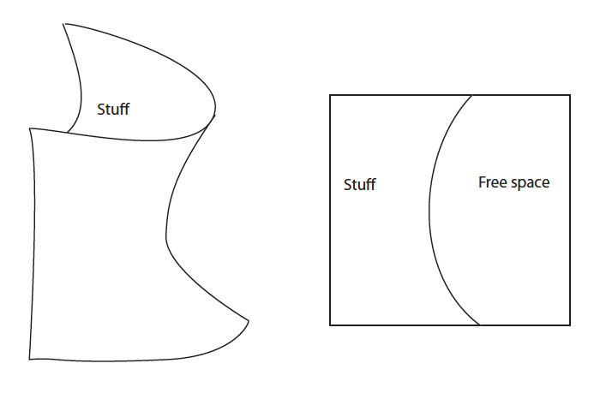
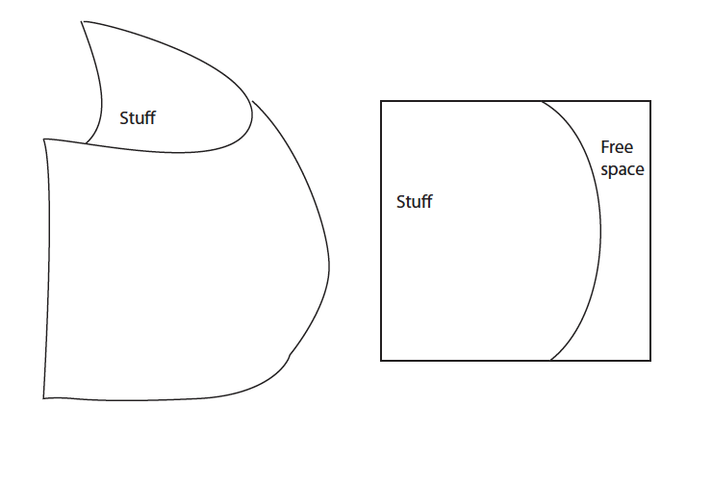
Projection of 3D shapes
J. Koenderink. What does the occluding contour tell us about solid shape? Perception 13 (321-330), 1984

Slide 42
Projection of 3D shapes
J. Koenderink. What does the occluding contour tell us about solid shape? Perception 13 (321-330), 1984

Slide 43
Projection of 3D shapes
J. Koenderink. What does the occluding contour tell us about solid shape? Perception 13 (321-330), 1984

Slide 44
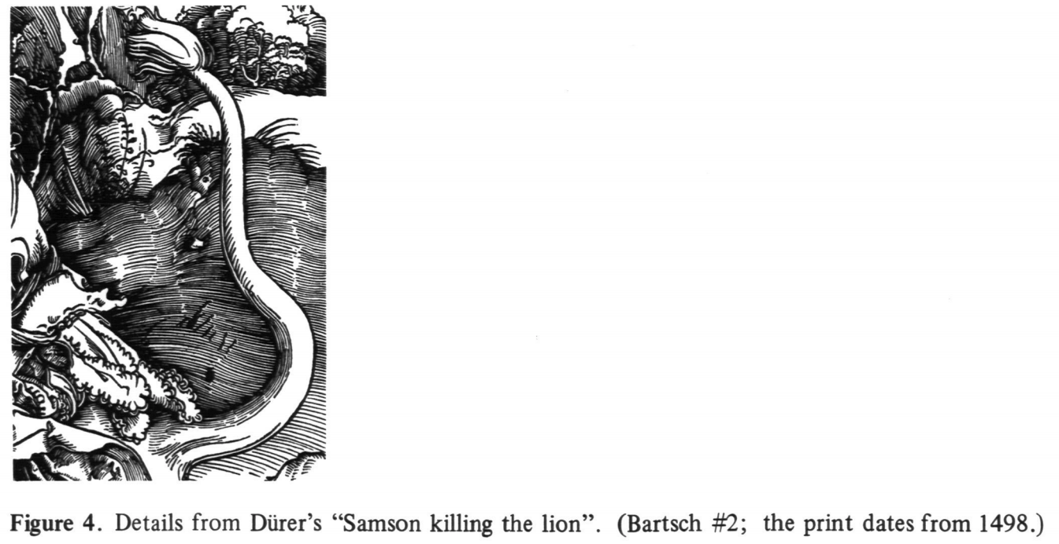
Projection of 3D shapes
J. Koenderink. What does the occluding contour tell us about solid shape? Perception 13 (321-330), 1984

Slide 45
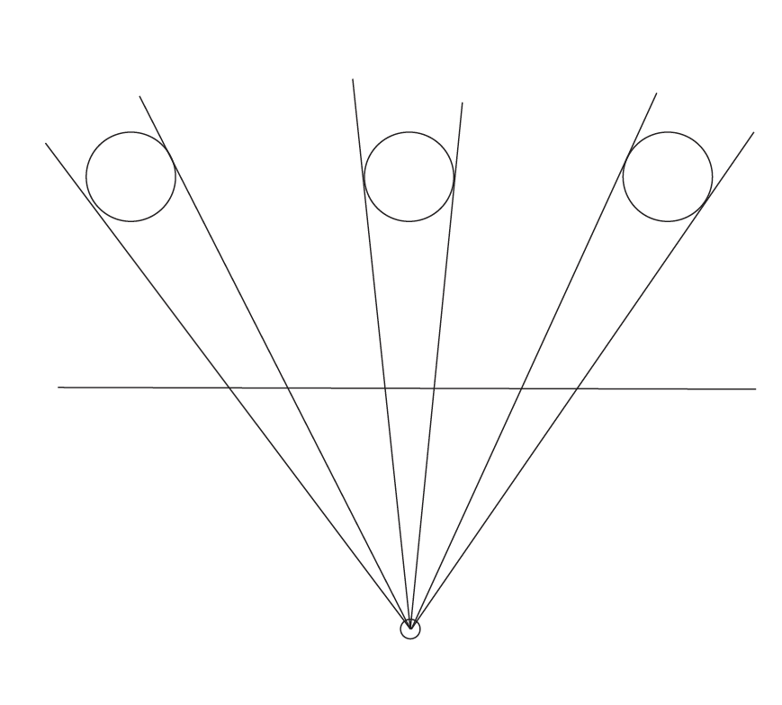
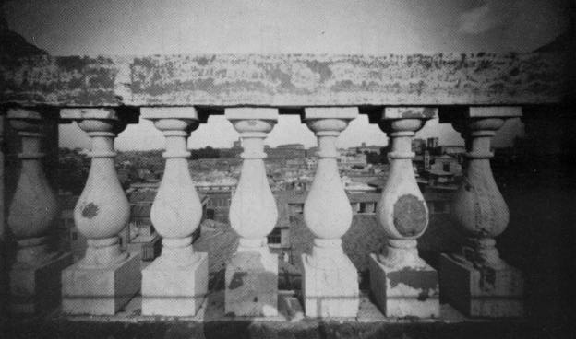
Projection of 3D shapes
Are the widths of the projected columns equal?
  The exterior columns are wider
  This is not an optical illusion, and is not due to lens flaws
  Phenomenon pointed out by Leonardo Da Vinci
Source: F. Durand

Slide 46

Perspective distortion: People

Slide 47
Overview
Motivation: recovery of 3D structure
Pinhole projection model
Properties of projection
Perspective projection matrix
Orthographic projection

Slide 48

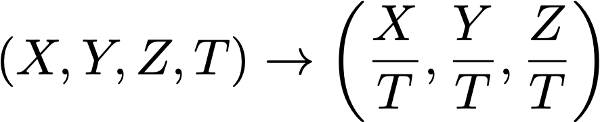
Homogeneous coordinates
Add an extra coordinate and use an equivalence relation
for 2D
  equivalence relation
  k*(X,Y,Z) is the same as (X,Y,Z)
for 3D
  equivalence relation
  k*(X,Y,Z,T) is the same as (X,Y,Z,T)
“Ordinary” or “non-homogeneous” coordinates
  properly called affine coordinates
  in 3D, affine -> homogeneous
  in 3D, homogeneous to affine

Slide 49


Homogenous coordinates
Notice (0, 0, 0, 0) is meaningless (HC’s for 3D)
  also (0, 0, 0) in 2D
Basic notion
  Possible to represent points “at infinity” by careful use of zero
  Where parallel lines intersect
    eg
  Where parallel planes intersect (etc)
Can write the action of a perspective camera as a matrix
and
intersect at

Slide 50
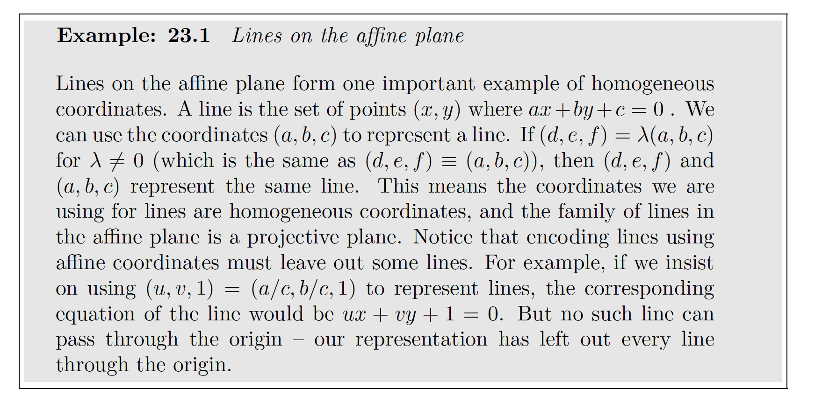
Homogeneous coordinates

Slide 51
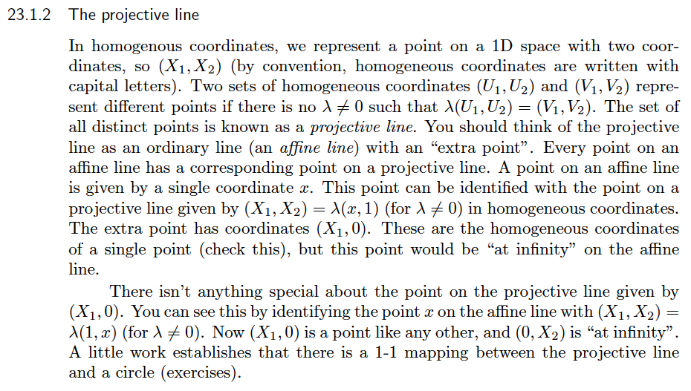
Homogeneous coordinates for a line

Slide 52
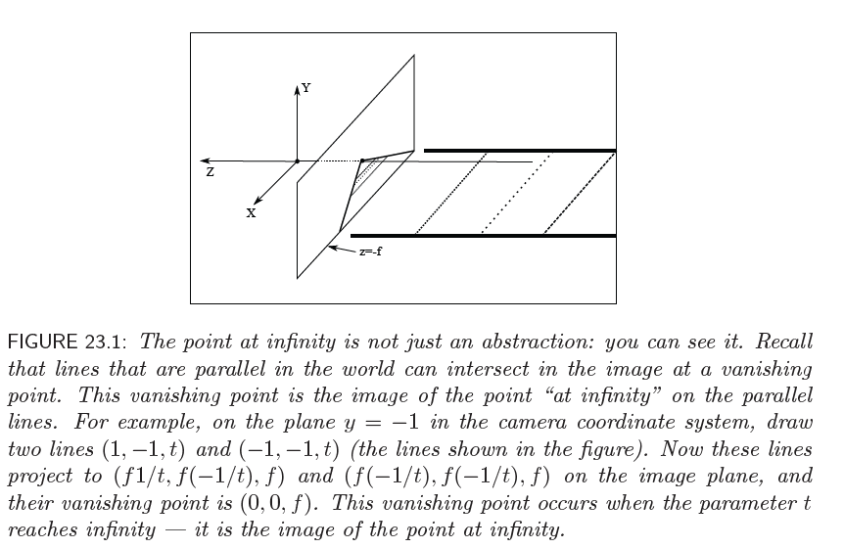
You can see the point at infinity

Slide 53
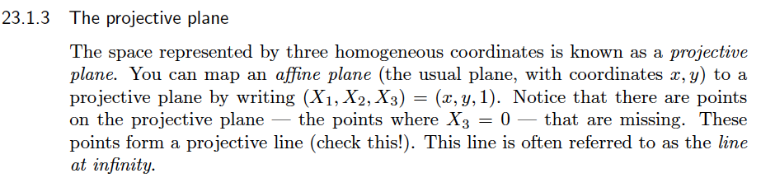
Homogeneous coordinates for the plane

Slide 54
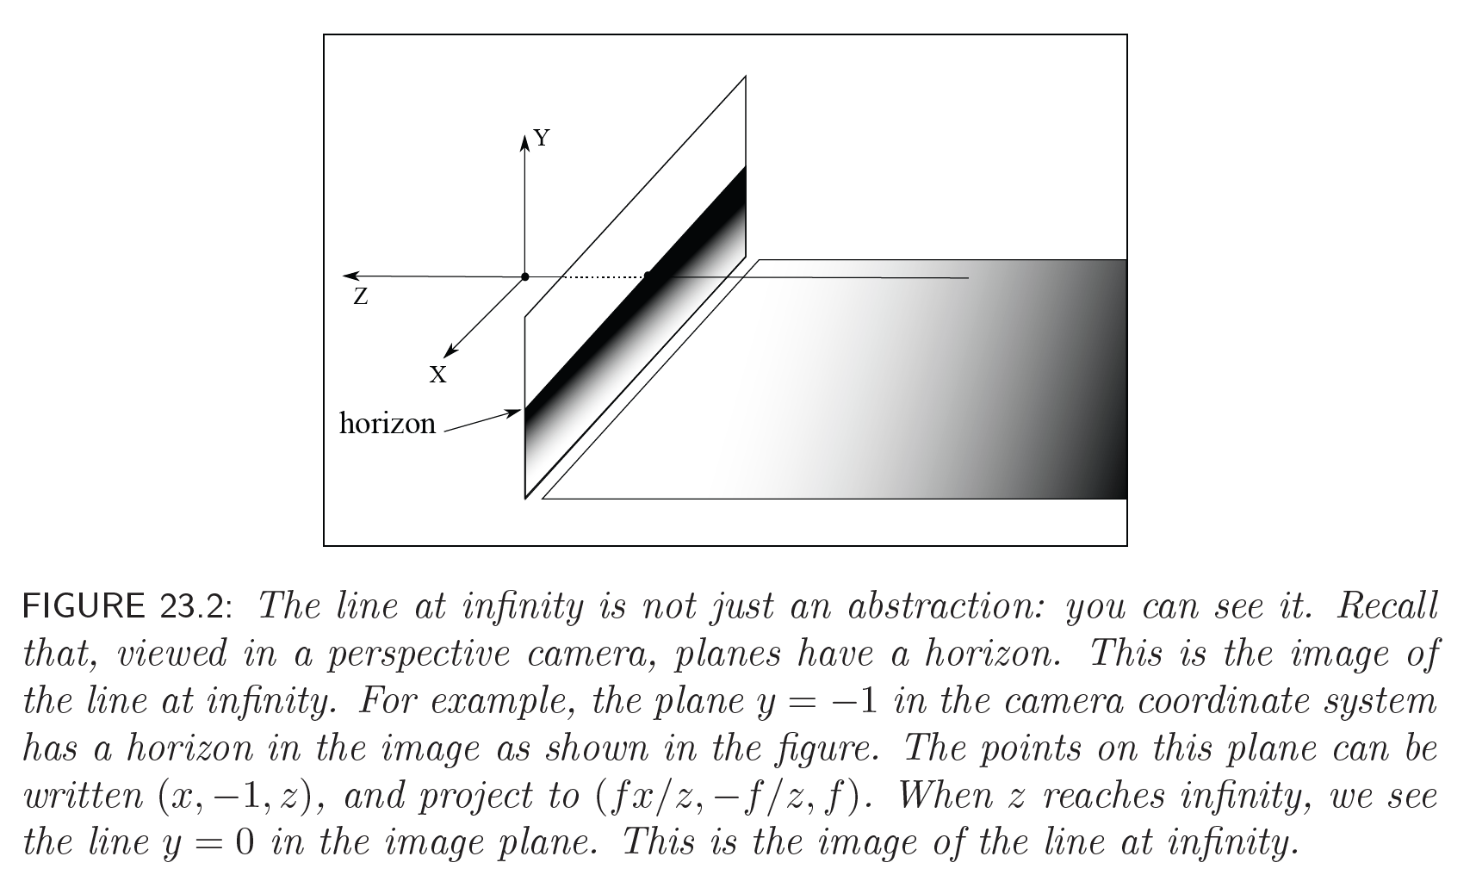
You can see the line at infinity, too!

Slide 55
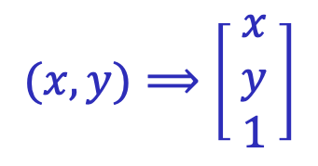
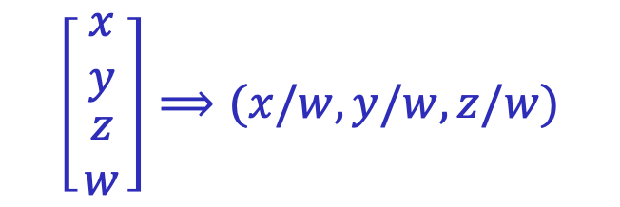
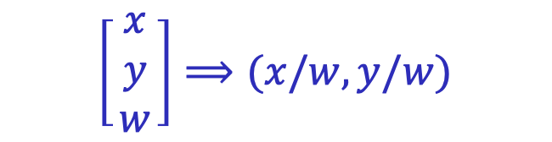
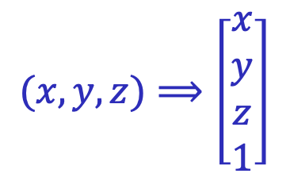
Recall: Homogeneous coordinates
To form homogeneous coordinates from normal Euclidean coordinates, append 1 as the last entry:
$$(x,y,z)⟹\left[\begin{aligned}x \\ y \\ z \\ 1\end{aligned}\right]$$
$$(x,y)⟹\left[\begin{matrix}x \\ y \\ 1\end{matrix}\right]$$
homogeneous image
coordinates
homogeneous scene
coordinates
To convert from homogeneous coordinates, divide by the last entry:
$$\left[\begin{matrix}x \\ y \\ \begin{aligned}z \\ w\end{aligned}\end{matrix}\right]⟹(x/w,y/w,z/w)$$
$$\left[\begin{matrix}x \\ y \\ w\end{matrix}\right]⟹(x/w,y/w)$$
In homogeneous coordinates, all scalar multiples represent the same point!

Slide 56
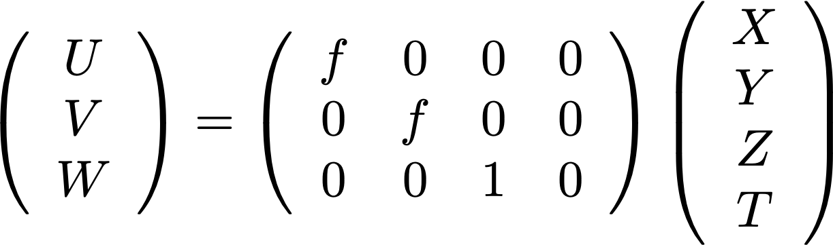
The camera matrix
Turn previous expression into HC’s
  HC’s for 3D point are (X,Y,Z,T)
  HC’s for point in image are (U,V,W)
In Camera coordinate system:

Slide 57
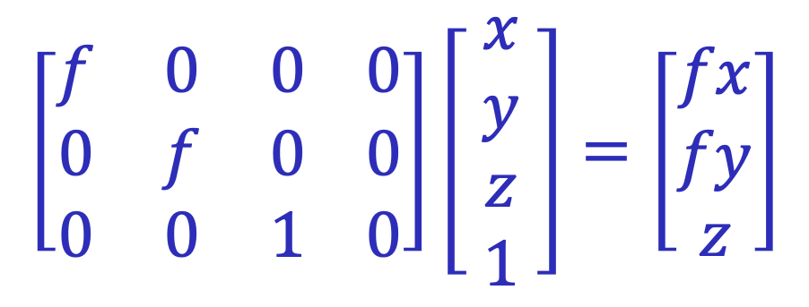
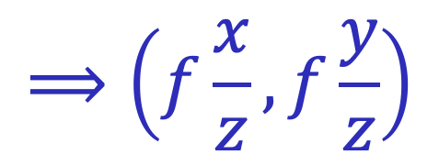
Perspective projection matrix
Projection is a matrix multiplication using homogeneous coordinates:
$$\left[\begin{matrix}f & 0 & 0 0 \\ 0 & f & 0 0 \\ 0 & 0 & 1 0\end{matrix}\right]\left[ \begin{aligned}x \\ y \\ z \\ 1\end{aligned} \right]=\left[\begin{matrix}fx \\ fy \\ z\end{matrix}\right]$$
$$⟹\left(f\frac{x}{z},f\frac{y}{z}\right)$$
divide by the third coordinate

Slide 58
Orthographic projection
Special case of perspective projection
  Distance from center of projection to image plane is infinite
  Also called “parallel projection”
Image
World
Slide by Steve Seitz
Notes:
Is this a linear function?

Slide 59
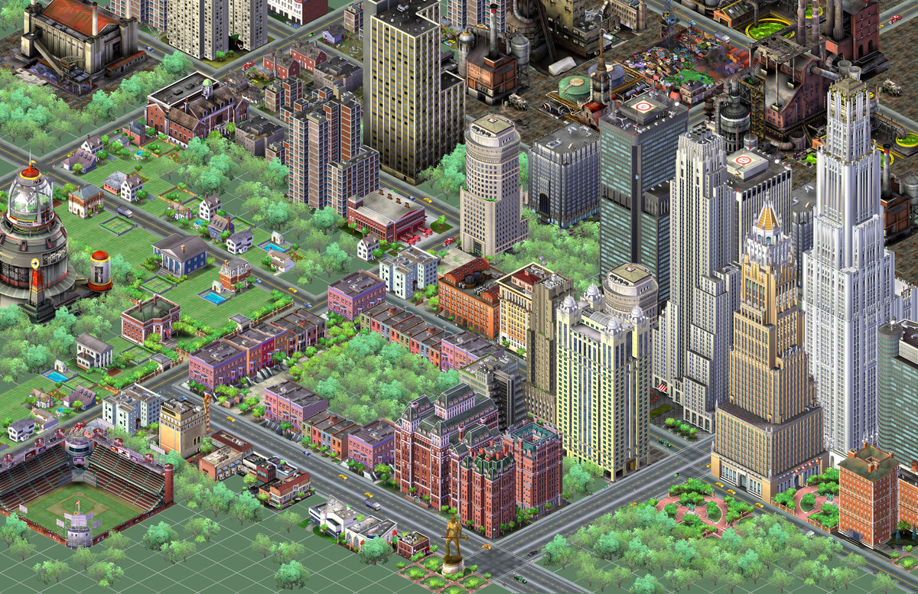
Orthographic projection
Special case of perspective projection
  Distance from center of projection to image plane is infinite
  Also called “parallel projection”
Notes:
Is this a linear function?

Slide 60

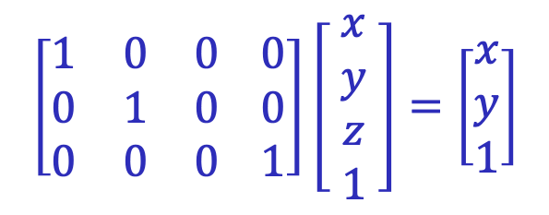
Orthographic projection
Special case of perspective projection
  Distance from center of projection to image plane is infinite
  Also called “parallel projection”
  Assuming projection along the $z$ axis, what’s the matrix?
Image
World
$$\left[\begin{matrix}1 & 0 & 0 0 \\ 0 & 1 & 0 0 \\ 0 & 0 & 0 1\end{matrix}\right]\left[ \begin{aligned}x \\ y \\ z \\ 1\end{aligned} \right]=\left[\begin{matrix}x \\ y \\ 1\end{matrix}\right]$$
Slide by Steve Seitz
Notes:
Is this a linear function?

Slide 61
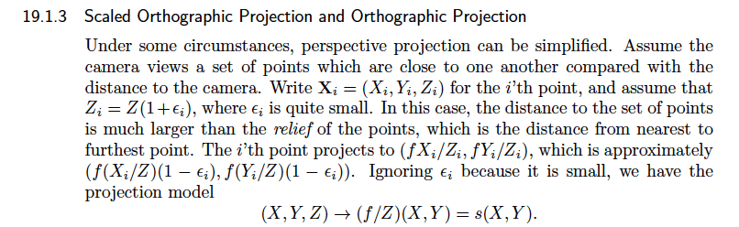
Orthographic projection

Slide 62

Orthographic projection and people

Slide 63

Camera matrix for orthographic projection
Almost never encounter orthographic projection

Slide 64



Approximating an orthographic camera
center at
infinity
Source: Hartley & Zisserman

