Slide 1
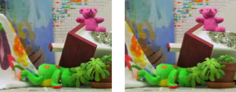

Two-View Stereo
Many slides adapted from Steve Seitz

Slide 2
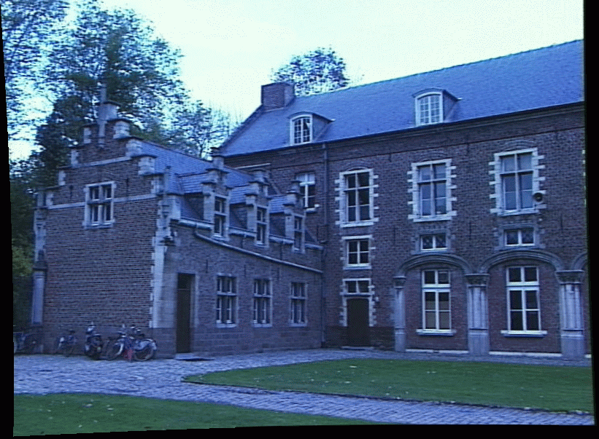
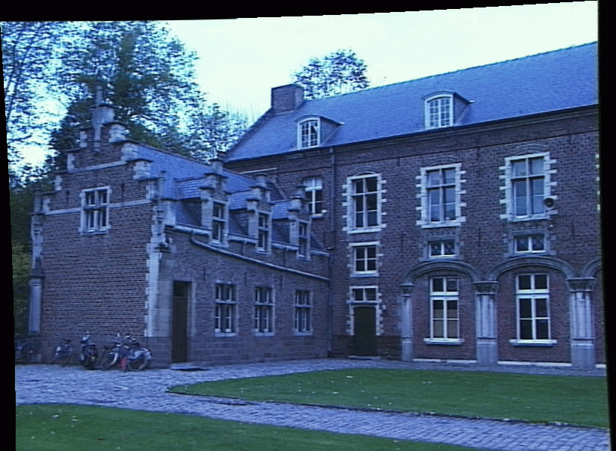
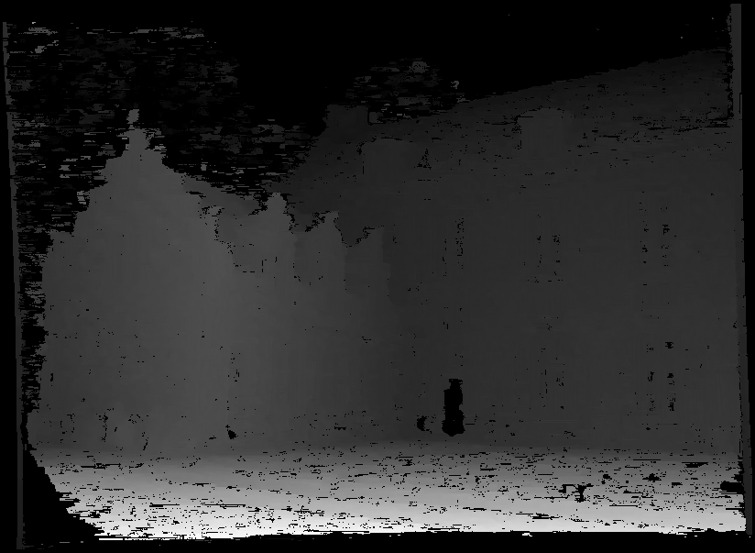
Problem formulation
Given: stereo pair (assumed calibrated)
Wanted: dense depth map

Slide 3
Outline
Motivation and history
Basic two-view stereo setup
Local stereo matching algorithm
Beyond local stereo matching
Active stereo with structured light

Slide 4
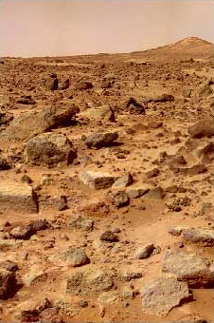
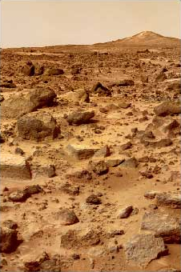
Stereo vision and perception of depth
What cues tell us about scene depth?

Slide 5
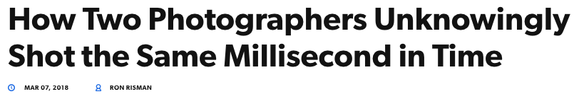

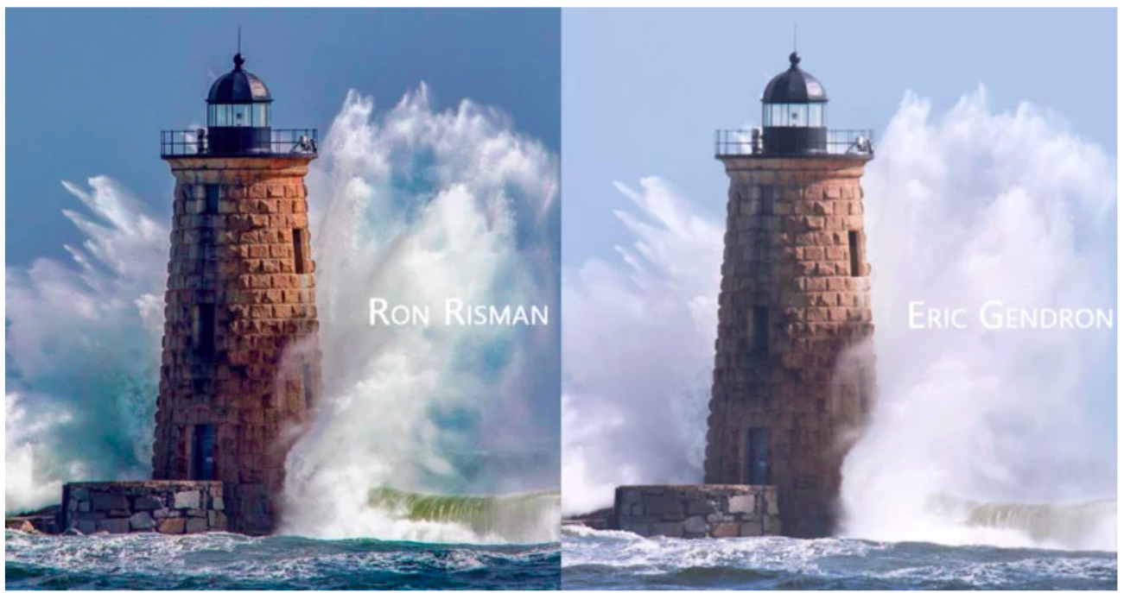
https://petapixel.com/2018/03/07/two-photographers-unknowingly-shot-millisecond-time/

Slide 6
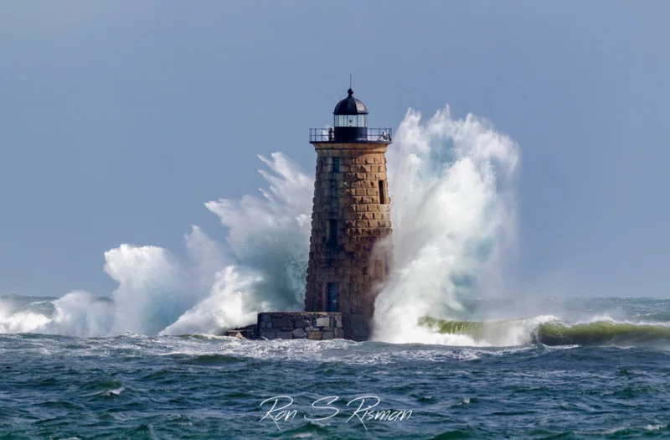
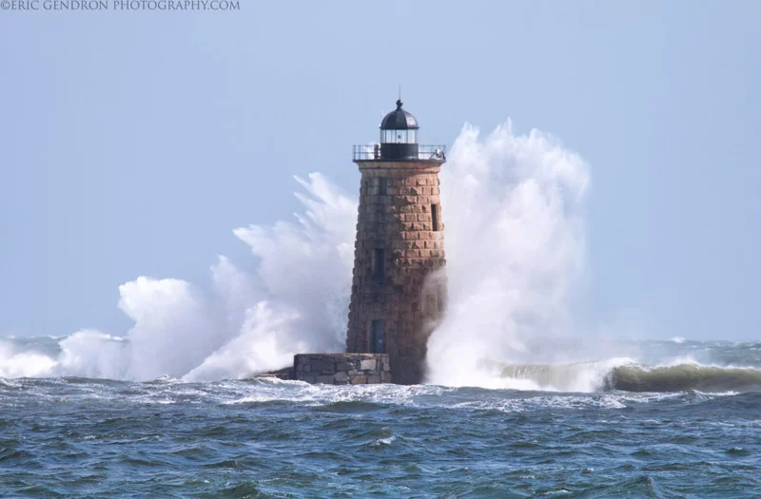
https://petapixel.com/2018/03/07/two-photographers-unknowingly-shot-millisecond-time/

Slide 7
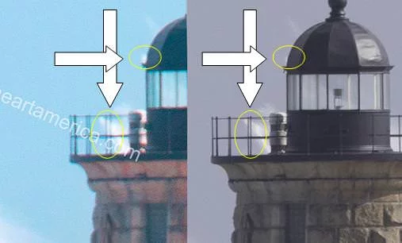
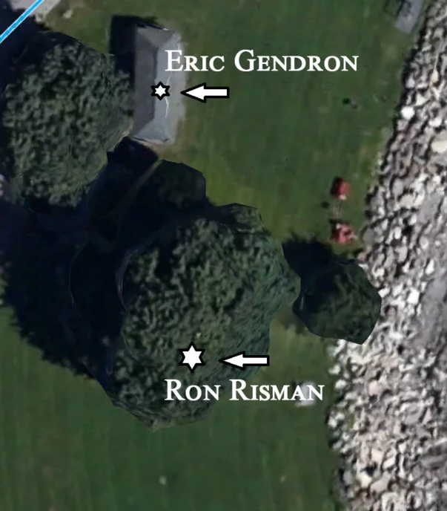
https://petapixel.com/2018/03/07/two-photographers-unknowingly-shot-millisecond-time/

Slide 8
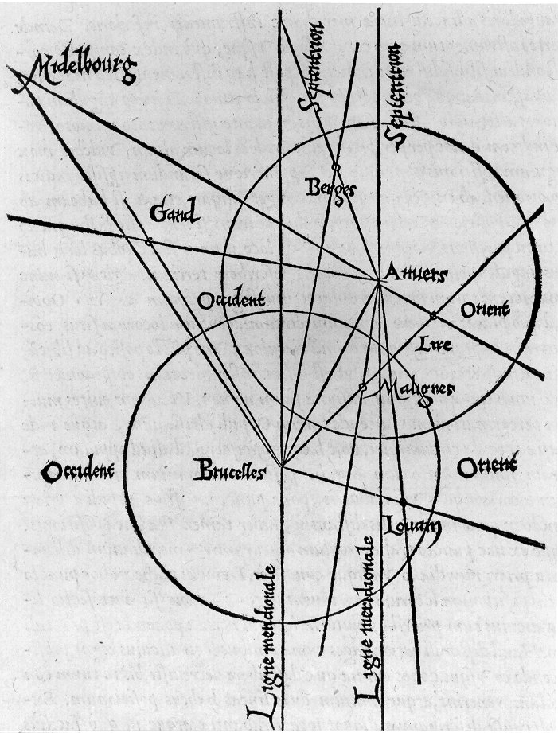
History: Triangulation
From Wikipedia: Gemma Frisius's 1533 diagram introducing the idea of triangulation into the science of surveying. Having established a baseline, e.g. the cities of Brussels and Antwerp, the location of other cities, e.g. Middelburg, Ghent etc., can be found by taking a compass direction from each end of the baseline, and plotting where the two directions cross. This was only a theoretical presentation of the concept — due to topographical restrictions, it is impossible to see Middelburg from either Brussels or Antwerp. Nevertheless, the figure soon became well known all across Europe.

Slide 9
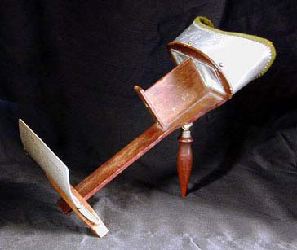
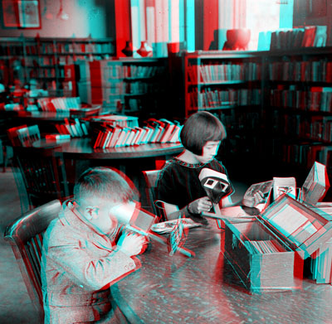
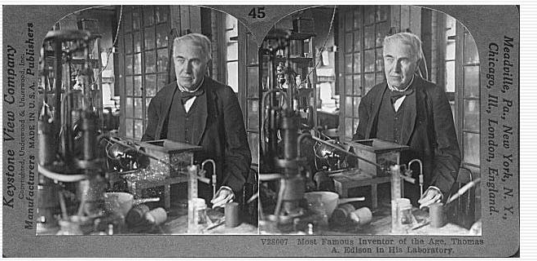
History: Stereograms
Humans can fuse pairs of images to get a sensation of depth
Stereograms: Invented by Sir Charles Wheatstone, 1838
https://en.wikipedia.org/wiki/Stereoscopy

Slide 10
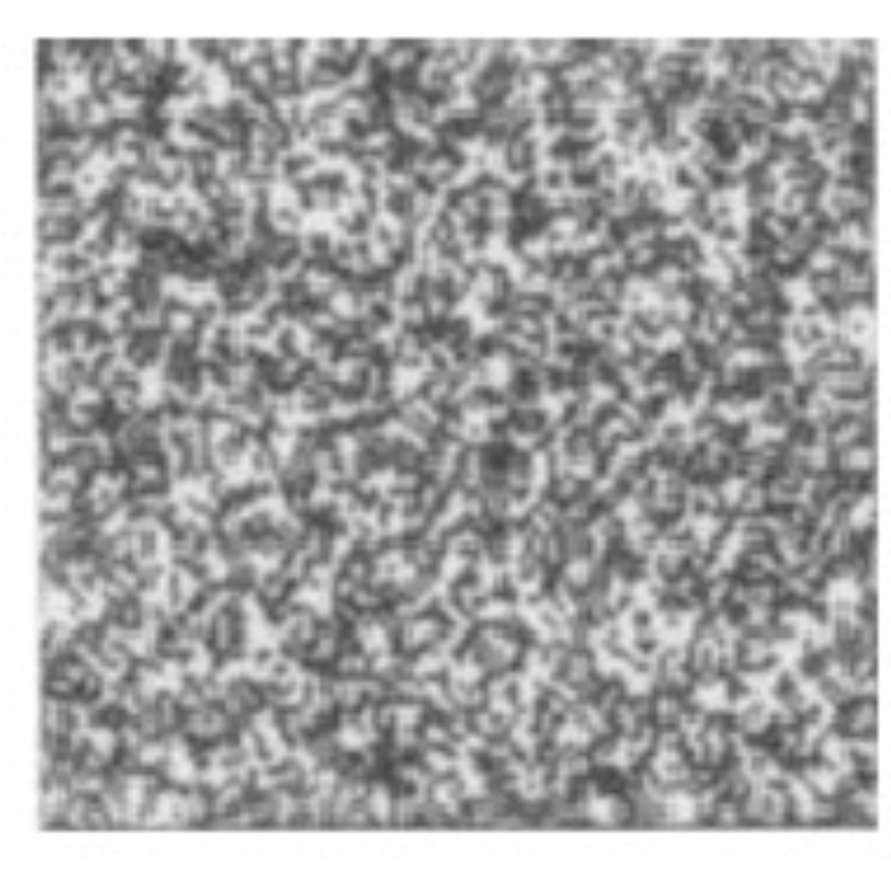
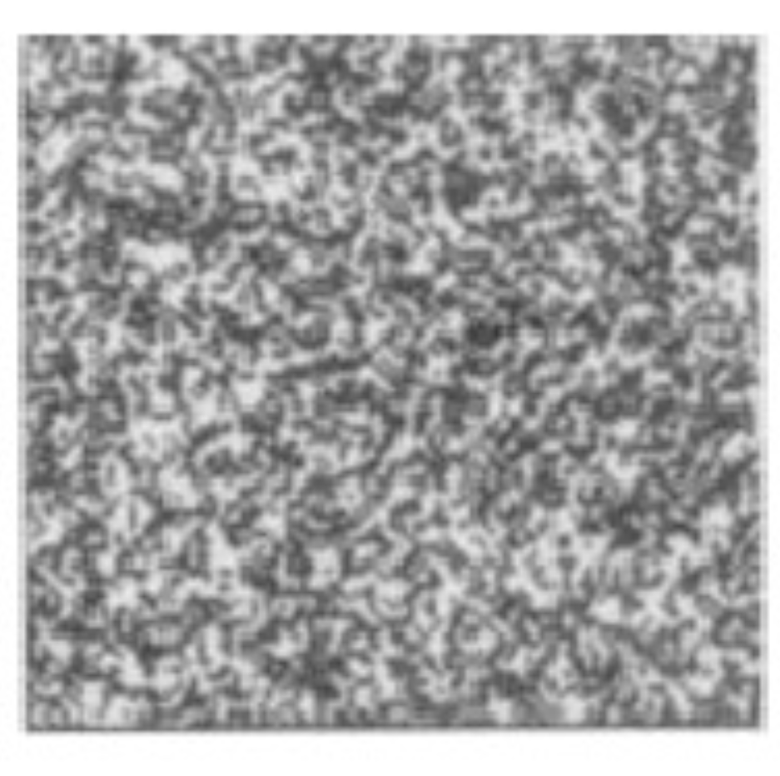

Slide 11
History: Random dot stereograms
Invented by Bela Julesz in the mid-20th century
Demonstration that stereo perception can happen without any monocular cues
https://en.wikipedia.org/wiki/Random_dot_stereogram

Slide 12
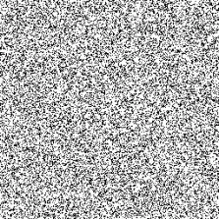
History: Random dot stereograms
Invented by Bela Julesz in the mid-20th century
Demonstration that stereo perception can happen without any monocular cues
https://en.wikipedia.org/wiki/Random_dot_stereogram
Notes:
From Wikipedia: According to Ralph Siegel, Dr. Julesz had "unambiguously demonstrated that stereoscopic depth could be computed in the absence of any identifiable objects, in the absence of any perspective, in the absence of any cues available to either eye alone."

Slide 13
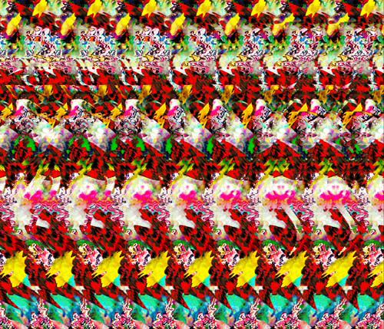
Autostereograms
Humans can fuse pairs of images to get a sensation of depth
Autostereograms: www.magiceye.com

Slide 14
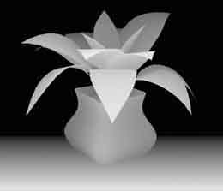
Autostereograms
Humans can fuse pairs of images to get a sensation of depth
Autostereograms: www.magiceye.com

Slide 15
Outline
Motivation and history
Basic two-view stereo setup

Slide 16
Problem formulation
Given: stereo pair (assumed calibrated)
Wanted: dense depth map

Slide 17
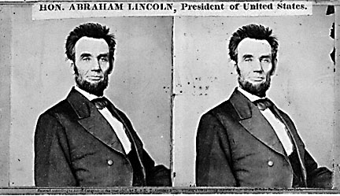
Basic stereo matching algorithm
For each pixel in the first image
Find corresponding epipolar line in the right image
Examine all pixels on the epipolar line and pick the best match
Triangulate the matches to get depth information
Simplest case: epipolar lines are corresponding scanlines
When does this happen?

Slide 18
Parallel images
Image planes of cameras are parallel to each other and to the baseline
Camera centers are at the same height
Focal lengths are the same
Then epipolar lines fall along horizontal scan lines of the images

Slide 19
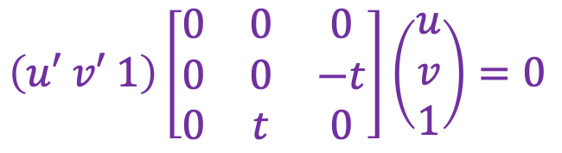
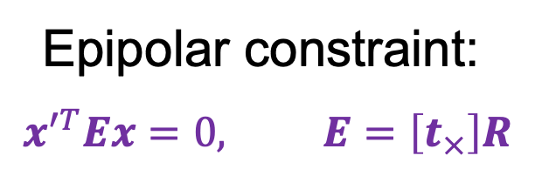
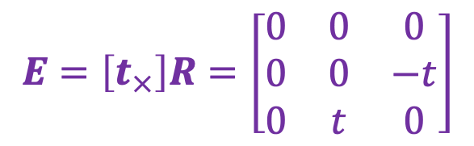


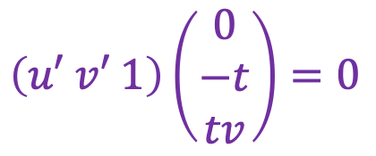


Essential matrix for parallel images
Epipolar constraint:
$$x^{′T}Ex=0, E=\left[t_{×}\right]R$$
$$R = I t = (t, 0, 0)$$
x
$$E=\left[t_{×}\right]R=\left[\begin{matrix}0 & 0 & 0 \\ 0 & 0 & −t \\ 0 & t & 0\end{matrix}\right]$$
$$x′$$
t
$$\left(u′ v′ 1\right)\left[\begin{matrix}0 & 0 & 0 \\ 0 & 0 & −t \\ 0 & t & 0\end{matrix}\right]\left(\begin{aligned}u \\ v \\ 1\end{aligned}\right)=0$$
$$\left(u′ v′ 1\right)\left(\begin{aligned}0 \\ −t \\ tv\end{aligned}\right)=0$$
$$−tv+tv′=0$$
$$v=v′$$
The $y$-coordinates of corresponding points are the same!

Slide 20
Stereo image rectification
If the image planes are not parallel, we can find homographies to project each view onto a common plane parallel to the baseline
C. Loop and Z. Zhang. Computing Rectifying Homographies for Stereo Vision. CVPR 1999

Slide 21
Stereo image rectification
If the image planes are not parallel, we can find homographies to project each view onto a common plane parallel to the baseline
C. Loop and Z. Zhang. Computing Rectifying Homographies for Stereo Vision. CVPR 1999

Slide 22
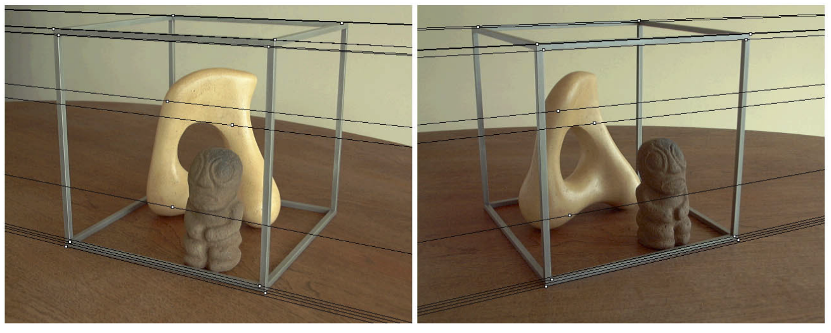
Stereo image rectification
Before rectification:
Image source

Slide 23
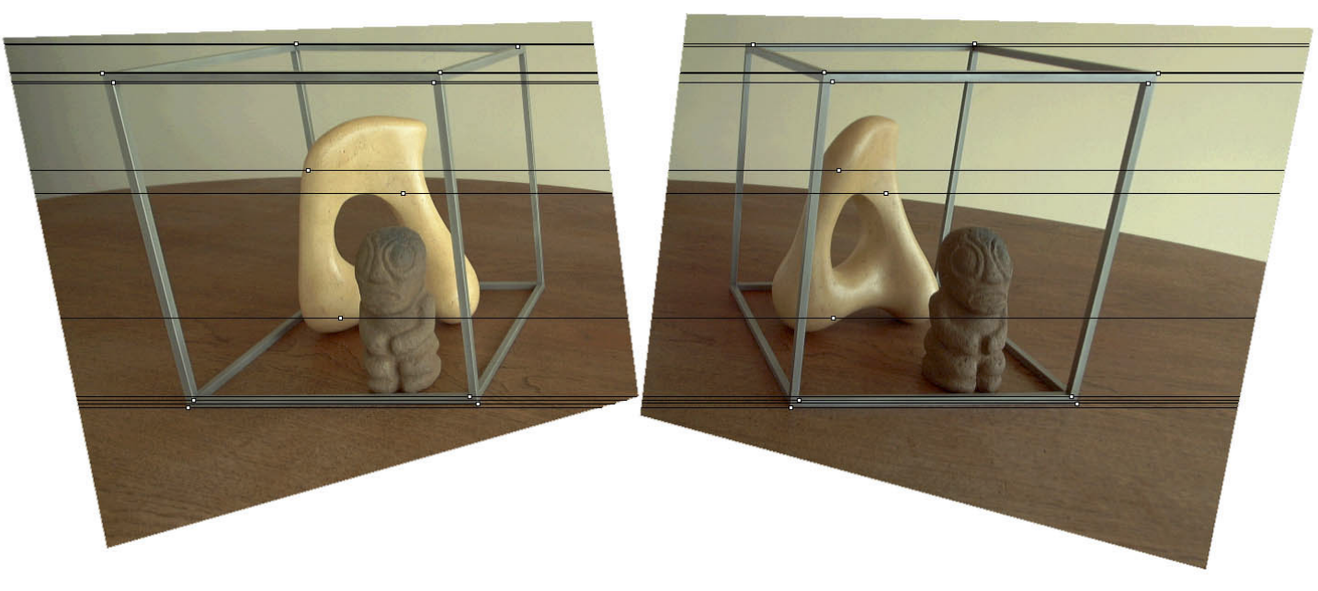
Stereo image rectification
After rectification:
Image source

Slide 24
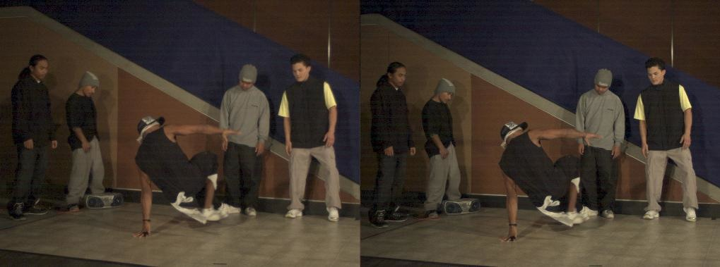
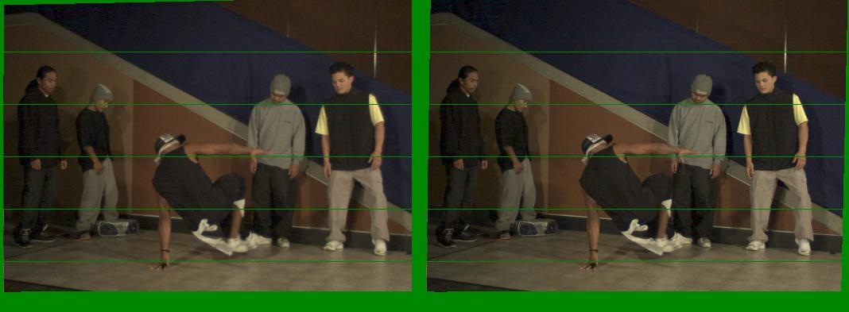
Another rectification example
Unrectified
Rectified

Slide 25
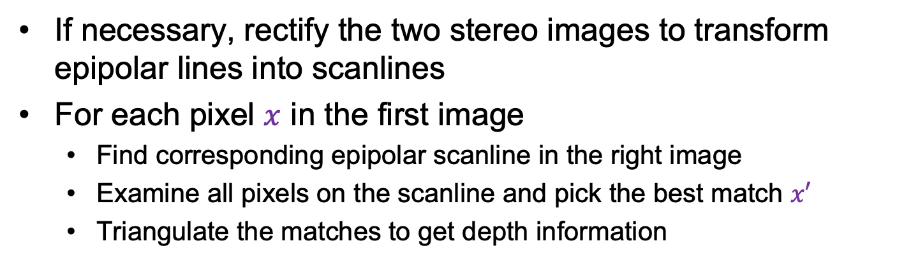
Basic stereo matching algorithm
If necessary, rectify the two stereo images to transform epipolar lines into scanlines
For each pixel $x$ in the first image
Find corresponding epipolar scanline in the right image
Examine all pixels on the scanline and pick the best match $x′$
Triangulate the matches to get depth information

Slide 26
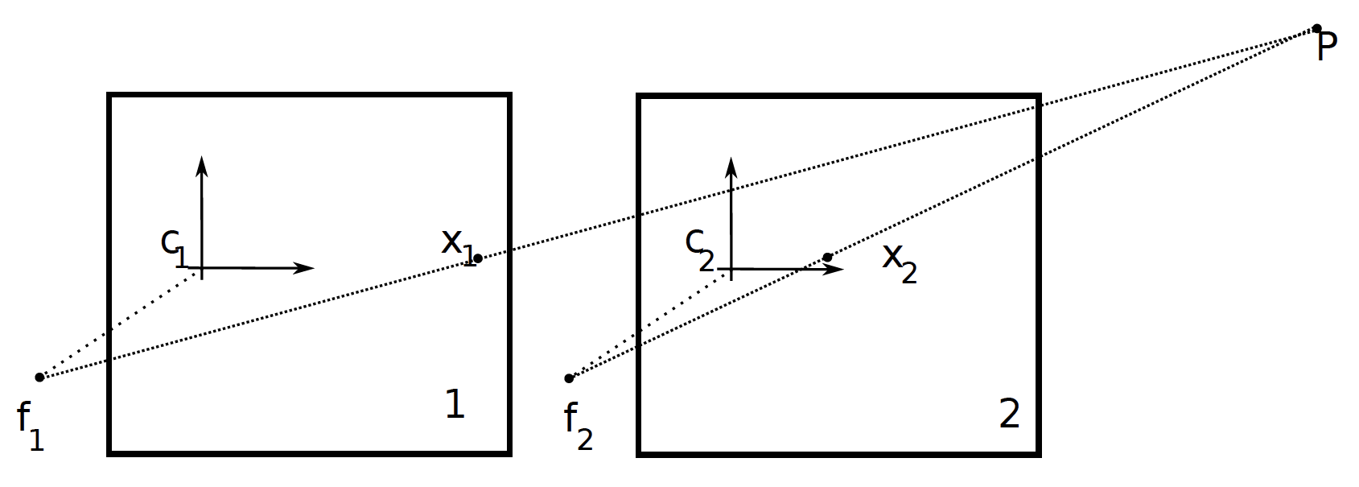
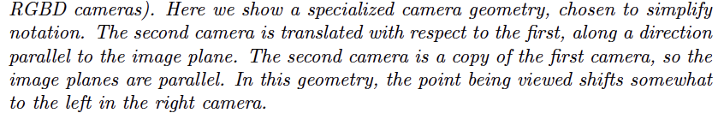
Two cameras view a point…

Slide 27
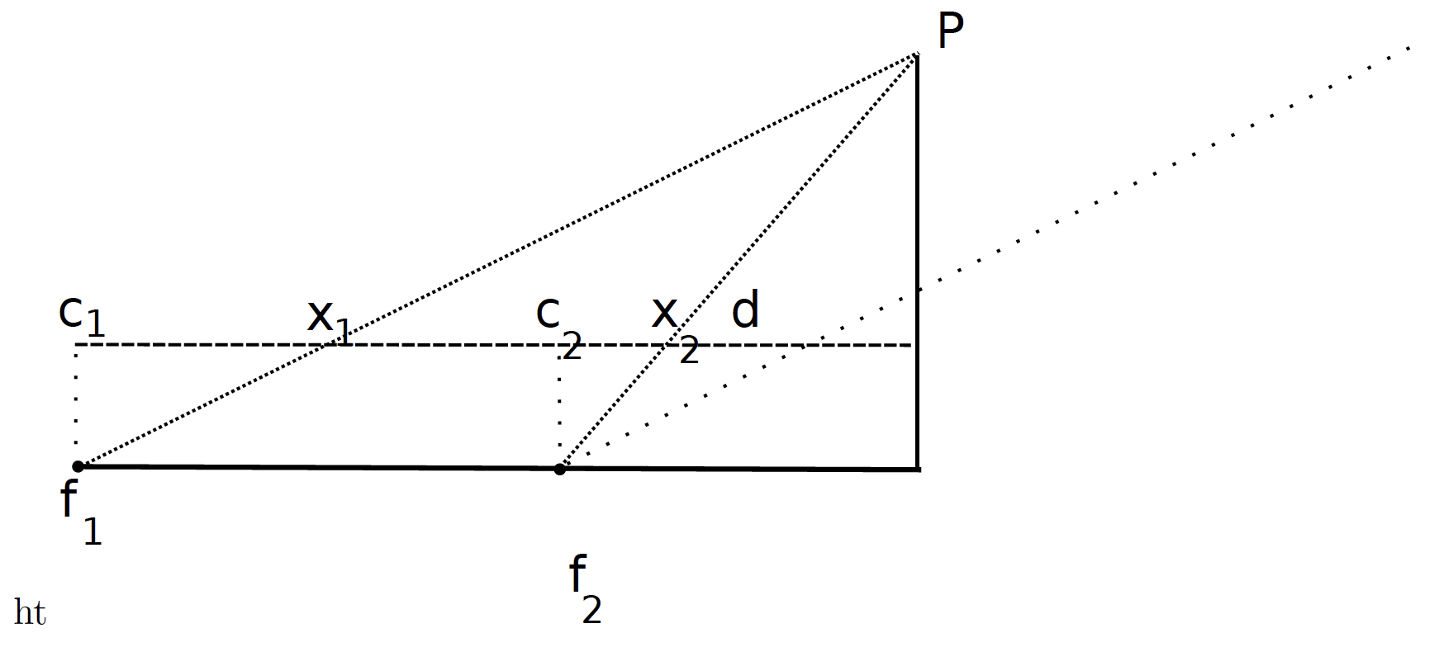
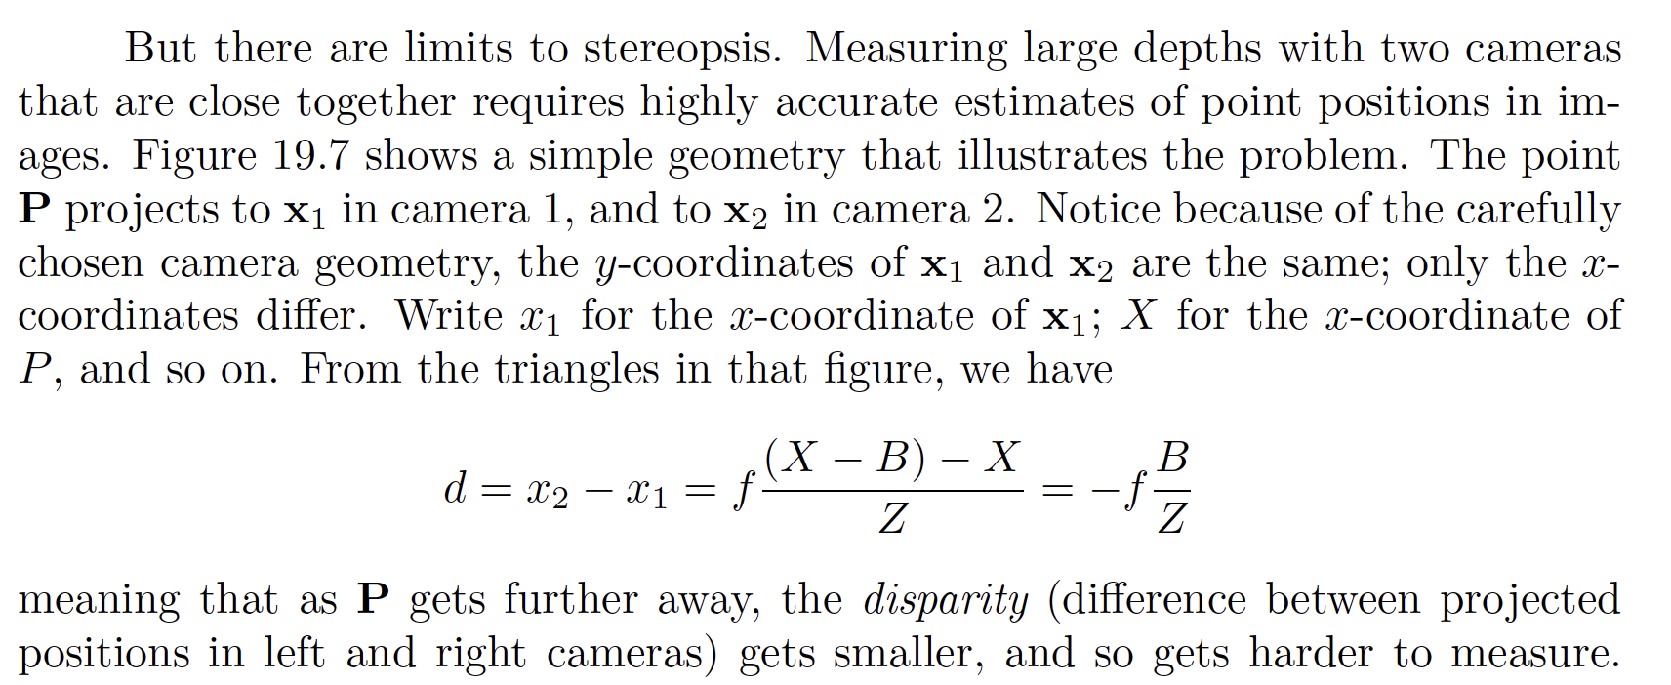
Two cameras view a point…

Slide 28





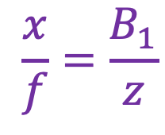
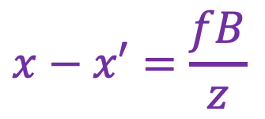
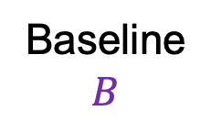


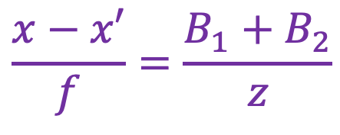



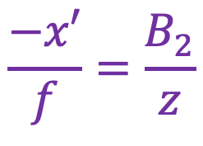
Depth from disparity
$$X$$
$$\frac{x}{f}=\frac{B_{1}}{z}$$
$$\frac{−x′}{f}=\frac{B_{2}}{z}$$
$$z$$
$$\frac{x−x′}{f}=\frac{B_{1}+B_{2}}{z}$$
$$x$$
$$x′$$
$$f$$
$$B1$$
$$B2$$
$$f$$
$$x−x′=\frac{fB}{z}$$
$$O$$
Baseline $$B$$
$$O′$$
Disparity is inversely proportional to depth!

Slide 29


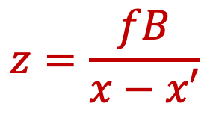



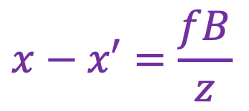
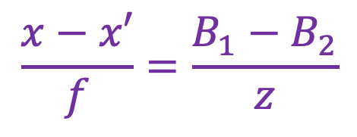




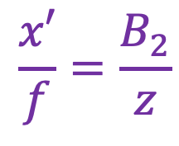
Depth from disparity
$$X$$
$$\frac{x}{f}=\frac{B_{1}}{z}$$
$$\frac{x′}{f}=\frac{B_{2}}{z}$$
$$z$$
$$\frac{x−x′}{f}=\frac{B_{1}−B_{2}}{z}$$
$$x$$
$$x′$$
$$f$$
$$B$$
$$f$$
$$O$$
$$O′$$
$$x−x′=\frac{fB}{z}$$
$$B1$$
$$z=\frac{fB}{x−x′}$$
$$B2$$

Slide 30
Effect of baseline on stereo results
Larger baseline
Smaller triangulation error
Matching is more difficult
Smaller baseline
Higher triangulation error
Matching is easier

Slide 31
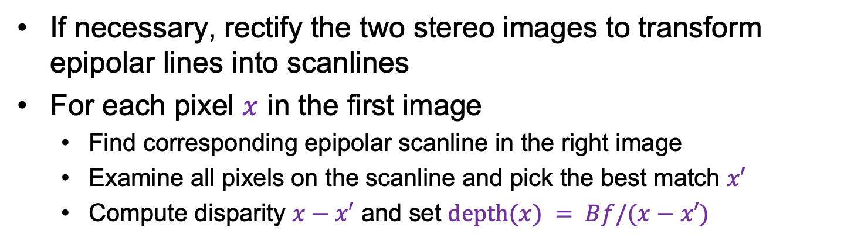
Basic stereo matching algorithm
If necessary, rectify the two stereo images to transform epipolar lines into scanlines
For each pixel $x$ in the first image
Find corresponding epipolar scanline in the right image
Examine all pixels on the scanline and pick the best match $x′$
Compute disparity $x−x′$ and set $depth(x) = Bf/(x−x′)$

Slide 32
Some points don’t have matches - I
This is a depth cue, though not much used directly
Effect sometimes known as
Da Vinci stereopsis

Slide 33
Some points don’t have matches - II
This is a depth cue, though not much used directly
Effect sometimes known as
Da Vinci stereopsis

Slide 34
Outline
Motivation and history
Basic two-view stereo setup
Local stereo matching algorithm

Slide 35
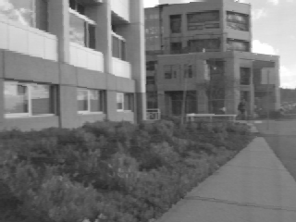
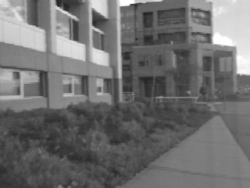
Correspondence search
Left
Right
scanline
Matching cost
disparity
Slide a window along the right scanline and compare contents of that window with the reference window in the left image
Matching cost: SSD or normalized correlation

Slide 36
Correspondence search
Left
Right
scanline
SSD

Slide 37
Correspondence search
Left
Right
scanline
Norm. corr

Slide 38
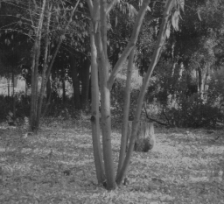
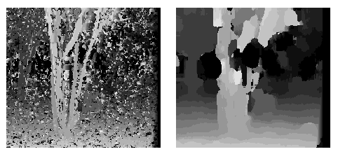
Effect of window size on correspondence search
Window size 3
Window size 20
Smaller window:
More detail
More noise
Larger window:
Smoother disparity maps
Less detail
Notes:
smaller window: more detail, more noise
bigger window: less noise, more detail

Slide 39

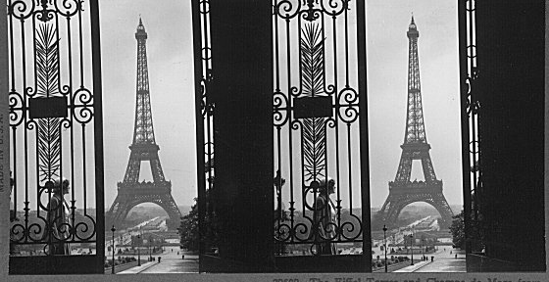
Where will basic window search fail?
Textureless surfaces
Occlusions, repetition
Non-Lambertian surfaces, specularities

Slide 40

Example: Textured neighborhood
Window size: 1 pixel
Patch Size = 1 pixel
Source: D. Hoiem

Slide 41

Example: Textured neighborhood
Window size: 7 pixels
Source: D. Hoiem

Slide 42

Example: Smooth neighborhood
Window size: 1 pixel
Source: D. Hoiem

Slide 43

Example: Smooth neighborhood
Window size: 7 pixels
Source: D. Hoiem

Slide 44

Example: Edge (occlusion)
Window size: 1 pixel
Source: D. Hoiem

Slide 45

Example: Edge (occlusion)
Window size: 3 pixels
Source: D. Hoiem

Slide 46

Example: Edge (occlusion)
Window size: 7 pixels
Source: D. Hoiem

Slide 47

Example: Specular highlight
Window size: 1 pixel
Source: D. Hoiem

Slide 48

Example: Specular highlight
Window size: 7 pixels
Source: D. Hoiem

Slide 49

More interesting matching costs
Instead of SSD of pixel window, compute filter outputs for many filters
SSD those
Advantage: more detailed description of points
Disadvantage: Filter support interacts badly with fast changes in depth

Slide 50
Dealing with Da Vinci
Consequence:
some points in L (R) image do not
have matches in R (L) image
Note asymmetry in previous algorithm
(find best matching point in other side - what if best matches aren’t consistent?)
Strategy:
match L to R
match R to L
use only consistent matches

Slide 51
Outline
Motivation and history
Basic two-view stereo setup
Local stereo matching algorithm
Beyond local stereo matching

Slide 52




Stereo as optimization with non-local constraints
Global optimization method (graph cuts)
Data
Ground truth
Window-based matching
Y. Boykov, O. Veksler, and R. Zabih, Fast Approximate Energy Minimization via Graph Cuts, PAMI 2001

Slide 53
Non-local constraint: Uniqueness
Each point in one image should match at most one point in the other image
Does uniqueness always hold in real life?
Source: J. Johnson and D. Fouhey

Slide 54
Non-local constraint: Uniqueness
Each point in one image should match at most one point in the other image
Does uniqueness always hold in real life?
Source: J. Johnson and D. Fouhey

Slide 55
Non-local constraint: Ordering
Corresponding points should appear in the same order
Is ordering always preserved in real life?
a
b
c
Source: J. Johnson and D. Fouhey

Slide 56
Non-local constraint: Ordering
Corresponding points should appear in the same order
Is ordering always preserved in real life?
a
b
c
d
Source: J. Johnson and D. Fouhey

Slide 57
Non-local constraint: Smoothness
We expect disparity values to change slowly (for the most part)

Slide 58
Scanline stereo by dynamic programming
Match pixels along the entire scanline while preserving uniqueness and ordering
Different scanlines are still optimized independently
Left image
Right image
Y. Ohta and T. Kanade. Stereo by Intra- and Inter-Scanline Search Using Dynamic Programming. IEEE Trans. PAMI, 1985

Slide 59
Scanline stereo by dynamic programming
Left image
Right image
Right
occlusion
q
Left occlusion
correspondence
t
s
p
Source: Y. Boykov
Y. Ohta and T. Kanade. Stereo by Intra- and Inter-Scanline Search Using Dynamic Programming. IEEE Trans. PAMI, 1985

Slide 60

Scanline stereo by dynamic programming
Generates streaking artifacts!

Slide 61
Stereo as an optimization problem
Originally:
find x_1, x_2 that match, compute depth
Now:
choose depth at x_1 that causes x_2 to be best match

Slide 62
Stereo as an optimization problem
=(X, Y, Z)
Disparity
Baseline
Depth
Assume camera 2 is translated wrt camera 1, both are calibrated
IF you choose the right depth for x_1, then:
you know disparity, so you know x_2
and you can optimize ||color(x_1)-color(x_2(d))||^2 + smoothness(depth)
or something like it

Slide 63
Stereo as an optimization problem (sketch)
Quantize depth to a fixed number of levels (say, 256)
Encode depth at every pixel with a one-hot vector (say, 256 d)

Slide 64
Stereo as an optimization problem (sketch)
Quantize depth to a fixed number of levels (say, 256)
Encode depth at every pixel with a one-hot vector (say, 256 d)
Typically: cheap if depth(x_1)= depth (neighbors)
expensive otherwise
EG

Slide 65
Stereo as an optimization problem (sketch)
Result:
large discrete optimization problem, at least NP-hard
There are excellent approximation algorithms (below)
For a small set of cases, true optimum is known (by good luck)
Yield:
excellent stereo algorithms
Y. Boykov, O. Veksler, and R. Zabih, Fast Approximate Energy Minimization via Graph Cuts, PAMI 2001

Slide 66




Stereo as an optimization problem (sketch)

Slide 67

Stereo matching as global optimization
I₁
I₂
D
W₁(i )
W₂(i+D(i ))
D(i )
$$E\left(D\right)= \sum_{i}{{\left(W_{1}\left(i\right)−W_{2}\left(i+D\left(i\right)\right)\right)}^{2}+λ\sum_{(i,j)∈𝒩 }{ ρ\left(D\left(i\right)−D(j)\right)}}$$
Data term
Neighborhood smoothness term
Energy functions of this form can be minimized using graph cuts
Y. Boykov, O. Veksler, and R. Zabih, Fast Approximate Energy Minimization via Graph Cuts, PAMI 2001

Slide 68

Stereo matching with deep networks
L. Lipson et al. RAFT-Stereo: Multilevel Recurrent Field Transforms for Stereo Matching. arXiv 2021

Slide 69

Self-supervised depth estimation
R. Garg et al. Unsupervised CNN for Single View Depth Estimation: Geometry to the Rescue. ECCV 2016

Slide 70

Stereo datasets
Middlebury stereo datasets
KITTI
Synthetic data

Slide 71
Outline
Motivation and history
Basic two-view stereo setup
Local stereo matching algorithm
Stereo with non-local optimization
Active stereo with structured light

Slide 72


Active stereo with structured light
Project “structured” light patterns onto the object
Simplifies the correspondence problem
Allows us to use only one camera
camera
projector
L. Zhang, B. Curless, and S. M. Seitz. Rapid Shape Acquisition Using Color Structured Light and Multi-pass Dynamic Programming. 3DPVT 2002

Slide 73

Active stereo with structured light
L. Zhang, B. Curless, and S. M. Seitz. Rapid Shape Acquisition Using Color Structured Light and Multi-pass Dynamic Programming. 3DPVT 2002

Slide 74
Active stereo with structured light
http://en.wikipedia.org/wiki/Structured-light_3D_scanner

Slide 75


Kinect: Structured infrared light
http://bbzippo.wordpress.com/2010/11/28/kinect-in-infrared/

Slide 76

Example: Book vs. No Book
Source (via D. Hoiem)

Slide 77

Example: Book vs. No Book
Source (via D. Hoiem)

Slide 78


Apple TrueDepth
https://www.cnet.com/news/apple-face-id-truedepth-how-it-works/

Slide 79

Laser scanning
Digital Michelangelo Project
Levoy et al.
http://graphics.stanford.edu/projects/mich/
Optical triangulation
Project a single stripe of laser light
Scan it across the surface of the object
This is a very precise version of structured light scanning
Source: S. Seitz

Slide 80

Laser scanned models
The Digital Michelangelo Project, Levoy et al.
Source: S. Seitz

Slide 81

Laser scanned models
The Digital Michelangelo Project, Levoy et al.
Source: S. Seitz

Slide 82

Laser scanned models
The Digital Michelangelo Project, Levoy et al.
Source: S. Seitz

Slide 83

Laser scanned models
The Digital Michelangelo Project, Levoy et al.
Source: S. Seitz

Slide 84

Laser scanned models
1.0 mm resolution (56 million triangles)
The Digital Michelangelo Project, Levoy et al.
Source: S. Seitz

Slide 85

Aligning range images
A single range scan is not sufficient to capture a complex surface
Need techniques to register multiple range images
B. Curless and M. Levoy, A Volumetric Method for Building Complex Models from Range Images, SIGGRAPH 1996

Slide 86
Aligning range images
A single range scan is not sufficient to capture a complex surface
Need techniques to register multiple range images
… which brings us to multi-view stereo

