Slide 1
The Extended Kalman Filter
D. A. Forsyth, UIUC

Slide 2
The Kalman filter is wonderful, but…
The linear model of measurement isn’t always helpful
The linear model of movement isn’t always helpful
Example:
the car in ND Kalman filter example is completely unrealistic
What to do about non-linearities?

Slide 3
Example: Hard localization
Example we saw
Assume
car state is (position; velocity; acceleration)
it doesn’t rotate!
this yields D_i, and noise
we know M_i and noise for beacons
Then it’s all easy (plug in equations and go)
but what if we localize with IRLS?

Slide 4
IRLS localization
Write state of vehicle:
Can extract position as:
State update is:
Measurement is:
HUH?

Slide 5
Harder localization trick
Model the cost function as:
at the minimum - so actually, v=0
now the cost function might be slightly wrong, which will cause errors in u
if we use the model:
then we have:
And a kind of “evenness” property

Slide 6
Harder localization trick, II
This property is reasonable:
we can’t tell noise directions apart by their effect on the cost function
Now we’re in business:
Choose this
Hessian of cost function at best location

Slide 7
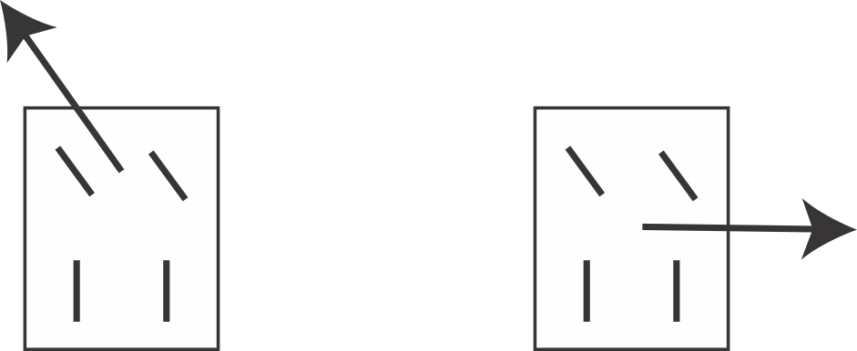
Example: a car has a nasty dynamical model
OK
Not OK
Formally: car is non-holonomic

Slide 8
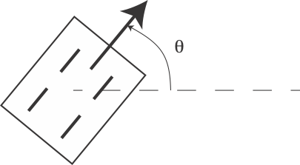
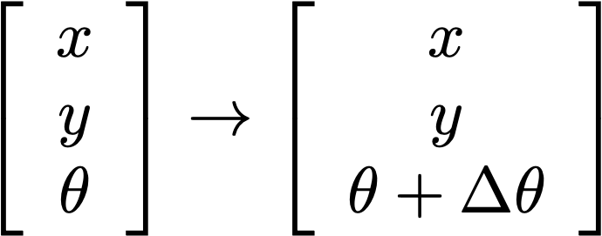
Building a movement model

Slide 9
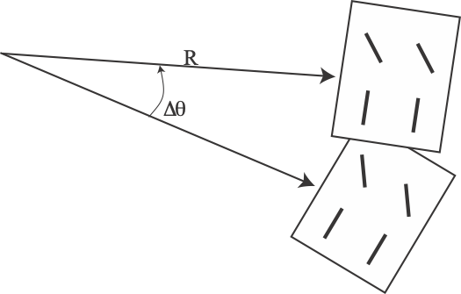
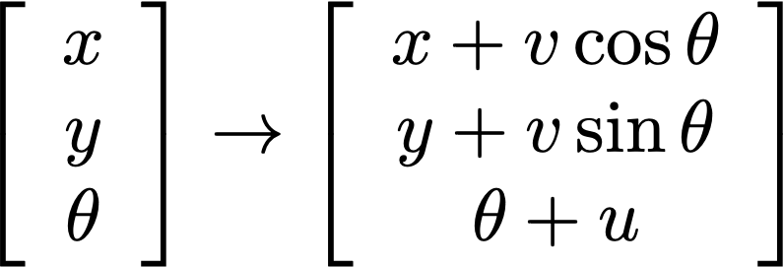
A general movement model
THIS ISN’T LINEAR!
For sufficiently small timestep, bounded rate of change in angle, we get
v, u parameters of motion
THIS ISN’T LINEAR!

Slide 10
The extended Kalman filter
What happens if state update, measurement aren’t linear?
linearize and approximate (EKF)
Noise - normal, mean 0, Cov known

Slide 11
The steps, KF:
Have:
Mean and covariance of posterior
after i-1’th measurement
Construct:
Mean and covariance of predictive
distribution just before i’th measurement
Measurement arrives:
Now construct:
Mean and covariance of posterior
distribution just before i’th measurement
posterior mean is weighted combo
of prior mean and measurement
posterior covar is weighted combo
of prior covar, measurement
matrix and measurement covar

Slide 12
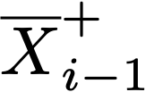
The steps, KF:
Have:
Construct:
Measurement arrives:
Now construct:
Where:

Slide 13
Recall: The Kalman filter
Assumption: state update
and measurement are linear
with normal noise
Difference between
predicted and observed
measurement

Slide 14
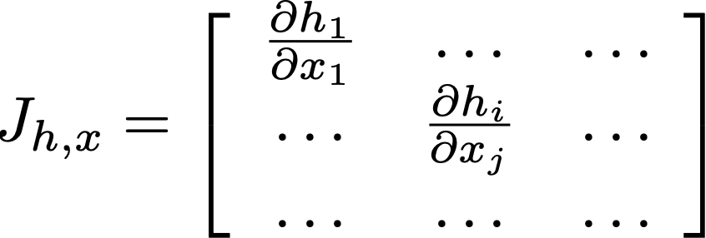
Linearization and noise
Two ways in which noise could affect x_i
x_{i-1} is noisy
AND there is n to account for
Now consider some nonlinear function with noisy input
first case
Approximate
Yields
Jacobian === derivative

Slide 15
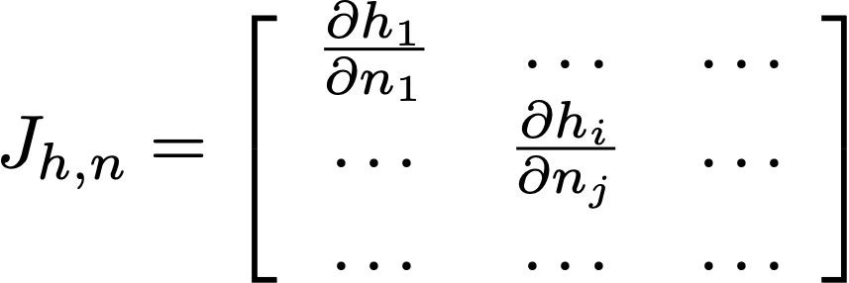
Linearization and noise
Two ways in which noise could affect x_i
x_{i-1} is noisy
AND there is n to account for
Now consider some nonlinear function with fixed input, noise
second case
Approximate
Yields
Jacobian === derivative

Slide 16
The extended Kalman filter
Linearize:
Posterior covariance of x_{i-1}
Noise covariance

Slide 17
The steps, EKF:
Have:
Construct:
Measurement arrives:
Now construct:
Where:

Slide 18
The steps, EKF:
Have:
Construct:
Measurement arrives:
Now construct:
Where:

Slide 19
The extended Kalman filter
Linearize:

Slide 20
Recall: The steps, KF:
Have:
Construct:
Difference between
predicted and observed
measurement
Measurement arrives:
Now construct:
Where:

Slide 21
The steps, EKF:
Have:
Construct:
Difference between
predicted and observed
measurement
Measurement arrives:
Now construct:
Where:

Slide 22
Recall: The steps, KF:
Have:
Construct:
Linear measurement
model
Measurement arrives:
Now construct:
Where:

Slide 23
The steps, EKF:
Have:
Construct:
Measurement arrives:
Now construct:
Where:

Slide 24
Recall: The steps, KF:
Have:
Construct:
Measurement arrives:
Inverse of the covariance of y_i
Now construct:
Linear measurement
model
Where:

Slide 25
The steps, EKF:
Have:
Construct:
Measurement arrives:
Now construct:
Where:

Slide 26
Outcome and issues
In principle, can now filter position/orientation wrt map
linearize dynamics following recipe above
linearize measurements ditto
There could be problems
EKF’s are fine if the linearization is reliable
can be awful if not (examples)
in fact, the map points are uncertain
why not try to make/update map while moving? SLAM, to follow

