Slide 1
The Weather
D.A. Forsyth, UIUC

Slide 2
Key points
Weather effects cause detectors to work poorly
We can collect weathered data
OR unweather using regression procedures
OR we can train on artificially weathered data

Slide 3
How weather affects images

Slide 4
Scattering
Fundamental mechanism of light/matter interactions
Visually important for
slightly translucent materials (skin, milk, marble, etc.)
participating media

Slide 5
Participating media
for example,
smoke,
wet air (mist, fog)
rain
dusty air
air at long scales
Light leaves/enters a ray travelling through space
leaves because it is scattered out
enters because it is scattered in
New visual effects

Slide 6
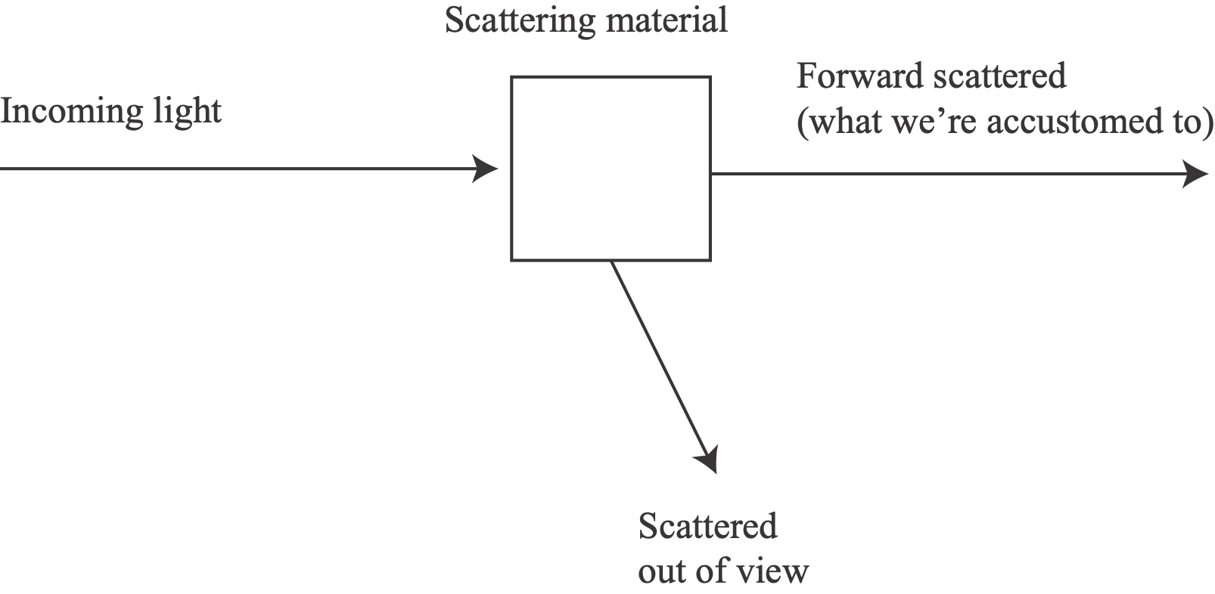
Light hits a small box of material

Slide 7
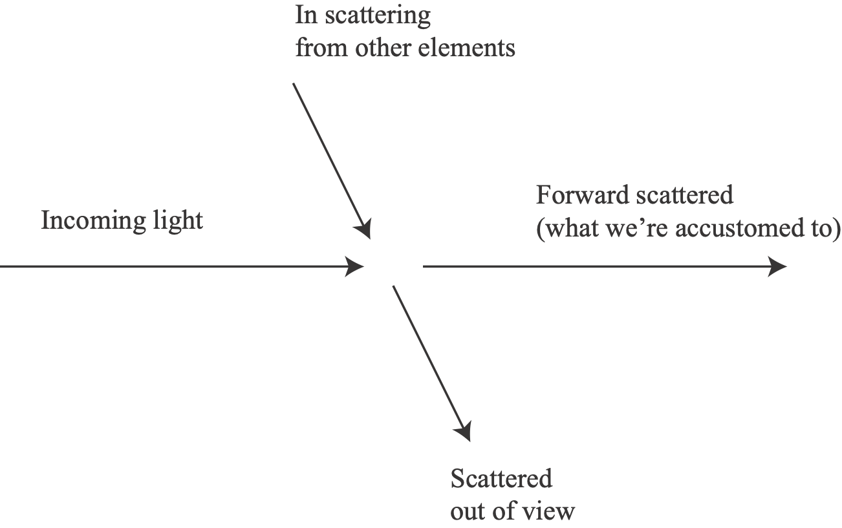
A ray passing through scattering material

Slide 8
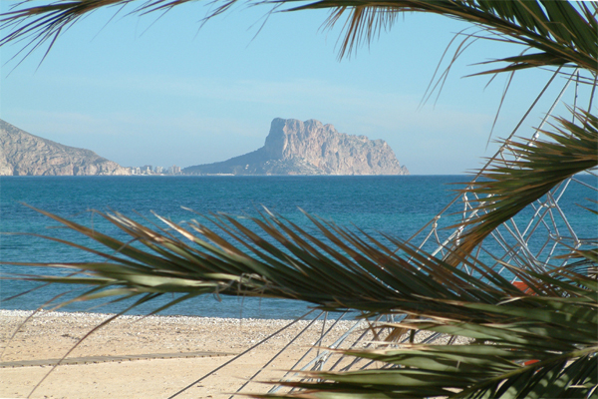
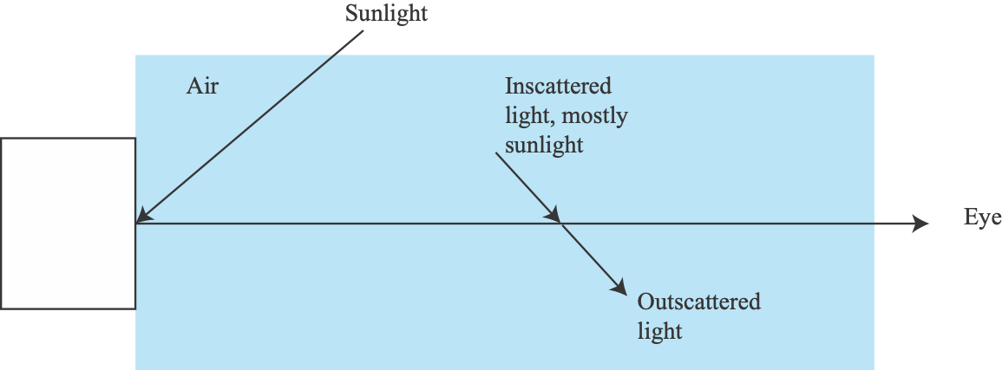
Airlight as a scattering effect

Slide 9
Absorption
Box of material
Eye ray
Eye ray
Want I(0)
(at start of eye ray)
dt
t
Ignore in-scattering
only account for forward scattering
Assume there is a source at t=T
of intensity I(T)
what do we see at t=0?

Slide 10
Cross sectional area of “slab” is E
Contains particles, radius r, density rho
Too few to overlap when projected
% light absorbed = (area of projected particles)/
(area of slab)
This is:
Eye is at 0
Intensity at T

Slide 11
From Lynch and Livingstone, Color and Light in Nature

Slide 13
This sort of thing affects detectors, etc.
Fairly clear (more later)
What to do:
Train detectors on real weather images
hard - collect and mark them up; rich collection of effects
mostly, this won’t work out
Remove weather effects, then apply detector
Q: Remove how?
Simple physics
Regression (next)
Take training images, synthesize weather on top
Q: How?
complicated mixture of physics and advanced regression tricks

Slide 14
Paired data
Collect data on good days, bad days
along the same routes, w/ GPS
use dynamic programming, GPS to compute alignment at the image level
Now label
annotator labels bad image round 1
compares to good image; fixes labelling round 2
Sakaridis et al, 21

Slide 15
Weather and Speculation
0: Why
I: Weather
simple physics of fog;
II: Image regression
images from images, using training data
II: Weather, more
what to do? correct, or train on weather data; either requires simulation
III: Speculation
the idea of image generation; adversaries
fun with styleGAN -II relighting
extreme case: NERFY representations and weather NERF

Slide 16
Fog and airlight

Slide 17
This sort of thing affects detectors, etc.
Fairly clear (more later)
What to do:
Train detectors on real weather images
hard - collect and mark them up; rich collection of effects
mostly, this won’t work out
Remove weather effects, then apply detector
Q: Remove how?
Simple physics
Regression (next)
Take training images, synthesize weather on top
Q: How?
complicated mixture of physics and advanced regression tricks

Slide 18
Removing haze by physical reasoning
Airlight color at p
Image color at p
Consequences
Brightness is a depth cue
Reasoning about airlight color yields dehazed image
Surface radiance color at p
Absorption term, exponential in depth, at p

Slide 19
Airlight yields a depth cue
Assume that airlight is dominant
(i.e. most of light arriving at camera is airlight)
then you can recover depth from a single image
Disadvantages
requires significant fog (but not too much) or large scales

Slide 20
Nayar and Narasimhan, 1999

Slide 21
Model
Airlight color - same at all points
Observed
Shading x albedo
Independent of shading
With work, this yields
neighboring pixels with same albedo yield
constraints on shading and T
assume shading and T independent
estimate A to yield “most independent” shading and T
result: J(p)

Slide 22
Fattal, 08 - note depth map AND dehaze; note also slightly odd colors

Slide 23
Improved estimation by cleaner model
Fattal, 08 - note depth map AND dehaze; note also slightly odd colors

Slide 24
This sort of thing affects detectors, etc.
Fairly clear (more later)
What to do:
Train detectors on real weather images
hard - collect and mark them up; rich collection of effects
mostly, this won’t work out
Remove weather effects, then apply detector
Q: Remove how?
Simple physics
Regression
Take training images, synthesize weather on top
Q: How?
complicated mixture of physics and advanced regression tricks

Slide 25
Image regression
Take an image, predict something “like” an image
Underlying technology is straightforward, significant tricks
Cases
train with real paired data eg (image, foggy version of image)
train with fake paired data eg (image, simulated foggy version of image)
train with unpaired data; important, we’ll ignore
Motivating problems
image -> depth
also, image pair -> optic flow; low res image-> high res image
image -> foggy image; image -> rainy image
Mechanics sketched yesterday

Slide 26
Paired datasets
Obtain pairs (hazy image, clear image)
Real data:
Take photos outdoors; introduce fog; repeat
NH-HAZE
https://data.vision.ee.ethz.ch/cvl/ntire20/nh-haze/
Synthesized data:
Fake fog model on real image
Foggy cityscapes
https://people.ee.ethz.ch/~csakarid/SFSU_synthetic/
Render synthetic images fog/no-fog
RESIDE
https://arxiv.org/pdf/1712.04143.pdf

Slide 27
Cai et al 16 (DeHazeNet)

Slide 28
Single image dehazing
Shen et al 19

Slide 29
Qin et al 19 - Use feature attention

Slide 30
Side topic - Adversarial losses
Issue:
we are making pictures that should have a strong structure
eg - it should be “like” a true image
but we don’t know how to write a loss that imposes that structure
Strategy:
build a classifier that tries to tell the difference between
true examples
examples we made
use that classifier as a loss

Slide 31
A GAN
Generative
Adversarial
Network
Grosse slides

Slide 32
Notice: we want the discriminator to make a 1 for real data, 0 for fake data
Solution (if exists, which is uncertain; and if
can be found, ditto) is known as a saddle point.
It has strong properties, but not much worth
talking about, as we don’t know if it is there or
whether we have found it.
Grosse slides

Slide 33
Thakar slides

Slide 34
Important, general issue
If either generator or discriminator “wins” -> problem
Discriminator “wins”
it may not be able to tell the generator how to fix examples
discriminators classify, rather than supply gradient
Generator “wins”
likely the discriminator is too stupid to be useful
Very little theory to guide on this point

Slide 35
Grosse slides

Slide 36
Grosse slides

Slide 37
One must be careful about losses…
Grosse slides

Slide 38
One must be careful about losses…
Grosse slides

Slide 39
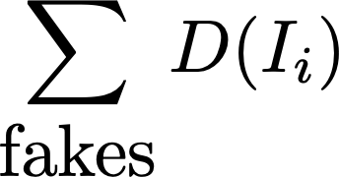
Alternative losses
Hinge:
Discriminator makes D(im)
want
real images -> -1
fake -> 1
Discriminator loss:
where y_i=-1 for real, y_i=1 for fake
Generator loss:

Slide 40
Dong et al 21 - Use an adversarial loss

Slide 41
More complicated weather effects

Slide 42
Light hits a small box of material

Slide 43
A ray passing through scattering material

Slide 44
More interesting…
Cross sectional area of “slab” is E
Contains particles, radius r, density rho
Too few to overlap when projected
Light out = Light in -
Light absorbed+
Light generated
Light generated: C x (area fraction
of proj. particles)
which is
Intensity is “created along the ray”
by (say) airlight
Model - the particles glow with intensity C(x)

Slide 45
Shen et al 20 - Use sequence model (resnet as implicit euler method)

Slide 46
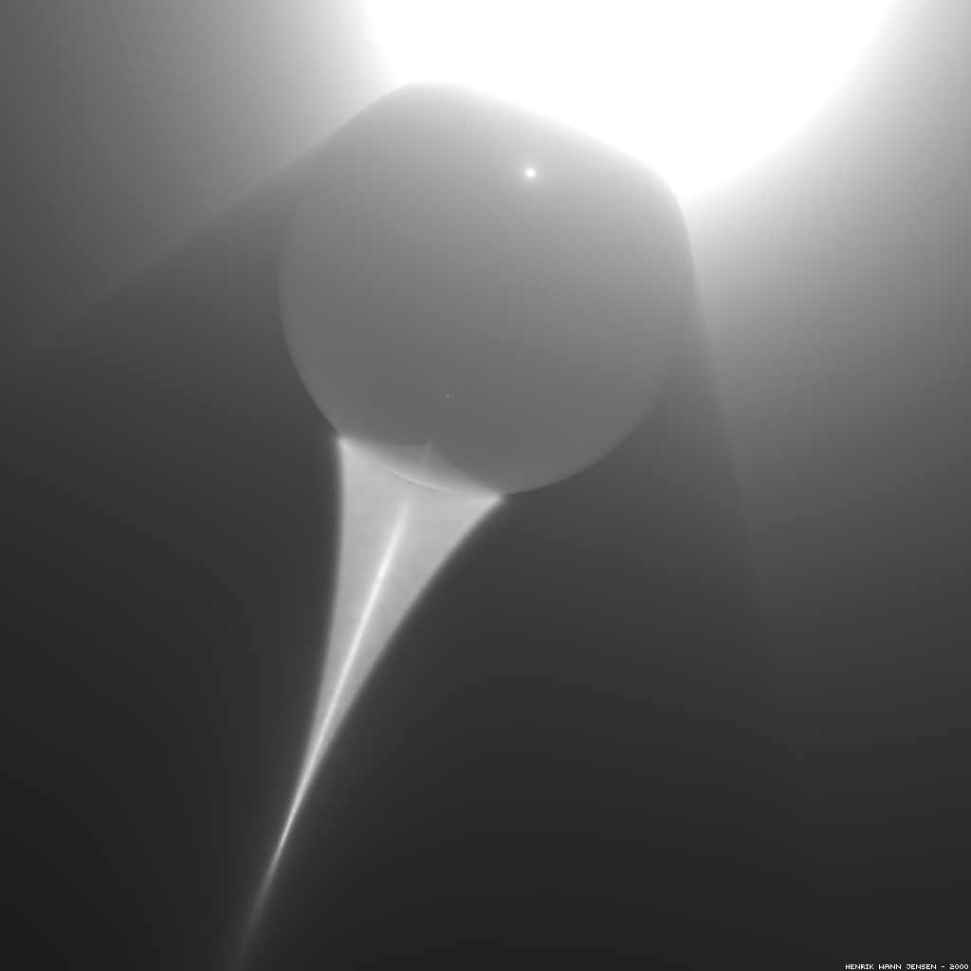

Slide 47
From Lynch and Livingstone, Color and Light in Nature

Slide 48
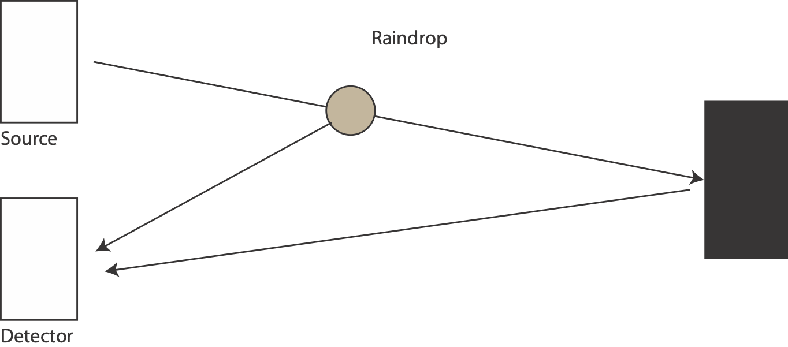
Raindrop scatter

Slide 49
Backscatter
Refraction in drops causes backscatter of headlight light
makes driving in rain at night harder
Neat trick
(Tamburo et al 14)
Do not illuminate raindrops by
having headlights that are highly steerable (multiple micro mirrors)
very fast exposure with usual illumination identifies raindrops
too fast for driver to resolve
now direct light between drops

Slide 50
Tamburo et al 14

Slide 51
Rain has multiple interesting effects
Blur from wet air
Puddles
Color shifts
Streaks
These are often quite strongly coupled to scene geometry

Slide 52
Rain - phenomena
Drops move fast, and so create motion blur (streaks)
Garg and Nayar 07

Slide 53
Rain - phenomena
Shallow free space - individual rain streaks
Deep free space - more bulk, fog-like effects
Hu et al 19

Slide 54
Rain mangles detection

Slide 55
Tremblay et al 20

Slide 56
Simulating rain - issues
Near field:
drops are bright, discrete, likely ballistic motion
how bright?
where?
how moving?
likely air is “wet”
so some fogging, depending on depth
Far field:
fog like effects
So we need to know
depth, environment map, falling drops, camera movement

Slide 57
Simulating rain
Tremblay et al 20

Slide 58
Simulating rain
Trick:
rain causes color effects, specular effects etc.
CycleGAN is good at this, but bad at streaks
Physics based simulation is bad at this but good at streaks
Tremblay et al 20

Slide 59
Tremblay et al 20

Slide 60
Tremblay et al 20

Slide 61
Fog and rain affect LIDAR

Slide 62
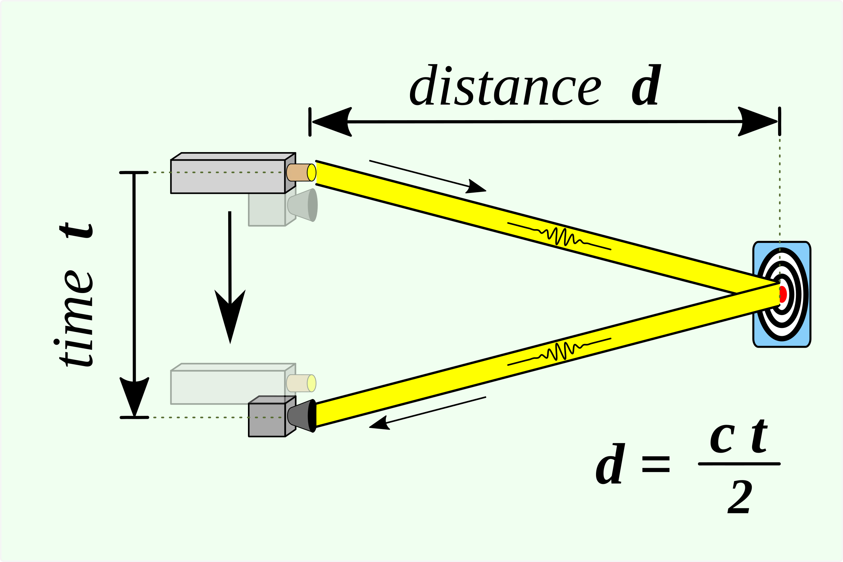
Fog and Lidar: Lidar
About 800-1000 nm
wavelength (longer than red)
Wikipedia

Slide 63
Raindrop scatter

Slide 64
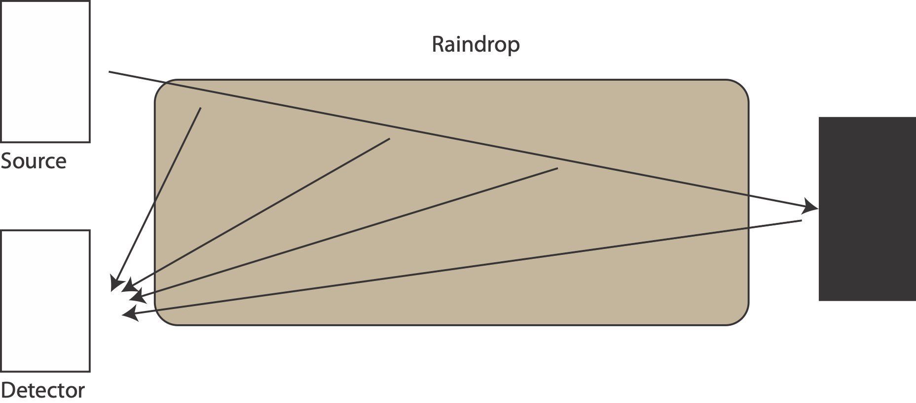
Fog scattering
FOG

Slide 65
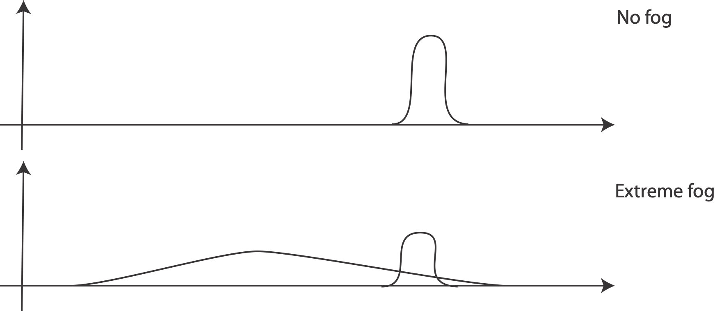
What the sensor sees…

Slide 66
Carballo, 20

Slide 67
Fog
Rain
Very
bright
light
Carballo, 20

Slide 68
Qualitative effects
lost returns
fog torus
early returns
rain pillars
noise
Carballo, 20

Slide 69
Hahner 21

Slide 70
Radar is unaffected
Bansal et al 20

Slide 71
Lighting affects methods, too

Slide 72
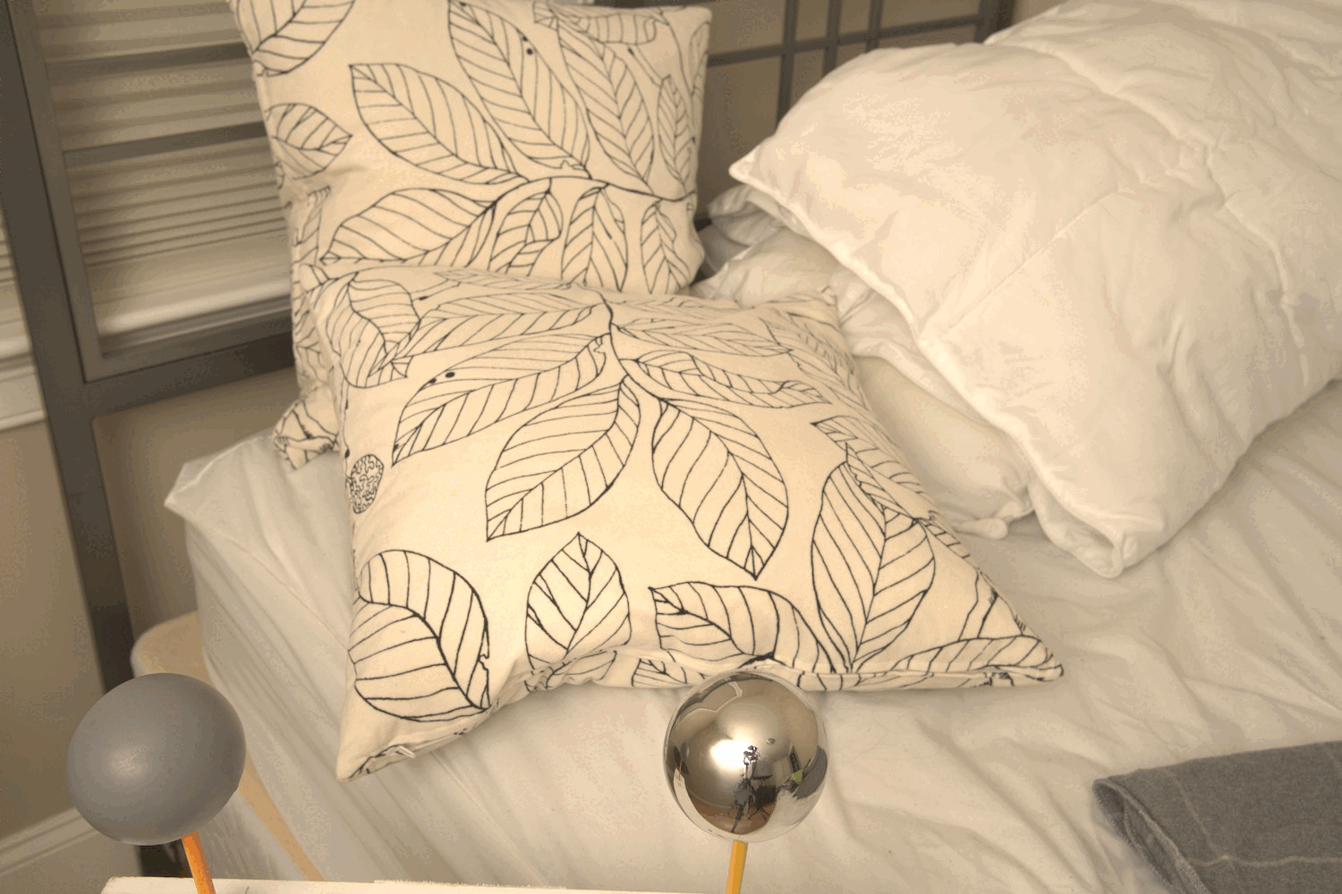
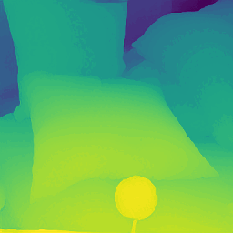
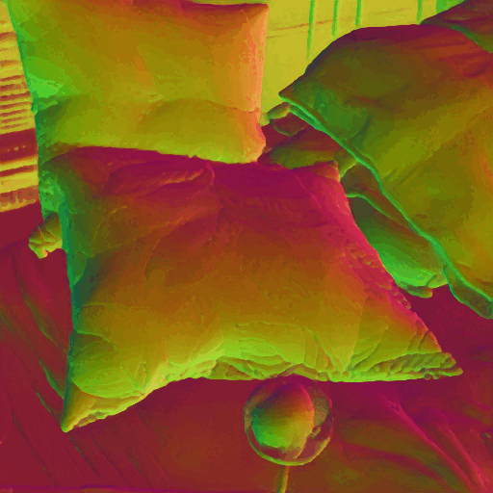
Depth (omnimap, current best depth est)
Normal (omnimap, current best normal est)

Slide 73
What to do?
Maybe:
generate multiple lightings of the same image
analogy with rain
force method to produce same result for each
Q: How to generate multiple lightings of the same image?

Slide 74
Hijacking knowledge
StyleGAN2 is a network that
accepts random vectors
produces very convincing face images (and some others; churches, etc)
is trained by adversarial procedures
This process can be “inverted”
GAN-inversion: given face, what random number made it?
Pretrained models like StyleGAN2 “know” a lot
established literature around the idea that StyleGAN2 outputs are faces
pretty much whatever you do to the input

Slide 75
Relighting synthetic scenes
Significant literature based on “inverse graphics”
Impute: geometry, albedo, luminaires; change luminaires; render
Zhengqin Li thesis, 2022
But this involves CGI,
which we don’t trust and
may not be available
StyleGAN Judo
Search latent space of a generative model to find directions that
change image
don’t change computed albedo
for free, resurfacing
change image
don’t change shading

Slide 76
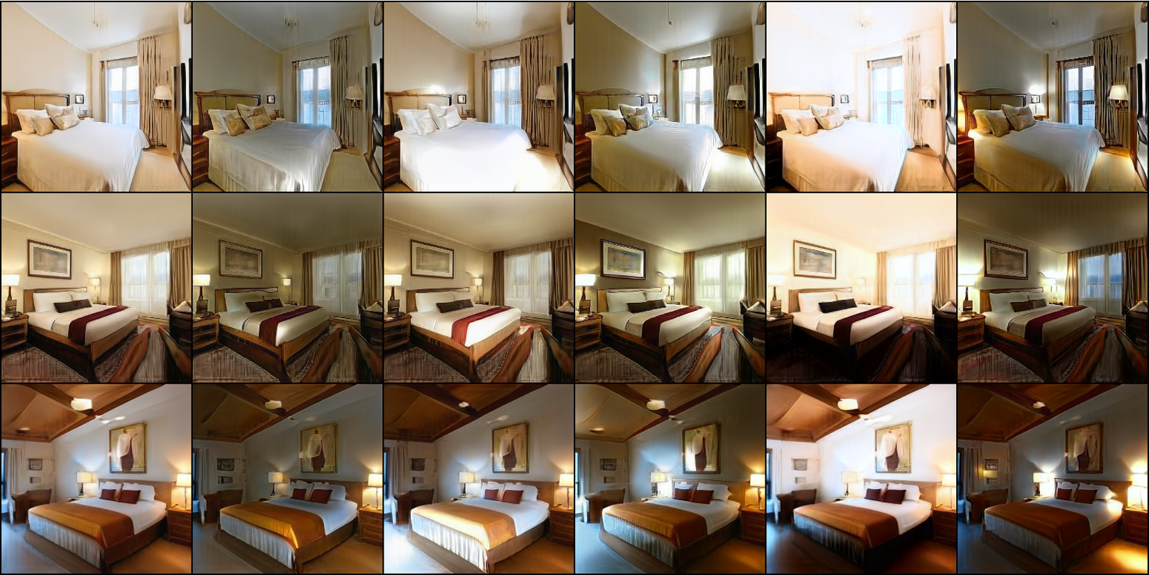
StyLitGAN Relighting

Slide 77
Luminaire aware
Bhattad et al, 23

Slide 78
Luminaire aware
Bhattad et al, 23

Slide 79
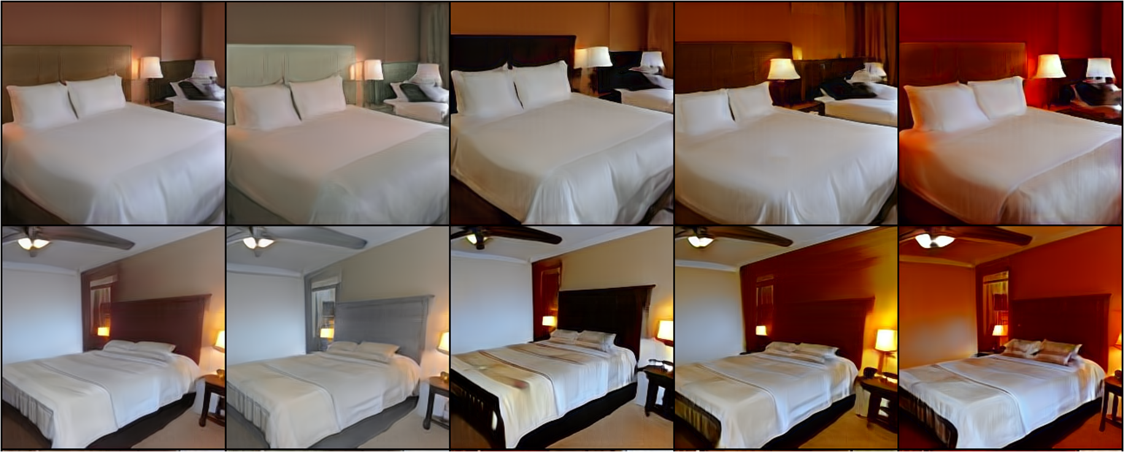
StyLitGAN Resurfacing

Slide 80
Real Images
Problem:
who cares about normals/depth/albedo of generated images?
Idea
apply GAN inversion to real image
then fiddle with lighting
THIS DOESN”T WORK
GAN inversion doesn’t actually get you the image you started with

Slide 81
Current GAN inverters don’t

Slide 82
Make it so - inversion
Bhattad et al, 23

Slide 83
Bhattad et al, 23

Slide 84
Bhattad et al, 23

Slide 85
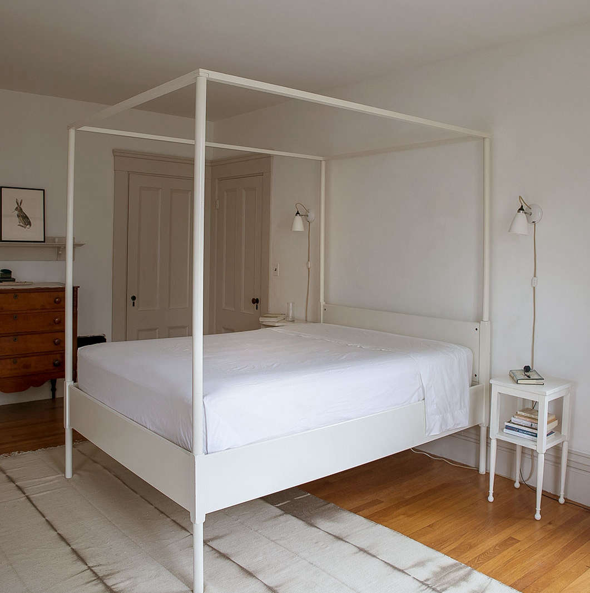
Image
Bhattad et al, 23

Slide 86
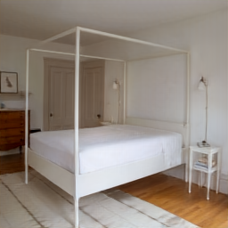
Invert
Bhattad et al, 23

Slide 87
Relights
Bhattad et al, 23

Slide 88
Key points
Weather effects cause detectors to work poorly
We can collect weathered data
OR unweather using regression procedures
OR we can train on artificially weathered data

