Slide 1
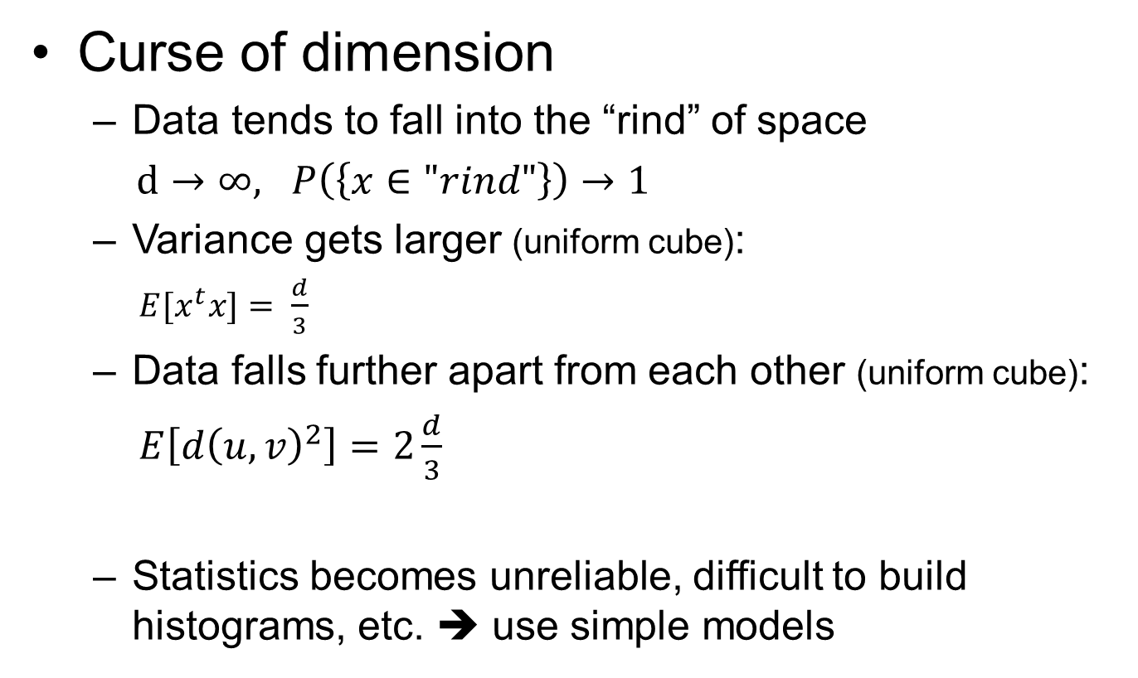
Recap
Curse of dimension
  Data tends to fall into the “rind” of space
  $d→∞, P\left(\left\{x∈"rind"\right\}\right)→1$
  Variance gets larger (uniform cube):
  $E[x^{t}x]= \frac{d}{3}$
  Data falls further apart from each other (uniform cube):
  $E\left[d{\left(u,v\right)}^{2}\right]=2\frac{d}{3}$
  Statistics becomes unreliable, difficult to build histograms, etc. ➔ use simple models
Notes:
Last lecture David talked about as we get to higher dimension, things get trickier, this phenomenon is called the curse of dimension. While it’s hard to imagine how would things get tricky, here are a few important facts that help to understand.
First, data tends to fall into the outer layer of the space, we showed that as dimension approaches to infinity, almost all the data will lie in the rind of the space.
The second fact is that variance gets higher, or it means data falls far from the mean. This formula was derived for a cube, the variance grows linearly with dimension.
And also, data falls further apart from each other, the expected distance is twice as large as the variance, and also grows linearly.
The linearly growing variance makes statistics of high dimensional data very unreliable; it is also difficult to build histograms because the number of bins grows exponentially and most of them will be empty. Because of these difficulties, a rule of thumb is to use simple models instead.

Slide 2

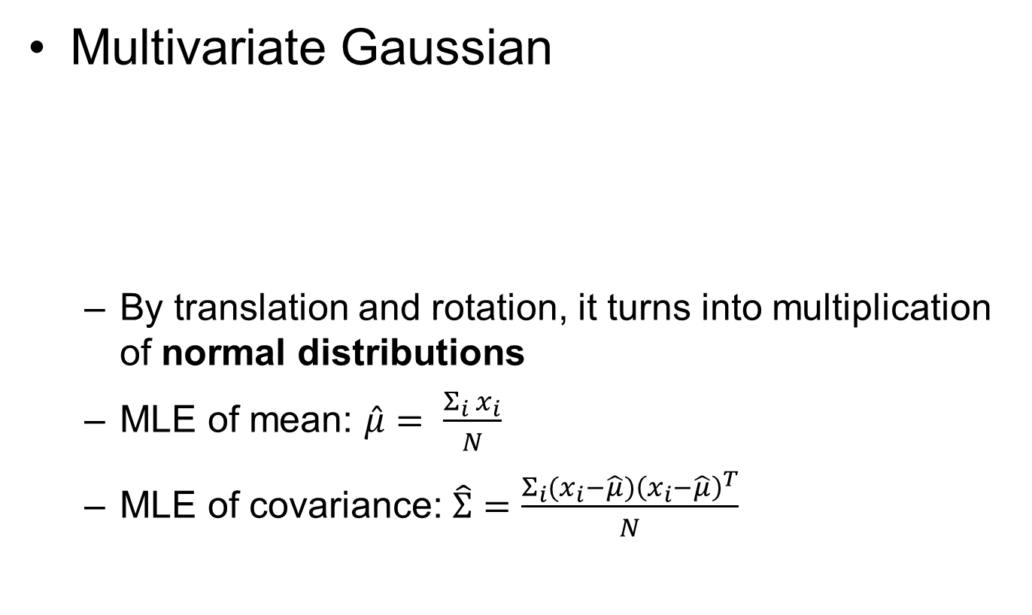
Recap
Multivariate Gaussian
  By translation and rotation, it turns into multiplication of normal distributions
  MLE of mean: $\hat{μ}= \frac{Σ_{i}{ x}_{i}}{N}$
  MLE of covariance: $\hat{Σ}=\frac{Σ_{i}{(x_{i}−\hat{μ})\left(x_{i}−\hat{μ}\right)}^{T}}{N}$
Notes:
One of the simplest model for high dimensional data is Multivariate Gaussian. The formula looks a bit scary but it’s just an extension of normal distribution to higher dimension. In fact we showed by translation and rotation, the above formula becomes multiplication of normal distribution. This is a very neat property, meaning that by choosing the coordinate system properly, we can model high dimensional data by looking at each dimension separately!
The model has two parameters, mean and covariance. Now suppose we’ve got a high dimensional dataset and we want to build a multivariate Gaussian model for it. How do we estimate model parameters \mu and \Sigma? MLE.

Slide 3
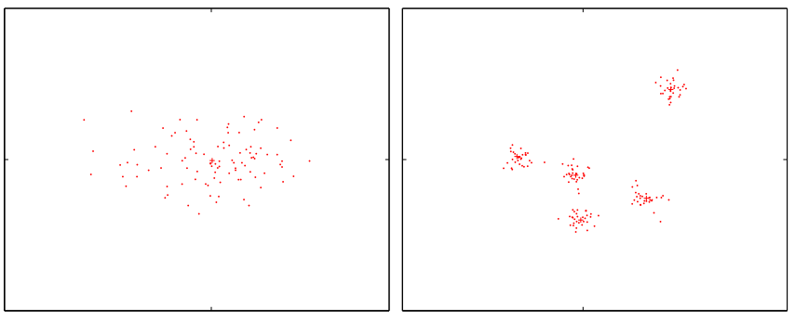
Be cautious..
Data may not be in one blob, need to separate data into groups
Clustering
Notes:
But we need to be cautious on this. When we do the MLE we are assuming the dataset is in a single blob; but if it is not, like the one in the right figure, we would want to build a Gaussian model for each data blob.
This requires us to separate the dataset into different groups and process each individually. The process of separating a dataset into different groups is called clustering.

Slide 4

CS 498 Probability & Statistics
Clustering methods
Zicheng Liao
Notes:
So today’s we are going to talk about clustering. Clustering is a very important topic and it’s a huge topic that could take a whole semester. Today we are only going to touch a small part of it, but the most important part. The content is also going to be much easier than previous lectures.

Slide 5
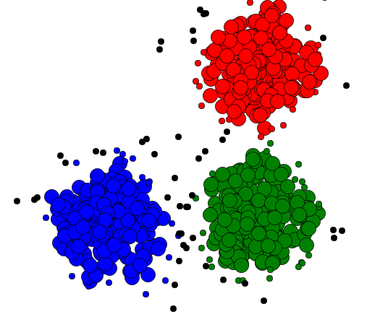
What is clustering?
“Grouping”
  A fundamental part in signal processing
“Unsupervised classification”
Assign the same label to data points that are close to each other
Why?
Notes:
In layman’s language it’s just grouping. It’s one of the fundamental part of signal processing and we do it every moment. E.g., when you see a scene, your brain first group similar parts of a scene together. From the segmented regions your brain can further recognize higher-level objects and their spatial relationship. But all of these happen so quickly that you don’t realize it’s ever happening.
In machine learning, clustering is also called unsupervised classification, in contrary to supervised classification. In supervised classification, we have labeled data to train a model; In clustering, there is no labeled data for supervision. We try to predict labels of data based on their internal structure. In principle, we assign the same label to data points that are close to each other.
Before we move onto the algorithm part, it’s important to understand why.. why do we care about clustering, and ultimately, why does it ever exist in data.

Slide 6
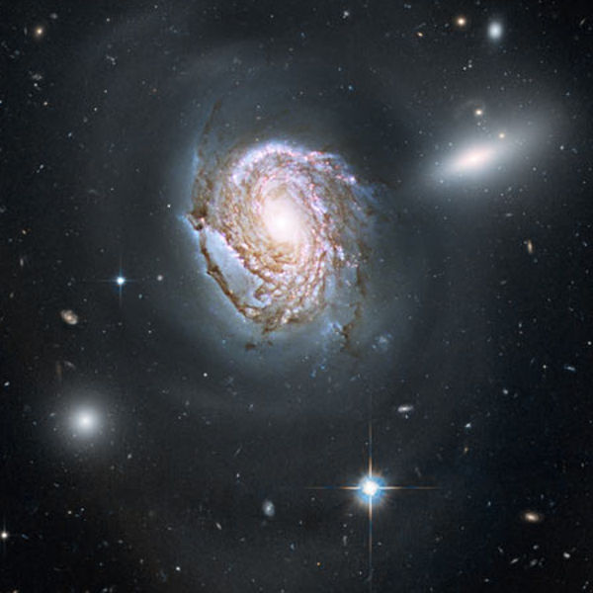

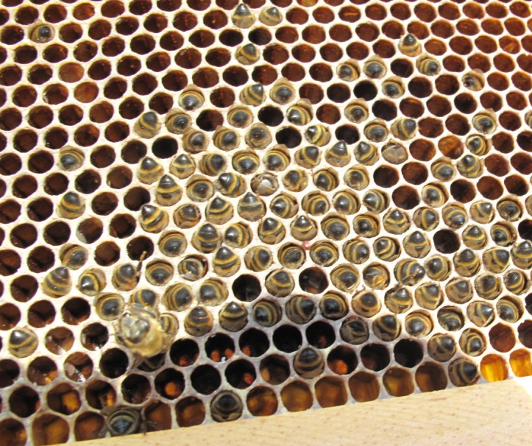

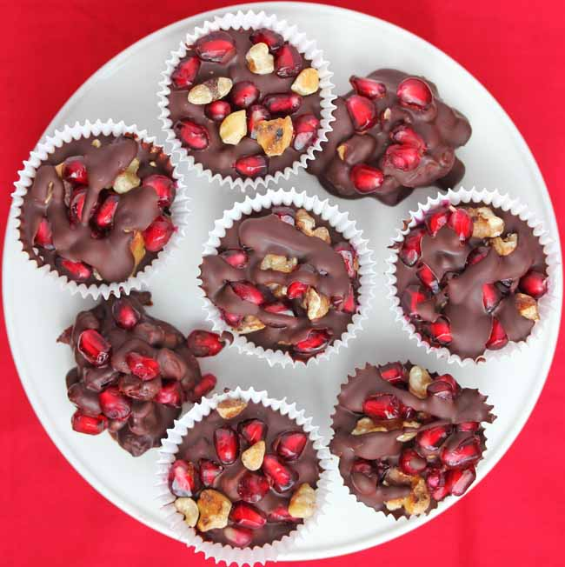

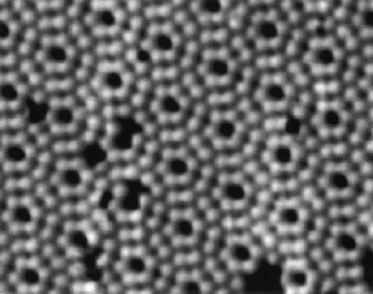
We live in a universe full of clusters
Notes:
I think it relates to the very fundamental property about the universe we live.
It’s a universe full of clusters, from the splendid form of galaxy systems to the layout of atoms; in the middle we see thousands of people are coordinated to form a giant figure of a lady.
What a wonderful world, don’t take it for granted.
Because the world is not a chaos, the data we receive will contain all sorts of clusters. All we need to do is to discover them and then try to make sense out of it.

Slide 7
Two (types of) clustering methods
Agglomerative/Divisive clustering
K-means
Notes:
Today, we introduce two clustering methods: agglomerative/divisive clustering, and K-means.

Slide 8
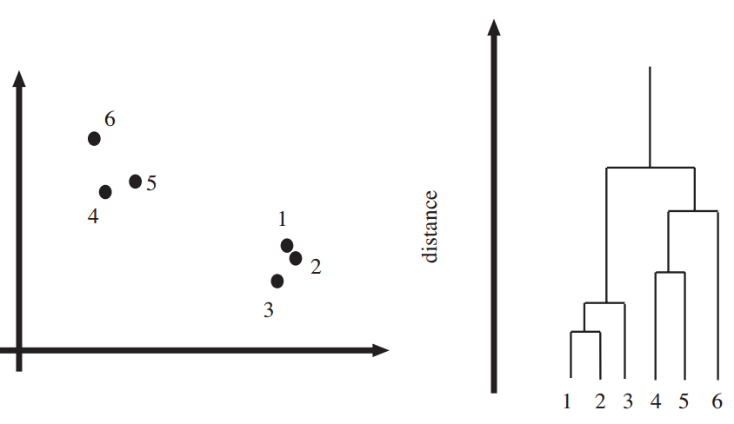
Agglomerative/Divisive clustering
Agglomerative
clustering
Divisive clustering
Hierarchical
cluster tree
(Bottom up)
(Top down)
Notes:
Agglomerative and divisive clustering are a pair of two closely related method that both produce a hierarchical clustering structure that we call hierarchical cluster tree.
The difference is that agglomerative clustering builds the tree in a bottom-up manner; divisive clustering take the opposite direction, it builds the tree in a top-down manner.

Slide 9
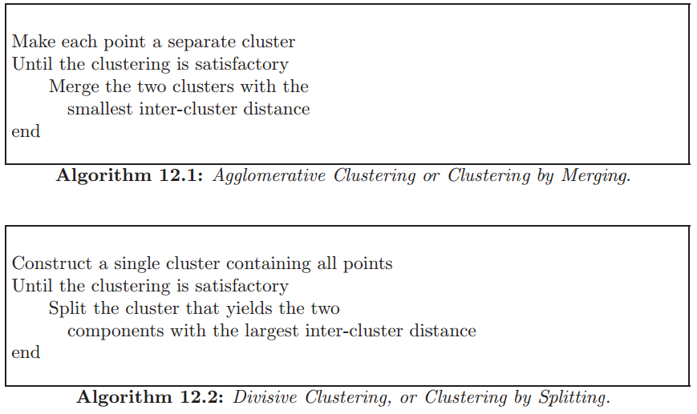
Algorithm
Notes:
These looks like very simple algorithms, but such bottom-up and top-down procedure are very powerful in constructing a hierarchical structure.

Slide 10
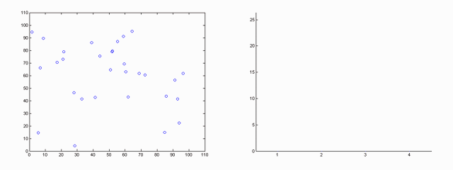
Agglomerative clustering: an example
“merge clusters bottom up to form a hierarchical cluster tree”
Animation from Georg Berber
www.mit.edu/~georg/papers/lecture6.ppt

Slide 11

Dendrogram
Distance
$$d(1,2)$$
>> X = rand(6, 2); %create 6 points on a plane
>> Z = linkage(X); %Z encodes a tree of hierarchical clusters
>> dendrogram(Z); %visualize Z as a dendrograph
Notes:
Let’s take the simple graph for example. Each upside down U-shape indicates a merge of two nodes, the height of the horizontal line shows the distance of the two nodes being merged. Clusters with smaller distance are merged first, so from the graph we can see that 1 and 2 are first merged, then 3 is merged into the cluster of 1 and 2, ..

Slide 12
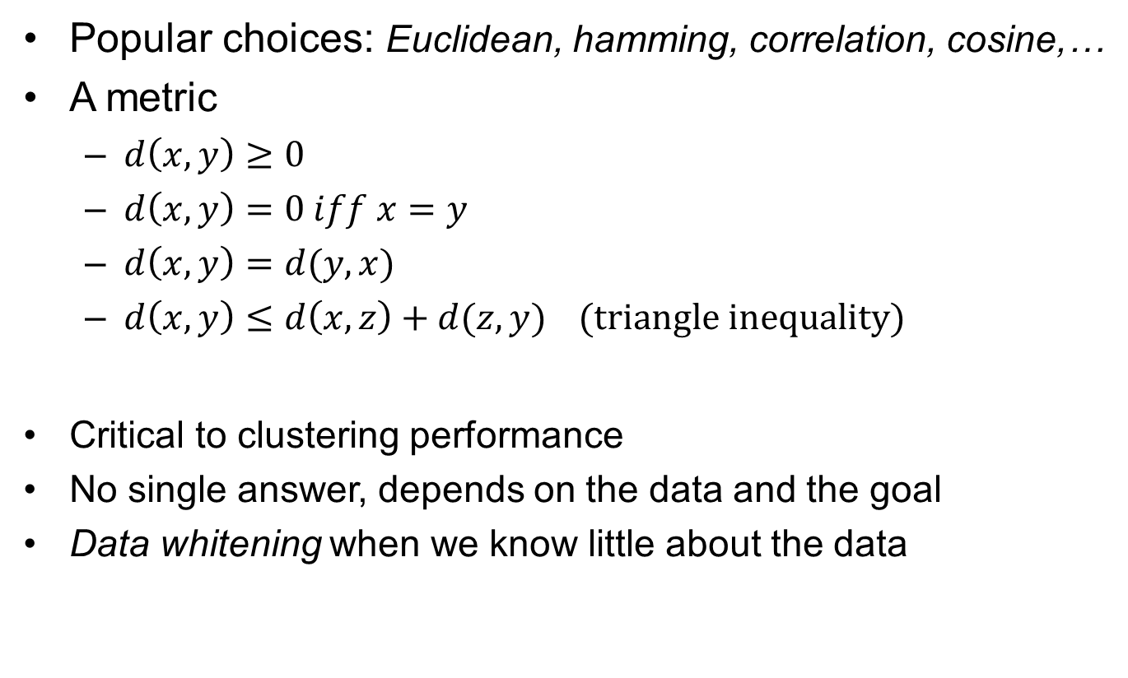
Distance measure
Popular choices: Euclidean, hamming, correlation, cosine,…
A metric
  $d\left(x,y\right)≥0$
  $d\left(x,y\right)=0 iff x=y$
  $d\left(x,y\right)=d(y,x)$
  $d\left(x,y\right)≤d\left(x,z\right)+d(z,y)$ (triangle inequality)
Critical to clustering performance
No single answer, depends on the data and the goal
Data whitening when we know little about the data
Notes:
To perform this algorithm, One thing we need to think of is how do we define distance between two points.
In mathematics, a distance measure has to be a metric, which has the following requirement:
In practice, the choice of distance measure is critical. However, there is no single answer to which one should we choose—it all depends on the data and the goal—we always want to choose the distance measure that matches the goal.
If we know much about the data, the choice of distance would be easier, otherwise, it’s good practice to do data whitening as a preprocessing to the data.

Slide 13
Inter-cluster distance
Treat each data point as a single cluster
Only need to define inter-cluster distance
  Distance between one set of points and another set of points
3 popular inter-cluster distances
  Single-link
  Complete-link
  Averaged-link

Slide 14
Single-link
Minimum of all pairwise distances between points from two clusters
Tend to produce long, loose clusters

Slide 15
Complete-link
Maximum of all pairwise distances between points from two clusters
Tend to produce tight clusters

Slide 16
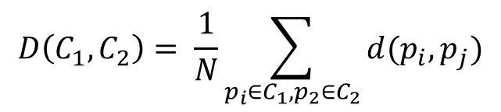
Averaged-link
Average of all pairwise distances between points from two clusters
$$D\left(C_{1},C_{2}\right)= \frac{1}{N}\sum_{p_{i}∈C_{1},p_{2}∈C_{2}}{d(p_{i},p_{j})}$$

Slide 17

How many clusters are there?
Intrinsically hard to know
The dendrogram gives insights to it
Choose a threshold to split the dendrogram into clusters
Distance
$$threshold$$

Slide 18
An example
do_agglomerative.m

Slide 19
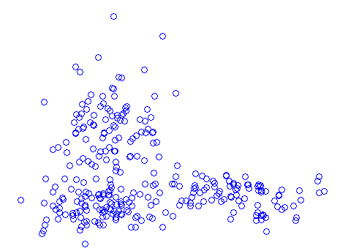
Divisive clustering
“recursively split a cluster into smaller clusters”
It’s hard to choose where to split: combinatorial problem
Can be easier when data has a special structure (pixel grid)
Notes:
Now let’s look at divisive clustering.
Philosophically this is just the opposite of agglomerative clustering, but in practice it’s hard to operate. The difficulty is that it’s hard to choose where to split a cluster into two: it’s a combinatorial problem and NP hard.

Slide 20
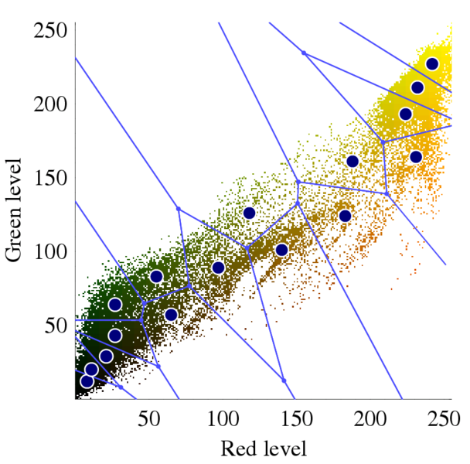
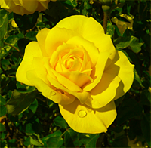
K-means
Partition data into clusters such that:
  Clusters are tight (distance to cluster center is small)
  Every data point is closer to its own cluster center than to all other cluster centers (Voronoi diagram)
[figures excerpted from Wikipedia]
Notes:
Last lecture we talked about clustering. We first talked about the agglomerative/divisive cluster methods, and then Kmeans. Let’s pick up from Kmeans. Kmeans is a widely used clustering method. It partitions data into clusters such that
1. clusters are tight
2. Every data point is closer to …

Slide 21

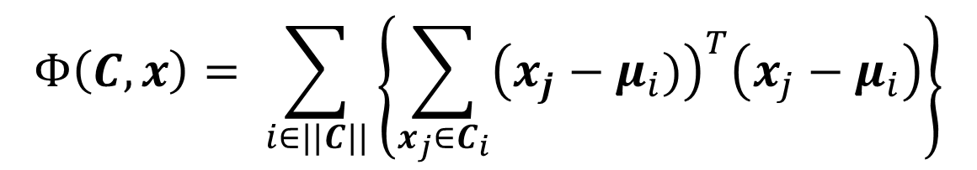
Formulation
Find K clusters that minimize:
Two parameters: $\{label, cluster center\}$
NP-hard for global optimal solution
Iterative procedure (local minimum)
Cluster center
$$Φ\left(C,x\right)= \sum_{i∈||C||}{\left\{\sum_{x_{j}∈C_{i}}{{\left(x_{j}−μ_{i})\right)}^{T}\left(x_{j}−μ_{i}\right)}\right\}}$$
Notes:
The problem is formulated as minimizing this energy function with two parameters: labels and cluster center. We showed that it’s difficult to optimize these two parameters together and find global optimal solution. Instead, we use an iterative procedure.

Slide 22
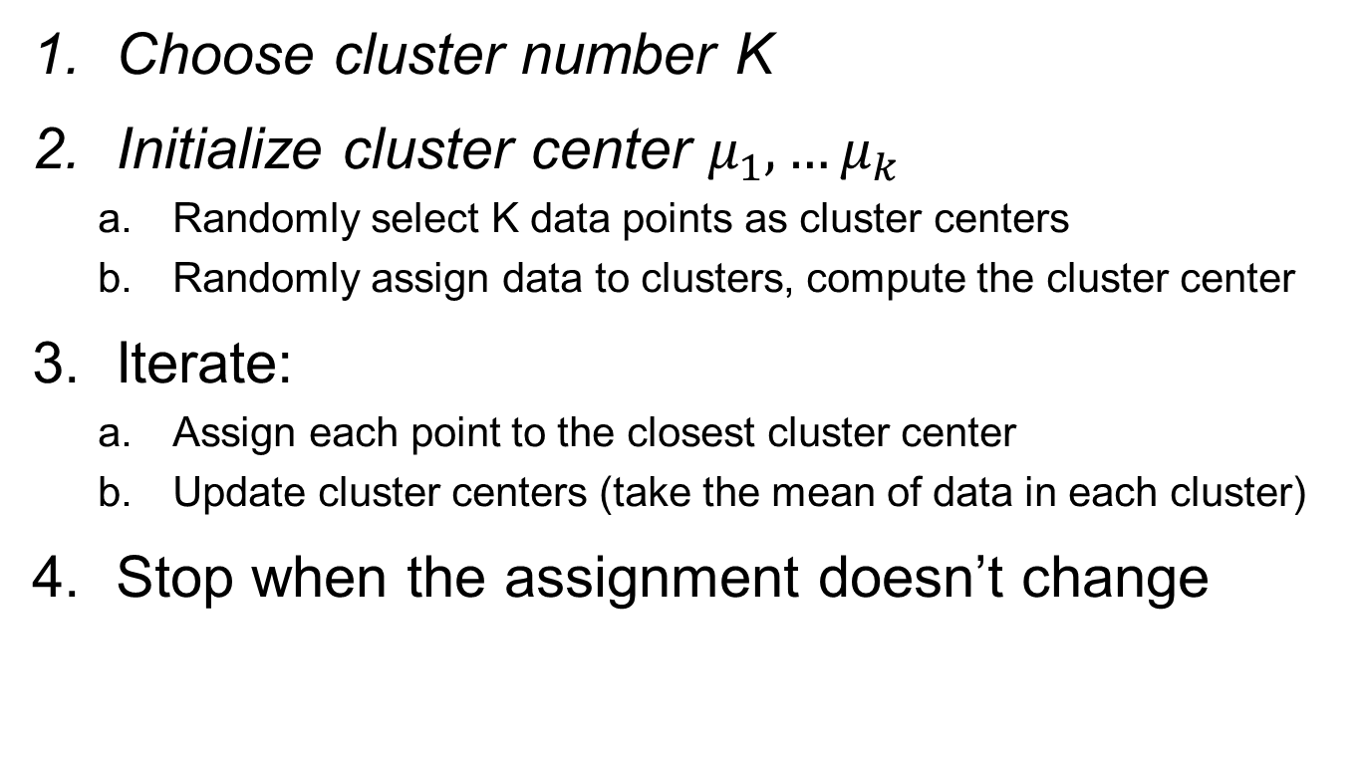
K-means algorithm
Choose cluster number K
Initialize cluster center $μ_{1},…μ_{k}$
  Randomly select K data points as cluster centers
  Randomly assign data to clusters, compute the cluster center
Iterate:
  Assign each point to the closest cluster center
  Update cluster centers (take the mean of data in each cluster)
Stop when the assignment doesn’t change
Notes:
The iterative procedure works as follows: choose a cluster number K;
Randomly initialize k cluster center;
Then we enter the iteration: in each iteration we first assign each point to the closest cluster center; given the assignment of data to cluster, we then update the cluster center by taking the mean of data points in each cluster.

Slide 23
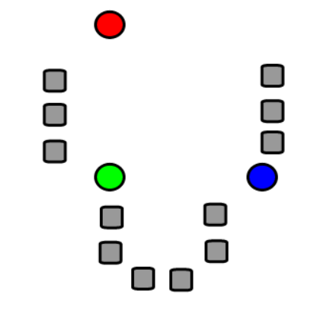
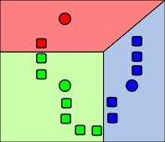
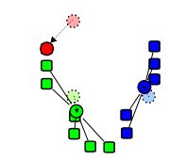
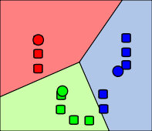
Illustration
Randomly initialize 3
cluster centers (circles)
Assign each point to the
closest cluster center
Update cluster center
Re-iterate step2
[figures excerpted from Wikipedia]
Notes:
Here is a graphical illustration: First we pick up 3 locations as the cluster centers. Step 2 and 3 are one iteration: we first assign data points to the closest cluster centers, and then update cluster center. This is where we stopped in last lecture. Any questions before we proceed?

Slide 24
Example
do_Kmeans.m
(show step-by-step updates and effects of cluster number)

Slide 25
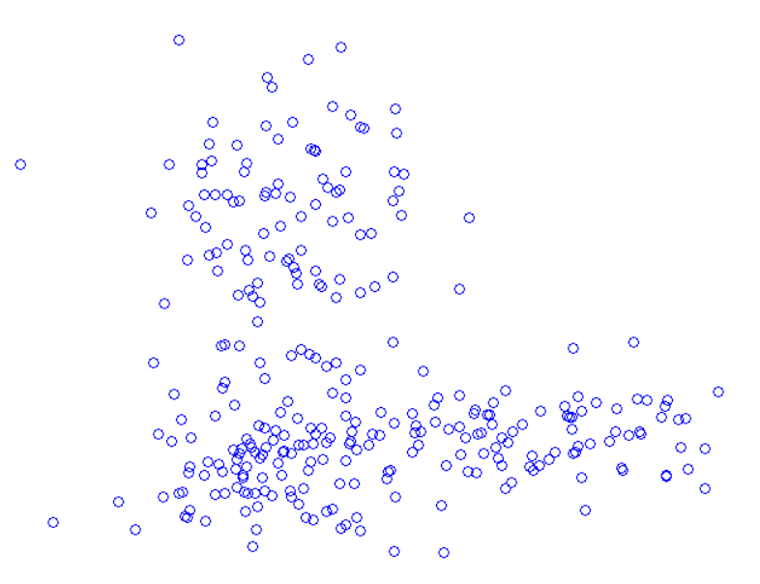

Discussion
How to choose cluster number $K$?
  No exact answer, guess from data (with visualization)
  Define a cluster quality measure $Q(K)$ then optimize $K$
K = 2?
K = 3?
K = 5?

Slide 26
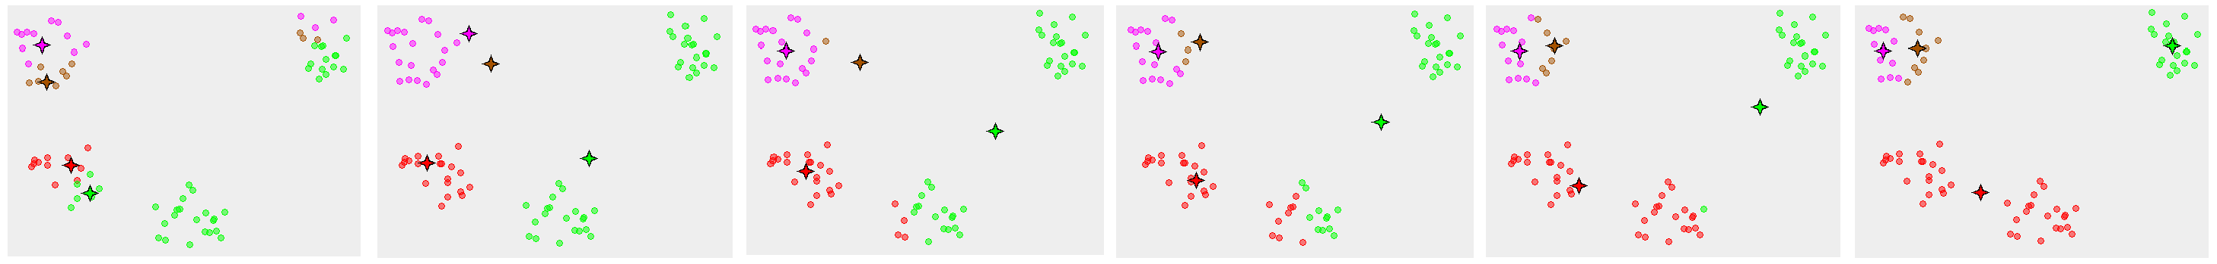
Discussion
Converge to local minimum => counterintuitive clustering
1
2
3
4
5
6
[figures excerpted from Wikipedia]
Notes:
Another fact is that Kmeans only converges to a local minimum, with different initialization, it may produce different clustering results. Sometimes the result can be rather bad. Here is an example. If we look into it and try to figure out this happened. Two reasons can be found: first very obviously the initialization is very unusual: the four cluster centers are initialized within only two of the clusters. Another reason, which is more fundamental to the problem, is that the clusters are far apart from it: this make the optimization more sensitive to initialization and prone to local minimum.

Slide 27
Discussion
Favors spherical clusters;
Poor results for long/loose/stretched clusters
Input data(color indicates true labels)
K-means results
Notes:
Another thing to notice is that Kmeans’s distance metric favors spherical

Slide 28
Discussion
Cost is guaranteed to decrease in every step
  Assign a point to the closest cluster center minimizes the cost for current cluster center configuration
  Choose the mean of each cluster as new cluster center minimizes the squared distance for current clustering configuration
Finish in polynomial time

Slide 29
Summary
Clustering as grouping “similar” data together
A world full of clusters/patterns
Two algorithms
  Agglomerative/divisive clustering: hierarchical clustering tree
  K-means: vector quantization
Notes:
So far we’ve finished the clustering chapter: we talked about clustering as…
We then emphasized the reason that clustering is important and ever possible, is because we are so lucky living in a world full of clusters and patterns. All we need to do is to find out the clusters; And doing so is always of interest. Last we talked about two algorithms:
Any questions before we proceed?

Slide 30
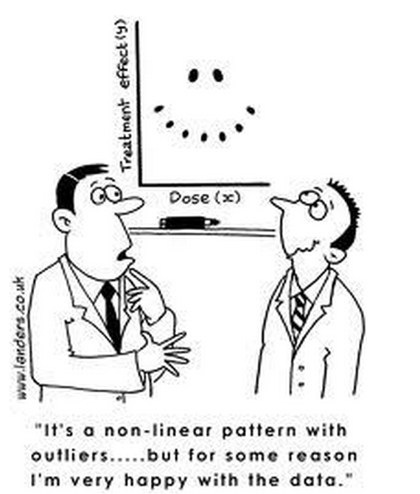
CS 498 Probability & Statistics
Regression
Zicheng Liao
Notes:
Now we are entering a new chapter called regression. This is another very exciting topic.
Regression is to find a model that fits your data, or in other words, explain your data with a model, preferably a simple model. It’s a very basic tool of data analysis and frequently used in scientific research and as you can imagine, in commercials. For example, there is an emerging industry called quantitative analysis, in which a major part of their work is to …

Slide 31
Example-I
Predict stock price
Stock price
t+1
time
Notes:
To predict stock price. Suppose we have historical data of a stock’s price and we want to predict what’s the most likely price next. In this example, one could use a line to fit the data and predict the price to go up. Or one might fit the data with a 2nd order polynomial and predict the price to go down.
Two things you might observe in this example: A, the model never perfectly fit the data; B, different models can lead to quite different predictions.

Slide 32
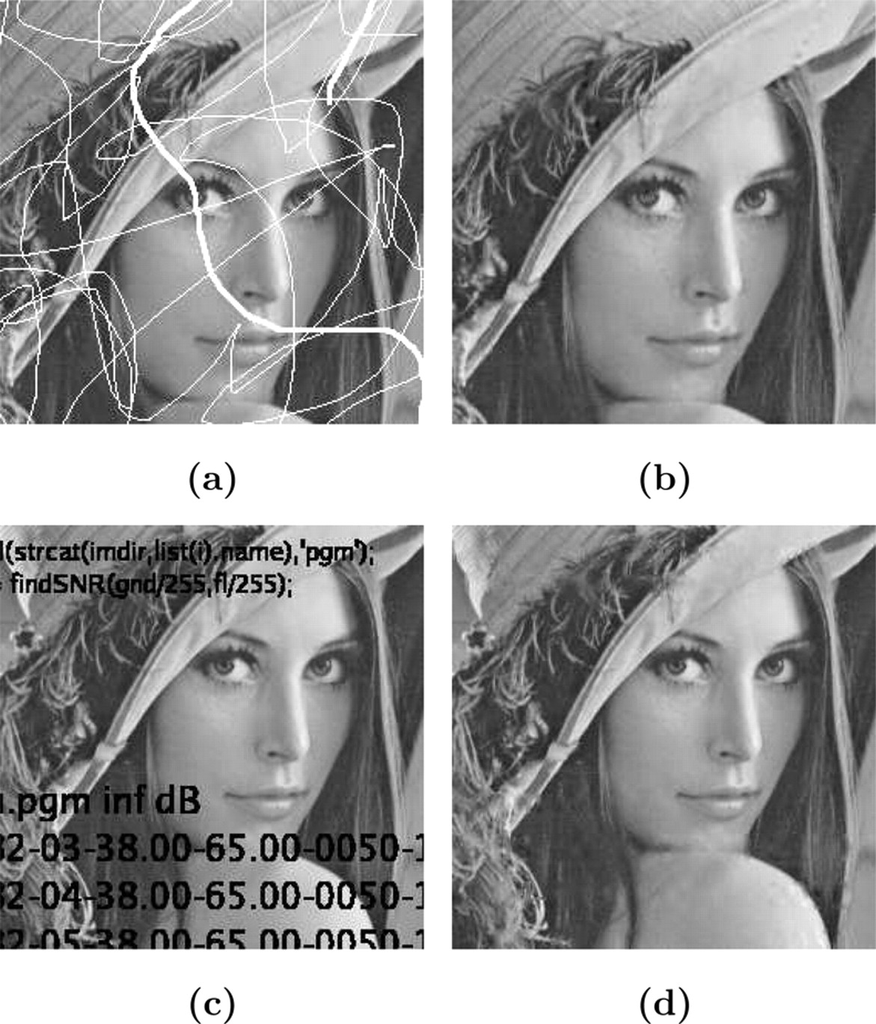
Example-II
Fill in missing pixels in an image: inpainting
Notes:
Another example is to fill in missing data in images, which is also called inpainting. A very typical example is to restore old photos corrupted by scratches or text. Because the missing regions are thin strips, one can fairly robustly fill in the missing values by looking at nearby pixels.

Slide 33
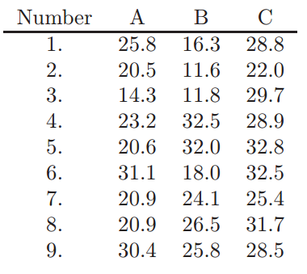
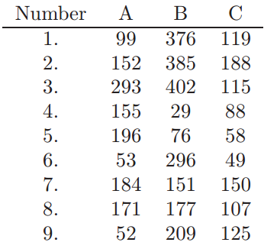
Example-III
Discover relationship in data
Amount of hormones by devices from 3 production lots
Time in service for devices
from 3 production lots
Notes:
Yet another example is to discover relationship hidden in data. Here is an example in the text book. A company produces a medical device that sits inside human body and releases Hormones. There are three production lots A, B, and C that make the device. On the left is a table displaying the amount of hormones by …; on the right is a table display the corresponding time in service for the devices. The numbering 1 – 9 in both tables do not have any particular meaning.
Now we want to find out is there any pattern in the data. If so, what is it?

Slide 34
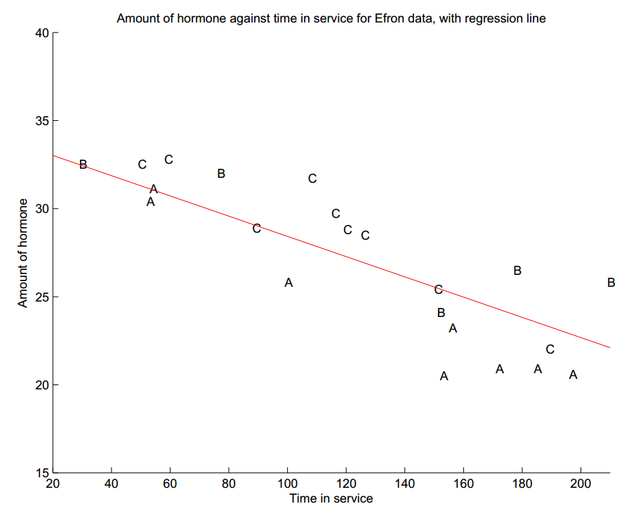
Example-III
Discovery relationship in data
Notes:
Now if we plot the data out, it is fairly clear that as time in service goes up, amount of hormones consistently goes down.
A simple model to explain this trend is a line. Intuitively, we want to find a line to pass through the data points and be close to them as much as possible, as the red line in the figure. This is called linear regression.

Slide 35
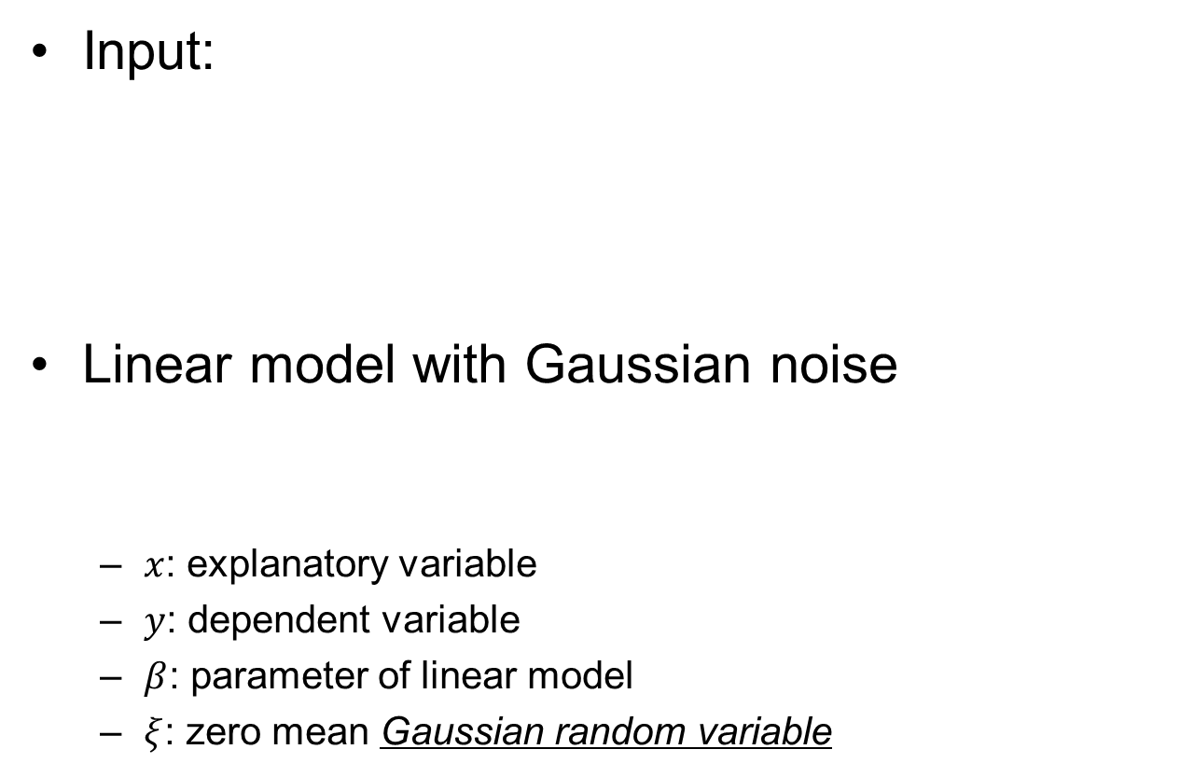
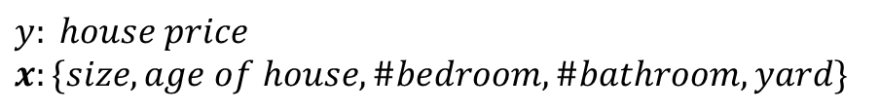



Linear regression
Input:
Linear model with Gaussian noise
  $x$: explanatory variable
  $y$: dependent variable
  $β$: parameter of linear model
  $ξ$: zero mean Gaussian random variable
$$\{\left(x_{1},y_{1}\right),\left(x_{2},y_{2}\right),…\left(x_{M},y_{M}\right)\}$$
$$y: house price$$
$$x:\{size, age of house, \#bedroom, \#bathroom, yard\}$$
$$y=x^{T}β+ξ$$
$$x^{T}=\left(x_{1},x_{2},…x_{N},1\right)$$
Notes:
The problem of linear regression is to take a set of points and estimate a line. The input data is in the format of x-y pairs: x is a feature vector, and y is a number. For example, y could be house price and x could be a vector of features including size, …
The linear model assumes that the value of y can be expressed as a linear combination of the feature vector x. x is called the explanatory variable, y is the dependent variable, \beta is the parameter of the linear model.
Because x and y are measurements of physical things, it must come with noise, \xi is here to take account all sorts of error that could have occurred in measurement. It is modeled by a zero-mean normal distribution, meaning that y is unlikely to deviate too much from the line. One question here: why do we model \xi by a normal distribution? A lot of random effects add up to a normal distribution.
Questions!!

Slide 36




Parameter estimation
MLE of linear model with Gaussian noise
$$maximize:$$
$P\left({\left\{\left(x_{i},y_{i}\right)\right\}}^{M} | β\right)$
$$=\prod_{i=1}^{M}{g(y_{i}−{x_{i}^{}}^{T}β;0, σ)}$$
$$=\frac{1}{const}exp⁡\{−\frac{\sum_{i=1}^{M}{{\left(y_{i}−{x_{i}^{}}^{T}β\right)}^{2}}}{2σ}\}$$
Likelihood function
$$\sum_{i=1}^{M}{{\left(y_{i}−{x_{i}^{}}^{T}β\right)}^{2}}$$
➔
$$minimize:$$
[Least squares, Carl F. Gauss, 1809]
Notes:
So now we have a set of data points, a linear model with Gaussian noise that explains the data. How do we estimate the parameter \beta of the model?
Likelihood function P(X|\beta)

Slide 37


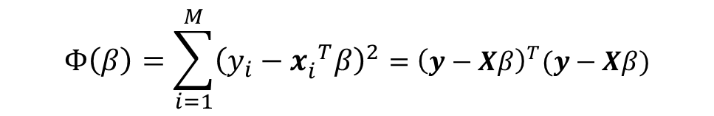

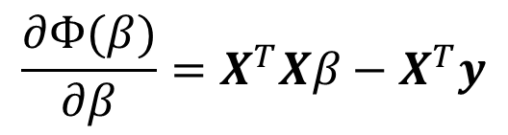

Parameter estimation
Closed form solution
Cost function
$$Φ\left(β\right)=\sum_{i=1}^{M}{{\left(y_{i}−{x_{i}^{}}^{T}β\right)}^{2}}={\left(y−Xβ\right)}^{T}(y−Xβ)$$
$$X=\left(\begin{matrix}{x_{1}^{}}^{T} \\ {x_{2}^{}}^{T} \\ \begin{aligned}… \\ {x_{M}^{}}^{T}\end{aligned}\end{matrix}\right)$$
$$y=\left(\begin{matrix}y_{1} \\ y_{2} \\ \begin{aligned}… \\ y_{M}\end{aligned}\end{matrix}\right)$$
$$\frac{∂Φ(β)}{∂β}=X^{T}Xβ−X^{T}y$$
➔
$$X^{T}Xβ−X^{T}y=0$$
Normal equation
➔
$$β={\left(X^{T}X\right)}^{−1}X^{T}y$$
(expensive to compute the matrix inverse for high dimension)

Slide 38
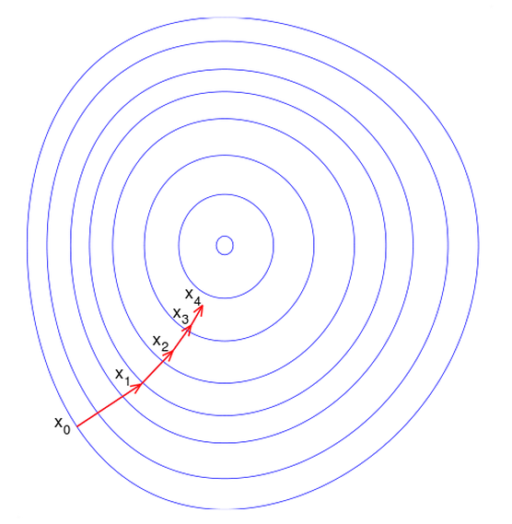
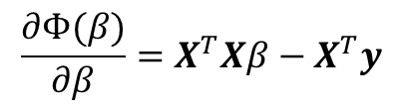

Gradient descent
http://openclassroom.stanford.edu/MainFolder/VideoPage.php?course=MachineLearning&video=02.5-LinearRegressionI-GradientDescentForLinearRegression&speed=100 (Andrew Ng)
$$\frac{∂Φ(β)}{∂β}=X^{T}Xβ−X^{T}y$$
Init: $β^{(0)}=(0,0,…0)$
Repeat:
$$β^{(t+1)}=β^{(t)}−α\frac{∂Φ(β)}{∂β}$$
Until converge.
(Guarantees to reach global minimum in finite steps)

Slide 39
Example
do_regression.m

Slide 40
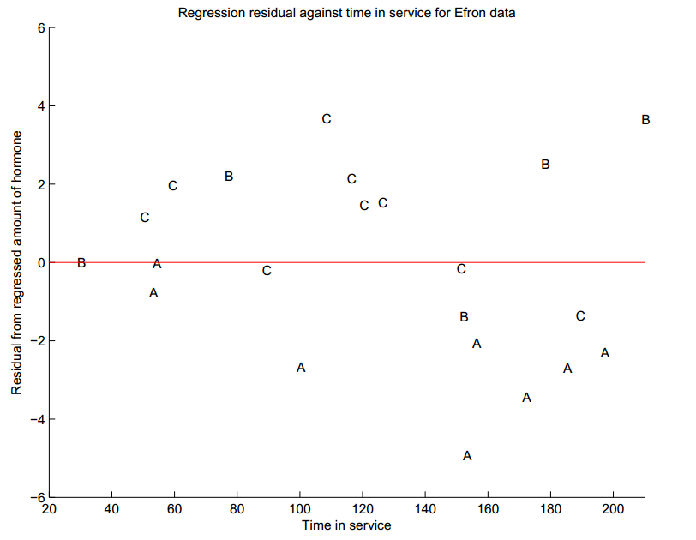

Interpreting a regression
$$y=−0.0574t+34.2$$
Notes:
Prediction of A is higher than observation: A is different from B and C
Residual has zero mean; also appears de-correlated from the explanatory variable (time in service)

Slide 41
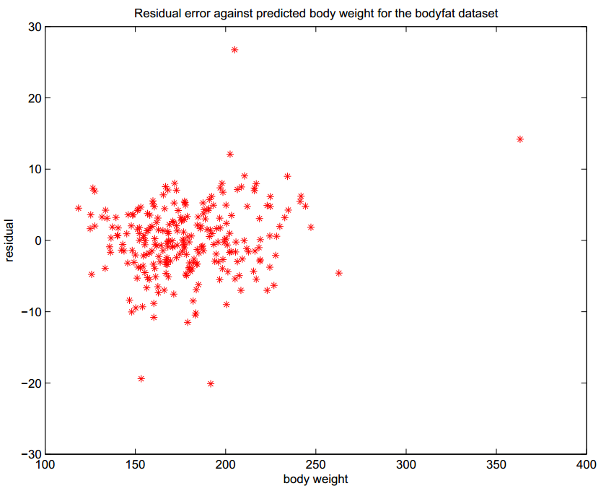
Interpreting a regression
Zero mean residual
Zero correlation

Slide 42
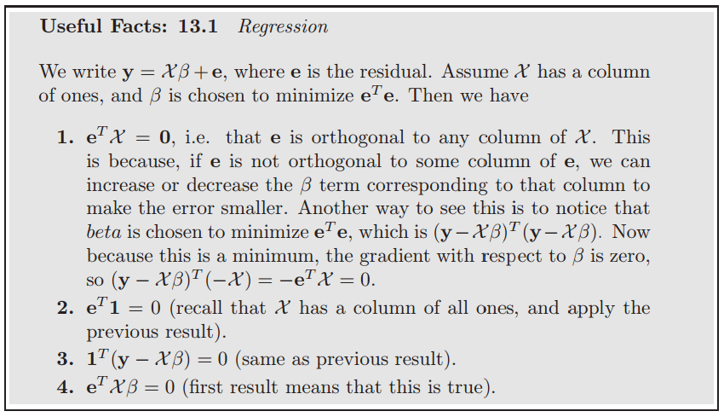
Interpreting the residual

Slide 43
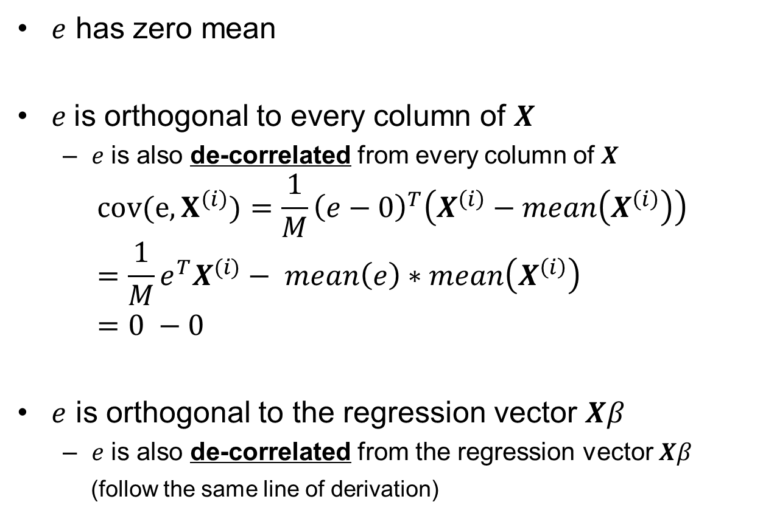
Interpreting the residual
$e$ has zero mean
$e$ is orthogonal to every column of $X$
  $e$ is also de-correlated from every column of $X$
$$cov(e, X^{\left(i\right)})={\frac{1}{M}\left(e−0\right)}^{T}\left(X^{\left(i\right)}−mean\left(X^{\left(i\right)}\right)\right) \\ =\frac{1}{M}e^{T}X^{(i)}− mean\left(e\right)∗mean\left(X^{\left(i\right)}\right) \\ =0 −0$$
$e$ is orthogonal to the regression vector $Xβ$
  $e$ is also de-correlated from the regression vector $Xβ$
  (follow the same line of derivation)

Slide 44

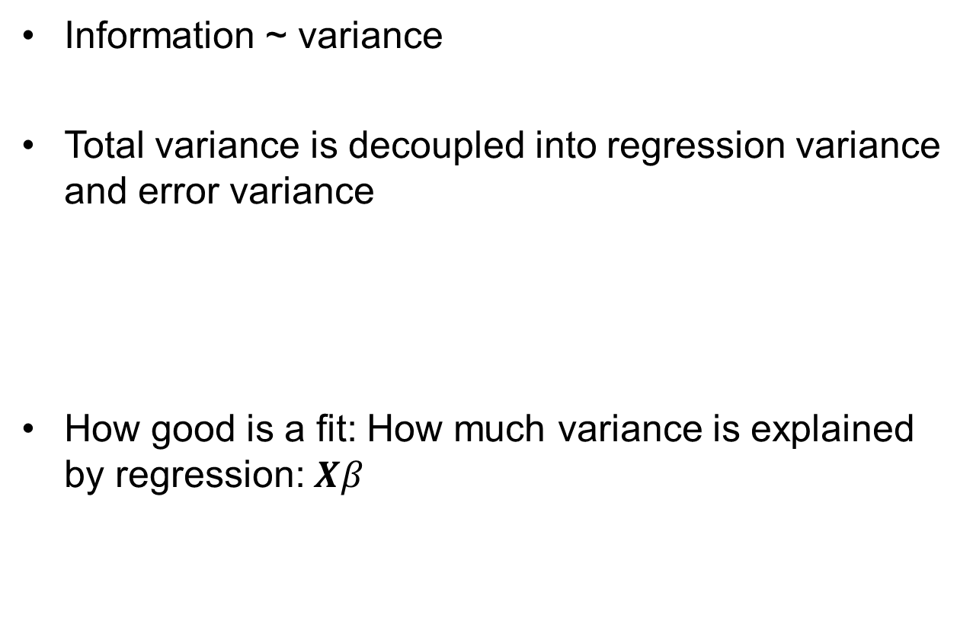

How good is a fit?
Information ~ variance
Total variance is decoupled into regression variance and error variance
How good is a fit: How much variance is explained by regression: $Xβ$
$$var\left[y\right]=var\left[Xβ\right]+var[e]$$
(Because $e$ and $Xβ$ have zero covariance)

Slide 45

How good is a fit?
R-squared measure
  The percentage of variance explained by regression
  Used in hypothesis test for model selection
$$R^{2}=\frac{var\left[Xβ\right]}{var\left[y\right]}$$

Slide 46


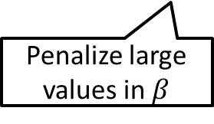
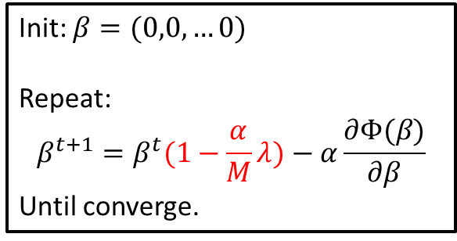

Regularized linear regression
Cost
Closed-form solution
Gradient descent
Penalize large values in $β$
$$β={\left(X^{T}X+λI\right)}^{−1}X^{T}y$$
Init: $β=(0,0,…0)$
Repeat:
$$β^{t+1}=β^{t}(1−\frac{α}{M}λ)−α\frac{∂Φ(β)}{∂β}$$
Until converge.

Slide 47


Why regularization?
Handle small eigenvalues
  Avoid dividing by small values by adding the regularizer
$$β={\left(X^{T}X\right)}^{−1}X^{T}y$$
$$β={\left(X^{T}X+λI\right)}^{−1}X^{T}y$$

Slide 48


Why regularization?
Avoid over-fitting:
  Over fitting
  Small parameters ➔ simpler model ➔ less prone to over-fitting
$$y$$
Smaller parameters make a simpler (better) model
Over fit: hard to generalize to new data
$$x$$

Slide 49


L1 regularization (Lasso)
  Some features may be irrelevant but still have a small non-zero coefficient in $β$
  L1 regularization pushes small values of $β$ to zero
  “Sparse representation”

Slide 50



How does it work?
  When $β$ is small, the L1 penalty is much larger than squared penalty.
  Causes trouble in optimization (gradient non-continuity)

Slide 51

Summary
Linear regression
  Linear model + Gaussian noise
  Parameter estimation by MLE ➔ Least squares
  Solving least square by the normal equation
  Or by gradient descent for high dimension
How to interpret a regression model
  $R^{2}$ measure
Regularized linear regression
  Squared norm
  L1 norm: Lasso

